Slide 1

Welcome/Opening Activity
Unlinked video to downsize the deck- see resources page
Notes:
Do I create an environment where people feel safe and confident to adapt and collaborate freely, as starlings do?
How do I react under pressure—do I enable my team to stay united and focused, or do I inadvertently cause fragmentation?
What can I learn from watching a murmuration about my own role in influencing collective behavior?

Slide 2

Notes:
Flow of Presentation:
Success Criteria and Anticipation Guide
Our Why
About NLL
Standards
Learning Strands
Six Components
Who can be a part…
How do I register/apply....I think we need an explicit slide just for this.
Anticipation Guide

Slide 3

Success Criteria
By the end of this session, you will be able to:
Articulate how your problem of practice aligns to a student objective, and provide examples and non-examples of what that looks like.
Name and describe 1-2 enemies of efficacy.
Identify specific leadership practices to overcome an enemy of efficacy.
Identify how Ai can be used to overcome enemies of efficacy.
Notes:
kim

Slide 4
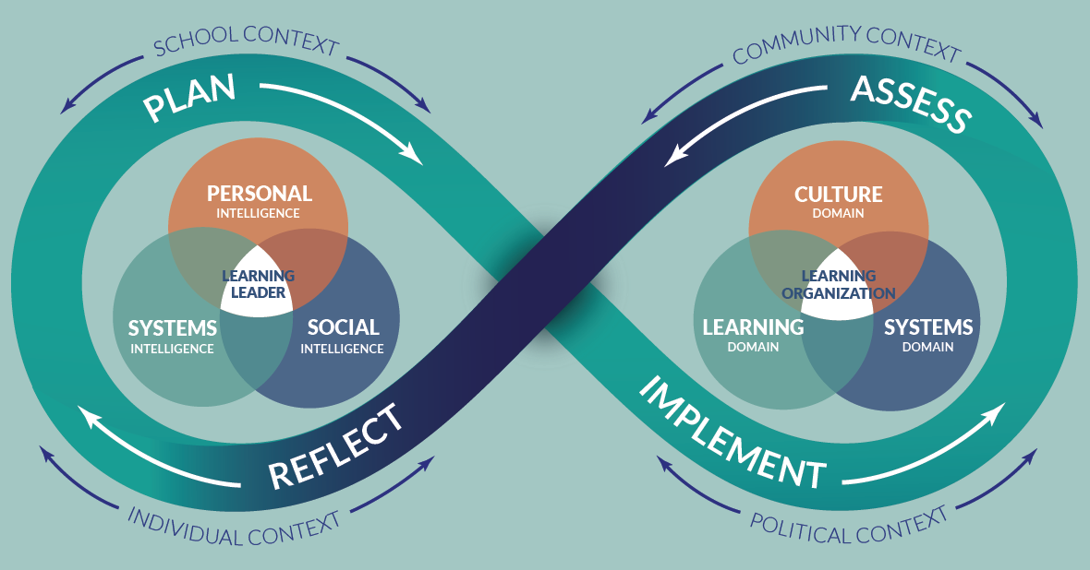
School Leader Paradigm©

Slide 5
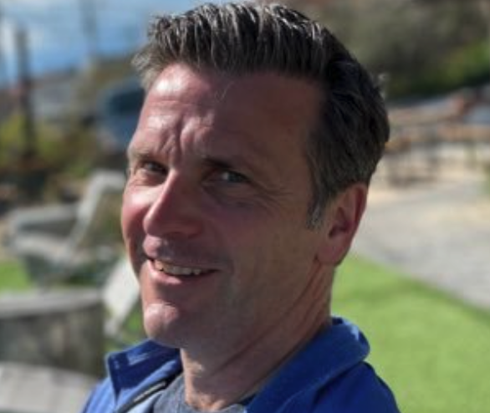

About Us- Our Advisors
Peter DeWitt
Next Level Leaders Advisor, Facilitator and Evaluator
pmdewitt518@gmail.com
Jenni Donohoo
Next Level Leaders Advisor, Facilitator and Evaluator
jenni.donohoo@praxis-engage.com

Slide 6


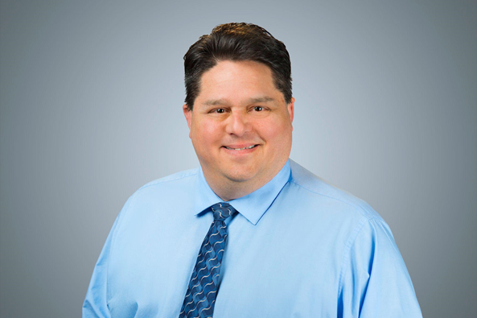

Advocate Role- we are here to help!
Ashley Barker
Monica Chandler
NLL Advocate
Paul Harvey
NLL Advocate
https://forms.gle/2QgMYttYv65LzKe39
NEW! Office Hours- TODAY at 3:30!

Slide 7
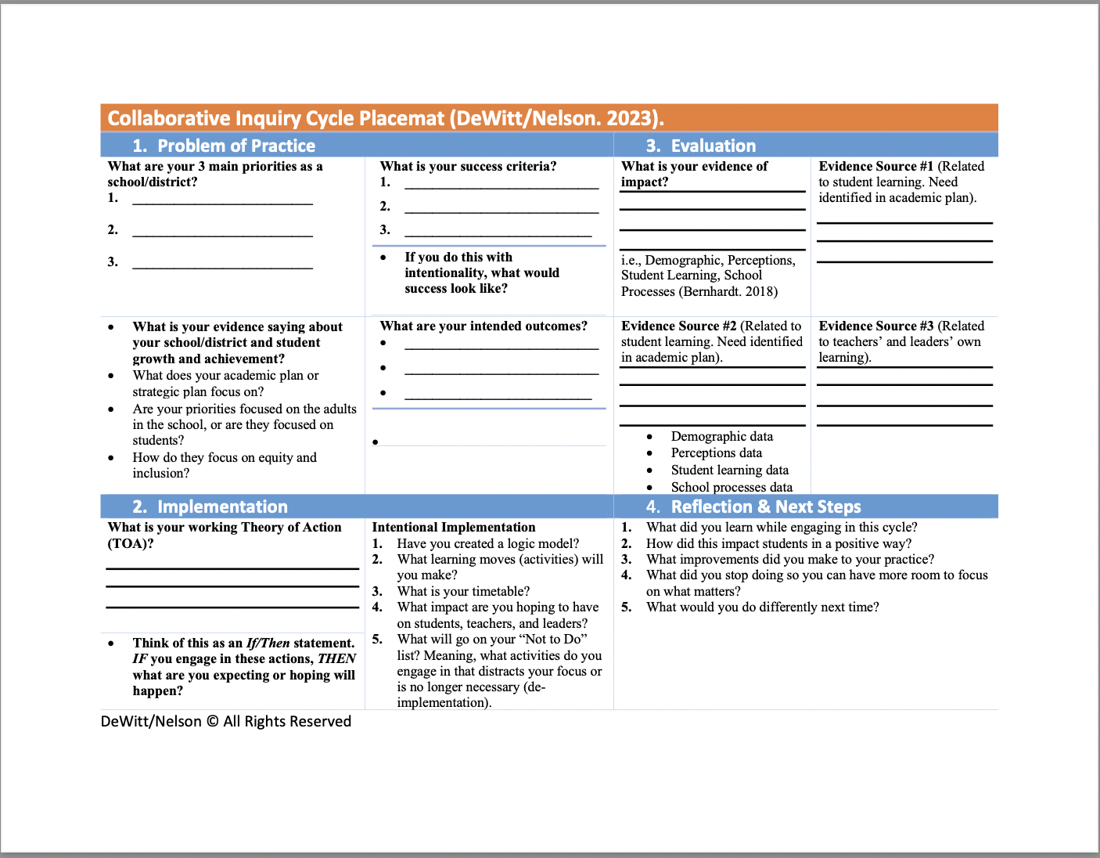

Slide 8
Collective leader efficacy is a school or district leadership team’s ability to develop a shared understanding and engage in joint work that includes evaluating the impact they have on the learning of adults and students in a school.
pp.xix
DeWitt, Nelson (2024). Leading with Intention: How School Leaders Can Unlock Deeper Collaboration and Drive Results. Corwin Press.

Slide 9
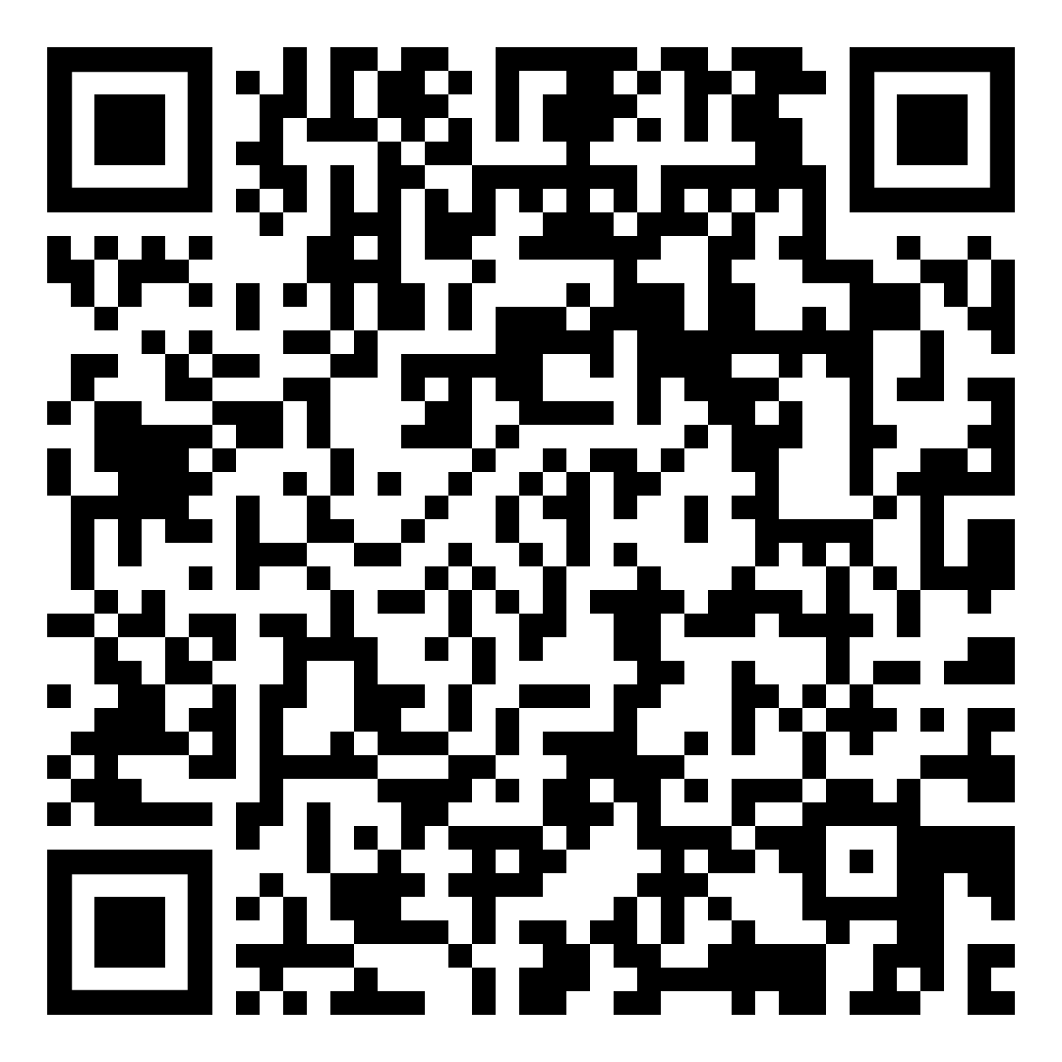


Student Objective
Data
Problem of Practice
Example
Non-Example

Slide 10
Student Objective
Data
We use common formative assessment, and use it for assessment as learning.
Assessment AS learning – Students develop an awareness of how they learn and use that awareness to adjust and advance their learning, taking increased responsibility for their learning (Bernhardt).
We want students to understand:
Where they are as a learner.
How they got there.
Where they are going to next (Hattie).
Checking for Understanding
Example
Non-Example
Teachers engage in short assessment cycles, which might happen within and between lessons, often multiple times during a single session. For example, teachers might ask students to solve a quick problem on a mini whiteboard or engage in a quick "turn-and-talk" discussion with a partner. This immediate feedback allows teachers to adjust their instruction on the spot—whether that means reteaching a concept, providing targeted support to a small group, or accelerating the pace of the lesson.
Teachers engage students in a turn and talk but only call on 1 or 2 students to explain their thinking.
Evans et al (2019) found that when students struggled in the classroom, “Teachers connected student performance data to their instruction approximately 15% of the time. Teachers more frequently connected student performance data to student characteristics. Notably, student behavior accounted for 32% of all teacher explanations for student performance.”

Slide 11
Student Objective
Data
Problem of Practice
Example
Non-Example

Slide 12

“
Collective teacher efficacy is the belief that “teachers in a given school make an educational difference to their students over and above the educational impact of their homes and communities”.
Tschannen-Moran, M., & Barr, M. (2004). Fostering student learning: The relationship of collective teacher efficacy
and student achievement. Leadership and Policy in Schools, 3(3), 189-209.

Slide 13
Enemies of Efficacy
What are some things that might pose a direct threat to individual and collective efficacy?
What are things that ‘do damage’ or actively oppose the development of efficacy?
In other words, what might be some ‘enemies’ of efficacy?

Slide 14
Anticipation Guide: Before
Statement | Agree | Disagree
People’s perception of ‘magnitude’ comes into play when forming efficacy judgements. ‘How difficult is this task?’
A school culture built on collaborative decision-making leads to deeper implementation of initiatives than one built on authority-driven compliance.
When educators focus on factors within their control rather than external circumstances, they are more likely to improve student outcomes.
Schools are most effective when they maintain sustained focus on core initiatives rather than continuously adding new programs.

Slide 15
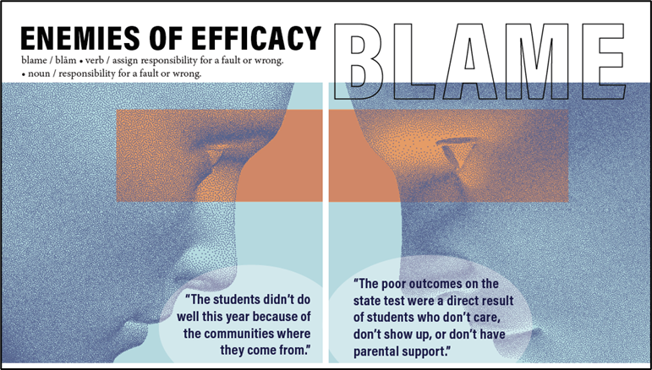
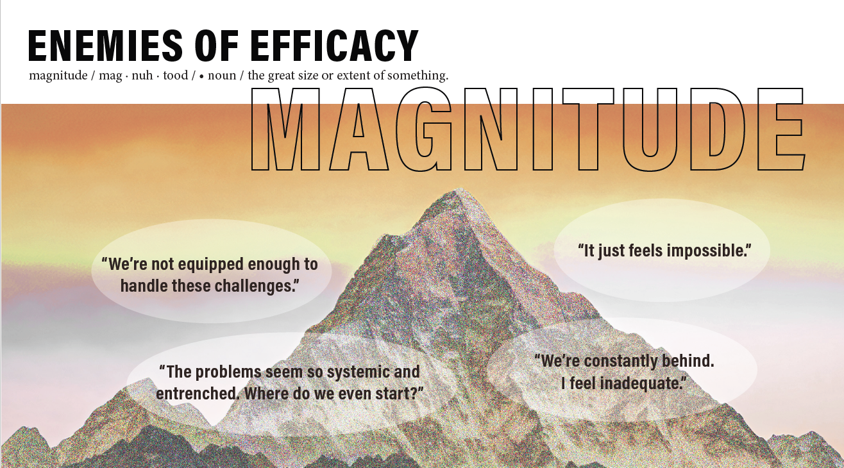
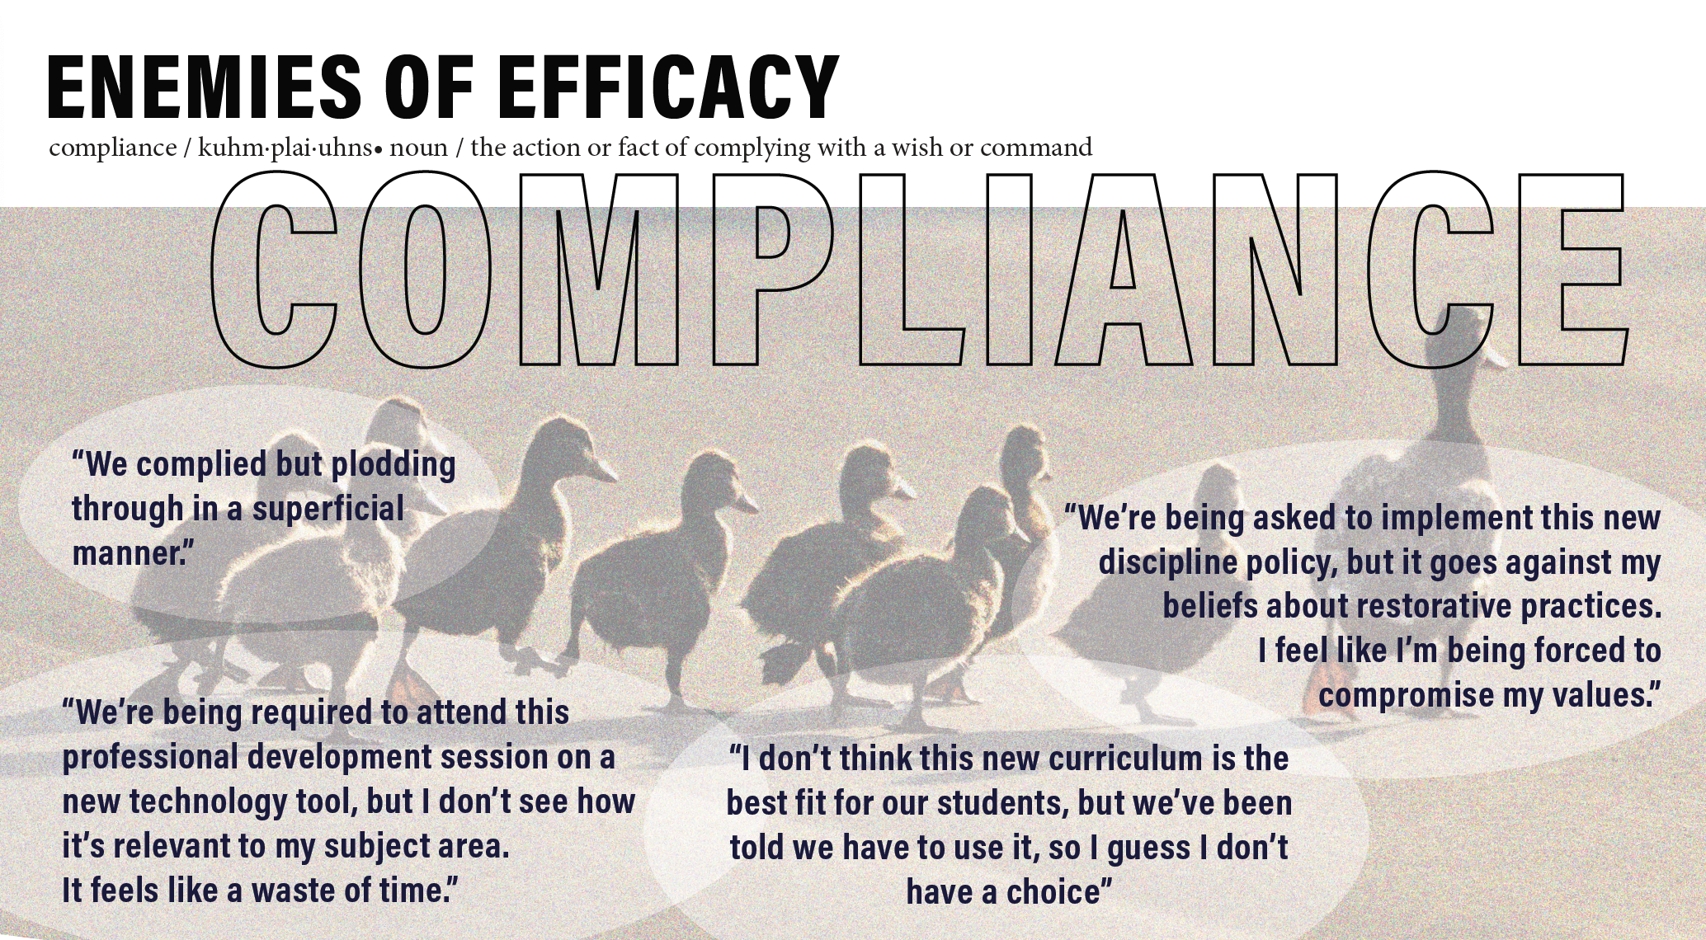
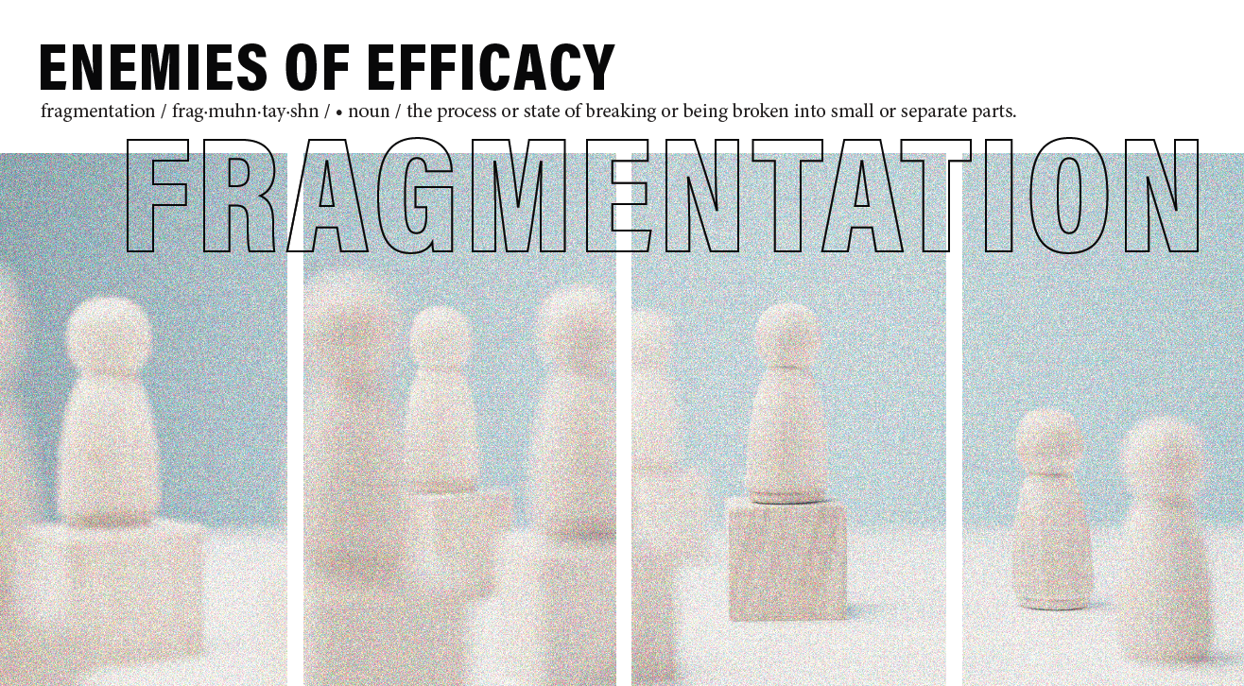
1.
2.
3.
4.
Which one resonates with you the most?

Slide 16


1.
Which one resonates with you the most?

Slide 17

2.
Which one resonates with you the most?

Slide 18

3.
Which one resonates with you the most?

Slide 19

4.
Which one resonates with you the most?

Slide 20
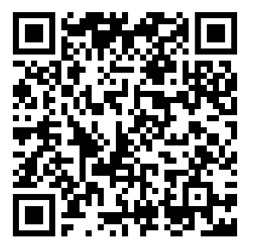
Which one do you want to learn more about?
Select one of the enemies of efficacy.
Locate the passage that corresponds.
Read it and code the text:
I= Interesting
C= Connections
Q= Questions
https://tinyurl.com/32rwutyu

Slide 21
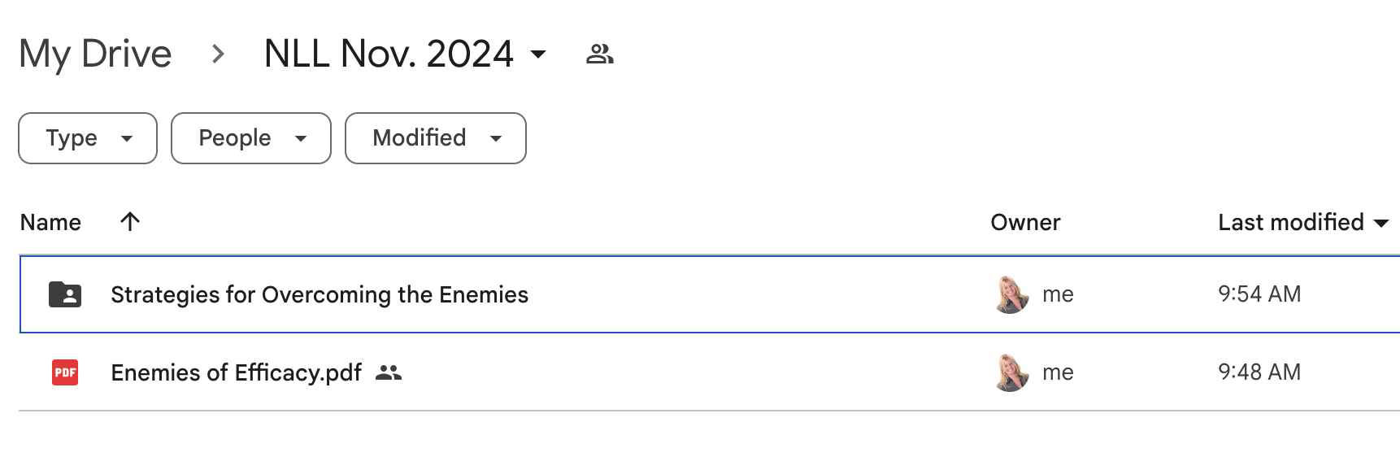
Which one do you want to learn more about?
https://tinyurl.com/32rwutyu

Slide 22
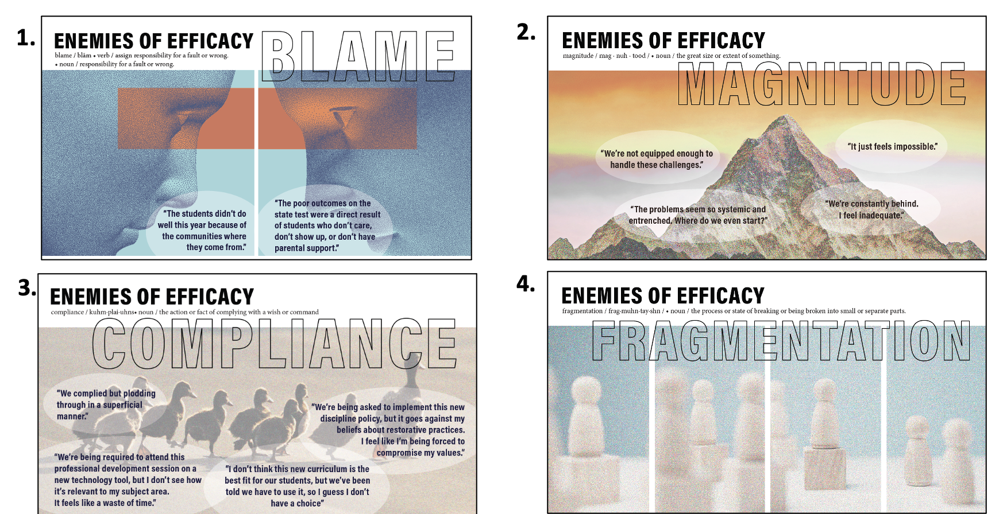
Select the breakout room that corresponds with the enemy of efficacy that you just read about.
Which one do you want to learn more about?

Slide 23
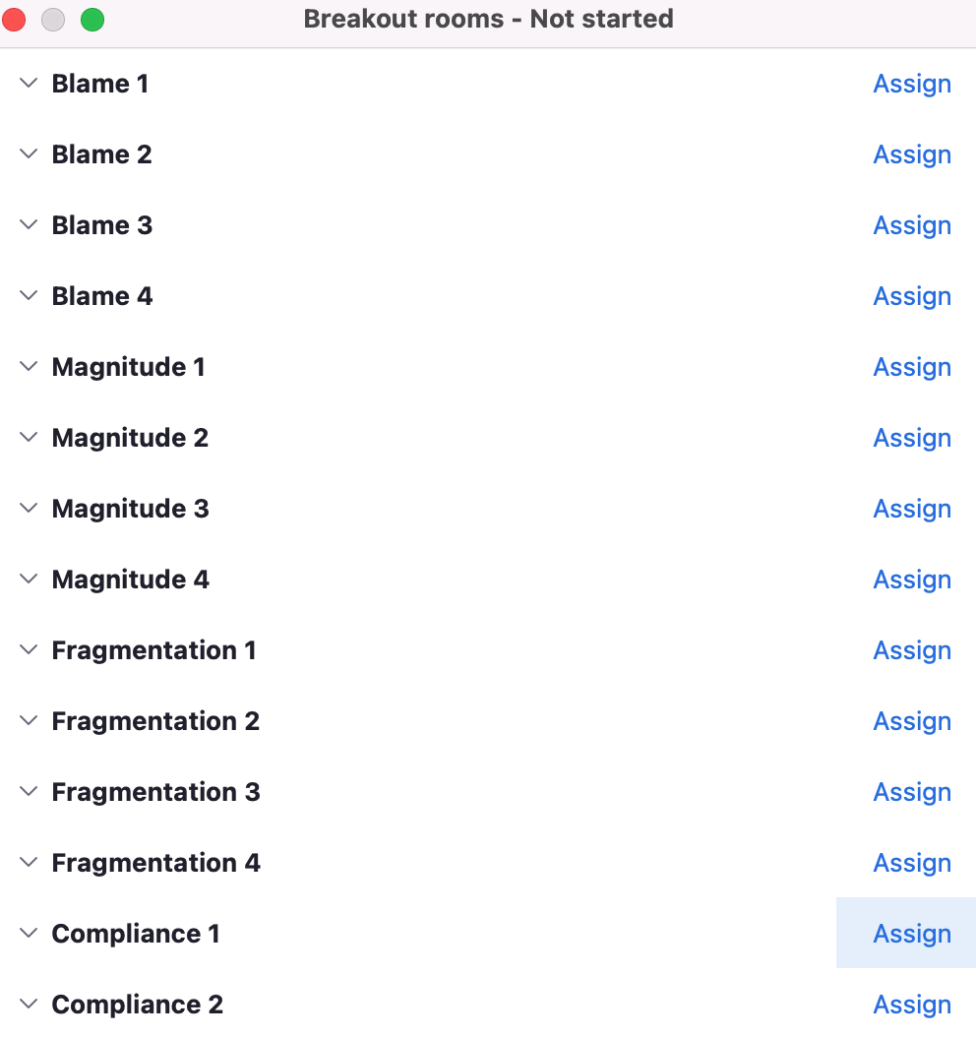
Breakout Room Organization
Select the breakout room that corresponds with the enemy you just read about. 4-5 people per room

Slide 24

In Your Breakout Room
Share why you selected that ‘enemy of efficacy’.
Discuss your I, C, and Qs.
Be prepared to share back in the MAIN room.
Make Note of the Breakout Room You’re In!

Slide 25
1.
2.
3.
4.
What was some of the discussion in the breakout rooms?

Slide 26
Back In Your Breakout Room
Read the ‘Strategies for Overcoming Enemies of Efficacy’.
Discuss how you might put these strategies into practice.
Be prepared to share back in the MAIN room.

Slide 27

Through feedback, school leaders can overcome blame as an enemy of efficacy.
Normalizing Coaching Feedback
Emphasizing the Role of Effort and Strategy Use
Providing Frequent Updating
Blame: Overcoming the Enemies of Efficacy

Slide 28
By framing challenges appropriately, school leaders can overcome magnitude as an enemy of efficacy.
Framing Through Emphasizing and De-Emphasizing
Framing Different Futures
Framing Challenges into Smaller Pieces
Magnitude: Overcoming the Enemies of Efficacy

Slide 29
By garnering commitment, school leaders can overcome compliance as an enemy of efficacy.
Highlighting a Gap
Learning from Marker Students
Surfacing the Cost of Inaction
Compliance: Overcoming the Enemies of Efficacy

Slide 30
By focusing on implementation, school leaders can overcome fragmentation as an enemy of efficacy.
Gatekeeping
Applying the 80-20 Principle
Prioritizing Evidence-Based Strategies
Fragmentation: Overcoming the Enemies of Efficacy

Slide 31
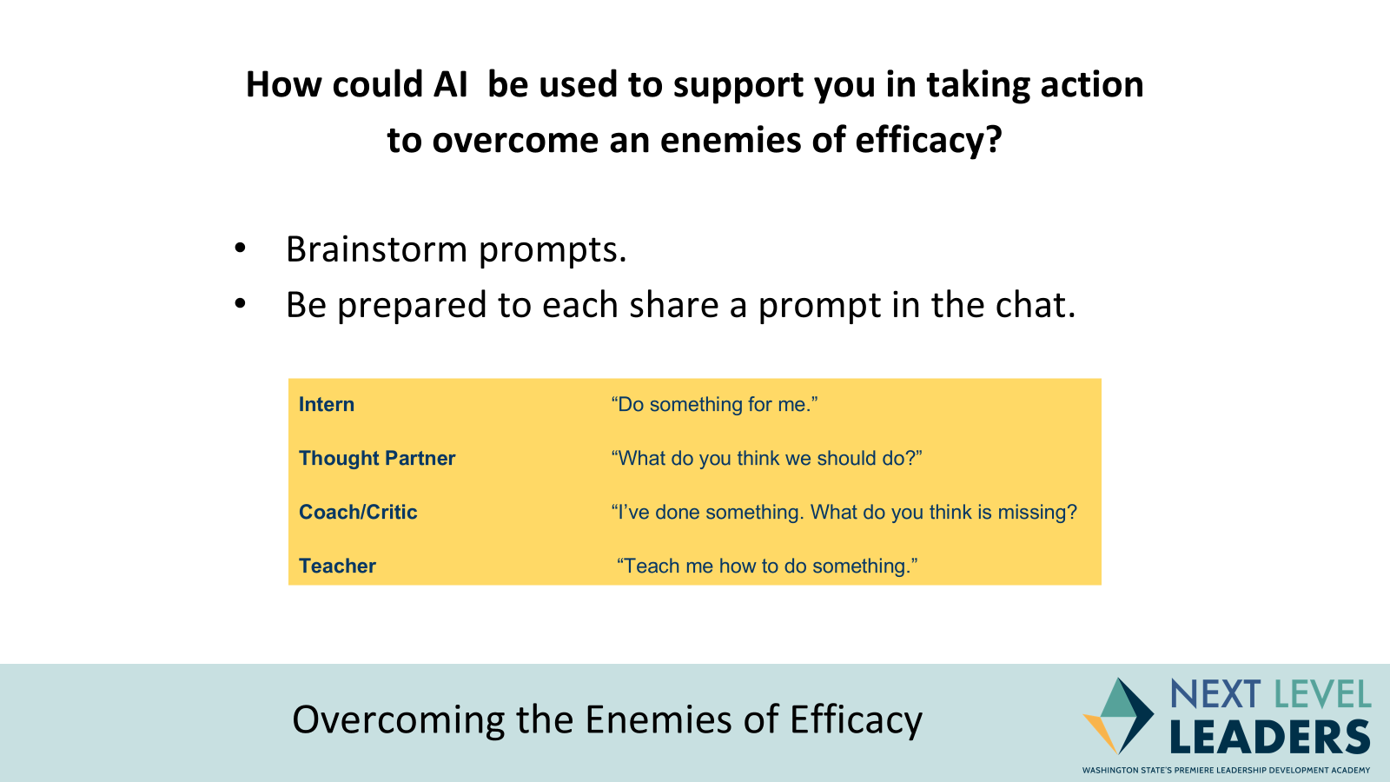
By focusing on implementation, school leaders can overcome fragmentation as an enemy of efficacy.
Gatekeeping
Applying the 80-20 Principle
Prioritizing Evidence-Based Strategies
Fragmentation: Overcoming the Enemies of Efficacy

Slide 32
Anticipation Guide: After
Statement | Agree | Disagree
People’s perception of ‘magnitude’ comes into play when forming efficacy judgements. ‘How difficult is this task?’
A school culture built on collaborative decision-making leads to deeper implementation of initiatives than one built on authority-driven compliance.
When educators focus on factors within their control rather than external circumstances, they are more likely to improve student outcomes.
Schools are most effective when they maintain sustained focus on core initiatives rather than continuously adding new programs.

Slide 33



Fry, K. Leading with Intelligence. WASA
Notes:
15 minutes

Slide 34
Access Codes - 1 Yr. Free
code: NEXTLEVEL
code: NEXTLEVEL
One subscription to each section per NLL Member
Sign-up Support:
Sign-up Instructions Video
Beau Wilson - bwilson@wasa-oly.org
Notes:
15 minutes

Slide 35
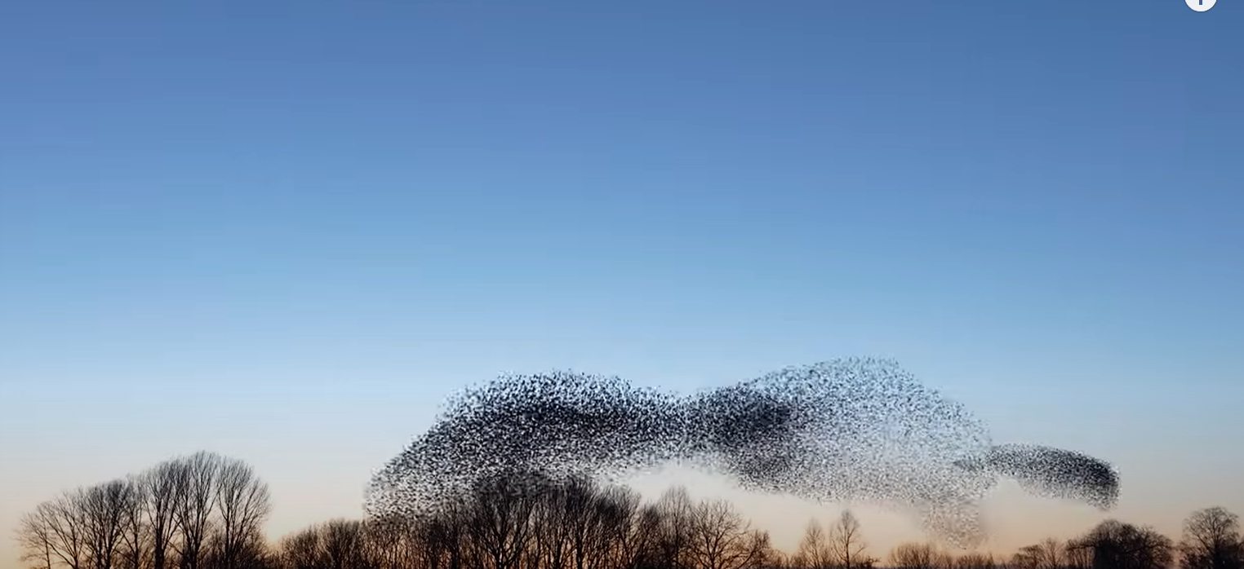
Reflection-
Do I create an environment where people feel safe and confident to adapt and collaborate freely, as starlings do?
How do I react under pressure—do I enable my team to stay united and focused, or do I inadvertently cause fragmentation?
What can I learn from watching a murmuration about my own role in influencing collective behavior?
Notes:
kim

Slide 36
Review- Success Criteria
By the end of this session, you will be able to:
Articulate how your problem of practice aligns to a student objective, and provide examples and non-examples of what that looks like.
Name and describe 1-2 enemies of efficacy.
Identify specific leadership practices to overcome an enemy of efficacy.
Identify how Ai can be used to overcome enemies of efficacy.
Notes:
kim

Slide 37
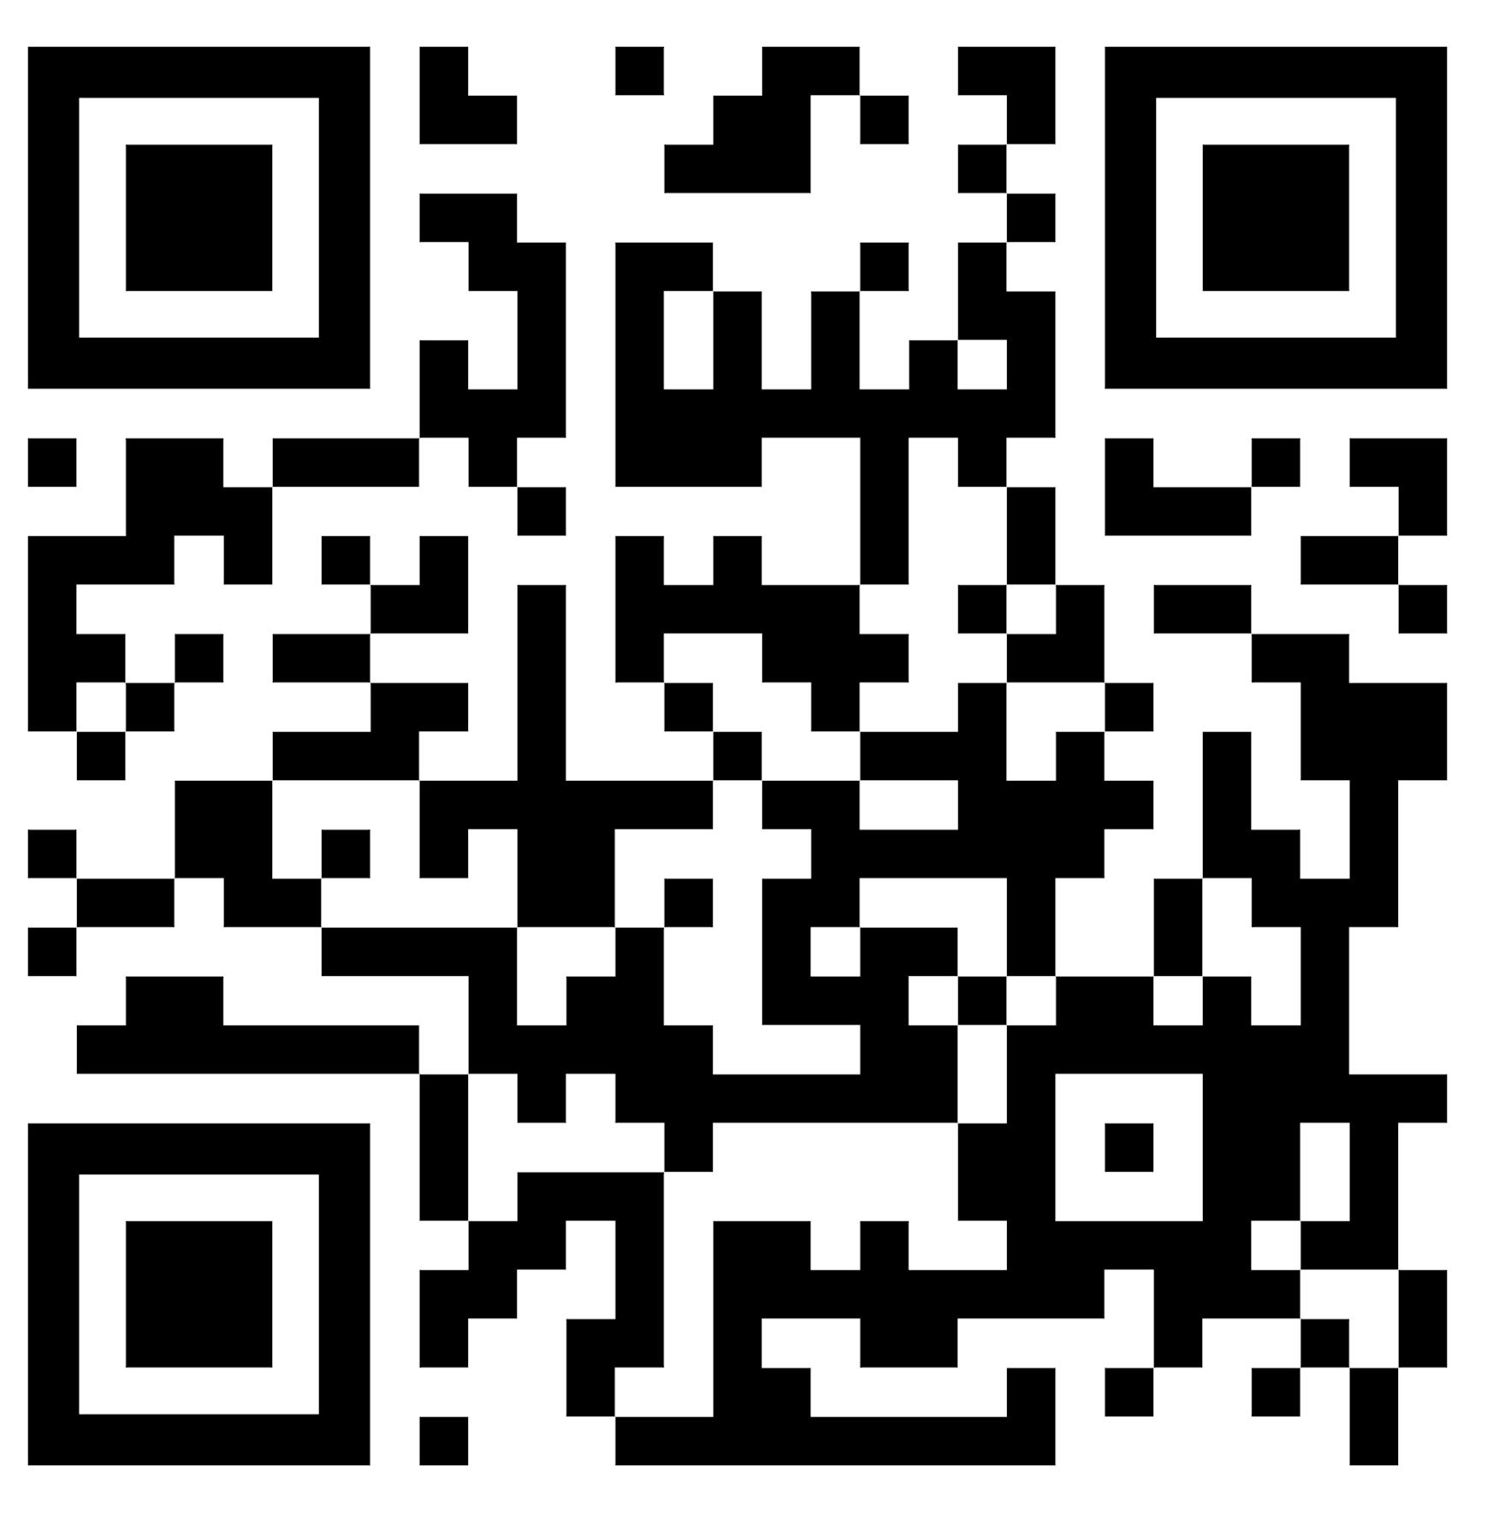
Exit Ticket!!!

Slide 38


NEXT LEVEL LEADERS
Term 2- In Person MEETING
CEDARBROOK LODGE, SEATAC ~ March 2 (5PM)- March 3 (8-3:30PM), 2025
https://bit.ly/4dVUqIP- Register ASAP! Participants will stay
at Cedarbrook until full and Crown Plaza!

Slide 39



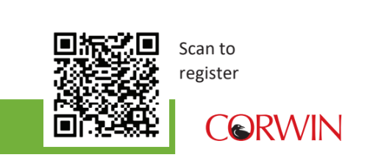

Slide 40

Participants by ESD Region
7
9
44
7
18
25
2
5
29

Slide 41




Are you an experienced, innovative leader who wants to
keep learning and growing your leadership?
Consider joining the Next Level Leaders 2025/26 Cohort!
Washington State’s Premier Leadership Development Program
Please contact: ashley@NLL.academy or visit https://nll.academy
Now Accepting Applications for Cohort Two
Starting Summer 2025

Slide 42
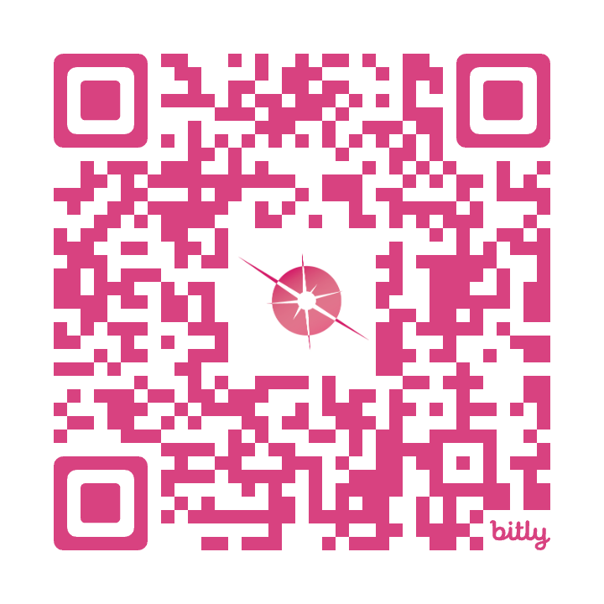
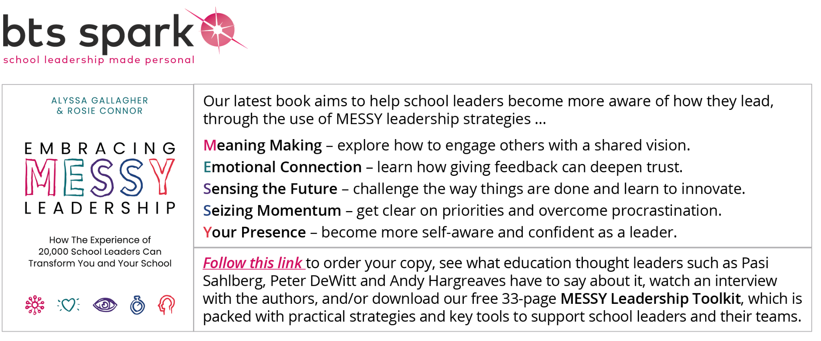
1:1 Leadership Coaching Offer
Personalized Leadership Coach
Six (3) x 60-minute sessions and a leadership assessment!
Your schedule, your context
No additional costs!
To secure your spot sign up using the QR code or email
Alyssa.Gallagher@btsspark.org

Slide 43
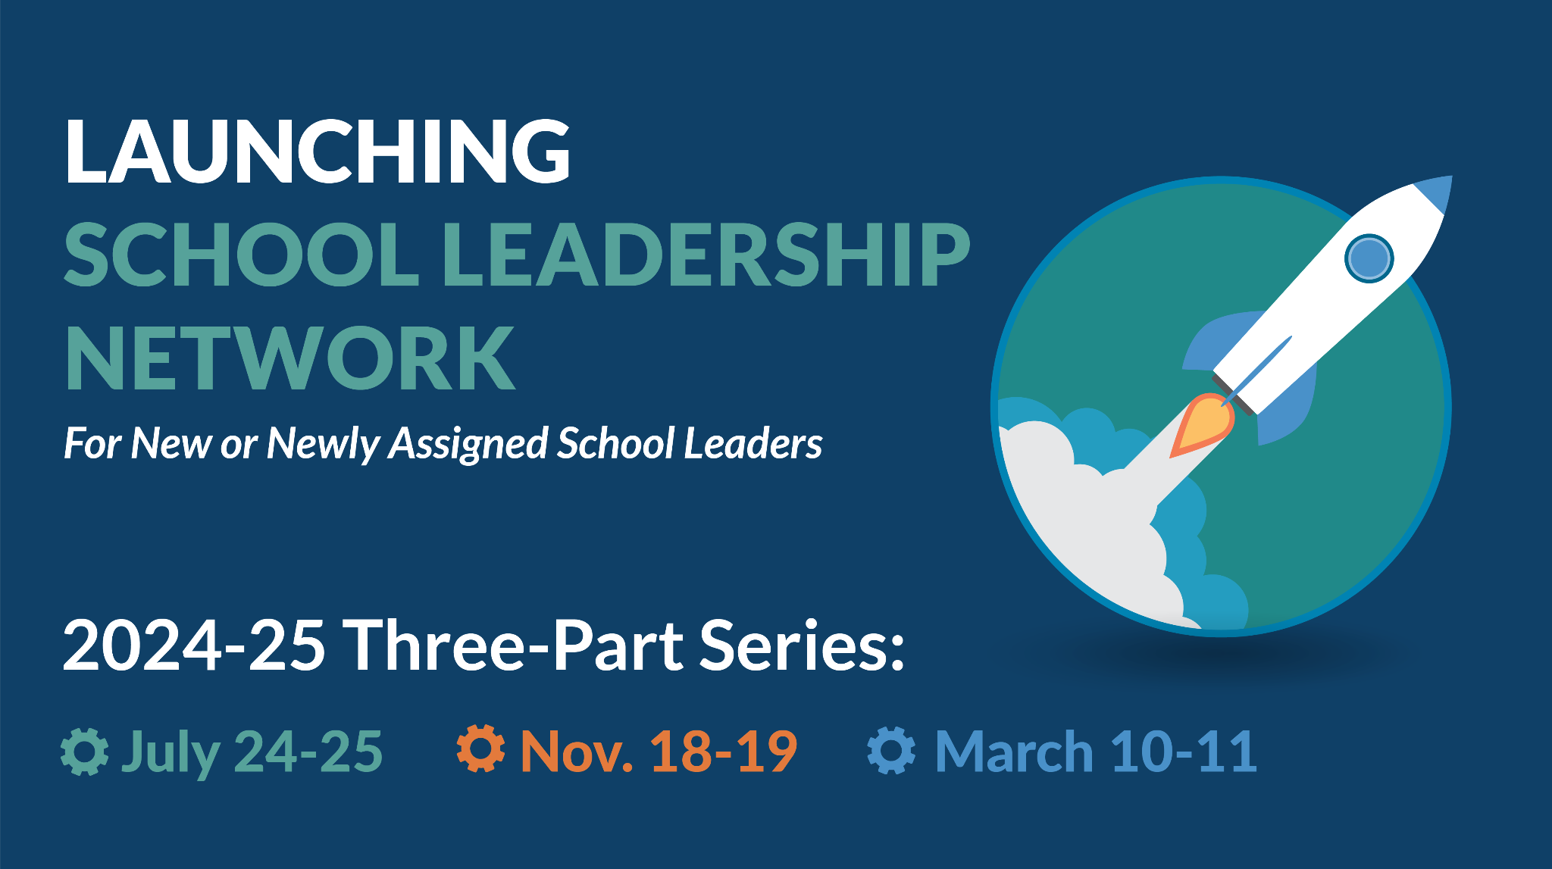
Register today at www.awsp.org/LSL

Slide 44


For More Information
Kamrica Ary-Turner Beaver| Associate Director,
ESDs 189 & 121 | (800) 562-6100
Leaders of Color Network (awsp.org)
Notes:
2:45 p.m.- 3:00 p.m.

Slide 45


