Slide 1
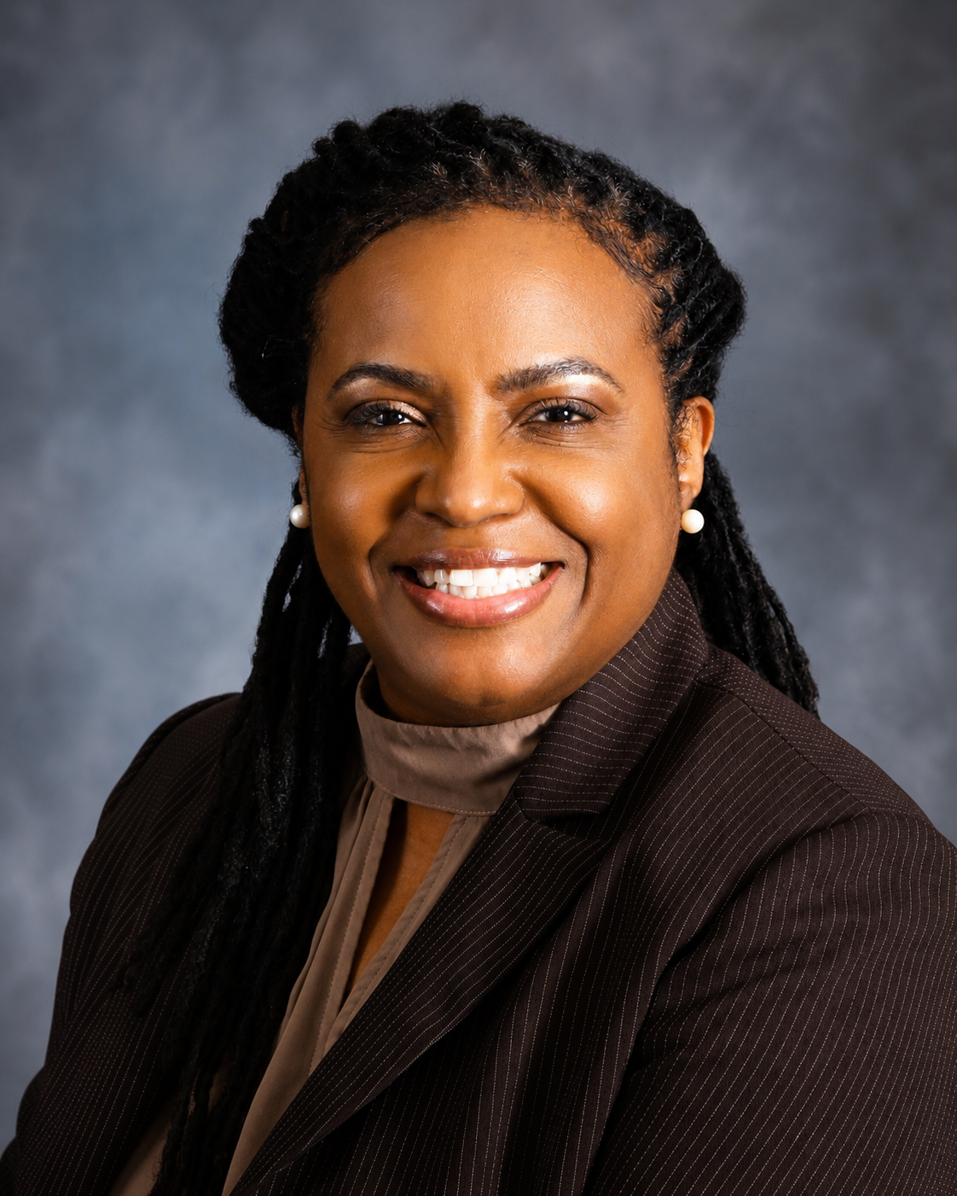
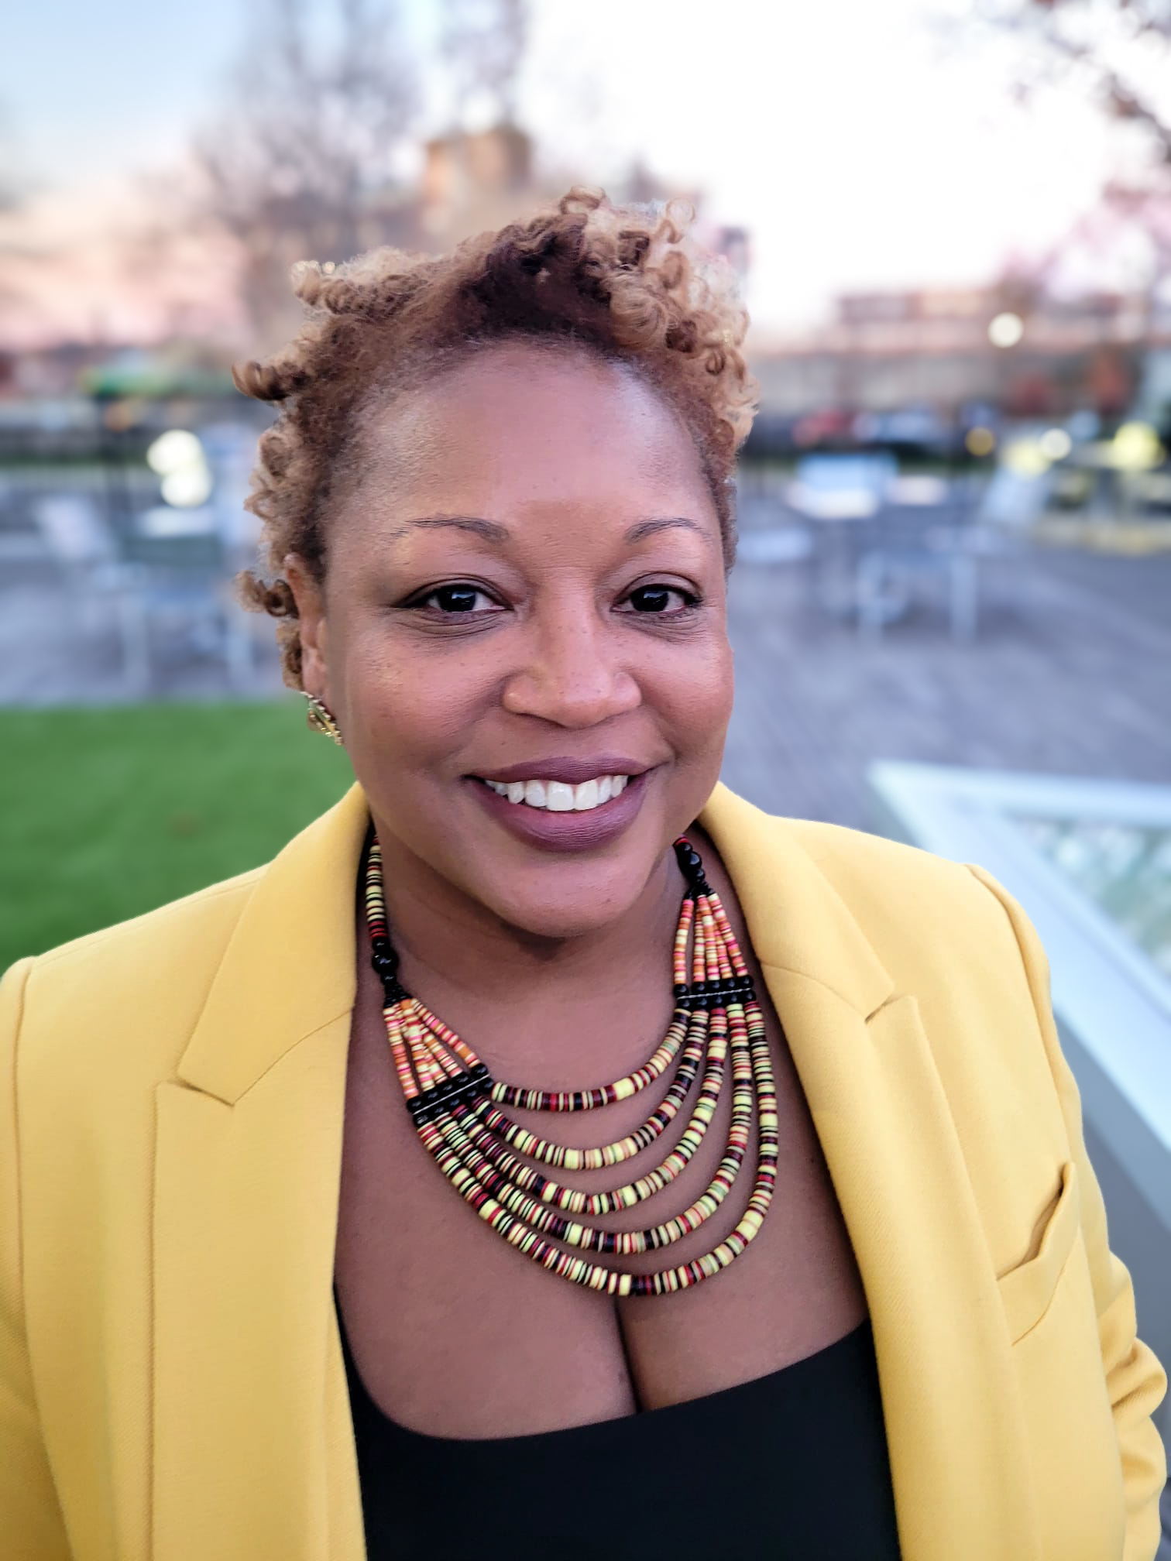
Culturally Responsive Community Engagement with Black Children, Teens, and Their Families
Johnnetta Miller
Sheltering Arms Early Education and Family Centers
Tandeca King Gordon, Ed.D., MEd
Morehouse School of Medicine
National African American Child and Family Research Center
SRCD Webinar
June 23, 2026
12:00-1:30pm
Moderator:
Keisha Bentley-Edwards, PhD
SRCD Black Caucus Chair

Slide 2

The Black Caucus of the SRCD
Officially founded at the 1973 Biennial meeting of the SRCD in Philadelphia, Pennsylvania.
The purpose of the SRCD Black Caucus is (1)
  to promote rigorous, culturally grounded research on Black children around the globe and
  to promote the development of scientists of African descent who study child development.
  Learn more about the Black Caucus at https://www.srcd.org/blackcaucus/home
Notes:
Five objectives were outlined at the Philadelphia (1973) meeting:
To provide opportunities for Black people who are interested in research in child development to meet and interact
To establish inter-communication networks between Blacks in this area
To become acquainted with other groups who have similar interests in Black children
To adopt a position on the future relationship of Blacks to SRCD and these other groups
To discuss issues of significance for Black researchers and Black children

Slide 3
2025-2027 SRCD Black Caucus Steering Committee
KEISHA BENTLEY-EDWARDS, CHAIR
VALERIE ADAMS-BASS, CHAIR-ELECT
NAILA SMITH, SECRETARY
JUDITH SCOTT, TREASURER
RIANA ANDERSON, MEMBER AT LARGE
AMBER SANSBURY, MEMBER AT LARGE
ALEXANDRIA ONUOHA, EARLY CAREER REP.
KEIANA MAYFIELD, EARLY CAREER REP.
RAVEN ROSS, STUDENT REP.
KELA ALLEN, STUDENT REP.

Slide 4
What is Culturally Responsive Community Engagement?
And why it is necessary?

Slide 5
Community-Engaged Research (CEnR)
CEnR – A collaborative approach in which researchers and community members work together to conduct research that addresses community-identified needs. It exists on a spectrum from community consultation to full co-leadership.
Relevance l Trust l Mutual Benefit
Core Components
Community members are co-investigators, not just participants.
Findings are shared back with the community in accessible formats.
Interventions reflect priorities identified by community members themselves.

Slide 6
Community-Engaged Research (CEnR) Applied Examples
Relevance l Trust l Mutual Benefit
    Dr. Amber B. Sansbury partnered with the Gates-Educare Black Majority Schools Project and Sheltering Arms for four years, co-constructing knowledge on family engagement that builds on African American families and preschool teachers’ intergenerational racial socialization processes and cultural identity in Black-majority ECE programs. Her work identifies authentic assets to strengthen relationships, joint family-teacher training, and shared roles in early racial identity development.
  Dr. Alexandria Onuoha had an initial idea for a research project but remained open to letting it evolve based on the expertise of the Black middle school girl partners. School leaders mentioned the need for girl empowerment activities. They co-designed a program around the girls’ meaning-making and visualizations of joy through photovoice methods, and she shared example sessions so they could continue running it on their own if they chose to.
Notes:
For Alex -She translated collective insights into a few workshops centered on Black children’s emotional wellness in educational contexts, illustrating how community members can act as co-investigators whose prioritizes and expertise shape the work from the start.

Slide 7
Culturally Responsive
Community Engagement
An approach to engaging Black communities that centers community values, norms, and lived experiences. It requires adapting communication, methods, and partnerships to reflect the cultural context of the Black community.
Cultural Humility l Acknowledging Systemic Inequities l Respect
Core Components
Ongoing self-reflection and openness to learning from community members about their culture, history, and strengths.
Building trust through consistent presence, transparency, and centering community voice in all phases of research and engagement design.

Slide 8
Culturally Responsive Community Engagement - Applied Examples
Cultural Humility l Acknowledging Systemic Inequities l Respect
    Dr. Judith Scott and her team collaborated with a Black-led and Black-serving community social services agency, to conduct focus groups with staff and program participants to determine if the agency’s mission of bringing peace of mind to children and families was being achieved. Intergenerational racial trauma, Black lived experiences, and structural racism were centered in the development and facilitation of the focus groups.
    This process required frequent meetings with staff to understand who the agency served, how to engage the community, what may affect Black individuals’ and communities’ peace of mind and to build trust considering the historical exploitation of communities by academic scholars. Agency staff were involved in all decision-making, research materials, implementation, and dissemination.

Slide 9
Community Based Participatory Research (CBPR)
“CBPR is a collaborative research approach that is designed to ensure and establish structures for participation by communities affected by the issue being studied, representatives of organizations, and researchers in all aspects of the research process to improve health and well‐being through taking action, including social change.” Viswanathan, et al. 2004
Shared Decision-Making l Co-Learning & Expertise l Mutual Ownership
Core Components
Co-Creation
Sustainability
Focused on action and systemic change
Power-sharing and fully integrated community participation
Capacity-Building

Slide 10
Community Based Participatory Research (CBPR) - Applied Examples
Shared Decision-Making l Co-Learning & Expertise l Mutual Ownership
Dr. Valerie Adams-Bass’ work with Youth Voices included relationship building exercises, research skill building, youth driven topic identification and leadership. Defining and capturing civic engagement based on how youth described their community participation and engagement.*
*See new measurement created by Hope, et al
Dr. Adams-Bass also collaborated with Food for the Ear, a Social Psychology-based project with emerging adults in South Africa. Project evolved to integrate the voice and some of the desires of the young people. Consideration for the experiences and expectations for them at the community level. As a result, the project included a book that was written and published in English and Zulu. Research interviews and project facilitation included a community-based facilitators. Most of the interviews were conducted in isiZulu and translated to English. Time to establish relationships and build trust was built into the project timeline.
Notes:
when CIRCLE measures were the go-to for capturing youth civic engagement

Slide 11
Why is Culturally Responsive Community Engagement Necessary?
Effective Implementation l Sustained, Trustworthy Relationships
Scholarly Rigor l Innovation & New Approaches
l Ethical Research Practices

Slide 12


Advancing Research with Black Families
Tandeca King Gordon, EdD, MEd
Associate Director, NAACFRC

Slide 13

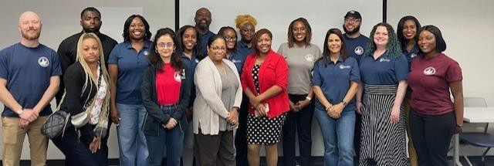
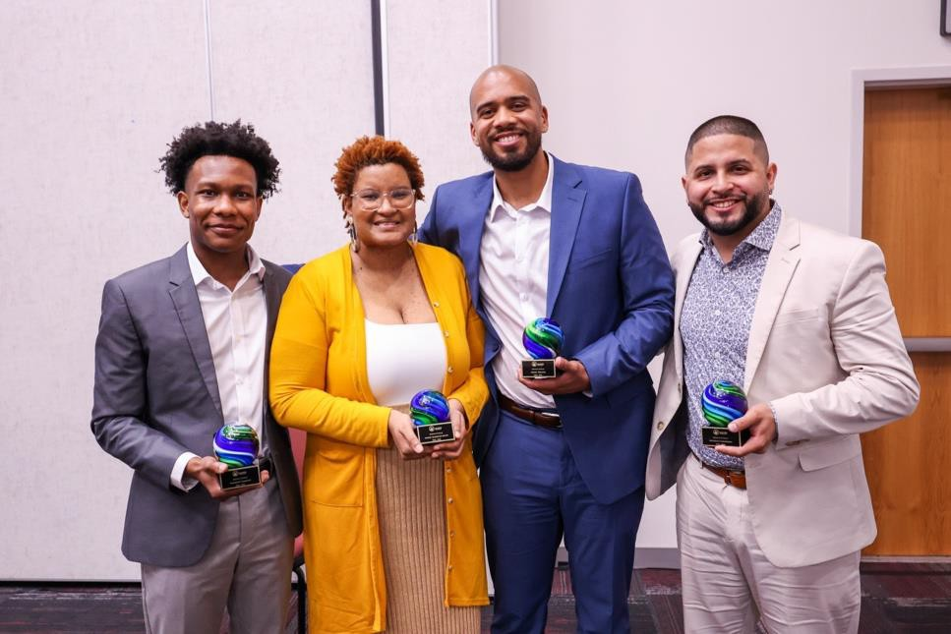
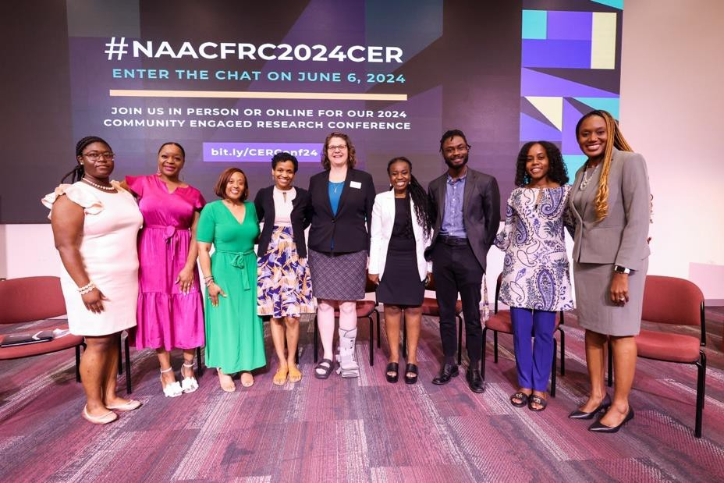


Slide 14
Priority Areas
Economic Mobility (Temporary Assistance for Needy Families (TANF)
Early Care and Education (Head Start/Early Head Start & (Childcare assistance programs)
Cross-cutting Areas (Rural Populations, Legal System
Involvement, Fatherhood, Health)

Slide 15
Research Priorities
Assess:
Definitions & measurements of the needs, assets, & experiences of African American children & families
Barriers & facilitators that impact human service provision to & utilization by African Americans
Strategies to promote the social & economic well-being of African American children & families
Promising approaches for service provision to African American children & families

Slide 16



Research Approach

Slide 17


Model for Community
Engagement
Recognition
Evaluation
Implementation
Training & Technical Assistance
Project
Coalition/
Partnership
Development &
Work
Issue ID,
“Bonding”
& Trust
Development
Goal-setting, ^{Development}
Assessment
Braithwaite, R. L., Akintobi, T. H., Blumenthal, D. S., & Langley, W. M. (2020). The Morehouse Model: How One School of Medicine Revolutionized Community Engagement and Health Equity. JHU Press..

Slide 18
What is CBPR?
CBPR is a collaborative research approach t hat is designed to ensure and establish structures for
participation by communities affected by the issue being studied, representatives of organizations, and researchers in all aspects of the research process to
improve health and well-being through taking action,
including social change.
Blumenthal, D., Hopkins, E., & Yancey, E. 2013. Community-Based Participatory Research: An Introduction. Pp. 1-17. In Blumenthal, D., DiClemente, R., Braithwaite, R., & Smith, S. Community-Based Participatory Health Research: issues, Methods, and Translation to Practice.

Slide 19
Why CBPR?
New views
Resources
Increased capacity for bo th researcher and
com mu ni ty partners
Visibility and voice for comm unity
Results mo re easily translatable into practice
Breland-Noble, A., Streets, F. J., & Jordan, A. (2024). Community-based participatory research with Black people and Black scientists: the power and the promise. The Lancet Psychiatry, 11(1), 75-80.

Slide 20

Wh o sits at the table?
Com munity mistrust of
“research”
Researcher reluctance to
relinquish control
Wh o sets the table?
Structures/procedures
Training, budget,
implementation, dissemination
WHERE IS THE TABLE?
Location, location, location
Com munity setting

Slide 21


Research Agenda
Development

Slide 22
Community Assessment
National Surveys
ACF Administrative Program Data
State Administrative Program Data
Secondary Data Collection
Primary Data Collection
Community Survey
Community Listening Sessions
Community Conversations

Slide 23

Community Survey
African American Caregivers in AL, GA, MS, LA, DC, MD, NC, SC, & VA
Questions:
In the past year, have you or your family experienced any of the following challenges
How can the current programs (i.e., TANF/welfare, Head Start, Childcare assistance) improve to help you
and your family?

Slide 24


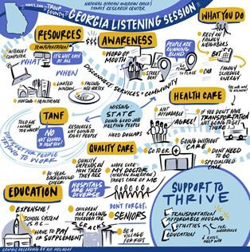
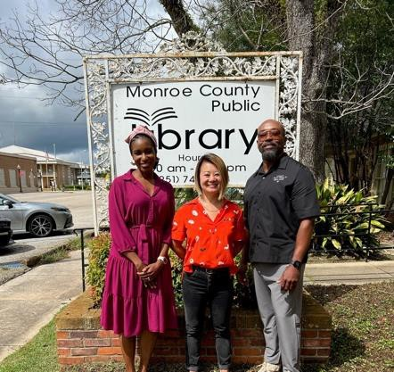
Community Listening Sessions
Topics:
Community-Level Resources
Geographic Location/Residential Factors
Economic Mobility
Health and Family Wellness
Education and School Readiness
Engagement and Community
Perceptions

Slide 25
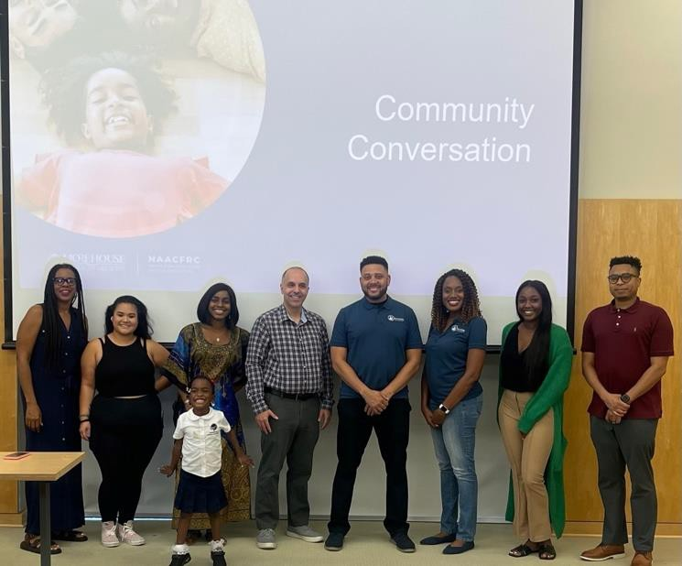
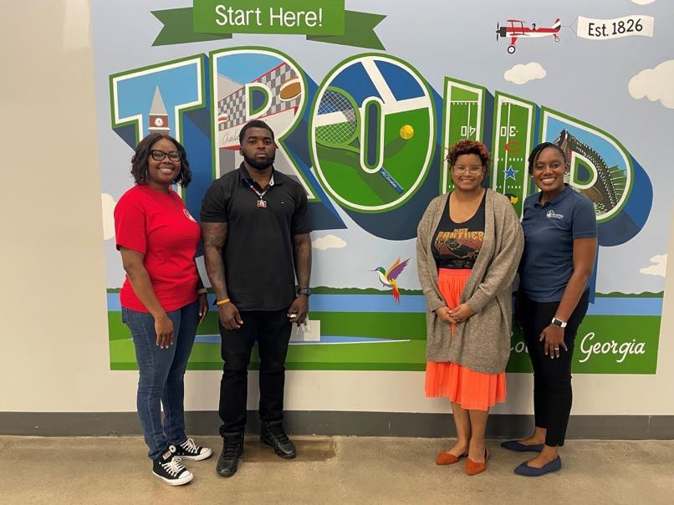
Community Conversations
Discussion Questions
What surprises you about the information? Anything?
What is the good news? What is the bad news?
What information is missing or needed?
How should this information be shared?
What issues should be prioritized?

Slide 26
Community Priorities
Awareness
Enrollment
Eligibility
Maintaining Assistance (i.e., Retention)
Quality
Access
More Benefits (e.g., Money)
Better Employment Opportunities
Service (e.g., communication w/programs & staff, friendliness)
Other drivers of well-being (health, housing, food, safety, etc.)

Slide 27


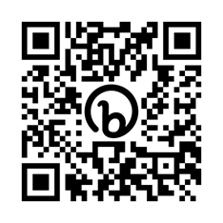
National African American Child and Family Research Center
Follow Us
@NAACFRC
www.naacfrc.org

Slide 28
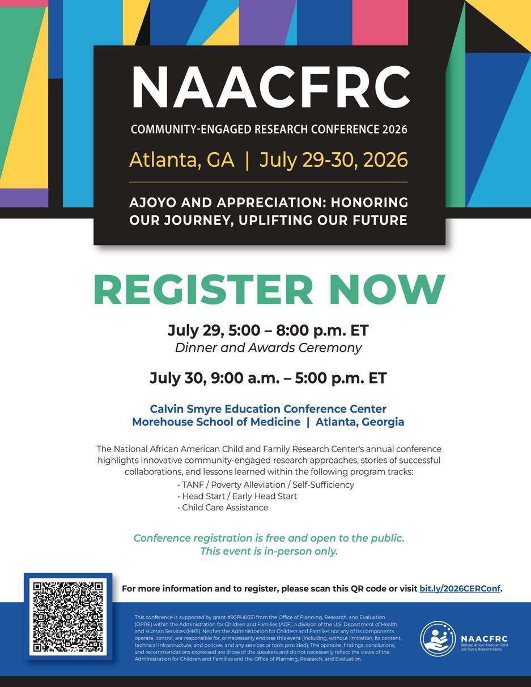

Slide 29
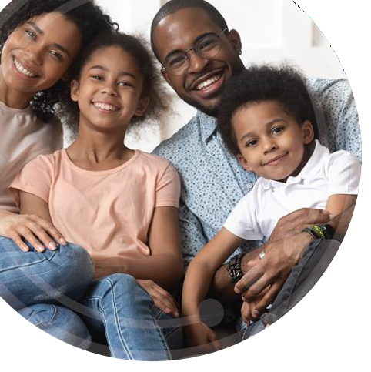



720 Westview Drive, SW, Atlanta, GA 30310 | Phone (404) 752-1187 Fax (404) 752-1707 | info@naacfrc.org | @NAACFRC
www.naacfrc.org
This project is supported by the Administration for Children and Families (ACF) of the United States (U.S.) Department of Health and Human Services (HHS) as part of a financial assistance award (Grant #: 90PH0031-01-00) totaling $1.8 million with 100 percent funded by ACF/HHS. The contents are those of the author(s) and do not necessarily represent the official views of, nor an endorsement, by ACF/HHS, or the
U.S. Government. For more information, please visit the ACF website:
acf. hhs. gov/administrative-and-national-policy-requirements

Slide 30

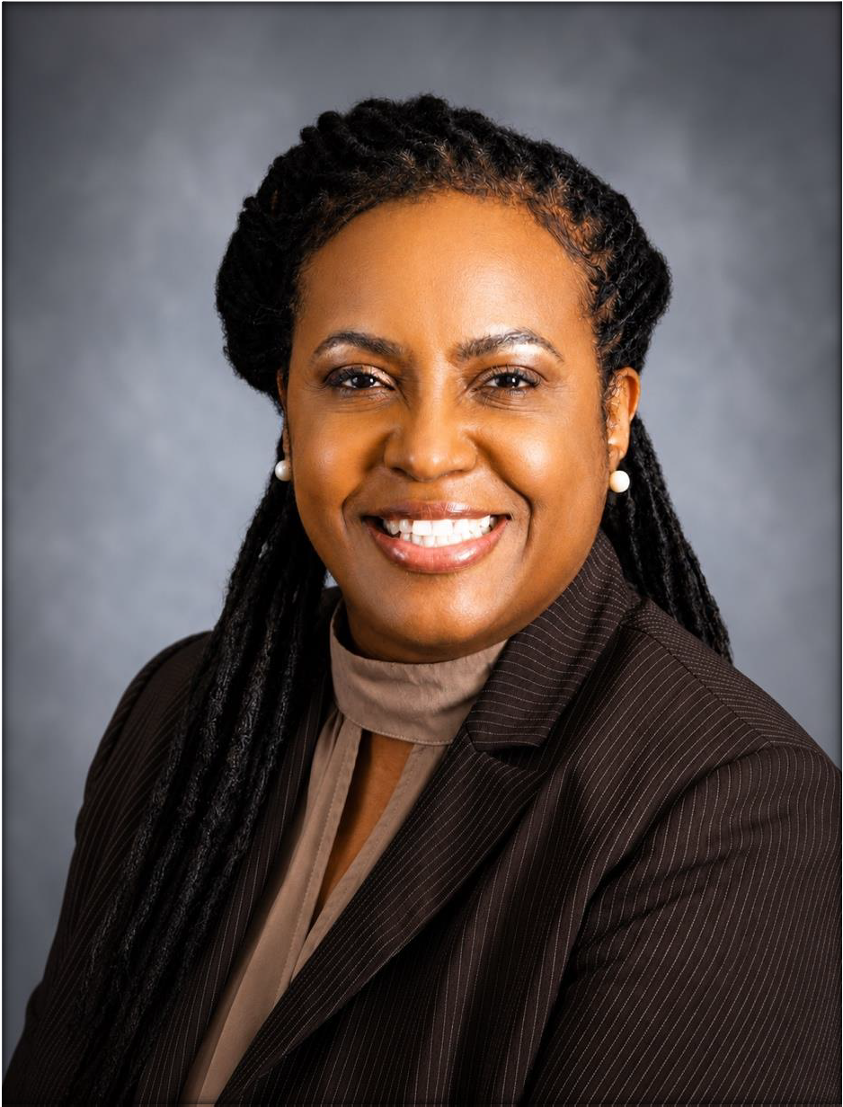
MRS. JOHNNETTA MILLER, CENTER DIRECTOR

Slide 31

OUR HISTORY
Sheltering Arms
Dunbar Learning Complex
The Educare Network
Sheltering Arms Educare Atlanta

Slide 32
Enhances the well-being and success of children and families
Expand resources and expertise
Strengthen community trust
Increase community participation
Create sustainable solutions to local challenges
WHY COMMUNITY PARTNERSHIPS MATTER

Slide 33
Identify community voices
  Align actions around common goals and
objectives
    Build trust through consistent engagement
Celebrate successes and learn from challenges
BUILDING COMMUNITY
PARTNERSHIPS

Slide 34
Let’s Talk About It!
Learn more about the SRCD Black Caucus at
https://www.srcd.org/blackcaucus/home

