Slide 1
Preparing young minds for school
St. Joseph Institute for the Deaf-IN
.
Teri Ouellette, MSEd., LSLS Cert. AVEd.
.

Slide 2
Ready for Kindergarten?
Basic “kindergarten readiness” skills
book awareness
basic number concepts
colors and shapes
social and play skills
Notes:
Early studies indicated that DHH students had similar delays in ToM to children with ASD diagnosis – delays in both cognitive and affective performance that persisted into young adults.

Slide 3
Concerns for children with hearing loss
Basic foundations of Listening:
auditory access
auditory skills
auditory function
Notes:
Early studies indicated that DHH students had similar delays in ToM to children with ASD diagnosis – delays in both cognitive and affective performance that persisted into young adults.

Slide 4
Concerns for children with hearing loss
Basic foundations of Language
phonology – how sounds make words
semantics – the meaning of words
syntax- putting words together into thoughts
pragmatics – using thoughts in socially meaningful ways
Notes:
Early studies indicated that DHH students had similar delays in ToM to children with ASD diagnosis – delays in both cognitive and affective performance that persisted into young adults.

Slide 5
Pre-frontal cortex development
Executive Functions
Organization of actions and thinking
Theory of Mind - ToM
“Mega-cognition” – Thinking about thinking
Inhibit Shift Flexibly Modulate Emotions Initiate
Working Memory Plan Organize Self-monitor & evaluate

Slide 6
Pre-frontal cortex development
Executive Functions

Slide 7
Executive Functions in PS/K
Working Memory
> immediate/short term memory (minutes)
> working memory (minutes to months)
until you don't use it or you need it
> long term memory (years)
5-13 year olds can carry 5-7 things in working memory

Slide 8
Executive Functions in PS/K
Initiation – ability to start an action
Inhibition – ability to delay an action
Examples: driving
answering a class question

Slide 9
Executive Functions in PS/K
Planning and Organization
Space – where do we put it and why
Time – what do we do, in what order, and how long will it take us to do it
*Note connection to working memory, initiation and inhibition

Slide 10
Are YOU your child’s Prefrontal Cortex?

Slide 11
Adult Executive Function
Inhibit Shift Flexibly Modulate Emotions Initiate
Working Memory Plan Organize Self-monitor & evaluate
How strong are your skills as an adult? Where do you struggle?
How can you model Executive Function management?
How can you build memory, initiation, inhibition, planning/organization in your child?

Slide 12
Pre-frontal cortex development
Theory of Mind – thinking about thinking
Cognitive (thinking) and Affective (emotions)
Interpersonal (internal) and
Intrapersonal (external)
Notes:
Early studies indicated that DHH students had similar delays in ToM to children with ASD diagnosis – delays in both cognitive and affective performance that persisted into young adults.

Slide 13
Theory of Mind development
Dependent on Executive Function:
working memory
inhibition
Built through contextual language
overhearing
Notes:
Early studies indicated that DHH students had similar delays in ToM to children with ASD diagnosis – delays in both cognitive and affective performance that persisted into young adults.

Slide 14
Theory of Mind in PS/K
Theory of Mind
Diverse Desires –persons have different desires about object
Diverse Beliefs – persons have different beliefs about unknown
Knowledge Access – persons have different access to information
False Belief
Contents – judging knowledge about misleading information
Explicit – judging actions based on mistaken belief

Slide 15
Theory of Mind in PS/K (Hutchins, Prelock, Ph.D, & Bonazinga-Bouyea, 2019)
Progression in the development of Theory of Mind:
Late infancy and toddlerhood: gaze monitoring, joint attention, and social referencing (looking at mom’s reaction)
Preschool years: meta-representation (representation of another person’s thoughts), theory of mind-based action, seeing-leads-to-knowing, and false belief understanding
Late childhood into adolescence: second-order false belief, sarcasm, and complex social judgment
Notes:
Another presentation of ToM developmentfrom ToM Inventory looks at the stages from Birth -
Metarepresentation – representing one thing with another (words for objects, one object for another, drawings for concepts, print for meaning)
Seeing leads to knowing – Conservation concepts

Slide 16
Impact of ToM on Social Interaction
Conversation
Jokes
Lies
Sarcasm
Irony
Notes:
Many educators have long been concerned with Pragmatics / Social skills for our students – roots of these issues may lie principally in ToM Delays
Just beginning to look at how INTENTIONAL FOCUS on teaching conversation skill, jokes, “white lies” (sabotage), and Sarcasm can affect long-term progress.
Intentionally build humor through modeling and stages – I have found that when little listeners are learning how to reply and tell jokes a script is helpful. “I have a joke for you.” introduces the topic of conversation. Explaining that jokes are not logical and the answers are tricky is important. Teaching the child to respond promptly with “I don’t know. I give up.” works well. Child: I have a joke for you. Adult: Ok. I’m ready. Child: What is a dog’s favorite snack? Adult: I don’t know. I give up. Child: Pup-corn! LOL!
Model and LABEL sarcasm and irony

Slide 17
Key Language impacts on ToM Development:
Emotion Recognition: ability to recognize and discriminate basic and complex emotions
Mental State Term Comprehension: understanding of terms such as ‘want’, ‘think,’ ‘know,’ and ‘promise’
Pragmatics: understanding of idiomatic language, play on words, and audience adaptation.
Notes:
Again – we are often trying to address issues in pragmatics without the consideration of the underlying issues around not just the language, but the ToM constructs as well.

Slide 18
Impact of ToM on Academics
Literacy is the process of coming to understand what someone else is thinking
Reading Fiction is the process of understanding another person’s perspective, experiences, thoughts, and feelings
Notes:
No Lets look at the affect of ToM on Academics, and specifically literacy.
Think about literature you may have read in high school
Shakespeare plays are largely built on issues re. False belief and real-apparent emotion – Romeo and Juliet / sarcasm and second order false belief (mid-summer nights dream). In fact, this bears a lot of resemblance to most Middle – School angst – How could Susie have asked her about the dance? Didn’t she know that they broke up after the first song?
Novels based on difference in perspective
Sound and Fury by Faulkner
Poisonwood Bible by Kingsolver
Harry Potter and the Sorcerer’s Stone by Rowling
The Giver Lowrey
Ramona by Cleary
Junie B Jones by Park
The Monster at the End of this Book
Going on a Bear Hunt

Slide 19
Impact of EF and ToM on Academics
Writing requires ToM to share YOUR thoughts with others:
working memory, planning
What is known vs shared knowledge
Sequence of occurrence
Referencing previous information
Pronouns
Ellipses
What is assumed/general information
Descriptions
Notes:
Writing is a collision between applying ToM and EF

Slide 20
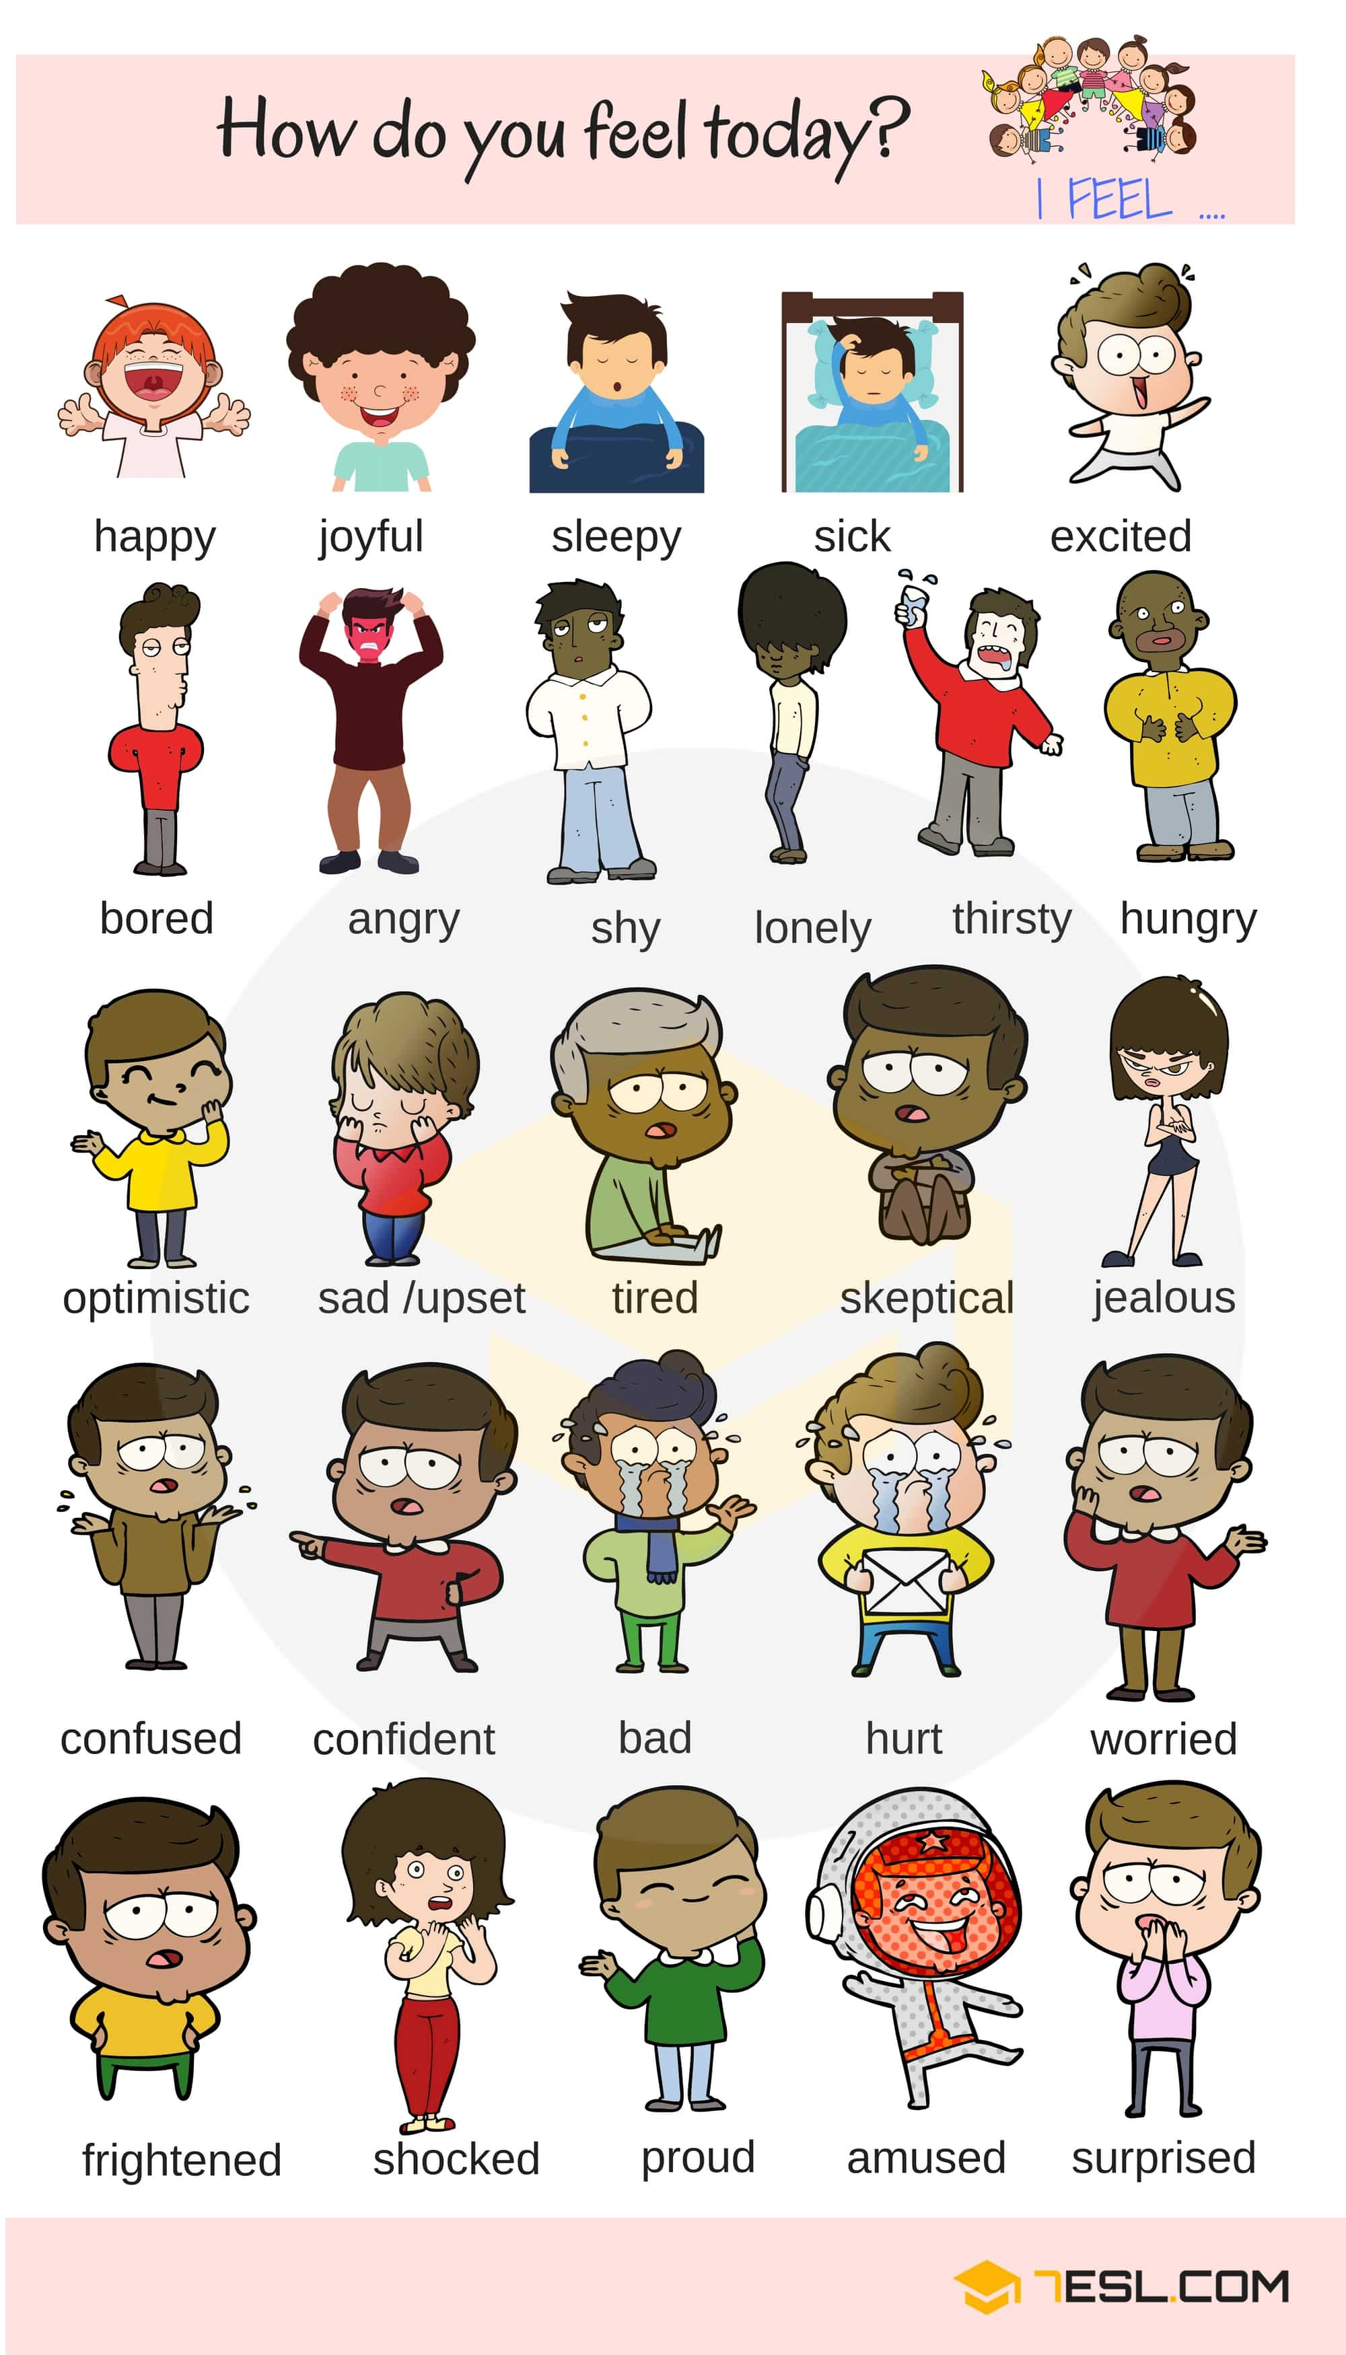
Impact on educational practices
Parents and caregivers using broader emotional vocabulary at earlier ages
Move beyond “happy, sad, scared”
“I’m disappointed because…”
“I wonder if Sam is laughing because it’s funny or because he’s scared?”
Notes:
Starting with young children, we need to move beyond the “basic three” Happy Sad Angry, Adding information about WHY we feel that way, and observing other people and characters in stories with discussion about feelings and why

Slide 21
Impact on educational practices
Parents and educators asking “real” questions – don’t ask questions if you know the answer!
Move from “what is that?” to “do you remember what that is called?”
From “what were you doing?” to “can you tell me why you…?” or “do you know why we don’t ….?”
“I don’t know – you could ask …?”
Notes:
Authentic representation of known information
What is that? Implies I don’t know what it is
Do you know what that is? Or Do you remember what it is called?
What are you doing? implies I did just see you color on the wall
Admitting when we don’t know an answer and asking someone else
VIDEO

Slide 22
Impact on educational practices
Parents and educators “self-talking” about thoughts and beliefs, identifying un-known information
I think
I wonder
What do you think?
Why did he make that face?
Help me remember
How do you know what she’s feeling?
How do you know?
I don’t know – I wasn’t there.
Notes:
Increase use of self talk regarding thoughts, feelings and beliefs

Slide 23
Impact on educational practices
Use “thought bubbles” to illustrate various perceptions and emotions

Slide 24
Impact on educational practices
Use early reading opportunities to build perspective and specifically discuss feelings
Use sabotage to discuss known and unknown information
Talk about the author and discuss why they included information or put it in the picture
Include building working memory and planning skills in IEP goals

Slide 25
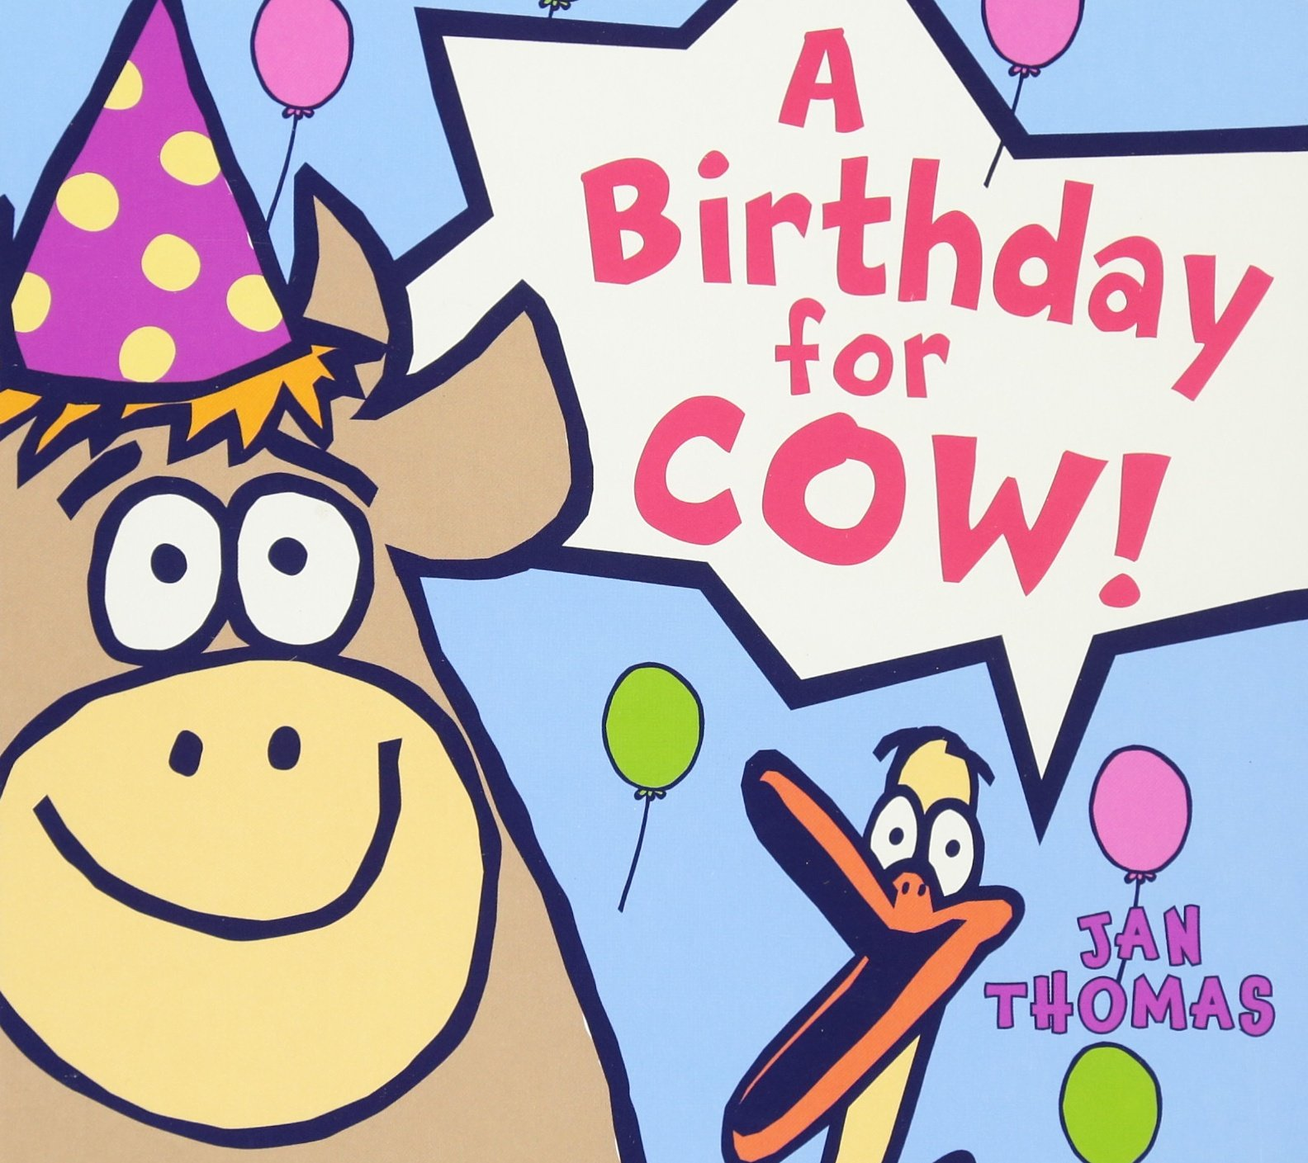
Impact on educational practices
Choose literature that emphasizes ToM development
Jan Thomas books

Slide 26
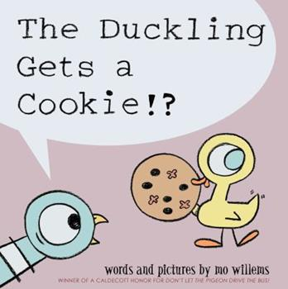
Impact on educational practices
Choose literature that emphasizes ToM development
Mo Willems books

Slide 27
Impact on educational practices
Use writing opportunities to practice planning and sequencing
Add information about emotions
Discuss known and unknown information

Slide 28
Impact on educational practices
Have children “read” their writing out-loud to others to help build an understanding of shared information

Slide 29
References: Publications
Alber, D. (2019). A little spot of anxiety. Diane Alber Art, LLC.
Hearing First: www.hearingfirst.org
Thomas, J. (2008). A Birthday for Cow. HMH Books for Young Readers.
Willems, Mo. (2012). The Duckling gets a cookie. Walker and Co.
Willems, Mo. (2007). There is a bird on your head. Hyperion Books for Children
Zweber Palmer, K., Tarshis, N., Hendrix, R., & Garcia Winner, M. (2016). We Thinkers Vol 2: Social Problem Solvers Curriculum. Think Social Publishing, Inc.

Slide 30
References: Research
Beck, I.L. & McKeown, M. G. (2006) Improving comprehension with questioning the author. New York, NY: Scholastic.
Hutchins, T., Prelock, P., & Bonazinga-Bouyea, L. (2019). Theory of Mind Inventory. https://www.theoryofmindinventory.com/about/test-description/
Marschark, M., Edwards, L., Peterson, C., Crowe, K., & Walton, D. (2019) Understanding theory of mind in Deaf and hearing college students. Journal of Deaf Studies and Deaf Education, 24, 104. doi:10.1093/deafed/eny039
Moeller, M.P., Ertmer, D., Stoel-Gammon, C. (2016). Promoting language and literacy in children who are deaf or hard of hearing. Paul H Brooks Publishing: Baltimore, MD.
Shamay-Tsoory, S., & Aharon-Peretz, J. (2007). Dissociable prefrontal networks for cognitive and affective theory of mind: A lesion study. Neuropsychologia, 45, 3054-3067.
Wellman, H.M., & Liu, D. (2004). Scaling of theory-of-mind tasks. Child Development, 75, 523-541.

