Slide 1



ISMPP University
We’re Not In Kansas Anymore
Harnessing The Power of Data Visualization
Webinar will begin promptly at:
11 AM ET /
4 PM GMT
May 21, 2025
Notes:
Hi everyone; welcome and thank you for joining today’s ISMPP U on “Harnessing The Power of Data Visualization”
This webinar has been approved for 1 ISMPP CMPP recertification credit.
This webinar is being recorded and will be made available on the ISMPP website within 24 hours after the webinar.

Slide 2

CMPP CE Credit
LIVE WEBINAR: Are YOU registered for the webinar? ISMPP will load the required information into each participant’s credit tracker on their behalf. No documentation required!
LIVE WEBINAR: Are you watching with a group and not personally registered? You will need a screen shot of the title slide for documentation and enter your credits into the tracker.
Are you watching the recording? You will need screen shot of the title slide for documentation and enter your credits into the tracker
Notes:
This webinar has been approved for 1 ISMPP CMPP recertification credit. For CMPPs who register for the webinar, ISMPP will upload the required information into each participant’s credit tracker on their behalf; documentation is not required. This benefit is limited to those participants of the live webinar (not applicable to those who listen to the recorded version). For CMPPs who opt to enter their own credits, documentation is required in the form of a certificate of attendance or a screenshot of the first presentation slide.

Slide 3























ISMPP Would Like to Thank…
Notes:
ISMPP would like to thank the following Titanium and Platinum Corporate Sponsors for their ongoing support of the Society

Slide 4

ISMPP Announcements
Application deadline for the September CMPP
exam is August 1
Notes:
And, for those who are seeking to become CMPP-certified or looking to renew your certification, the application deadline for the next exam window is August 1st, 2025

Slide 5
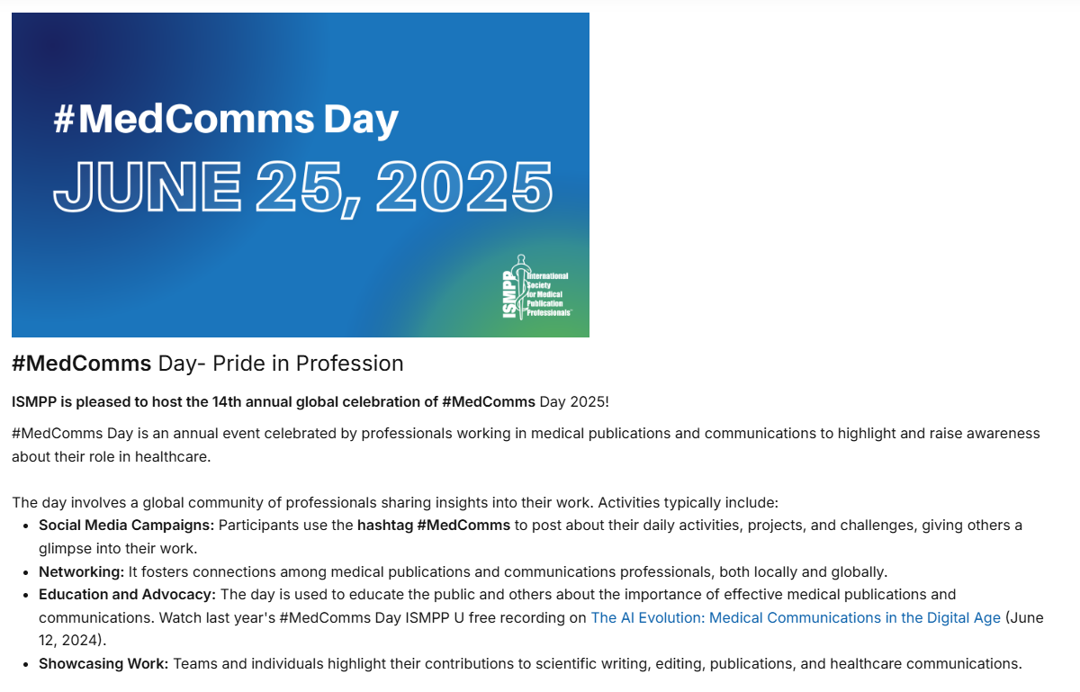
Notes:
ISMPP is pleased to host the 14th Annual global celebration of Medcomms day 2025. Please join us for an open to all 90-minute webinar offering. You can also view last year's open webinar titled the AI Evolution: Medical Communications in the Digital Age here.

Slide 6

How to Ask Questions
6
Feel free to ask a question at any time; however, all questions will be held until the end of the presentation.
To ask a question, open the Q&A window and type your question into the Q&A box. Click Send.
Note: Check Send Anonymously if you do not want your name attached to your question in the Q&A.
We will make every effort to respond to all questions live (out loud).
Notes:
Reminder that for today’s webinar, You can submit a question at any time during the presentation by following the instructions on this slide.
To ask a question, open the Q&A window, type in your question, and click send.
The faculty will answer questions at the end of all the presentations.

Slide 7


Disclaimer
Information presented reflects the personal knowledge and opinions of the faculty and does not necessarily represent the position of their current or past employers
Notes:
Please take a moment to read our general disclaimer.
OR
Please know that the Information presented by our speakers today reflect their personal knowledge and opinions and do not necessarily represent the position of their current or past employers

Slide 8




Objectives
Understand the traditional approach of publication development with typical content and within typical industry expectations
Appreciate challenges of a using a nontraditional approach from the pharma perspective
Identify differences between traditional and innovative data visualization, including visual elements and story telling narrative
Recognize the keys to successful implementation of a creative visual and storytelling publication
Notes:
These are the learning objectives for today’s webinar. We want you to....
1. Touch on the traditional approach of publication development with typical content and within typical industry expectations
2. Appreciate challenges of a using a nontraditional approach from the pharma perspective
3. Identify differences between traditional and innovative data visualization, including visual elements and story telling narrative
4. Recognize the keys to successful implementation of a creative visual and storytelling publication

Slide 9




Faculty
Moderator
Amanda Spear Hartley, PhD
Senior Director, Head of Publications
Sage Therapeutics amanda.hartley@sagerx.com
Amy Kuang, PhD
Director, Medical Writing, Global Scientific Publications
AbbVie
amy.kuang@abbvie.com
Matt Brierley, PhD
Global Medical Director
Ashfield MedComms,
an Inizio Company
Matthew.Brierley@
ashfieldmedcomms.com
Sean Taylor, FRSA
Creative Data Visualization Lead
Ashfield MedComms,
an Inizio Company
Sean.Taylor@
ashfieldmedcomms.com
With thanks to Lauren McMath Riley of Ashfield MedComms for help with slide design and layout
Notes:
Hi, I am Amanda Hartley, today’s session moderator,
With me are:
• Sean Taylor, Creative Data Visualization Lead, at Ashfield MedComms, an Inizio Company
• Matt Brierley, Global Medical Director, at Ashfield MedComms, an Inizio Company
• and...Amy Kuang, Director Medcal writing at Abbvie

Slide 10
What Is Your Level of Experience With Data Visualization?
A
I present data exclusively in a traditional manner
B
I use novel data graphics for some projects
C
I am a big advocate of novel data visualization and use it wherever possible
We hope that after this Webinar, you will endeavor to utilize novel data visualization in your publications
Notes:
Let’s begin with a survey question, and also use this as an opportunity to get everyone comfortable with the polling we will do during today’s webinar.
So, “What is your level of experience with publication planning?”
• Are you a BEGINNER dishwasher)
• Consider yourself at the INTERMEDIATE level
• Or, do you consider yourself ADVANCED (or a master chef)
OK, let me hand this over to Alanna Kennedy.

Slide 11
Before the Tornado:
Monochrome Data Visualization and Stories
Amy Kuang
Director, Medical Writing
AbbVie

Slide 12





An important journey to embark on
  Enable rapid release of data into the public domain
  Support development activities (eg, trial enrollment, early input and reactions)
  Extend for downstream use
  (eg, field team, medical information, medical education)
Why are congress posters important?
  Allow for meaningful interactions and insights
  Supplement enterprise-led communications
  (eg, investor reports, press releases)

Slide 13





A familiar place to start
Traditional poster style
  A lot of detailed information (ie, include everything for everyone)
  Standard colors and visuals
  Key takeaways lost in sea of text
  Authors comfortable with traditional style
Why we need to brave the storm
  Provide area of focus
  Encourage interactions
  Maximize insights gained

Slide 14
Reality of our situation: 4 key points*
Information collection and retention
  Visuals processed 60,000x faster than text
  Visuals cause faster and stronger reaction than words
  Visual memory is encoded in same place where emotions are processed
Our audience (AbbVie Physician Survey, >1000 respondents)
  Typically attend a poster session just once per day or per congress
  More likely to view a poster with bright colors, technology incorporated, infographics, native language
Traditional poster content (AbbVie Poster Analysis)
  Average >1300 words per poster in addition to tables and graphs
  Average reader needs ~10 min to read 1400 words (ie, not likely at a congress)
Eye tracking assessment
  Focus on title, conclusions, figures
*Remember this slide when Sean revisits some of these points later in the webinar
Notes:
#Amy I took the liberty to reformat, tweak the title and added a footnote for consideration
I cannot fix the bullet formatting for #1, our studio will do that

Slide 15
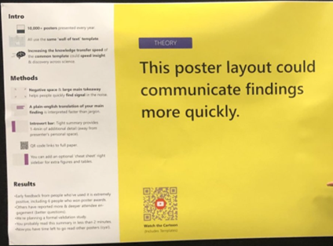


Exploring a new landscape
Natural evolution of data presentation opened the door to change
Poster 2.0, #Betterposter

Slide 16



Preparing for the storm
Anticipate needs and concerns
Be ready with a plan
  Ensure alignment with company brand standards
  Consider needs of stakeholders (eg, authors,
  cross-functional partners, field team)
  Identify impact on processes and potential roadblocks (eg, governance, alliance)
  Maintain scientific vs promotional data presentation
  Confirm decision maker
  Roll out to internal teams first
  Have data available to justify the changes
Start with small steps
  Decrease text volume, highlight key results
  Use conclusive table and figure titles (ie, key result)
  Consider supplemental materials (maximize impact while maintaining depth of information needed downstream)

Slide 17
3-min Conversation Break…
What does your flying monkey look like?
What is the
biggest impediment
to streamlining poster content for rapid learning?
Notes:
"We have always done it this way", it’s the standard traditional format", "its what doctors expect" "you are going to dumb down the data"
How will folk react, what are the needs for the poster
Getting internal teams to even consider a different approach is a big hurdle
Senior team member expectations
The need to just get content out into the public domain so it can be utilised

Slide 18
What Do You Think Is the Most Important Goal of a Congress Publication?
A
Get data into the public domain for awareness and reactive use
B
Enhance knowledge of the treatment or disease
C
Leave a memorable impression of the treatment or disease
All of these can be achieved with improved data visualization and storytelling
Notes:
Let’s begin with a survey question, and also use this as an opportunity to get everyone comfortable with the polling we will do during today’s webinar.
So, “What is your level of experience with publication planning?”
• Are you a BEGINNER dishwasher)
• Consider yourself at the INTERMEDIATE level
• Or, do you consider yourself ADVANCED (or a master chef)
OK, let me hand this over to Alanna Kennedy.

Slide 19
Follow Your Yellow Brick Road
Optimizing Data Visualization, Storytelling and Reader Engagement
Matt Brierley
Global Medical Director
Ashfield MedComms, an Inizio Company

Slide 20




What Does ‘Better’ Look Like?
The quest towards amazing!
Key goal:
Your data is accessible, readers engage with it, and they can place your narrative appropriately within the broader treatment landscape
Data visualisation is robust, it does not dumb down the science!
Remain accurate and scientific throughout
Ask your team…
What do we want to achieve with this publication?
Agree from the outset on our elevator pitch
Do we have a clear key message and topline narrative
Encourage the reader in… and continue to engage
Intuitive, appealing, intriguing, do readers want to explore further?
Glinda’s suggestion
Do you need to incorporate ‘all’ the available data to successfully convey your narrative,
is additional data diluting or confusing the take home message?
Notes:
call out points
Your team might not embrace DV, incremental steps are ok, you don’t have to go full on all in one go
Maintaining scientific credibility throughout is a given
Can you better engage your potential readership
To Glinda’s suggestion, understand if data just needs to be published so it can be referenced, but is there a way of doing this without disrupting the central narrative?

Slide 21







Build a strong framework for everyone to work within
Who is wearing the ruby slippers?...we all are!
Embrace complicated data sets and scenarios
Evolve the elevator pitch
…constantly
Time
What is realistic before the deadline?
Are you confident enough to stop and reset the course?
Open discussion
Are you prepared to back down on a point that isn’t critical? Are you prepared to fight your corner?
Embrace everybody’s skill set
(Industry:Agency partnership)
Understand how designers work with scientists (they are different species!)
Everybody needs to pull in the same direction
Use our scarecrow brain and the lion's heart to achieve our goals
Glinda’s suggestion
Is your personal preference on a particular point disrupting development?
Remember you want to resonate with a broad audience of HCPs, with a diversity of perspectives
Notes:
Call out points
Understand everybody's role in the development team
Create a safe place for honest feedback
Prepare to be wrong and admit it. Be brave

Slide 22
Transitioning from a tried and tested ‘traditional’ approach
Understand the internal barriers to change
If it isn’t broken, you don’t have to fix it
Do you have authors as advocates for change?
Be prepared to make incremental changes
Are you
open to more radical
ideas?
What push back are you getting?
Classic, well understood graphs, analyses and formats do not need to be reimagined
Can you leverage author opinion?
Are there small changes you can make to test the water?
Interactivity to allow information layering
Let individual readers delve as shallow or deep into the data as they wish
Glinda’s suggestion
Work out what internal barriers you need to overcome, what do key stakeholders need to see to be convinced?
Notes:
Call out points
Understand your scenario, and the key stakeholders and their opinions
You do not need to change something if it already conveys the message
How open are your authors to change?
You don’t have to do it all at once. Can you create a culture of change and take small steps. Can you question how you are currently doing things and start to challenge the authors and team to think about things differently?
How crazy are you going to get? Do you need crazy? Will crazy and radicle achieve your communication needs
1. What do you need to do to demonstrate the benefit of a new approach to improving data narratives?
Who is right? How do we find out? How can we ‘experiment’ safely? What metrics do you need?
2. Focus your energy elsewhere?
But can you place the data in a better context using data visualisation
3. Do they question large unwieldly tables for example?
Are there people you can consult with to help drive change?
Can we understand what your HCPs really want in 2025 and beyond?
4. Using a more infographic approach for some elements of figures and posters
Is your poster layout optimised…how do you know?

Slide 23
3-min Conversation Break…
What would the scarecrow's new brain think?
What is an incremental change that someone can try today to improve data visualization in publications?
Agency
perspective only!
…we have a case study to show you in just a few slides time!
Notes:
This very much depends on individual circumstances. It could be to just use conclusionary titles, or to add summary banners. It might be adding a QR code, or it might be a total design revamp. I know Amy is going to discuss a great case study toward the end of the presentation and this will demonstrate what is possible. One of the key things to consider is what can be reused elsewhere? This is an importent consideration when reimaging figueres for example, can these be used in digital platforms or social media.
One of the most important incremental things you can do is start the discussion with your team and authors. And ask your agency what they suggest might improve things. You don’t need to have a specific poster or manuscript in mind, but a few top level conversations might get the ball rolling

Slide 24
In Your Opinion, What Would Be the Most Impactful Poster Revision?
A
Condense the amount of text
B
Reduce the number of figures and tables
C
Creative redesign of figures and tables
C
Use extenders (supplements) with a QR code
All of these can be achieved with improved data visualization and storytelling;
but you should try the one that resonated with you
Notes:
Let’s begin with a survey question, and also use this as an opportunity to get everyone comfortable with the polling we will do during today’s webinar.
So, “What is your level of experience with publication planning?”
• Are you a BEGINNER dishwasher)
• Consider yourself at the INTERMEDIATE level
• Or, do you consider yourself ADVANCED (or a master chef)
OK, let me hand this over to Alanna Kennedy.

Slide 25
Publications Revisited
With a Heart, Brain and Courage
Sean Taylor
Creative Data Visualization Lead
Ashfield MedComms, an Inizio Company

Slide 26

Why do we need to transform data?
Text vs Visuals
Our eyes are the windows to the world.

Slide 27




Scientific Posters
Being Courageous
Creating clarity from the complex
Redesign and enhancement whilst conforming to guidelines
A better way of storytelling whilst retaining scientific evidence
Making print work with digital to enhance the message

Slide 28
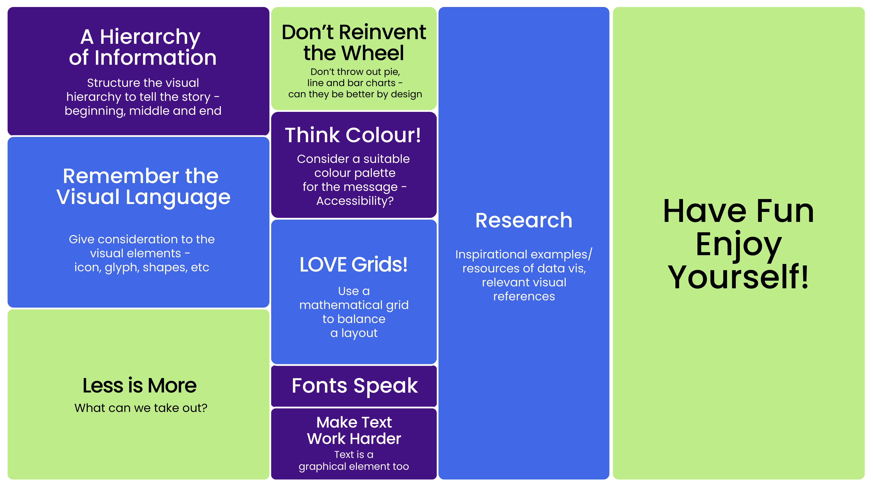
Top Ten Visualisation Considerations
Brains, heart and courage…

Slide 29
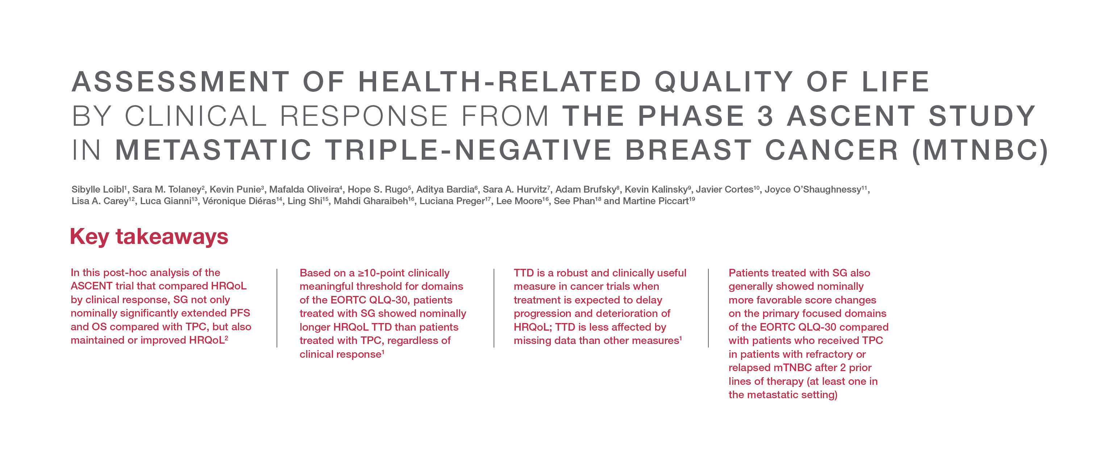
Scientific posters
The ‘masthead’ principle
Strong title using font weights for emphasis
Concise key takeaways

Slide 30

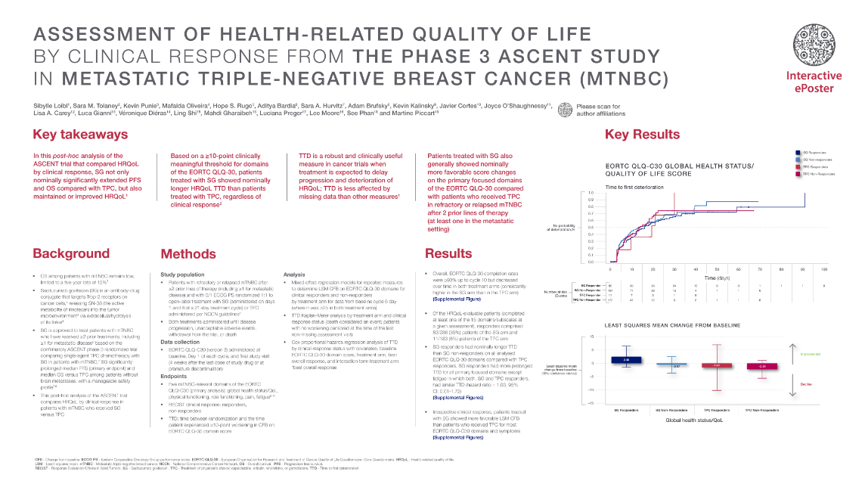

Scientific posters
Before
After
QR Code – A world of evidence at your fingertips
Visualisations
Augmented reality
Virtual presenter
Supporting graphs
Scientific evidence animations
Therapy area websites
Data is for demonstration purposes only

Slide 31
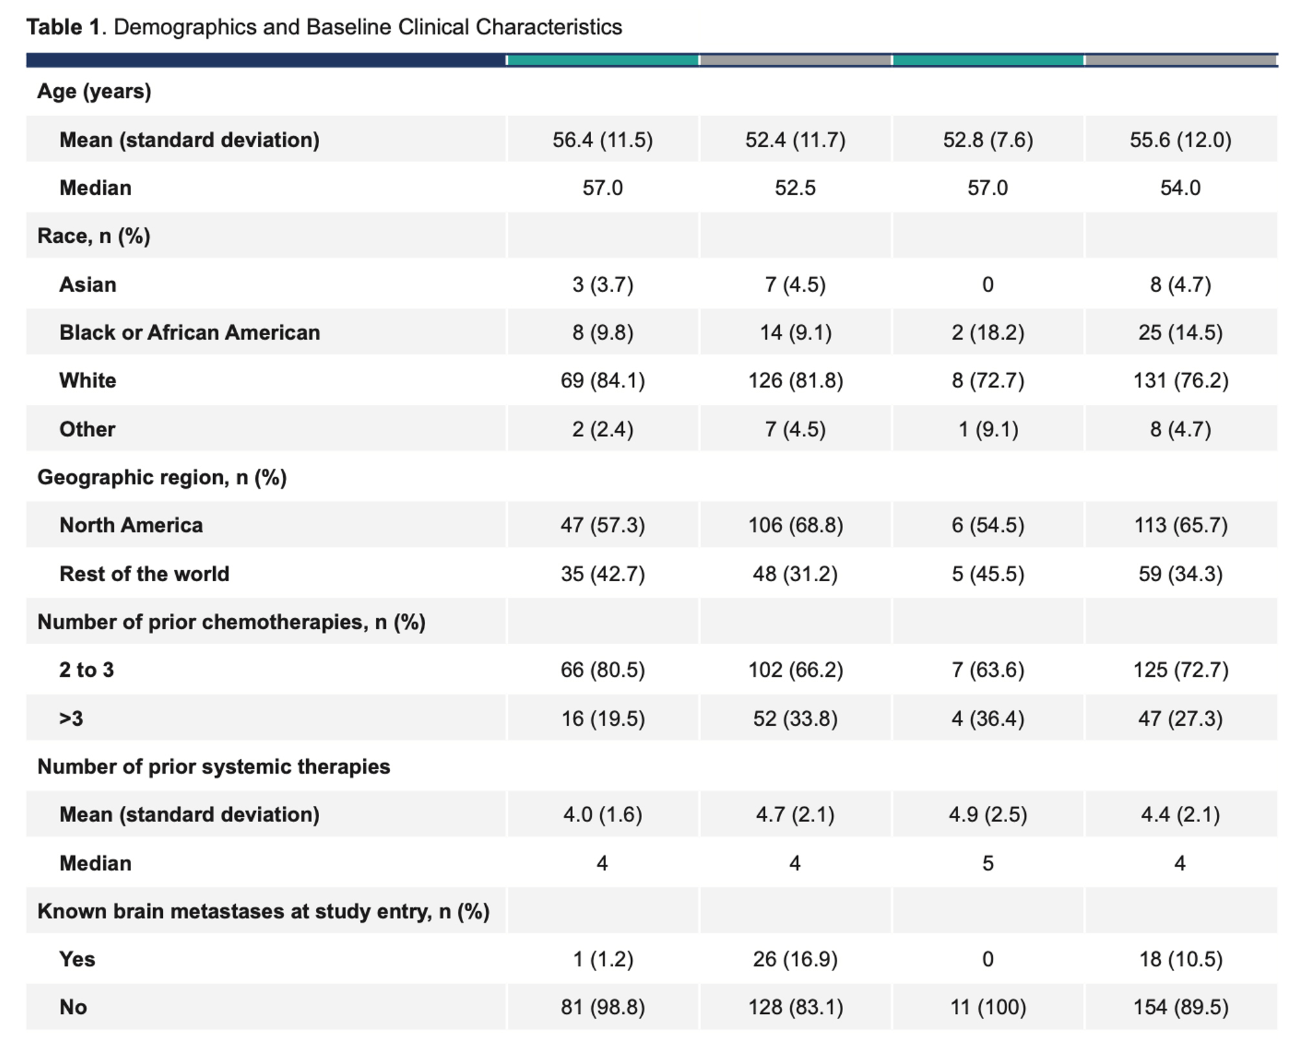
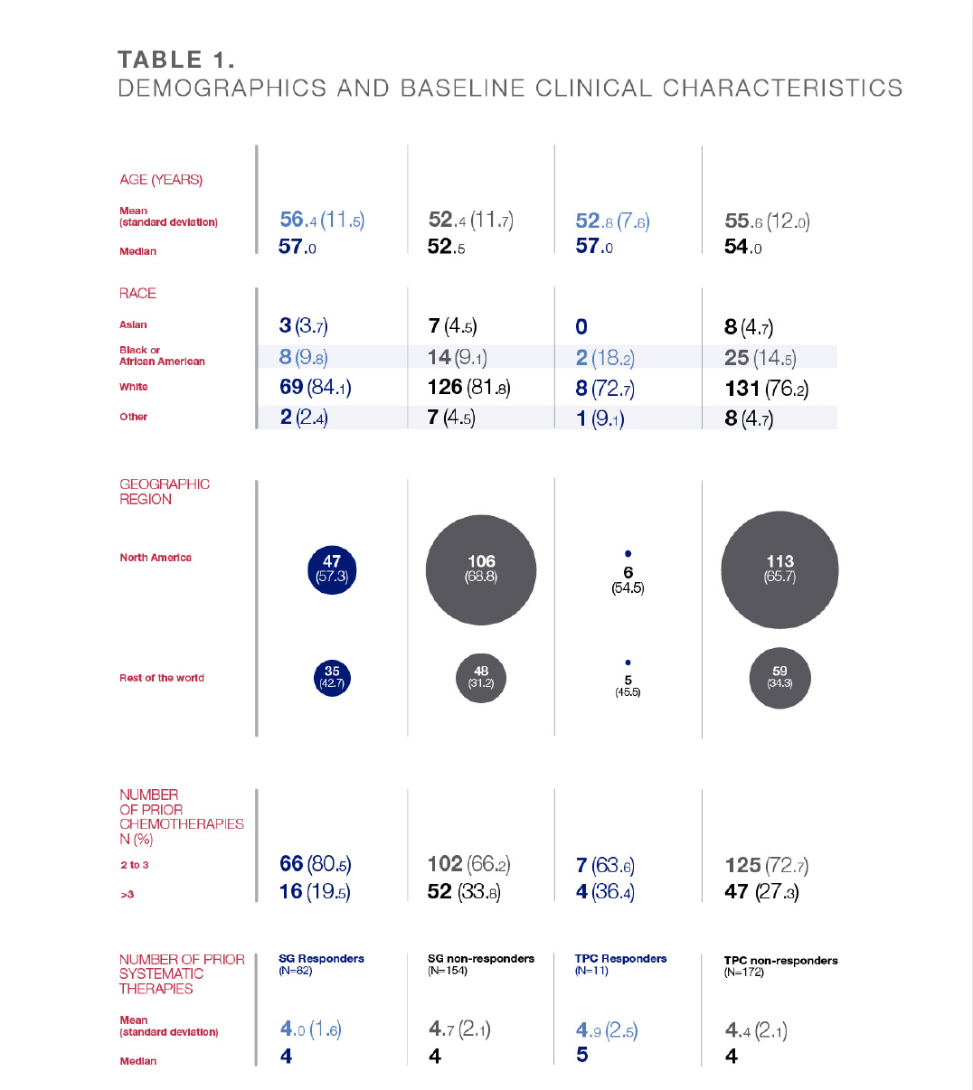
Scientific posters
Content
Before
After
Data is for demonstration purposes only

Slide 32
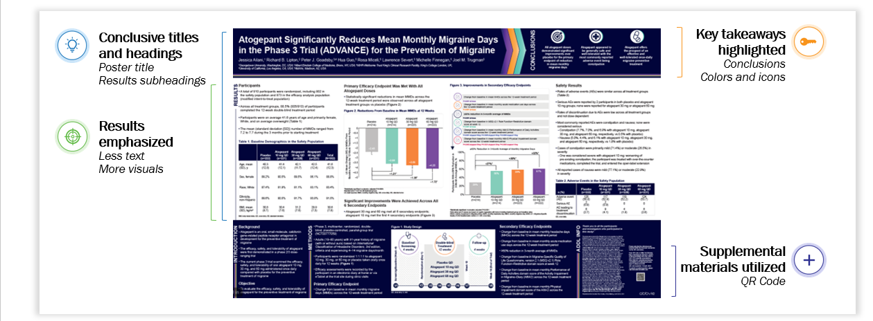
Exploring the new environment
Stepping in with courage

Slide 33
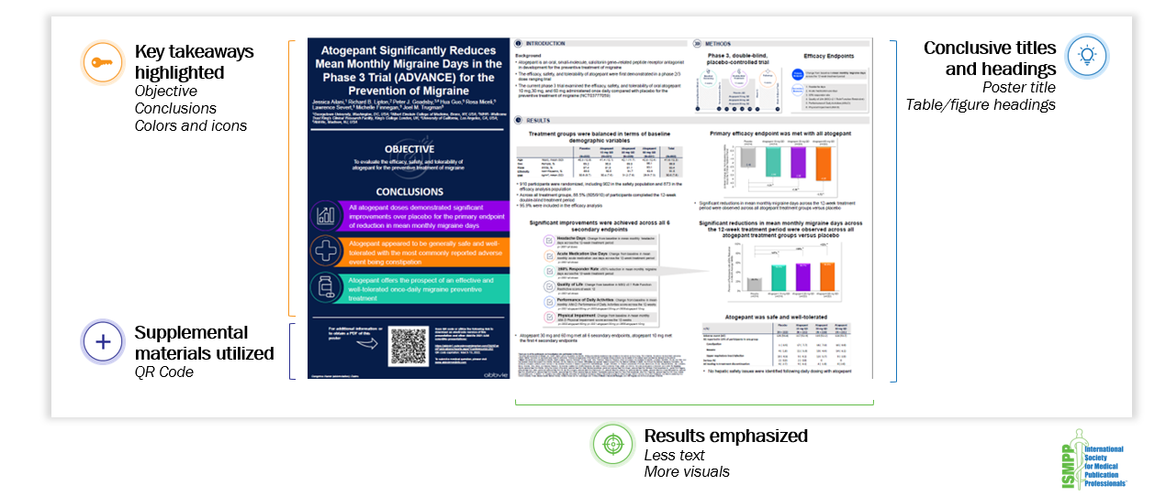
Exploring the new environment
Updating with wisdom

Slide 34
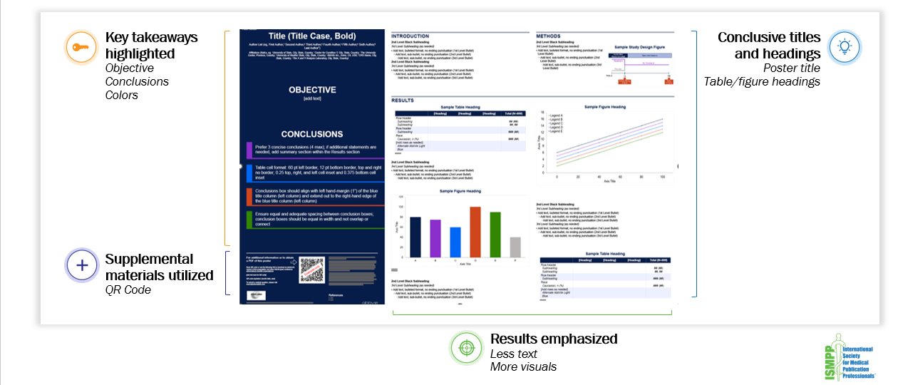
Exploring the new environment
Simplifying with understanding and care

Slide 35
3-min Conversation Break…
What is the heart of your narrative?
What elevator pitch best summarizes today's learnings about data visualization?
Notes:
Just getting data visualization onto your teams radar, can be a first big step. But you don’t need to scare them by suggesting radical changes from the outset. Incremental changes are perfectly acceptable. It is vital to remember that data visualization isn't the end goal, it is communication of the data and engaging with your readership, allowing them to discover the layers of information available to them and for them to go into as deep a dive into the detail as they want too. This is a really important consideration, if you recall Amy's data at the beginning and the average word count and reading speed... what is realistic in terms of content volume? For posters, we advocate getting the key points across in 30-45 seconds of viewing and making the nitty gritty detail available for the reader at their convenience.

Slide 36

Thank You!

Slide 37
Audience Q&A
To ask a question, open the Q&A window and type your question into the Q&A box. Click Send.
Notes:
And now it's time to answer your questions. As a reminder, please type them into the Q&A box at the bottom of your screen.
[ask seeding question]

Slide 38
Upcoming ISMPP University Webinars
June 2025
Open to all! In Honor of #MedComms Day: ISMPP U - Navigating the Journey to Effective Omnichannel Solutions
June
2025
Open to all! In Honor of #MedComms Day: AP ISMPP U - A Publications Rhapsody - An encore from the ISMPP 2025 Annual Meeting
June 2025
Open to all! In Honor of #Medcomms Day: ISMPP U - Dive Deep into the World of the CMPP Credential
Notes:
Also, be on the lookout for ISMPP’s next 3 ISMPP U’s…being offered on JUne 25 in honor of Medcomms day.

Slide 39
ISMPP University
We’re Not In Kansas Anymore
Harnessing The Power of Data Visualization
Webinar will begin promptly at:
11 AM ET /
4 PM GMT
May 21, 2025
Notes:
Hi everyone; welcome and thank you for joining today’s ISMPP U on “Harnessing The Power of Data Visualization”
This webinar has been approved for 1 ISMPP CMPP recertification credit.
This webinar is being recorded and will be made available on the ISMPP website within 24 hours after the webinar.

Slide 40

Thank You for Attending!
We hope you enjoyed today's presentation.
After closing out of Zoom, please click the CONTINUE button
on your screen to take our short survey. Thank you!
Notes:
Thank you again for attending today’s webinar. Please take a moment to fill out the survey link that will be sent to you.
After closing out of ZOOM, please click the ‘continue’ button on your screen to take a short survey.
Thank you!

