Slide 1

Toxics Release Inventory (TRI)
Reporting Guidelines and
Data Trends
2019 Environmental Trade Fair and Conference
Air Quality Division
K K. Blake Kidd May 14, 2019

Slide 2
TRI Topics
Origin and History
Reporting Guidelines
Reporting Process
Texas Data and Trends
Information Resources

Slide 3
Origin and History

Slide 4
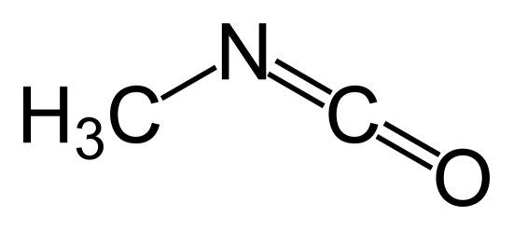
Why was TRI established?
Simple, methyl isocyanate
A Union Carbide chemical plant located in Bhopal, India was the site of one of the most significant chemical industry disasters in history. Beginning on the night of December 2, 1984 and continuing into the morning hours of December 3, 1984 a runaway hydrolysis reaction caused the uncontrolled release of thousands of pounds (lbs) of methyl isocyanate and related byproducts. The gas settled over the nearby town causing thousands of fatalities and injuring upwards of 500,000 people.

Slide 5

What followed the Bhopal accident
Eight months later, the town of Institute, West Virginia was also exposed to aldicarb oxime vapors (made using methyl isocyanate) from a leaking tank. The accident didn’t cause any fatalities, but around 100 residents reported medical problems.
At this point, the United States Environmental Protection Agency (EPA) was tasked via the Emergency Planning and Community Right-to-Know Act (EPCRA) by Congress to create the Toxics Release Inventory program.
2-Methyl-2-(methylthio)propanal O-(N-methylcarbamoyl)oxime

Slide 6
Purpose and Goals of TRI
Provides public access to the EPA database containing information on disposal and other releases of approximately 709 toxic chemicals reported from more than 21,000 United States industrial facilities
Provides communities with information regarding toxic chemical releases and waste management activities
Supports informed decisions by industry, government, nongovernmental organizations, and the public

Slide 7
Major Milestones in the TRI Program
1986 - EPCRA established
1990 - Pollution Prevention Act adds further requirements to TRI reporting
1993 - Executive order requires all federal facilities to report to TRI
1994 - TRI chemical list adds 286 chemicals
1997 - Addition of new reportable industry sectors (i.e. metal and coal mining, electric utilities, solvent recovery services)
1999 - Addition of Persistent Bio accumulative Toxic (PBT) chemical classification to reporting requirements
2006 - Changed from Standard Industrial Classification (SIC) codes to North American Industrial Classification System (NAICS)
2013 - Required online reporting with TRI-MEweb application
2017 - Proposed addition of natural gas processing facilities with SIC code 1321 or NAICS code 211112
2018 – Addition of 13 specific nonylphenol ethoxylates to the TRI reporting list

Slide 8
The Texas Commission on Environmental Quality (TCEQ) and the TRI Program
Texas Health and Safety Code, Chapter 370 establishes the state requirements for reporting TRI forms and imposes a fee for Form R reports.
The TCEQ TRI Coordinator acts as a liaison to the EPA TRI program by supplying online and phone support for businesses and the general public.
The TCEQ does not have compliance and enforcement authority for the TRI program.

Slide 9
Reporting Guidelines

Slide 10
Reporting Criteria
Facilities must meet all three criteria:
  10 or more full-time employees or 20,000 man hours as defined by the EPA;
  Industry sector must be covered by the NAICS code list found in Table I of the January 2019 EPA publication 740-B-18-001, Toxic Chemical Release Inventory Reporting Forms and Instructions; and
  Manufacture, process, or otherwise use more than the triggering amount for that classification of a TRI chemical.

Slide 11
Full-Time Employee Determination
Employees include contractors, sales, and support staff.
Hours worked include paid vacation, sick leave, and paid holidays.
Calculate the number of full-time employees by adding up all hours worked for all employees and divide by 2000.

Slide 12
TRI Industries
NAICS Six-digit code prefixes
Mining - 212XXX
Utilities - 221XXX
Manufacturing - 31XXXX – 33XXXX
Other Miscellaneous Manufacturing - 1119XX, 1131XX, 2111XX, 4883XX, 5417XX, and 8114XX
Merchant Wholesalers, Non-durable Goods - 424XXX
Wholesale Electronic Markets and Agent Brokers - 425XXX
Publishing - 511XXX, 512XXX, and 519XXX
Hazardous Waste - 562XXX
Federal Facilities

Slide 13
Common TRI Industry Sectors
Reporting Releases in Texas
Chemicals
Electric utilities
Petroleum
Hazardous waste/Solvent recovery
Primary metals
Paper
Food/Beverage/Tobacco
Fabricated metals
Plastics and rubber
Stone/Clay/Glass

Slide 14
TRI Chemicals
Approximately 594 individual chemicals, 27 chemical categories (i.e., cyanide compounds), and six delimited chemical categories (i.e., diisocyanates) with 82 specifically listed chemicals are currently on the TRI list.
Some individual chemicals and chemical categories are classified as PBT chemicals and have different reporting requirements.
Qualifiers are applied to some chemicals and chemical categories to account for physical forms, including dust, fumes, fibrous forms, friable materials, aerosols, and chemical allotropes, or manufacturer or manufacturing techniques, or geographical origins.

Slide 15
Threshold Reporting Amounts
Facilities meet the criteria requirements for reporting if site-level usage totals for each non-PBT chemical are at least:
  25,000 lbs, manufactured (produce, prepare, compound, or import a TRI chemical);
  25,000 lbs, processed (preparation of a TRI chemical for distribution in commerce); or
  10,000 lbs, otherwise used.

Slide 16
Threshold Reporting Amounts (cont.)
For a facility to meet criteria requirements for PBT chemicals (manufacturing, processing, and otherwise used), site-level totals must be at least:
  100 lbs for aldrin, lead, lead compounds, methoxychlor, polycyclic aromatic compounds, pendimethalin, tetrabromobisphenol A, and trifluralin;
  10 lbs for benzo(g,h,i)perylene, chlordane, heptachlor, hexachlorobenzene, isodrin, mercury, mercury compounds, octachlorostyrene, pentachlorobenzene, polychlorinated biphenyls, and toxaphene; or
  0.1 grams for dioxin and dioxin-like compounds.

Slide 17
2018 Reporting Year Updates

Slide 18
TRI Updates for Reporting Year (RY) 2018
Several new TRI developments impact 2018 reports.
  A facility must now indicate if it is filling a combined form for an elemental metal and a metal compound containing the same elemental metal.
  A facility must indicate more specific subcategories for certain processing and otherwise use activities.
  Recycling is now an activity under processing in Part II, Section 3.2.

Slide 19
TRI Updates for RY 2018 (cont.)
  A facility may indicate that on-site disposal includes quantities of the chemical being managed in “waste rock piles” (Part II, Section 5.5).
  New management codes are available for transfers of waste to POTWs (Part II, Section 6.1).
  New barrier code is available for use when a reduction does not appear to be technically feasible (Part II, Section 8.11).

Slide 20
Updates to Form R Reporting
Use indicator where the elemental metal and the metal compound are being reported.
When reporting the activity of the chemical as manufactured, processed, or otherwise used (MPO), the processing and otherwise used categories have a specific subcategory that needs to be indicated.
In Part II, Section 3.2, an MPO activity of “recycling” is available instead of “repackaging” under Processed.

Slide 21
Updates to Form R Reporting (cont.)
Facilities will report quantities individually with waste management activities for each Publicly Owned Treatment Works (POTW). Because not all facilities may have POTW waste management information, the EPA is providing two codes that a facility should use when the ultimate disposition of the chemical is unknown.
“P36: Other or Unknown Disposal” or
“P37: Other or Unknown Treatment”
There may be situations where a facility will find itself unable to conduct a source reduction activity for an industrial operation for reasons other than technical or financial support. For these situations, the EPA created a new code;
“B8: Reduction does not appear to be technically feasible.”
The prior B8 (“B8: Other barriers”) has been recategorized as B99 (“B99: Other barriers”).

Slide 22
Reporting Process

Slide 23
Reporting Process
Each chemical meeting all three criteria must be reported using either Form A or Form R.
Facilities determine which reporting form to use by
following the EPA guidance document, Toxic Chemical
Release Inventory Reporting Forms and Instructions
available at: https://ofmpub.epa.gov/apex/guideme_ext/guideme_ext/guideme/
file/ rfi_ry18_draft.pdf
TRI reports should be submitted to EPA using TRI-MEweb by July 1st following the reporting year.
When using TRI-MEweb, the submission is automatically
submitted to the TCEQ.

Slide 24
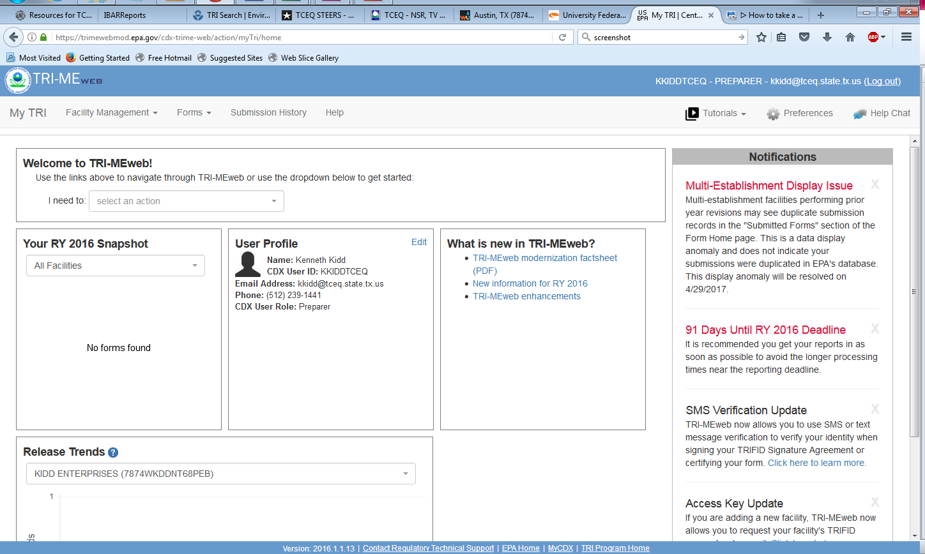
TRI-MEweb Homepage

Slide 25
Form A vs. Form R Reporting
Form A reports only include facility information and the chemical name.
Form R reports include facility information, chemical name, release amounts, transfer information, and other waste management activities for air, water, underground injection, and land media both on-site and off-site. Other sections of the Form R include source reduction and pollution prevention information.

Slide 26
Information Reported by Forms
Forms A and R
Facility information including physical address, mailing address, facility TRI ID, and parent company information
Chemical information includes TRI chemical or chemical category name and chemical abstracts service (CAS) number
Release amounts includes on-site air, water, underground injection, and land releases
Off-site transfers include POTW and other locations
On-site waste disposal including waste treatment methods (i.e. neutralization), energy recovery, and recycling processes
Other source reduction, waste management, and pollution prevention information as needed
Form R only

Slide 27
Form A Reporting Criteria
Form A use is allowed if the following criteria are met:
The total annual reportable amount* for that chemical does not exceed 500 lbs, and the chemical amounts manufactured, processed, or otherwise used does not exceed one million lbs.
*The total annual reportable amount is equal to the combined total
quantities released, treated, recovered, and combusted at
the facility, plus the amounts transferred to off-site locations.

Slide 28
Form A Reporting Scenarios
Scenario A
Company A make copper parts. They process 50,000 lbs of copper metal by melting and casting the parts. The casting process loses 0.1% by weight to air emissions. The parts are trimmed of 0.5% excess copper that is then recycled on site.
The total annual reportable amount is 50 lbs (air emissions) + 250 lbs (on-site recycling) = 300 lbs. The facility is under the 1 million lbs processed and the 500 lbs total annual reportable amount; therefore, they can report copper using Form A.

Slide 29
Form A Reporting Scenarios (cont.)
Scenario B
Company B also makes copper parts. They process 50,000 lbs of copper metal by melting and casting the parts but use a dirty kettle. The casting process loses 0.1% by weight to air emissions and 0.5% to copper slag that is sent off site for recycling. The parts are trimmed of 0.5% excess copper that is then recycled on site.
The total annual reportable amount is 50 lbs (air emissions) + 250 lbs (off-site recycling) + 250 lbs (on-site recycling) = 550 lbs. The facility is under the 1 million lbs processed but in excess of the 500 lbs total annual reportable amount, therefore, they cannot report copper using Form A and must use Form R.

Slide 30
Submitting TRI Data to the EPA
Create Central Data Exchange (CDX) user accounts for both the preparer of the forms and a certifying official. The certifying official will need to sign an Electronic Signature Agreement
Login through the TRI-MEweb application and enter the access key that was provided by email from the CDX
Enter facility and chemical information as applicable
Validate the form and correct any errors if needed
Select a certifying official and submit the form(s) for certification
Certify, sign, and submit the form(s) to the EPA

Slide 31
TRI-MEweb Resources
Registering with the CDX
https://cdx.epa.gov/Registration/Terms
TRI-MEweb Tutorials
https://www.epa.gov/sites/production/files/2018-03/documents/tri-meweb_mini-tutorial_list.pdf
Troubleshooting Guide
https://www.epa.gov/sites/production/files/2017-01/documents/ry_2016_cdx-tri-meweb_troubleshooting_guide.pdf

Slide 32
Texas Data and Trends

Slide 33
Texas 2017 TRI Data
Total Facilities Reported: 1,808
Total Form R Reports: 7,678
Total Forms Reported: 8,555
Total Form A Reports: 877

Slide 34
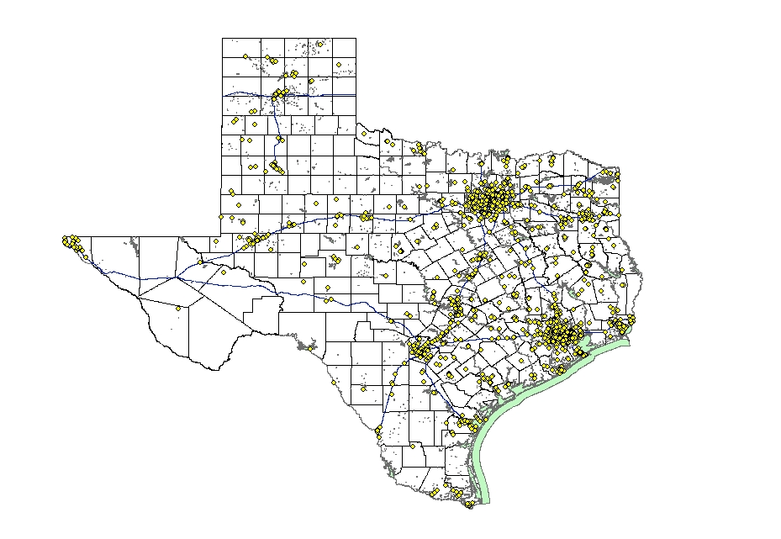

TRI Facilities in Texas 2016

Slide 35
TRI Releases by Media Type
2016 – 2017
Media Type | RY2016 (million lbs) | RY2017 (million lbs) | Change from 2016 to 2017 (million lbs) | Percent change | Reduction/ Increase
Air | 52.75 | 52.26 | -0.49 | -1% | Reduction
Water | 14.00 | 16.45 | 2.45 | 18% | Increase
Underground Injection | 77.54 | 80.53 | 2.99 | 4% | Increase
Land | 36.47 | 34.30 | -2.17 | -6% | Reduction
Total On-site | 180.76 | 183.54 | 2.78 | 2% | Increase
Off-site* | 20.12 | 19.45 | -0.67 | -3% | Reduction
On- and Off-site | 200.88 | 202.99 | 2.11 | 1% | Increase
* Double counting of chemicals reported as transferred off-site for release or disposal and as an on-site release at the facility receiving the off-site transfer have been accounted for by the EPA. This issue is normally
resolved by tracking the Resource Conservation and Recovery Act (RCRA) ID numbers identifying the transferring and receiving facilities.

Slide 36
Texas Trends in TRI Chemical Releases
2001 - 2017

Slide 37
Information Resources

Slide 38
EPA Online Training
Toxic Chemical Release Inventory Reporting
Forms and Instructions
https://ofmpub.epa.gov/apex/guideme_ext/guideme_ext/guideme/files/rfi_ry18_draft.pdf
TRI Basic Training
https://ofmpub.epa.gov?apex/guideme_ext/guideme_ext/r/files/static/v3407/RY18_Basic_Concepts_3_08_19.pdf
TRI Advanced Training
https://ofmpub.epa.gov?apex/guideme_ext/guideme_ext/r/files/static/v3407/RY18_Advanced_Concepts_
3_08_19.pdf

Slide 39
TRI Information Sources
EPA TRI home page
https://www.epa.gov/toxics-release-inventory-tri-program
EPA TRI Explorer
http://www.epa.gov/triexplorer/
EPA Envirofacts
http://www.epa.gov/enviro/

Slide 40
Contact Information
EPA Region 6 Enforcement Coordinator
Morton Wakeland, Jr. (214) 665 - 8116
wakeland.morton@epa.gov
TRI Information Center (operated by the EPA)
(800) 424 - 9346
Central Data Exchange Helpline
(888) 890 – 1995
TCEQ TRI Helpline
Blake Kidd (512) 239 - 4TRI {4874}
blake.kidd@tceq.texas.gov

