Slide 1

2016 Member Summit Meeting Summary

Slide 2



Table of Contents
Slide 3 – Event Summary
Slide 4 – Opening Keynote: Eduardo Conrado & Paul Steinberg, Motorola Solutions
Slide 5 – Plenary: Digitalization → Big Data
Slide 6 – Plenary: Digitalization → Collaboration
Slide 7 – Plenary: Digitalization → Virtual Experimentation & Simulation (VE&S)
Slide 8 – Panel: Future of Digitalization
Slide 9 – Session: How will Digitalization Inform, Enable, and Disrupt R&D?
Slide 10 – Keynote: Stephan Biller, GE Global Research
Slide 11 – Next Big Research Initiative → Human Capital Management
Slide 12 – Holland Award Address
Slide 13 – Closing Keynote: Steven Fifita, City Digital
Slide 14 – Interactive Breakout Sessions
Slide 15 – Working Group Sessions
Slide 16 – R&D Talent Management Breakout Sessions
Slide 17 – Recommended for Follow-Up
Slide 18 – Thank You Industry Sponsors!
Slide 21– About IRI

Slide 3
Event Summary
Theme: Digitalization and its Implications in R&D Management. Focus areas:
    Big Data
    Collaboration
    Virtual Experimentation & Simulation
Attendance: 245 Attendees; 100 organizations represented
Resources Available:
  PPT presentations are available on IRI Mobile app (download from Google Play or App Store). Login with IRI member credentials
  Video recordings and PPTs will be available soon on the web. Visit the IRI Learning Center: https://www.pathlms.com/iri-learningcenter
  For more information contact: Martha Malone, IRI

Slide 4
Opening Keynote
Driving Motorola Solutions’ Digital Transformation
October 17
Eduardo Conrado, Executive Vice President, Strategy & Innovation Office, Motorola Solutions & Paul Steinberg, Chief Technology Officer, Motorola Solutions
Conrado and Steinberg shared the story of Motorola's change from a communication company to a digital company. The key trends that support this change are:
  Connected everything: people becoming walking sensors
  Access and availability of 'real-time data' - data can be collected, stored, and moved "almost for free"
  New modes of accessing data: heads-up and hands-free replacing computers, tablets, or smart phones
  ‘Context aware' data - the data is filtered based on location and current events
  Cognitive computing
Motorola defines Design Thinking as 'knowing people (your customers) in human terms'
Motorola has implemented 3 peer roles to support their business: CIO, CTO, and Chief Strategy Officer
Open Innovation starts with the customer:
Incubation (co-creation), inorganic (start-up eco-system), and organic (inside-out)

Slide 5
Big Data Report Out
October 17
Jeffrey Alexander, PhD, Senior Manager, Innovation Policy, RTI International
Michael (Mike) Blackburn, MS, ThD, Portfolio/Program Leader, Cargill Global Research Management
Diego Klabjan, PhD, Professor, Department of Industrial Engineering and Management Sciences, Director, Master of Science in Analytics, Northwestern University
Big data is defined as 'uncomfortable data' that is of size and complexity to challenge contemporary analytical techniques.
Team has developed an industry segment framework of where big data will impact R&D:
  Inform – numerous examples
  Enable – multiple examples
  Transform – growing number of examples
Segments include Industrial Manufacturing; Consumer Goods; Food & Beverage; High Tech; Energy; Chemical; Healthcare & Pharma; Government
Transformation will likely come via start-ups
IRI Members download the Big Data Primer
Non IRI Members can purchase the Big Data Primer on Amazon

Slide 6
Collaboration Report Out
October 17
Stephanie Orellana, Vice President - Service Delivery, NineSigma, Inc.
Terry L. Rosenstiel, Director, Partnerships and Innovation Pipeline, USG Corporation
Hila Lifshitz-Assaf,, NYU, Stern School of Business,
Felicia Ng, PhD student, Carnegie Mellon University
The team discussed trends that will change how we conduct R&D in the next 5-10 years. Emerging trends are:
  Boundary-less R&D bringing together teams from inside the company, suppliers, customers - all working together
  On-demand teams (The Hollywood model)
Challenges discussed included:
  Solutionism: jumping to solutions vs defining the problem (customers don't care about your solution they care about their problem)
  Technical language barriers - different groups use different words and jargon
  Inside the box thinking: groups tend to think the same
Approaches to overcoming these challenges are:
  Re-frame the problem: clearly define the problem
  Abstract the problem: restate the problem generically
  Find analogies: look for similar problems in other contexts
  Distribute the problem: brainstorm individually and then with the team
  (Digital tools have been found to be particularly useful for the final 2 steps)

Slide 7
Virtual Experimentation & Simulation (VE&S) Report Out
October 17
Steve Moskowitz, Senior Principal, Innovation Management, Entegris
AJ Rao, PhD, Senior Researcher, Building Science & Technology Commercialization, USG
Anita Friis Sommer, PhD, Senior Consultant, Continuous Improvement, The LEGO Group
Need codification of tacit knowledge and a champion along with software/hardware to advance VE&S. When deployed correctly helps accelerate innovation.
VE&S is a way of thinking, working and innovating, not just tools and techniques.
VE&S provides opportunity to merge design and testing -- co-create with customers using virtual worlds and augmented reality.
In addition to improved speed and reduced cycle time/cost VE&S has advantages for safety since concepts that might be dangerous to try in reality can be tested. Rationale for VE&S varies by company and segment.
Research team developed a maturity model with levels from pioneering, best-in-class, mature, evolved and basic. Score based on Investment, Organization, Fidelity (how impacts decision) Application.
Team identified 11 pitfalls but most significant are:
Tacit knowledge (lack of understanding of model beyond few experts or not knowing limits and boundaries of model
Insufficient data quality
Uneven engagement of customers (internal or external) leading to false or narrow view

Slide 8
Future of Digitalization Panel Discussion
October 17
Moderator: Ted Farrington, IRI Emeritus
Anita Friis Sommer, PhD, Senior Consultant, Continuous Improvement, The LEGO Group
Diego Klabjan, PhD, Professor, Department of Industrial Engineering and Management Sciences, Director, Master of Science in Analytics, Northwestern University
In 5-10 years, the benefits of digitization (big data, simulation, collaboration) will be accessible to anyone, anytime. It will become "the new normal".
Need to select "big data" opportunities with a real ROI going forward. Only 20% of efforts to date show a positive ROI; this has to change.
More sharing and standardization are needed going forward to realize the benefits more quickly.
Models predicting human behavior are very tricky and can contain overt or covert biases.

Slide 9
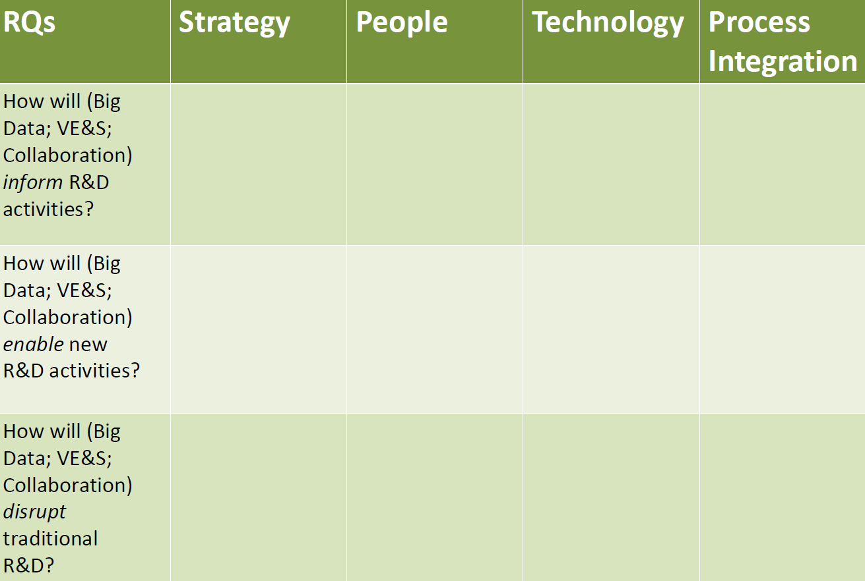
Digitalization Project – Small Group Session
October 17
Research project leaders facilitated discussion of “How will Digitalization Inform, Enable, and Disrupt R&D?” in the 3 focus areas

Slide 10
Keynote: The 21st Century Brilliant Factory
October 18
Stephan Biller, Chief Manufacturing Scientist, GE Global Research
The physical and digital worlds are converging
New collaborative ecosystems emerging from the intersection of Additive Manufacturing and Industrial Internet
  The Brilliant Factor
A “digital thread” forms the 21st Century Brilliant Factory
  Reduce physical iterations to get a good process and part
  Identify which process parameters introduce greatest process variability
  Enables faster introduction of new technologies
  Impacts entire cycle
GE’s Brilliant Factory acts as an App store to deliver unprecedented speed and efficiency in manufacturing
  Engages with supply chain partners through Digital Manufacturing Commons (DMC)
  Interconnected, automated – a factory that never stops

Slide 11
Next Research Initiative: Strategic Challenges in R&D Talent Management
October 18
Theresa Garcia, Senior Organization Effectiveness Advisor, Talent & Leadership, Boeing
Garcia cited trends from the IRI2038 Futures Study as trends we MUST pay attention to attract and retain talent: Hollywood Model; MOOGs Everywhere; Augmented Humans; Crowdsourced Funding; Era of Women; Cognitive Computing; Open Innovation; Innovation Ecosystems; Intelligent Avatars; End of the Patent.
We are on the verge of a demographic and culture shift
30-40% of our talent base will turn over in the next 10 years
Millennials will become the largest demographic as early as 2020
Attract, Develop, Retain
Provide growth opportunities across full talent spectrum
  Boeing Leadership Center
Offer multiple career paths without leaving ecosystem
  Enterprise level innovation initiatives
Learn more about IRI2038 Futures Study or order your
copy of the study.

Slide 12
Holland Award - Agile/Stage-Gate Hybrid
October 18
Anita Friis Sommer, The LEGO Group
The pace of technology, competitiveness, and customer needs combined with increased use of Open Innovation are raising conflicts with traditional Stage-Gate processes.
Hybrid Agile/Stage-Gate approach deals with the increased value chain interaction and resulting increased volatility of project requirements, specifications, and management challenges.
Agile, works for physical products too (not just software)!
The hybrid approach addresses many key pain points of a conventional Stage-Gate only approach including “the new reality” of increased rate of change, uncertainty in the market, and the need for faster innovation.
Hybrid approach provides a way to effectively manage a “dynamic product specification,” actively engaging the customer throughout the development cycle – get the scope right, not scope creep!
Leverage, leverage, leverage…
  Leverage Stage-Gate for the strategic management of the project; long-term project planning still required.
  Leverage Agile for the fast moving operational requirements within the project. Agile wins in directing the daily activities and short-term deliverables of the project.
  Keep looking for new opportunities to leverage the Hybrid
  Agile/Stage-Gate (Virtual Experimentation & Simulation)

Slide 13
Keynote: Closing the Innovation Gap
October 18
Steven Fifita, Executive Director, City Digital
UI Labs established a 5-yr cooperative agreement with $70M in federal funding, over $105M in matching funding from industry, academia, local government and community partners.
City Digital Current Projects
· Smart green infrastructure monitoring (reduce flooding)
· Underground infrastructure mapping (reduce damage from digging)
· Smart buildings data service
Future projects might include
· Dynamic storm water management
· Road integrity management
· Mobility optimization
· Urban freight management

Slide 14
Breakout Sessions
Past, Present, and Future of Simulation at John Deere
Emily Horn, Manager, Simulation & Analysis, Deere & Company
Using People Analytics to Accelerate Innovation
William Pike, Director, Computational and Statistical Analytics (CSA) Division, PNNL
Keep Cool. Innovation Contests & Hershey
Dr. Eloise Young, Senior Program Manager, NineSigma
Progress in Fire Protection VE&S at FM Global
Sergey B. Dorofeev, PhD, Assistant Vice President, Director of Fire Hazards and
Protection Research, FM Global
RTI and Online Analysis
Ian Thomas, Research Data Scientist I, RTI
Clinical Trial Data Lake for R&D Organizations
Raj Deshpande, Architecture & Consulting Head, TATA Consultancy Services
Prototyping a Future Vision of R&D Collaboration
Digitalization Collaboration Research Team

Slide 15
Working Group Sessions
Adding Sustainability to the NPD Process
Team members: Debbie Kalish, Ingersoll Rand; John Taylor, Schneider Electric; Sue Burek, Newell Rubbermaid; Larry Schwartz, IP Business-Tech Solutions (SME)
Aftermarket is an Afterthought
Proposing member: Alex Foessel, John Deere
Growth Outside the Core
Team members: Sue Burek, Newell Brands; Ted Farrington, Kalypso (EAG); Gene Slowinski, Rutgers University (SME)
Lean Start Up in Large Organizations
Team members: Jim Euchner, Goodyear; Norm Golm, Regal Beloit; Peter Koen, Stevens Institute (SME)
Monetizing Long Term Vision for R&D
Team members: Kent Young, Sherwin Williams; Ken Perry, BASF; Terry Rosenstiel, USG; John Gavenonis, DuPont; Pam Henderson, New Edge (SME)
Product Design for Mass Customization
Team members: Charlie Wartgow, Harley-Davidson; Mark Zhuravel, TCS; Rob Williams, Boeing; Cole Harris, Harley Davidson; Mike Alstrin, Harley Davidson; Pushpa Manukonda, Deere & Co.; Kent Crawford, Schneider Electric; Tim Simpson, Penn State (SME)
For more information on ROR working groups and how you can become involved, please contact Lee Green, green@iriweb.org

Slide 16
R&D Talent Management Breakout Sessions
Recruiting/Retaining Early Career Technical Talent
Facilitator: Catherine Conaghan Rivan, Sealed Air
Strategic Planning in the Age of Liquid Talent
Facilitator: Richard Dodge, Kimberly-Clark
Career Paths for Innovation
Facilitator: Ted Farrington, Kalypso
Effective Performance Reviews for R&D
Facilitator: Lou Gritzo, FM Global
For more information about IRI’s new research initiative and how you can become involved, please contact Lee Green, green@iriweb.org

Slide 17
Recommendations for Follow-Up
(for personalization by member company representatives)
Key Take-Aways , Quotes, and Implications for our Company:
1.
2.
3.
Key Follow-Up Actions for our Company
1.
2.
3.
Note: IRI is a member-driven organization and would like to address your key issues and topics. Please provide any request for topics and suggestions for future speakers to Martha Malone, 703.647.2580

Slide 18

Thank You 2016 Industry Sponsors!
Platinum:

Slide 19




Thank You 2016 Industry Sponsors!
Gold:

Slide 20


Thank You 2016 Industry Sponsors!
Silver:

Slide 21
About IRI
The mission of IRI is to enhance the effectiveness of technological innovation by networking the world’s best practitioners and thought leaders to seek, share, learn and create. IRI is the nation's leading association of almost 200 companies and federal laboratories working together to improve their research and development capabilities.
Upcoming Meetings:
February 22 – 24 | ROR Remix| Research Triangle Park, NC
March 13 – 15 | Spring Multi-Networks Meeting | New Orleans, LA
May 8 – 11 | 2017 Annual Meeting | Boston, MA
May 13 – 19 | Shaping Innovation Leaders | Evanston, IL
June 26 – 27 | CTO Forum | Littleton, CO
October 3 – 5 | Member Summit | Fort Worth, TX
June 4 – 7, 2018 | 2018 Annual Meeting | Atlanta, GA
Brown Bag Meetings: Generally the First Friday of the Month
Jan 6 | Feb 3 | March 3 | April 7 | May 5 |Sept 8 | Oct 6| Nov 3 | Dec 1
New Member Orientation Webinars: Second Tuesday of Each Month
Regional Meetings: Check to see if IRI will be visiting your neighborhood:
www.iriweb.org/regionalmeeting

