Slide 1

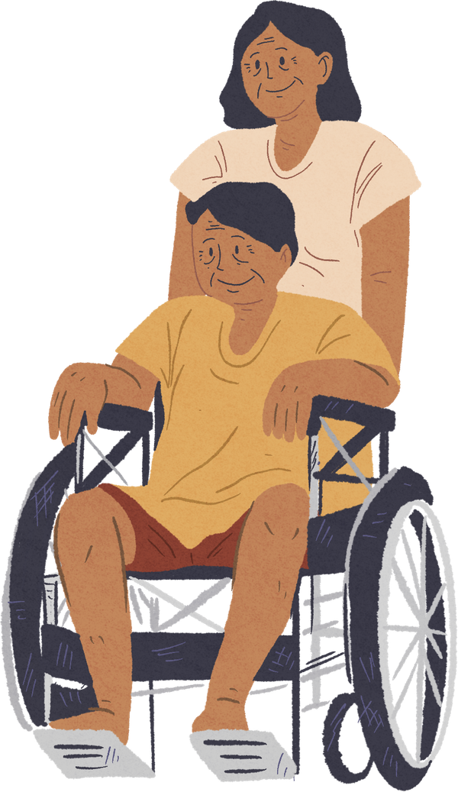

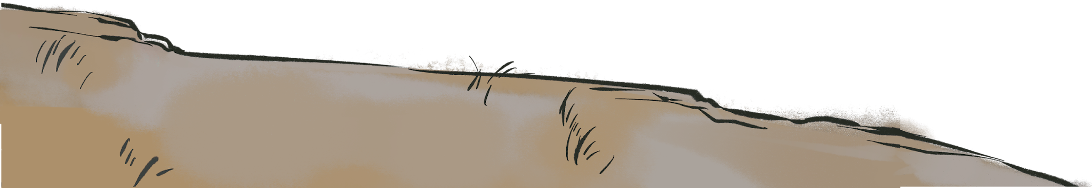


Disability Justice Foundations for Public Health
How Health Departments Strive for Accessibility and Disability Justice

Slide 2


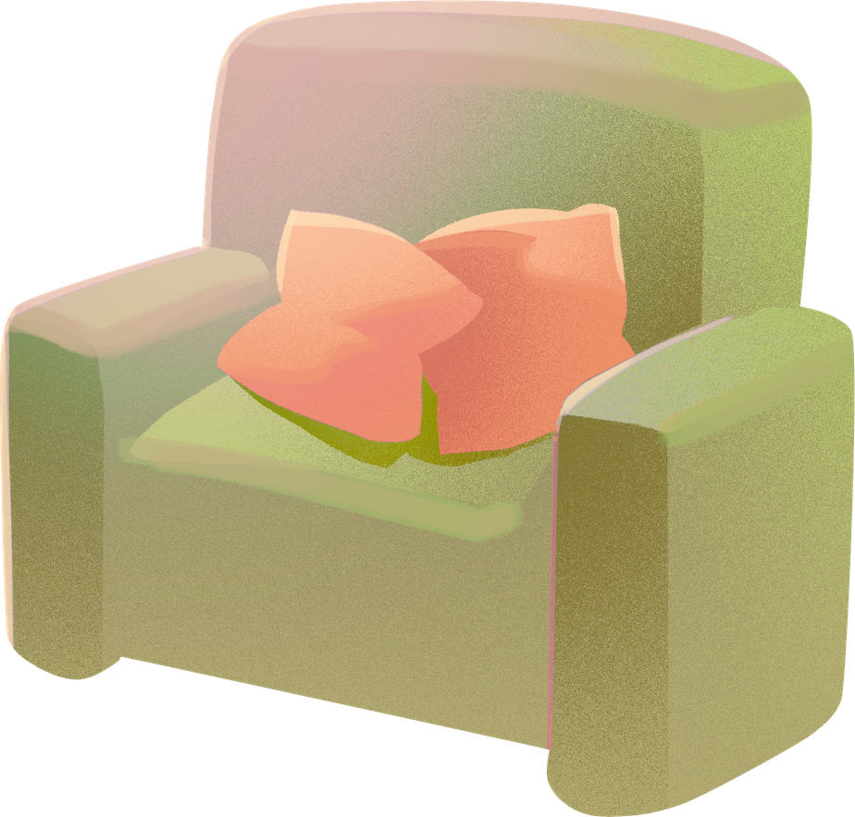

Land Acknowledgement
We are hosting this webinar from the ancestral and unceded territory of the Nacotchtank (Anacostan), Piscataway, and Pamunkey People.
www.piscatawaytribe.org
www.pamunkey.org

Slide 3
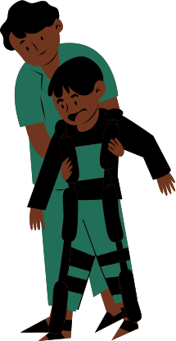
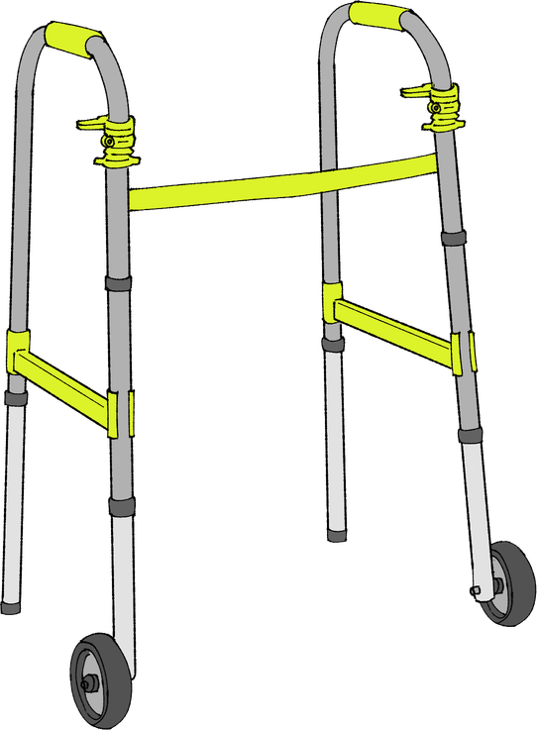
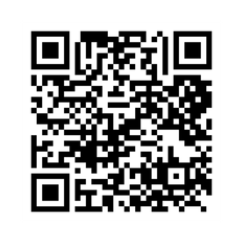
reminders
Disability justice is:
  A public health imperative
  A systems-change framework, not an awareness training
Catch the rest of the series
And webinar 1-3 recordings
Disability Justice Foundations for Public Health
From Awareness to Action: Disability Justice as an Everyday Practice
Access, Communication & Belonging in Health Care & Public Health

Slide 4
Acknowledgements
Thank you to the APHA staff who brought this webinar together!
Ki'Ana Speights, Tia Taylor Williams, Rya Griffis , Mary Storstrom, Kate Robb, Shweta Arya, Anush Hakobyan, Katie Avelar, Samiha Ahmed
Special thanks to our disability justice advisory board and our funder, Robert Wood Johnson Foundation.

Slide 5


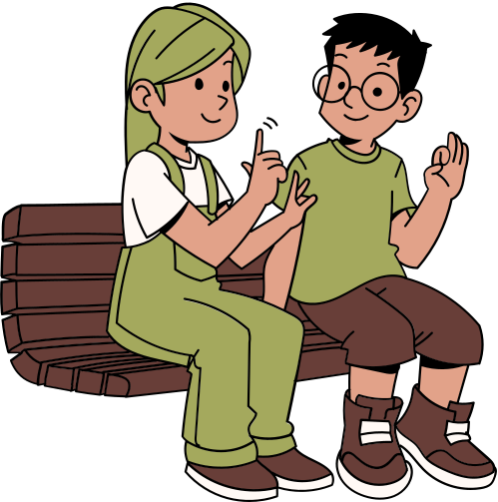


Housekeeping
  Participation norms:
    Cameras optional
    Engagement in the chat is welcomed
    Put questions in the Q&A feature
    Take care of access needs without apology
  This entire webinar series offers continuing education (CE) credit
  Recording, slides and resources will be available by 8/6
  Zoom accessibility features: Captions, ASL & Spanish interpreters
    Chat Rya Griffis for additional access needs

Slide 6
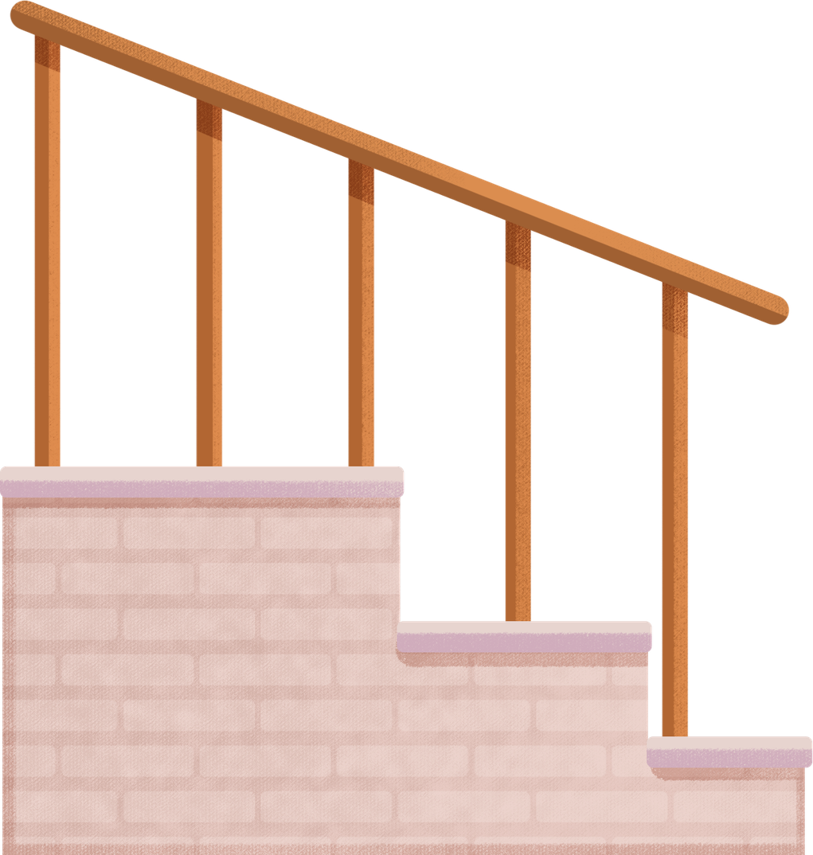

CE Disclosure
During the past 24 months, the speakers and moderators had no financial relationship with an ineligible company that might potentially be biased or impact the content of the webinar.

Slide 7
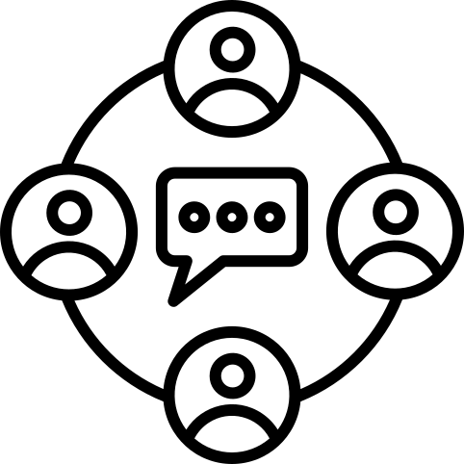
What to expect today
Option for audience engagement
01
04
Implementation Workshop Activity
Grounding
02
05
Q &A
Case Study Presentation 1
03
Case Study Presentation 2

Slide 8
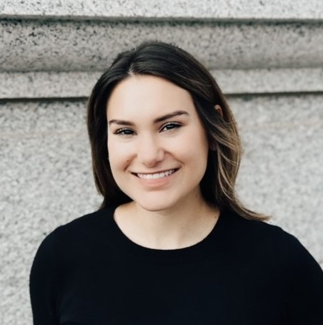
Presenters
Moderator
Mary-Kathryn Curcio Stoddard (she/her), MPH, CPH, CHES
Disability Justice Advocate | Chronic Disease Epidemiologist with Lived AuDHD |

Slide 9
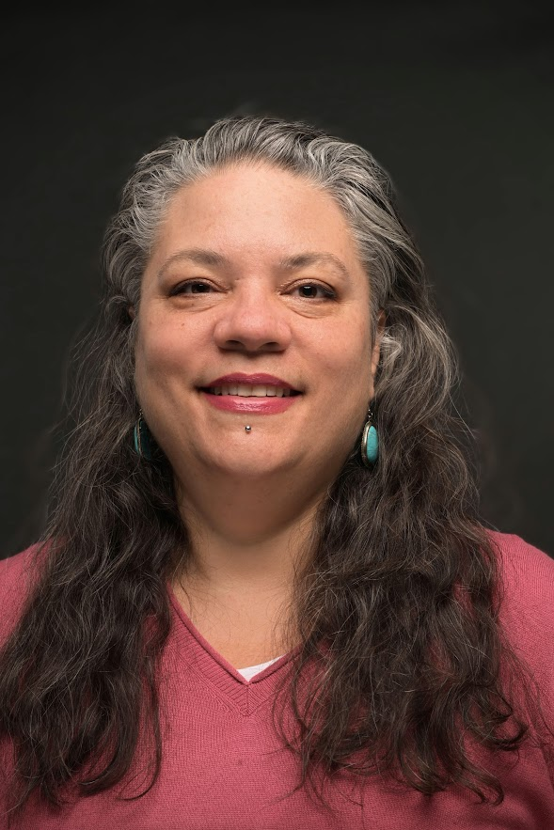
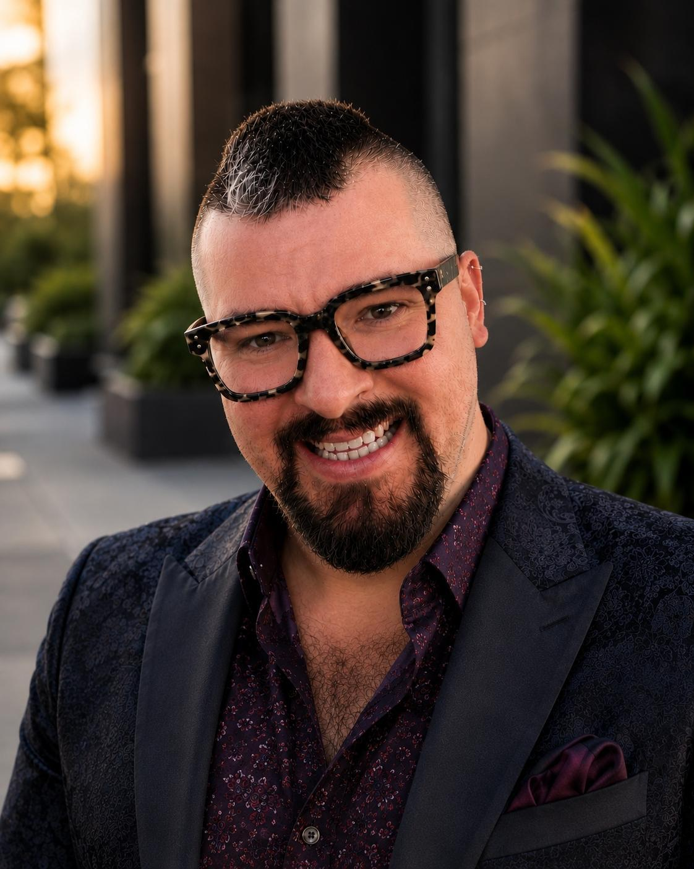
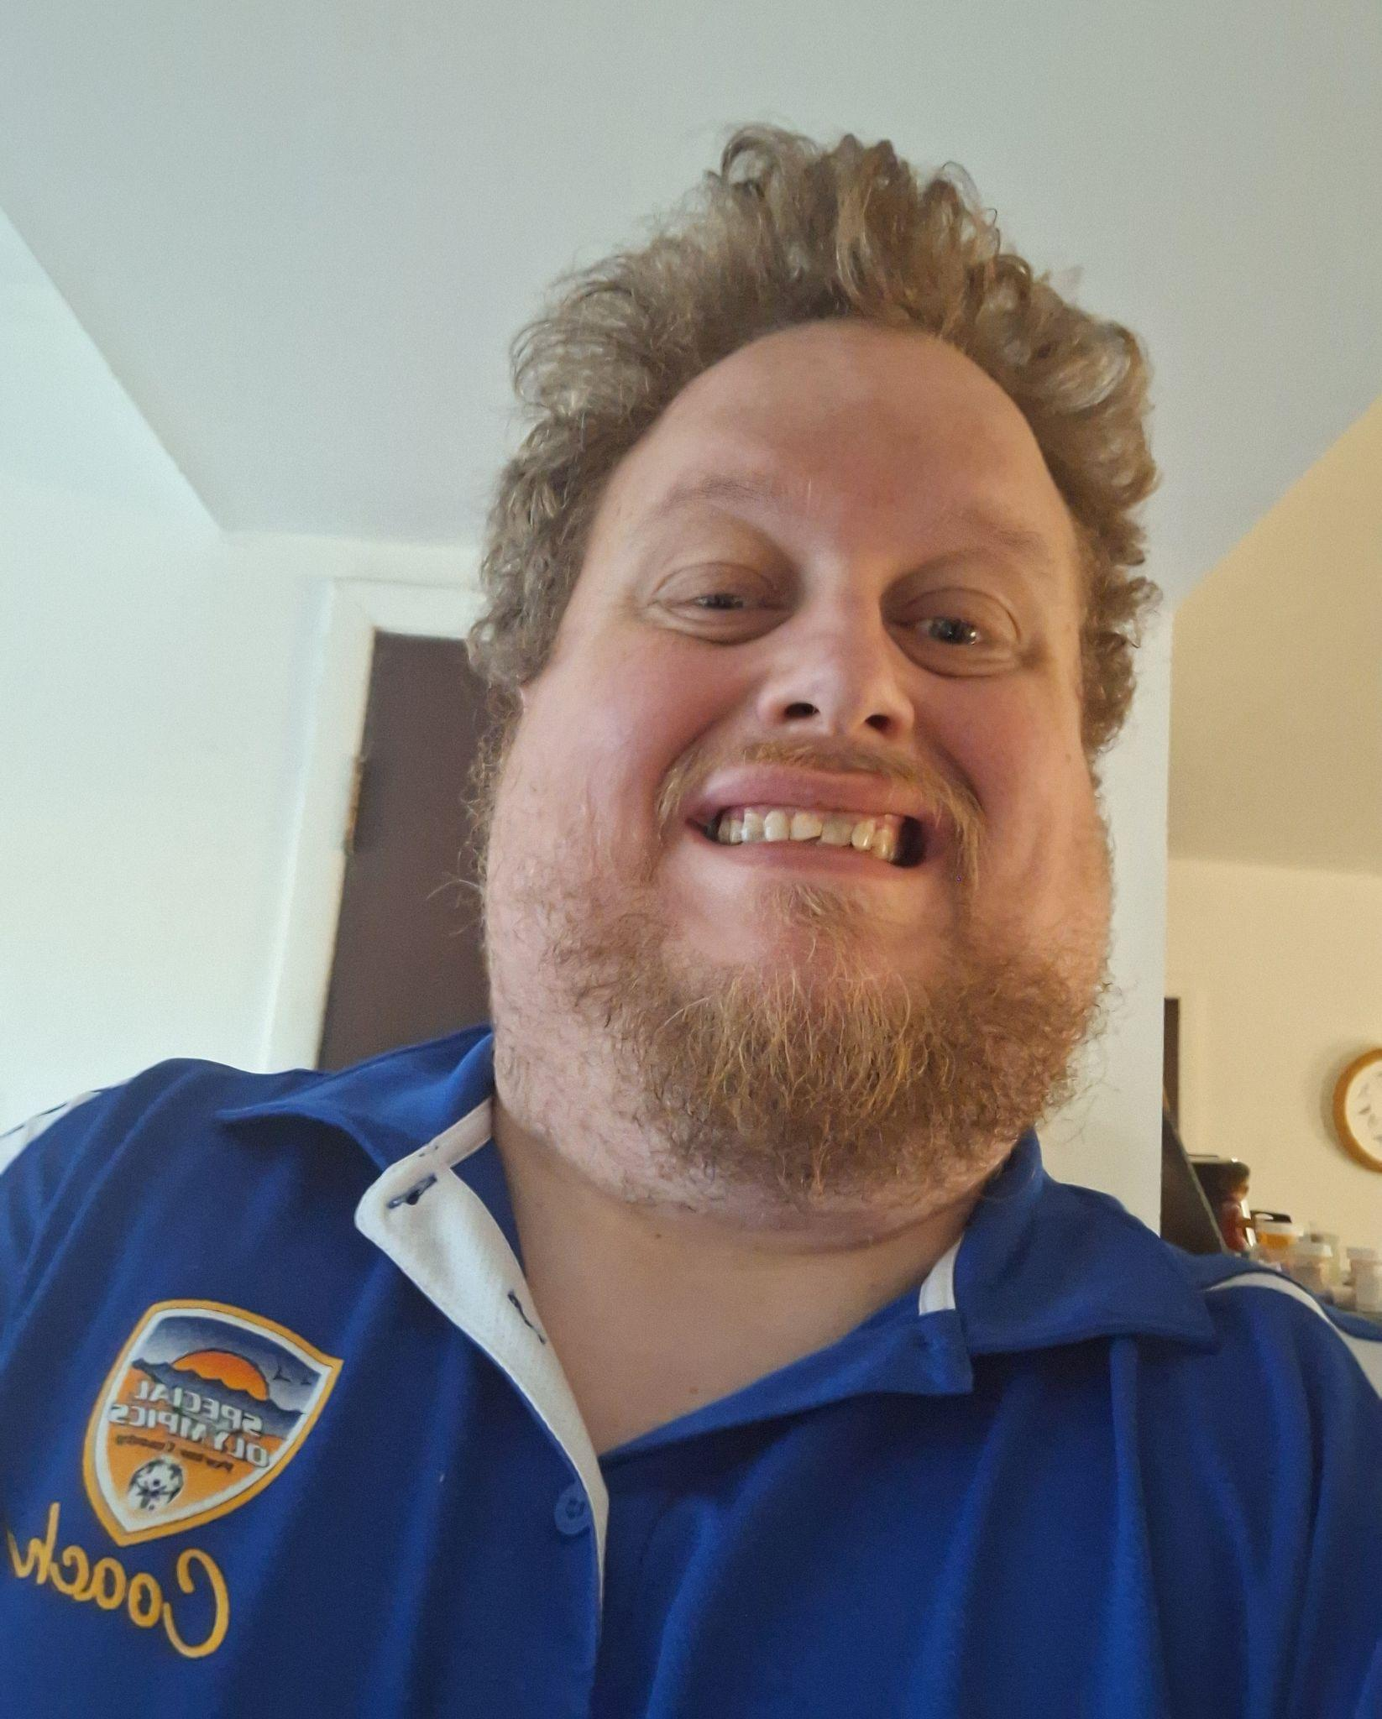
Presenters
Presenters
Tony Gunter
Disability Advocate| Coach| Member of the Indiana Department of Health Disability & Tobacco Workgroup and project implementation team
Cierra Olivia Thomas Williams, M.A.
Disability and Public Health Consultant | Founder of Nothing Without Us Collective
Blayne Amson
Americans with Disabilities Act (ADA) and Disability Equity Program Manager, Seattle King County Public Health

Slide 10
New Resources!
You can download plain language versions of the case studies from the links in the chat, or by visiting APHA.org/Disability
By the end of August the non plain language, longer versions and guide will be published online, we can send via email to everyone registered

Slide 11
Disability justice and health departments
Mary Kathryn Curcio Stoddard, MPH, CPH, CHES

Slide 12
Policy impacts everyone.
Federal, state, and local policies have changed the way we interact with each other, how we perform our jobs, and how we engage with public health.

Slide 13
Disability justice centers the whole self experience, which invites collaboration across the public health sector.
https://sinsinvalid.org/10-principles-of-disability-justice/

Slide 14



STAFF
OTHER DEPARTMENTS
We all deserve to be in a supportive work environment.
Collaboration can ensure disability justice practices are the standard.
Health departments have the influence for positive motion.
COMMUNITY
SUCCESS
Programs and events that are accessible invite in all who wish to attend.
Sharing the learning process and successes supports other organizations in their disability justice journey.

Slide 15


Case studies
Public Health - Seattle & King County Washington
Indiana’s No Barriers Just Better Health

Slide 16
Case study themes
Disability integration
Process standardization
Sustainability prioritization
Responsibility is shared across programs and centered around the whole person lived experience.
Disability justice resources and materials are created and communicated.
Sustainability of the programs and initiatives are prioritized, while also creating space for continued improvement.

Slide 17
Disability justice and its 10 principles are a practice.
No one has the perfect system, but there is a collective dedication to inclusion and equity.

Slide 18
No Barriers,
Just Better Health
and the Indiana GCPD partnership with IN Department of Health, Tobacco Prevention and Cessation, and Cancer Prevention

Slide 19

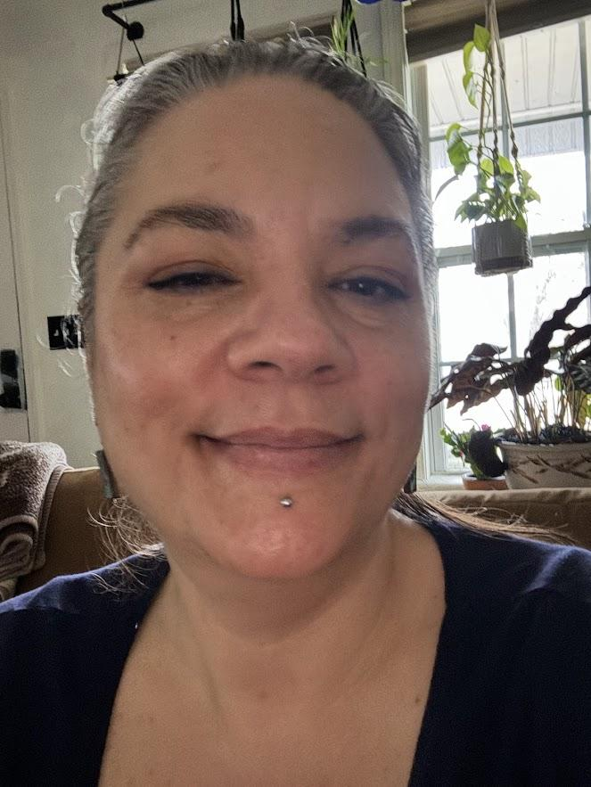
Who We Are
Cierra Olivia Thomas Williams, MA
GCPD 5x5 Public Health Initiative Contractor
Tony Gunter
Special Olympics Chair Valparaiso
Notes:
I am tony gunter from porter county special Olympics
Health degree in this project to talk about how lung cancer and tobacco
The Council brings together many perspectives, but they all share one purpose: That is improving the lives and systems for people with developmental disabilities in Indiana. We want all Hoosiers to live their best lives, and most importantly for the Council, for Hoosiers with developmental disabilities.

Slide 20
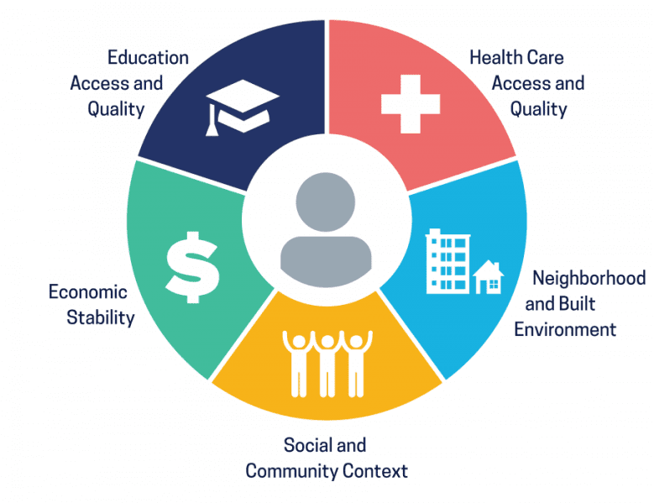
GCPD State Plan & the 5x5 Public Health Initiative
GCPD State Plan Goals
  Leadership & Advocacy
  Community Inclusion & Belonging
GCPD Collaboration with State Agencies
  Aligning Social Drivers of Health and Charting the LifeCourse Life Domains
Graphic credit: Healthy People 2030, U.S. Department of Health and Human Services, Office of Disease Prevention and Health Promotion. Retrieved February 26, 2024, from https://health.gov/healthypeople/objectives-and-data/social-determinants-health
Notes:
State plan.
Goal 2. Community Inclusion & Belonging -
Systemic barriers are addressed to facilitate increased community inclusion and belonging on the part of people with intellectual and developmental disabilities. (put in plain language: We work to remove the problems that stop people with intellectual and developmental disabilities from feeling like they belong in their community.
Objective 2.1
HCBS/Social Drivers
Improve policy, practice, and programs to support people with ID/DD at the intersection of Home and Community Based Services and Social Drivers of Health.
Objective 2.3
Community Capacity
Increase community capacity for understanding, inclusion and belonging.
Life Domains means the parts of a person’s daily life that are specific, connected, and add to the whole-person’s quality of life.
Embeds person-centered principles into project
Uses Charting the LifeCourse foundational tools to support collaboration between GCPD and partnering State agencies in strategic planning for 5x5 PHI projects
Creates a pathway for the Council to explore emerging opportunities that support federal performance metrics
Individual and Family Advocacy
Systems Change
Examples: A neighborhood that works to include all the people who live in the neighborhood boundaries helps to make that neighborhood a good place to live, work, and enjoy leisurely activities, like going to the local park, restaurants in the neighborhood, or faith-based groups. When the people in the neighborhood work together to make the neighborhood welcoming, we are talking about the social and community context of a person’s health. Having social connection to the community, feeling welcomed, and having a sense of belonging reduces loneliness and isolation, and increases positive health outcomes, such as reporting good mental health wellness.
Supporting self-advocacy skill-building for people with ID/DD in the corrections system gives individuals the person-centered tools that may support them more effectively in the re-entry process or will help individuals get the support and accommodations needed while serving their sentence in the corrections system; self-advocacy groups provide a social network within the corrections system and for those who have a shared lived-experience of being justice involved outside of the corrections facility

Slide 21
APHA Case Study
“Trying to navigate health services is hard for regular people. It's twice as hard for a person with a disability.” - Tony
Notes:
Cierra – explain the APHA case study
Ask Tony to talk about accessing healthcare

Slide 22
IDOH: Core Challenges to Healthcare
Health communication was not accessible.
Healthcare professionals were not trained to help people with disabilities.
Health screenings were not accessible for people with disabilities.
People with disabilities were not involved in program planning.
Notes:
IDOH:
The National Institutes of Health in 2023 said people with disabilities are a health disparities population – meaning people with disabilities don’t have the same opportunities for health as people without disabilities in the U.S. In Indiana, we were helping lots of people avoid things like tobacco and cancer, but we were not helping people with disabilities enough.
We talked to a lot of people from the disability community and reviewed lots of research to figure out what we needed to change. We realized there were a lot of reasons why people with disabilities were not getting the same help as people without disabilities, among those: our health communication was not accessible, healthcare professionals were not trained to help people with disabilities, health screenings were not accessible for people with disabilities, PWD were not involved in program planning, and our tobacco and cancer programs weren’t doing anything about it.
Because of that, people with disabilities were not getting the same help to quit using tobacco and prevent cancer, so their tobacco use and cancer rates weren’t going down as fast as it was for everyone else. So we said, “We need to fill in these missing pieces so everyone is supported and can be healthier.”
Why is this project so important from TPC perspective:
Every Hoosier should have the opportunity to reach their optimal health – including Hoosiers with disabilities. PWD should not die more often from preventable diseases.
Tobacco industry uses predatory marketing to target certain groups.
People with disabilities want to quit smoking. We need to make sure they can get tobacco treatment if they want it.
Quitting tobacco can improve mental health.
People with disabilities should be able to access screenings that help them stay healthy.
Helping healthcare professionals provide better access to tobacco treatment and cancer screenings for people with disabilities could improve overall experiences with the healthcare system.
Cierra – then ask Tony to talk about what this means (next slides)

Slide 23
Barriers to the Leadership of People with Disabilities (Tony)
Lack of general knowledge about the resources, and organizations like Special Olympics, or organizations that hire people with disabilities
Lack of transportation
People struggle with smoking and quitting
Not a lot of people with disabilities speak out
Disability is a spectrum, some people are non-verbal
Professional language and terms that doctors use
Notes:
Cierra: Tony, you have taught us a lot about what gets in the way of accessing healthcare for people with disabilities. Can you share some of those barriers?
Tony: "Sure. Knowledge is a big one. People do not know how to get screenings. Transportation is another. Organizations that support people with disabilities do not always know how much people with disabilities are struggling with smoking. Some people are very vocal. Some are silent. Some are nonverbal. The spectrum is wide. And then there is the language. Doctors use terms that most people do not know. Acronyms can mean different things in different groups."
Cierra: Language use, specifically academic or field language of public health was something we ran into during our first meeting. Your recommendation was to use everyday language. You said if you didn’t know the word, others probably don’t either. That suggestion made a huge impact on the project that Sally will talk about a little later.
Before we get into that, let’s learn a bit more from Sally about the project.

Slide 24
Health Departments Can Start Today!
Relationship building
Lived experience expertise
Disability leadership
Shared decision-making
Shared ownership of project
Shared power to shape outcomes
Accessibility as strategy
  Plain language
  Data literacy
  Evaluation
Educating professionals
  Social model of disability
  Healthcare provider systems change
  Plain Language Toolkit
  Organizational Audit

Slide 25
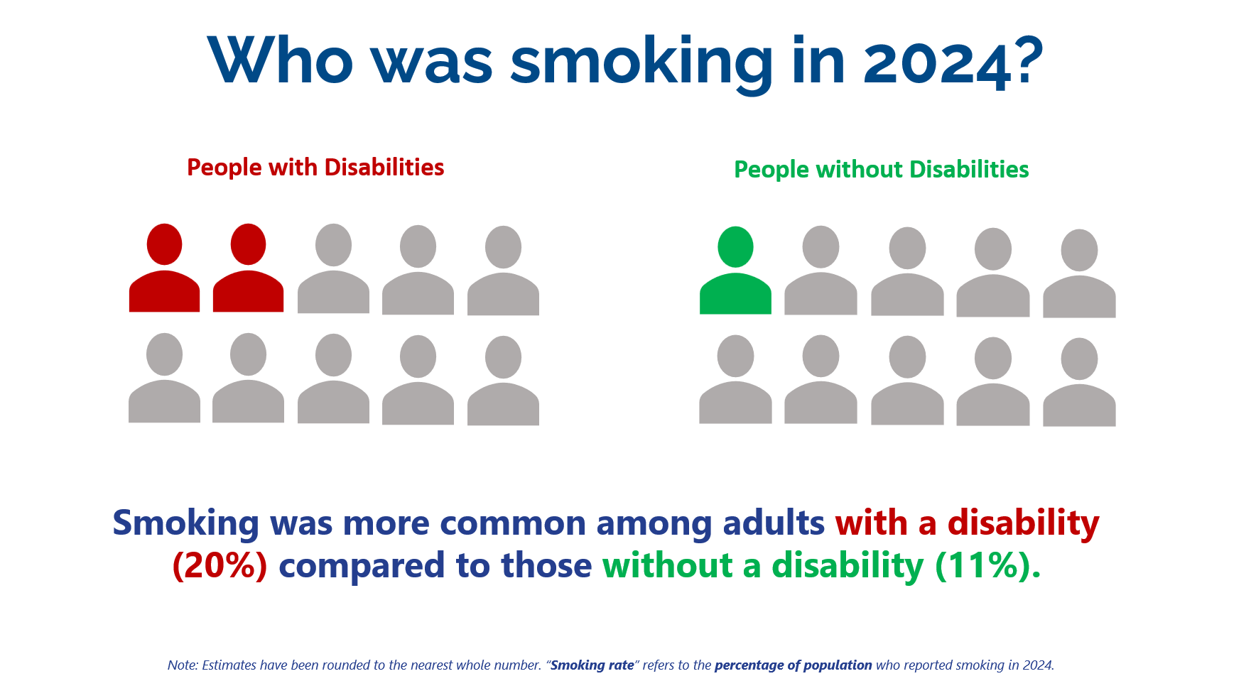
Notes:
TONY’s slide
The problem

Slide 26
Outcome Examples: Plain Language in Public Health
We want Indiana to be a place where people with disabilities are healthy
All health professionals should help people with disabilities stay healthy
People with disabilities should be able to make choices about their healthcare
People with disabilities should be able to get services that prevent cancer
People with disabilities should be able to get help to quit tobacco products if they need it and they want to
IDOH Program Vision (Academic Language)
An Indiana where health systems support people with disabilities to make informed choices about their health and to access opportunities for cancer and tobacco prevention and treatment.
Notes:
Disability leadership helped us decide on our program vision, goal, objective, and activities.
Having disability leadership at the table also changed how we worded things. We created plain language versions of our plan, and we used word choices emphasizing systems change and individual autonomy and choice.
We did this because PWD told us: Healthcare access is a top priority for PWD. Ability to make their own choices also very important.
Tobacco use can be seen as a choice they get to make in an environment where few choices are available.
We used wording that recognizes the history of systemic barriers/trauma for PWD. Incorporates trauma informed approaches.
But this is not just words. It changes what we do and how we approach the work.
Share about Tony’s input on the words: “health professionals” and “if they want to.”

Slide 27
What We Learned
IN Department of Health
Accessibility takes time
Ask what people need
Create accessible materials
Use plain language
Plan for flexibility
Follow through
IN Governor’s Council for People with Disabilities
Build trusting relationships first
Include people with ID/DD from the beginning
Treat lived experience as expertise
Take time for planning and follow up
Redesign communication practices
Get in touch with GCPD for technical assistance: Kate Barrow, E.D., kbarrow@gcpd.in.gov
Notes:
IDOH from the case study.
We have always tried to include community input in public health planning, but we have never been so intentional about including the disability community because we didn’t know how to. Partnering with GCPD helped us by providing a skilled professional and by teaching us along the way.
Here are some lessons we learned about public health planning in collaboration with PWD:
Use plain language. We used AI to rewrite in plain language; use bullet points, pictures, and formatting.
Build in extra time in agendas.
Provide supports, be prepared to follow through and provide the support they need.
Trauma informed approaches were used in engagement with group members and will be applied healthcare provider trainings. We have done this with behavioral health communities and are applying that knowledge here now as well.
Now more IDOH staff are working on making our education and communication documents accessible – this is growing beyond the No Barriers project into other areas of TPC and IDOH (like trauma and injury prevention). My hope is that not only will our work increase access to tobacco treatment and cancer screening for PWD, but also that other state and local public health programs will see what we’ve done and the value of working with leaders from the disability community, creating more opportunities for disability leadership.
GCPD

Slide 28
How Public Health – Seattle & King County is building disability equity into everyday public health
Blayne Amson | ADA and Disability Equity Program Manager
Notes:
Good afternoon. I’m Blayne Amson, and I serve as the ADA and Disability Equity Program Manager for Public Health – Seattle & King County. (IMAGE DESCRIPTION) I also come to this work as a disabled professional and a power wheelchair user, so access is not an abstract program standard for me. It determines whether a person can enter, understand, participate, receive a service, and feel that they belong.
Today I want to share our case study honestly. This is not a victory lap, and it is not a polished model that another health department can simply copy and paste. It is the story of a public institution learning to move from reacting to access needs toward designing access into its everyday work. We are still learning, and that unfinishedness is an important part of the story.

Slide 29

A quick summary of the case study
We moved from scattered compliance activities toward a permanent, cross-department Disability Equity and ADA Program.
Compliance existed, but access was uneven
No single program coordinated the work
Community feedback, COVID-19, and an accessibility review made the gaps visible
Notes:
For many years, our disability work looked like it does in many health departments: the primary focus was complying with disability laws and responding when someone requested an accommodation. That work mattered. The ADA establishes enforceable civil rights, and people need clear ways to ask for modifications, accommodations, and effective communication.
But we learned that legal compliance alone did not consistently produce access. Disabled people still encountered barriers when they tried to get information, use services, or participate in community programs. Some teams had strong practices; others needed much more support. Disability-related work was happening in multiple places across the department, but no single program was coordinating the effort or helping us see patterns across those individual encounters.
Community members and advocates were telling us about barriers. COVID-19 exposed and intensified inequities. Racial justice movements sharpened our understanding that disability could not remain outside our broader equity work. An accessibility review then made the organizational gaps harder to ignore.
The result was a permanent Disability Equity and Americans with Disabilities Act Program within our Office of Equity and Community Partnerships: a shift from scattered activity toward coordinated, department-wide practice.

Slide 30
Our framework:
the floor, the practice, and the horizon
DISABILITY JUSTICE​
Center disabled expertise,
intersectionality belonging, and accountability​
ACCESSIBILITY + EQUITY
Identify and remove
barriers proactively
COMPLIANCE
Protect rights and meet
legal obligations
Compliance is the floor. Full participation is the goal.
Notes:
The framework we use has three connected layers: compliance, accessibility and equity, and disability justice.
Compliance is the floor. It protects rights, creates obligations, and gives us mechanisms for reasonable modifications, effective communication, program access, and accountability. We do not move beyond compliance by leaving it behind. We keep doing it, and we need to do it well.
Accessibility and equity change the questions we ask. Instead of only asking, “Did we respond correctly after somebody requested help?” we ask, “Where are people encountering barriers? Who has the least reliable access? What can we change before an individual has to disclose a disability, diagnose our system, and propose the solution?” That moves access from a private negotiation into program design.
Disability justice pushes us further. It asks whose knowledge is treated as expertise, who has influence over decisions, and how ableism interacts with racism, poverty, language, gender, sexual orientation, age, immigration status and geography—among other identities. People do not experience those systems one at a time, and our programs cannot responsibly treat disability as if it exists in isolation.
I am also careful about the language here. We do not claim that our department has arrived at disability justice. Government should be very cautious about declaring itself just. We use disability justice as a horizon and an accountability framework: a way to keep asking whether disabled people—especially those most affected by multiple systems of exclusion—can fully participate, shape decisions, and belong.

Slide 31
Put the work where it can influence the work
Workforce
Permanent program in the Office of Equity and Community Partnerships
Department-wide scope
Close partnership with leaders, programs, operations, workforce, and community
Centralized expertise + shared responsibility
Comms
Leaders
Disability Equity
& ADA Program
Community
Programs
Operations
Notes:
Organizational placement matters. ADA work is often located only in a legal office, human resources, or risk management. Those functions are essential, but that placement can unintentionally narrow the work to liability, employment, or individual transactions.
Our program is housed in the Office of Equity and Community Partnerships which itself is housed in the director’s office. That structure lets us treat disability as a civil-rights issue, an equity issue, a workforce issue, a community-trust issue, and a core public-health issue at the same time.
The program works across lines of business—from emergency preparedness and communications to workforce development, community services, and Jail Health Services. That reach helps us notice when several teams are wrestling with the same barrier and turn an isolated fix into department-wide guidance.
The model depends on a productive tension: expertise is centralized, but responsibility is distributed. My program can provide consultation, identify patterns, create tools, support problem-solving, and help build accountability. But one office cannot personally make every meeting, document, policy, and service accessible.
Program leaders and staff have to own access within their daily work. Otherwise, the ADA office becomes a bottleneck and the rest of the organization learns to outsource responsibility.

Slide 32
Implementation: assess, equip, embed, learn
ASSESS
programs, policies, communications, & everyday practices
Plan for access before
someone has to ask.​
LEARN
from disabled people, data, & implementation
EQUIP
staff with practical tools, training & consultation
EMBED
access in planning and service design
Notes:
Implementation begins by helping staff see barriers that may have become ordinary or invisible inside their own work.
First, we assess. Staff examine programs, policies, communications, meetings, and routine service pathways. We identify what is working, where access depends on individual improvisation, and where a disabled person is likely to encounter friction or exclusion.
Second, we equip. The program develops practical resources—accessibility guides, communication tools, training, planning aids, data systems and opportunities for staff to work through problems together. The goal is not to turn every employee into an ADA expert. It is to make sure employees can recognize a likely barrier, take the next responsible step, and know where to get support.
Third, we embed. We work alongside teams as they create or revise services so access becomes part of the plan from the beginning. Our accessible events and meetings guidance, for example, prompts staff to use microphones, preserve space for wheelchair users, provide clear information, and create a more welcoming participation environment. Those are not exotic interventions. They are repeatable practices that reduce the need for people to fight for basic access every single time.
Finally, we learn. We pay attention to staff experience, disability community feedback, accessibility requests, and available data. Then we revise the tools and practices. This is a cycle, not a rollout with a tidy completion date.

Slide 33
What implementation looks like in practice
Accessible meetings and events​
Clearer communications and easier-to-use materials​
Staff training, tools, and cross-team collaboration​
Jail Health Services: document, track, and respond to disability-related requests​
Disability data and community feedback to guide decisions​
Notes:
The implementation becomes real in the ordinary mechanics of public health.
It looks like staff planning a meeting and thinking about communication, physical space, remote participation, and materials before sending the invitation. It looks like clearer public information and documents that are easier to navigate. It looks like training paired with usable tools, rather than awareness with nowhere to go.
One concrete example from the case study is our work with Jail Health Services, the operation of which, I recognize is not common for health departments but is what we do no less. Within the jail staff needed clearer, more consistent ways to document, track, and respond to disability-related requests. That may sound administrative, but administrative systems determine whether access survives a shift change, a handoff, or competing demands. By clarifying the process, the team made responses more consistent and services easier to access.
That example also illustrates an important point: a good intention is not a system. If access depends on one especially knowledgeable employee remembering what to do, it is fragile. We need processes that help ordinary staff do the right thing under ordinary working conditions.
We are also working to improve disability information and feedback so leaders and community partners can better understand who may be missing, where barriers recur, and where resources are needed. Data will never replace relationship or lived expertise, but the absence of disability data can make exclusion remarkably easy for an institution not to see.

Slide 34
What is working
Visible, sustained leadership support
Practical tools connected to real work
Relationships across teams and with disabled communities
Proactive planning and repeated learning
Open conversation about disability
Early outcomes: clearer communication, better meetings, easier-to-use materials
Notes:
Several conditions have made the work more effective.
Visible leadership support matters because it tells staff that accessibility is part of good performance and an expectation, not an optional interest competing with the real work. Practical tools matter because people need to know what to do on Tuesday afternoon, not only what values to endorse during a training. Relationships matter because the hardest access problems usually cross teams, systems, and areas of expertise.
Repetition matters too. Culture does not change because we delivered one excellent presentation and everyone clapped in the appropriate places. Staff need repeated opportunities to learn, practice, ask questions, and see disability reflected in leadership priorities.
One of the most meaningful early changes has been more open conversation about disability inside the workplace. After trainings and presentations, some employees shared that they had disabilities and had never previously felt comfortable saying so at work. Others said they felt seen and included for the first time. That openness helps reveal barriers that silence had allowed the organization to miss.
Staff also reported clearer communication, better meetings, easier-to-read materials, and a stronger understanding of barriers. Those improvements often help many people. At the same time, I do not want “access helps everyone” to blur the point: accessibility remains a civil-rights obligation to disabled people, and broad benefits do not replace individual modifications when they are needed.

Slide 35
What does not work—or does not work by itself
Waiting for individual accommodation requests
Treating access as one person’s job
One-time training without follow-through
Tools without time, staffing, or authority
Projects disconnected from measurement and accountability
Notes:
The case study also asks us to be candid about what does not work.
A purely reactive model does not work. Waiting for an individual request places the full burden on the disabled person to recognize the barrier, disclose a disability, understand the institution, identify a remedy, and ask the right person. By the time we respond, exclusion may already have occurred.
Treating access as one person’s job does not work. It creates a bottleneck, makes progress dependent on one position, and gives everyone else permission to send disability somewhere else.
One-time training does not work by itself. Training can open a door, but without tools, reinforcement, leadership expectations, and support for applying the learning, it becomes an event rather than organizational change. The same is true of guidance. A beautiful policy sitting quietly on a website is not implementation.
And we cannot build sustainable access on goodwill alone. Staff do not wake up with additional time, authority, or technical skill simply because accessibility is important. Limited funding, limited staff capacity, competing priorities, and the need for ongoing training are real constraints.
Naming those constraints is not an excuse to stop; it is how we identify what the work actually requires.

Slide 36
The hard part: making change durable
FOUNDATION
ACCOUNTABILITY
  supportive leaders
  trained staff
  practical tools
  clear guidance
  inclusive culture
  ownership
  request tracking
  disability data
  progress measures
  community feedback
Meaningful change requires real resources​.
Notes:
The early work is often the most visible: a guide, a training, a revised process. The harder work is building infrastructure that makes those improvements durable.
The case study identifies several foundation pieces: supportive leaders, trained staff, practical accessibility tools, clear guidance, and an inclusive workplace culture. Those pieces create the conditions for staff to act. But conditions are not the same as accountability.
Accountability requires named ownership, consistent ways to document and track requests, useful disability data, clear expectations, and measures that tell us whether people are actually getting access. Counting trainings or downloads may tell us what we produced. It does not tell us whether a person received effective communication, whether requests were resolved consistently, whether public information was accessible from the beginning, or whether disabled community members had meaningful influence.
We are still developing better ways to measure progress, and that is one of our growing edges. Start thinking about accountability early. Ask what success should look like in a person’s experience, who will notice when the process fails, and how the organization will correct course.
Meaningful change also requires real resources. If accessibility has no staff time, no operational home, and no leadership attention, the organization has made an aspiration—not an implementation plan.

Slide 37

A practical starting agenda for health departments
Start with the law—and do not stop there
Name accountable leadership and provide resources
Map barriers across everyday service pathways
Partner with disabled people and disability organizations
Give staff practical tools, training, time, and support
Track experience, learn, and correct course
Treat access as continuous public-health practice.
Notes:
For health departments asking where to begin, I would offer six practical actions.
First, start with the law—and do not stop there. Make sure your ADA responsibilities, notices, modification processes, communication practices, and program-access obligations are clear. Compliance is foundational, even when it is not sufficient.
Second, name accountable leadership and provide resources. Decide where disability access lives organizationally, who has authority to move barriers, and how the work connects to executive priorities. A mandate with no time or staffing is a memo, not a strategy.
Third, map barriers across ordinary service pathways. Look at how someone finds information, contacts you, registers, enters a space, communicates, receives a service, requests a modification, and raises a concern. Pay particular attention to places where success depends on disclosure, persistence, or knowing an unwritten rule.
Fourth, partner with disabled people and disability organizations. Treat lived experience as expertise that shapes the question, the design, and the evaluation—not as a testimonial added after the decisions are made. Include people whose disability experiences also intersect with racism, poverty, language barriers, gender inequity, justice-system involvement, and geographic isolation.
Fifth, give staff practical tools, training, time, and support. Make the accessible choice easier to recognize and carry out in everyday working conditions.
Finally, track experience, learn, and correct course. Pick a meaningful process, improve it, gather feedback, notice who is still being left out, and revise. You do not need a perfect five-year plan to begin. You do need to treat accessibility as continuous public-health practice rather than a one-time project.

Slide 38
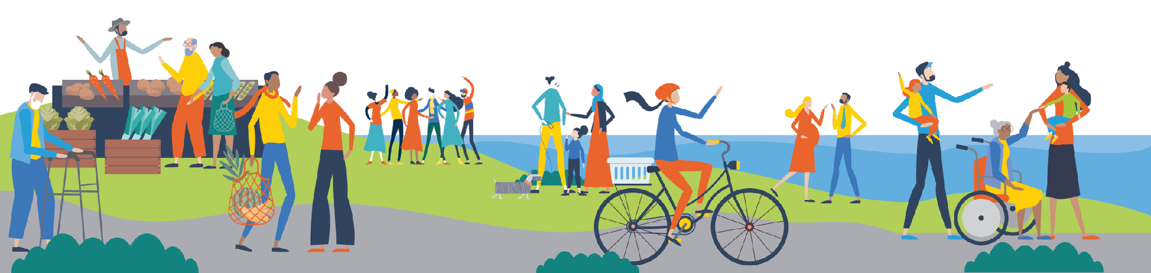
The measure of the work
Can people with disabilities, as their full selves, fully participate—not only enter, but understand, influence, receive service, and belong?
Access is ongoing work, not a one-time project.
Notes:
I want to close with the question that sits underneath our case study: Can people with disabilities fully participate, as their full selves—not only enter, but understand, influence, receive service, and belong?
Following the ADA is essential, but it is the first step. The larger goal is public health that works with disabled people and is accountable to the full complexity of our lives.
We are not finished. We are building organizational muscles, relationships, and infrastructure that should have existed all along. If you take one question back to your department, let it be this: Instead of waiting to ask, “Did someone request an accommodation?” ask, “What barriers are we creating, and how can we remove them before they become someone else’s private burden?”
Thank you.

Slide 39
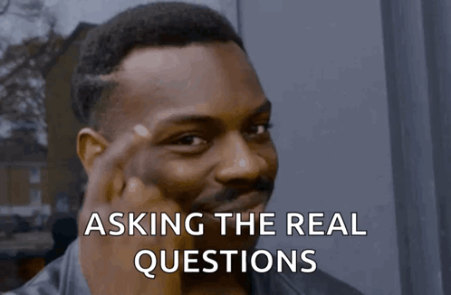
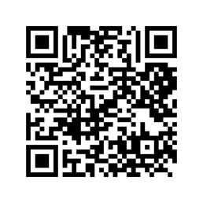
Q&A
Disability Justice: Public Health for Collective Liberation

Slide 40
Thank You!
Disability Justice: Public Health for Collective Liberation
Catch the rest of the series

