Slide 1


ISMPP University
Cooking up a Pub Plan: Adding Some Flavor to the Usual Fare
March 27, 2024
Webinar will begin promptly at: ​​
11 AM ET / 4 PM GMT
Notes:
Hi everyone; welcome and thank you for joining today’s ISMPP U on “Cooking up a Pub Plan - Adding Some Flavor to the Usual Fare.”
This webinar has been approved for 1 ISMPP CMPP Recertification Credit. You may continue to collect a screenshot for CMPP certification but you will now be sent a certificate of attendance after every ISMPP U that you can also upload into the credit tracker. ​
​
This webinar is being recorded and will be made available on the ISMPP website within 24 hours after the webinar.

Slide 2





















ISMPP Would Like to Thank…
2
. . . the following Titanium and Platinum Corporate Sponsors for their ongoing support of the Society:
Notes:
First a sincere thank you to all of ISMPP’s titanium and platinum corporate sponsors for their ongoing support of the Society.

Slide 3

ISMPP Announcements
Application deadline for the September CMPP
exam is August 1
Notes:
And, for those who are seeking to become CMPP-certified or looking to renew your certification, The application deadline for the next exam window is August 1, 2024

Slide 4

ISMPP Announcements
20th Annual Meeting of ISMPP
Storytelling: Its Art and Power
April 29–May 1, 2024
Grand Hyatt Washington, Washington DC
Registration is open!
Closes April 12, 2024
Notes:
Just a reminder that Registration is now open for the 20th Annual meeting of ISMPP

Slide 5
How to Ask Questions
5
Feel free to ask a question at any time; however, all questions will be held until the end of the presentation.
To ask a question, open the Q&A window and type your question into the
Q&A box. Click Send.
Note: Check Send Anonymously if you do not want your name attached
to your question in the Q&A.
We will make every effort to respond to all questions live (out loud).
Notes:
Reminder that for today’s webinar, You can submit a question at any time during the presentation by following the instructions on this slide.
To ask a question, open the Q&A window, type in your question, and click send.
The faculty will answer questions at the end of all the presentations.

Slide 6
Disclaimer
Information presented reflects the personal knowledge and opinions of the faculty and does not necessarily represent the position of their current or past employers
Notes:
Please take a moment to read our general disclaimer.
OR
Please know that the Information presented by our speakers today reflect their personal knowledge and opinions and do not necessarily represent the position of their current or past employers

Slide 7
Objectives
Review the approach and process of developing a publication plan from workshop to implementation
Identify differences between traditional and nontraditional publication plans, including tactical and strategic components
Appreciate challenges of a nontraditional approach from the pharma perspective
Recognize the keys to successful implementation of a nontraditional publication plan
Notes:
These are the learning objectives for today’s webinar. We want you to....
1. Review the approach and process of developing a publication plan from workshop to implementation
2. Identify differences between traditional and nontraditional publications plans including tactical and strategic components
3. Appreciate challenges of a nontraditional approach from the pharma perspective
4. Recognize the keys to successful implementation of a nontraditional publication plan

Slide 8

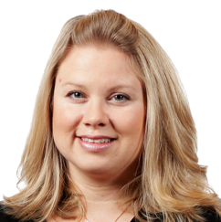

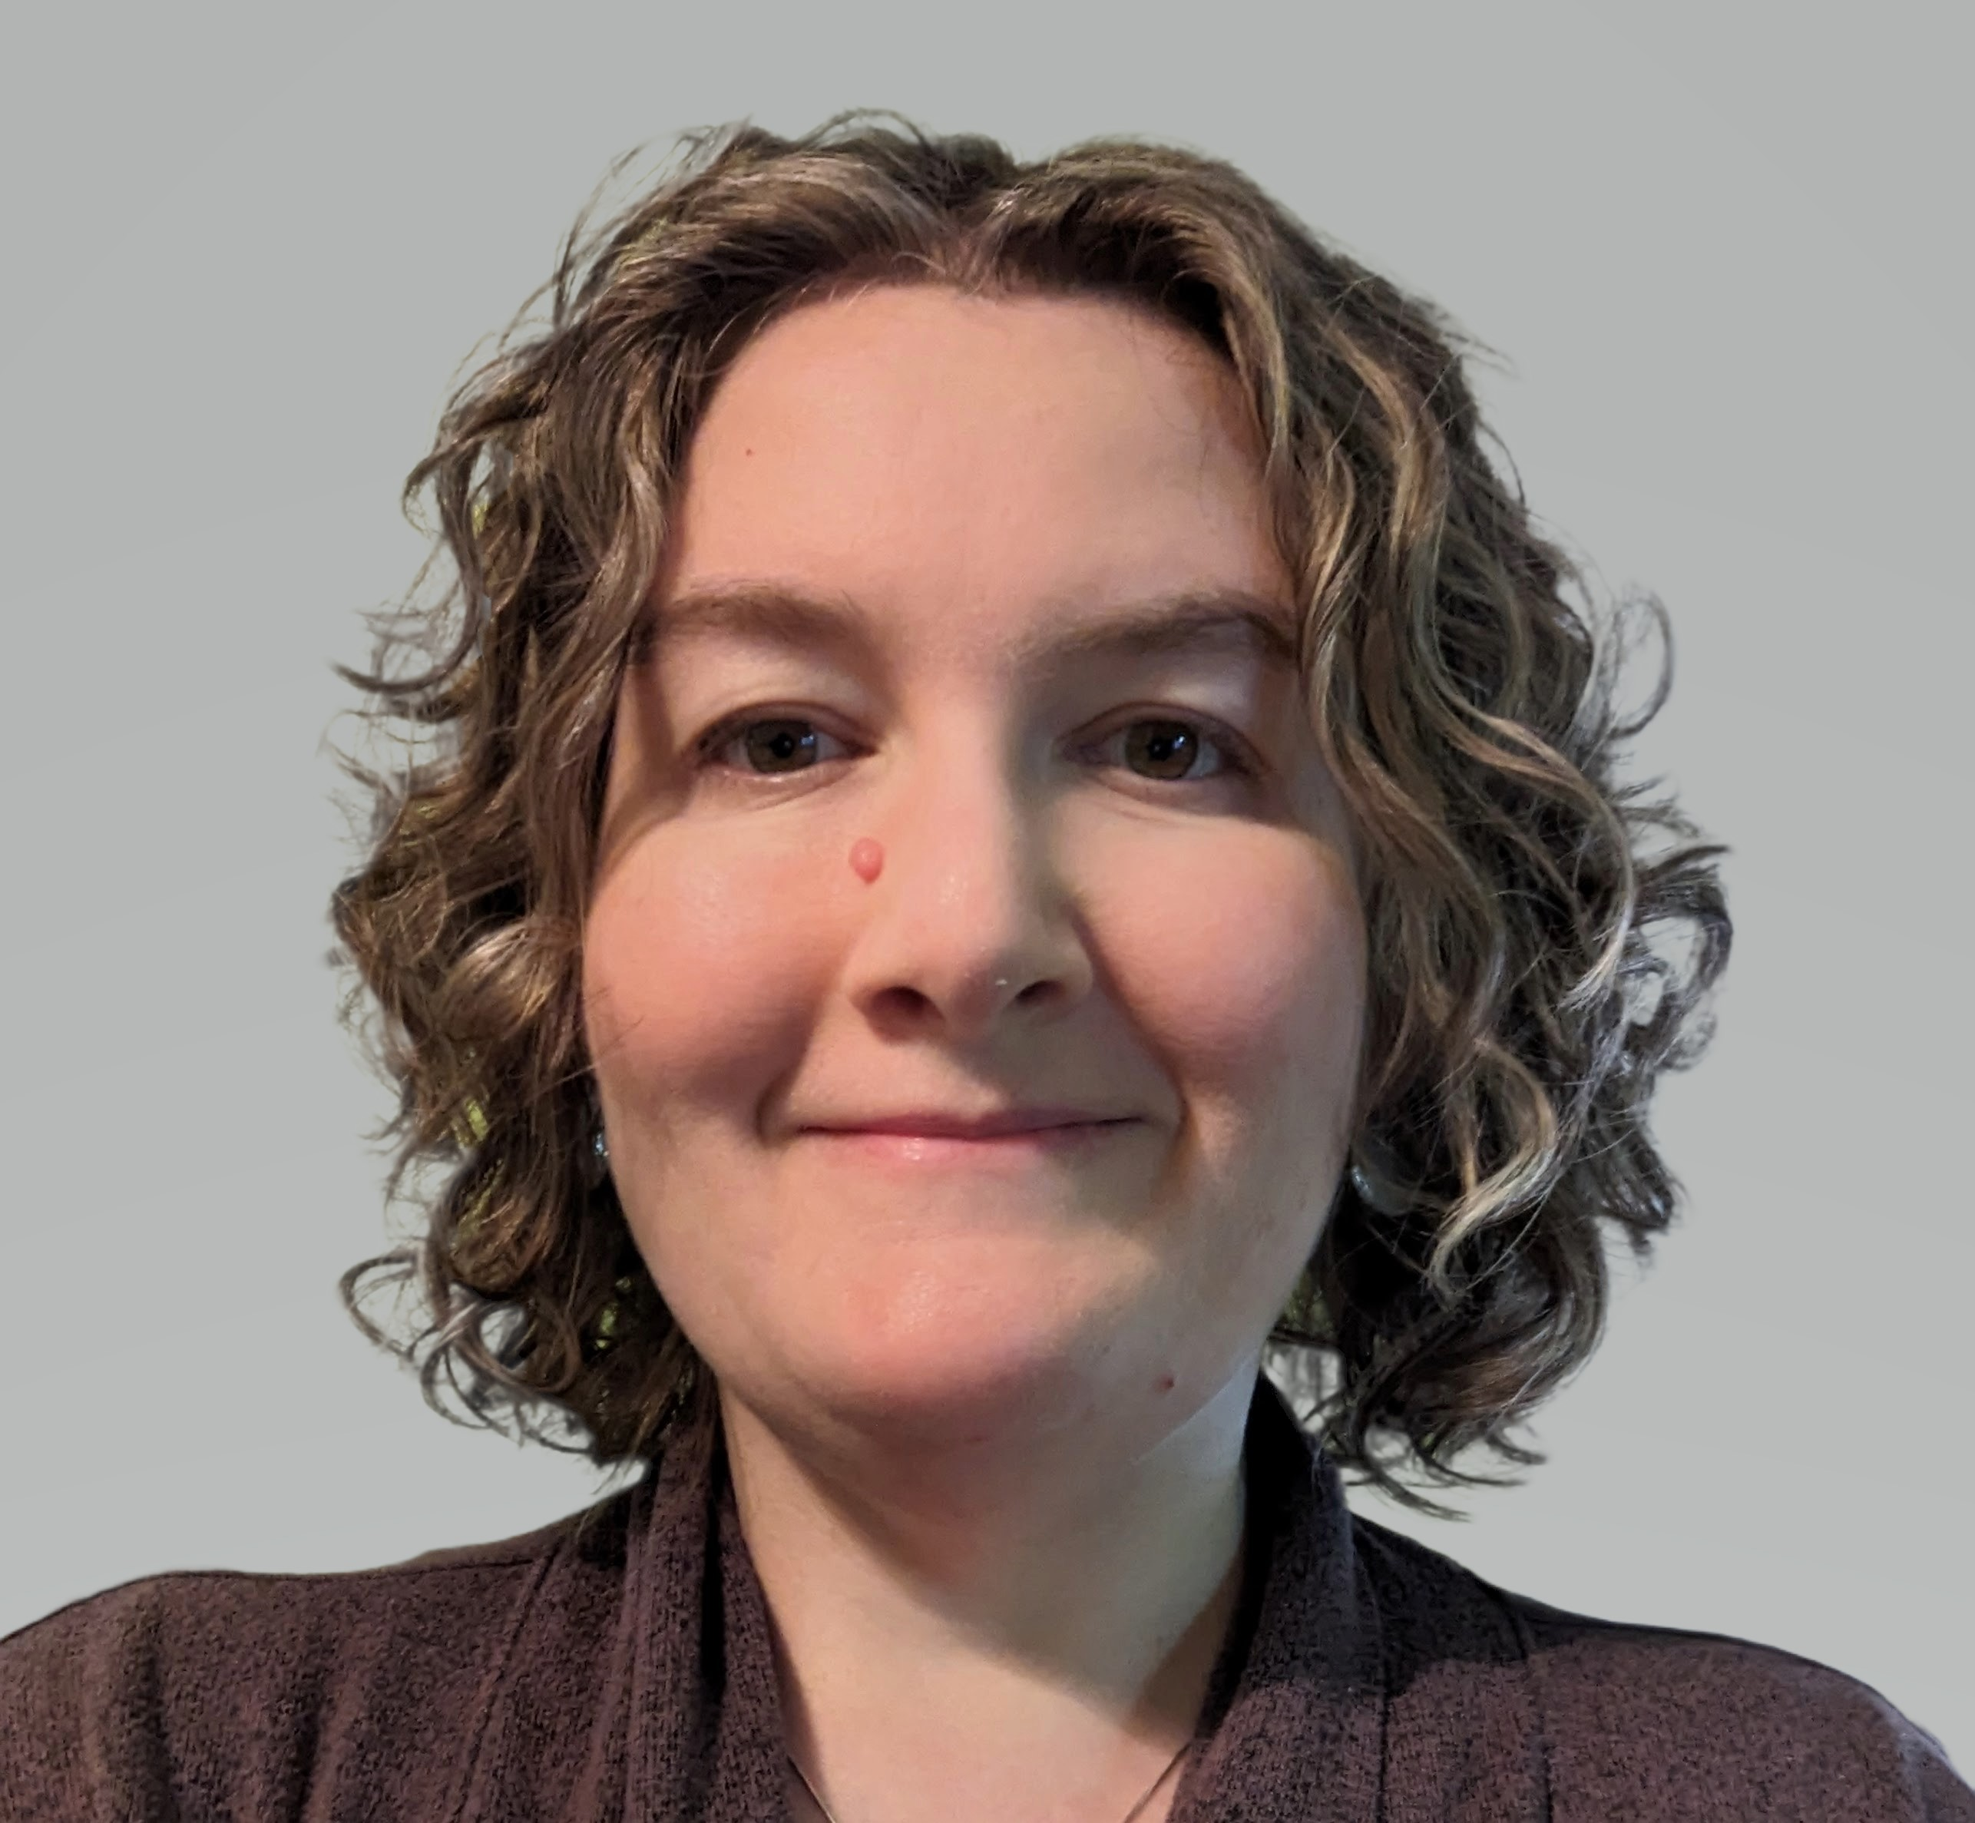

Faculty
Moderator:
Steve Palmisano
EVP, Publication Services
The Lockwood Group
Alanna Kennedy, PhD
VP, Group Scientific Director
Publications
The Lockwood Group
Maria McGill, RPh
SVP, Scientific Services
Publications
The Lockwood Group
Jill See, PhD
Associate Director
Publications
Daiichi Sankyo
Amanda Hartley, PhD
Director
Medical Affairs Publications
Sage Therapeutics
Notes:
Hi, I am Steve Palmisano, today’s session moderator,
With me are:
• Alanna Kennedy, VP, Group Scientific Director at the Lockwood Group
• Maria McGill, Sr VP, Scientific Services, at The Lockwood Group
• Amanda Hartley, Director, Medical Affairs Publications at Sage Therapeutics
• AND, Jill See, Associate Director Publications at Daiichi Sankyo

Slide 9
What Is Your Level of Experience
With Publication Planning?
Beginner (Dishwasher)
Intermediate (Sous chef)
Advanced (Master chef)
Notes:
Let’s begin with a survey question, and also use this as an opportunity to get everyone comfortable with the polling we will do during today’s webinar.
So, “What is your level of experience with publication planning?”
• Are you a BEGINNER dishwasher)
• Consider yourself at the INTERMEDIATE level
• Or, do you consider yourself ADVANCED (or a master chef)
OK, let me hand this over to Alanna Kennedy.

Slide 10
Publication Planning:
The Secret Sauce
Alanna Kennedy
Elements of a Publication Plan
Publication Plan: From Planning to Analysis
Workshop

Slide 11

Courses of a Publication Plan
Year 1
Year 2
Year 3
Sep
Oct
Nov
Dec
Jan
Feb
Mar
Apr
May
Jun
Jul
Aug
Sep
Oct
Nov
Dec
Jan
Feb
Strategic
Projects
Literature Analysis
Publication Plan
Scientific Platform and Lexicon
Manuscripts
1
5
Study A (Journal)
Study B (Journal)
2
3
Study C Primary (Journal)
4
Study D (Journal)
1
4
5
Review (Journal)
1
2
3
4
5
SOC for Treatment (Journal)
1
3
Patient Research (Journal)
1
Congress
Activities
Meeting 1
Meeting 4
Meeting 6
Meeting 8
Study A Primary (O)
1
5
Encore: Study A (P)
1
4
5
Encore: Study B Secondary Analysis (P)
1
4
5
Study D Subanalysis (O)
4
Meeting 2
Meeting 9
4
Study B Primary (O)
1
3
4
Meeting 5
Meeting 7
Encore: Study D C Primary Data (P)
Study B: Secondary Analysis (O)
Study C Primary Data (O)
1
Encore: Study B (P)
Encore: Study B Analysis (P)
Study D Primary Data (P)
1
4
5
Meeting 10
Meeting 3
1
4
5
4
1
3
4
Study D Subanalyses (O)
5
Encore: Study B (P)
5
Communication
Objectives
Key
1
Unmet Need
2
Pathophysiology
3
MOA
4
Efficacy and Safety
5
Value
Targeted completion for ongoing projects (epub or final deliverable)
Completion expected into Year 3 (epub or final deliverable)
MOA, mechanism of action; O, oral; P, publication; SOC, standard of care.

Slide 12

Publication Plan at Its Core
What?
  The plan to disseminate scientific and clinical data for a product to target audiences at scientific congresses and society meetings and in peer-reviewed journals
  The plan should begin with a strategic vision that informs strategic imperatives and communication objectives
Why?
  To ensure timely publication (12-18 months) of all clinical study data regardless of result
  To align with the cross-functional team on strategy, prioritization, and resource allocation for data dissemination

Slide 13

Planning the Menu
13
Stage in Life Cycle
EARLY
MID
LATE
Product-Specific
Factors
Available preclinical, PK/PD, and safety data
Unmet need
Place in therapy
Product MOA
  Regulatory pathways
Clinical data (primary, secondary, subanalyses, etc)
Data evolution requiring changes to publication plan, target therapeutic area, etc
Generate additional data and publish
  Expand therapeutic area, age group, indication
  HEOR and RWE
  Combinations
Increased collaboration across functional teams
Outside
Factors
Unmet need in therapeutic area landscape
Differentiation by MOA
  Region for target audiences (congress and journal)
Communicate clinical safety and efficacy as differentiators
Continue unmet need communication
Timing of publications (sequential vs concurrent)
Reassess region for target audiences (congress and journal)
Monitor the therapeutic area landscape
  New entrants
  Loss of patent
  Generics
Expand audiences
Broaden educational initiatives
HEOR, health economics and outcomes research; MOA, mechanism of action; PK/PD, pharmacokinetic/pharmacodynamic; publication; RWE, real-world evidence; SOC, standard of care.

Slide 14


The Chefs and
Essential Ingredients
Workshop for
review, prioritization,
and alignment
Kickoff meeting for alignment, focus, and outline scope
Strategic assessment
Identify key stakeholders and decision-makers (clinical, med affairs, HEOR, etc)
Therapeutic areas
Key competitors
Time frame
Final deliverable
Administrative
Policy/process
Clin development plan
Investigator’s brochure
Protocols
Study reports
Gap analysis
Competitor analysis
Lexicon
SWOT
Strategic imperatives
Communication objectives
Timing of data availability with congress submission deadlines
Milestones
Competitor info
Data dissemination
Targets (audience, congress, encore, and journal)
Build the
core team
Immersion in context
and data
Tactical
assessment
HEOR, health economics and outcomes research; SWOT, strengths, weaknesses, opportunities, threats.

Slide 15
Workshop to
Refine Pub Plan Flavor
Physically map out timing
  Prepopulation with key milestone dates and congress deadlines
  Color coding by audience target
  Virtual
    Whiteboard
    PowerPoint slide (Live notes)
  Live
    Printed poster and sticky notes
Breakouts
Key Elements
Process
Review
  Key milestones
  Congress timing
  (submission deadline for abstracts, late-breakers)
  Are encores permitted?
Decisions
  Priority
  Audience
  Congress
Resolve conflicts
Vetting

Slide 16

Workshop Map Sampler
Topic | Product A - Publication Plan
 | Priority | Key audience | 2024
 |  |  | Jan | Feb | Mar | Apr | May | Jun | Jul | Aug | Sep | Oct | Nov | Dec
Key milestones |  |  |  | Jan data cut |  | STUDY A DBL | STUDY A CSR |  | STUDY B DBL | STUDY B CSR |  |  |  | NDA TBD
Key abstract deadlines |  |  | ABC |  | ABC DEF |  | GHI DEF | JKL MNO |  | PQR | JKL | MNO PQR
Key congress dates |  |  |  |  |  | ABC 14-18 |  | DEF 1-5 | GHI 17-19 |  |  | JKL 10-13 | MNO 1-3
STUDY A primary analysis
STUDY A Cohort X
STUDY A Cohort Y
Case study
Review article
Submission Deadline
Late-breaker Deadline
DBL, database lock; CSR, clinical study report; NDA, new drug application.

Slide 17

Cooking, Plating, and Leftovers
Revise per Feedback and Updates
Draft for Governance
Alignment With Scientific Platform/Lexicon
Vetting
Functionality and Graphics

Slide 18
Publication Planning:
The Unexplored Culinary Territory
Maria McGill
Nontraditional Strategic Publication Planning: The Next Frontier
Scenario Planning: When Will the Data Be Available?
Challenges

Slide 19




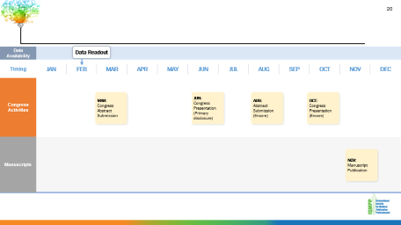

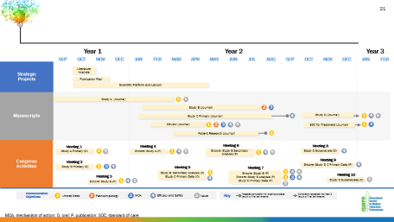

Traditional Publication Plan
The Classic Recipe
  Audiences
  Focus on specialists, HCPs
  Considerations of product
  life cycle
  Focus on sequential steps
  Tactics mapped to strategic imperatives/communication objectives
HCP, healthcare professional.

Slide 20
Data
Availability
  Data Readout
Timing
JAN | FEB | MAR | APR | MAY | JUN | JUL | AUG | SEP | OCT | NOV | DEC
Congress
Activities
MAR:
Congress Abstract Submission
JUN:
Congress Presentation (Primary disclosure)
AUG:
Abstract Submission
(Encore)
OCT:
Congress Presentation
(Encore)
Manuscripts
NOV: Manuscript Publication

Slide 21
Year 1
Year 2
Year 3
Sep
Oct
Nov
Dec
Jan
Feb
Mar
Apr
May
Jun
Jul
Aug
Sep
Oct
Nov
Dec
Jan
Feb
Strategic
Projects
Literature Analysis
Publication Plan
Scientific Platform and Lexicon
Manuscripts
1
5
Study A (Journal)
Study B (Journal)
2
3
Study C Primary (Journal)
4
Study D (Journal)
1
4
5
Review (Journal)
1
2
3
4
5
SOC for Treatment (Journal)
1
3
Patient Research (Journal)
1
Congress
Activities
Meeting 1
Meeting 4
Meeting 6
Meeting 8
Study A Primary (O)
1
5
Encore: Study A (P)
1
4
5
Encore: Study B Secondary Analysis (P)
1
4
5
Study D Subanalysis (O)
4
Meeting 2
Meeting 9
4
Study B Primary (O)
1
3
4
Meeting 5
Meeting 7
Encore: Study D C Primary Data (P)
Study B: Secondary Analysis (O)
Study C Primary Data (O)
1
Encore: Study B (P)
Encore: Study B Analysis (P)
Study D Primary Data (P)
1
4
5
Meeting 10
Meeting 3
1
4
5
4
1
3
4
Study D Subanalyses (O)
5
Encore: Study B (P)
5
Communication
Objectives
Key
1
Unmet Need
2
Pathophysiology
3
MOA
4
Efficacy and Safety
5
Value
Targeted completion for ongoing projects (epub or final deliverable)
Completion expected into Year 3 (epub or final deliverable)
MOA, mechanism of action; O, oral; P, publication; SOC, standard of care.

Slide 22



Publication Extenders
The Savory Additions to Elevating Publications Experiences
Unmet Need
Simpler Is Better
Journal publications are the most important source of scientific information for HCPs¹
Infographics are
65%
90%
30× MORE
68%
of physicians are overwhelmed by the sheer volume of information they must keep up with²
likely to be read than
text-only articles⁵
95%
of HCPs want short-form, bite-sized, fast facts content²
of people are visual learners⁵
of information transmitted to the brain is visual⁵
Increased Engagement and Metrics
Shareability Creates More Attention
citations
Altmetric Attention Score
views
A visual abstract is shared 8 times more often on social media than a text-only summary, resulting in:
3 times more visits to an online article⁶
26 more tweets
per article⁶
15%
25%
35%
2× increase in the use of an article
Video abstracts are associated with increased³
Video abstracts and plain language summaries (PLS)⁴
  Produced the highest comprehension, understanding,
  and enjoyment⁴
1. EPG Health. Accessed January 22, 2024. https://epghealth.com/reports/the-gaps-between-hcp-demand-and-pharma-supply-of-medical-information/. 2. Doximity. Accessed January 22, 2024. https://press.doximity.com/reports/physician-learning-report-2022.pdf. 3. Bonnevie T, et al. Scientometrics. 2023;128(5):3001-3015. 4. Bredbenner K, Simon S. PLoS One. 2019;14(11):e02807-19.
5. Digital Information World. https://www.digitalinformationworld.com/2017/12/how-infographics-can-help-your-business.html? Accessed January 22, 2024. 6. West CC, et al. J Plast Reconstr Aesthet Surg. 2020;73(12):2103-2105.
HCP, healthcare professional.
© The Lockwood Group LLC

Slide 23


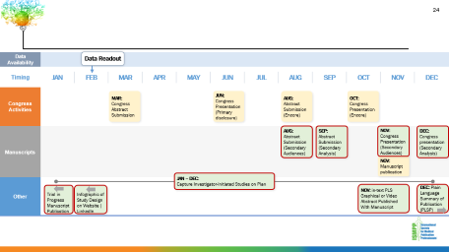

Nontraditional Publication Plan
The Innovative Publications Fusion Recipe
  Audiences expand
  Focus
  Graphical abstracts
  PLS-P
  Video abstracts
  Infographics
  In-text PLS
  Consider inclusion of investigator-initiated studies
PLS, plain language summary; PLS-P, plain language summary of a publication.

Slide 24
Data
Availability
  Data Readout
Timing
JAN | FEB | MAR | APR | MAY | JUN | JUL | AUG | SEP | OCT | NOV | DEC
Congress
Activities
MAR:
Congress Abstract Submission
JUN:
Congress Presentation (Primary disclosure)
AUG:
Abstract Submission
(Encore)
OCT:
Congress Presentation
(Encore)
Manuscripts
AUG:
Abstract Submission
(Secondary Audiences)
SEP:
Abstract Submission
(Secondary Analysis)
NOV:
Congress Presentation (Secondary Audiences)
DEC:
Congress presentation
(Secondary Analysis)
NOV: Manuscript publication
Other
JAN – DEC:
Capture Investigator-Initiated Studies on Plan
Trial in Progress Manuscript Publication
Infographic of Study Design on Website | LinkedIn
NOV: in-text PLS
Graphical or Video Abstract Published With Manuscript
DEC: Plain Language Summary of Publication (PLSP)

Slide 25



Challenge: Data Availability
Ingredient Sourcing Hurdles
Timing of High-Priority
Data Readout
  Discuss priorities: getting data out quickly vs waiting for a key congress
  Look for late-breaker options for key congresses
  Consider presenting secondary analyses at key congress
  Plotting data rollout with congress dates and abstract deadlines when data availability is uncertain
Scenario
Planning
  Create multiple scenarios for congress presentations and timing of manuscript submission based on data availability
  Identify timing for when publication needs to published and work backwards for timing to start manuscript development and congress presentations
Best
Practices
  Include agency partner in data study readout meeting
  Fluid process: need for flexibility

Slide 26
Recipe Resilience “Scenario” Planning
Data
Availability
  Data Readout
Timing
JAN | FEB | MAR | APR | MAY | JUN | JUL | AUG | SEP | OCT | NOV | DEC
Congress
Activities
1
1
MAR:
Meeting 1: Abstract Submission Deadline
1
MAY:
Meeting 1:
LBA (Submission Deadline)
JUL:
Meeting 1:
Congress Presentation (Primary Disclosure)
2
OCT:
Meeting 2: Congress Presentation (Primary Disclosure)
2
2
2
JUN:
Meeting 2: Abstract Submission
AUG:
Meeting 3: Abstract Submission
(Encore)
NOV:
Meeting 3: Congress Presentation
(Encore)
Manuscripts
1
1
1
FEB: Start Manuscript Development
APR: Manuscript Submission
JUL: Manuscript Publication
2
2
2
MAR: Start Manuscript Development
JUL: Manuscript Submission
DEC: Manuscript Publication
1
Option 1
2
Option 2
LBA, late-breaker abstract.

Slide 27




Recipe Roadmap
Product
Life Cycle
Good Publication
Practices (GPP)
Strategic Publication
Plan Creation
Publication Plan
Management
Clinical
Indication(s)
Scope:
US vs Global
Scenario
Planning

Slide 28

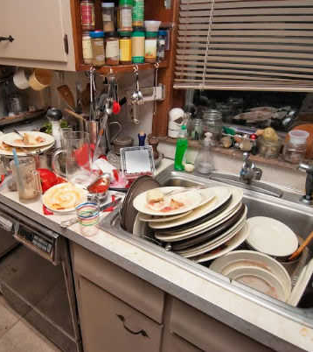
Nontraditional
Publication Planning:
Expanding the Menu
Jill See
Pharma Perspective on What Successful Nontraditional Publications Plans Can Look Like

Slide 29
If You Have Tried to do Nontraditional Pub Planning,
Which of the Following Barriers Have You Encountered?
Select all that apply.
Awareness of tactics
Budget
Stakeholder bandwidth
Aggressive timelines
Appropriate capabilities

Slide 30
Agenda
1
Defining Your Goals – Planning Your Menu
Encore Planning – Expanding the Table
Graphical Abstracts – Information Garnish
Video Content – Dynamic Presentation
Author Interviews/Podcasts – Adding Flavor
Plain Language Summaries – Something for Every Palate
2
3
4
5
6

Slide 31




Planning Your Menu
What would you like to provide for your audience?
Access to the study data for multiple audiences
What is the audience background?
Digestible content for busy clinicians
What platforms are they likely to
access?
A study summary that is accessible to audiences at varying levels of knowledge
How large is the spread in expertise?
Will they be able to access the journal article itself?
A deep-dive into a particular aspect of a publication
What is the interest to the community?
Is there flexibility in what content you want to explore?

Slide 32



Planning Your Menu:
Farm-to-Table or Molecular Gastronomy?
Multiple HCP audiences
Presenting detailed mechanism or process
Detailed context or unexpected finding
Comprehensive encore planning
Plain language summary
Social media
Graphical abstract
Video abstract
Interview or podcast
Commentary or
review article
HCP, healthcare professional.

Slide 33
An Example Menu –
Traditional Global Plan for Hematology
Data
Availability
Early Oct 2024
Timing
4Q 2023 | 1Q 2024 | 2Q 2024 | 3Q 2024 | 4Q 2024 | 1Q 2025 | 2Q 2025 | 3Q 2025 | 4Q 2025
Congress
Activities
ASH 2023
Phase 3 Trial in Progress
EHA 2024
Phase 2 Extended Follow-up
ASH 2024
Phase 3
Primary
(Late-breaker)
EHA 2025
ASH 2025
Phase 3
~1-Year
Follow-up
ISTH 2024
Phase 2 Subgroup Analysis
ISTH 2025
Phase 3 Secondary Endpoints
Phase 3 Subgroup
ISPOR 2025
Phase 3 PROs
Manuscripts
Phase 2 Secondary Manuscript - PROs
Phase 3 Primary Manuscript
Phase 3 Secondary analysis
PRO, patient-reported outcomes.

Slide 34





Which New Dishes to Add to the Menu?
Graphical
abstracts
Encores
Video
content
Author
interviews/
podcasts
Plain language
summaries

Slide 35



Encore Planning – Expanding the Table
A robust encore plan can ensure that every relevant audience is provided with the latest data
Geography
Audiences
Timing
What regions need this information the most?
Is this relevant to all audiences?
Do we need translation?
Do we need an
additional author?
Do I need to adjust my content?
What are their priorities?
Would a separate topic serve
them better?
When are submission deadlines for each congress?
What is the timing for any
planned manuscripts?

Slide 36
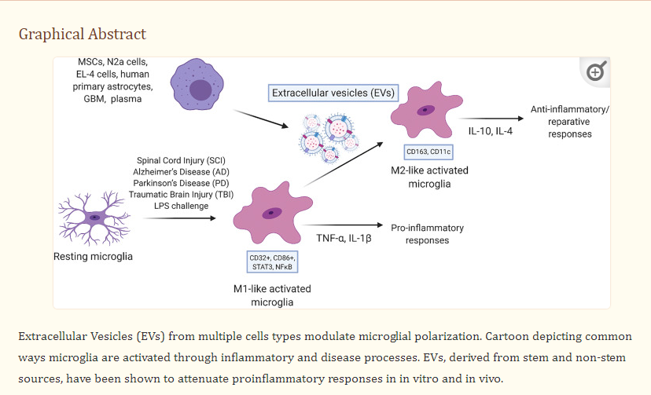
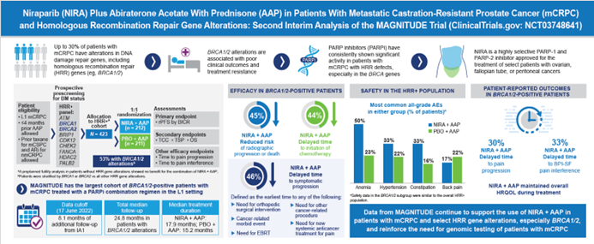


Graphical Abstracts – Information Garnish
May be developed by the journal (eg, NEJM) or submitted with a manuscript (eg, Neurology)
  Journal-developed graphical abstracts may be extensive and credible but reduce control over content and formatting
  Graphical abstracts submitted with a manuscript must be developed in time for submission or during the revision process
Advantages: Infographic format is visually engaging and can summarize the most salient aspects of a paper, and reusability can be high across audiences
Challenges: Costs can escalate quickly; short-form content may not allow for nuanced discussion or complex study designs
Spellicy SE, Stice SL. Stem Cell Rev Rep. 2021;17(2):357-368.
Chi KN, et al. Ann Oncol. 2023;34(9):772-782.
Notes:
https://www.nejm.org/doi/full/10.1056/NEJMoa2212948

Slide 37


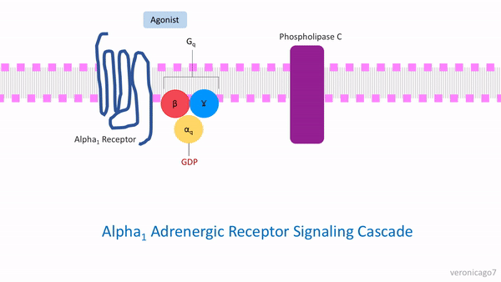
Video Abstracts – Dynamic Presentation
Video abstracts: provide a brief video summarizing the publication
  Journal uptake is not consistent
  Requires commitment early in the process
Advantages: Potential for wide reach in possibly the most digestible format
Challenges: Require additional planning, may be expensive depending on content, limits on journal selection
Wikimedia Commons

Slide 38


Author Interviews/Podcasts – Adding Flavor
Author interviews/journal podcasts
  Few journals participate, and only selected articles are presented this way
  May be a less focused discussion vs a video abstract, and may discuss context surrounding an article vs providing an overview of the study
Advantages: Potential for wide reach in possibly the most digestible format, a direction that journals seem to be moving (JAMA Neurol, Eur J Neurol)
Challenges: Require high level of author commitment, no guarantee that publication will be selected
JAMA Neurology
Author Interview Podcast
Click here

Slide 39
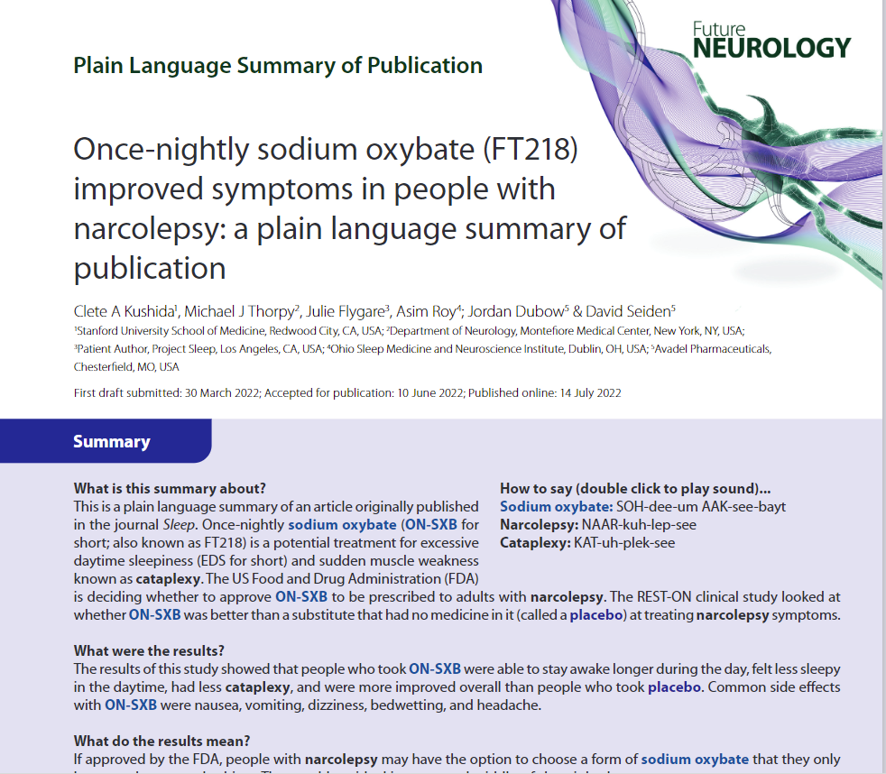
Plain Language Summaries – Something for Every Palate
Plain language summary of publication (PLS-P): published in a journal, but independent of the original manuscript
Advantages: Does not constrain journal choice for primary publication; will be published and citable
Challenges: Requires permission from journal of primary publication; timelines may be more lengthy
In-text plain language summary (PLS): published in a journal with the original manuscript
Online summary: “published” online (not by a journal) and hosted on company website
Roth T, et al. J Comp Eff Res. 2023;12(12):e230133. doi: 10.57264/cer-2023-0133.
PLS, plain language summary; PLS-P, plain language summary of a publication.

Slide 40





Designing a Cohesive Menu
Educate the publication team on nontraditional publication options
Identify author preferences regarding interest and availability
Determine journal options in an evolving landscape
Consult with compliance team regarding appropriate implementation
Consider timing, resourcing, and budgetary constraints

Slide 41
An Example Menu –
Traditional Global Plan for Hematology
Data
Availability
Early Oct 2024
Timing
4Q 2023 | 1Q 2024 | 2Q 2024 | 3Q 2024 | 4Q 2024 | 1Q 2025 | 2Q 2025 | 3Q 2025 | 4Q 2025
Congress
Activities
ASH 2023
Phase 3 Trial in Progress
EHA 2024
Phase 2 Extended Follow-up
ASH 2024
Phase 3
Primary
(Late-breaker)
EHA 2025
ASH 2025
Phase 3
~1-year
Follow-up
ISTH 2024
Phase 2 Subgroup Analysis
ISTH 2025
Phase 3 Secondary Endpoints
Phase 3 Subgroup
ISPOR 2025
Phase 3 PROs
Manuscripts
Phase 2 Secondary Manuscript - PROs
Phase 3 Primary Manuscript
Phase 3 Secondary Analysis
PRO, patient-reported outcomes.

Slide 42
An Example Menu – Nontraditional Global Plan for Hematology
Data
Availability
Early Oct 2024
Timing
4Q 2023 | 1Q 2024 | 2Q 2024 | 3Q 2024 | 4Q 2024 | 1Q 2025 | 2Q 2025 | 3Q 2025 | 4Q 2025
Congress
Activities
ASH 2023
Phase 3 Trial in Progress
EHA 2024
Phase 2 Extended Follow-up
ASH 2024
Phase 3
Primary
(Late-breaker)
EHA 2025
Phase 3 Primary
Encore
ASH 2025
Phase 3
~1-year
Follow-up
With Graphical Abstract
ISTH 2024
Phase 2 Subgroup Analysis
ISTH 2025
Phase 3 Secondary Endpoints
Phase 3 Subgroup
ISPOR 2025
Phase 3 PROs
Manuscripts
Phase 3: Plain Language Summary of Publication
Phase 2 Secondary Manuscript - PROs
Phase 3 Primary Manuscript
Podcast Publication on Subgroup of Interest
With Video Abstract
PRO, patient-reported outcomes.

Slide 43
Publication Planning:
5-Star Dining or “Throw Down?”
Amanda Hartley
Alternatives to the Traditional Publication Plan Ingredients
The Realities of Strategic Publication Planning
Best Practice Tips

Slide 44
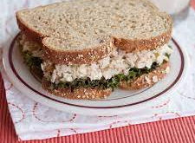
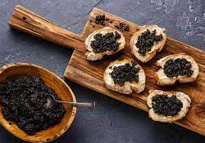
Publication Planning: Traditional vs Specialty
Traditional
Specialty

Slide 45






Traditional Strategic Publication Planning
Start With Gap Analysis, Evidence Generation Plan, and Strategic Imperatives
Category | Add Traditional Ingredients
Audiences | HCPs
Communication points | Efficacy, Safety, PROs, HEOR
Data source/analyses | Trial outcome (primary data)
Authors | Investigators
Timing | Development starts immediately at data readout
Location | Scientific congress or journal
HCP, healthcare professional; HEOR, health economics and outcomes research; PRO, patient-reported outcomes.

Slide 46
Specialty Strategic Publication Planning
Add a lexicon,
SWOT analysis, SCP or GSP, life cycle roadmap
Start With Gap Analysis, Evidence Generation Plan, and Strategic Imperatives
Category | Specialty Alternatives to the Traditional
Audiences | Ancillary HCPs (ie, midwives); advocacy, patients, caregivers
Communication points | ie, Mechanism of action written in plain language
Data source/analyses | Consensus (Delphi); combine data (preclinical + clinical); opinion/viewpoint; systematic literature review
Authors | Investigator nurses; community investigators; advisory/working groups; patients/caregivers
Timing | Avoid the data dump; strategize to play out over time
Location | Consider other congresses and journals beyond the typical
Go beyond HCPs
Reimagine with novel language
Amplify the data
Find unique voices
Consider immediate and long-term needs
Broaden journal or congress options
GSP, global scientific platform; HCP, healthcare professional; SCP, strategic communications platform; SWOT, strengths, weaknesses, opportunities, threats.

Slide 47

Strategic Publication Planning Is Difficult:
How Was Your Last (Meal) Publication Plan?
1
Empty plate: I’m new to pub planning
Watered Down: Lacking in diversity or innovation—same audience, same congresses, same journals, same style
Overdone: Overloaded with tactics, making execution challenging for our people and budget
4 stars: Close to perfect to get the right communications points to the public domain and on budget
James Beard Award Winner: Exemplary, with the right publications at the right times to the right audiences
2
3
4
5

Slide 48
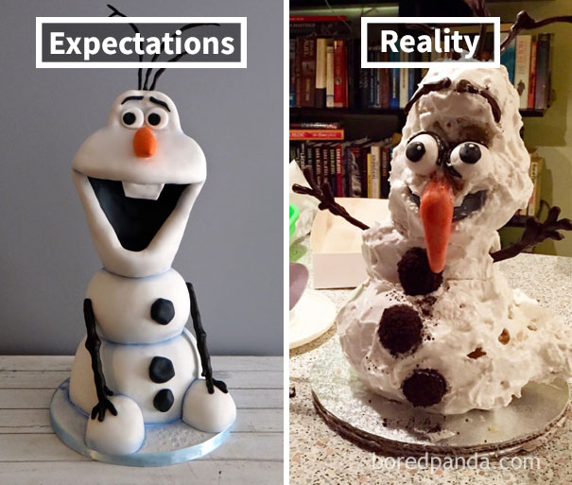
How Did the Meal Turn Out?
Notes:
What are we taking to XYZ Congress?”
“The data readout is in June. What’s the soonest Congress we could target?”
“The lead author doesn’t agree with XYZ journal.”
“The field team needs those data in the public domain—today!”
“The Pub Plan looks empty—what can we encore?”
“My company won’t allow us to publish PLS.”

Slide 49





Best Practice Tips:
Many Cooks Do Not Spoil the Broth
Build Relationships
Update and/or roadshow your SOP—remind people this is how we do it here
Lay a policy foundation (legal, compliance)
Change your talking points from “nice to haves” to “need to haves”
Plan Ahead
Start earlier than the Annual Operating Plan (AOP) calendar
Understand your governance process (ie, your company’s system for Publication Plan approval)
Get Help
Agency support
(ie, smart, experienced people who want you to succeed)
Hold a Good Meeting
Avoid didactic presentations (blah, blah, blah)
Make it interactive (whiteboards, posters)
Capture live comments (post-it notes)
Allow adequate time (and breaks!) to foster brainstorming
Start the Tactic
Convert your short title to a publication proposal as soon as possible
Vet the proposal to internal stakeholders, before starting your publication
SOP, standard operating procedure.

Slide 50
Best Practice Tips
After Dining: Be Your Own Best Critic
Ask yourself, “Does this plan help change
patients’ lives?”
Can you make changes to strengthen your next Publication Planning session?
What made a successful publication?
Really. Did that publication make a difference?
Survey your cross-functional partners about their planning experience.
Showcase successful publications
Learn from those and the others (not so impactful)
Metrics are your friend
Notes:
Use metrics to track your publications (ie, publication key performance indicators [KPIs])
Poster attendance and captured comments
Publication access metrics
Social listening, including media coverage (Almetrics)
Field insights and Med Info (what is or is not being “heard”)
Create and update Workflows, so that updates and changes are easy to track

Slide 51



Summary
Appropriate prework and defined goals can increase the efficiency of nontraditional publication planning
There are several options for increasing reach of a publication, each with different strengths and challenges
It is vital to work with internal and external stakeholders before work begins to ensure that any concerns are resolved appropriately

Slide 52

Thank You!

Slide 53
Audience Q&A
To ask a question, open the Q&A window and type your question into the Q&A box. Click Send.
Notes:
And now it's time to answer your questions. As a reminder, please type them into the Q&A box at the bottom of your screen.
[ask seeding question]

Slide 54
Upcoming ISMPP University Webinars
May 2024
Highlights From the Annual Meeting
June
2024
Can Health Literacy Best Practices in Publications Fuel Innovation in Patient-Friendly Electronic Package Information?
Notes:
Also, be on the lookout for ISMPP’s next 2 ISMPP U’s…in May and June

Slide 55
ISMPP University
Cooking up a Pub Plan - Adding Some Flavor to the Usual Fare
March 27, 2024
Webinar will begin promptly at: ​​
11 AM ET / 4 PM GMT
Notes:
​Thank you again for joining us today, if you were unable to take a screen shot for credit at the start of the webinar, please go ahead and do so now.

Slide 56

Thank You for Attending!
We hope you enjoyed today's presentation.
After closing out of Zoom, please click the CONTINUE button
on your screen to take our short survey. Thank you!
Notes:
Thank you again for attending today’s webinar. Please take a moment to fill out the survey link that will be sent to you.
After closing out of ZOOM, please click the ‘continue’ button on your screen to take a short survey.
Thank you!

Slide 57
Faculty Bios

Slide 58
Steve Palmisano
Head of Publication Services at The Lockwood Group
35+ years of medical communications experience in roles with industry and agency
Current Co-Chair, ISMPP Digital/Visual Communications Committee
ISMPP CMPP™ past Board Chair
Recipient of the PM360 ELITE Disrupter award for innovations in the publication services and
medical communications space
Launched/managed 3 publication agencies
CMPP, certified medical publications professional; ISMPP, international society of medical publications professional

Slide 59
Alanna Kennedy, PhD, ISMPP CMPP™
VP, Group Scientific Director at The Lockwood Group
16 years of experience in publications, medical communications, and regulatory affairs
Facilitated the development and execution of numerous strategic and tactical publication plans for her clients
Strong advocate for proactive publication planning throughout full product life cycle, including nontraditional tactics to enhance and extend data dissemination
Current member of the ISMPP University committee and CMPP™ since 2017
CMPP, certified medical publications professional; ISMPP, international society of medical publications professional

Slide 60
Maria McGill, RPh, ISMPP CMPP™
SVP, Scientific Services at The Lockwood Group
20+ years of medical communications and publications experience
Extensive experience in strategic publication planning
Spearheaded leadership training initiatives for publication extenders and digital features
Oversees team of scientific publications professionals
ISMPP Patient Engagement Task Force Member
CMPP, certified medical publications professional; ISMPP, international society of medical publications professional

Slide 61
Jill See, PhD, ISMPP CMPP™
Associate Director, Publications, Daiichi Sankyo
Over 10 years of experience in publication planning
Led publication planning in challenging
small-pharma settings
Current activities prioritize innovative approach

Slide 62
Amanda Hartley, PhD
Head of Publications at Sage Therapeutics
20+ years of experience in medical communications and publications in industry and agency
Therapeutic expertise focused on oncology and
brain health
“Squiggly” career as a small business owner employing persons with cognitive differences and as Board Chair for a not-for-profit mental health care provider
Proponent of the servant leadership model

