Slide 1

Intro to ARCS Surveys: Field Conservation and Mission Research
Hosted by:
  Jenevieve Hernandez
Guest Speakers:
  Adrienne Mrsny – Oakland Zoo
  Bob Merz – Saint Louis Zoo
Notes:
Hello everyone and welcome to the Intro to ARCS Surveys: Field Conservation and Mission Research! This is designed with new ARCS contacts in mind, but will also be a helpful refresher for those of you who have been doing this for years as well. I am joined today by Adrienne from the Oakland Zoo and Bob from St. Louis Zoo. Before we go through how to access and input ARCS survey data, I wanted to take a moment to go through some background.

Slide 2

What is ARCS?
Annual Report on Conservation and Science
Summary of the education programs, field conservation activities, green business practices, and scientific research of AZA community
Data are collected annually from facilities via ARCS Surveys
Serves as a database for AZA members and organizations
Notes:
The Annual Report on Conservation and Science (ARCS) began in 2010, when it was exclusively reporting on conservation data. As of 2013, however, ARCS has expanded to include the education programs, green business practices, and scientific research alongside the field conservation activities performed by the AZA Community.
Each year, we collect data from member institution via the ARCS surveys.
Collectively, this then serves as a database for AZA members and organizations for conservation research and projects, along with education programs, and sustainability efforts.

Slide 3
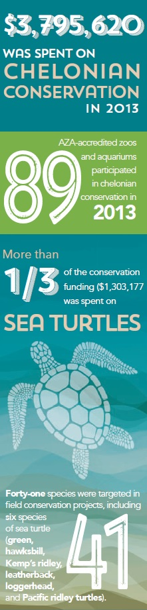
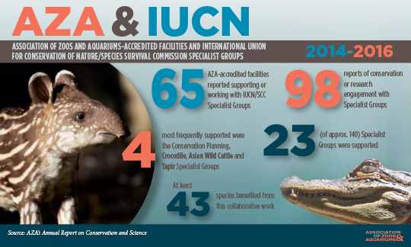
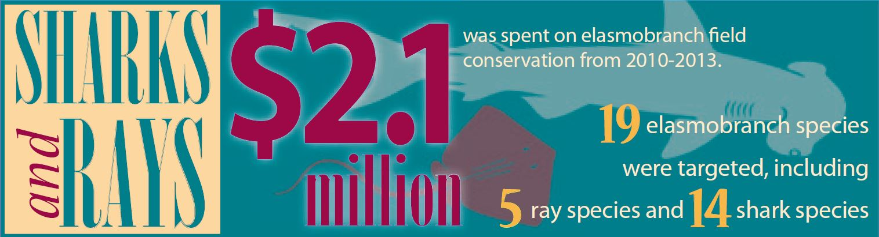
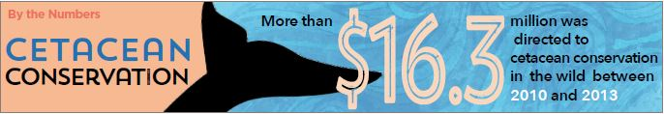
How are the Data Used?
Announcements and press releases from AZA Communications
Queries for member organizations looking for specific data
Benchmarks for institutions and programs
Accountability for conservation and scientific efforts performed by AZA members
Notes:
We use ARCS survey data a variety of ways. First and foremost, they serve as the backbone for our ARCS and Highlights publications. They also provide us with information for the “By the Numbers” section of Connect magazine, showcasing a snippet of conservation science efforts and sustainability practices across institutions.
Aside from publications and press releases, we use ARCS data to perform queries for member organizations and program leaders looking for specific information such as conservation spending, percent of research on species, multi-year analyses, and more! Once refined, these statistics can be used by institutions and programs to see if they are accomplishing benchmarking goals. It is also a useful accountability metric as it provides unbiased demonstration of the work that members have put in.

Slide 4
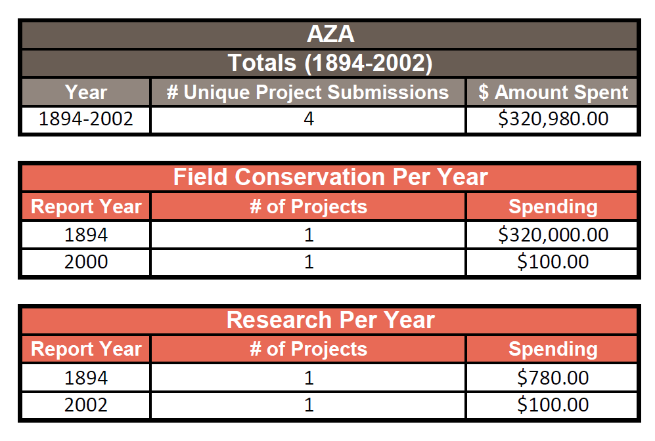
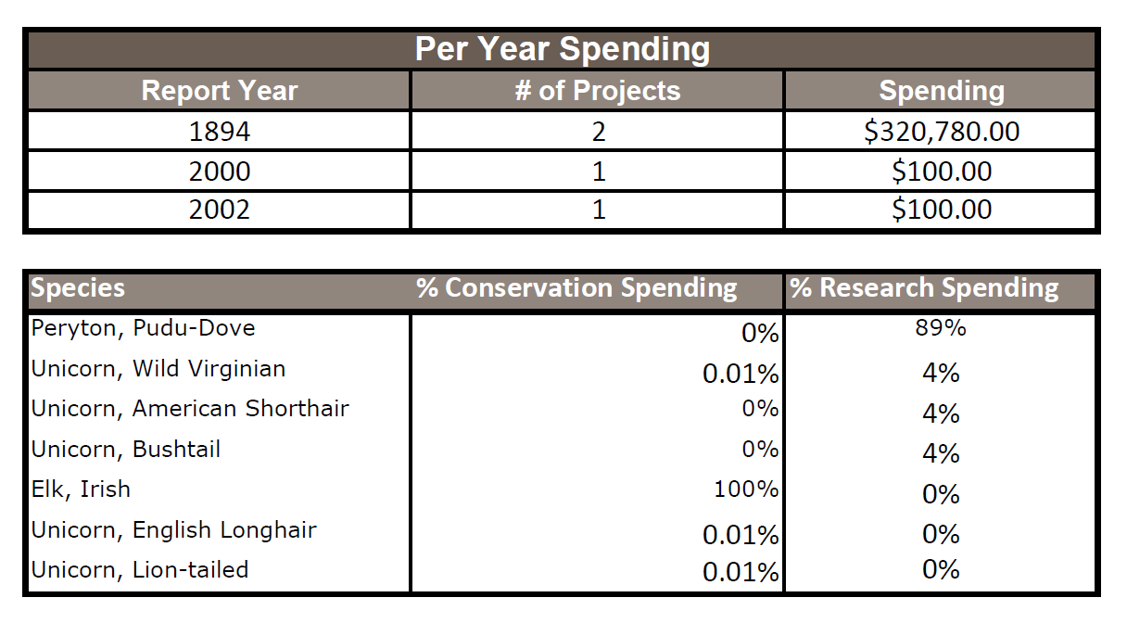
What You Get:
Notes:
Here is an example of a data query request. AZA wanted to know how much they spent on research and conservation projects they participated between 1894 and 2002. AZA also wanted to know the per-year breakdown, along with how much was spent on field conservation vs. research. Finally, AZA also wanted to know which species benefitted most from conservation and research spending. However, in order to provide this easy-to-read results summary…

Slide 5
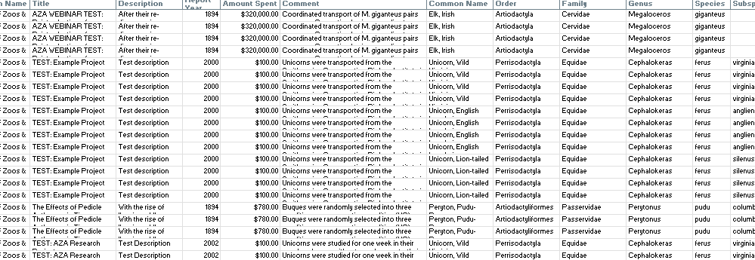
What I Need:
Notes:
…I need to have all of the data provided as consistently and as accurately as possible. If your institution has multiple ARCS contacts for the same survey, I highly recommend discussing how you will be filling in the data for your institution, or to use the excel sheet provided on the ARCS Resources webpage! The more consistent the data, the faster I can process the request, and the more accurate the results.

Slide 6


Why it’s Important
Demonstration of AZA community’s commitment to conservation science
Accreditation Standard
Verifiable source of information
  Committee discussions
  Grant Funds
Public perception of zoos and aquariums
Notes:
Why is ARCS important?
Well, it provides an overview of each member’s engagement in conservation, celebrates the cumulative conservation activity of the AZA community, and underscores what can be accomplished together!
ARCS is also required for accreditation. Again, it serves as an accountability standard for AZA’s Accreditation department to ensure that members are following their conservation action plan/strategy.
It also provides us with an unbiased, verifiable source of information that can be used when creating statistics and observing trends. We can then use these results when meeting with local, regional, national, and international stakeholders. Furthermore, we can use the data to support our requests for increased grant funds that we can use for CGF and the SAFE Granting Programs.
Finally, it allows us to increase conservation awareness to general public thereby garnering public support. Zoos and Aquariums are generally regarded as scientific authorities, but oftentimes the public cannot describe what or how we engage in conservation. Moreover, while we are seen as a general authority on the “Science” of “STEM,” without knowledge of the research institutions are doing, the public cannot know about the technological, engineering, or mathematical research that we perform. By seeing the various ways in which we engage with and discuss conservation, we increase the likelihood that they will continue to think of and discuss this with others once they leave our institutions.

Slide 7


jhernandez@AZA.org
(301) 244-3331
ARCS Resources webpage:
https://www.aza.org/resources-for-the-arcs-surveys

