Slide 1
Best Practices in Adult Learning
Trainer: Kristen Wall, MA, EdD
Notes:
Title option 1

Slide 2
Introduction
Kristen Wall, MA, EdD
Consultant with Blue Sky eLearn
Notes:
Worksheet: opportunities to reflect, create a list of tools you can use to supplement the materials you are provided

Slide 3
Warming Up
Describe the perfect teaching/learning environment.
What does the instructor do? What do the learners do?
What resources are available?
Notes:
Coffee, well-rested, feel comfortable with materials
Learners are attentive, ready to engage, bring ideas I’d never thought of
Collaborative learning

Slide 4
Hierarchy of Needs/Motivation (Maslow)
Self Actualization
Acceptance of who I am, accurate self-view, autonomy
Esteem
Confidence, strength, respect, self-belief
Belonging and Love
Do I fit in? Am I welcome?
Safety and Security
Physical and emotional
Physiological
Food, shelter, clothing

Slide 5
Creating A Learning Environment
Try to get out of your own head
Set aside your own agenda
Psychological safety
Watch your language and tone
Challenge language that’s not helpful
Dealing with “mistakes”
Challenging identity can be…challenging

Slide 6
Questions to Practice Using
How did that make you feel?
How do you think someone else might have interpreted what you just said?
Is this the person you want to be in this moment?
Would you like to try again?
What do you want to do differently next time?

Slide 7
Application
Write 3 questions you would like to practice using that would contribute to a learning environment.

Slide 8
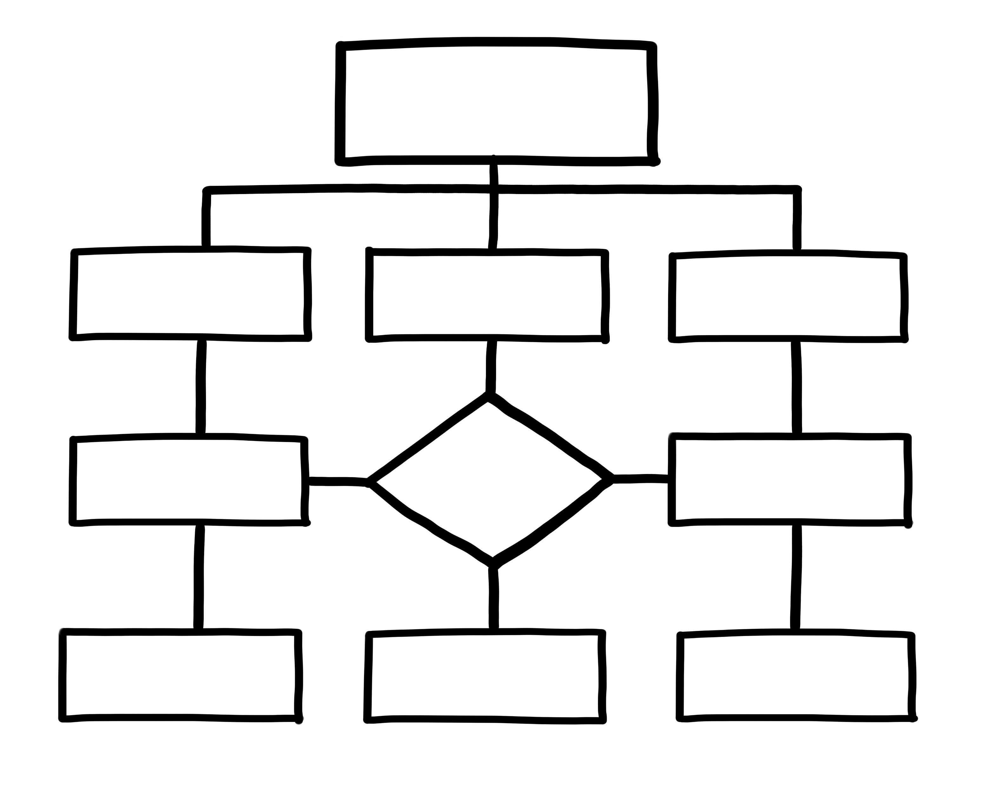
Critical v. Creative Thinking

Slide 9
Application
Where do your learners have to demonstrate critical thinking?
Where do they demonstrate creative thinking?
Where can you encourage your learners to think more independently?

Slide 10
Experiential Learning (Kolb)
Concrete Experience
Active Experimentation
Reflective Observation
Abstract Conceptualization
Notes:
Adults learn best by doing
Task-oriented
Example: Making soup

Slide 11
Application
Create an environment where testing/experimenting is encouraged
Ask questions:
What do you see?
What surprised you?
What do you need to learn to do in order to master this task?
I do, we do, you do, teach

Slide 12
Application
Think of a task that would be appropriate for experiential learning.
How can you incorporate “I do, we do, you do, teach”?

Slide 13
Transformational Learning (Mezirow)
Experience
Action
Critical Reflection
Reflective Discourse
Notes:
Change the way they see themselves and the world, contributes to creative thinking
Critical reflection: examine our own perspectives, POV
Reflective discourse: how do others see the problem?
Can challenge people’s identities
Mentor required
Help the learners create their own meaning
Case studies, role plays, simulations, problem-based learning
Example: lack of funding for program

Slide 14
Application
Ask your learners to identify a problem
Discuss the “right” way of doing things, hearing from multiple perspectives
Test ideas
Reflect on what worked and what didn’t

Slide 15
Application
Think of a problem that would be appropriate for transformational learning. How would you introduce the problem? How would you work with your learners to solve it?

Slide 16
Evaluating Effectiveness (Kirkpatrick)
Level: 4
Results
What benefits has the organization experienced as a result of the training?
Have participants applied what they learned from the training?
How much did participants learn from the training and have their skills improved?
How did participants respond to the training?
Level: 3
Behavior
Level: 2
Learning
Level: 1
Reaction

Slide 17
Level 1 - Reaction
Level 2 - Learning
Did you feel the training was worth your time?
What are the three most important things you learned from this training?
Would you recommend this training?
Will you be able to apply what you’ve learned?
Did the participants learn what was taught?
Quiz/test based on content
Demonstrate skills based on content

Slide 18
Level 3 - Behavior
Level 4 - Results
Did the participants apply what they learned?
Are participants able to teach what they’ve learned to other people?
Do participants talk about how they’ve changed?
Has the new knowledge/behavior stuck?
Did the training cause the change you wanted to see?
Reduced waste
Increased engagement
Fewer complaints
Did the change hold over time?

Slide 19
Application
What ideas do you have to measure behavior and results? What data could you collect? What questions could you ask?

Slide 20
Wrapping Up
Create a learning environment
Critical v. creative thinking
Experiential learning
Transformational learning
Evaluating effectiveness

Slide 21
Wrapping Up
What is one idea you could apply to your
teaching/instructional practice today?

Slide 22
Thank you! Once you close this presentation, go back to the Learning Management System to download this PowerPoint deck and explore the other LEAD to Succeed materials.

