Slide 1
How Faculty, IT Staff, & Others Can Contribute to Making Courses Accessible to All Students
Sheryl Burgstahler
sherylb@uw.edu

Slide 2

2 Units in Accessible Technology Services
        IT Accessibility Team
          1984–
          Funded by UW
          DO-IT Center
          USA, 1992–
          Supported with federal, state,
          corporate, private funds
          DO-IT Japan, 2007–
          Center on UD in Education, 1999–
Disabilities
Opportunities
Internetworking
Technology

Slide 3













Collaborations
DO-IT WA

Slide 4
Individual-Centered Community Building Model
Key stakeholders (like you!) that contribute to the success of people with disabilities
Success of people with disabilities in academics & careers
Person with disability
Family members
Peers, near peers, mentors, allies
Postsecondary administrators, faculty, staff
Technology vendors
Professional organizations and broadening participation efforts
Service providers
Legislators, policy makers
Funding agencies

Slide 5
Today’s topics
Accommodations-only & universal design (UD) approaches in providing access to students with disabilities
UD in Higher Education (UDHE) Framework
Model for exploring stakeholder roles
Resources, Q&As

Slide 6
We need a paradigm shift
from “ableism” to celebration of all forms of diversity, including disability
from deficit view of disability to social justice
from reactive reliance on accommodations alone to proactive, UD design of accessible, inclusive, & sustainable products, environments, & services
from design for the “average” to design for everyone
Once upon a time we already did it…

Slide 7
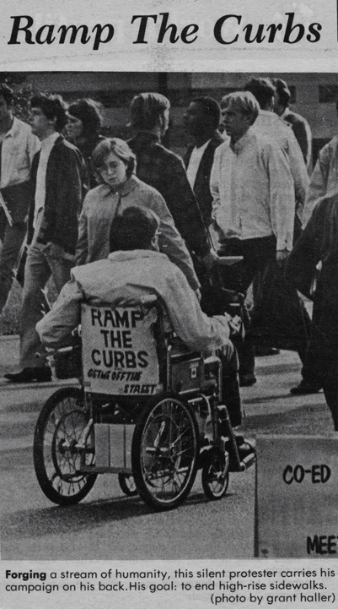
UD of physical spaces
“The Daily” @UW
1970

Slide 8
Basic approaches
When we are working with students, we promote
SELF DETERMINATION
When we are working with faculty, staff, institutions, technology companies, we promote
UNIVERSAL DESIGN (UD)

Slide 9
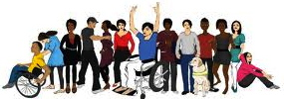
In an “inclusive” environment everyone
  who meets requirements, with or without accommodations, is encouraged to participate
  feels welcome
  is fully engaged in accessible & inclusive environments & activities

Slide 10
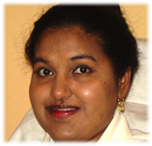
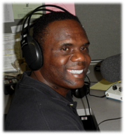
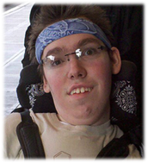
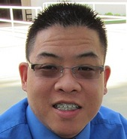
One-minute history of the evolution of responses to human differences:
        Eliminate, exclude,
        segregate
        Cure, rehabilitate,
        accommodate
        Social justice,
        universal design +
        accommodations

Slide 11
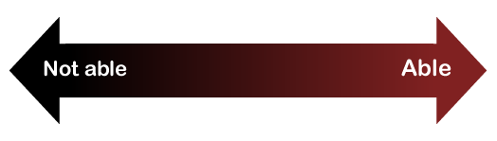
Consider ability on a continuum
understand English, social norms
see
hear
walk
read print
write with pen or pencil
communicate verbally
tune out distraction
learn
manage physical/mental health

Slide 12
Common/expensive accommoda- tions for online courses
Making inaccessible documents accessible, mainly those in PDF format
Captioning videos

Slide 13

“When you plant lettuce,
if it does not grow well, you don't blame the lettuce. You look for reasons it is not doing well.
It may need fertilizer,
or more water,
or less sun...”
-Thích Nhất Hạnh,
Vietnamese
Buddhist Monk

Slide 14
Scope
Definition
Principles
Guidelines
Process
Practices
Universal Design in Higher Education (UDHE) Framework

Slide 15
Scope: Courses
  Fully on-site courses
  Fully online courses
  Hybrid courses

Slide 16
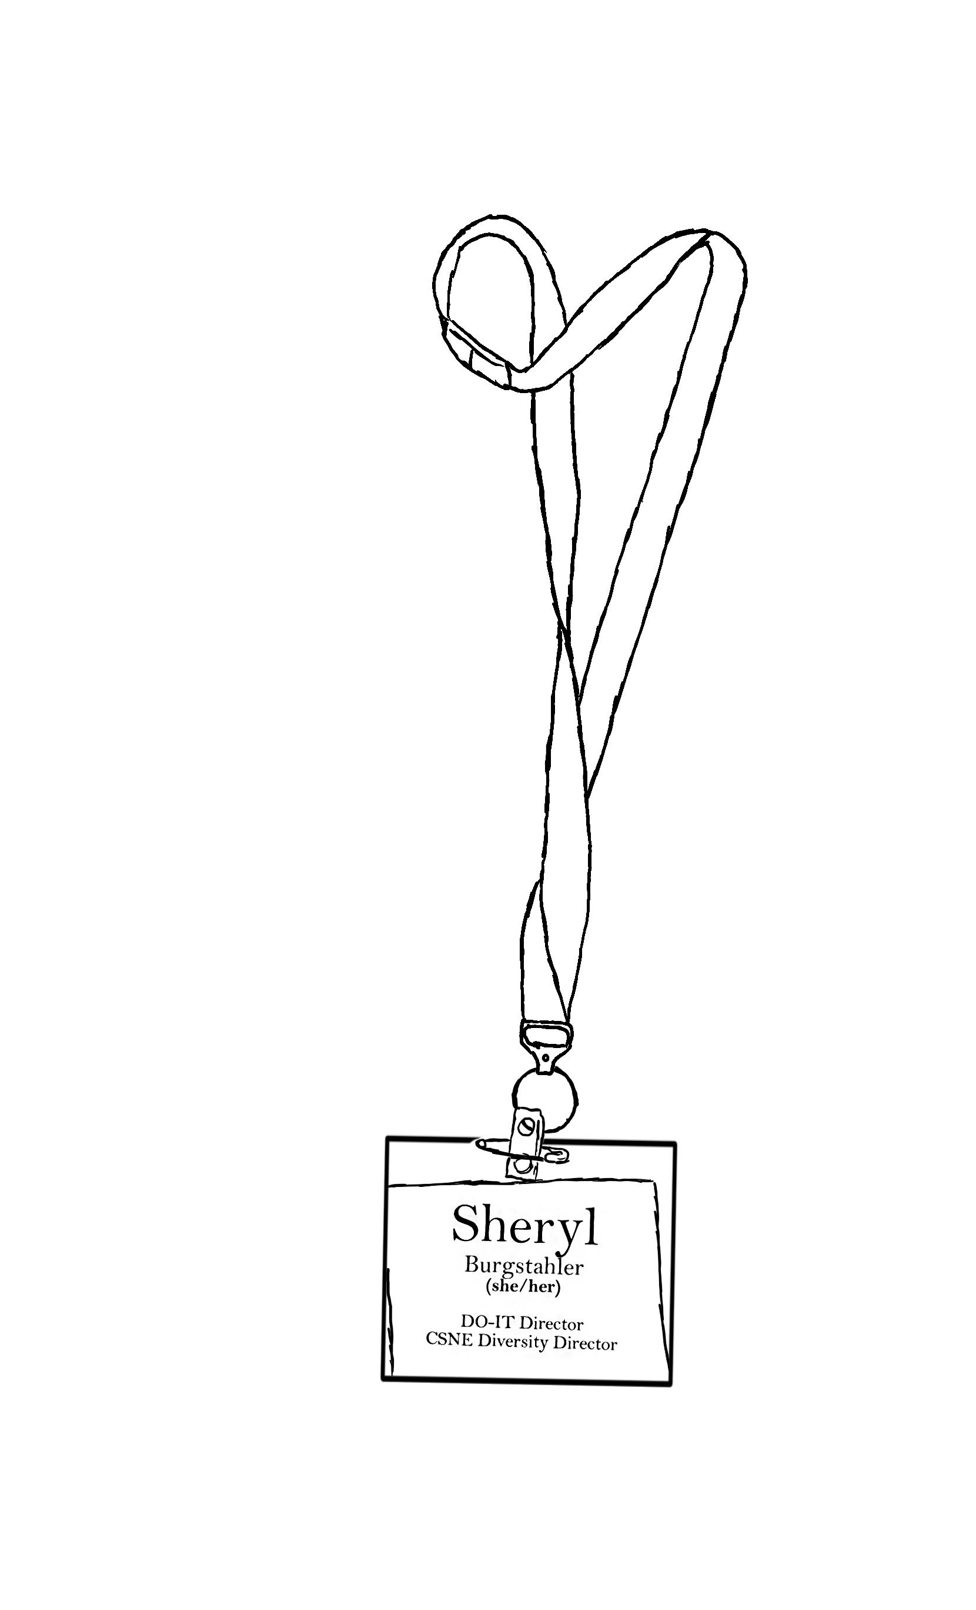
Universal Design (UD) =
“the design of products & environments to be usable by all people, to the greatest extent possible, without the need for adaptation or specialized design.”
The Center for Universal Design
www.design.ncsu.edu/cud

Slide 17
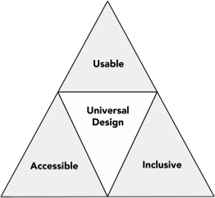
Applying
UD makes materials & activities…

Slide 18
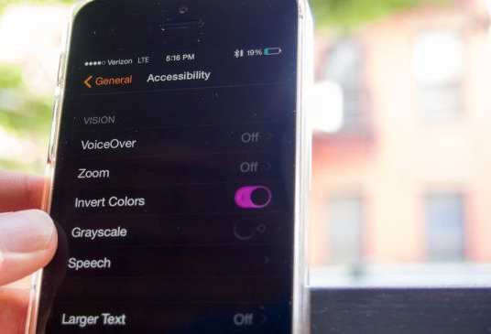
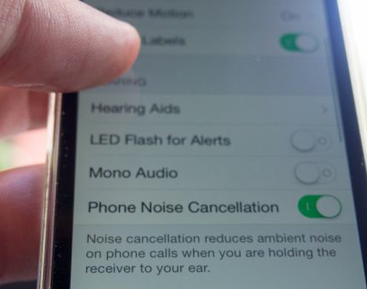
UD of technology
builds in
accessibility
features
ensures compatibility with assistive technology

Slide 19
Instructors should consider characteristics of students who might be in their courses & the assistive technologies (AT) they might be using as they develop a course.

Slide 20
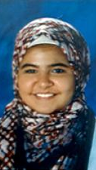
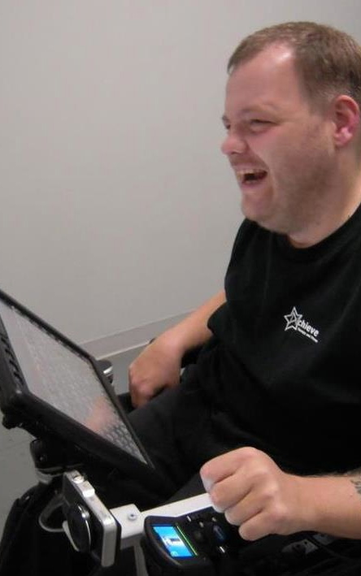
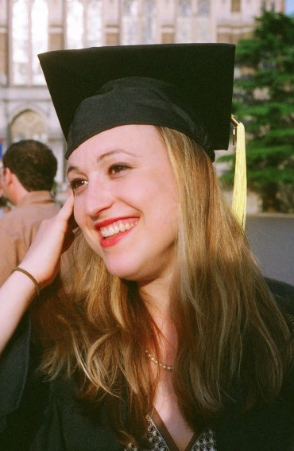
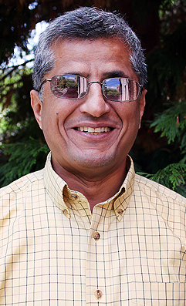
students
Consider people with a range in English language skills, cultures, interests, abilities, technologies
Zayn
Anthony
Jesse
Hadi

Slide 21
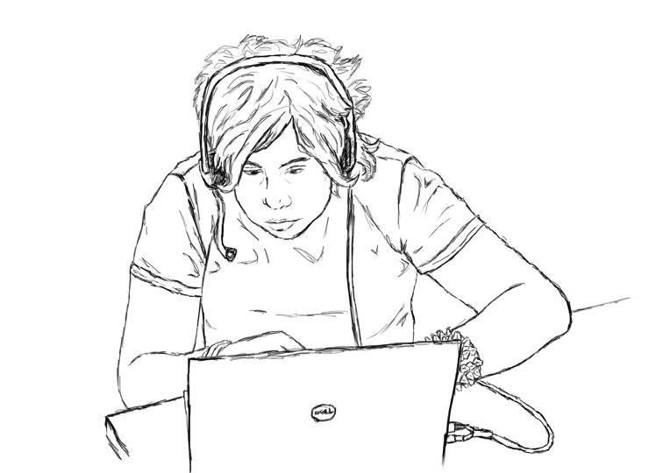
Universal Design for Learning
Offer:
Multiple means of
representation
Multiple means of
engagement
Multiple means of action & expression
- Center for Applied Special Technology (CAST)

Slide 22
3 sets of principles & guidelines underpin UD for educational applications
UD
UDL
WCAG
7 Universal Design
3 Universal Design for Learning
4 Web Content Accessibility
Guidelines

Slide 23
In a nutshell,
Provide multiple ways for participants to learn & to demonstrate what they have learned, & to engage.
Ensure that all technologies, facilities, services, resources, & strategies are accessible to individuals with a wide variety of abilities & other characteristics.

Slide 24
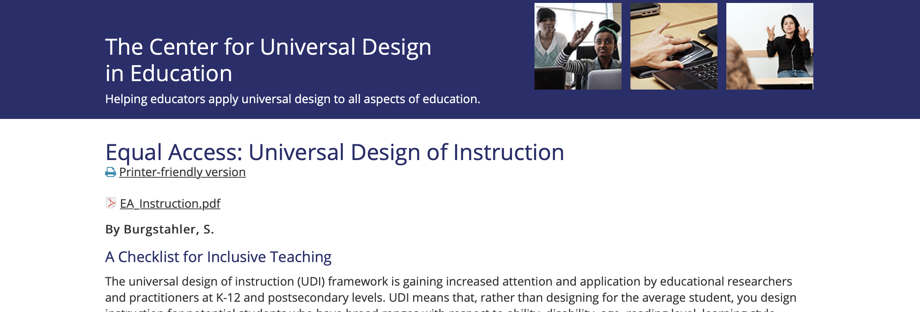
20 tips for teaching an accessible online course
        To help instructors get started
        With how-to references
        Developed from research & reports from online instructors & students

Slide 25
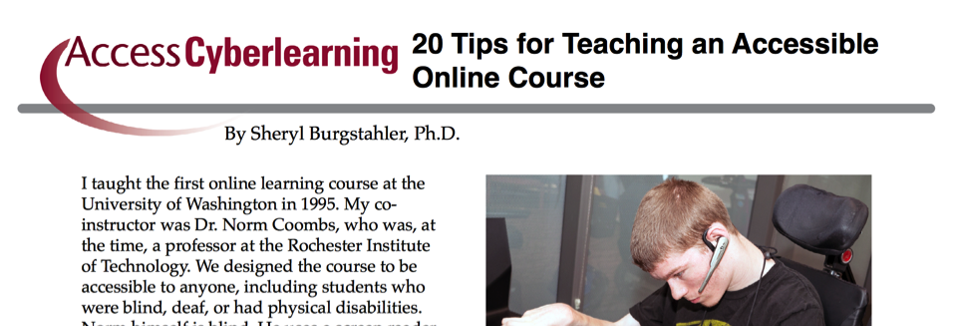
20 tips for teaching an accessible online course
        To help instructors get started
        With how-to references
        Developed from research & reports from online instructors & students

Slide 26
Examples of Practices in 20 Tips, 1/3
Content presented in multiple ways
Multiple ways to communicate
Multiple ways to demonstrate learning
Videos captioned; audio transcribed
Clear instructions; consistent layouts & organization
PDFs avoided; no scanned image PDFs

Slide 27
Examples from 20 Tips, 2/3
Text format, structured headings, lists, tables; descriptive text for hyperlinks, content in images
Large, bold, sans serif fonts; uncluttered pages; plain backgrounds; high contrast color combinations, with no reliance on color alone
Use plain English, spell/define acronyms

Slide 28
Examples from 20 Tips, 3/3
Examples, assignments relevant to diverse audience
Outlines, other scaffolding tools provided
Adequate time provided for activities, projects, tests
Feedback on parts & corrective opportunities provided

Slide 29
Scope
Definition
Principles
Guidelines
Process
Practices
Universal Design in Higher Education (UDHE) Framework

Slide 30
An attitude; a framework, goal, process—UD:
Values diversity, equity, & inclusion
Promotes best practices & does not lower standards
Is proactive & can be implemented incrementally
Benefits everyone
Minimizes the need for accommodations

Slide 31
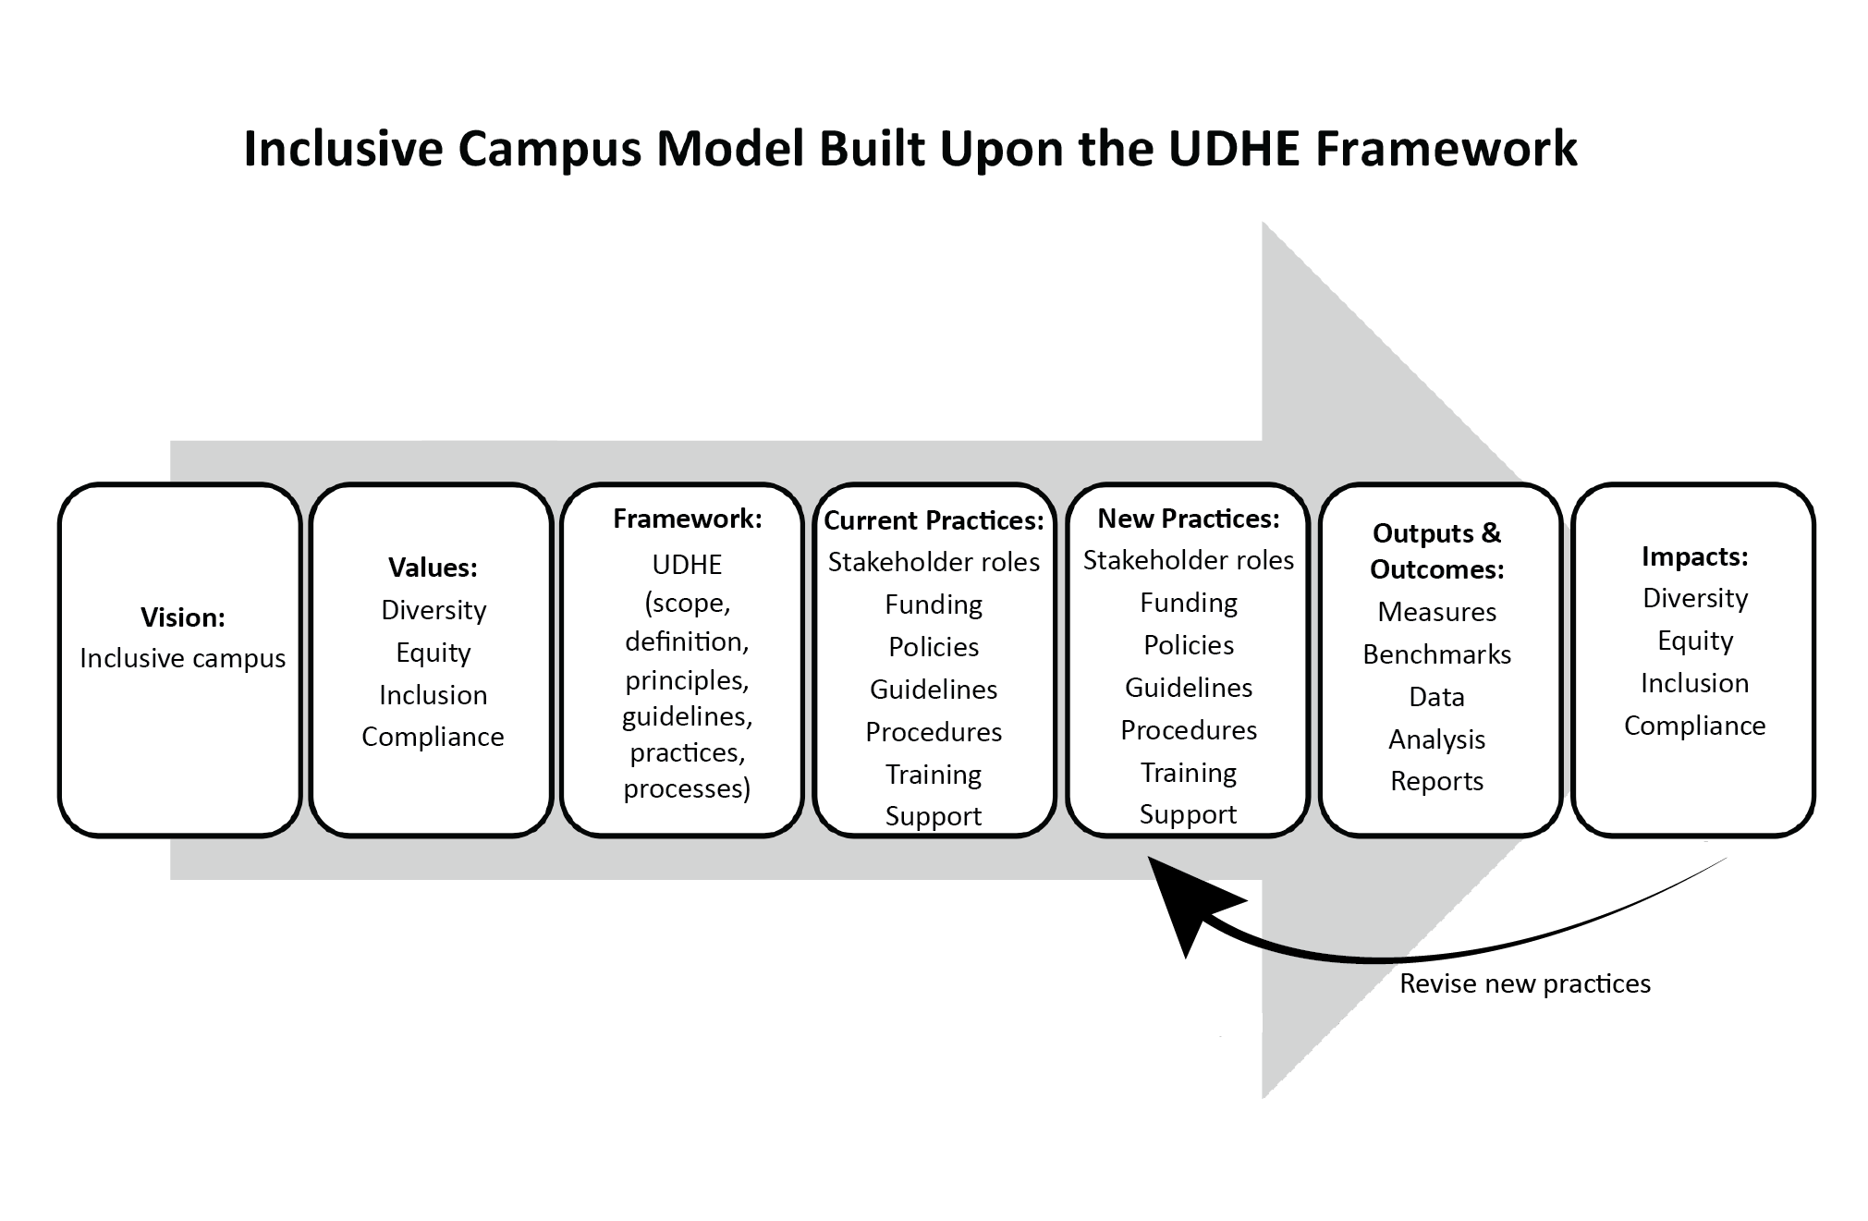
Example: DEI Initiative in HE underpinned by UDHE Framework

Slide 32
Apply the Model to accessible IT
Vision: IT procured, developed, used is accessible
Values: Diversity, equity, inclusion, compliance
Framework: UDHE’s scope, definition, principles, guidelines, practices, processes
Current & new practices: Stakeholder roles, funding, policies, guidelines, procedures, training, support
Outputs & outcomes: Measures, benchmarks, data, analysis, reports
Impacts: Increased alignment with vision & values

Slide 33
For your school, describe your ideal state:
Stakeholder | Role
Central support Disability services IT services Teaching & learning center ADA compliance office + ??? Departmental support IT services Teaching & learning support + ??? Instructors | Accommodations

Slide 34
Example: Faculty planning example
Application | UD I will | UD I will rely on [service] to | Accommodation I will rely on DS to
Documents | make Word, PPt, other documents I create accessible not use inaccessible documents of others first week of class |  | remediate documents of others as necessary
Captioning | accurately caption videos I create not use uncaptioned videos of others first week of class |  | caption videos of others

Slide 35
Examples of what UW-IT does regarding
Accessible Technology website
Routine training on accessible online learning accessible documents, videos, websites, etc.
Individual/group consultation
Limited ‘free” captioning
Limited “free” document remediation

Slide 36
Resources
UW’s Accessible Technology uw.edu/accessibility
DO-IT uw.edu/doit
  Knowledge Base
  Center for Universal Design in
  Education uw.edu/doit/cude
    A book…
    Equal Access: Universal Design of Instruction
    20 Tips for Teaching an Accessible Online Course
    checklist + tutorial
Sheryl Burgstahler sherylb@uw.edu

