Slide 1
Data Usability Reviews and Documentation for
Texas Risk Reduction Program and Petroleum Storage Tank Projects
Based on RG-366/TRRP-13 and RG-411 TCEQ Regulatory Guidance
Mark Maglitto
Lead Program QA Specialist
Technical Program Support Team
TCEQ Remediation Division

Slide 2
Objectives
Laboratory data review versus independent usability review
Appropriate level of data review (dependent on decision criteria and importance)
Laboratory data reporting requirements
Quality Control (QC) sample information
Documentation of data usability
  TRRP Projects: Data Usability Summary (DUS)
  LPST Projects: QA/QC Summary

Slide 3
Data Review and Reporting: 3 Steps
LABORATORY
  Data Review: Evaluate lab results relative to technical QC acceptance criteria (e.g., criteria based on lab methods and SOPs).
  Reporting: Reportable data, laboratory review checklist, and the associated exception report(s) (for TRRP) or the laboratory case narrative (for LPST).
PERSON
  Data Usability Review: Compares lab results and QC to project measurements quality objectives (MQOs). Determines usability of the data to meet the project data quality objectives (DQOs).
  Reporting: DUS (for TRRP) and QA/QC summary (for LPST).
TCEQ
  Review: Verify reviews conducted, reports completed, and data usability is justified for its intended purpose.
KEY POINT: Laboratory and method QC acceptance criteria may be different from
the project specific MQOs.

Slide 4
Data Quality Requirements
  Data Quality Responsibility:
    The person (i.e., consultant, contractor) IS responsible,
    Not the TCEQ,
    Not the laboratory or sub-contractor.
  Data Quality must be:
    Known (evaluated) and adequately documented,
    Adequate to meet project objectives and program requirements.

Slide 5
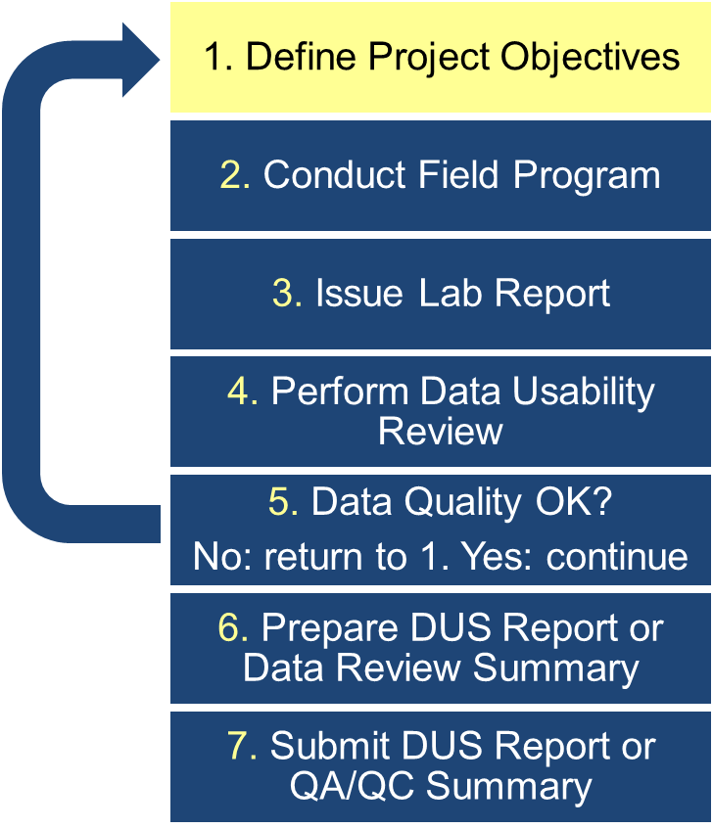
Data Quality Assessment: Process Overview (1)
Data Quality Objective (DQO) process
Identify goals (CSM) – project & data needs
Identify performance & acceptance criteria
Establish minimum data quality requirements
  Measurement performance criteria in terms of data quality indicators (DQIs) - data properties descriptors (e.g., precision, accuracy, and bias)
  Project Measurement Quality Objectives (MQOs) (e.g., establishing data acceptance criteria)
KEY POINT: Communication with the laboratory concerning required analytical sensitivity is essential.

Slide 6
Key Definitions: Data Quality Indicators (DQIs)
Precision: Agreement between two or more measurements made under identical conditions, measured by relative percent difference (RPD).
Accuracy: Agreement between a measurement and a known value (is an indicator of bias in measurements).
Representativeness: Degree to which data accurately characterize sample medium.
Comparability: Confidence with which one data set can be compared to others.
Completeness: Fraction of valid data points obtained from a measurement system or method.
Sensitivity: capability of an analytical instrument to detect and quantitate an analyte at a required or specified concentration (e.g., PCL)

Slide 7
Project Objectives: Determining MQOs
Project specific criteria (i.e., MQOs) must be defined and the project data objectives should be developed prior to sampling. The criteria below is from highest to lowest preference:
Project Specific MQOs: most stringent requirements.
Program Specific MQOs: as specified in a program Quality Assurance Project Plan (QAPP).
In absence of 1 and 2; the data usability reviewer needs to provide the review criteria (i.e., MQOs) and rationale for qualifying the data based on the intended use of the data (the suggested TRRP-13 guidance for MQOs is on next slide).

Slide 8
Project Objectives: Determining MQOs - Cont.
The reviewer should ensure the MQOs meet the project objectives, but in general, the TRRP-13 guidance MQOs (page 22) should be acceptable as follows:
    Organic analytes:
      (%Rs) between 60-140%, but not less than 10%, and RPDs within 40%.
    Inorganic Analytes:
      (%Rs) between 70-130%, but not less than 30%, and RPDs within 30%.
%R = percent recoveries
NOTE: These guidance MQOs will be used as example criteria throughout the
presentation during QC examples.

Slide 9
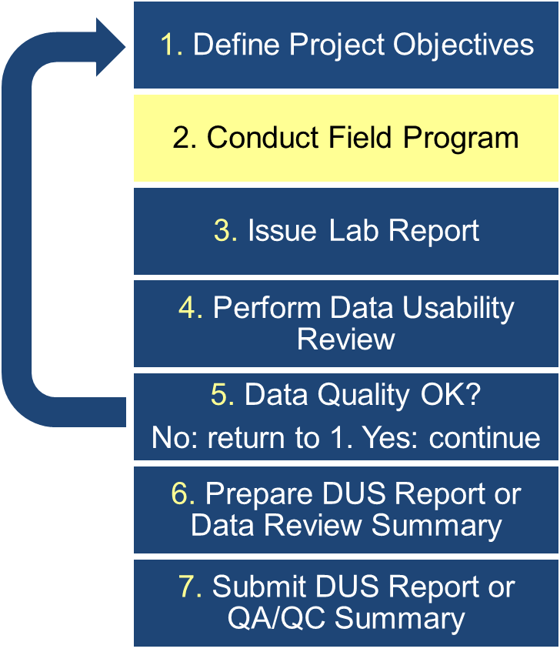
Data Quality Assessment: Process Overview (2)
Person collects samples, field QC, and measures field parameters (e.g., pH, conductivity, and temperature).
Documented abnormalities during field activities.
Custody documentation completed and signed for all samples (handling, preservation).

Slide 10
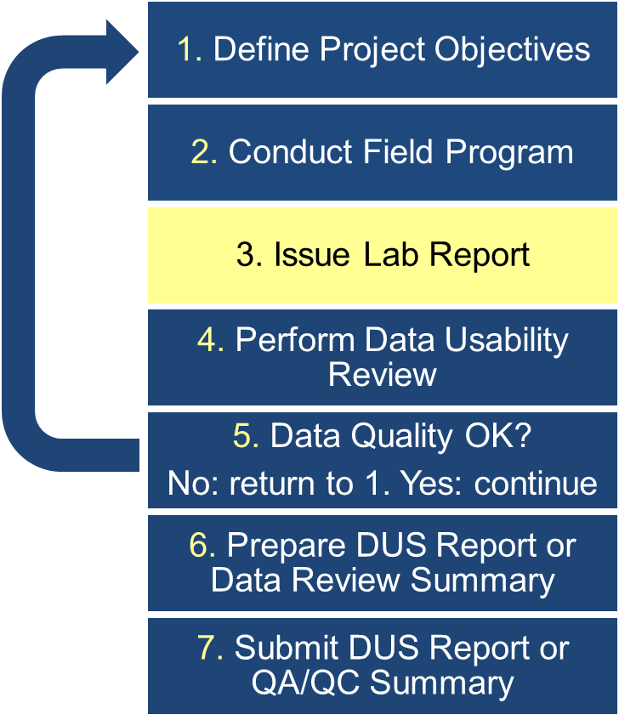
Data Quality Assessment: Process Overview (3)
Laboratory analyzes samples
Reviews QC data based on technical laboratory QC criteria
Issues laboratory data package
For TRRP Projects
  Laboratory Review Checklist (LRC) & exception report (ER)
For LPST Projects
  Laboratory case narrative or Laboratory Review Checklist (LRC) & exception report (ER)
NOTE: The lab does not determine the usability of the data in regards to the project objectives

Slide 11
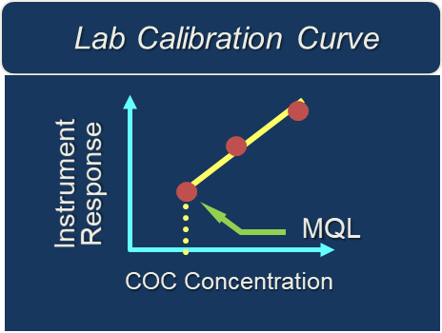
Key Definitions: Analytical Limits
Method Quantitation Limit (MQL): Lowest detectable and quantifiable concentration from the laboratory instrument calibration curve.
KEY POINT: The MQL must be less than the level of required performance
(LORP) (e.g., assessment level or action level) or the person
must document the MQL is obtained from the most sensitive
standard method available.

Slide 12
Key Definitions: Analytical Limits – Cont.
Method Detection Limit (MDL)
  Minimum concentration at which a chemical can be measured.
  Statistical confidence is 99% that the concentration is distinguishable from the method blank results
Sample Detection Limit (SDL)
  For each COC in each sample, the SDL is equal to the MDL adjusted for dilution, sample size, and moisture content
  MDL x Sample-specific factors = SDL
NOTE: The lab must report nondetected results for COCs as less than the
value of the SDL.

Slide 13
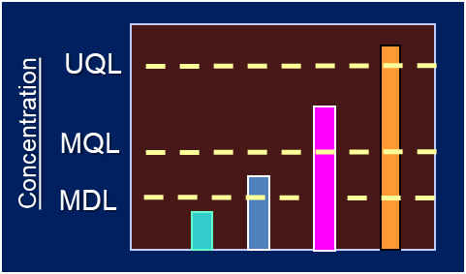
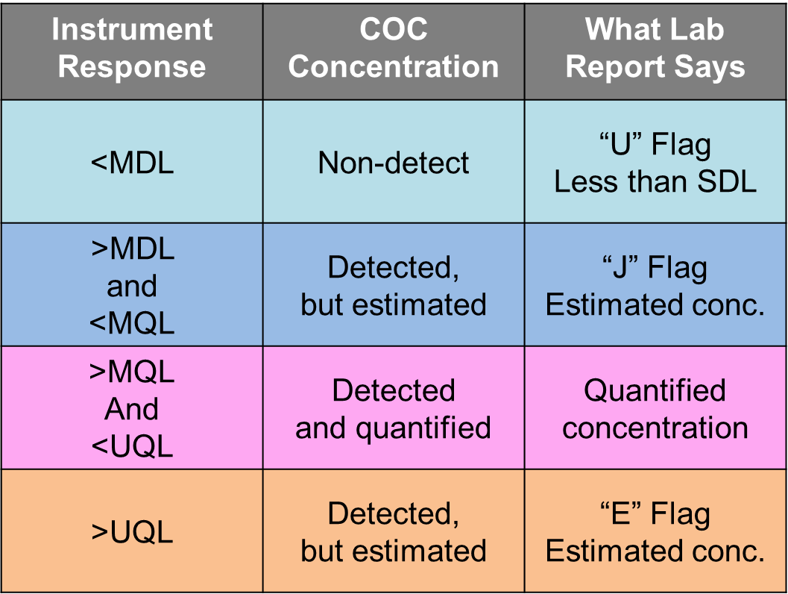
Reporting the Results

Slide 14
Lab Data Package: Required Contents
Reportable Data
    Results of sample analyses
    Results of sample-specific QC parameters (e.g., surrogates and analytical duplicates)
LRC/ER or Laboratory Case Narrative
  Documentation or discussion of:
    Laboratory data review;
    Deviation from the method or lab SOPs;
    QC failures and affected samples;
    And corrective actions taken by the laboratory.

Slide 15
Lab Data Package: Reportable Data
R1 Chain-of-Custody Documentation: Field and lab forms
R2 Sample and QC Cross Reference: Field-lab correspondence
R3 Test Reports: Sample results and methods
R4 Surrogates: Percent recovery and lab QC limits
R5 Laboratory Blanks: Results for blanks (e.g., method, preparation)
R6 Laboratory Control Samples: Demonstrates capability of method

Slide 16
Lab Data Package: Reportable Data - Cont.
R7 Matrix Spike/Matrix Spike Duplicates: COC analytes are spiked in a field sample to determine the effect of the sample matrix on analyte recoveries. Precision is determined if the MSD is analyzed. Must be from site-specific sample.
R8 Analytical Duplicates: Laboratory duplicate to determine precision (RPDs).
R9 Method Quantitation Limits and Detectability Check Samples: Results for each COC for a given matrix and method.
R10 Other Information: Documents other problems or conditions that may impact data quality (e.g., dilutions or interferences causing the reporting limits (i.e., MQLs, SDLs) to be raised above LORP.

Slide 17
Laboratory Review Checklist: Contents
Reportable data (“R” items) are generally related to sample-specific quality control parameters.
Supporting data (“S” items) are generally related to the laboratory quality control parameters.
Documents any technical problems with either the reportable data or the supporting data via exception reports to the LRC.
KEY POINT: The laboratory review checklist is a tool the data user can use
to get a quick idea of the overall quality of the data for specific
samples.

Slide 18
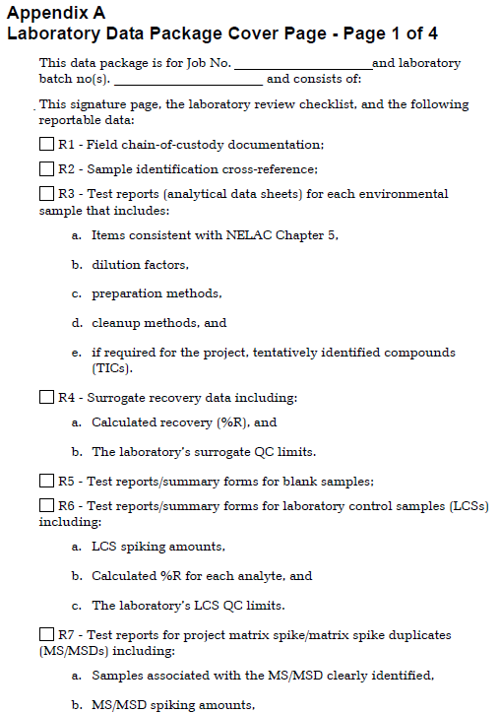
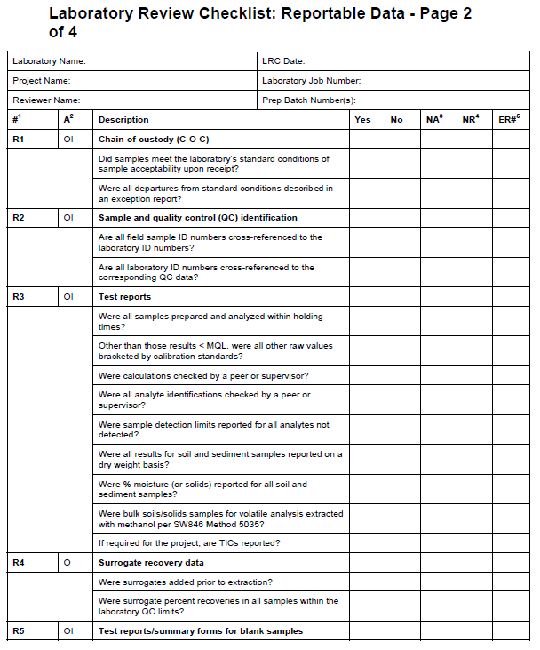
Laboratory Data Package Example
TRRP-13 pg. 28
TRRP-13 pg. 30

Slide 19
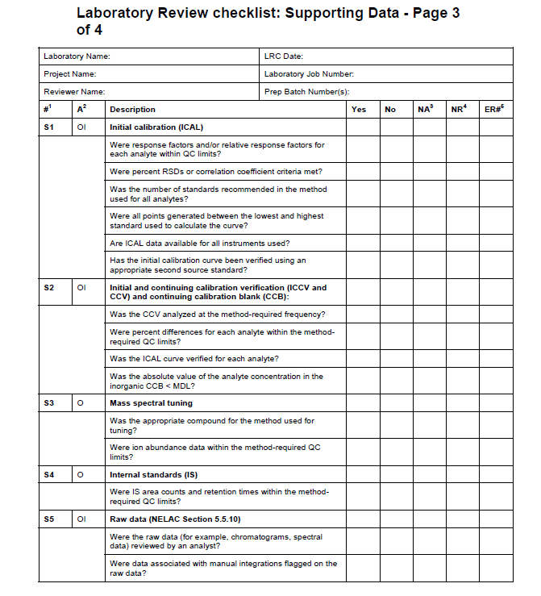
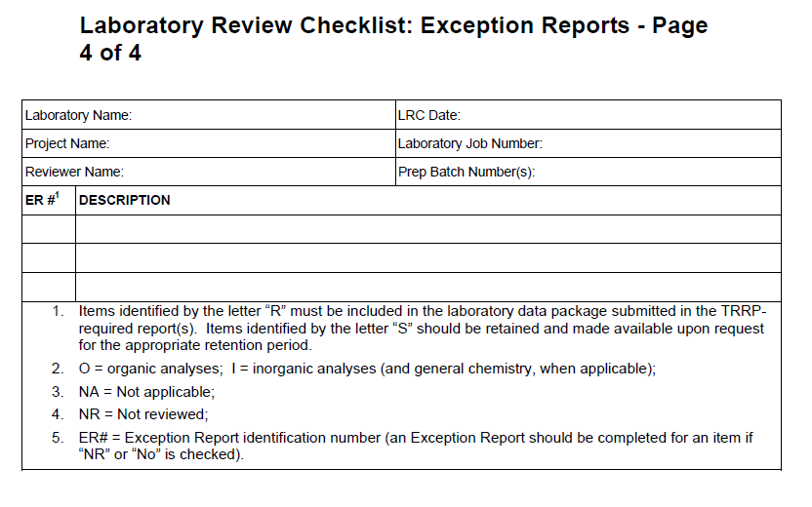
Laboratory Data Package Example Cont.
TRRP-13 page 36
TRRP-13 page 33

Slide 20
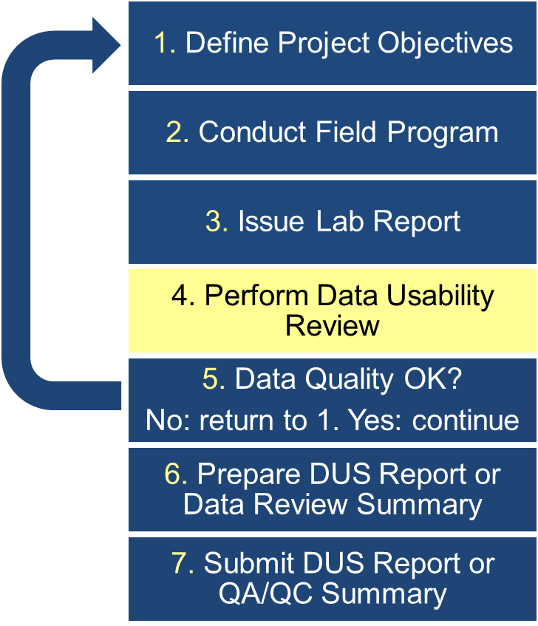
Data Quality Assessment: Process Overview (4)
The Person (e.g., consultant or contractor) conducts data usability review.
Review laboratory QC, custody documents, and the field logbook (e.g., field duplicates “blind to the lab”)
Reviews the project QC data based on the project MQOs.
Determines the usability of the lab data for meeting the project DQOs.
NOTE: Final review qualifiers (used for project decisions) supersede lab qualifiers and are incorporated into data summary tables (e.g., DUS or QA/QC Summary)

Slide 21
What the Person Checks During a Data Usability Review
Field to Lab: Holding times, preservation, sample containers, sample collection, and field duplicates (representativeness and precision)
Lab Control Samples: LCS/LCSD (accuracy and precision)
Matrix Spikes: MS/MSD (accuracy and precision)
Surrogates: Percent recoveries for organics only (accuracy and representativeness)
Analytical Duplicates: Relative percent differences (RPD) usually inorganics (precision)
MQLs and SDLs: Compare to LORPs and check that non-detect results are reported less than the SDL (sensitivity)
Supporting Data: Results of lab’s review on the LRC (comparability)

Slide 22
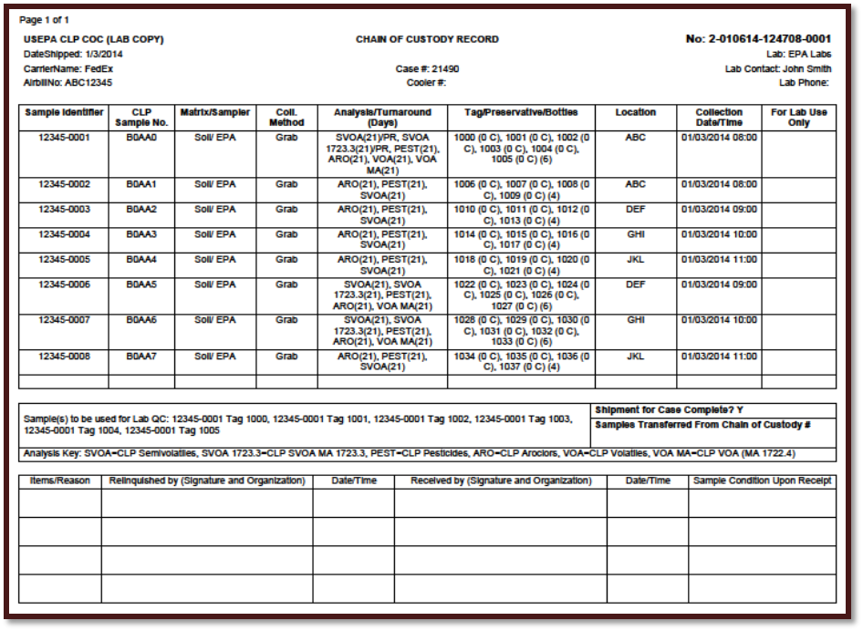
What QC Data Tell the Data Users:
Chain-of-Custody Documentation
Custody signatures
Location, time and type of sample collected
Analyses requested (methods and/or COCs)
Condition of samples upon receipt by the laboratory
Sample preservation; chemical, thermal, light
PASI FY2019 QAPP (QTRAK 18-513) CLP Sampler’s Guide pg. 39

Slide 23
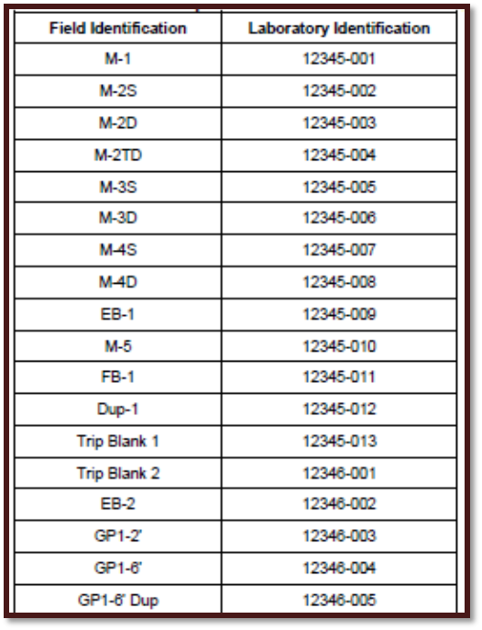
What QC Data Tell the Data Users:
Sample and QC Cross-Reference
Matches the field ID with the lab ID
Links lab ID numbers to the corresponding QC data
Facilitates locating certificates of analysis or test reports for specific samples of interest in the data package
TRRP-13 Table B-1 pg. 42

Slide 24
What QC Data Tell the Data Users:
Laboratory Control Sample (LCS)
  LCS is an analyte free lab matrix spiked with COCs at a known concentration processed just like environmental samples.
  If the LCS fails, the validity of the environmental results associated with the LCS are of concern.
  The LCS indicates the condition of the analytical operating system when the environmental sample was analyzed.
  Typically one LCS is run per preparation batch.

Slide 25
What QC Data Tell the Data Users:
Matrix Spike (MS)
Indicates the ability of the test method to generate a correct result from the environmental sample.
Provides bias result information from sample matrix affects;
Addition of a known amount of the COCs to a representative environmental sample (ideally a project sample).
Typically one MS/MSD is run for every 20 project samples per matrix.
KEY POINT: If concentration in unspiked sample is greater than 4 times the
concentration of the spike, the MS results are considered inappropriate for
assessing accuracy.

Slide 26
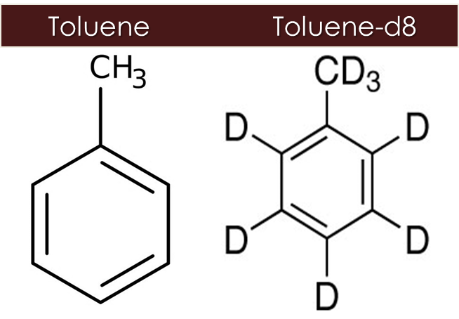
What QC Data Tell the Data Users:
Surrogates
Indicate extraction efficiency (bias) and analytical conditions during lab sample prep and analysis
Chemicals added to every sample, for organic analysis only
Not naturally occurring or found in the environment
Mimic their respective COCs and represent a chemical property
Usually isotopically labeled
COC Surrogate

Slide 27
What QC Data Tell the Data Users:
Blank Sample Data
Indicates laboratory and/or field contamination introduced to the sample potentially affecting results. There are multiple types of blanks (e.g., field blanks, trip blanks, equipment blanks, method blanks etc.)
Blank data are especially important when:
  The data user is trying to attribute the presence of a COC at low levels to a specific environmental source or location.
  The data user is contemplating action based on a COC being present in a sample at low levels (e.g., near report limits).

Slide 28
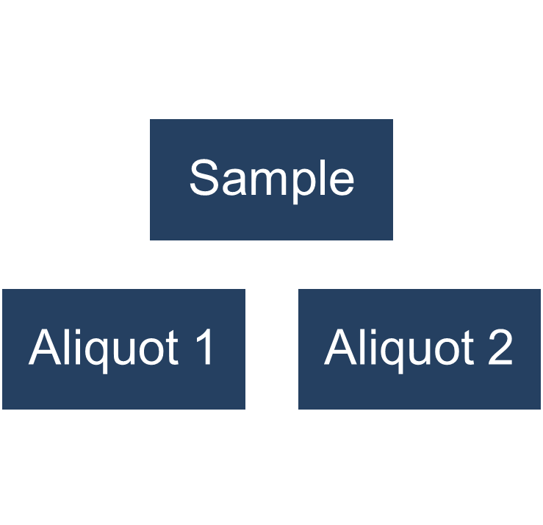
What QC Data Tell the Data Users:
Analytical Duplicate Data
Determines analytical precision.
Preparation and analysis of two separate aliquots of the same sample (different from field duplicates).
Measures the ability of the test to obtain the same result on repeated analysis.
Demonstrates reproducibility of the test method.
Are results from
Aliquot 1 comparable to results from Aliquot 2?

Slide 29
What QC Data Tell the Data Users:
MQLs and Detectability Check Sample Results
Unadjusted MQLs and DCSs must be submitted for all analytes in the calibration curve for each matrix associated with reported data results.
The MQL is a measure of analytical sensitivity.
The DCS is a reagent matrix spike (spiked at 2-3 times the calculated MDL) analyzed to demonstrate the reasonableness of the MDL.
The DCS is spiked with COCs and carried through the sample preparation procedures at least on a quarterly basis during the period program samples are being analyzed.
KEY POINT: The DCS data must clearly demonstrate that the MDL reported for an
analyte can still be achieved by the laboratory.

Slide 30
TRRP-13 Data Usability Review: Data Usability Qualifiers
U Not Detected: Analyte not detected above SDL
J Estimated: Analyte detected above SDL, but concentration is estimated
UJ Not Detected: Analyte not detected above SDL, but the SDL is estimated
NJ TIC: Tentatively identified compound
R Rejected: Data are unusable due to QC problems
KEY POINT: After data review, the data reviewer applies data usability qualifiers
to the data to indicate possible data QC problems.

Slide 31
TRRP -13 Data Usability Review:
Lab Accreditation Data Qualifiers
An X qualifier indicates the lab is not NELAP accredited for this analyte in this matrix analyzed by this method.
X1 The laboratory is an on-site or in-house laboratory, defined in 30 TAC 25, and inspected at least every 3 years.
X2 The laboratory is an on-site or in-house laboratory, defined in 30 TAC 25, is located outside of Texas, and is accredited or periodically inspected by that state.
X7 The Laboratory is not NELAC accredited under the Texas Laboratory Accreditation Program for this analyte, in this matrix, analyzed by this method. The TCEQ does not offer accreditation for this analyte, in this matrix, analyzed by this method.

Slide 32
TRRP-13 Data Usability Review:
Bias Codes
H High: Lab result could be higher than actual value.
L Low: Lab result could be lower than actual value.
KEY POINT: If sufficient QC information is available, the data reviewer adds bias
codes to the data usability qualifiers to give the data user an idea
of the direction of bias (e.g., “JL” for an estimated, biased low result).

Slide 33
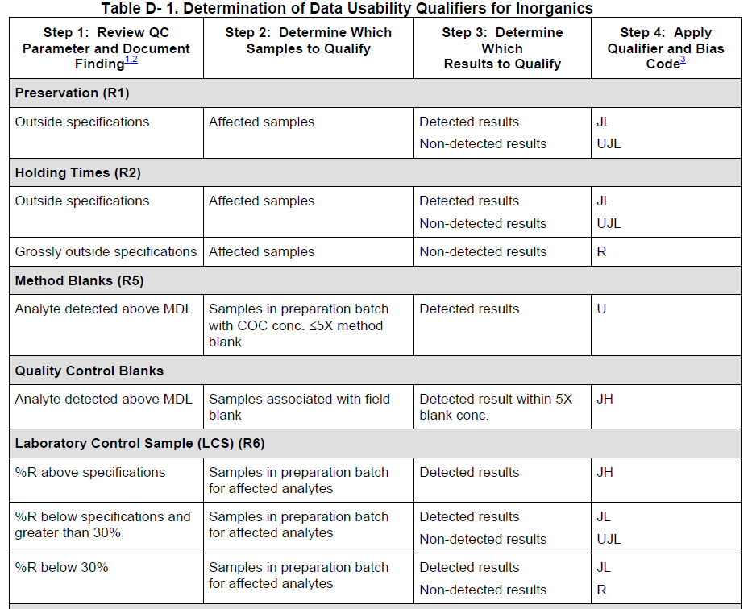
TRRP-13 Data Usability Review:
Assignment of Data Usability Qualifiers
TRRP-13 provides QC acceptance criteria for assigning data usability qualifiers and bias codes.
Table D-1: Inorganic Analyses
70% -130%, but not below 30%; RPD less than 30
Table D-2: Organic Analyses
60% -140%, but not below 10%; RPD less than 40

Slide 34
TRRP-13 Data Usability Review:
Qualifying Project Analytical Data
The data reviewer may use the project MQOs in conjunction with TRRP-13 Tables D-1 (for inorganic analyses) and D-2 (for organic analyses) to assign data usability qualifiers to the project data.
For example, if the data reviewer is qualifying organic analyte sample results based on LCS recoveries using the default TRRP-13 accuracy acceptance criteria of 60-140% recovery and TRRP-13 Table D-2, the QC acceptance criteria would be as follows:

Slide 35
TRRP-13 Data Usability Review:
Qualifying Project Analytical Data – Cont.
LCS Recovery > 140%
60% > LCS Recovery ≥ 10%
LCS Recovery < 10%
Detected Results:
Data are usable
Qualified “JH” or estimated high bias
Non-detected Results:
Data are usable
No qualifications are needed
Detected Results:
Data are usable
Qualified “JL” or estimated low bias
Non-detected Results:
Data are usable
Qualified “UJL” or non-detected estimated low bias
Detected Results:
Data are usable
Qualified “JL” or estimated low bias
Non-detected Results:
Data are not usable
Qualified “R” or rejected

Slide 36
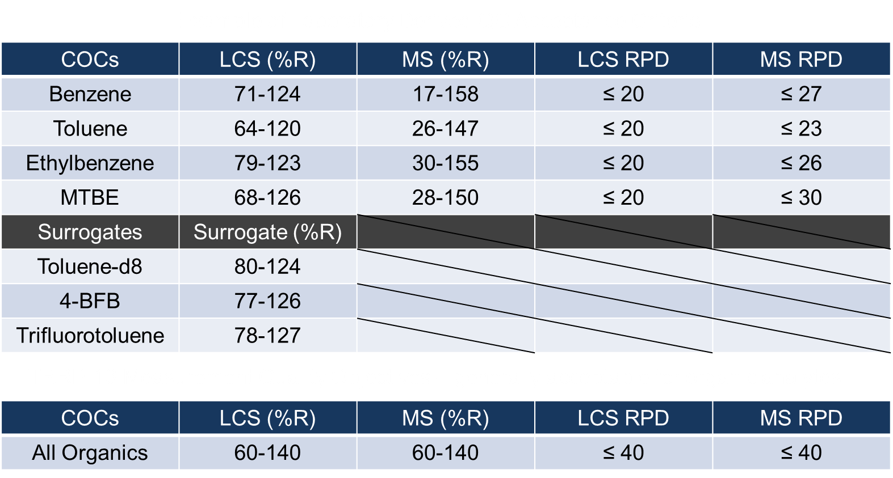
Lab QC Criteria vs. Project-Specific MQOs

Slide 37
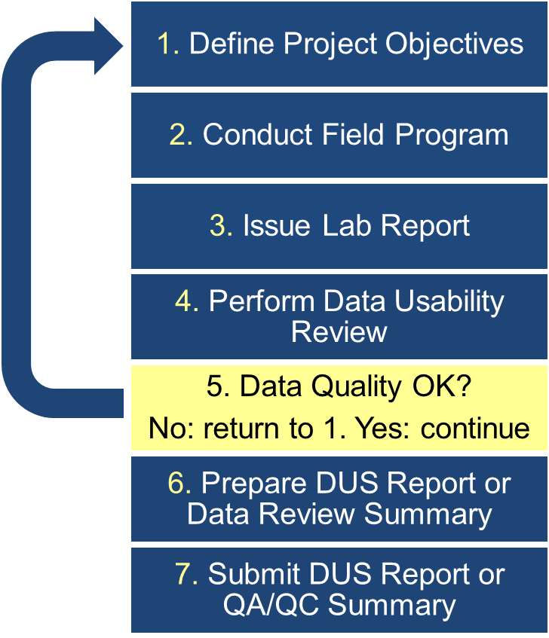
Data Quality Assessment: Process Overview (5)
Do the data meet the project objectives?
Yes: Continue to preparing the DUS Report.
No: Refine the project objectives and collect additional data.

Slide 38
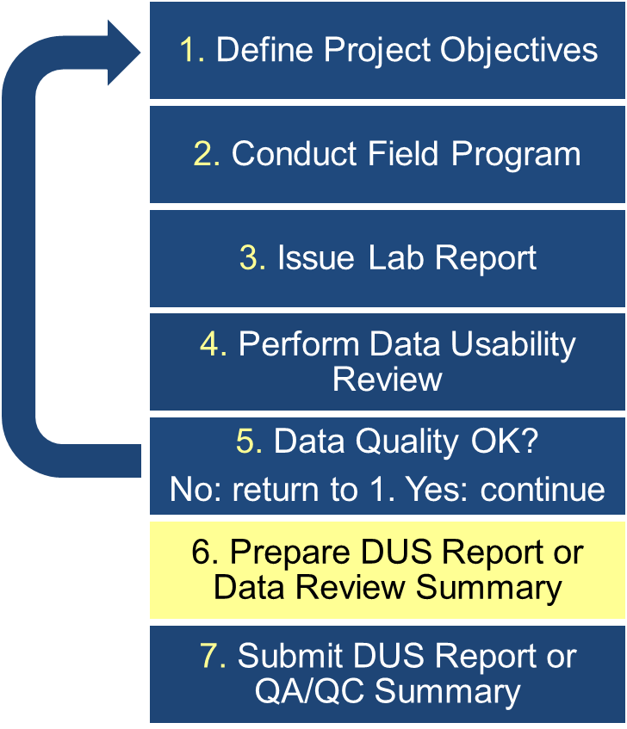
Data Quality Assessment: Process Overview (6)
The Person incorporates data and prepares the DUS report (TRRP) or the QA/QC summary (LPST)

Slide 39
LPST: QA/QC Summary
Data review summary required for all LPST report submittals.
  Documents technical review of the data and LRC.
  Addresses problems with data and corrective actions taken.
  Discusses usability of the data in terms of the program and project objectives.
KEY POINT: Data reviewer is not required to qualify the project data for PST projects.

Slide 40
TRRP: Data Usability Summary
Documents the Person’s technical review of the project data.
Summarizes the person’s findings related to data quality and the justification for using the qualified data.
Allows for an in-depth assessment of data quality.
KEY POINT: The person knows the most about the intended use of the data
collected and is required to identify the intended use in the
DUS.

Slide 41
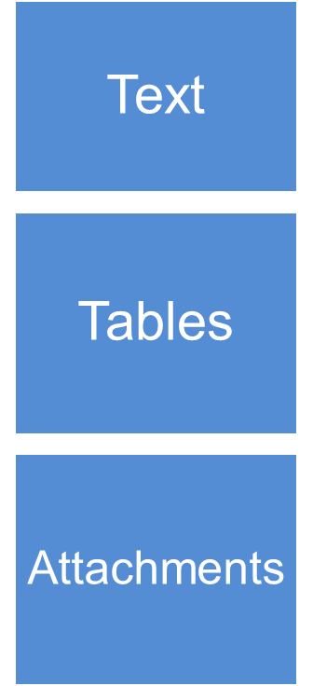
Data Usability Summary: Contents
Intended use of data (e.g., delineation, closure)
Results of field data review
Rationale for assigning data usability qualifiers and bias codes
Conclusions regarding data usability
Lab methods and COCs analyzed
Cross-reference of field and lab sample IDs for each medium sampled
Evaluation of field QC results relative to QC acceptance criteria
Summary of qualified data
Lab data packages containing reportable data and laboratory review checklists
Laboratory NELAP accreditation certificates issued under the Texas Laboratory Accreditation Program applicable to the period during which the project data were generated
KEY POINT: The DUS must include the justification for and the potential
consequence of using qualified data.

Slide 42
Preparing the Data Usability Summary
The data reviewer must clearly state in the Data Usability Summary (DUS):
Whether the laboratory was NELAP accredited under the Texas Laboratory Accreditation Program (TLAP) at the time the data were generated and accredited for the specific:
  Matrices
  Methods
  Analytes
Intended use of the data.
Project MQOs used to qualify the data.

Slide 43
Preparing the Data Usability Summary – Cont. 1
The data reviewer must:
Evaluate and Qualify Project Data by reviewing:
  LRCs.
  Exception reports to the LRCs.
  Reportable data.
  Field Notes.
  Adequacy of the MQLs for the COCs in all media.
  Adequacy of the SDLs for non-detected results.
    Compare to the action levels (e.g. LORPs).

Slide 44
Preparing the Data Usability Summary – Cont. 2
The data reviewer must include:
Table summarizing qualified analytical data.
  Provide reason(s) for the qualification.
Table summarizing and evaluating field QC sample results
  Field Duplicates, MS/MSD, LCS/LCSD, Blanks.
  Use QC acceptance criteria given in Tables D-1 and D-2 of the TRRP-13 guidance (if applicable).

Slide 45
Preparing the Data Usability Summary – Cont. 3
The data reviewer must:
Provide rationale for any professional judgment used.
  Include if the data can be used to the regulatory compliance decisions being made for the project.
Identify:
  rejected data as a result of the data usability review.
  unusable data for meeting project objectives.
Discuss if rejected, unusable, or qualified sample results are considered critical for meeting project objectives.

Slide 46
Example Data Usability Scenario (Ex. 1)
Action level = 0.005 mg/L
Sample result concentration = 0.0035 mg/L (qualified JL)
Sample result 30% below action level
BUT Data Usability Reviewer found:
  Surrogate spike recovery* = 40% *MS or LCS recovery would also apply
  Potential Low Bias (magnitude 60%)
Cannot confidently conclude result is truly below action level
Additional sampling may take place to confirm results.

Slide 47
Example Data Usability Scenario (Ex. 2)
Action level = 0.500 mg/L
Sample result concentration = 0.0035 mg/L (qualified JL)
Result is more than 2 orders of magnitude less than the action level.
BUT Data Usability Reviewer found:
  Surrogate spike recovery* = 40% *MS or LCS recovery would also apply
  Potential Low Bias (magnitude 60%)
Result is definitely below action level.

Slide 48
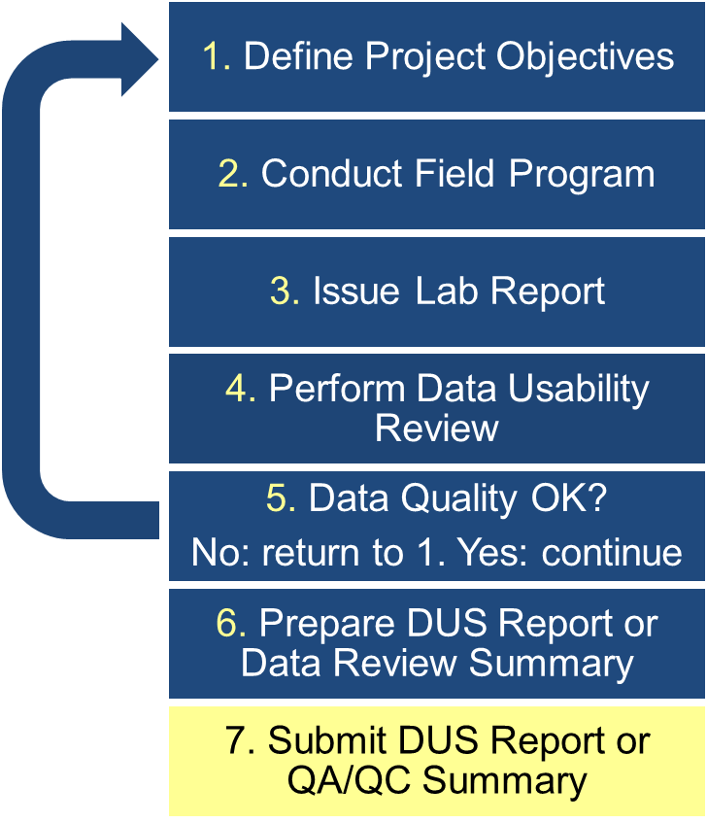
Data Quality Assessment: Process Overview (7)
The Person submits the DUS report or QA/QC summary and TCEQ conducts review.
  APARs
  RACRs,
  RDRs,
  ARFs.

Slide 49

Office of Waste, Remediation Division
Technical Program Support Team
Lead Program QA Specialist/QA Program Coordinator:
Mark Maglitto, 512-239-3153, mark.maglitto@tceq.texas.gov
Project QA Specialists:
Steve Childress, 512-239-2440, steven.childress@tceq.texas.gov
Damian Simonini, 512-239-1878, damian.Simonini@tceq.texas.gov

Slide 50
Questions?

