Slide 1
Are you ready to leverage your meeting content?
Reach more people more effectively!

Slide 2
The Digital Shift
Convenient
Flexible
Free or small fee
Secure
Fast
Mobile
Notes:
Our World has changed…..
Today People expect to access most everything digitally.
And when they do, they expect an Amazon-like experience.
They want to access it at any time of the day or night, on any device
They want to easily and confidently make purchases they can count on.
And they want it all served up quickly –not just because it will help them but the dreaded FOMO disease- Fear of Missing Out.

Slide 3
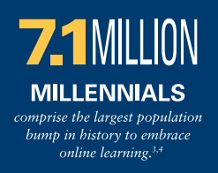
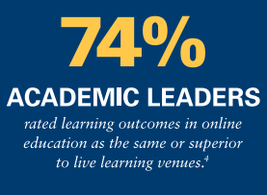
Digital Learning & Disruptive Innovation
Organizations have two options:
Get serious about eLearning to grow membership, revenue, and reputation
Or be extremely cautious and tentative like the music, publishing, and taxi industries, and find yourself left behind as your customers move on.
*Scitent – Turning eLearning Disruption to Your Advantage
Notes:
This digital shift is definitely evident in the event and learning industry.
Our traditional learning system is being disrupted. (Graduating with Large debts and coming out without applicable job skills are prevelent. And With fast-paced changes in industry, frequent job changes, and people living longer, People are essentially facing “the other fifty years” once they exit our formal educational systems (whether that is high school, college or grad school. Thus, life-long learning, professional development and continuing education is not a “nice to have” but rather a “must have”.
The Tagoras Learning Business manifesto states that lifelong learning is the imperative of our age and those who lead learning in their fields will lead their fields.
Those who capitalize on this disruption and deliver high quality education that is accessible, timely, and on target to their respective industries, and also partner with the right technology and services, will be the ones who come out on top and be seen as the “GoTo” resource.
Across generations and industries, the data shows Professional Development as the biggest driver of engagement and value received.
The bottom line, is if these organizations are not the ones effectively delivering learning online to their core audience,- the learners will find it elsewhere.

Slide 4
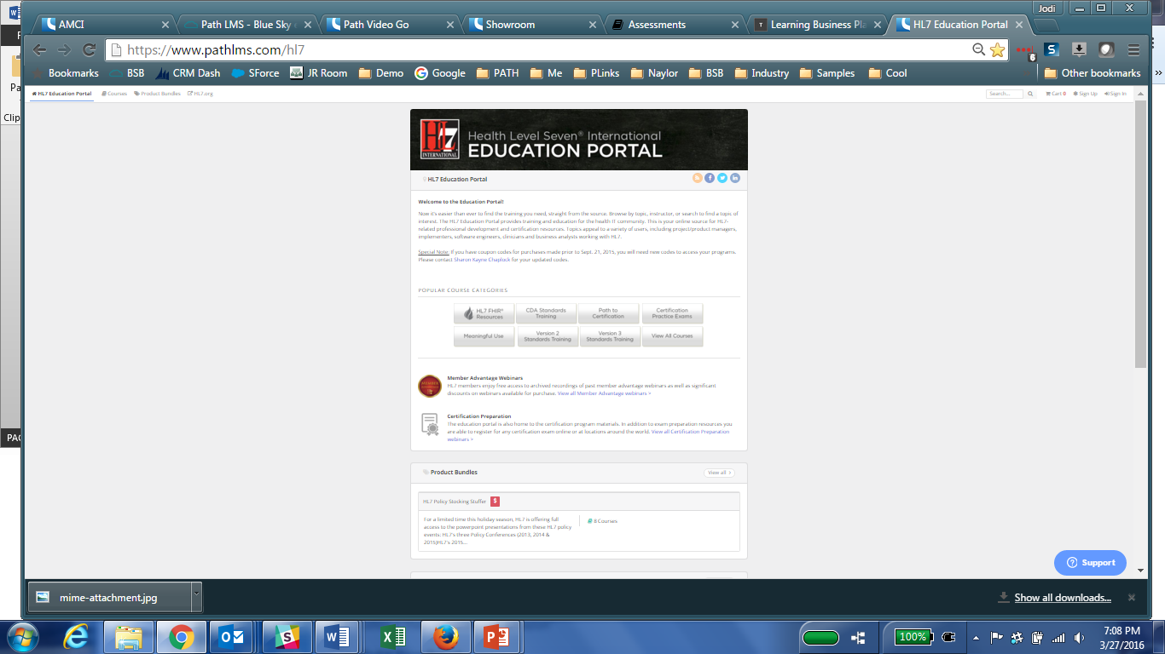
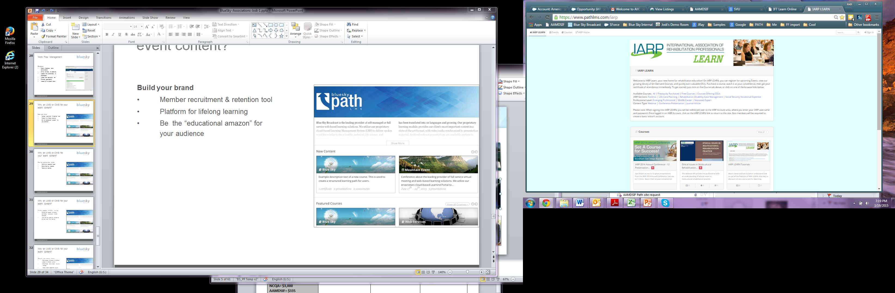
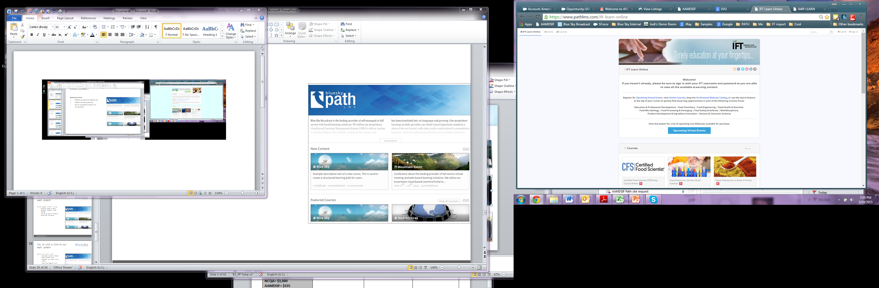
Be your industries “Educational Amazon”
Build your brand
Provide engaging learning
Increase Revenue
Notes:
Our mission is to help you become your industries “Educational Amazon”!
We set you up with your own branded site that you will be able to easily manage in numerous ways.
For most of our clients, their Path site becomes the hub of their organizations education and event content based on their initiatives for increasing revenue, increasing the reach of their audience and growing relevance in their industry. They become that trusted go-to source for relevant content.
We call this platform Path- so when I reference Path, just know that this is our brand name, but it is YOUR site to be branded and called as you wish- some examples include “Education Station”, XYZ University or Learning Center, Virtual Campus, Technical Learning Library.

Slide 5

Extends the life of your event
Grow your membership and retain members by providing ongoing value after the conference concludes
Increase your non-dues revenue by selling on-demand content to those who could not attend
Create brand recognition and uphold your reputation of an educational leader in your industry

Slide 6
How?

Slide 7

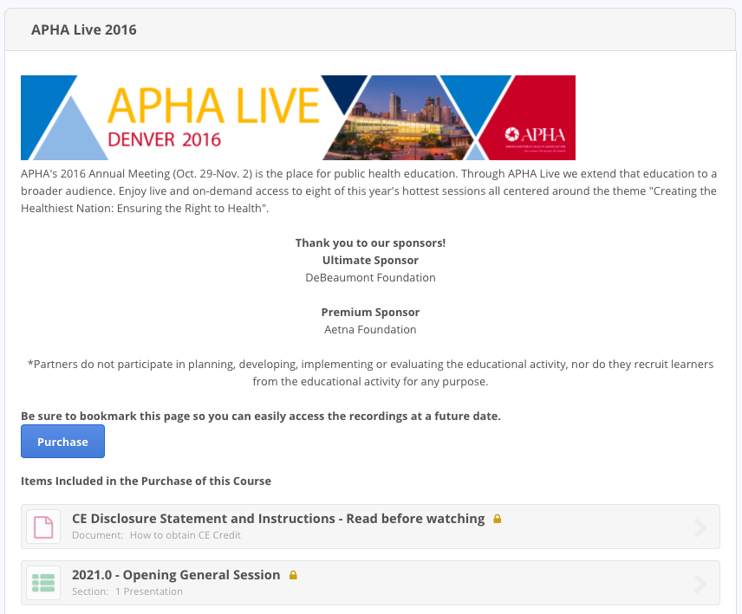
Monetize Content
Notes:
Path includes a very Robust eCommerce engine. We hook up with your existing merchant account (PayPal, Authorize.net, Stripe…) All the money goes direct into your account, we don’t touch it and it’s all PCI compliant.
For the end-user it’s a 1 click process to make a purchase.

Slide 8
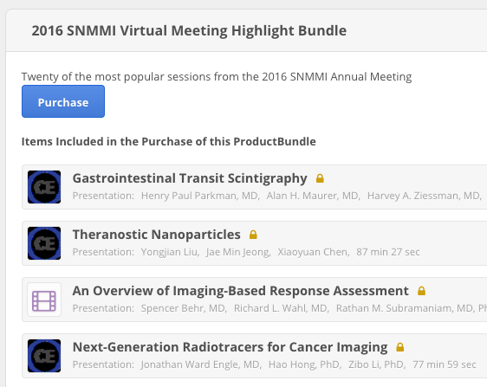
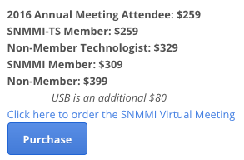
Monetize Content
Group Pricing
  Member/Nonmember
  Gold Member
Notes:
And your staff can think creatively about how to sell content effectively and give your users options- perhaps sell an entire event or perhaps individual presentations.

Slide 9
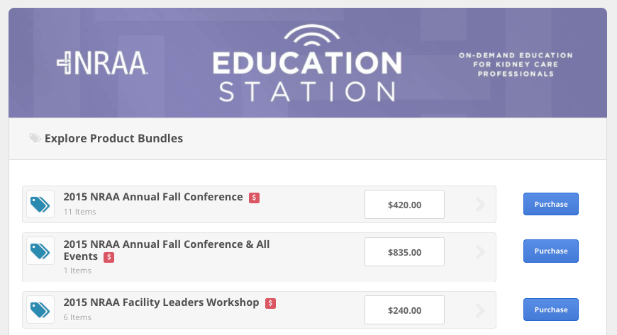
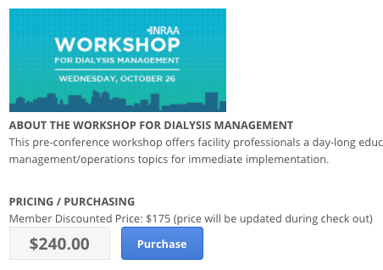
Monetize Content
Product Bundles
  Multi-year
  “Top 5”
  Additional relevant
Notes:
Or bundle together the top 5 presentations. You can even expire the content after a certain number of days or on a certain day. You can create coupon codes (dollar or percentage off) or even issue Credits. And then staff can pull reports on all ecommerce 24/7

Slide 10
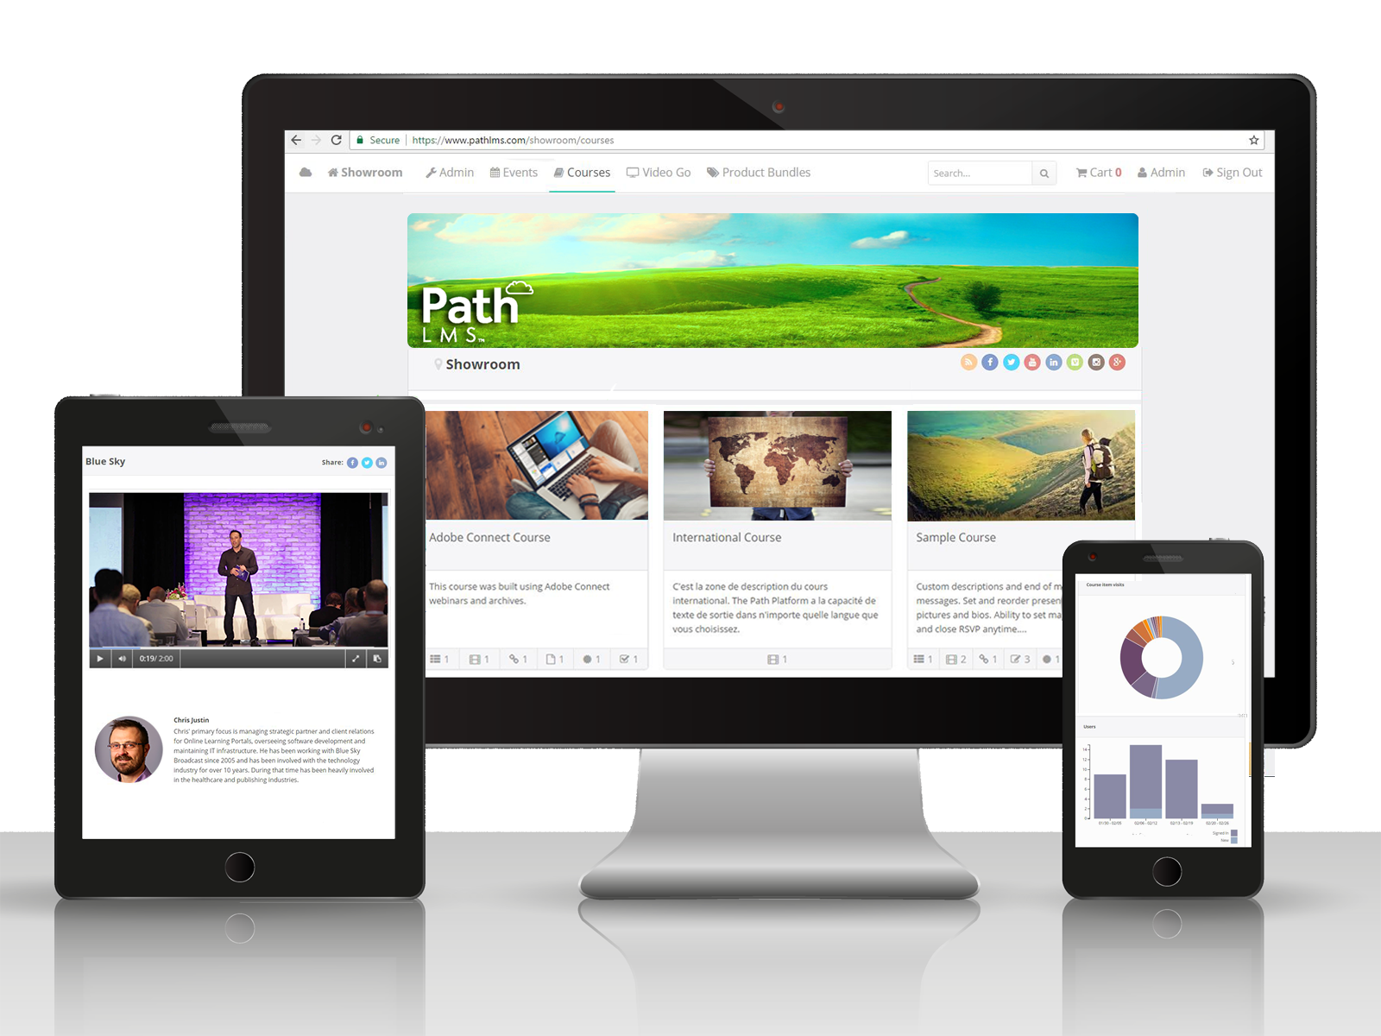
Mobile Viewing
Your audience will be able to access Path no matter where they are or what device they’re on

Slide 11
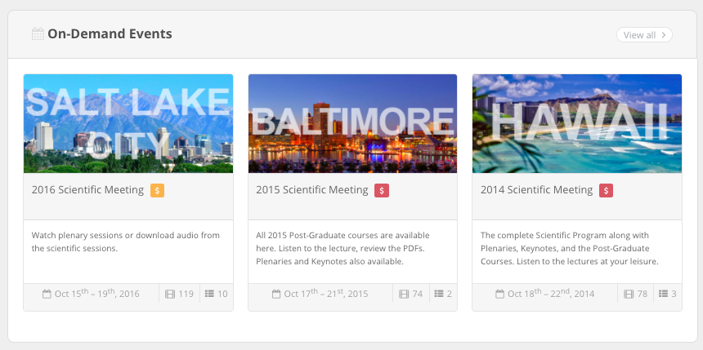
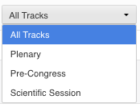

Make Your Content Easy to Find and Access
Categorize content by year
Organize presentations by day and track
Search across all content (title, descriptions, presenters and key words)

Slide 12
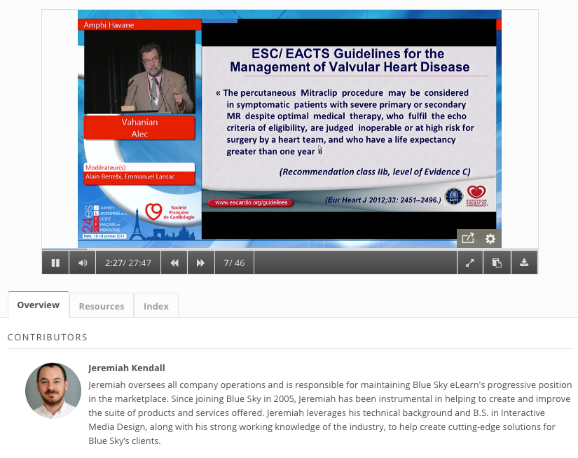
Presentation Player
Easy play, pause, fast forward and rewind functionality
Volume control within the player
Provide your audience the ability to download the presentation or restrict their ability to fast forward
Go full screen, mouse over for thumbnails, take and download notes
Add additional resources, contributor headshots and bios, and slide indexes

Slide 13
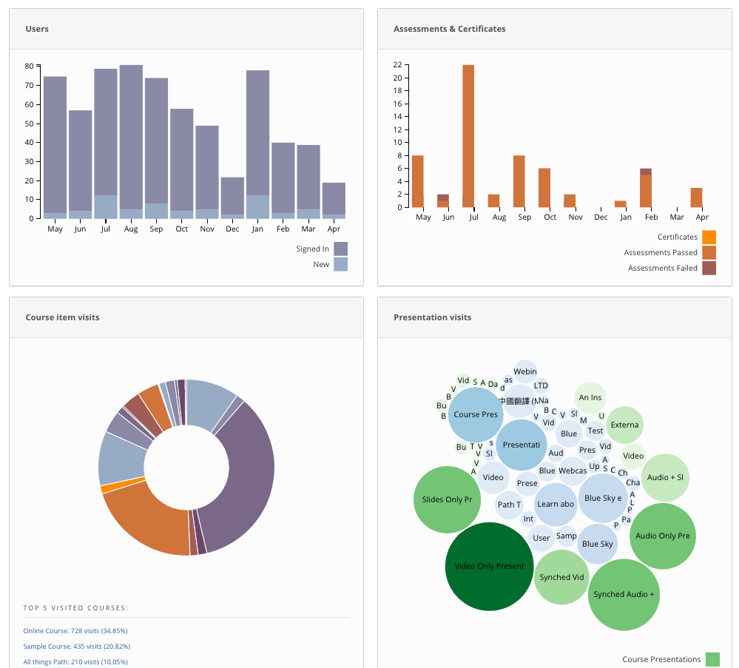
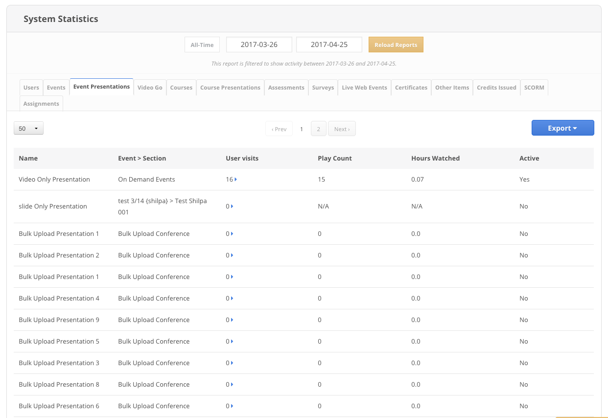
Track and Report
Notes:
Not only will you have access to the eCommerce reports, but a dashboard view and detailed reports all filterable and exportable to CSV and then manipulate if you want further in Excel. You can prove ROI and learn where improvements could be made.

Slide 14
Client Success

Slide 15

Client Success
Client & Goal
ACOG – Revenue Generation
Solution
Sold content to attendees via the OnlineEvent Platform, bundling the online product with onsite registration
Result
ACOG earned $120K in revenue for their 2016 event

Slide 16
Why now?
Pricing and next steps

Slide 17
Why now?
The platform has been setup for you – a savings of over $3,000!
30-day free trial after your event – zero risk!
Easily add e-commerce, additional content, access controls, and more!

Slide 18

Pricing
$3,500 set up fee – WAIVED!
$195 per month, annual contract

Slide 19

Would you be interested in MORE?
Create Learning Content
Easy course authoring tools
Order & set pre-requisites
Tests (timed, passing scores, retakes, question pools)
Assign Credits; Issue Certificates
Supports SCORM, AICC & Tin Can
Presentations as video, slides, audio, 3rd Party
Path LMS
Notes:
Your Path site can be upgraded at any time to take advantage of our award-winning full-featured Learning Management System

Slide 20
Jodi Ray
Channel Manager
Direct: 858-900-2258| jray@blueskyelearn.com

Slide 21
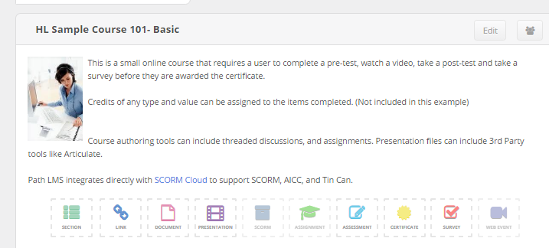
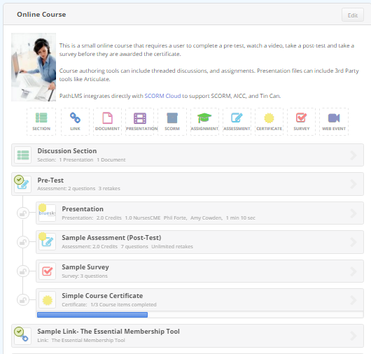
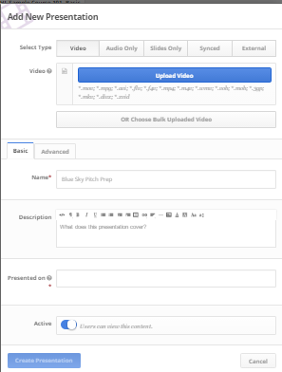

Create Content
Easy course authoring tools
Order & set pre-requisites
Tests (timed, passing scores, retakes, question pools)
Assign Credits; Issue Certificates
Supports SCORM, AICC & Tin Can
Presentations as video, slides, audio, 3rd Party
Notes:
And the administrators will easily be able to create a course, using friendly tools already built into Path, This includes, presentations, tests, surveys, CEUs, Certificates, documents…

