Slide 1
TOWN HALLS: NEW OBSTETRIC CODES
ACOG COMMITTEE ON HEALTH ECONOMICS & CODING
ACOG HEALTH & PAYMENT POLICY TEAM
June 2026

Slide 2
DISCLAIMER
This session and the information presented is designed as an educational resource to aid clinicians when providing obstetric and gynecologic care and for information purposes only. The use of this information is voluntary, and clinicians should be familiar with and comply with all applicable laws and regulations. This information is not intended to be used as a substitute for your independent judgment, is not medical advice and should not be considered as inclusive of all proper treatments or methods of care or as a statement of the standard of care. The information provided reflects the views of the presenters and not necessarily the views of the ACSM or ACOG, and is provided “as is” without any warranty of accuracy, reliability or otherwise, either express or implied. ACOG Foundation, the American College of Obstetricians and Gynecologists, and their officers, directors, members, employees, and agents, will not be liable for any loss, damage, or claim with respect to any liabilities, including direct, special, indirect, or consequential damages, incurred in connection with this session or the information presented.

Slide 3
Part 2: Labor and Delivery
June 16, 2026

Slide 4
Failings of the Obstetric Global Code
OB global inconsistencies with ACOG clinical guidance
Work performed that was not accounted for with, nor separately billable from, the OB global codes
The one-provider assumption: all the work in the entire antepartum period, labor, delivery, and postpartum period
Limited data available to assist in calculating risk adjustment for alternative payment models or maternal/birth outcomes
Complex pregnancies are paid the same rate as an uncomplicated pregnancy
Inconsistent application of cost sharing by health plans using the OB global codes
Transfers of care during labor/delivery result in lost funds
Placenta accreta and/or hysterectomy after cesarean is not billable by another surgeon
Multiple postpartum visits are often not paid
Multiple surveys and messages from ACOG members requested that the OB global codes “go away.” The CHEC and ACOG acknowledged the needs of the members and responded.
Notes:
As a quick reminder, ACOG studied the issues with the OB globals and surveyed the membership prior to determining an unbundled code set was in the best interest of the profession and the patients served.

Slide 5
New Codes Starting January 1, 2027
Antepartum Care
E/M for every visit
Labor Management
Reported daily
Initial or Subsequent; Straightforward or Complex
Delivery
Vaginal or VBAC
Postpartum Care
E/M for inpatient and outpatient
Hysterectomy; 3rd/4th repair; Uterine tamponade
Primary or Repeat Cesarean
Notes:
The new codes – which you will be hearing today – go into effect January 1, 2027.

Slide 6
Codes Deleted as of January 1, 2027
Global Codes
Routine obstetric care including antepartum care, delivery, and postpartum care
Delivery + Postpartum
Delivery only, including postpartum care
Delivery-Only
Delivery only
Other Deletions
Antepartum care only (4-6 visits, 7+ visits)
Postpartum care only
Notes:
Similarly, the current OB global codes will be deleted effective January 1, 2027.

Slide 7
LABOR MANAGEMENT CODES
Notes:
So let’s start by looking at the new labor management codes and delivery codes.

Slide 8
Labor Management Requirements
 | Initial | Subsequent
Straightforward | 59080 | 59082
Complex | 59081 | 59083
Requires face-to-face services
Includes interim physical examinations, collection/interpretation of physiologic data, and induction/augmentation of labor
Typically, one Labor Management code is reported per day
Notes:
Labor management will be billed with one code per calendar day depending on if it is the initial day of labor, subsequent day, and depending on whether the labor is straightforward or complex. One code is reported per day including for multiple gestations, regardless of the number of fetuses.
Labor management requires face-to-face services, onsite. It includes the physician examinations, collection and interpretation of all data and the induction or augmentation of labor.

Slide 9
Initial Day Labor Management
 | Initial
Straightforward | 59080
Complex | 59081
The first calendar date that labor management / induction begins
Facility transfers: Each facility may report initial day labor management if performed at both facilities
Escalation of care: Each specialty/subspecialty may report initial day labor management if care transfer occurs for higher-level care (not coverage)
Notes:
Read slide. Any date that is not Initial is Subsequent

Slide 10
Straightforward and Complex Labor Management
Straightforward
Complex
Singleton vertex presentation
Routine maternal/fetal monitoring
Fetal monitoring (eg, heart rate) not requiring physician or other QHP intervention
Normal progression of labor, or routine labor induction or augmentation
Stable medical conditions (eg, well-controlled hypertension, diet-controlled diabetes) not requiring additional management during labor
No previous cesarean delivery
Any Labor Management that does not meet all the Straightforward criteria
Notes:
Read slide

Slide 11
DELIVERY CARE
Notes:
The delivery codes will look familiar, but they are new codes.

Slide 12
Delivery
Vaginal
59431
VBAC
59432
Primary Cesarean
59502
Repeat Cesarean
59503
Delivery begins when labor is
Complete: Presenting part of the fetus is visible and firmly rimmed by the vaginal introitus (for vaginal deliveries)
Interrupted: Decision is made for cesarean delivery (after labor)
Avoided: When a cesarean delivery has been scheduled
Notes:
Read slide

Slide 13
Vaginal Delivery Codes
Code | Description
59431 | Vaginal delivery, with or without episiotomy
59432 | Vaginal delivery, with or without episiotomy; after previous cesarean delivery
Vaginal delivery services include the delivery of the placenta and the work of repairing a first- or second-degree episiotomy or laceration.
If a vaginal delivery is attempted but results in a cesarean delivery, report the appropriate cesarean delivery code only.
For vaginal delivery of multiple gestations, report one vaginal delivery code per fetus delivered vaginally.
Notes:
Read slide

Slide 14
Cesarean Delivery Codes
Code | Description
59502 | Cesarean delivery; primary
59503 | Cesarean delivery; repeat
A primary cesarean delivery is reported for a patient who has not previously had a cesarean.
A repeat cesarean delivery is reported for a patient who has previously had a cesarean delivery, including one who undergoes labor management (TOLAC) resulting in repeat cesarean delivery.
For cesarean delivery of multiple gestations, report only one cesarean delivery code.
Notes:
Read slide

Slide 15
Other New Delivery and Postpartum Codes
Code | Description
59433 | Repair of episiotomy or laceration; third-degree laceration
59434 | Repair of episiotomy or laceration; fourth-degree laceration
59504 | Subtotal or total hysterectomy after cesarean delivery
59623 | Uterine tamponade (eg, balloon, catheter, vacuum, packing material)
A hysterectomy after cesarean may be reported by the same or different physician performing the cesarean delivery.
Do not use 59623 for pharmacologic management of hemorrhage.
Notes:
There are other codes new to delivery and postpartum that will be discussed at the Town Hall on June 30. With that, let’s go to our experts for questions!

Slide 16
RESOURCES

Slide 17
RESOURCES
ACOG.org Payment for Obstetric Services
Courses at every ADM www.acog.org/education-and-events/annual-district-meetings
Course in Las Vegas Sept 3 – info to come!
Course in New Orleans Nov 7 www.acog.org/education-and-events/meetings/payment-in-practice-in-person
Future podcast episodes www.acog.org/practice-management/coding/coding-library/payment-in-practice-podcast
New Clinical Coding on Demand anticipated Nov 2026
AMA-assn.org CPT Maternity Care Services Codes and Guidelines | AMA

Slide 18



Explore more ACOG resources to stay ahead of the changes to 2027 obstetric codes.
acog.org/obcodes
Payment in Practice—In Person!
.
New Orleans, Louisiana | November 7
.
Join us in for more details on the new obstetric codes,
and other new coding and billing policies for the year.

Slide 19

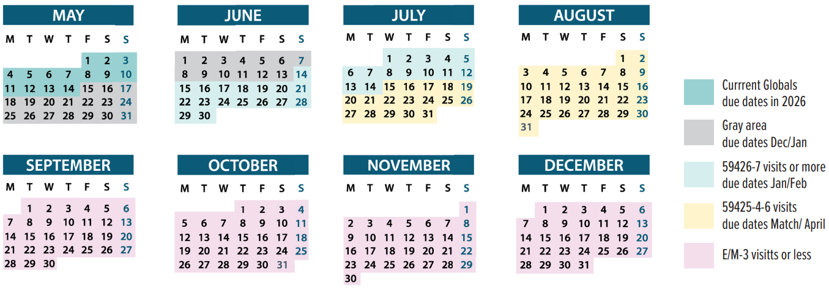
Consider Switchover by September 1, 2026
Notes:
QR code links to toolkit OBGYNs can use for talking with payers who use globals – this is what you will see when you open the toolkit
For payers who use globals, you will have two batches of patients – those using global codes and those in the new coding system

Slide 20
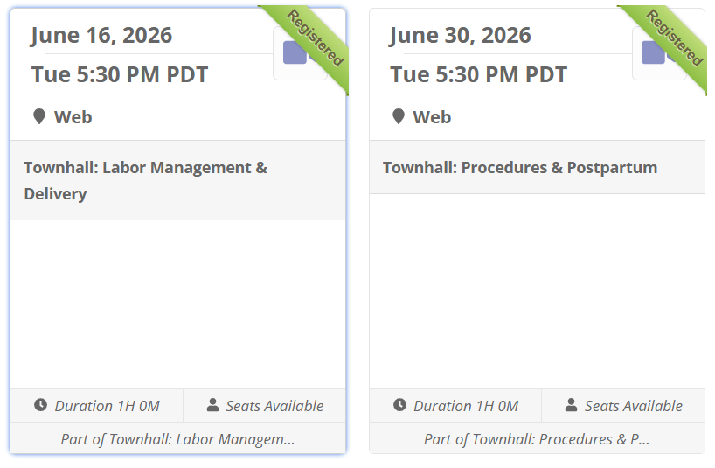

www.acog.org/education-and-events/webinars/new-ob-codes-virtual-town-hall-series

Slide 21

SUBMIT YOUR CODING QUESTIONS
THANK YOU!

