Slide 1


Welcome/Opening Activity
Leadership Word Cloud
As leaders, we each face unique challenges that shape our growth and decisions. In this activity, you’ll contribute to a collective Leadership Word Cloud by sharing a single word that captures the biggest challenge you face as a leader.
To participate:
Click the link in chat or Scan the QR Code
Enter your word.
Watch the cloud grow.

Slide 2

Notes:
Flow of Presentation:
Success Criteria and Anticipation Guide
Our Why
About NLL
Standards
Learning Strands
Six Components
Who can be a part…
How do I register/apply....I think we need an explicit slide just for this.
Anticipation Guide

Slide 3

Success Criteria
By the end of this session, you will be able to:
define collective teacher efficacy and provide examples and non-examples
name and describe 1-2 enemies of efficacy.
identify specific leadership practices to overcome an enemy of efficacy.
identify how AI can be used to overcome enemies of efficacy.
Notes:
kim

Slide 4
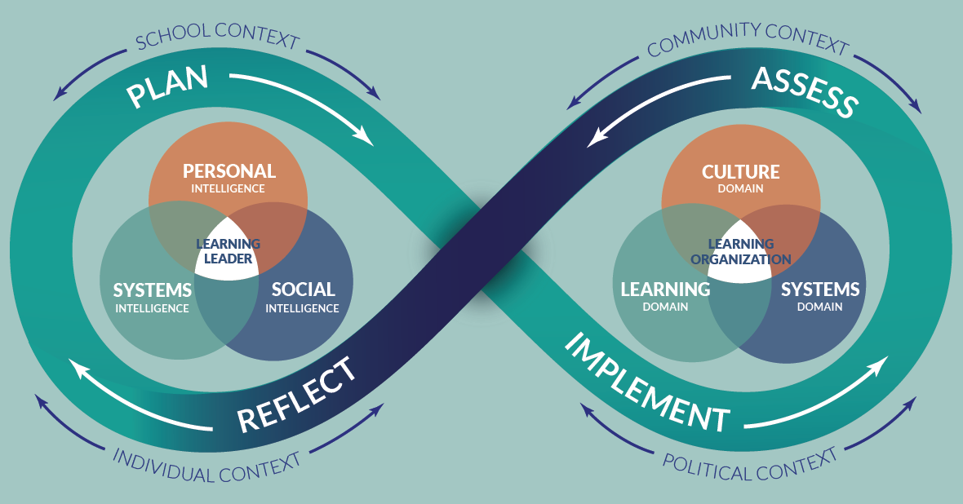
School Leader Paradigm©

Slide 5
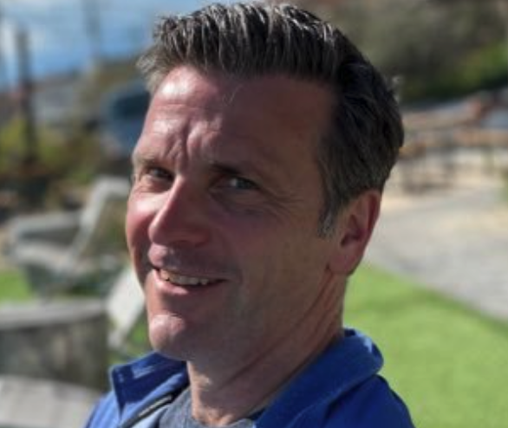
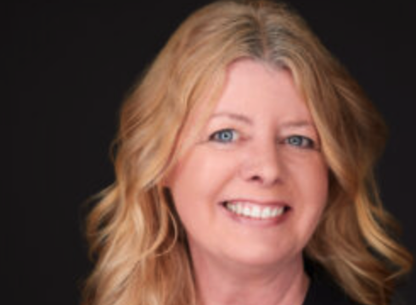
About Us- Our Advisors
Peter DeWitt
Next Level Leaders Advisor, Facilitator and Evaluator
pmdewitt518@gmail.com
Jenni Donohoo
Next Level Leaders Advisor, Facilitator and Evaluator
jenni.donohoo@praxis-engage.com

Slide 6
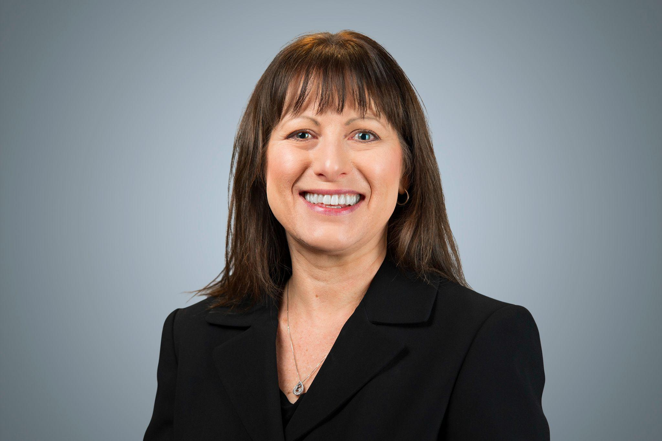
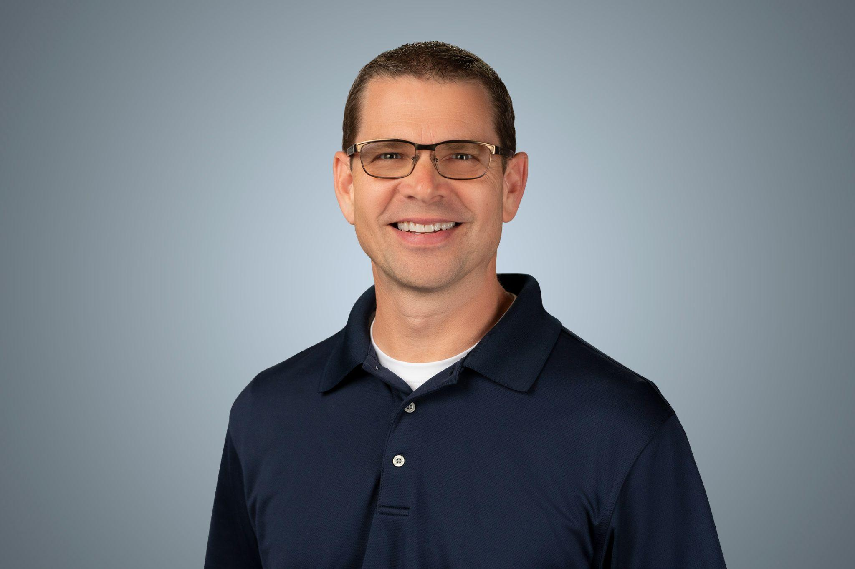
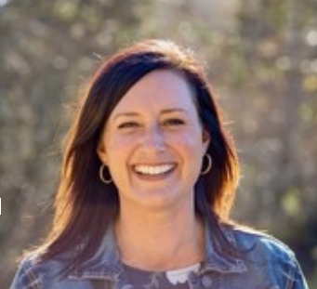
About Us- NLL Planning Team
Kim Fry
Assistant Executive Director, WASA
Shawn Batstone
Assistant Executive Director, WASA
Gina Yonts
Associate Director, AWSP

Slide 7


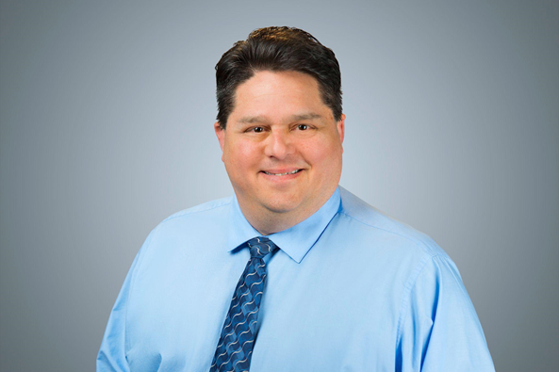
Advocate Role- we are here to help!
Ashley Barker
Monica Chandler
NLL Advocate
Paul Harvey
NLL Advocate
Office Hours- Monday at 4PM!

Slide 8

“
Collective teacher efficacy is the belief that teachers in a given school make an educational difference to their students over and above the educational impact of their homes and communities.
Tschannen-Moran, M., & Barr, M. (2004). Fostering student learning: The relationship of collective teacher efficacy
and student achievement. Leadership and Policy in Schools, 3(3), 189-209.

Slide 9
Collective teacher efficacy refers to the beliefs of teachers in a school that they can organize and execute the course of action required to have a positive effect on students.
Goddard, R., Hoy, W., & Woolfolk Hoy, A. (2004). Collective efficacy beliefs: Theoretical developments, empirical evidence, and future directions. American Educational Research Association, 33(3), 3-13.

Slide 10
Collective efficacy refers to a shared belief that the school's staff can have a positive impact on student achievement – despite other influences in the students' lives that
challenge their success.
Victoria State Government: Education and Training.
https://www.education.vic.gov.au/school/teachers/teachingresources/discipline/english/Pages/developingcollective-efficacy.aspx

Slide 11
Efficacy beliefs reveal themselves in different ways:
•Everyday conversations (in which teams attribute causes for success/failure).
•Behavior (e.g., tasks assigned to students).
•Verbal and Non-Verbal Messages (e.g., sending messages to students that they are capable).
•Motivations (e.g., goals individuals and teams set).

Slide 12

In Your Breakout Room
What role does collective teacher efficacy play in your current environment?

Slide 13
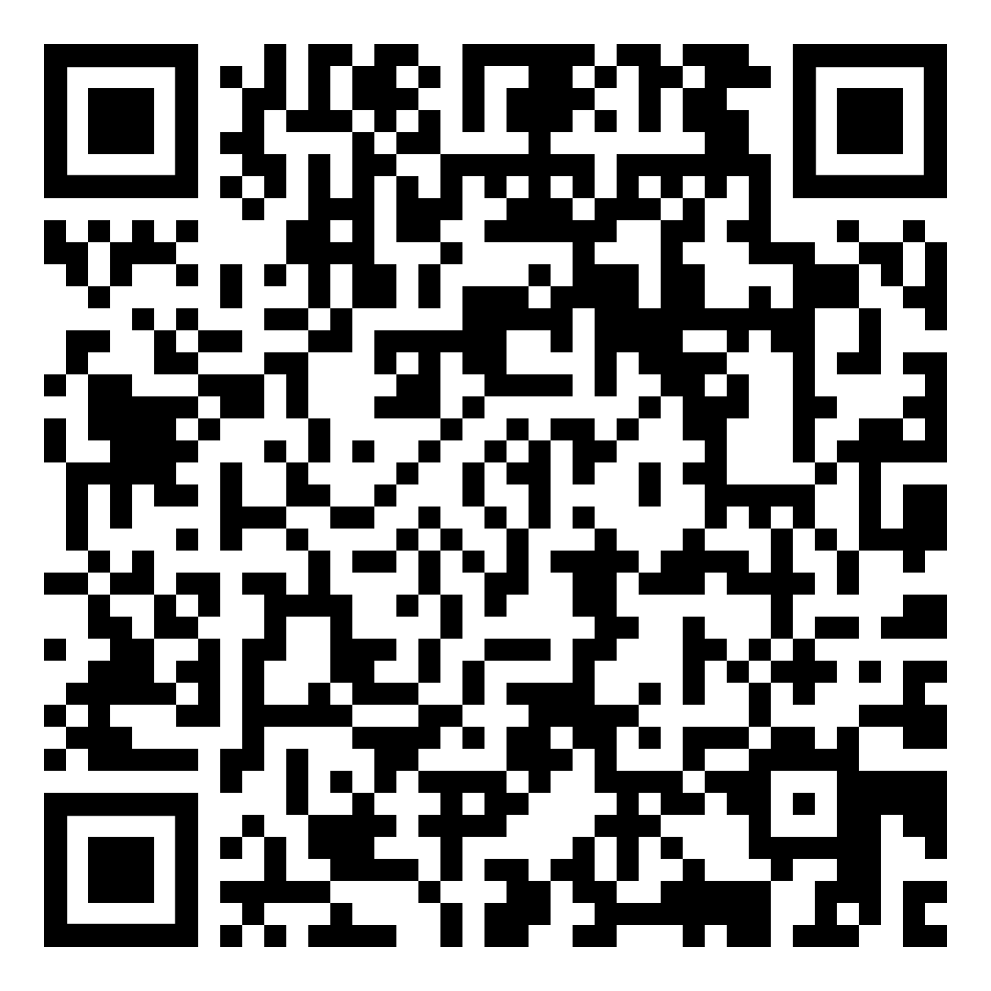

Definition
Why is it Important?
Collective Teacher Efficacy
Example
Non-Example
Concept Attainment: Frayer Diagram

Slide 14
In Your Breakout Room
What role does collective teacher efficacy play in your current environment?
Complete the Frayer Diagram

Slide 15
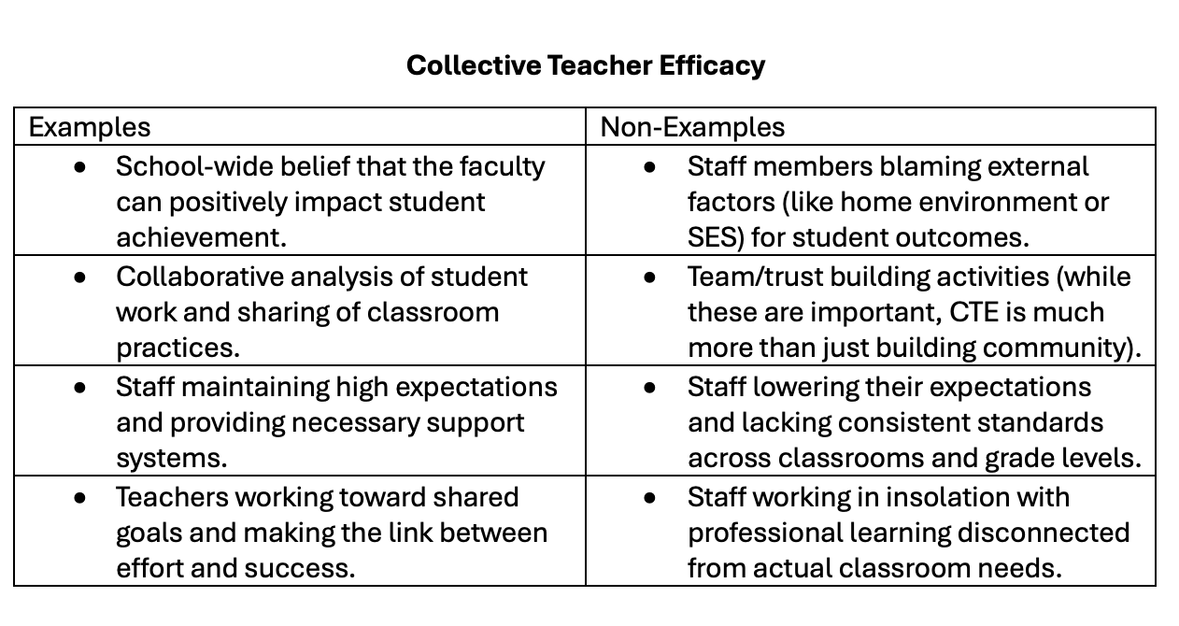

Slide 16
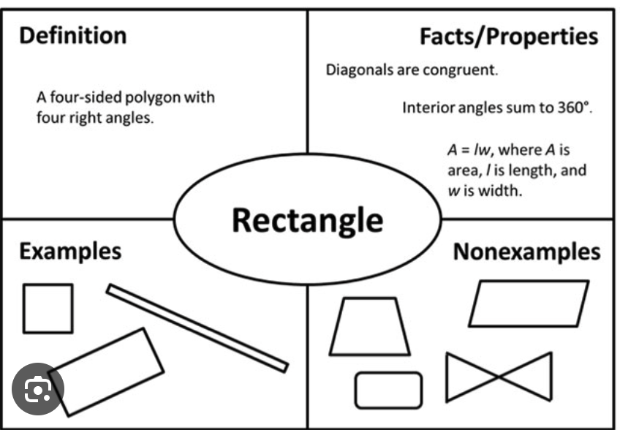
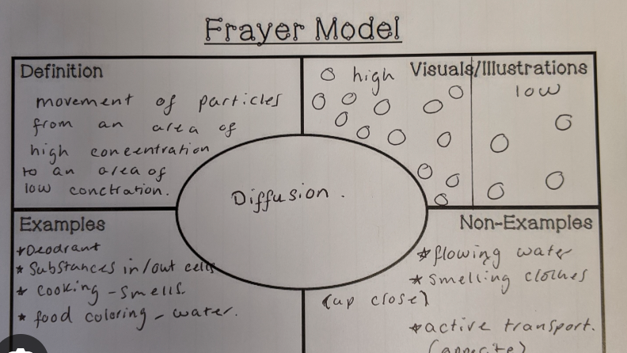
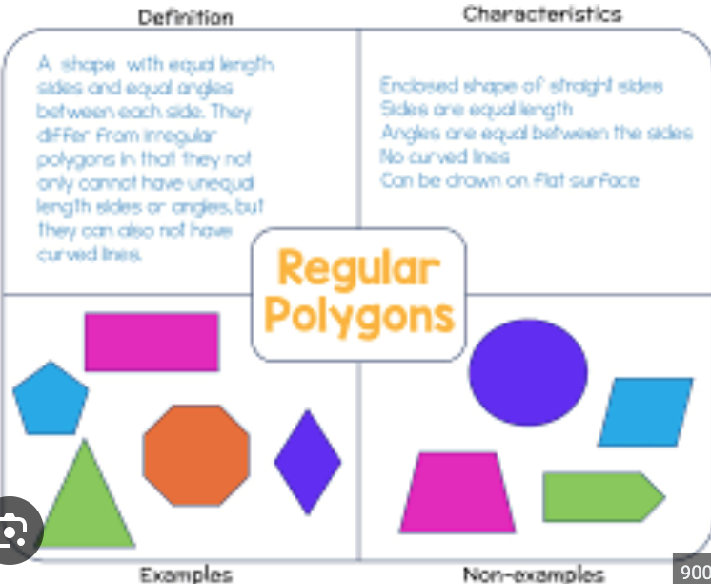
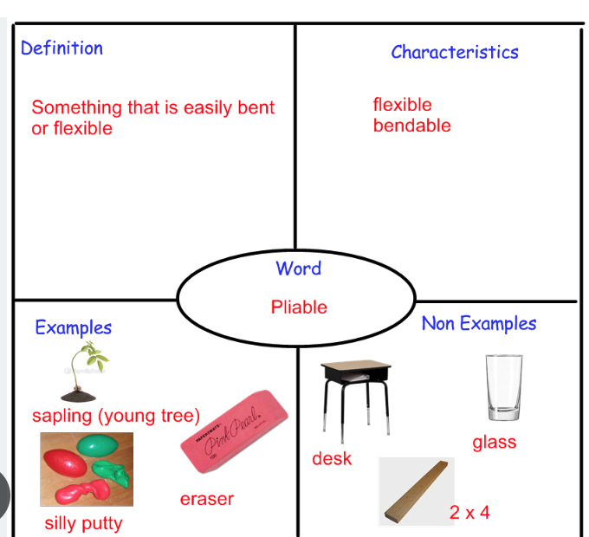
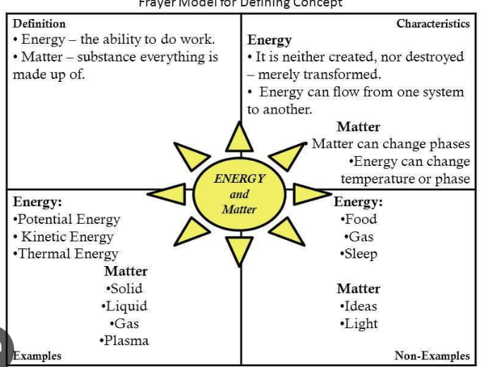

Slide 17
Enemies of Efficacy
What are some things that might pose a direct threat to individual and collective efficacy?
What are things that ‘do damage’ or actively oppose the development of efficacy?
In other words, what might be some ‘enemies’ of efficacy?

Slide 18
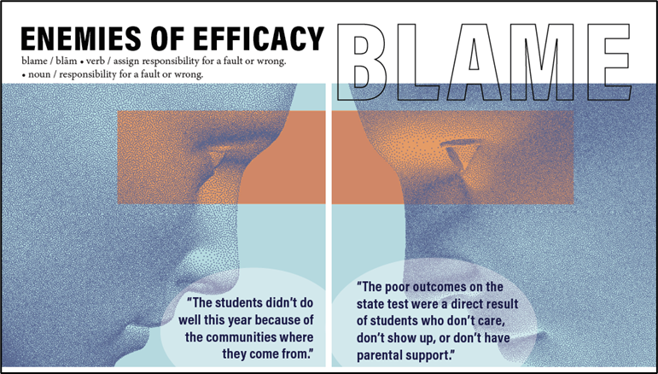
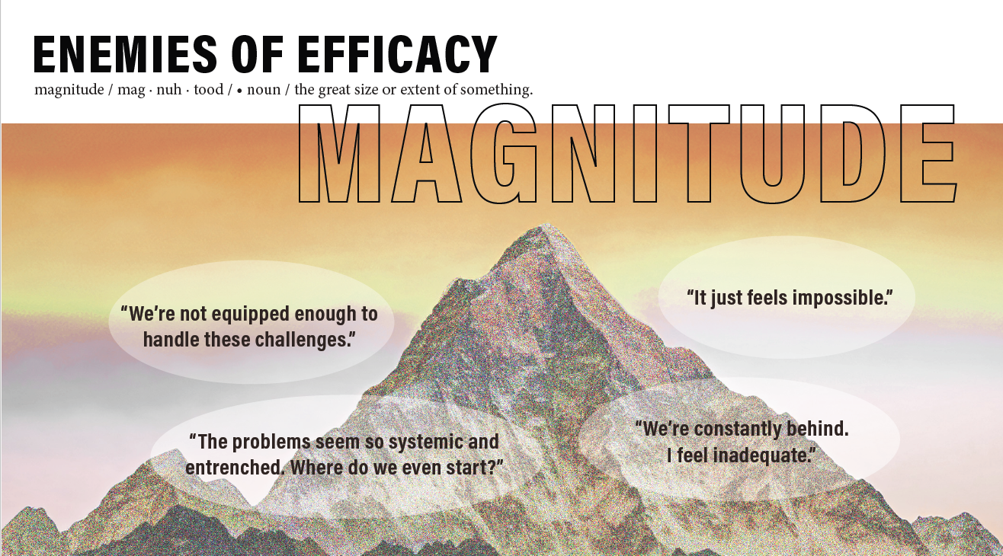
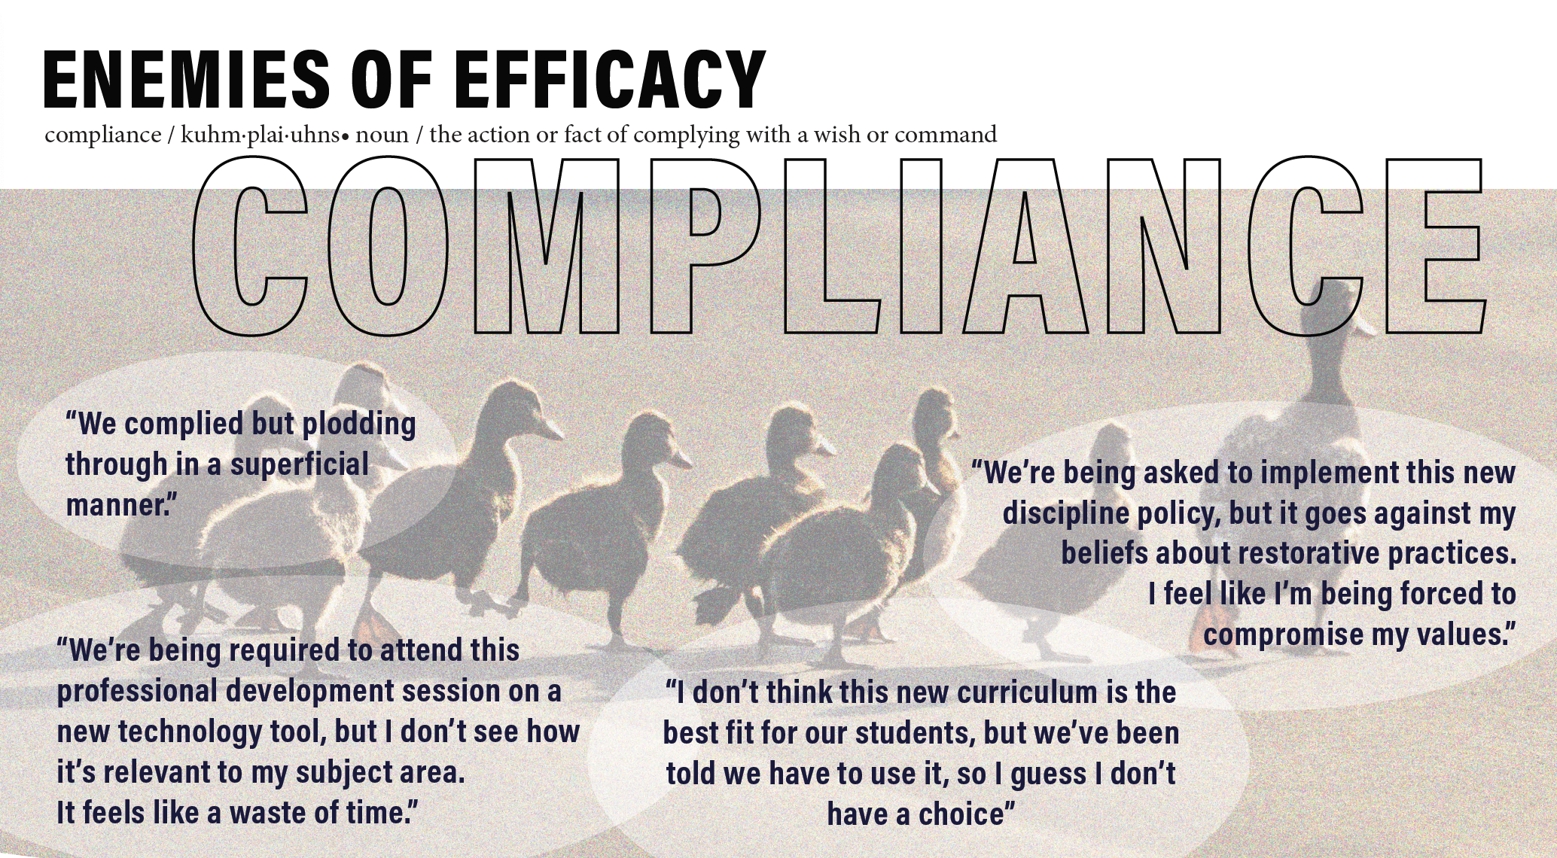
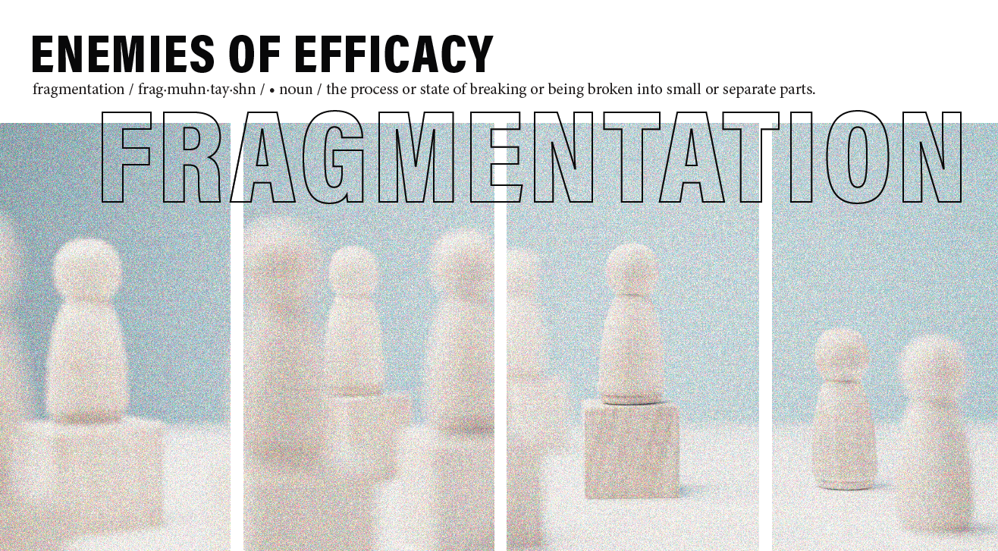
1.
2.
3.
4.
Which one resonates with you the most?

Slide 19
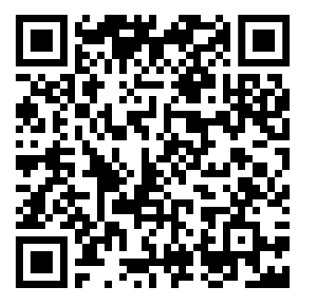
Which one do you want to learn more about?
You selected one of the enemies of efficacy.
I= Interesting
C= Connections
Q= Questions
https://tinyurl.com/32rwutyu

Slide 20
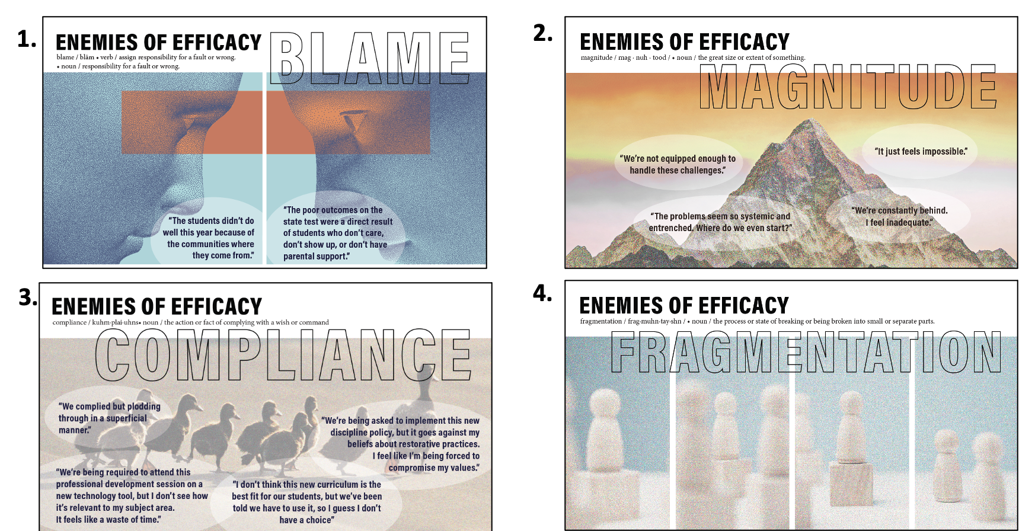
You read the ‘Strategies for Overcoming Enemies of Efficacy’.
You discussed how you might put these strategies into practice.

Slide 21
An Additional Enemy of Efficacy: Ambiguity

Slide 22
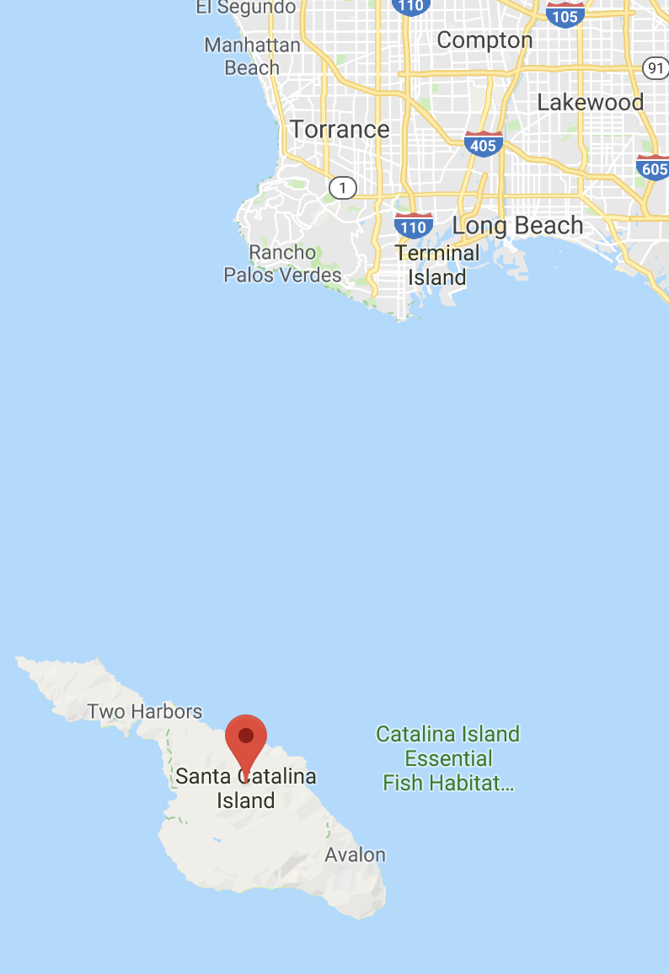

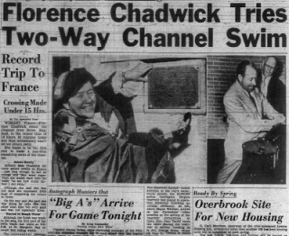
Finish
21 miles of open ocean
Ice-cold, shark infested
choppy water
QUIT HERE
Start
Tommy Thompson & Jenni Donohoo – Presentation at the Annual Visible Learning Conference, Las Vegas

Slide 23

“
All I could see was fog. I think had I seen the shore, I would have made it.”
Florence Chadwick, 1952

Slide 24
AMBIGUITY
Student Engagement
Differentiation
Personal Experiences
School/Home
Connections/Communication
School Improvement Goals
Reasons for Decisions

Slide 25

“
Results show distinctive patterns between perceived uncertainty and a lack of collective teacher efficacy.
Schechter, C. and Qadach, M. (2012), “Toward an organizational model of change in elementary
schools: the contribution of organizational learning mechanisms”, Educational Administration
Quarterly, Vol. 48 No. 1, pp. 116-153.
Notes:
Not only does the story of Florence Chadwick demonstrate that ambiguity is an enemy of efficacy - research shows that teachers’ ambiguity and uncertainty (stemming from lack of information about decisions and outcomes) impacts their collective efficacy and therefore, willingness to persevere against the challenges faced in schools today.
When efficacy is lacking (or diminished by ambiguity), school improvement teams will slacken their efforts and like Florence Chadwick, give up before they reach their destination.
This study (conducted in 2012 - included 801 elementary teachers) demonstrated that ambiguity was associated with a lack of efficacy.
However, there is another additional important piece of information from this study that we can use to help inform our practice….
The researchers concluded that processes –that enable teachers to learn and react effectively in uncertain and dynamic environments can mediate teachers’ uncertainty.
Goal setting is a process that can help reduce ambiguity.

Slide 26

“
One area where ambiguity can be reduced is through shared goals.
Donohoo, J. & Forbes, G. (2024). Collective Impact: Overcoming the Enemies of Efficacy, Solution Tree.

Slide 27

Shared goals foster
collective efficacy.
Kruz and Knight found a strong relationship between goal consensus/vision and collective teacher efficacy in high schools.
Kurz, T. B., & Knight, S. (2003). An exploration of the relationship among teacher efficacy,
collective teacher efficacy, and goal consensus. Learning Environments Research, 7(2),
111–128.
Notes:
That isn’t the only study to reach that conclusion…
Additional research (like this study by Kruz and Knight) demonstrated a strong relationship between goal consensus and collective teacher efficacy in high schools.

Slide 28
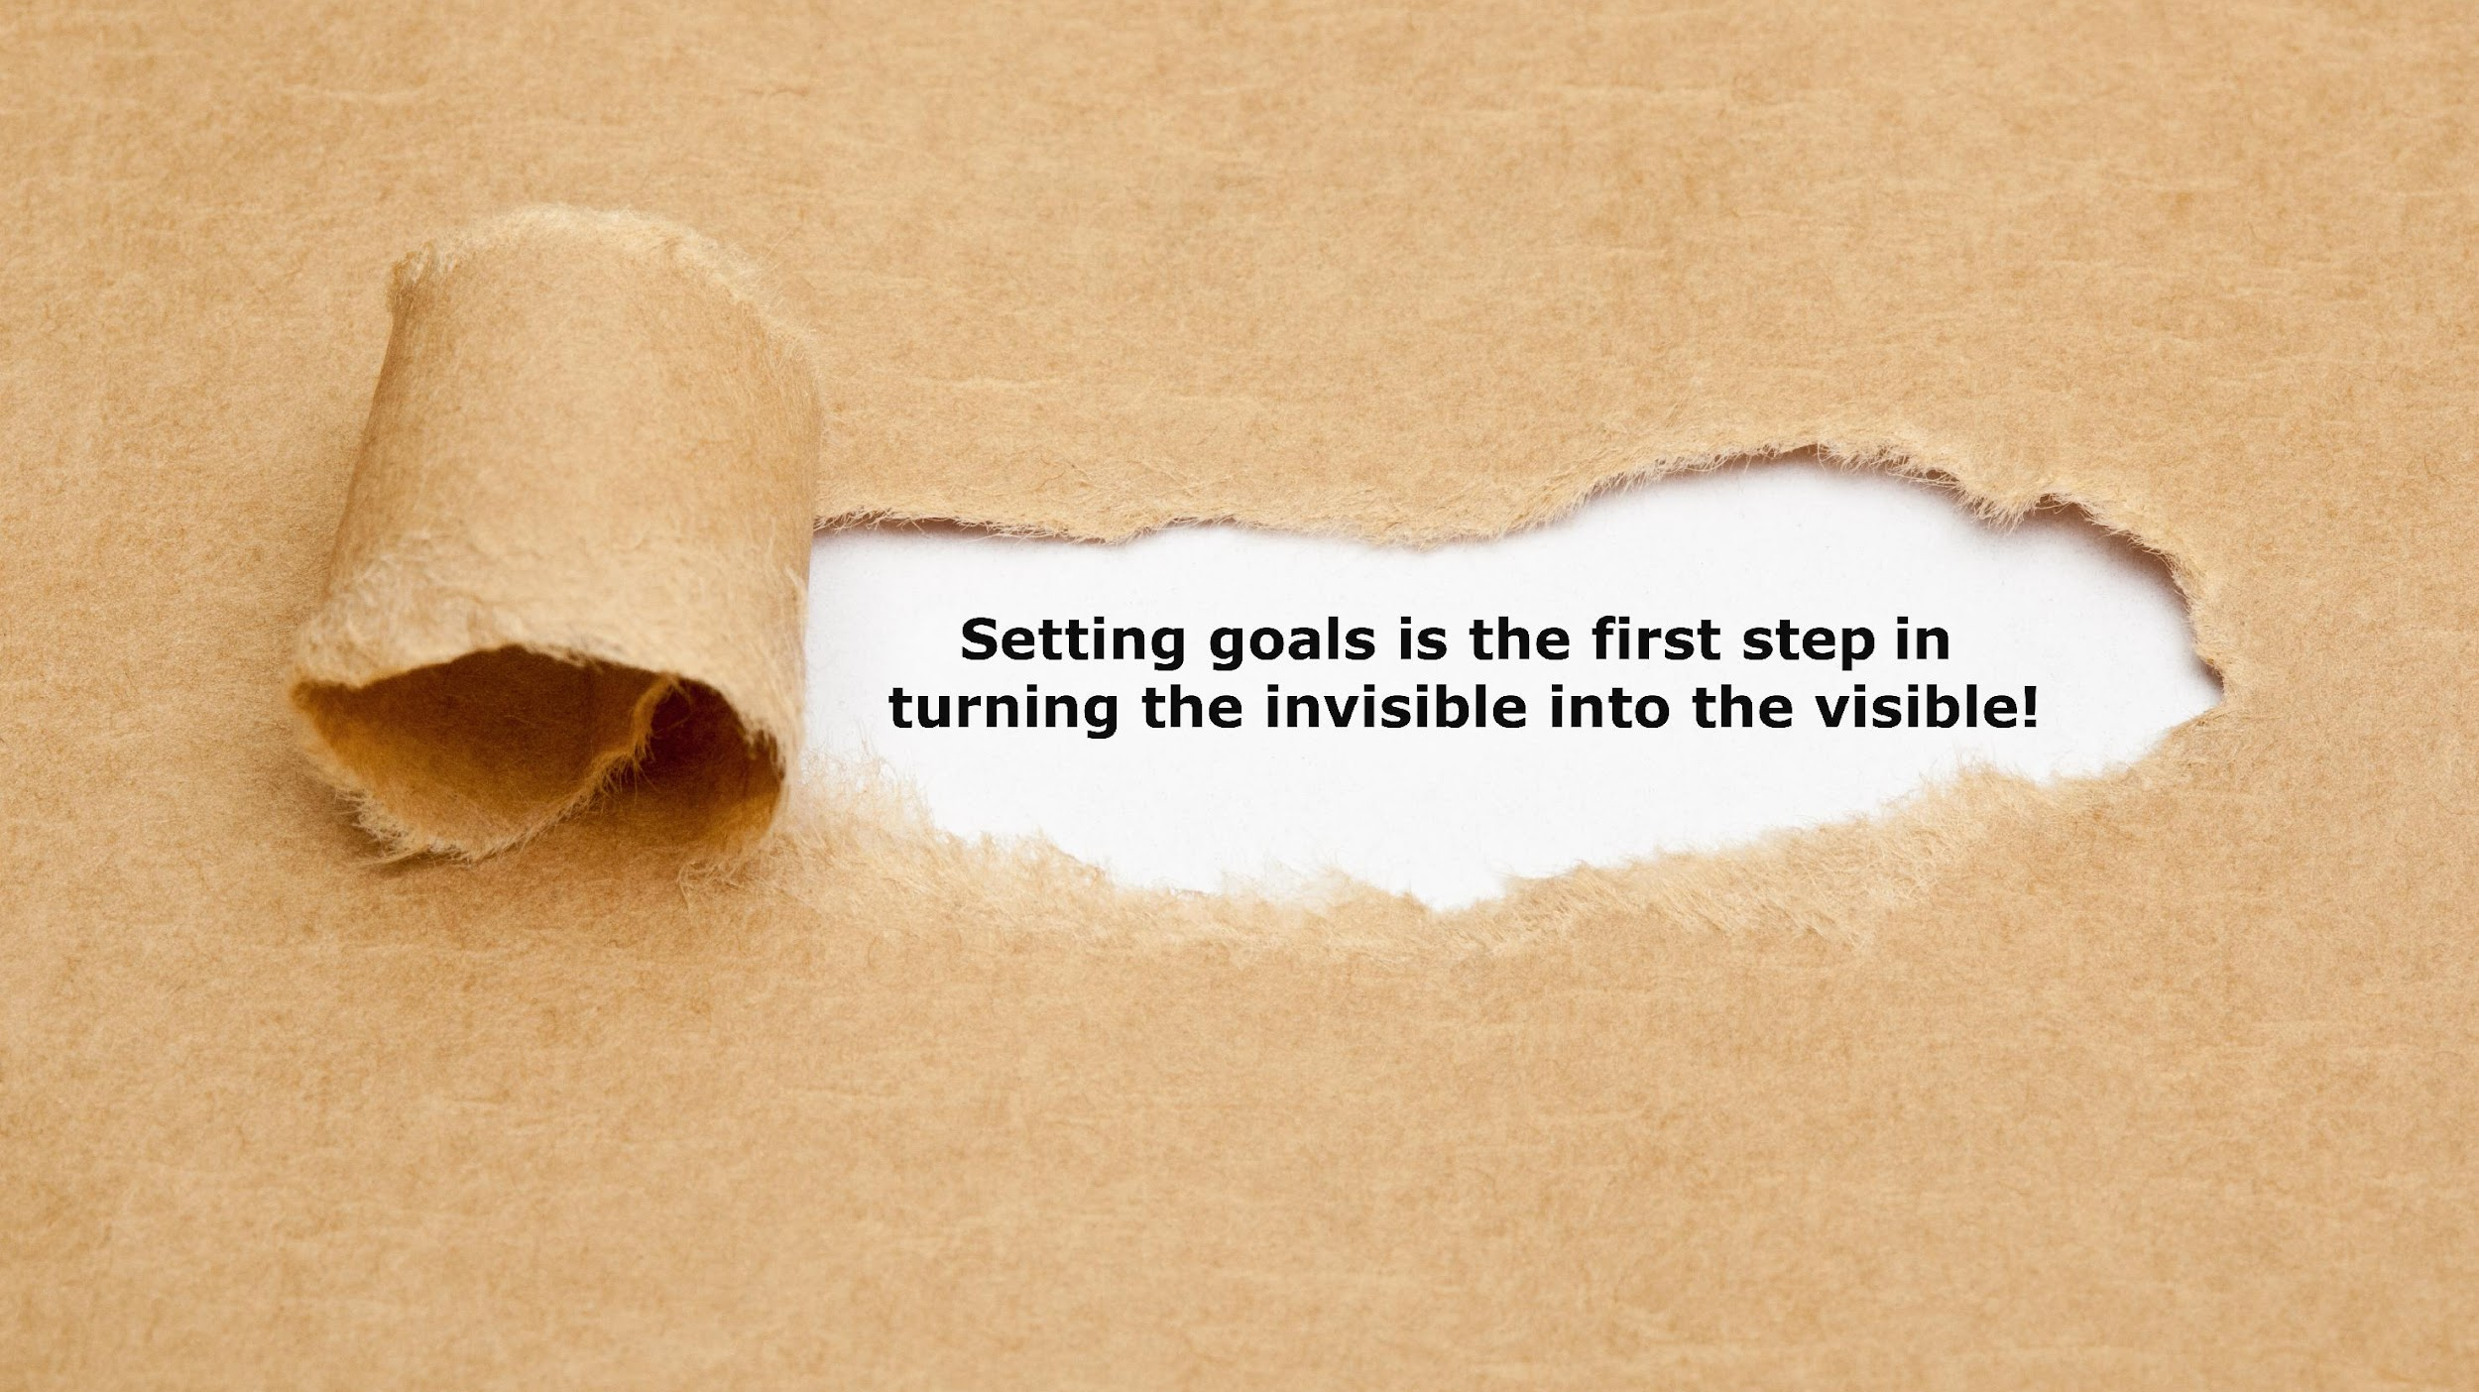

Slide 29
“
Another area where ambiguity can be reduced…
Donohoo, J. & Forbes, G. (2024). Collective Impact: Overcoming the Enemies of Efficacy, Solution Tree.

Slide 30
Three things occur when a problem of practice is surfaced…
It’s ignored.
It’s joked about.
It gets deflected.
Crow, T. (2008). Declaration of interdependence. Q & A with Judith Warren Little. Journal of Staff Development, 29(3), 53-56.

Slide 31
When a problem of practice is noticed, what happens next is that it gets normalized.
Crow, T. (2008). Declaration of interdependence. Q & A with Judith Warren Little. Journal of Staff Development, 29(3), 53-56.

Slide 32
Little identified a simple strategy that resulted in conversations developing in rich ways .
EXTENDING INVITATIONS TO SAY MORE
Crow, T. (2008). Declaration of interdependence. Q & A with Judith Warren Little. Journal of Staff Development, 29(3), 53-56.

Slide 33
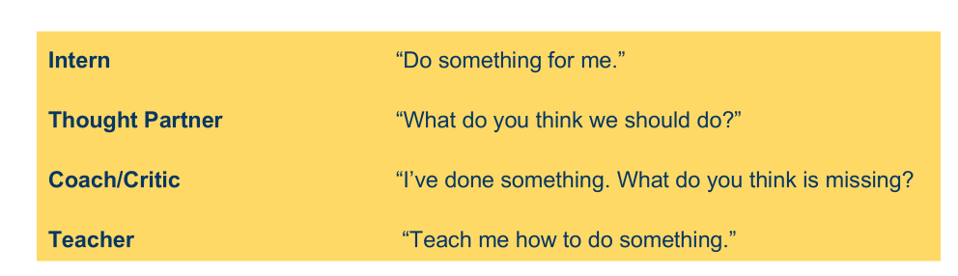
BLAME - MAGNITUDE - COMPLIANCE- FRAGMENTATION-AMBIGUITY
How could AI be used to support you in taking action to overcome an enemy of efficacy?
Task
Process
Write a prompt that supports taking action to overcome a specific enemy of efficacy.
Personal reasoning time
Breakout group support
Prepare to share a prompt in the chat
Product
A collection of prompts

Slide 34
BLAME - MAGNITUDE - COMPLIANCE- FRAGMENTATION-AMBIGUITY
How could AI be used to support you in taking action to overcome an enemy of efficacy?
What prior learning did the activity incorporate?
How did it stretch and support your learning?
How will you transfer your learning from this activity?
Notes:
The zone of proximal development (ZPD) refers to the difference between what a learner can do without help and what he or she can achieve with guidance and encouragement

Slide 35
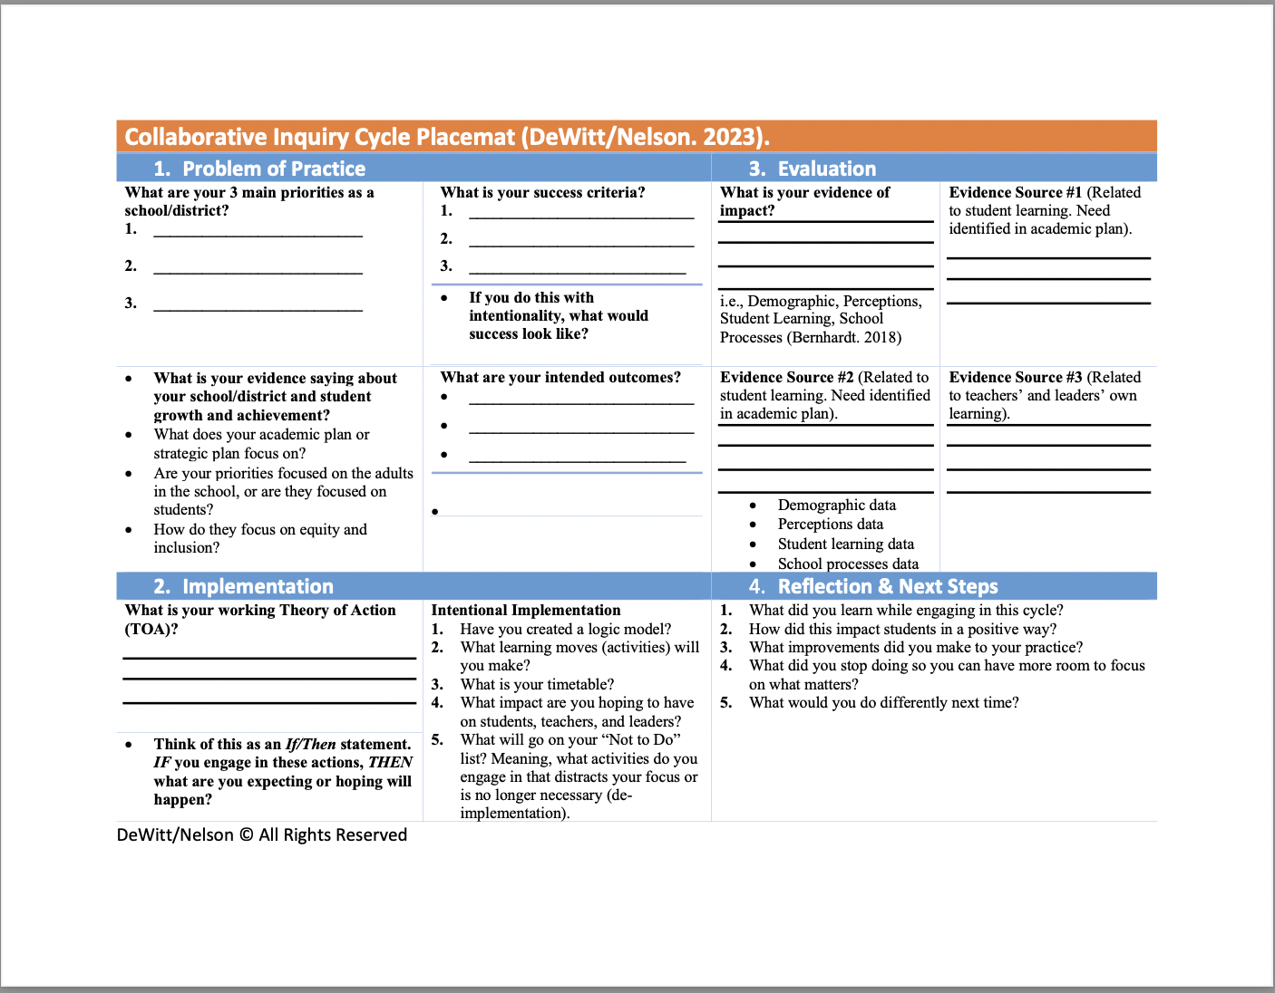

Slide 36
Student Objective
Data
We use common formative assessment, and use it for assessment as learning.
Assessment AS learning – Students develop an awareness of how they learn and use that awareness to adjust and advance their learning, taking increased responsibility for their learning (Bernhardt).
We want students to understand:
Where they are as a learner.
How they got there.
Where they are going to next (Hattie).
Checking for Understanding
Example
Non-Example
Teachers engage in short assessment cycles, which might happen within and between lessons, often multiple times during a single session. For example, teachers might ask students to solve a quick problem on a mini whiteboard or engage in a quick "turn-and-talk" discussion with a partner. This immediate feedback allows teachers to adjust their instruction on the spot—whether that means reteaching a concept, providing targeted support to a small group, or accelerating the pace of the lesson.
Teachers engage students in a turn and talk but only call on 1 or 2 students to explain their thinking.
Evans et al (2019) found that when students struggled in the classroom, “Teachers connected student performance data to their instruction approximately 15% of the time. Teachers more frequently connected student performance data to student characteristics. Notably, student behavior accounted for 32% of all teacher explanations for student performance.”

Slide 37
Student Objective
Data
We want students to understand:
Students develop language (more specifically for EL students, but could be for all)
All students able to process content and share their learning
Walkthrough data
Higher percentage of EL students able to exit EL (pass WIDA)
Do we have a literacy assessment or formative assessment to measure the impact of collaborative conversations?
Collaborative Conversations
Example
Non-Example
Teachers call on random students or intentionally call on specific students
Turn and talk with opportunities for sharing out and teacher checking for understanding
Teachers call on students who raise their hands
Turn and talk, but no share out or teacher checking for understanding

Slide 38



Fry, K. Leading with Intelligence. WASA
Notes:
15 minutes

Slide 39
Access Codes - 1 Yr. Free
code: NEXTLEVEL
code: NEXTLEVEL
One subscription to each section per NLL Member
Sign-up Support:
Sign-up Instructions Video
Beau Wilson - bwilson@wasa-oly.org
Notes:
15 minutes

Slide 40
Review- Success Criteria
By the end of this session, you will be able to:
Articulate how your problem of practice aligns to a student objective, and provide examples and non-examples of what that looks like.
Name and describe 1-2 enemies of efficacy.
Identify specific leadership practices to overcome an enemy of efficacy.
Identify how Ai can be used to overcome enemies of efficacy.
Notes:
kim

Slide 41


NEXT LEVEL LEADERS
Term 2- In Person MEETING
CEDARBROOK LODGE, SEATAC ~ March 2 (5PM)- March 3 (8-3:30PM), 2025
https://bit.ly/4dVUqIP- Register ASAP! Participants will stay
at Cedarbrook until full and Crown Plaza!

Slide 42





Slide 43

Participants by ESD Region
7
9
44
7
18
25
2
5
29

Slide 44




Are you an experienced, innovative leader who wants to
keep learning and growing your leadership?
Consider joining the Next Level Leaders 2025/26 Cohort!
Washington State’s Premier Leadership Development Program
Please contact: ashley@NLL.academy or visit https://nll.academy
Now Accepting Applications for Cohort Two
Starting Summer 2025

Slide 45
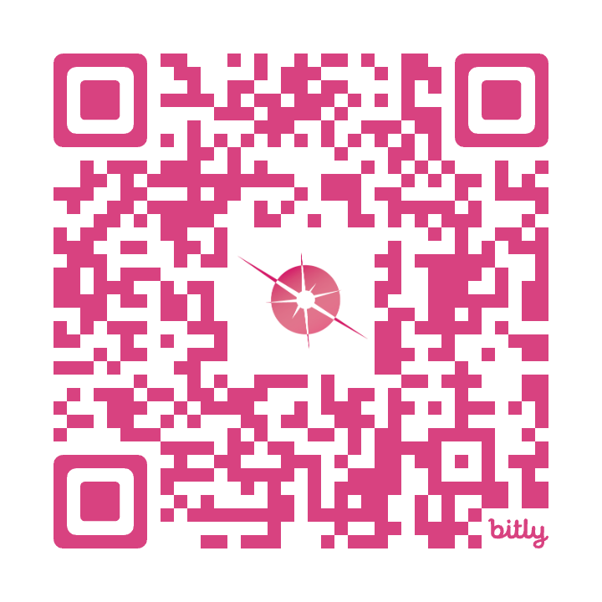
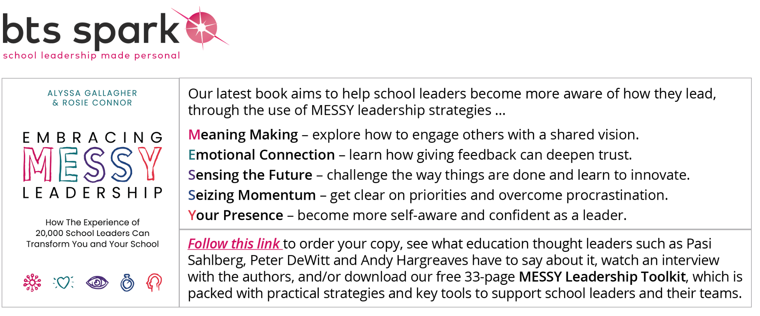
1:1 Leadership Coaching Offer
Personalized Leadership Coach
Six (3) x 60-minute sessions and a leadership assessment!
Your schedule, your context
No additional costs!
To secure your spot sign up using the QR code or email
    Alyssa.Gallagher@btsspark.org

Slide 46


For More Information
Kamrica Ary-Turner Beaver| Associate Director,
ESDs 189 & 121 | (800) 562-6100
Leaders of Color Network (awsp.org)
Notes:
2:45 p.m.- 3:00 p.m.

Slide 47


