Slide 1

AER Author Series
aer@aerbvi.org | 703-671-4500
www.aerbvi.org
Notes:
PLEASE DO NOT EDIT OR REMOVE

Slide 2

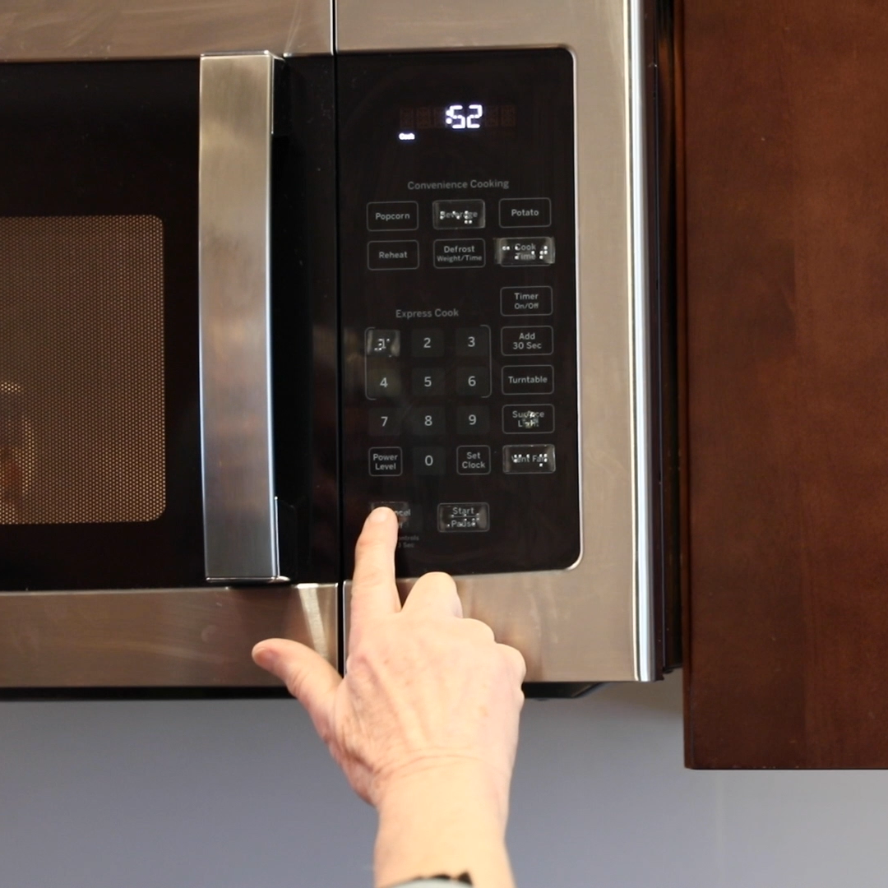
Vision Rehabilitation Therapy Division
Notes:
PLEASE DO NOT EDIT OR REMOVE

Slide 3


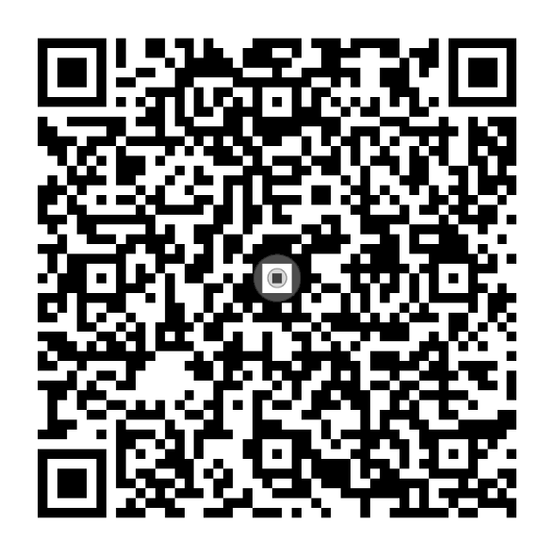
Foundations of Vision Rehabilitation Therapy
EDITORS
Dr. Helen Lee and Jennifer Ottowitz
To order online,
visit aph.org/shop
Or call 1-800-223-1839
Notes:
PLEASE DO NOT EDIT OR REMOVE

Slide 4
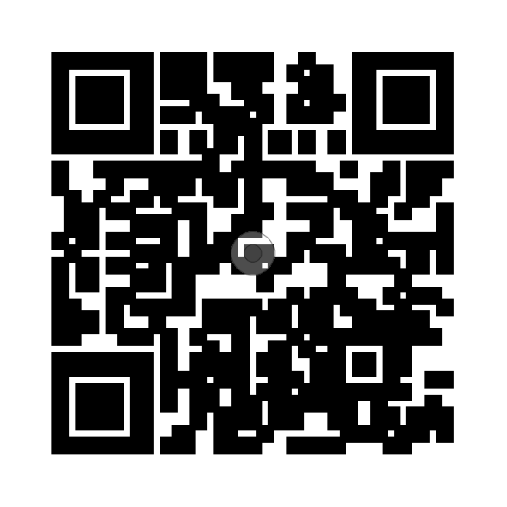

Foundations of Vision
Rehabilitation
Therapy
Access the entire AER eLearning series when you
scan the QR code.
Notes:
PLEASE DO NOT EDIT OR REMOVE

Slide 5

Earning ACVREP Continuing Education Credits
To earn your ACVREP credit for this session you must be in attendance for 85% of the webinar to qualify. At the end of this session, take the survey on the e-learning platform. Once you have completed the survey, the certificate of CEU’s will be sent in an email and also will be available in your e-learning account
Sessions and ACVREP CE credits are included in your AER Membership.
Notes:
PLEASE DO NOT EDIT OR REMOVE

Slide 6
Chapter 11: Adaptive Food Preparation
Presented by Lachelle Smith, CVRT, LVT
AER Foundations of Vision Rehabilitation Therapy Author Series
October 15, 2026

Slide 7
Introduction
This chapter outlines comprehensive instructional strategies for teaching food preparation to individuals who are blind or visually impaired, emphasizing that skills exist on a continuum from simple to complex. It highlights the importance of client-centered assessment—considering the individual's previous experience, physical abilities, and unique living situation—to tailor lesson plans effectively. By utilizing a "simple-to-complex" instructional sequence and breaking tasks into smaller units, VRTs can build client confidence and ensure safety, particularly when transitioning to more advanced tasks like using ovens and stovetops.
(Smith & Fugate, 2020)

Slide 8
Learning Objectives
At the conclusion of this webinar, attendees will be able to:
Identify: Recognize core safety principles and environmental modifications, such as lighting, contrast, and layout organization, needed for an accessible kitchen.
Demonstrate: Adapt fundamental food preparation methods, including pouring, cutting, and heat source management, to suit diverse functional vision and experience levels.
Develop: Construct a sequential lesson plan that breaks down complex cooking tasks into manageable units tailored to individual client goals and learning modalities.

Slide 9
Why Teach Adaptive Food Preparation?
“The ability to prepare food is an important daily living skill because of the basic role food and eating plays/has in our lives.” (Smith & Fugate, 2020, p. 438)
For individuals who are new to visual impairment, the ability to prepare their own meals will enable them to gain a level of independence that leads to self-efficacy, addressing one of the basic needs to sustain life.
For individuals whose role in their home was to prepare meals for their family, “the restoration of this skill will be a meaningful step towards rebuilding their self-image.”
(Smith & Fugate, 2020)

Slide 10
The Food Preparation Continuum (1 of 2)
Food preparation skills exist on a continuum, ranging from simple to complex.
Skills such as pouring, spreading, knife skills, and opening jars and packages may be considered on the simple end of the continuum.
Skills such as following recipes with multiple ingredients and preparation steps, using conventional and some small appliances are considered on the more complex end of the continuum.
(Smith & Fugate, 2020)

Slide 11
The Food Preparation Continuum (2 of 2)
Additional skills such as safe food handling, proper food storage, and eating skills may also need to be addressed in training depending on the experience level of the learner.
An individual’s preferences, abilities, needs, and living situation will determine how many of the skills involved in the continuum will need to be addressed.
(Smith & Fugate, 2020)

Slide 12
Special Considerations (1 of 2)
When planning instruction in adaptive food preparation skills:
Lessons should be client-centered and designed to meet learner goals and preferences, which may include the type of dishes/cooking methods that are unfamiliar to the VRT. This may involve the VRT learning new skils to prepare for instruction.
Those training goals should be relevant to the learner’s needs, abilities, and preferences.
(Smith & Fugate, 2020)

Slide 13
Special Considerations (2 of 2)
Training sessions should be sequenced and designed to introduce the learning of new skills and the transfer of previously learned skills from existing knowledge and from areas of training received in other daily living skill areas.
Lesson plans should be appropriate for the skill level of the learner and include manageable activities that help the individuals stay motivated to learn and participate.
(Smith & Fugate, 2020)

Slide 14
Factors Affecting the Instructional Process (1 of 3)
The VRT should address many of these factors during a comprehensive assessment, where targeted questions about level of experience, food selections and preparation preferences, and any other personal needs relative to food preparation would be discussed. Such factors impacting the instructional process may include:
Level of vision and physical abilities and limitations of the learner (additional disabilities, stamina, attention level);
Previous and current knowledge and experience with preparing foods;
Physical layout and organization of the kitchen area (Kitchen triangle and work simplification principles);
(Smith & Fugate, 2020)

Slide 15
Factors Affecting the Instructional Process (2 of 3)
Type of appliance(s) available to prepare food (conventional or small appliances, smart appliances);
Complexity of food preparation methods requested for training (baking, sautéing, deep frying);
Access to recipes in accessible formats (large print, braille, or digital, Apps);
(Smith & Fugate, 2020)

Slide 16
Factors Affecting the Instructional Process (3 of 3)
Special dietary needs and preferences (Diabetes, allergies, high blood pressure/cholesterol, cultural preferences);
Budget (types of foods and devices);
Number of people the learner needs to prepare food for (alone or a family);
Adaptive equipment, assistive technology, and/or low vision devices that may be used to assist the process (adaptive kitchen aids, Echo dot [Alexa/Google], smart phones, handheld magnifiers, smart glasses, etc.).
(Smith & Fugate, 2020)

Slide 17
Additional Considerations (1 of 2)
Age of client/learner (youth, transition-age, and young adult).
Learning style of the client/learner (andragogy vs. pedagogy or combination).
Culture (religion [kosher], special diets [spices and special food dishes/preparations]).
Lifestyle (frequency of cooking, volume of food [portions], special diets [health]).
(Smith & Fugate, 2020)

Slide 18
Additional Considerations (2 of 2)
Individuals with additional disabilities (chronic health [Diabetes, hypertension, cardiovascular, celiac], physical [amputations, CP, MS, Parkinson’s], sensory [hard of hearing/deaf, deaf-blindness, etc.], cognitive [stroke, autism, TBI]), adaptive equipment, medical equipment, modifications for kitchen layout and physical plan for storage.
(Smith & Fugate, 2020)

Slide 19
Learners with Adventitious Visual Impairment (1 of 2)
Many adult learners seeking training in food preparation skills typically come to the learning process with some cooking experience.
Previous food preparation experience can serve as a foundation for learning adaptive techniques.
These individuals may not need as many training hours as those new to the skill.
The VRT would adjust their instructional approach to meet the learner at their current knowledge and performance levels.
Areas that may need a greater emphasis when working with this individual may include:
(Smith & Fugate, 2020)

Slide 20
Learners with Adventitious Visual Impairment (2 of 2)
Sensory development exercises
Orientation to the kitchen area/equipment; locating, organization, and labeling food items, kitchen utensils, and tools
Adaptive spreading, pouring, measuring, and transferring
Adaptive knife skills (slicing, chopping, dicing)
Use of small appliances
Use of assistive devices/technology
Determining doneness of food
Cleaning techniques
(Smith & Fugate, 2020)

Slide 21
Clients with Congenital Impairments (1 of 3)
Learners with minimal to no experience with preparing food may need a comprehensive approach to assessment and instruction of basic skills, including concept development.
The VRT should address any fears and concerns the individual and their family/support team may have about kitchen safety, spatial relationships, and misconceptions about the cooking process.
Typical areas of initial instruction may need to focus on food identification, handling, packaging, and storage skills before any more complex preparation methods will be addressed.
(Smith & Fugate, 2020)

Slide 22
Clients with Congenital Impairments (2 of 3)
Teaching mechanics of skills such as measuring, mixing, and turning foods may often need to be instructed with strategies such as hand-over-hand/hand-under-hand techniques.
Understanding the preferred mode of learning of the individual is imperative (tactile, visual, auditory, or combination) when determining the instructional approach to use.
Use visual modeling or demonstration of the task to provide the individual with a foundation for completing the task themselves.
(Smith & Fugate, 2020)

Slide 23
Clients with Congenital Impairments (3 of 3)
Use scale models for teaching unfamiliar concepts or to orient to items and objects (food replicas, tactile graphics, raised drawings).
Strategies for incorporating family/support teams in the instructional process (observe and/or participation in lessons).
(Smith & Fugate, 2020)

Slide 24
Low Vision Considerations (1 of 3)
For learners with low vision participating in food preparation training, a special emphasis on enhancing the visibility of the environment, food items, and equipment/tools will be paramount for safe and efficient performance.
The VRT should review the individual’s ocular health records to understand the clinical diagnosis and implications impacting the learner’s vision, including any formal or informal functional vision assessments performed
Environmental modifications such as lighting, color and contrast, and size should be considered when planning instructional activities.
(Smith & Fugate, 2020)

Slide 25
Low Vision Considerations (2 of 3)
The VRT should instruct the individual on how to modify the environment to enhance visibility when performing food preparation and cooking tasks
For lighting modifications, individuals can be instructed to use task lighting, flexible arm lighting, undercounter lighting, and lighting fixtures positioned in high preparation areas (stovetop, sink, counter/tables).
For color and contrast, individuals can be instructed to choose prep bowls/plates, utensils, cooking equipment, and food ingredients of contrasting colors of items used to perform the task.
.
(Smith & Fugate, 2020)

Slide 26
Low Vision Considerations (3 of 3)
For increased size (relative distance), instruct individuals to bring items closer to the eye (that do not present a safety risk) for better visibility, use of large print recipes or cooking directions, and use of mobile apps such as the Android/IOS magnifier can be useful for enhancing visibility.
The VRT should emphasize that bringing the eye low towards an item such as the stove to see dials, items being sliced with a knife, should be avoided due to the risk of injury.
(Smith & Fugate, 2020)

Slide 27
Length of Lessons (1 of 2)
Length of instructional training may vary depending on the rehabilitation program, agency, or facility providing the service.
Rehabilitation agencies and facilities may have pre-determined schedules for their VRT personnel (Veterans Administration, Rehabilitation Centers).
Many training sessions are scheduled for an hour; however, when instructing food preparation and cooking skills, the length of the lesson may need to be adjusted to two hours to accommodate for cooking time, physical limitations, and processing.
(Smith & Fugate, 2020)

Slide 28
Length of Lessons (2 of 2)
Lessons can be broken up into smaller units of instruction to address specific needs of the client/learner (limited mobility, fatigue caused by chronic illness, attention deficit, cognitive overload).
The VRT can also suggest using different appliances to accomplish the goals such as the Crock Pot, Air Fryer, or convection oven that may reduce the time needing to cook or allow a less complex cooking process by placing all ingredients in one pot to cook for a set time.
(Smith & Fugate, 2020)

Slide 29
VRTs with Visual Impairment (1 of 2)
For VRTs who are blind or have low vision, their own visual abilities are also a part of planning effective instruction, monitoring performance, and evaluating progress. Strategies to assist the VRT in presenting a confident and professional presence during adaptive food preparation training include:
Organize and label materials to easily locate and identify them.
Become familiar with the workspace, equipment, and appliances before instruction.
Model the task using the teaching method appropriate for the learner.
(LeJeune & Ottowitz, 2020)

Slide 30
VRTs with Visual Impairment (2 of 2)
Use tactile, verbal, and nonvisual cues to monitor performance
Ask the learner to pause during higher risk steps of a task, such as turning food in a pan, and check for safety and accuracy.
Ask questions and/or request that the learner verbalize each step they are doing in the process of the task.
Use the learner’s verbal descriptions to support VRT feedback and the learner’s self-evaluation of the task.
(LeJeune & Ottowitz, 2020)

Slide 31
Assessment and Planning Instruction (1 of 2)
Before planning instruction, the VRT should assess the learner’s current knowledge and experience with the skill, then align instruction with the learner’s stated goal.
Assessment and planning steps:
Ask “How do you perform the task now? What is working?”
Have the learner demonstrate the task or provide a verbal walk through of the steps.
Ask how the learner prefers to receive instruction, then assess which visual, tactile, or auditory cues they can use during instruction.
(Smith & Fugate, 2020)

Slide 32
Assessment and Planning Instruction (2 of 2)
Identify effective methods, barriers, and skills that may need further assessment.
Select adaptations and equipment for instruction that will support accomplishment of the goal.
(Smith & Fugate, 2020)

Slide 33
Pouring skills (1 of 2)
For learners with previous experience, instruction may focus on safety, independence, and addressing a specific pouring need. For learners with little to no experience, instruction may begin with exploring different containers and pouring vessels.
Adaptation options:
Use sensory cues: sight of rising liquid, change in sound as the liquid rises, and change in weight of the receiving vessel.
Use a liquid level indicator: when the level of liquid is difficult to determine, when pouring hot liquids, and when pouring liquid for someone else.
(Smith & Fugate, 2020)

Slide 34
Pouring skills (2 of 2)
Select manageable equipment: choose pouring vessels with handles and spouts.
Contain spills: pour over a tray, cookie sheet, or the sink.
Adjust lighting and contrast: use task lighting and a vessel or background that makes pouring liquid easier to see; placing ice cubes or fruit/vegetable slices into the liquid may help some learners track the liquid rise.
For cold liquids only: a fingertip placed inside the glass near the rim may provide a tactile cue to detect the level of liquid.
(Smith & Fugate, 2020)

Slide 35
Cutting Skills
Cutting is a skill that may bring a level of fear or hesitation due to risk of injury. The VRT should assess the learner’s knowledge, skill, and experience; ask the learner what would make them feel safe; and explain how adaptive techniques can reduce the risk.
For learners with previous experience, instruction may focus on using familiar cutting tools and methods. For the learner with little to no experience, instruction may begin with teaching safe knife handling and how to hold the knife in the safe cutting position. Instruction can then progress to positioning the knife and food, determining the desired size of the slice, and then cutting the item.
(Smith & Fugate, 2020)

Slide 36
Cutting Skills – Safety Considerations (1 of 2)
Use sharp knives and select a knife that fits the learner’s hand and is comfortable to use.
Use a tray to define and organize the work area; use a cutting board for the cutting surface (not glass plates or countertops).
Establish a location for the knife when not in use (blade under the cutting board or the top of the tray with the sharp edge of the blade facing away from the cutting board).
(Smith & Fugate, 2020)

Slide 37
Cutting Skills – Safety Considerations (2 of 2)
Use task lighting and a cutting board that contrasts with the food (when appropriate).
Position food in the center of the cutting board, to allow space for both hands.
Consider using cut-resistant gloves, knife guards, knife with guide, or fork (for when there is a small piece at the end of the food).
(Smith & Fugate, 2020)

Slide 38
Cutting Skills – Locate and Position Food (1 of 3)
Secure food item with the nondominant hand: this allows the food to stabilize before introducing the knife.
Locate and grasp the knife: use the trailing technique to locate the knife in the established location, grasp the handle and then test to see if the knife is positioned in the safe holding position by running the blade portion of the knife against the top of the cutting board. If the learner feels tension on the knife or hears the knife scraping the board, it is in the proper position.
Bring the knife to the food: keeping the cutting edge of the blade in contact with the board as you glide the knife to the end of the food.
Instructional example: Lachelle Smith

Slide 39
Cutting Skills – Locate and Position Food (2 of 3)
Measure the size of the slice/cut: keeping the nondominant hand on the food item in a “C” shape, extend the index finger of that hand securing the food to the end of the food item and touch the top, non-sharp side of the knife to establish location of the knife (orientation). Then using the index finger, trail back (away from the end of the food item) on the item to mark the first cut of the item. Keeping the finger in that position, slightly curved, slowly bring the knife to the finger, by keeping the side of the knife in contact with the food item until the side or non-sharp side of the knife touches the finger.
Instructional example: Lachelle Smith

Slide 40
Cutting Skills – Locate and Position Food (3 of 3)
Once in contact, slowly rotate the knife upright in the cutting position (sharp-end of knife is positioned straight on top of the food item) and then move the index finger of the nondominant hand back to meet the other fingers on the food item.
Instructional example: Lachelle Smith

Slide 41
Cutting – Make the Cut
Cut the food item: Once the index finger of the nondominant hand is in a safe position, use a controlled sawing motion to cut the item until the sharp-end of the knife makes contact with the cutting board.
Keep the cutting edge against the board: Once it has been determined that the item has been cut, use the knife to push the cut piece of food away, clearing the space for additional cuts.
Cut round fruits and vegetables in half: this helps to stabilize the item before cutting.
Use food processors and chopper appliances: these small appliances can save time and physical effort to complete the task.
Smith & Fugate, 2020; instructional example: Lachelle Smith

Slide 42
Managing Heat (1 of 2)
Preparing food using conventional appliances such as the stovetop and oven can present another level of fear and concern for individuals who are blind or have low vision.
“Safety concerns associated with this task involve the risk of physical contact with the direct heat source, dropping food onto the heat source, splattering oil from frying foods, fear of an open flame when cooking on a gas stove, fear of contact with any part of the oven, and fear of falling into the oven.” (Smith & Fugate, 2020, p. 468)
Similar to other skills discussed, the VRT should assess the knowledge, skills, and experience with cooking to determine the appropriate starting point and instructional sequence needed to meet the learner’s goal(s).
(Smith & Fugate, 2020)

Slide 43
Managing Heat (2 of 2)
For the experienced learner, instruction can draw on their previous knowledge and focus on reorienting to the stovetop and oven, including burner locations, dials, and any digital panels that control the oven or its additional features, such as cooking modes and timer.
For learners with congenital visual impairment and little or no cooking experience, instruction may involve an orientation to the parts of the appliance and discussion on the concepts of how they work.
(Smith & Fugate, 2020)

Slide 44
Managing Heat – Preparing to Cook (1 of 2)
Start the cooking process on a cold burner/oven: for initial instruction, start with a cold burner/oven. This helps the learner orient to the cooking element without the fear of getting burned.
Wear protective clothing and hand protection: instruct learners to wear fitted clothing, closed-toe shoes, minimal jewelry, and hand protection (oven mitts or gloves) once the stove/oven has been turned on.
(Smith & Fugate, 2020)

Slide 45
Managing Heat – Preparing to Cook (2 of 2)
Use the handle of the oven door as a reference point before interacting with the stove: This allows a safe orientation to the appliance throughout the initial approach to the stove and during the cooking process. Learners can be instructed to keep their hands on the handle instead of the stove during the cooking process.
Perform a safety sweep/scan of the stovetop: this will allow the learner to detect if any burners are on, remain hot, or have items resting on the stove before use. Check for residual heat without touching a burner.
(Smith & Fugate, 2020)

Slide 46
Managing Heat – Stovetop Skills (1 of 3)
Identify burners and determine size/output level: depending on the type of appliance, burners have different heat output levels (gas) and shapes (electric). Learners should be instructed how to identify the appropriate burner for a specific task.
Select an appropriate burner for the task: learners should be instructed to choose an appropriate burner for the type of task they are performing. For example, on a gas stove, if the task involves boiling, the power boil burner may be appropriate. On an electric stove, the burners are different size circles and the pan used for cooking should match the size of the burner used.
(Smith & Fugate, 2020)

Slide 47
Managing Heat – Stovetop Skills (2 of 3)
Centering a pan on the burner: instruct learners to center a pan on a cold burner using their hands at the base of the pan, aligning the bottom of the pan with the edges of the burner on the right, left, top, and bottom. However, when needing to recenter a pan on a hot burner, the learner would be instructed to use a wooden spoon to help re-center the pan on the burner. Note: Have the learner initially center the pan with the food item already in the pan.
Setting the temperature on the stove: Orient the learner to the dials that correspond to the burners. Discuss marking the dials for easier identification
(Smith & Fugate, 2020)

Slide 48
Managing Heat – Stovetop Skills (3 of 3)
Monitoring food cooking: Use sensory cues to monitor cooking. Sounds such as sizzling, hissing, and rumbling, along with smells (peak smells), can provide useful information about the stage of the cooking process.
Determining doneness of food: Use timers, utensils, and sensory cues to determine doneness of food.
Always turn off the heat source prior to removing the food or pan from the burner: this protects the learner from forgetting to turn off the stove.
(Smith & Fugate, 2020)

Slide 49
Managing Heat – Using the Oven (1 of 2)
Position body to the side of the oven door: instruct learners to stand to the side (right or left) of the oven door when opening and anchor their hip/leg/opposite hand to something stable, such as the lower cabinets/countertop. This provides stability when opening the oven door. And helps the learner remain oriented. Never stand in front of the oven to open it.
Perform a visual or tactile scan of the oven before use: in a cold oven, instruct the learner to perform a scan of the oven prior to use. Many people store cookware and other items in the oven, so this is a preventive measure for safety.
(Smith & Fugate, 2020)

Slide 50
Managing Heat – Using the Oven (2 of 2)
Pull the oven rack out to insert and remove items from the oven: instruct learners to trail the side of the oven to locate the desired rack instead of reaching their hand into the open oven cavity. If starting with a cold oven, this allows the learner to place the food item where they choose without fear of getting burned. If the oven is hot, they MUST use elbow-length, flame-resistant oven mitts or long, Ove’ gloves. Also it is recommended that they wear a fitted, long-sleeved shirt.
Turn off heat prior to removing the food from the oven: this protects the learner from forgetting to turn off the oven.
(Smith & Fugate, 2020)

Slide 51
Flat-top Stoves and Touch Controls (1 of 2)
Flat-top stoves and touch controls can create challenges when centering cookware and accessing control functions. Strategies for addressing this may include:
Use a marked, heat-resistant utensil as a positioning guide: Marking a long-handled utensils, such as a wooden spoon or chop stickto measure the difference from the front and sides of the cooktop can assist with centering a pan on a burner.
Use a pot handle stabilizer: Can be positioned to the side of the cooktop to help keep the pot centered during the cooking process.

Slide 52
Flat-top Stoves and Touch Controls (2 of 2)
Establish landmarks and reference points: Place marks on the pot handle or appropriate locations along the side edge of the cooktop to help align the pot with the burner .
Mark touch controls: Use low-profile tactile markers, such as Touch Dots, to identify control locations, without interfering with their operation.
Consider smart controls: Use compatible voice assistants (Alexa/Google) or apps to access appliance functions.

Slide 53
Small Appliances
The use of small appliances is an effective alternative food preparation option for learners who prefer not to use conventional stovetops and ovens. The benefits include:
May save time and effort.
May save money, depending on the appliance and task.
Can provide relief for individuals who have mobility limitations and/or less stamina to stand for periods of time.
Can be positioned on a table for better access to learners who use wheelchairs.
(Smith & Fugate, 2020)

Slide 54
Alternative Food Preparation Options
Purchase precut and portioned foods
Purchase packaged and precooked foods
Subscribe to a food delivery service
Meals on Wheels
Hire a chef
(Smith & Fugate, 2020)

Slide 55
Technology and Adaptive Food Preparation
Technology can make food preparation more manageable by helping learners:
Use talking devices, such as timers, thermometers, scales, and accessible small appliances.
Magnify small print such as food labels.
Order groceries without leaving home.
Access online recipes and use apps such as Yes, Chef, that provide spoken cooking directions.
(Smith & Fugate, 2020)

Slide 56
References
Adaptive Food Preparation
Smith, L., & Fugate, L. (2020). Adaptive food preparation. In H. Lee & J. Ottowitz (Eds.), Foundations of vision rehabilitation therapy (pp. 437–512). APH Press.
Learning and Teaching
LeJeune, B. J., & Ottowitz, J. (2020). Learning and teaching. In H. Lee & J. Ottowitz (Eds.), Foundations of vision rehabilitation therapy (pp. 145–200). APH Press.

Slide 57
Thank You / Questions
Lachelle Smith, CVRT, LVT, Lachelle.smith@drexel.edu
Chapter 11: Adaptive Food Preparation

