Slide 1
Using AI in the
Medical Office
Deborah Kichler, RN, MSHCA
Dona Constantine, RN, BS
Monica Ludwick, PharmD

Slide 2
Disclosure to Learners
No planner, reviewer, faculty, or staff for this activity has any relevant financial relationships with ineligible companies.

Slide 3
Objectives/Outcomes:
Utilize AI technologies to engage patients in their care, enhance patient understanding, and improve communications between patients and healthcare providers.
Utilize AI technology for documentation to enhance the accuracy, thoroughness, and efficiency of patient medical records.
Evaluate the existing system infrastructure and work closely with AI professionals and vendors to ensure successful integration of AI technologies.
Create and enact protocols and guidelines for incorporating AI technologies in medical practice operations.

Slide 4

How AI is Transforming Healthcare
Improved diagnosis and treatment
Administrative tasks
Predictive analytics
Remote monitoring
Data integration
Drug discovery
Medical-Legal

Slide 5
Predictive vs Generative AI
Uses large language models (LLM) and natural language processing to generate humanlike interactions.
Ambient Scribes
Chatbots
Diagnostic/imaging/specimen analysis
Medical training and simulations
Predictive AI
Analyzes large historical data sets and identifies patterns to forecast future outcomes.
  Hospital Readmission Reduction
  Cancer Risk Prediction
  Sepsis Risk Prediction
Generative AI
Predictive AI

Slide 6

Role of AI in Healthcare
Clinical Decision Support
Personalized Medicine
Automated Image Diagnosis
Telemedicine and Remote Monitoring
Administrative Efficiency
Patient Engagement

Slide 7

Practice Workflow with AI
Operational Efficiency
  Virtual Assistants
  Appointment Scheduling
  Billing and Coding
Documentation
  Ambient Scribes
Clinical Decision Support
  Remote Monitoring
Patient Engagement
  Patient Portals
  Chatbots
  Education

Slide 8
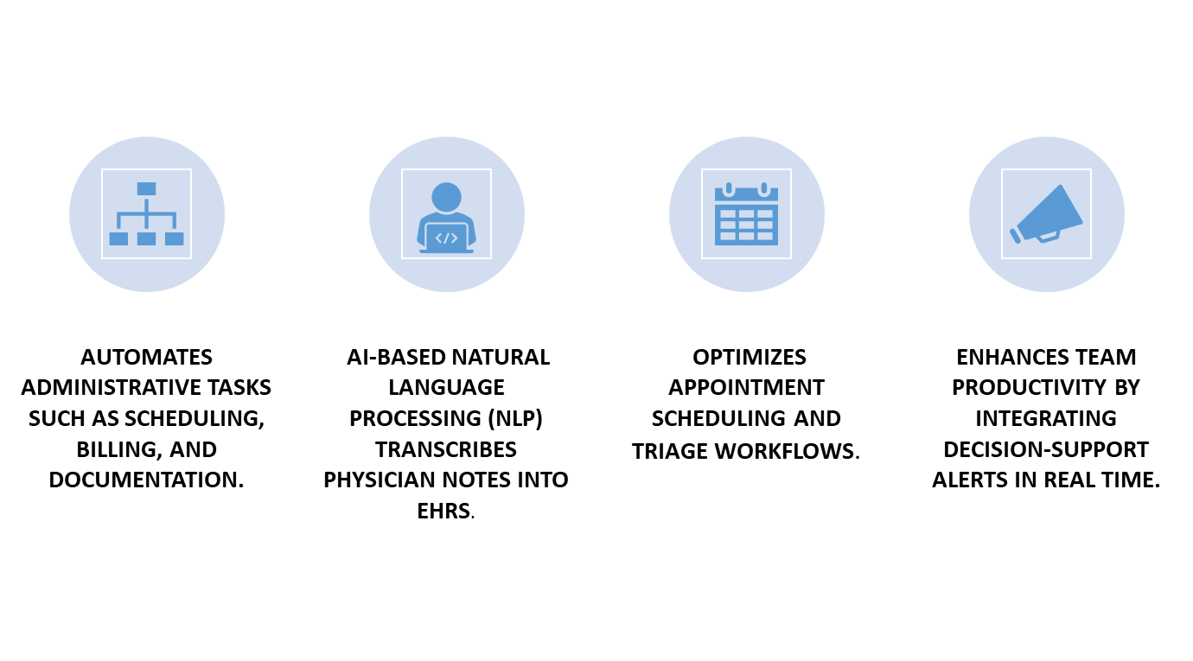
Increased Efficiency and Productivity

Slide 9
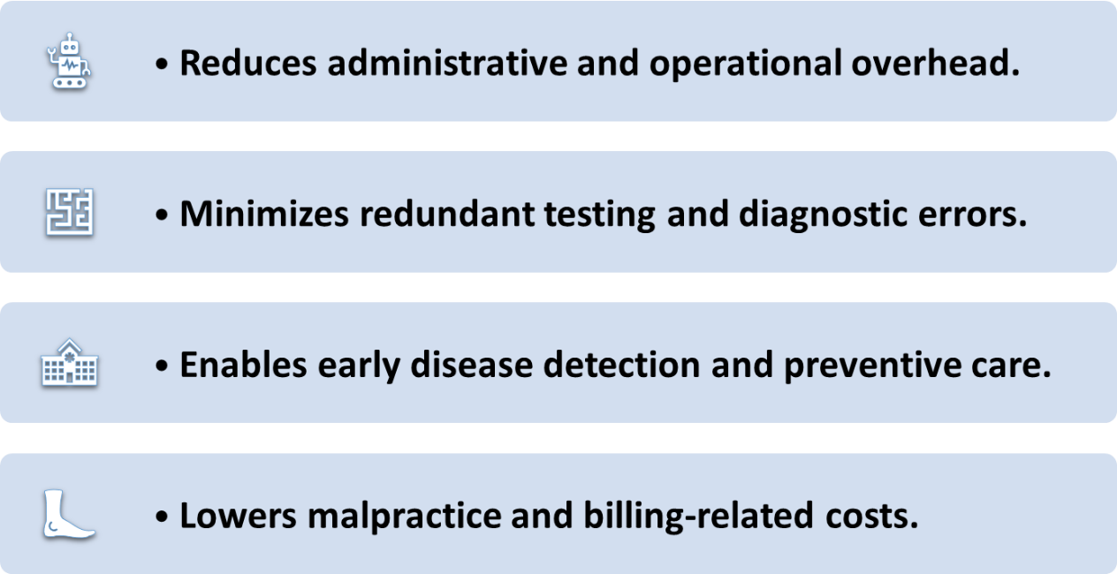
Cost Savings

Slide 10


Slide 11

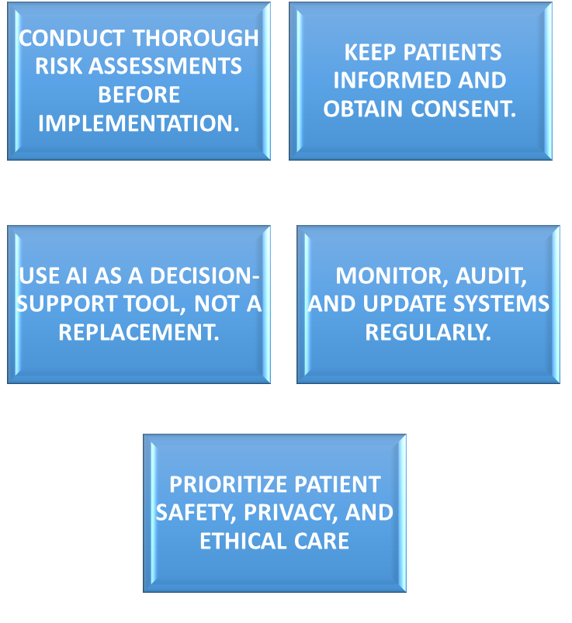
Challenges of Using AI in the Office

Slide 12

From the Patient’s Perspective

Slide 13

Ensuring Compliance and Evolving Regulations

Slide 14
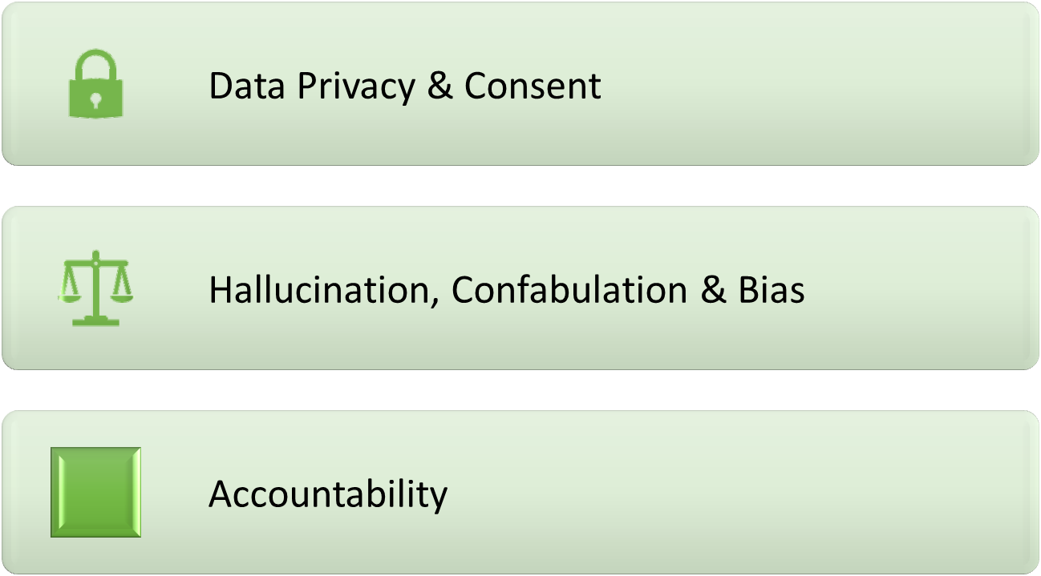
Ethical and Regulatory Considerations

Slide 15

Data Privacy and Consent

Slide 16

Hallucinations

Slide 17

Confabulations

Slide 18

Bias

Slide 19
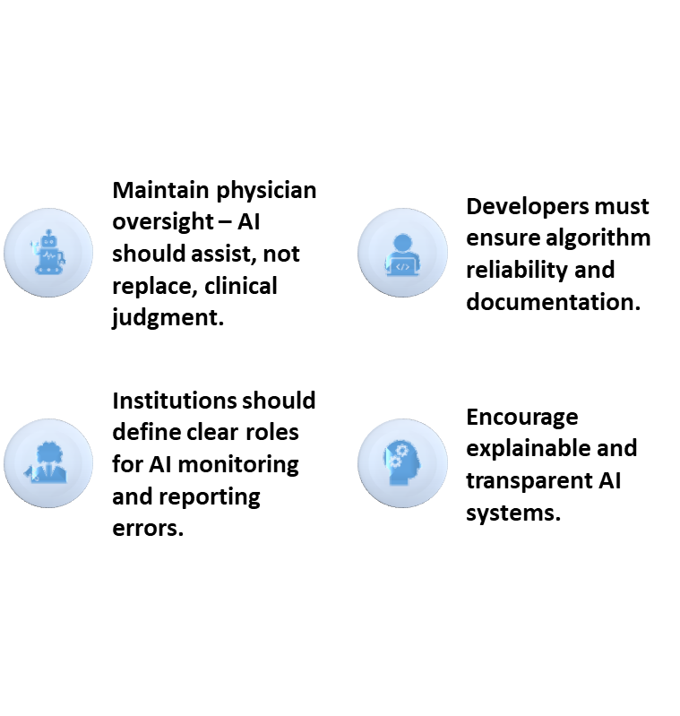

Accountability

Slide 20
AI Risk Reduction Strategies
Verify responses and validate sources
Business Associate Agreement
Cybersecurity strategy includes encryption, access controls and security audits
Patient transparency
Policy development

Slide 21

Integrating AI Into your practice
Start small
Involve your team
Choose clinician-centric tools
Monitor metrics
Stay updated

Slide 22

Integrating AI Into your practice
Where to start?​
  Pick one area of your practice to focus on.​
  Begin with pilot projects rather than full-scale rollout.1
  Accuracy, control, privacy and EHR integration are key before trusting AI.2
  Clinical artificial intelligence quality improvement​.
  Risk-management tip: keep the first use-case low risk, avoid core diagnostic decisions initially, review vendor claims and performance.1

Slide 23

Integrating AI Into Your Practice
Engage Your Staff – Build Workflow & Culture
Staff (nurses, medical assistants, front desk, billing) need to understand purpose, benefits, and roles.
Clinician acceptance is critical.
Workload impact, trust, risk—drive adoption.³
Open Communication
Communicate why you’re doing this (value-add, risk mitigation)
Train staff on new workflows, roles, AI tool usage.
Collect feedback from staff early – adjust workflows accordingly.
Define governance: who reviews outputs, who escalates issues, who monitors performance.
Word of caution: Integrating AI without staff understanding can create workflow breakdowns, trust erosion, patient-safety concerns.
"Engagement equals trust. Trust equals adoption." -Stephen Covey
This Photo by Unknown Author is licensed under CC BY-NC-ND
Notes:
https://www.fda.gov/medical-devices/software-medical-device-samd/artificial-intelligence-and-machine-learning-aiml-enabled-medical-devices 882 authorized artificial intelligence/machine learning devices
https://hitrustalliance.net/navigating-the-security-risks-of-ai-in-healthcare/#:~:text=Resistance%20to%20adoption%20by%20health,violations%2C%20ransomware%2C%20and%20malware.

Slide 24

Integrating AI Into Your Practice
Key criteria for selecting tools
  Seamless integration with your EHR/workflow.²
  Clinician control: tools that support, not replace decision-making.
  Transparency & explainability: clinicians should understand how the tool works.⁴
  Vendor due-diligence: data security, privacy, liability, accuracy, ongoing maintenance.
Fit the use-case: e.g., documentation, pre-visit triage, chronic-disease monitoring, analytics—choose what your practice needs and can support.
Word of Caution: Tools that are overly ambitious or mis-matched to workflow risk being under-used or causing harm.⁵

Slide 25

Integrating AI Into Your Practice
Monitor Metrics & Performance ¹
  Define success metrics up front: e.g., time saved per visit, documentation error rate, coding accuracy, patient satisfaction, staff satisfaction, workflow impact.
  Monitoring is essential: AI models may degrade over time.
  Establish an “AI-QI” (quality improvement) process: continuous monitoring, review of outputs, error tracking, reliance on human oversight.
  Also monitor unintended consequences: patient-physician relationship changes, documentation quality, bias, trust issues.
This Photo by Unknown Author is licensed under CC BY-NC-ND

Slide 26

Integrating AI Into Your Practice
Stay Updated – Regulation, Ethics, Technology
  Regulatory and ethical frameworks are evolving.⁵
  Be aware of liability
    Use-cases of AI in clinical decision-making raise issues of responsibility & oversight.⁶
  Technology evolves quickly: stay current on vendor updates, change in AI functionality, security/privacy changes, vendor support.
  Governance
    Have policies for AI deployment, vendor oversight, data governance, auditing.
  Practice tip: Review your AI-tool contracts annually, ensure vendor provides performance data, update training for staff, revisit use-cases.
This Photo by Unknown Author is licensed under CC BY-SA-NC

Slide 27

Conclusion
Thoughtful, strategic, and patient-centered AI adoption.
Start small – focus on simple, high impact.
Choose tools that support, not replace, clinical judgment.
Prioritize accuracy, privacy, and transparency.
Have a QI process – monitor, refine, improve.
Maintain strong governance and ongoing staff education.
AI amplifies, not replaces, physician expertise.
Goal: Less time on screens, more time with patients.
"AI won’t replace physicians—but physicians who use AI wisely may outperform those who don’t." -Jesse Ehrenfeld, MD, AMA president
© shutterstock/VesnaArt

Slide 28
References
“Clinical artificial intelligence quality improvement: towards continual monitoring and updating of AI algorithms in healthcare.” BMJ Health Care Inform. 2022/23.
“What medical practices need before trusting AI.” The Intake (Tebra) Sept 17 2025.
“Physicians’ perceptions of artificial intelligence: Focus on workload, risk, trust, clinical decision making, and clinical integration.” Healthcare (MDPI). 2024/25.
Lekadir K, et al. “FUTURE-AI: international consensus guideline for trustworthy and deployable artificial intelligence in healthcare.” 2023.
Iannone S, Kaur A, Johnson K.B. “Artificial Intelligence in Outpatient Primary Care: A Scoping Review on Applications, Challenges, and Future Directions.” J Gen Intern Med. 2025.
Morell et al. “The oversight of autonomous artificial intelligence: lessons from nurse practitioners as physician extenders.” Journal of Law and the Biosciences, Volume 9, Issue 2, July-December 2022.

Slide 29

Thank You

