Slide 1
Managing Inpatient Hyperglycemia: Moving to a basal/mealtime/corrective approach
Dr. Linda Thurby-Hay
Clinical Nurse Specialist
June 2024

Slide 2
Introduction
Course correction
Inpatient care standards
Case studies
Notes:
This presentation will be in four parts…

Slide 3
Introduction
Notes:
The American Diabetes Association states a three-fold rationale for controlling BGs. When blood glucoses are controlled while hospitalized, patients have 1) better outcomes; 2) reduced number of days in the hospital; and 3) fewer readmissions and ER visits

Slide 4
New Diagnosis Type 2 diabetes
REACTIVE APPROACH
51-year-old Hispanic female
Gestational diabetes 15 years ago
Family history of diabetes on both sides
Admission BG 236. A1c 8.3%
New diagnosis of Type 2 diabetes
Treated with correction insulin ONLY
Notes:
Now, let’s begin by looking at a common scenario:
A 51 y.o. Hispanic female presented with RLQ abdominal pain of two days duration. Pain was described as sharp and stabbing and measuring 8 on a 10-point scale. Aggravating factors included usual movement as well as riding over bumps. Nothing relieved the pain. PMH included GDM and ADD => Underwent an appendectomy
The CNS diabetes management service was consulted on the day of discharge. We noted that her Bgs had been in the 200s throughout her hospital stay, and that sliding scale insulin was the approach used. * We know that 50% of those who experienced GDM will convert to Type 2 diabetes within ten (10) years. The sliding scale insulin approach was ineffective in achieving inpatient BG targets of 140-180mg/dl.
The opportunity to establish an effective discharge diabetes medication regimen as well as provide survival skill education regarding her new diagnosis of Type 2 were missed. **

Slide 5
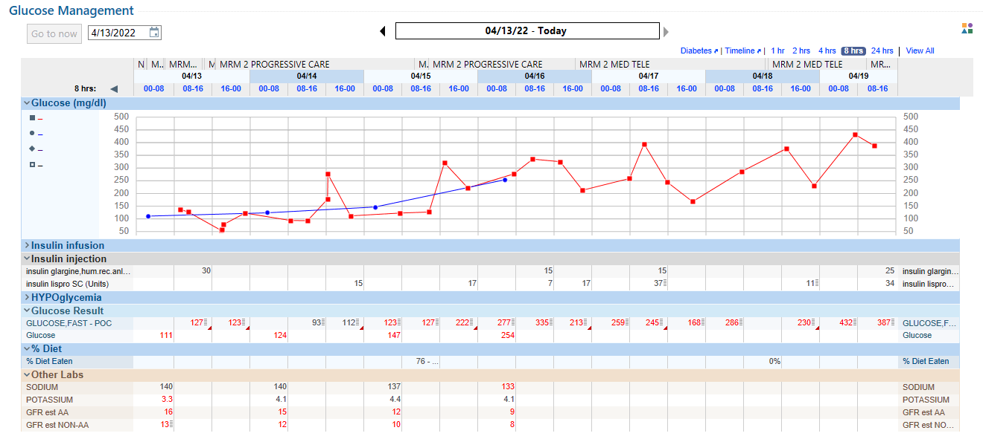
REACTIVE APPROACH
80-year-old AA female
Known Type 2 diabetes with kidney disease
On insulin therapy at home
Weight 74 kg/BMI 24
No record of oral intake
Notes:
Our second case is more complicated:
2) An 80-year old AA female, with known Type 2 diabetes, seeks care at our facility. Her home medication regimen included insulin therapy. On day one, her home insulin dose was ordered and she experienced hypoglycemia. * There is no record of whether she was eating. Subsequently, the insulin orders were changed to a sliding scale insulin, reactive approach.
Even in the setting of kidney dysfunction, you can see that her blood glucoses rose over the next two days as the sliding scale insulin approach was implemented. ** On day 4, a basal insulin dose was started but you can also see that she requires a significant amount of corrective insulin for those two days as we play “catch up.” *** This is unsuccessful in achieving BG targets. On day 6, she again receives no basal insulin. So by day 7, her BG reaches the 400s. ****
=> The reactive insulin doesn’t work.
My concern is that we have demonstrated to the patient that an educated, professional staff can’t manage blood glucose very well.

Slide 6
American Diabetes Association
“High-quality hospital care for diabetes requires standards for care delivery, which are best implemented using structured order sets and quality improvement strategies for process improvement.”
American Diabetes Association. (2024). Standards of Care in Diabetes-2024. Diabetes Care 47 (Supplement_1):S295–S306
Notes:
The American Diabetes Association sets the standard for how the best care can be achieved: “Diabetes management in the inpatient setting is facilitated when a dedicated inpatient diabetes service applies well-developed and validated standards of care, and transitions patients to the outpatient setting with a management plan. This approach shortens hospital stays, reduces the need for readmission and emergency department visits, and improves overall health outcomes.”

Slide 7
ADA Standard 16.3 When caring for hospitalized people with diabetes (with
an existing or new diagnosis) or stress hyperglycemia, consult with a
specialized diabetes or glucose management team when accessible. B
Clinical Nurse Specialist
DIABETES MANAGEMENT CONSULT SERVICE
Linda Thurby-Hay DNP,
APRN, ACNS-BC,
BC-ADM, CDCES
Trina Carter MSN,
APRN, AG-CNS
Shelly Milburn MSN,
APRN, AG-CNS, BC-ADM
Lauren Turner MSN,
APRN,AG-CNS, BC-ADM
Michele Smithson MSN,
APRN,AG-CNS
Educated at either the master’s or doctoral level
Nationally certified as Clinical Nurse Specialists
SERVICE: Provide advanced clinical expertise in diagnosis & intervention to prevent, remediate, or alleviate illness and promote health
Prescribe & bill for care services
Notes:
These are my colleagues & implementers of state of the science diabetes care

Slide 8
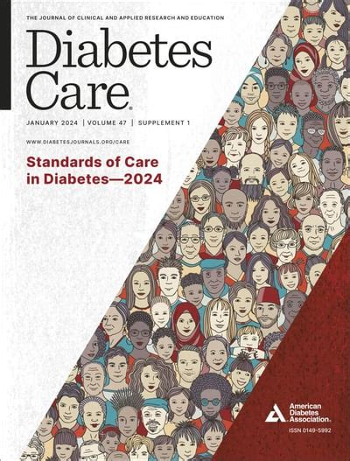
ADA Standard 16.1 Perform an A1C test on all people with diabetes or hyperglycemia (random blood glucose >140 mg/dL [>7.8 mmol/L]) admitted to the hospital if no A1C test result is available from the prior 3 months. B
ADA Standard 16.2 Institutions should implement protocols using validated written or computerized provider order entry sets for management of dysglycemia in the hospital (including emergency department, intensive care unit [ICU] and non-ICU wards, gynecology-obstetrics/delivery units, dialysis suites, and behavioral health units) that allow for a personalized approach, including glucose monitoring, insulin and/or noninsulin therapy, hypoglycemia management, diabetes self-management education, nutrition recommendations, and transitions of care. B
Notes:
The ADA provides guidance to improve patient outcomes as “Hyperglycemia, hypoglycemia, and glucose variability are associated with adverse outcomes, particularly increased morbidity and mortality.”
1) The first recommendation is intended to determine the level of diabetes control in those that already have a diagnosis, which can guide the inpatient team in medication management, but getting A1cs also identifies the undiagnosed;
2) The second recommendation discourages the reaction approach

Slide 9
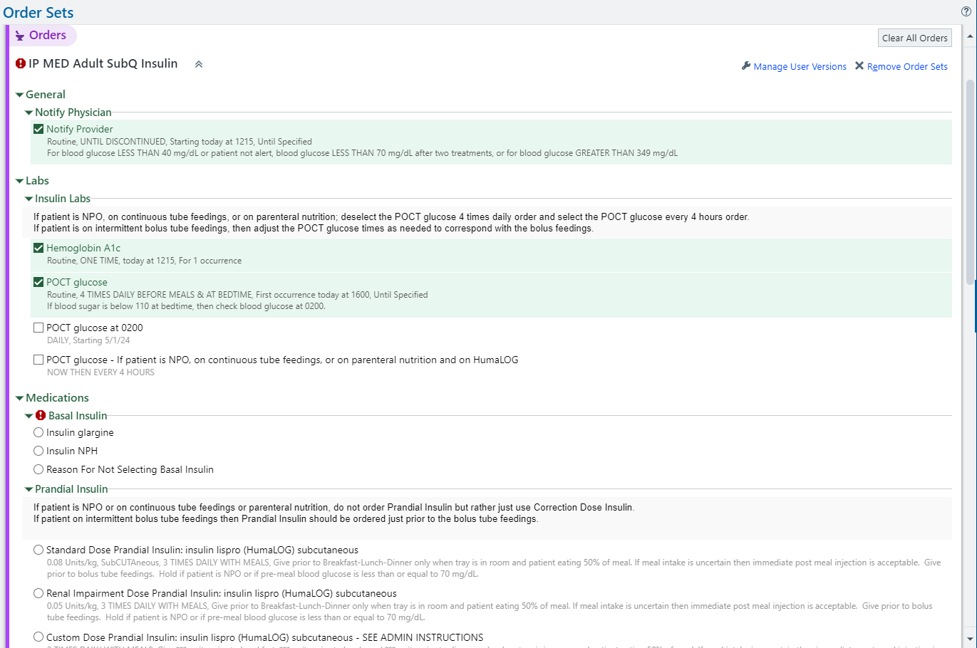
Subcutaneous Insulin Order set
Notes:
At our organization, a SQ insulin order set is available and should be the first step in optimizing hyperglycemia. The hospitalist is prompted to initiate the order set after two (2) blood glucoses are greater than 180mg/dl. The hospitalist, through the order set, draws an A1c and is guided to start basal insulin with or without mealtime insulin ALONG WITH corrective insulin.

Slide 10
Course correction
Evidenced-based findings
Notes:
I want to share the evidence from the literature for hyperglycemia management while people are hospitalized.

Slide 11
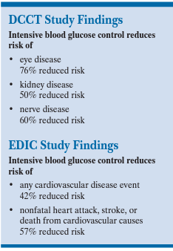
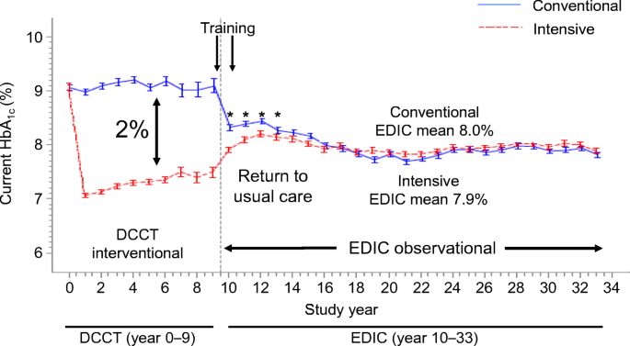
Chronic hyperglycemia & morbidity: Type 1 diabetes
Study group: 1441 children with Type 1 diabetes
Compared intensive control of blood glucose to standard control on diabetic complications
Goal: Keep A1c levels close to normal
Notes:
Two landmark studies initiated our course correction in hyperglycemia management:
1) The first study (DCCT) was conducted in those with Type 1 diabetes with the intention of determining if intensive blood glucose control was better than conventional therapy in preventing complications. Over 1400 kids with diabetes were studied. The interprofessional team worked closely with the patients to get & keep BGs in target. All DCCT participants were monitored for common diabetes complications. You can see the initial findings in the blue box on the right side of the slide:
A 76% reduction in risk of developing diabetic retinopathy;
A 50% reduction in the development of kidney disease, as well as slowing of the progression of nephropathy; and
A 60% reduction in the risk of developing neuropathy.
But what you need to also note is these patients continued to be followed (and are still being followed). The EDIC study findings demonstrate a reduced risk of CV disease, cardiac events, stroke and death, despite the return of A1cs to 8% as noted inside the purple box.

Slide 12
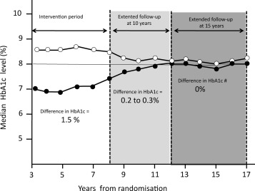
Chronic hyperglycemia & morbidity: Type 2 diabetes
Study group: 5102 adults with Type 2 diabetes
Compared intensive control of blood glucose to standard control on diabetic complications
Goal: Keep A1c levels close to normal
44-year follow-up findings:
Insulin injections or sulfonylurea tablets led to:
11% fewer deaths
26% fewer diabetic complications such as kidney failure and vision loss
Metformin led to 31% fewer heart attacks and 25% fewer deaths
https://www.dtu.ox.ac.uk/generic/article.php?ArticleID=350
Notes:
2) The second landmark study was UKPDS, which focused on the Type 2 population. Over 5000 adults were followed to answer the same question: Does Bg matter? Those who were intensively controlled had fewer deaths and diabetic complications.
These patients have continued to be studied. The results show that the legacy effects * of implementing intensive blood glucose control right after diagnosis continue to persist for up to 44 years. Early intensive blood glucose control with insulin injections or sulfonylurea tablets led to 11% fewer deaths and 26% fewer diabetic complications such as kidney failure and vision loss. Early intensive blood glucose control with metformin led to 31% fewer heart attacks and 25% fewer deaths.

Slide 13
ACUTE HYPERGLYCEMIA: Establishing the blood glucose target
Study | Setting | Glucose (mg/dl) | Mortality
DIGAMI (1999) | CCU (620 pts) | 172 vs 210 | 28% reduction in IT*
Furnary et.al. (2004) | CCU (4864) | 177 vs 214 | 50% reduction in IT*
Van den Berghe (2001) | Surgical ICU (1548 pts) | 103 vs 153 | 34% reduction in IT*
Van den Berghe (2006) | Medical ICU (1200 pts) | 111 vs 160 | 18% reduction in IT*
VISEP | Medical ICU | 112 vs 151 | No difference
Glucontrol (2008) | Medical-surgical ICU (1078 pts) | 117 vs 144 | No difference
NICE-SUGAR | Med-surg ICU | 115 vs 144 | No difference
140-180mg/dl
* = Intensively treated
Adapted from John Clore MD
Notes:
Moving to the inpatient environment, a series of studies were conducted to determine the BG target for those cared for in critical care units. You can see a reduction in mortality in those who were intensively treated. Progressively, studies delineated the “sweet spot” for inpatient blood glucose control. ADA & American College of Physicians then recommended a target glucose between 140-180mg/dl. *

Slide 14
Acute hyperglycemia in non-CC setting: Systematic Review & Meta-analysis
Search method: Medline (MESH), EMBASE, SCOPUS & Cochrane Library
Selection criteria: RCTs, observational studies & retrospective studies comparing BBI with SSI for treatment of hyperglycemia during hospitalization of non-critically ill patients with Type 2 diabetes
Results: Of the 817 studies identified, 5 RCTs, 2 observational, prospective studies and 5 retrospective studies
Conclusions: Basal/bolus strategy results in significantly lower mean daily BG but increases the risk of mild hypoglycemia
Christensen MB, Gotfredsen A & Norgaard K. (2017). Efficacy of basal-bolus insulin regimens in the inpatient management
of non-critically ill patients with Type 2 diabetes: A systematic review and meta-analysis.
Diabetes Metab Res Rev. 33:e2885. https://doi.org/10.1002/dmrr.2885
Notes:
There are two (2) systematic reviews that have been concluded the impact of a scheduled insulin strategy, a proactive approach in non-CC settings.
In this first review from 2017, Christenson and colleagues examined 5 RCTs, 2 prospective studies and 5 retrospective studies. They concluded that a basal/bolus strategy does a better job of getting Bgs to target *

Slide 15
Acute hyperglycemia in non-CC setting: Cochrane Systematic Review
Search method: Medline, Embase, LILACS &Cochrane Library through 12/2017
Selection criteria: RCTs comparing SSI with other strategies for glycemic control in non-critically ill hospitalized adult participants with diabetes
Results: Of 720 records screened, eight trials that randomized 1048 participants with Type 2 diabetes (387 SSI vs 615 basal/bolus)
Conclusions: Basal/bolus strategy achieves short-term glycemic control but increases the risk of hypoglycemia
Colunga-Lozano LE, Gonzalez Torres FJ, Delgado-Figueroa N, Gonazalez-Padilla DA, Hernandez AV, Roman Y,
Cuello-Garcia CA. (2018). Sliding scale insulin for non-critically ill hospitalized adults with diabetes mellitus.
Cochrane Database of Systematic Reviews, Issue 11. Art. No. CD011296.
Notes:
In this 2018 Cochrane review, Colunga-Lozano & colleagues evaluated 8 trials with a total of 1048 patients and concluded that a scheduled insulin strategy, again a proactive approach, did a better job of getting Bgs to target *

Slide 16
Inpatient diabetes care standards
American Diabetes Assocation
Notes:
So, what is the proactive approach to hyperglycemia?

Slide 17
ADA Standard 16.1 Perform an A1C test on all people with diabetes or hyperglycemia (random blood glucose >140 mg/dL [>7.8 mmol/L]) admitted to the hospital if no A1C test result is available from the prior 3 months. B
ADA Standard 16.2 Institutions should implement protocols using validated written or computerized provider order entry sets for management of dysglycemia in the hospital (including emergency department, intensive care unit [ICU] and non-ICU wards, gynecology-obstetrics/delivery units, dialysis suites, and behavioral health units) that allow for a personalized approach, including glucose monitoring, insulin and/or noninsulin therapy, hypoglycemia management, diabetes self-management education, nutrition recommendations, and transitions of care. B
Notes:
The ADA provides guidance to improve patient outcomes as “Hyperglycemia, hypoglycemia, and glucose variability are associated with adverse outcomes, particularly increased morbidity and mortality.”
1) The first recommendation is intended to determine the level of diabetes control in those that already have a diagnosis, which can guide the inpatient team in medication management, but getting A1cs also identifies the undiagnosed;
2) The second recommendation discourages the reaction approach

Slide 18
Differentiating diabetes types
Characteristic | Type 1 | Type 2
Etiology | The body no longer makes insulin | The body makes insufficient amounts of insulin and/or uses insulin inefficiently
Age | Often develops during childhood but can develop at any age | Often develops in adulthood but can develop at any age
Risk factor(s) | Family history | Family history Overweight or obese Chronic physical inactivity
Symptoms | Polyuria, polydipsia, polyphagia and weight loss | May experience no symptoms or the classic symptoms as noted in Type 1 diabetes. Acanthosis nigricans along neckline or in skin folds. Fatigue
Prevention | None at this time | Healthy lifestyle
Treatment | Insulin | Weight loss Meal planning Regular physical activity Non-injectable medicines & a variety of injectables
Notes:
As the inpatient strategy is considered, a history of the patient’s journey with diabetes is gathered in order to flush out the type of diabetes the patient has so the care approach is appropriate.

Slide 19
Notes:
In those with Type 2 diabetes, where the patient is on their diabetes journey should be discovered as there is a natural loss of beta cell function. You can see here that, after 10-15 years, the patient’s ability to make insulin falls. This is when insulin is often added to their outpatient medication regimen. If omitted, they may develop HHNK, particularly under times of physical stress.

Slide 20
PROACTIVE APPROACH
Basal
Provides insulin to meet basic metabolic needs
Mealtime
Provides insulin to override rise in blood glucose from carb consumption
Correction
Provides insulin to bring blood glucoses back into range
Considers state of insulin resistance & kidney function
Weight-based (0.2 - 0.4 units/kg/D)
Insulin resistance-based
Notes:
The proactive approach to hyperglycemia management is illustrated in this graphic:
Basal insulin is intended to control blood glucose when patients are not eating. It is the amount of insulin the patient needs to meet basic metabolic needs
Bolus or mealtime insulin is intended to override the expected rise in BG from carbohydrate consumption and is dosed based on the prescribed amount of mealtime carbohydrate
Corrective insulin is intended to fine-tune insulin dosing and establish the true basal dose

Slide 21
INPATIENT DIABETES EDUCATION
Identification of the health care professionals who will provide diabetes care after discharge
Level of understanding related to the diabetes diagnosis, glucose monitoring, home glucose goals, and when to call the health care professionals
Definition, recognition, treatment, and prevention of hyperglycemia and hypoglycemia
Information on making healthy food choices at home and referral to an outpatient registered dietitian nutritionist or diabetes care and education specialist to guide individualization of the meal plan, if needed
When and how to take blood glucose-lowering medications, including insulin administration.
Sick-day management
Proper use and disposal of diabetes supplies, e.g., insulin pen, pen needles, syringes, and lancets
American Diabetes Association. (2024). Standards of Care in Diabetes-2024. Diabetes Care 47 (Supplement_1):S295–S306
Notes:
Diabetes self-management knowledge and behaviors should be assessed on admission, and diabetes self-management education provided (if available), especially if a new treatment plan is being considered.
The ADA outlines these topics as essential to ensuring a safe transition to the ambulatory setting

Slide 22
Hyperglycemia management
Setting | Blood glucose targets
Critical care | 140 – 180 mg/dl
Non-critical care | 100 – 180 mg/dl
Cardiac surgery | 90 – 130 mg/dl
ADA Guidance regarding blood glucose monitoring:
POC blood blood glucose monitoring should be performed before meals or every 4-6 hours when not eating;
Hospital blood glucose monitoring should be performed via FDA-approved POC hospital-calibrated systems;
People using personal continuous glucose monitoring (CGM) may continue its use while hospitalized with confirmatory POC blood glucose monitoring measurements for insulin dosing decisions and hypoglycemia assessment
Notes:
The targets are noted in this table.

Slide 23
Case studies
Applying the standard

Slide 24
Stress hyperglycemia
85 year-old Caucasian male experiencing dyspnea, peripheral edema & generalized weakness
Lab:
A1c 6.3%
BNP 3740
Troponin 494
Lactic acid 9.7
Blood gas: on 6LNC
pH 7.41
pC02 20.6
p02 53
pC02 13
CXR: Pulmonary edema
CT Chest: Cardiomegaly, small bilateral pleural effusions, CAD at the LAD, circumflex & RCA
CT Abdomen: Hepatic venous congestion & hepatic steatosis
ECHO: RV and LV dilatation with visualized reduced systolic function
Notes:
A common occurrence in the hospital setting is seen here, demonstrating the challenge to the pancreatic beta cell to produce enough insulin to respond to stress
This 85 year-old Caucasian male was admitted after experiencing dyspnea, peripheral edema and generalized weakness. A CXR demonstrated pulmonary edema. The CTs identified pleural effusions and hepatic congestion
Initial treatment focused on stabilizing heart function. What should be noted is the elevated admission BG of 275. Following the ADA guidance of obtaining an A1c, we find this gentleman has pre-diabetes with an A1c of 6.3%, which should prompt a conversation with the patient and communication with the ambulatory provider
In this setting of physiologic stress, we see the impact of catecholamines => liver glycogen is released resulting in hyperglycemia. With stabilization of the symptoms prompting his admission, BGs normalized without medication. This is in line with recommendations that a proactive approach be initiated when Bgs rise above the 140-180mg/dl targets on 2 or more occasions

Slide 25
PROACTIVE APPROACH
Basal
Provide insulin to meet basic metabolic needs
Correction
Brings blood glucose back into range & assists in establishing true basal dose
Weight-based (0.2 - 0.4 units/kg/D)
Considers state of insulin resistance & kidney function
Notes:
It would be appropriate to begin with a basal/corrective approach in those who are insulin naïve, NPO or not consuming much orally.

Slide 26
Medical admission: Basal/correction strategy
ADA Standard 16.8 Basal insulin or a basal plus bolus correction insulin plan is the preferred treatment for noncritically ill hospitalized individuals with poor oral intake or those who are taking nothing by mouth.
80 year-old AA male with personal & family history of Type 2 diabetes experiencing facial droop, garbled speech and left-sided extremity weakness beginning two (2) hours ago
Weight/BMI: 99 kg/28
Lab:
Diabetes A1c 10.8%, BG 326
Hematology Elevated WBC, H&H, platelets
Creatinine/GFR 1.6/40
Liver enzymes Normal
CT Head: Acute ischemic stroke
EKG: Atrial fibrillation
ER Treatment: IV thrombolysis
Home diabetes regimen:
Metformin (generic)
Glimiperide (Amaryl)
Empaglifozin (Jardiance)
Notes:
Let’s look at a patient who comes to the ER with acute symptomatology. She is insulin naïve and not eating. In this case, an 80 year-old AA male was experiencing facial droop, garbled speech and left-sided weakness. A CT revealed an ischemic stroke, likely caused by thrombus from Afib. An ALTEPLASE infusion was given
Initially, BGs were elevated in the 300s. A proactive approach was taken, starting with a basal dose @0.2 units/kg, e.g., 20 units of Lantus insulin. This starting point for basal insulin dosing was chosen because the patient is insulin naïve and slightly overweight. Correction insulin was also initiated to begin establishing an appropriate basal insulin dose. In this case, by day three, the patient was consistently using an additional 10 units of correction insulin so the basal insulin dose would be increased to 30 units D. Establishing a basal insulin dose eliminates multiple insulin injections when patients aren’t eating and reduces the work of nursing
What also should be noted is that the home diabetes regimen of metformin, Amaryl & Jardiance had been insufficient to achieve the ambulatory A1c target of 7%. Exploration of this man’s home diabetes practices revealed that he could not afford the Jardiance and had stopped taking the medication after the coupon for reduced medication cost ran out. His primary care provider was unaware of this
This basal/correction strategy is instructive in establishing an initial basal insulin dose

Slide 27
PROACTIVE APPROACH
Basal
Provides insulin to meet basic metabolic needs
Mealtime
Provides insulin to override rise in blood glucose from carb consumption
Correction
Provides insulin to bring blood glucoses back into range
Considers state of insulin resistance & kidney function
Weight-based (0.2 - 0.4 units/kg/D)
Insulin resistance-based
Notes:
In the next scenario, a basal/mealtime/corrective approach will be used.

Slide 28
Medical admission: Basal/mealtime strategy
ADA Standard 16.9 An insulin plan with basal, prandial, and correction components is the preferred treatment for most noncritically ill hospitalized individuals with adequate nutritional intake. A
54 year-old AA female with personal & family history of Type 2 diabetes experiencing syncope and left groin pain. Denied fever, chills and leg trauma
Weight/BMI: 90 kg/37
Lab:
Diabetes A1c 13%, BG 383
Hematology Elevated WBC
Creat/eGFR 0.9/>60
CT LLE: 5.8X3.8X5.2 cm abscess with cellulitis
Treatment: I&D abscess
Home diabetes regimen:
Metformin 500mg D
Trulicity 0.75mg weekly
Lantus insulin 60 units D
Notes:
This 54 year old AA female was admitted with thigh abscess that was quickly lanced & drained. A home dose of 60 units of basal insulin is well over weight-based guidance. Since she is obese and it was suspected she was not taking that amount of insulin, insulin was started at 0.3 units/kg/D and mealtime insulin added. This brought Bgs to target and will likely assist in transitioning to home dosing. *

Slide 29
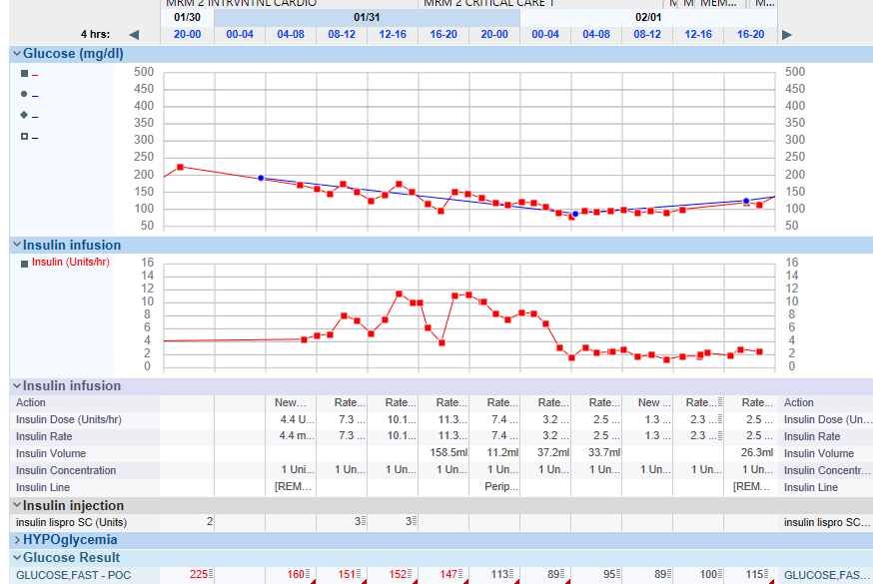
Cardiac surgery: Insulin infusion
ADA Guidance: Continuous intravenous insulin infusion is the most effective method for achieving specific glycemic goals and avoiding hypoglycemia in the critical care setting.
76 year-old Caucasian female with Type 2 diabetes & surgically-treated breast cancer admitted for planned CV surgery after experiencing dizziness, chest pressure, palpitations, dyspnea, LE edema & fatigue
Weight/BMI: 90 kg/36
Lab:
Diabetes A1c 8.4%, BG 202
Hematology Normal WBC, H&H, platelets
Creatinine/GFR 1.1/52
Liver enzymes Normal
CXR: No acute process noted
Cardiac cath: Severe 4 vessel CAD
ECHO: Normal left ventricular systolic function with a visually estimated EF of 60 - 65%. Left ventricle size is normal. Normal wall thickness. Normal wall motion. Normal diastolic function
Notes:
The insulin needs are quite different for this 76 year-old Caucasian female. She was admitted for planned cardiovascular surgery, after experiencing dizziness, chest pressure, palpitations, dyspnea, peripheral edema and fatigue. She has known Type 2 diabetes but has an A1c out of target range at 8.4%.
She was admitted 24 hours early to normalize BGs so she would be in the best possible position to heal post-operatively. You can see she required a fair amount of insulin * to establish good blood glucose control. **
Since the standard of care post-cardiac surgery at our organization is the more stringent BG target of 95-130mg/dl, you can see this woman is requiring 2.3-2.5 units/hr to achieve desired BG targets

Slide 30
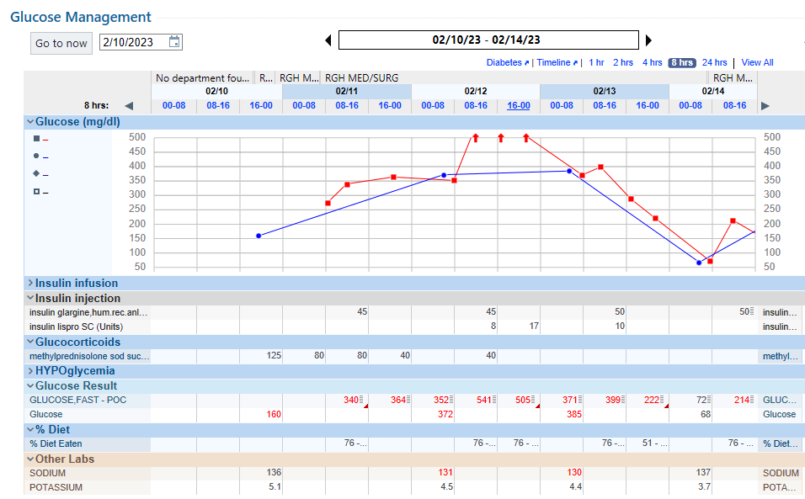
ICU admission
86 year-old Caucasian male with personal history of Type 2 diabetes for past five (5) years; family history of diabetes in father
Experiencing dyspnea with wheezing and marked peripheral edema. Known history of heart failure, OSA (on Cpap) and Afib (on anticoagulation)
Weight/BMI: 123 kg/42
Lab:
Diabetes A1c 6%. BG 160
Hematology Elevated WBC, Hgb 9.3/Hct 30.1
Creat/eGFR 1.5/43
Liver enz Normal
CXR: Pulmonary edema
Home diabetes regimen:
Lantus insulin 50 units D
Notes:
This 86 year old Caucasian male was transferred to our facility from an outside facility with dyspnea, wheezing and peripheral edema. He has known heart failure, sleep apnea and Afib. He was found to have pulmonary edema and was treated with pulmonary meds, steroids, diuretics and prophylactic antibiotics.
You can see he is quite heavy and that his home dose of basal insulin is dosed at 0.4 units/kg/D. The ICU team started basal insulin dose at abit less than home dose on 2/11/23. * In the setting of steroids, you can see that his BGs rose into the 500s by 2/12/23. ** Corrective insulin resulted in hypoglycemia. ****

Slide 31
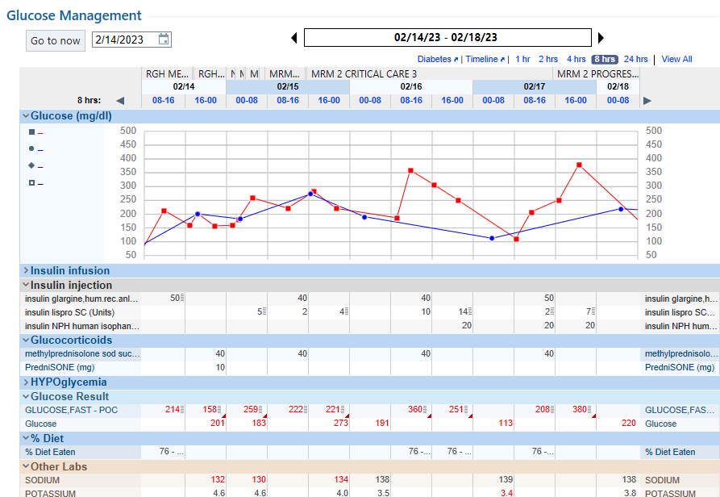
Notes:
A diabetes management consult was placed on 2/16/23. The plan included basal insulin at his home dose, e.g. Lantus insulin 50 units D (so we gave an additional 10 units to get to that dosing) along with NPH insulin twice daily to override the steroids. When methylprednisolone is used, BGs will be impacted over the following 24 hours. We use 0.4 units/kg/D dosing for steroids dosed at 40mg D. This equates to 20 units twice daily.

Slide 32
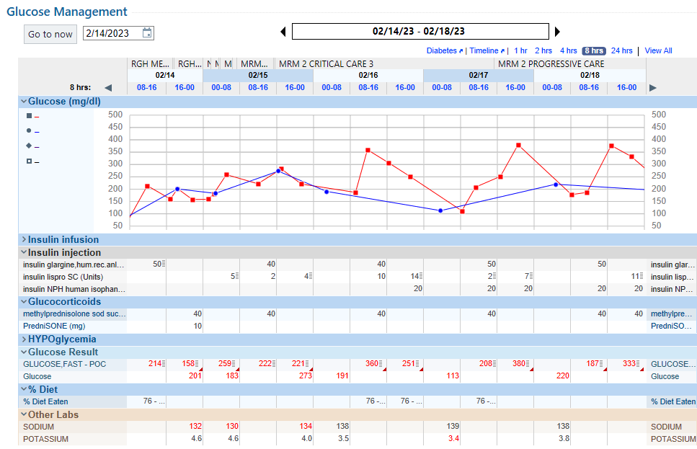
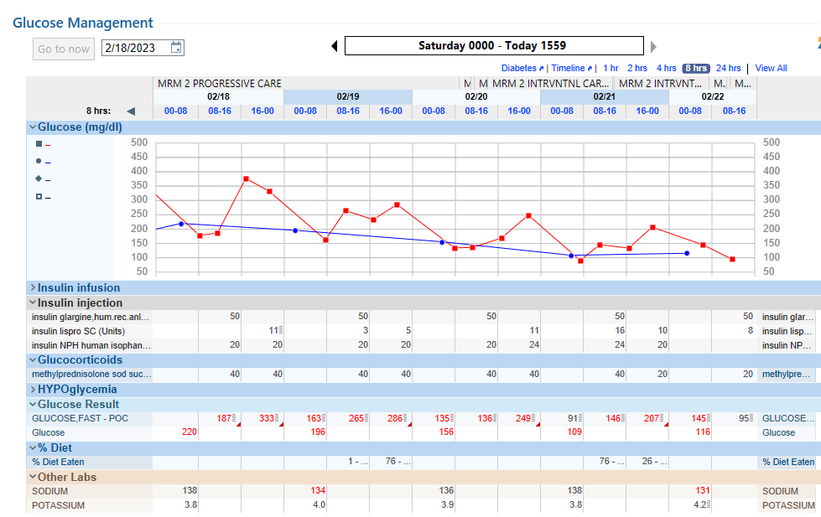
Basal/mealtime strategy
Notes:
By 2/18/23, BGs were reaching targets of <180mg/dl. The patient was beginning to eat so mealtime insulin was added.
2/20/21 The patient was NPO for Cardiac cath: No significant CAD but did have AVS * You note that his BGs were well controlled in the 130s. So, this confirms home basal insulin dosing *
2/21/23 Choking incident generated swallow evaluation. Passed bedside swallow test but patient revealed he had strictures in the past that required dilation => patient was NPO for modified barium swallow **
This demonstrates the effectiveness of basal/mealtime strategies ***

Slide 33
ADA Standard 16.10
The sole use of corrective or supplemental insulin WITHOUT BASAL INSULIN (formerly referred to as sliding scale) is strongly discouraged in the inpatient setting

Slide 34
Hypoglycemia
ADA Standard 16.12 A hypoglycemia management protocol should be adopted and implemented by each hospital or hospital system. A plan for preventing and treating hypoglycemia should be established for each individual. Episodes of hypoglycemia in the hospital should be documented in the electronic health record and tracked for quality assessment and quality improvement. E
ADA Standard 16.13 Treatment plans should be reviewed and changed as necessary to prevent hypoglycemia and recurrent hypoglycemia when a blood glucose value of <70 mg/dL (<3.9 mmol/L) is documented. C
Notes:
The standard of care to highlight is how to handle hypoglycemia.

Slide 35
Summary
Hyperglycemia management in hospitalized patients is supported by evidence that better health outcomes are achieved when blood glucoses are kept in the 100-180mg/dl range
The standard of care for inpatient diabetes management consists of a proactive approach using a basal/bolus/correction strategy
Establishing a basal insulin dose employs use of a basal/correction strategy initially when patients are not eating
Bolus insulin is added when patients are consuming >50% of their meals
A basal/bolus/correction strategy optimizes nursing workflow, providing opportunities to educate patients

Slide 36
REFERENCES
American Diabetes Association. (2024). Standards of Care in Diabetes-2024. Diabetes Care 46(Supplement_1): ):S295–S306
Christensen MB, Gotfredsen A & Norgaard K. (2017). Efficacy of basal-bolus insulin regimens in the inpatient management of non-critically ill patients with Type 2 diabetes: A systematic review and meta-analysis. Diabetes Metab Res Rev. 33:e2885. https://doi.org/10.1002/dmrr.2885
Colunga-Lozano LE, Gonzalez Torres FJ, Delgado-Figueroa N, Gonazalez-Padilla DA, Hernandez AV, Roman Y, Cuello-Garcia CA. (2018). Sliding scale insulin for non-critically ill hospitalized adults with diabetes mellitus. Cochrane Database of Systematic Reviews, Issue 11. Art. No. CD011296.
Malmberg K, Ryden L, Efendic S, Herlitz J, Nicol P, Waldenstrom A, Wedel H, & Welin L. (1995). Randomized trial of insulin-glucose infusion followed by subcutaneous insulin treatment in diabetic patients with acute myocardial infarction (DIGAMI): Effects on mortality at 1 year. JACC, 26(1): 57-65
NICE-SUGAR Study Investigators. (2009). Intensive vs conventional flucose control in critically ill patietns. N Engl J Med, 360: 1283-1297.
NIDDK. (2022). Diabetes control and complications trial / Epidemiology of diabetes interventions and complications (DCCT/EDIC). https://repository.niddk.nih.gov/studies/edic/
Preiser JC, Devos P, Ruiz-Santana S, et.al. (2009). A prospective randomized multi-centre controlled trial on tight glucose control by intensive insulin therapy in adult intensive care units: the Glucontrol study. Intensive Care Medicine, 35: 1738-1748.
Seisa MO, Saadi S, Nayfeh T, et.al. (2022). A systematic review supporting the Endocrine Society: Clinical practice guideline for the management of hyperglycemia in adults hospitalized for non-critical illness or undergoing elective surgical procedures. Journal of Clinical Endocrinology & Metabolism, 107:2139-214 https://doi.org/10.1210/clinem/dgac277

Slide 37
Preiser JC, Devos P, Ruiz-Santana S, et.al. (2009). A prospective randomized multi-centre controlled trial on tight glucose control by intensive insulin therapy in adult intensive care units: the Glucontrol study. Intensive Care Medicine, 35: 1738-1748.
Seisa MO, Saadi S, Nayfeh T, et.al. (2022). A systematic review supporting the Endocrine Society: Clinical practice guideline for the management of hyperglycemia in adults hospitalized for non-critical illness or undergoing elective surgical procedures. Journal of Clinical Endocrinology & Metabolism, 107:2139-214 https://doi.org/10.1210/clinem/dgac277
UKPDS. (2022). Overview. https://www.dtu.ox.ac.uk/ukpds/
Van den Berghe G, Wouters P, Weekers F, et.al. (2001). Intensive insulin therapy in critically ill patients. N Engl J Med, 345(19): 1359-1367.
Van den Berghe G, Wilmer A, Hermans G, et.al. (2006). Intensive insulin therapy in medical ICU. N Engl J Med, 354(5): 449-461.

Slide 38
Thank you
Dr. Linda Thurby-Hay
Linda_Thurby-Hay@bshsi.org
804-764-7885

