Slide 1



ATF INSPECTIONS
KNOW THE TRENDS.
REDUCE THE RISK.

Slide 2


Additional Educational Resources
Industry Compliance Courses & More!
Firearm E-Commerce Blueprint
Unlocking Success in the NFA Space
Winning at ATF Inspections
Completing the Form 4473
Multiple Sales Report
NSSF.org/Education

Slide 3

Why This Matters Now!
About Us.
ATF inspection and enforcement practices continue to evolve
FFLs should distinguish proposed reforms from rules already in effect
Inspection exposure remains concentrated in records, eligibility, and traceability
Early identification of compliance gaps reduces operational and licensing risk!
Call to action

Slide 4
Session Introduction: Attendee Takeaway
  Understand current ATF inspection & enforcement policy
  Identify frequently cited violations and recurring deficiencies
  Recognize conduct that can create heightened revocation risk
  Apply practical controls to improve inspection readiness and compliance

Slide 5
The 2026 Regulatory Reform Context
  On April 29, 2026, DOJ and ATF announced 34 final and proposed rulemaking actions
  ATF described the package as the first in a series of regulatory updates
  Reform themes include repeal, modernization, burden reduction, clarification, and alignment
  FFLs should track effective dates and final text-not rely on proposals as current law: https://www.federalregister.gov/agencies

Slide 6
ATF’s New Administrative Direction
  ATF ended the former Enhanced Regulatory Enforcement Policy
  A new Administrative Action Policy emphasizes traceability and public-safety significance
  ATF says immaterial paperwork errors receive less enforcement emphasis
  Recurring, Willful, or Public-Safety-Significant violations remain high risk

Slide 7
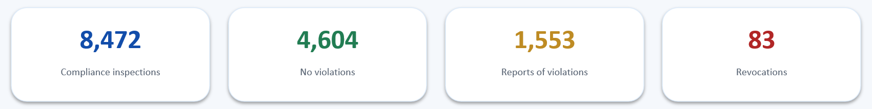
Fiscal Year 2025 ATF Inspection Snapshot
  ATF ended the former Enhanced Regulatory Enforcement Policy
  ATF conducted 8,472 firearm compliance inspections last year
  4,604 inspections resulted in a recommendation of NO VIOLATIONS
  1,553 resulted in Reports of Violations, 677 in Warning Letters
  547 Warning Conferences and 83 revocations were reported by ATF

Slide 8
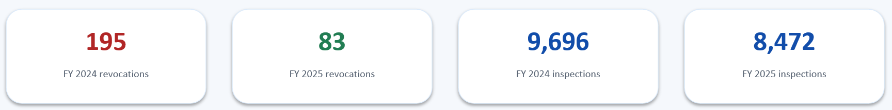
Revocation Trends: 2024 vs. 2025
  ATF ended the former Enhanced Regulatory Enforcement Policy
  FY 2024: 9,696 compliance inspections & 195 revocations
  FY 2025: 8,472 compliance inspections & 83 revocations
  The reported revocations count declined substantially year over year
  Trend data should be read alongside ATF’s changed administrative action policy (ATF O 5370.1H)

Slide 9
text
Most Frequently Cited Violation: A&D Record
  27 CFR § 478.125(e) led FY 2025 citations with 40,763 citations
  Focus areas include accurate, complete, and timely A&D entries for both paper and electronic records
  Inventory discrepancies can impair traceability and trigger inspections and broader review
  Routine reconciliation is one of the strongest preventive controls
text
text

Slide 10
text
Form 4473: Persistent Compliance Exposure
  27 CFR § 478.21(a): forms must be completed and available for inspection
  27 CFR § 478.124(c)(1): obtain a completed Form 4473 when required
  Common errors involve signatures, dates, identification, firearm information, and “Proceed NTNs”
  A disciplined pre-transfer and post-transfer review can catch errors early
text
text

Slide 11
text
NICS & Buyer Eligibility
  Required background checks before transfer unless exceptions apply
  Accuracy in recording NICS or POC responses
  Identification, residency, and documentation must support buyer eligibility
  Transfers to prohibited persons, missed required checks, and straw purchase transactions remain severe risk violations
text
text

Slide 12
text
Multiple-Sale Reporting & Other Required Reports
  ATF continues to cite failures involving required multiple-sale reporting
  FY 2025 recorded 6,608 citations under 27 CFR § 478.126a
  Internal triggers should identify reportable transactions before deadlines expire
  Establish internal controls through management to verify submission, retention, and supporting documentation
text
text

Slide 13
text
Trace Requests & Firearm Accountability
  Traceability remains a central theme in ATF’s administrative approach
  FFLs should maintain records that permit timely identification of firearm dispositions within the allotted timeline
  Failure to respond to an ATF trace request is identified as a revocation-level concern
  Escalation procedures should ensure urgent trace requests reach trained personnel
text
text

Slide 14
A Few High-Risk Revocation Areas
  Transfer of a firearm to a prohibited person
  Falsification of required records (Form 4473 or Bound Book Record)
  Failure to conduct a required background check
  Failure to respond to a trace request or refusal to permit a lawful inspection

Slide 15
Willfulness and Repeat Violations
  ATF describes willfulness as intentional disregard or plain indifference to a known duty/obligation
  A single willful violation can provide a legal basis for license revocation
  Repeat findings can demonstrate knowledge of a requirement and failure to correct it
  Documented remediation after prior inspections is therefore especially important

Slide 16
text
Enforcement Priorities: What Has Not Changed
  ATF continues to emphasize firearm traceability and public safety
  Illegal firearms trafficking and diversion remain central enforcement concerns
  Buyer eligibility and accurate transaction records remain core inspection subjects (are you the actual buyer………)
  Reform does not eliminate statutory or regulatory duties imposed on FFLs
text
text

Slide 17
text
Risk Mitigation: Audit Before ATF Does
  Perform scheduled inventory-to-bound book reconciliations
  Sample Forms 4473 for completeness, signatures, dates, IDs, and NICS documentation
  Review multiple-sale reports and other time-sensitive submissions
  Track findings through documented corrective action and follow-up testing
text
text

Slide 18
text
Inspection Readiness: People, Records & Response
  Train employees on inspection protocol and who is authorized to interact with ATF IOIs
  Keep required records organized, retrievable, and consistent with actual inventory
  Preserve prior inspection findings, corrective actions, and training documentation
  Address discrepancies factually and document remediation without altering historical records
text
text

Slide 19
Key Takeaways & Action Plan
  Know the trend: policy has shifted, but core compliance obligations remain
  Reduce the risk: prioritize traceability, eligibility, records, and required reporting
  Strengthen the program: train, audit, reconcile, document and remediate
  Stay current: ATF Rulemaking, effective dates, guidance, and inspection resources

Slide 20




Don’t Lie Kit’s Available at DontLie.org
20

Slide 21
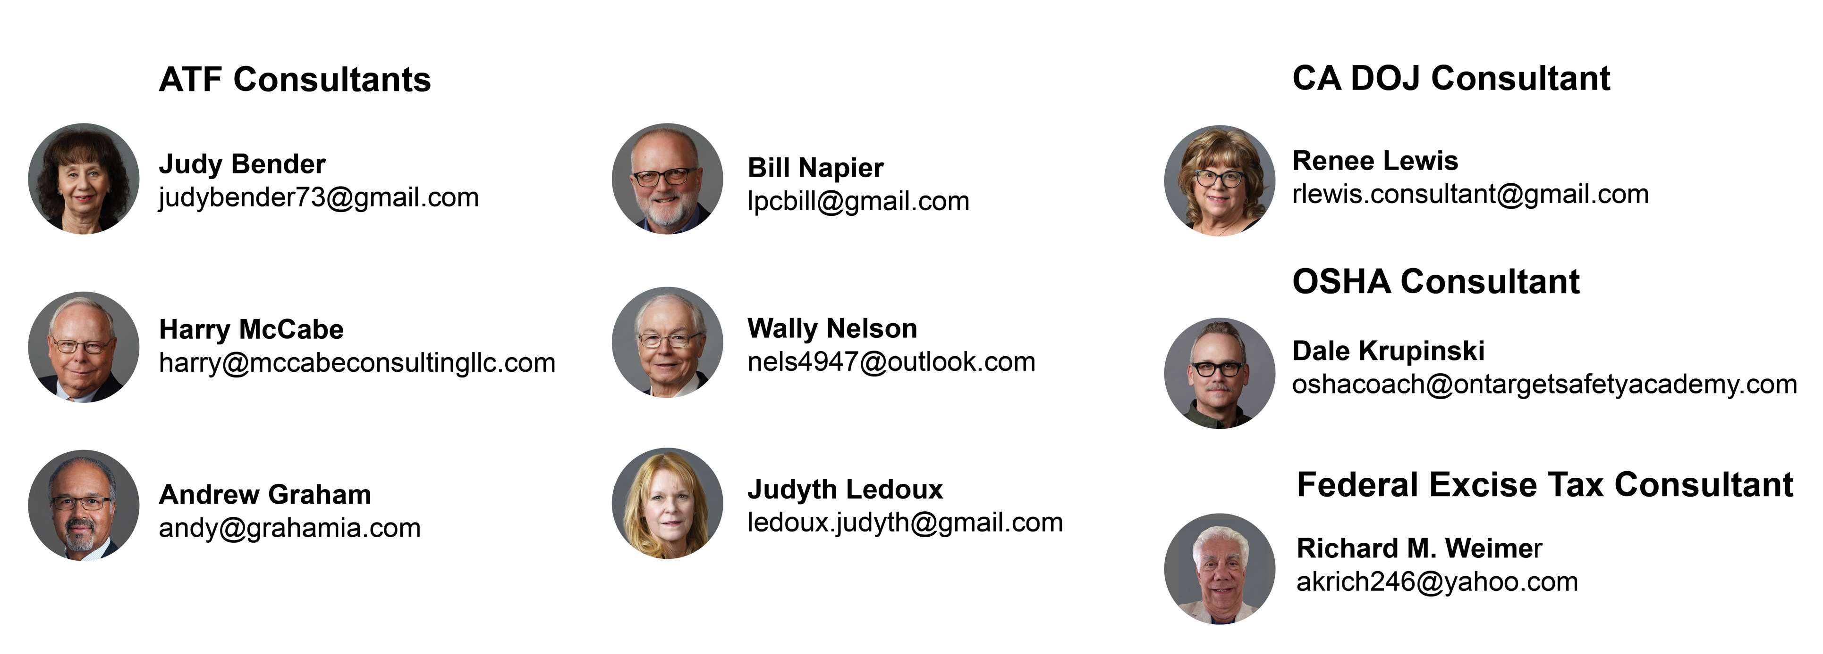
NSSF Member Benefits for Retailers
NSSF Compliance Consultant Team
Compliance Hotline
SHOT University Online
Discounts to Live Events including SHOT Show (first buyer badge is free - additional registrations discounted)
Member Benefit Provider Discounts
Access to Programs Such as
First Shots
nssf.org/membership/join/
NSSF Compliance Hotline
855-FFL-NSSF (335-6773)
21

Slide 22



