Slide 1
Enabling Staff Skill Building–Lessons learned from 10 years of delivering the British Library Digital Scholarship Training Programme
Nora McGregor, Digital Curator, British Library @ndalyrose
Digital Scholarship Meet SLA's Data Community and Military Libraries Community- 10 November 2022

Slide 2
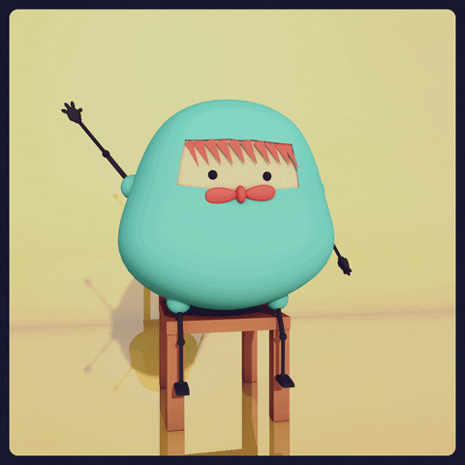
Hello!
I’m Nora McGregor, a Digital Curator in the British Library's Digital Research Team.
Our team’s mission is to enable the use of the British Library’s digital collections for research, inspiration, creativity, and enjoyment
Notes:
The British Library is the national library of the UK.
Our team’s mission is to enable the use of the British Library’s digital collections for research, inspiration, creativity, and enjoyment
But it’s not just our singular mission, this is a shared goal across many areas of the Library in some way or another.
One of the most effective ways we have found for support digital transformation over the last decade is by investing heavily and smartly in our staff skills development through this Digital Scholarship Training Programme we devised.

Slide 3
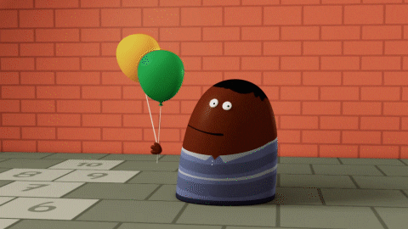
Running continuously since 2012, the DSTP provides unique opportunities for staff to learn how to do cool and useful stuff with our digital collections and data…
…and gain valuable data literacy skills and knowledge to support emerging areas of modern scholarship in the process!
We are celebrating TEN YEARS of the Digital Scholarship Training Programme!
Notes:
It’s bespoke, developed and managed by me and a team of 5 Digital Curators, and now, a full-time Business Support Admin, Digital Scholarship Training Initiatives!
Now, I know that some of you are thinking “well, we don’t have nearly that kind of resource!” or maybe even some of you here are like “I’m a staff of one!”
But I think in sharing our story of how we got here that there are some practical approaches in that experience that might help, no matter your institutional context.

Slide 4
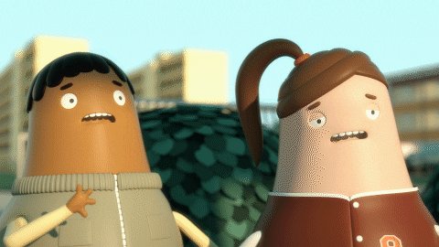
How it all began…
Back in 2010 our small team was formed to “support digital scholarship”….and we quickly realised we had a LOT to learn about what this actually entailed!
So off to school we went!
Notes:
We weren’t always so digitally astute!
When our team was formed in 2010, it was because the library recognised a need to focus attention on the changing landscape of research.
Importantly, the very first job descriptions included a skill building imperative:
Implicitly:
To support curators and other professionals in collections areas in the implementation and integration of digital collections and digital tools into curatorial functions, whether project based or routine.
And explicitly:
To train staff throughout the Library in the opportunities for and practices of digital scholarship.
The team was formed entirely from existing employees, and none of us who moved into the first Digital Curator roles had particularly strong digital skills, what we had was a very strong interest in learning about this new domain and its potential to transform the way we support researchers.
Questions were coming to us of a wholly different nature, instead of just being asked about whether or not a manuscript had been digitised and was available online, we were getting very computationally heavy questions around text mining thousands of newspapers for digital humanities research!
And frankly, we weren’t at all prepared to answer them at the time.

Slide 5
What we learned from digital scholars…
The world of digital tools and methods is INCREDIBLY EXCITING…
“We have GOT to somehow let staff know about all this!”
and practical too-they’re using them to do things that WE care about TOO, like correcting OCR, or normalising and tidying up tons of records, automatically extracting information from digitised texts to understand what’s in them better, etc....
“If we could use these tools and methods too it’d be transformative!”
and these folks aren’t computer and data scientists, they’re REGULAR PEOPLE JUST LIKE US, just, giving it a go…
“We can definitely try this kind of stuff out!”
…but in collaboration with all sorts of other people who have different bits of skills and knowledge to get exciting digital projects done….
“Oh nice. We don’t all have to become programmers there’s a place for everyone in digital scholarship!”
Notes:
It has been crucial that this training remit was established early on in the new role, it has meant that upwards of 20% of our time is dedicated to this giving back. Often times folks have to fight for that time and space in the job to learn, so having a training obligation laid out in the role helps to ensure that. When we learn something, everyone learns something.
So we were tasked with training colleagues in digital scholarship, and yet, had none of this knowledge ourselves yet!
So we fanned out around the UK and abroad and attended every digital humanities course we could find, data centric events and talks around london (like databeers).
What we learned, alongside budding digital scholars, helped to inform not just the content but the ethos itself of what would become our Digital Scholarship Training Programme.
[list]
Crucially, it was by really embedding ourselves in with our target audience and understanding what they needed from us to better support them, we were able to be open minded about what digital knowledge we needed to get there.
We realised the sort of digital transformation required to support our users was going to be a continuous thing, and it wasn’t the sort of need you can capture from a typical digital skills survey (it wasn’t as simple as “Learn Excel” or any other particular technology for a specific end).
It would require some faith from managers across the organisation at first that there is value in allowing people to explore new ideas and experiment on company time, even at the risk that they may not apply the concepts practically straight away. A sort of “lab” mentality. Eventually this pays off!
We also realised that learning (and teaching) this stuff needed to be shared across the Library, digital could not just be the domain of the digital research team in isolation. It has always been important to us that the DSTP was a place for knowledge sharing across, not just broadcasting.
The DSTP represents a dedicated and supported space, a fertile environment, for encouraging and sustaining digital transformation.

Slide 6
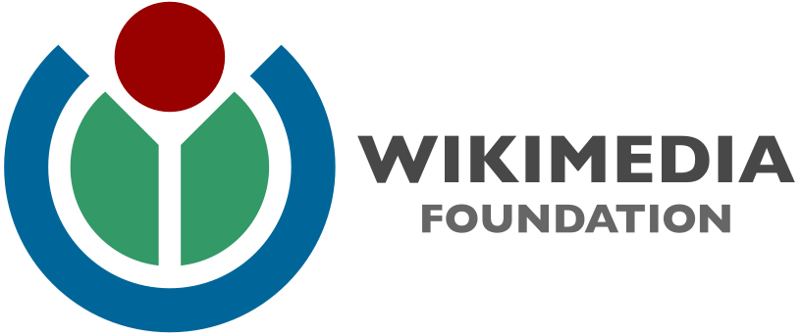
Topics we are exploring this year...
How to use state-of-the-art OCR and Handwritten Text Recognition technologies (ex: for automatically transcribing collection items)
Intersection of sustainability, environment + machine learning
Cleaning up & visualising data
Setting up a crowdsourcing project
Introduction to IIIF
Digital tools and methods to support the library's Anti-Racism work (terminology management, looking at bias in machine learning etc.)
More Introduction to Python for Librarians courses and build communities to support this
How to make Gifs
Useful machine learning applications in GLAMS​ (ex: Language, Genre Classification, computer vision for image classification )
Wikimedia Wednesdays w/ our Wikimedian in Residence
Notes:
What we teach…
Courses aimed at academics often have a different practical emphasis so we spend a lot of time adapting things to the cultural heritage perspective. So we decided we need to build our own offering staff. Though there are positive movements in this area with some 'DH for librarians' courses available now on Library Juice Academy, software skills training through the Library Carpentries, and expertise sharing through Research Libraries UK Digital Scholarship Network and the AI4LAM community, there is still a need for a similarly comprehensive, cohesive, and convenient sector-specific training like the DSTP that can be delivered and managed at scale across the sector. I’m hoping to do some of that work through a working group as part of the LIBER (research libraries across Europe)
Create machine-readable text for search/analysis (OCR/HTR)
Work more efficiently with our data and keep it tidy (data cleaning)
Classify data about people, places, concepts (georeferencing/named-entity recognition)
Automatically extract, analyse and understand useful information from a single image or a sequence of images (computer vision)
Explore a bigger body of material computationally than by individually reading entire texts (text & data mining)
Look for trends, patterns and relationships not apparent from close reading (distant reading)
Gain a broad overview of a topic (topic modeling)

Slide 7
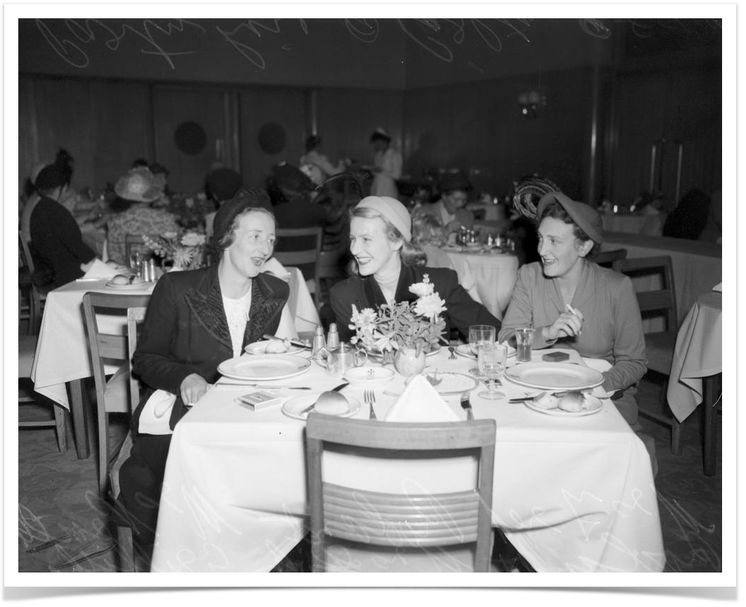
Something for everyone…
Hack & Yacks
21st Century Curatorship Talks
Formal Courses & Workshops
Digital Scholarship Reading Group
Notes:
How we teach it…
We aim to have something for everyone, from introductory courses aimed at novices to more advanced engagements.
It is very important to us that learning is inclusive and accessible, challenging but not terrifying and with any new concept we focus primarily on appealing to an introductory audience where no programming or particular digital skills are required.
The programme offers a sort of scaffolding to complex topics that allows staff to engage as little or as much as they want/can. For example: we might introduce something like “handwritten text recognition” in a 21st Century Talk & in the reading group to whet people’s interest, then they can go further by giving it a try in our Hack & Yacks and finally attend a proper hands on introduction. In the early days we had to hire academics in for these and offer a small stipend, but a decade later we now have the expertise in-house to deliver the training.
We find that Library staff appreciate hands-on, practical exercises; time to explore innovative digital projects; trying new tools (particularly with BL or similar collections); the expertise and enthusiasm of instructors; and meeting colleagues and learning about BL projects.
We would also recommend that DH training in libraries includes: practical tips; case studies and real world examples; clearly articulated learning outcomes; clear, printable instructions for technical exercises, including the expected results for an activity; optional activities for advanced participants. We would also suggest a maximum of 16 people in hands-on courses, and piloting activities to ensure all participants have time to complete exercises.
In recent years, demand from staff to learn practical programming skills to undertake data science projects and use digital research methods for their own work has grown. And meeting this need still remains a bit of a challenge! To support that, we collaborated with Birkbeck, University of London, and the National Archives to co-develop a trial of a one-year part-time postgraduate Certificate (PGCert), Computing for Cultural Heritage Computing for Cultural Heritage Student Projects - The British Library (bl.uk) but I’m also trying to do this work through Research Libraries UK next year.

Slide 8
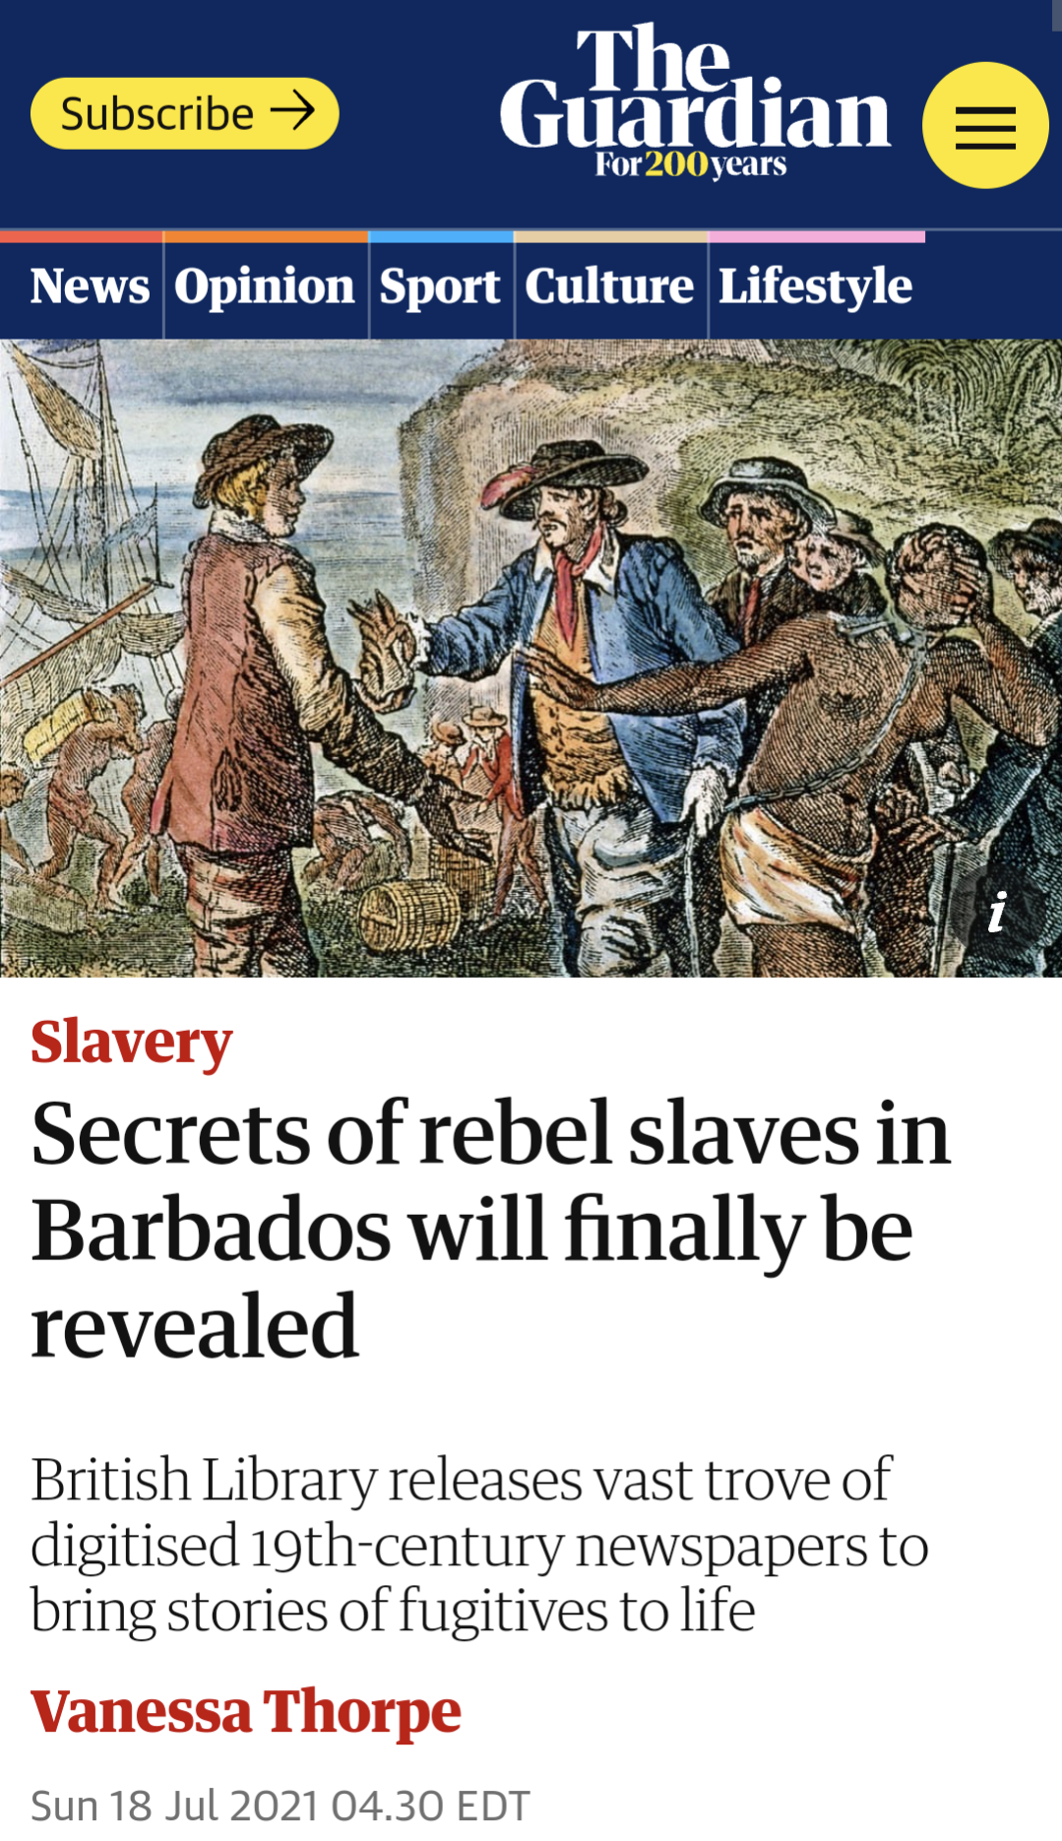
Meet Graham.
“Since joining the library in 2018, the Digital Scholarship training programme has been integral to the trajectory of both my personal development and the working practices within my team.”
-Graham Jevon, Cataloguer, Endangered Archives Programme
Graham Jevon Digital Transformations – A DSTP Case Study The British Library (bl.uk)
Secrets of rebel slaves in Barbados will finally be revealed | Slavery | The Guardian
Notes:
I could show you lots of bar charts and such that say we put on 53 training events last year. We had over 1,000 sign ups to them. That those signs up equate to over 300 individual staff members coming to an average of 3 events, so roughly 20% of British Library staff getting involved!
But the real value is in the stories that come after. This year as part of our celebrations we’re starting to capture a wide range of case studies for a “story bank” from those who have benefitted from the training programme over the years in a variety of ways. And let me tell you, it’s inspiring stuff!
For example…Meet Graham.
Graham started at the Library in 2018 as a Cataloguer for the Endangered Archives Programme. That same year he attended his first Digital Scholarship Training Programme Courses including OpenRefine, a software popular with the digital humanities crowd for cleaning up and visualising data…and he’s immediately hooked! He told us: “With OpenRefine I created a semi-automated workflow that required the kind of logical thinking associated with computer programming, but without the need to understand a computer programming language.”
He’s been an avid attender of our range of training events ever since and ultimately ended up on our Computing for Cultural Heritage trial at Birkbeck, which saw 12 colleagues from across the collection areas gain data science skills. From that he created a piece of software that automatically generates structured catalogue references for archival collections, now used in their day-to-day activities. He said “An error-prone task that could take hours or days to complete manually in Excel now takes just a few seconds and is always 100% accurate!”
Flashforward to today and Graham was awarded a British Library Coleridge Research Fellowship to work on a project, Agents of Enslavement: Colonial newspapers in the Caribbean and hidden genealogies of the enslaved The project examines the extent to which newspapers facilitated and challenged the practice of slavery. It will also help to reveal the identities, networks, and acts of resistance of enslaved people hidden within these printed texts. In order to uncover these stories from digitised newspapers and analyse them, he set up a crowdsourcing project, asking the public to identify four specific types of newspaper advertisement by drawing rectangles around them. He tells us:
“My previous academic research experience was based on traditional analogue methods. But for the Coleridge project, I used crowdsourcing [and machine learning algorithms] to extract data for analysis from two collections of newspapers. To help ensure that no adverts were missed and to account for individual errors, each image was classified by five different people. I therefore had to aggregate the results. Thanks to the new data science skills I had learned, I was able to write a Python script that used machine learning algorithms to aggregate 92,000 total rectangles drawn by the public into an aggregated dataset of 25,000 unique newspaper advertisements!”
His research has recently been featured in The Guardian and I invite you to read more about his training journey on our website!
Graham is just one success story amongst so, so many others and I wish I had time to give everyone the spotlight! We have attendees from all areas of the Library who have in their own way supported digital transformations big and small, and all of them are important!
We measure impact against these goals we set:
Support colleagues to become familiar and conversant with the foundational concepts, methods and tools of digital scholarship
Promote an environment and spirit of innovation and creativity
Encourage collaborative digital initiatives to flourish across subject areas within the Library as well as externally
Nourish and sustain an internal digital scholarship community of interest/practice across the organisation

Slide 9
Learn more about our programme at:
https://www.bl.uk/projects/digital-scholarship-training-programme
Or just drop us a line anytime at digitalresearch@bl.uk

