Slide 1
Modeling and Effects Review Applicability (MERA) Updates
Cheryl Covone
Air Permits Division
Texas Commission on Environmental Quality
Environmental Trade Fair 2018
Notes:
Modeling and Effects Review Applicability (MERA) Updates
Cheryl Covone
Air Permits Division
Texas Commission on Environmental Quality
Environmental Trade Fair 2018

Slide 2
Background
Purpose
History
Update
Notes:
Background
Purpose
History
Update

Slide 3
Changes
Ease of Use and Clarity
Steps Not Used
Structure
Extraneous Background
Technical
Notes:
Changes
Ease of Use and Clarity
Other Changes to MERA Guidance:
Structure
Removal of Steps
Removal of Extraneous Background
Technical

Slide 4
Step Zero Applicability
Chemical Species
With an ESL
Without State or Federal Standard
Not on Tox Screening List
Notes:
Step Zero Applicability
Chemical species without a federal or state standard
Chemical species not on Toxicology Screening List
Chemical Species with an Effects Screening Level (ESL)

Slide 5
Step Zero General Procedures
When, How, What
When long-term analysis needed
How to determine long-term GLC_{max}
What to do for APWL
When to include MSS and PBRs
Notes:
Step Zero General Procedures
When a long-term analysis is needed
How to determine long-term maximum ground level concentrations (GLC_{max})
When to include permits by rule (PBRs) and maintenance, startup, and shutdown (MSS)
What to do for the Air Pollutant Watch List (APWL)

Slide 6
Structure of Steps Example
Step 6: Ratio Test
• Sum emission increases from the project to obtain the total project increase.
• Sum currently authorized new and increased emissions from the project.
Is the following inequality true? GLCmax divided by ESL less than or equal to project increase divided by proposed site wide emissions. If No, then go to Step 7. If Yes, then go to End.
$\frac{{GLC}_{max}}{ESL}≤\frac{{ER}_{P}}{{ER}_{S}}$
If “No” → Step 7. If “Yes” → End.
Notes:
Structure of Steps Example
Step 6: Ratio Test
• Sum emission increases from the project to obtain the total project increase
• Sum currently authorized new and increased emissions from the project
Is the following inequality true?
$\frac{{GLC}_{max}}{ESL}≤\frac{{ER}_{P}}{{ER}_{S}}$
If “No” → Step 7. If “Yes” → End.
GLC_{max} = maximum ground level concentration
ESL = effects screening level
ER_{P} = project increase
ER_{S} = proposed site-wide emissions

Slide 7
Steps Removed
Step 2 Toxicology Screening List
Step 3 APWL
Step 6 Chemical Substitution
Step 7 Annual Reduction
Step 8 Permit or Project Modeling
Steps 9B and 9C Permit Modeling
Notes:
Steps Removed
Step 2 Toxicology Screening List
Step 3 APWL
Step 6 Chemical Substitution
Step 7 Annual Reduction
Step 8 Permit or Project Modeling
Steps 9B and 9C Permit Modeling

Slide 8
Technical Change 10% Step
$$E_{i−n}=0.1\left[\frac{{ER}_{1}}{E_{total}}×\left(\frac{ESL}{X_{1}}\right)+\frac{{ER}_{2}}{E_{total}}×\left(\frac{ESL}{X_{2}}\right)\right]$$
$$\sum_{i=1}^{n}{(X_{i}∗{ER}_{i})}≤0.1∗ESL$$
Equation: 0.1 multiplied by the following [(E R1 divided by E total) multiplied by (ESL divided by X1) plus E R2 divided by E total multiplied by (ESL divided by X2)]
Inequality comparison: (X i multiplied by E R i) less than or equal to 0.1 multiplied by ESL
Additional information can be found in the speaker notes.
Notes:
Technical Change 10% Step
$$E_{i−n}=0.1\left[\frac{{ER}_{1}}{E_{total}}×\left(\frac{ESL}{X_{1}}\right)+\frac{{ER}_{2}}{E_{total}}×\left(\frac{ESL}{X_{2}}\right)\right]$$
$$\sum_{i=1}^{n}{(X_{i}∗{ER}_{i})}≤0.1∗ESL$$
n = total number of emission points
X_{i} = unit impact multiplier from Screening Tables in App. C or approved EPA model for EPN_{i}
ER_{i} = project emission rate increase of chemical species being evaluated
ESL = Effects Screening Level

Slide 9
References/Contacts
MERA Guidance (APDG 5874)
Cheryl Covone: cheryl.covone@tceq.texas.gov
Beth Akers: beth.akers@tceq.texas.gov
Question icon created by Gan Khoon Lay from Noun Project
Notes:
References/Contacts
The updated Modeling and Effects Review Applicability (MERA) guidance document (APDG 5874) can be found at https://www.tceq.texas.gov/assets/public/permitting/air/Guidance/NewSourceReview/mera.pdf.
Cheryl Covone: cheryl.covone@tceq.texas.gov
Beth Akers: beth.akers@tceq.texas.gov

Slide 10
TCEQ Toxicology Division Updates
Tiffany Bredfeldt, Ph.D.
Toxicology Division
Texas Commission on Environmental Quality
Environmental Trade Fair 2018
Notes:
TCEQ Toxicology Division Updates
Tiffany Bredfeldt, Ph.D.
Toxicology Division
Texas Commission on Environmental Quality
Environmental Trade Fair 2018

Slide 11
UPDATES
Streamline Air Permits Process
PM
No ESLs
TCEQ Toxicology Division has modified the way it approaches some chemical species during air permits; particulate matter; chemicals without ESLs in the available online database
Particulate Matter
Chemicals without Effects Screening Levels (ESLs) in the available online database
Notes:
Updates
To streamline the process of air permits, TCEQ Toxicology Division has modified the way it approaches some chemical species during air permits
Particulate matter
Chemicals without Effects Screening Levels (ESLs) in the available online database

Slide 12
NAAQS
PM
For chemicals that are particulate matter that are considered of relatively low toxicity, evaluation can occur in the site-wide NAAQS evaluation
ESL database
The chemical will be listed in the ESL database as must meet NAAQS
No ESL
If the chemical does not have an ESL, contact Toxicology
Notes:
NAAQS (National Ambient Air Quality Standards)
For chemicals that are particulate matter that are considered of relatively low toxicity, evaluation can occur in the site-wide NAAQS evaluation
The chemical will be listed in the ESL database as must meet NAAQS
If the chemical does not have an ESL, contact Toxicology

Slide 13
Chemicals Without ESLs
No ESL
If the chemical does not have an ESL, contact Toxicology
Chemicals for which an ESL is not listed in the Toxicity Factor Database must satisfy BACT requirements
If the applicant desires an ESL, it is possible to have one generated by the TCEQ Toxicology Division: product or chemical substitution would require an ESL
Product or chemical substitution would require an ESL
Notes:
Chemicals Without ESLs
Chemicals for which an ESL is not listed in the Toxicity Factor Database must satisfy best available control technology (BACT) requirements
If the applicant desires an ESL, it is possible to have one generated by the TCEQ Toxicology Division:
Product or chemical substitution would require an ESL

Slide 14
Navigating the New Toxicity Factor Database
Tracie Phillips, Ph.D.
Toxicology Division
Texas Commission on Environmental Quality
Environmental Trade Fair 2018
Notes:
Navigating the New Toxicity Factor Database
Tracie Phillips, Ph.D.
Toxicology Division
Texas Commission on Environmental Quality
Environmental Trade Fair 2018

Slide 15
Toxicity Factor Database Overview
One Stop Shop -
AMCV List
Supporting Documentation
ESL List
Shopping icon created by JHON from Noun Project
Notes:
Toxicity Factor Database Overview
ESL = Effects Screening Level
AMCV = Air Monitoring Comparison Value
DSD = Development Support Documents
The database is the one-stop-shop at the TCEQ for all toxicity values derived by the Toxicology Division (i.e., ESL and AMCV lists), as well as their associated supporting documentation (e.g., DSDs, interim documents, etc.).

Slide 16
Dynamic Data
Dynamic Database
No More Published Lists
Data icon created by Gregor Cresnar from Noun Project
Notes:
Dynamic Data
TCEQ initially released the Toxicity Factor Database in November 2016 as a three-month beta phase where the database matched the last published ESL list. This was to allow users to become familiar with the new application. As of February 2017, the database became fully launched with implementation of dynamic changes (changes to the database as needed rather than quarterly). While changes were more frequent at the beginning of the full database launch, they have slowed to a more reasonable pace; changes do not happen daily. Current ESLs are obtained from the database, while previous published ESL lists are now outdated and remain archived on the website.

Slide 17
TAMIS Toxicology Reports
Tox Reports
ESL
Summary
ESLs used in Air Permitting
Detail
All ESLs
AMCV
Document
Spreadsheet icon created by heathersabrina from Noun Project
Notes:
Texas Air Monitoring Information System (TAMIS) Toxicology Reports
There are three main types of Toxicology Reports: ESL, AMCV, and Document. The AMCV report provides the user with air monitoring comparison values, to be used when evaluating ambient air data. The document report provides the user the ability to search for a substance’s associated document(s) outside of downloading the ESL or AMCV lists. There are two ESL lists available for users: the Summary and the Detail ESL lists. The Summary list provides users with an output that is most similar to the previously published ESL List; it only provides the ESLs that are used in air permitting. The Detail list provides users with all available ESLs, not just those that are used in air permitting. This allows a user to, for example, see what the health-based ESL is for a substance that utilizes an odor-based ESL in air permitting.

Slide 18
More Search Options
Date
Effective Date
Substance
CAS #
Synonyms
Type
Category
Target Parameter
Search icon created by Dev Patel from Noun Project
Notes:
More Search Options
A user has the ability to search (or query) the database for information in several different ways. The date can be used to search for ESLs based on either the current date (system default) or on a past date. A substance can be searched based on the Chemical Abstracts Service (CAS) number (recommended) or based on the substance name/synonym. While TAMIS does store some more common synonyms for most substances, not all synonyms are available, and the entered substance spelling must match that in TAMIS. A user can also search the database by type of substance through the substance category (e.g., mercaptan) or target parameter (for air monitoring).
However, if the entire ESL list is desired, it is recommended that a user leave all criteria filters in their default form (i.e., blank or pre-chosen) and press the create report button. Since TAMIS is a relational database, as filters are modified from their default, data become limited.

Slide 19
Demonstration
DEMONSTRATION
http://www17.tceq.texas.gov/tamis/index.cfm
Demonstration icon created by Claire Jones from Noun Project
Notes:
Demonstration
Live demonstration of downloading the entire ESL list.

Slide 20
Questions
E-mails: tracie.phillips@tceq.texas.gov
TOX@tceq.texas.gov
Question icon created by Gan Khoon Lay from Noun Project
Notes:
Questions
E-mails:
tracie.phillips@tceq.texas.gov
TOX@tceq.texas.gov

Slide 21
Backup Slides
Slides showing step-by-step instructions on how to download the entire ESL List
Notes:
Backup Slides
Backup slides are provided to show a step-by-step process to download the entire ESL list from the database and upload into Excel.

Slide 22
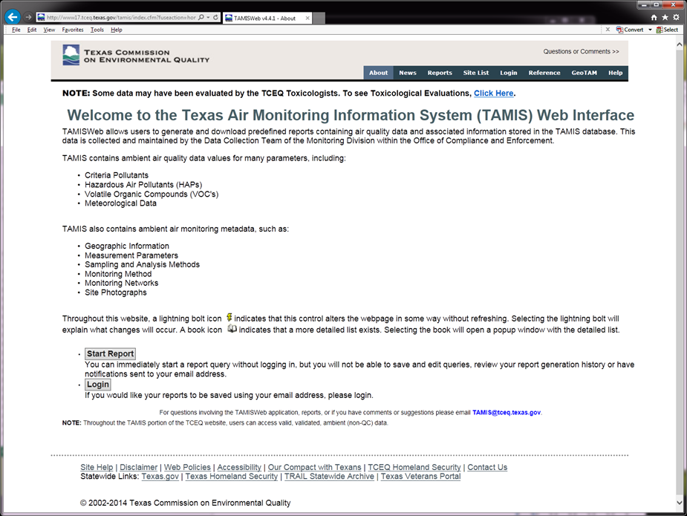
Backup Slide 1
1) Click one to go to Reports Screen
Notes:
Backup Slide 1
TAMIS Welcome Page: the user can either click the Reports Ribbon at the top of the page or click Start Report at the bottom of the page.

Slide 23
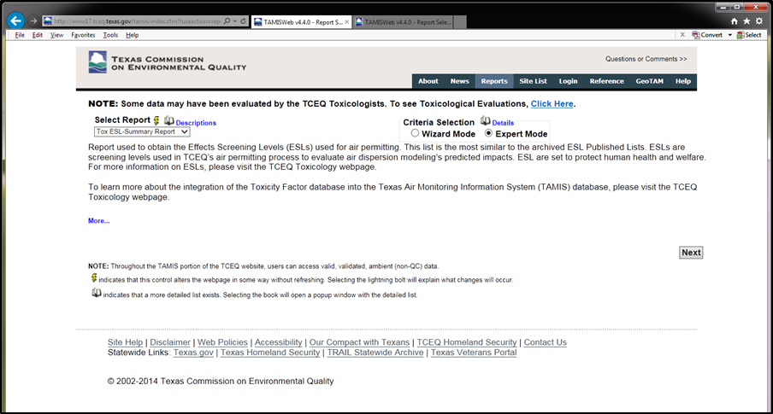
Backup Slide 2
3) Select Expert Mode
2) Choose Tox ESL-Summary Report
4) Click Next
Notes:
Backup Slide 2
Accessing the different reports:
Under Select Report, choose Tox ESL-Summary Report.
For criteria selection, choose Expert Mode.
To go to the Criteria Selection Page, click Next.

Slide 24
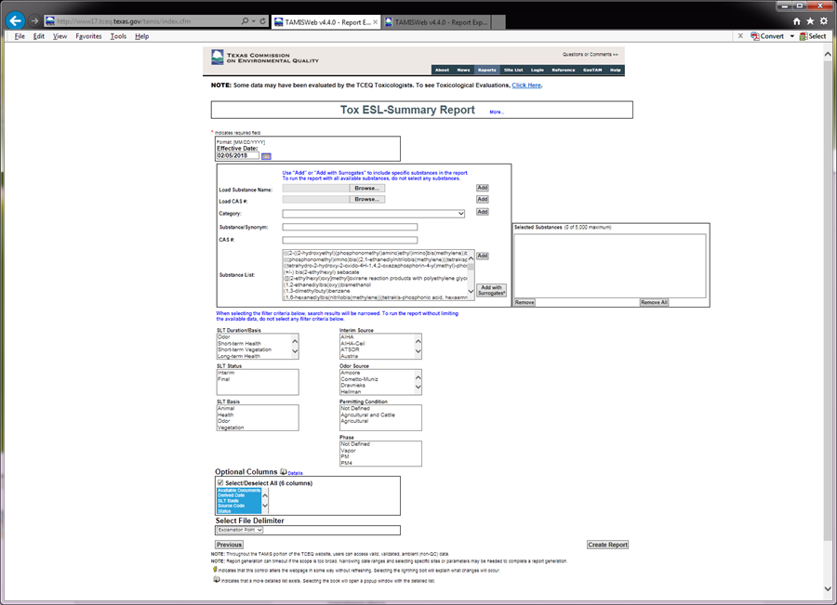
Backup Slide 3
5) Enter Date
6) Leave As Is, DO NOT:
-select substances
-select filter criteria
-un-select Optional Columns
-change Delimiter
7) Click Create Report
Notes:
Backup Slide 3
On the Criteria Selection Page, date is defaulted to current date; the user can change this if a past date is desired. To download the entire ESL list, the user should leave all criteria selections blank, as well as leave the optional columns selected and the file delimiter as exclamation point (essentially, leave all default settings). Click Create Report.

Slide 25
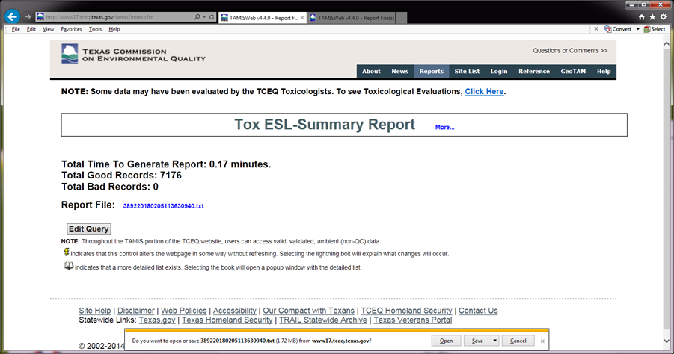
Backup Slide 4
8) Click link
9) Click Open
Notes:
Backup Slide 4
Report Output Page:
Output can be obtained from the .txt link. Click link to open document download pop-up (Internet Explorer).
Click Open to open the .txt file.

Slide 26
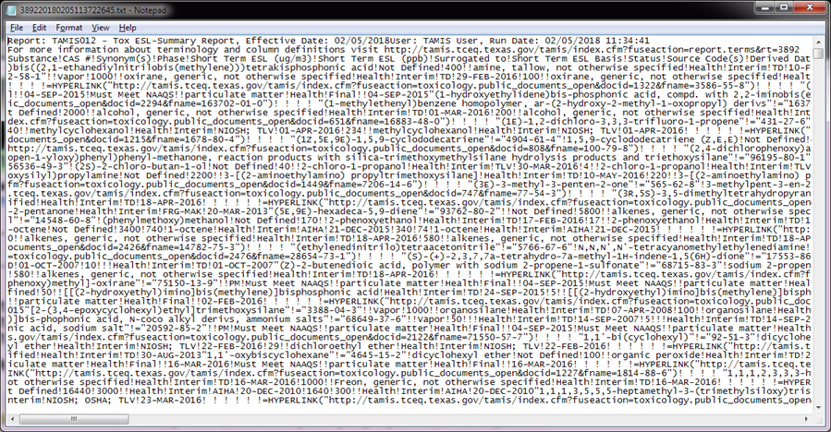
Backup Slide 5
9) Select all data (Ctrl A)
10) Copy (Ctrl C)
11) Open Excel
Notes:
Backup Slide 5
Open .txt file:
Select all data in file (Ctrl A)
Copy (Ctrl C)
Open Excel

Slide 27
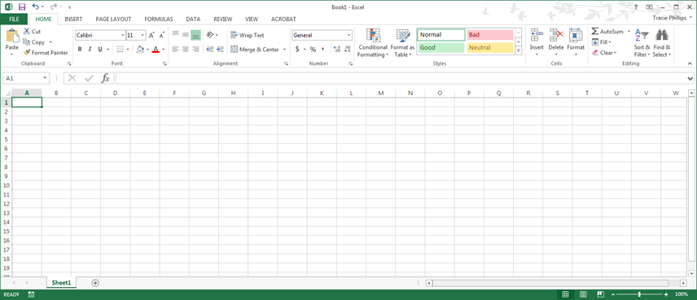
Backup Slide 6
12) Select Cell A1
13) Paste data (Ctrl V)
Notes:
Backup Slide 6
Loading data into Excel:
Select Cell A1 (should be selected by default when Excel is opened)
Paste data (Ctrl V)

Slide 28
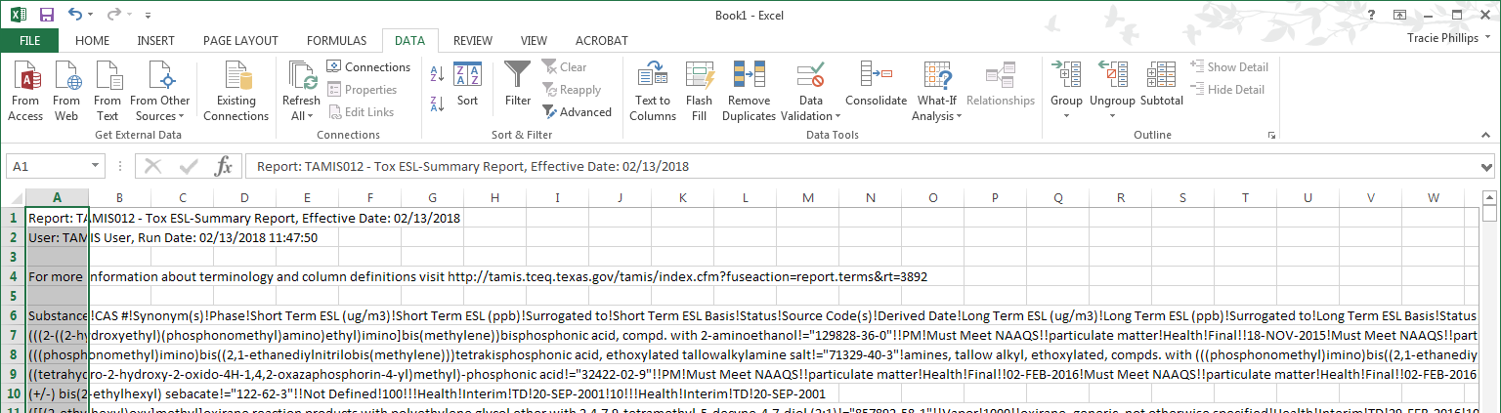
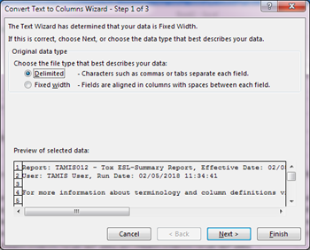
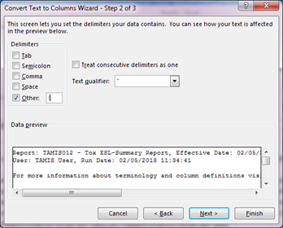
Backup Slide 7
15) Click Text to Columns
14) Go to Data Ribbon
16) Click Delimited
18) Click Other & add !
17) Click Next
19) Click Finish
Notes:
Backup Slide 7
How to delimit data in Excel:
Go to Data Ribbon at the top of the page.
In the Data Ribbon, click Text to Columns.
In the pop-up window, be sure Delimited is selected and click Next.
In the next window, check the box in front of Other and enter an exclamation point in the data field.
Optional - uncheck the Tab box.
Click Finish.

Slide 29
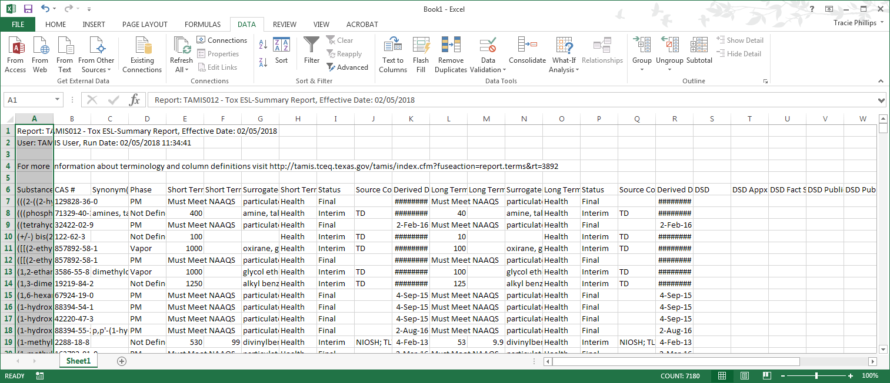
Backup Slide 8
ESL List is Ready
Notes:
Backup Slide 8
Final output (Excel), with data delimited into columns. The user can now use the data.

Slide 30
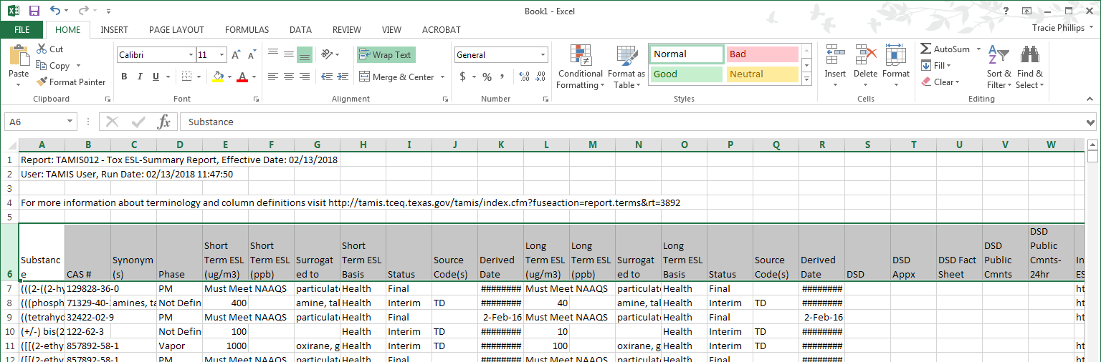
Backup Slide 9
20) Highlight Row 6
22) Click Wrap Text
21) Go to Home Ribbon
Notes:
Backup Slide 9
Optional formatting begins here - How to make the column titles easily visible without expanding the width of the columns:
Highlight the entire title row (should be Row 6).
Go to the Home Ribbon.
Under the Home Ribbon, click Wrap Text.

Slide 31
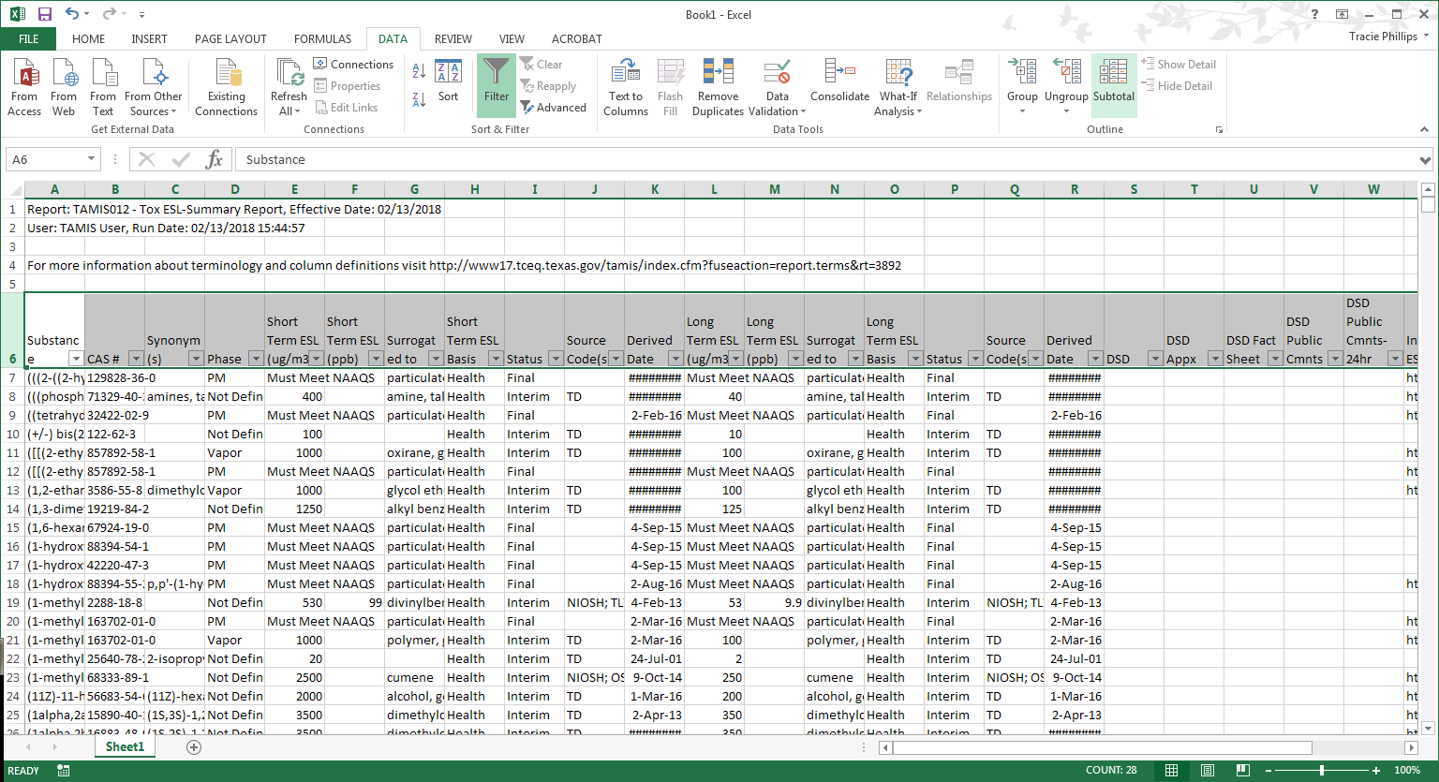
Backup Slide 10
24) Click Filter
23) Go to Data Ribbon
Notes:
Backup Slide 10
Optional formatting - How to make the data filterable:
While the title row (Row 6) is still highlighted, go to the Data Ribbon.
Under the Data Ribbon, click Filter.
Now, the data can be filtered as desired. Be careful not to make any changes to the data while filtered, or the data may get misaligned.

Slide 32
Backup Slide 11
How to Upload Substance Name/CAS #
The database allows users to upload an Excel file of names or CAS RNs for searching
Names –OR– CAS RNs must be located in:
(1) Column A
(2) Sheet 1
Notes:
Backup Slide 11
If the desire is to download a subset of substances, a list of substance names or CAS numbers can be uploaded into the database for searching. The list must be in Excel, and the desired data must be in Column A of Sheet 1. All other data is ignored by TAMIS. Step-by-step instructions follow.

Slide 33
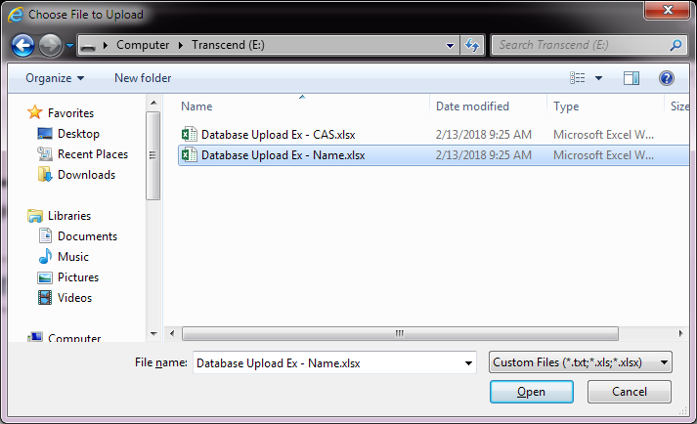
Backup Slide 12
1) Click Browse
2) Select file and click Open
Notes:
Backup Slide 12
If a user has a list of specific substances he/she would like to search the database for, that list can be uploaded to the database either as names or CAS numbers. It is recommended to use CAS numbers as they are more accurate than names.
Uploading a file to the database for list download:
Click Browse located next to either Load Substance Name or Load CAS #.
In the pop-up window, navigate to desired file and click Open. Note that the file must be Excel, and data must be in Column A of Sheet 1 in the workbook. No other data will be loaded into the database.

Slide 34
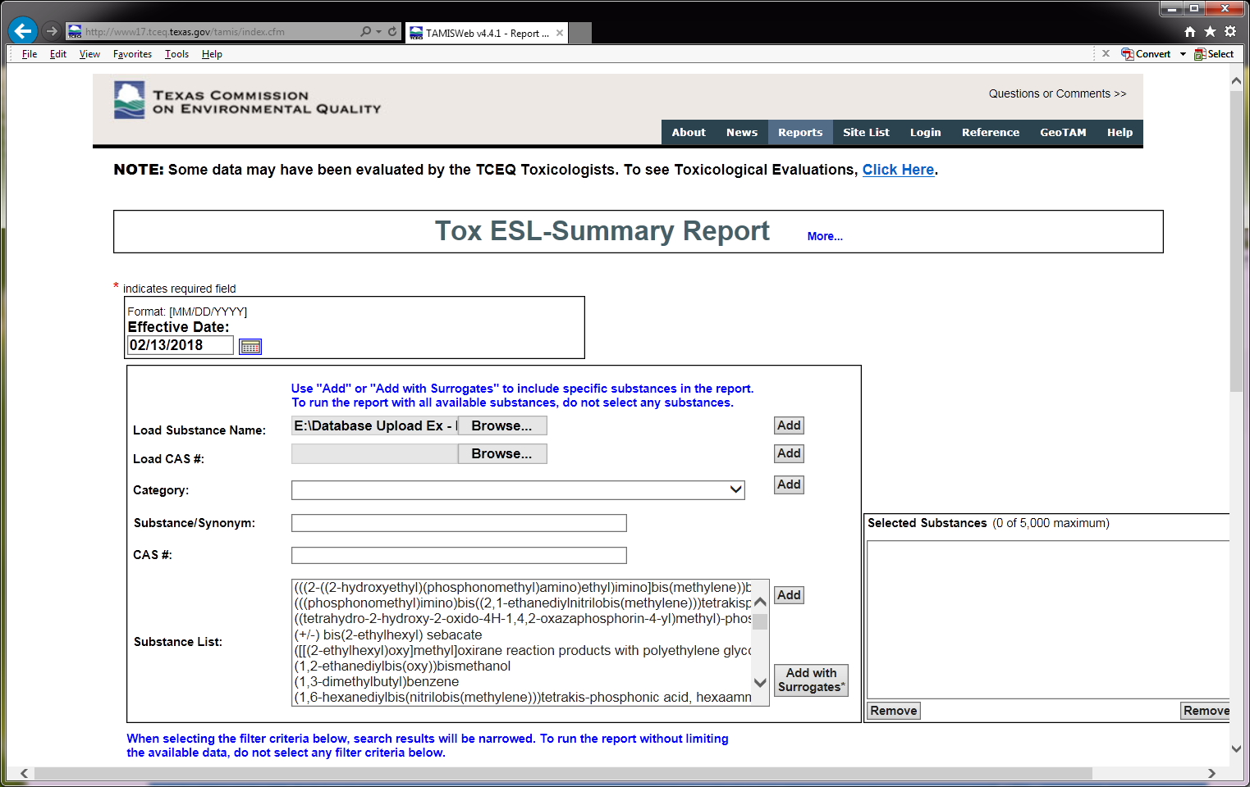
Backup Slide 13
Data file is loaded
3) Click Add
Notes:
Backup Slide 13
The data file extension is now loaded. Click the Add button next to the load function used.

Slide 35
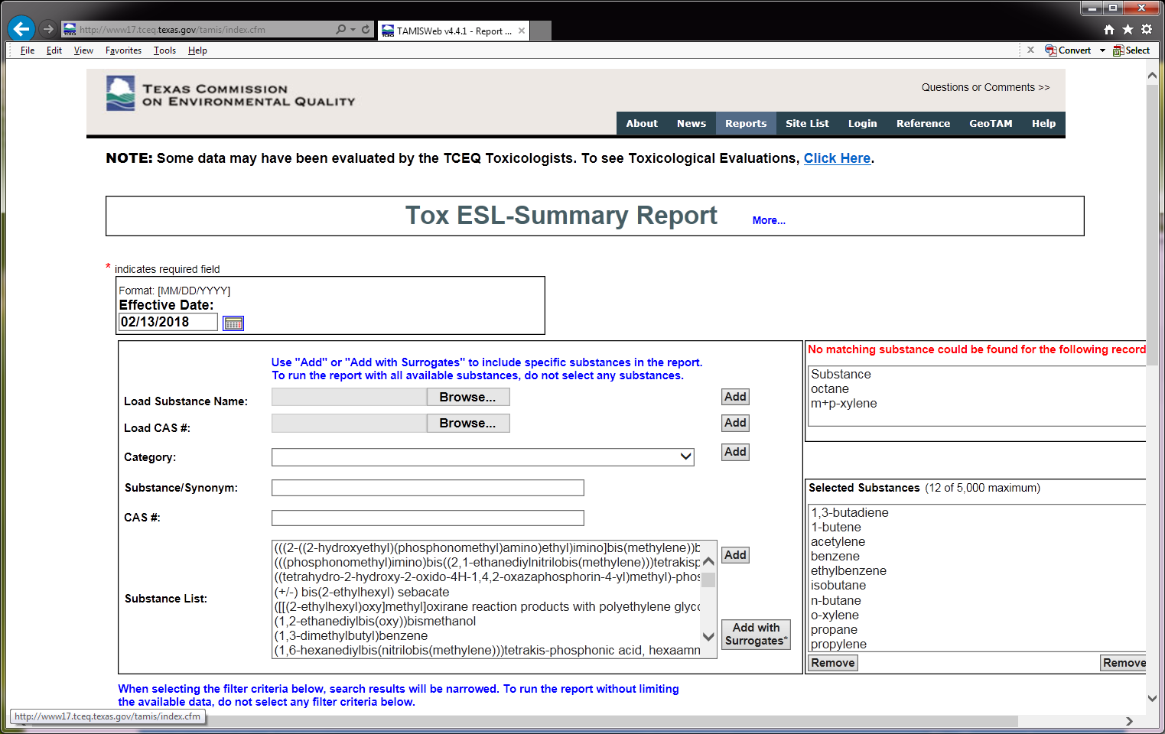
Backup Slide 14
Substances not matching are listed here
Substances with a match are loaded
Notes:
Backup Slide 14
How the data are loaded into the Selected Substances window:
Substances with a match in the database are loaded for the search, while substances that do not have a match are listed in a new box above the Selected Substances box. This allows the user to check the name they are using.
Substances can be manually added by typing in the substance/synonym box (this box autosuggests database substances as you type).
Follow instructions as above to retrieve data output.
If a substance name or CAS number that has been uploaded does not match one that exists in the TAMIS system, a list will appear in a new box above the selected substances box. This list allows the user to see what was rejected from their list. If names are rejected, it may simply be the synonym used is not available in TAMIS or the spelling does not match TAMIS. It is recommended a CAS number be used to double check. If a CAS number is rejected, it may be that there is an error in the CAS number uploaded. It is recommended that a check on the CAS number be made.

