Slide 1
CSRO: Federal Policy Virtual Town Hall
Emily L. Graham, RHIA, CCS-P VP, Regulatory Affairs Hart Health Strategies, Inc.
Judith Gorsuch, JD VP & Counsel Hart Health Strategies, Inc.

Slide 2
Legislative Issues

Slide 3
Recently Introduced Drug Pricing/ Drug Policy Legislation
H.R.2279 — To amend the Employee Retirement Income Security Act of 1974 to require a group health plan (or health insurance coverage offered in connection with such a plan) to provide an exceptions process for any medication step therapy protocol, and for other purposes; Sponsor: Rep. Ruiz, Raul [D-CA-36]; Committees: House - Education and Labor
H.R.2038 — To allow State-based, market-oriented, prescription drug negotiations to lower pharmaceutical drug prices, to encourage competition, to increase consumer choice and access, and for other purposes; Sponsor: Rep. Meadows, Mark [R-NC-11]; Committees: House – Judiciary
S.988 — A bill to amend title XVIII of the Social Security Act to prohibit prescription drug plan sponsors and MA-PD organizations under the Medicare program from retroactively reducing payment on clean claims submitted by pharmacies; Sponsor: Sen. Capito, Shelley Moore [R-WV]; Committees: Senate – Finance
H.R.1499 — To prohibit brand name drug manufacturers from compensating generic drug manufacturers to delay the entry of a generic drug into the market, and to prohibit biological product manufacturers from compensating biosimilar and interchangeable product manufacturers to delay entry of biosimilar and interchangeable products, and for other purposes; Sponsor: Rep. Rush, Bobby L. [D-IL-1]; Committees: House - Energy and Commerce, Judiciary

Slide 4
Recently Introduced Drug Pricing/ Drug Policy Legislation
S.640 — A bill to amend title XVIII of the Social Security Act to require pharmacy-negotiated price concessions to be included in negotiated prices at the point-of-sale under part D of the Medicare program, and for other purposes; Sponsor: Sen. Kennedy, John [R-LA]; Committees: Senate – Finance
H.R.1264 — To amend titles XVIII and XIX of the Social Security Act to provide the Medicare Payment Advisory Commission and the Medicaid and CHIP Payment and Access Commission with access to certain drug payment information, including certain rebate information; Sponsor: Rep. Doggett, Lloyd [D-TX-35]; Committees: House - Energy and Commerce, Ways and Means
S.475 — A bill to amend title XVIII of the Social Security Act to prevent catastrophic out-of-pocket spending on prescription drugs for seniors and individuals with disabilities; Sponsor: Sen. Wyden, Ron [D-OR]; Committees: Senate – Finance
S.476 — A bill to amend title XI and XVIII of the Social Security Act to provide greater transparency of discounts provided by drug manufacturers; Sponsor: Sen. Wyden, Ron [D-OR]; Committees: Senate – Finance

Slide 5
Regulatory Issues

Slide 6
2019 MPFS
Evaluation and Management (E/M) Services (Immediate changes)
Elimination of the requirement to document the medical necessity of a home visit in lieu of an office visit;
For established patient office/outpatient visits, when relevant information is already contained in the medical record, practitioners may choose to focus their documentation on what has changed since the last visit, or on pertinent items that have not changed, and need not re-record the defined list of required elements if there is evidence that the practitioner reviewed the previous information and updated it as needed. Practitioners should still review prior data, update as necessary, and indicate in the medical record that they have done so;
Additionally, CMS clarified that for E/M office/outpatient visits, for new and established patients for visits, practitioners need not re-enter in the medical record information on the patient’s chief complaint and history that has already been entered by ancillary staff or the beneficiary. The practitioner may simply indicate in the medical record that he or she reviewed and verified this information; and
Removal of potentially duplicative requirements for notations in medical records that may have previously been included in the medical records by residents or other members of the medical team for E/M visits furnished by teaching physicians.

Slide 7
2019 MPFS
E/M Services (2021/future changes)
Reduction in the payment variation for E/M office/outpatient visit levels by paying a single rate for E/M office/outpatient visit levels 2 through 4 for established and new patients while maintaining the payment rate for E/M office/outpatient visit level 5 in order to better account for the care and needs of complex patients;
Permitting practitioners to choose to document E/M office/outpatient level 2 through 5 visits using medical decision-making or time instead of applying the current 1995 or 1997 E/M documentation guidelines, or alternatively practitioners could continue using the current framework;
Beginning in CY 2021, for E/M office/outpatient levels 2 through 5 visits, CMS will allow for flexibility in how visit levels are documented— specifically a choice to use the current framework, MDM, or time. For E/M office/outpatient level 2 through 4 visits, when using MDM or current framework to document the visit, CMS will also apply a minimum supporting documentation standard associated with level 2 visits. For these cases, Medicare would require information to support a level 2 E/M office/outpatient visit code for history, exam and/or medical decision-making;
When time is used to document, practitioners will document the medical necessity of the visit and that the billing practitioner personally spent the required amount of time face-to-face with the beneficiary;
Implementation of add-on codes that describe the additional resources inherent in visits for primary care and particular kinds of non-procedural specialized medical care, though they would not be restricted by physician specialty. These codes would only be reportable with E/M office/outpatient level 2 through 4 visits, and their use generally would not impose new per-visit documentation requirements; and
Adoption of a new “extended visit” add-on code for use only with E/M office/outpatient level 2 through 4 visits to account for the additional resources required when practitioners need to spend extended time with the patient.

Slide 8
2019 MPFS
Virtual Care
Separate payment for “virtual check-in” by phone or other telecom device
Separate payment for remote evaluation of recorded video/images submitted by patients
Separate payment for interprofessional internet consultation
WAC-Based Payment for Part B Drugs
Reducing the 6 percent add-on for WAC-based payments for new Part B drugs when ASP is unavailable to 3 percent
Appropriate Use Criteria
CMS previously delayed implementation of this program by including a voluntary reporting period, which started in July 2018 and runs through December 2019. In 2020, the AUC program period will begin with an educational and operations testing period, during which CMS will continue to pay claims whether or not they correctly include AUC information.
Conversion Factor
The 2019 PFS conversion factor is $36.04, a slight increase above the 2018 PFS conversion factor of $35.99
Overall Impact to Rheumatology: o% or -2% (when E/M policies finalized)

Slide 9
MACRA “Technical Changes” in Bipartisan Budget Act (BBA) of 2018
Excludes Medicare Part B drug costs from MIPS payment adjustments and eligibility calculations;
Eliminates improvement scoring for the cost performance category for the second, third, fourth and fifth years of MIPS;
Allows CMS to reweight the cost performance category to not less than 10 percent and not greater than 30 percent for the second, third, fourth, and fifth years of MIPS;
Allows CMS flexibility in setting the performance threshold for years two through five to ensure a gradual and incremental transition to the performance threshold set at the mean or median for the sixth year;
And allows the Physician Focused Payment Model Technical Advisory Committee (PTAC) to provide initial feedback on models regarding the extent to which they meet criteria and an explanation of the basis for the feedback.

Slide 10
Key MIPS Year 3 Changes
2019 Performance Threshold
Performance threshold set at 30 points; exceptional performance threshold set at 75 points
MIPS Eligible Clinicians
Expanded to include the following professionals: physical therapist, occupational therapist; clinical psychologist; qualified speech-language pathologist; qualified audiologist; and registered dietitian or nutrition professionals
Low-Volume Threshold
Added a third element to the low-volume threshold determination, while maintaining the other two elements
Dollar Amount (≤ $90,000) (current)
Number of Beneficiaries (≤ 200) (current)
Number of Covered Professional Services (≤ 200) (NEW)
MIPS Opt-in Policy
Clinicians or groups will be able to opt-in to MIPS if they meet or exceed at least 1, but not all three, of the low-volume threshold criterion

Slide 11
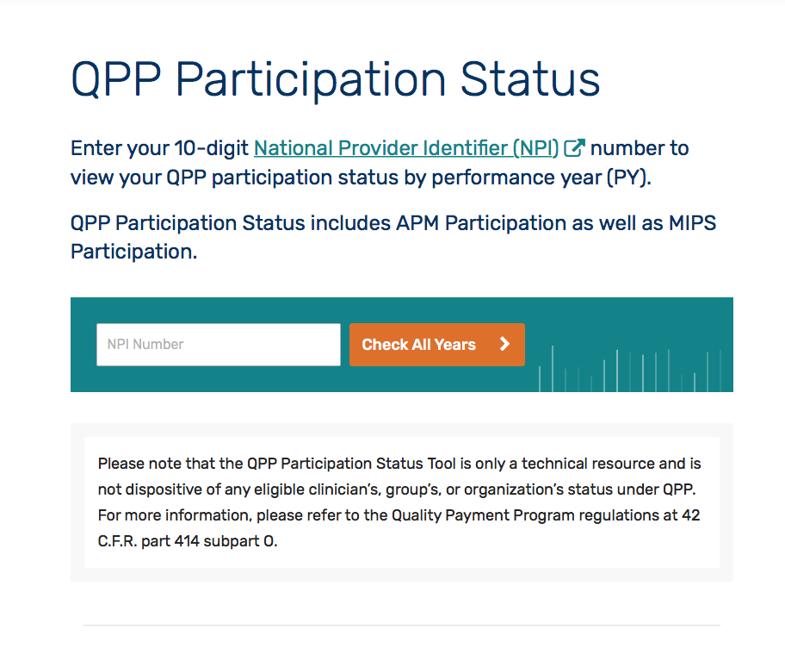
Check your eligibility @ qpp.cms.gov

Slide 12
MIPS Year 3 Changes
Quality (45%)
Meaningful Measures initiative: removal of low-value, low-priority process measures to streamline clinician reporting
Allowing the use of a combination of collection types for the Quality performance category
Small practice bonus increased to 6 points, but moved under Quality performance category
Retaining the 3 point floor for small practices that report measures that don’t meet the data completeness requirements
Claims-based reporting reserved for individuals and small practices only
Cost (15%)
Retained the Medicare Spending Per Beneficiary (MSPB) and Total Per Capita Cost (TPCC) Measures, and added 8 episode-based cost measures (e.g., Knee Arthroplasty, Routine Cataract Removal w/ IOL Implantation, Simple Pneumonia with Hospitalization)
Ongoing effort to develop additional cost measures (e.g., Wave 3 nominations underway)

Slide 13
MIPS Year 3 Changes
Promoting Interoperability (formerly Advancing Care Information) (25%)
Requiring use of 2015 Edition CEHRT
Reducing the number of objectives and measures
Simplified scoring based on performance
Report measures from four objectives for a total of 100 points
E-prescribing
Health information exchange
Provider-to-Patient Exchange
Public Health and Clinical Data Exchange
Aligning requirements with the new Promoting Interoperability Program for hospitals
Security Risk Analysis required, but not scored
Improvement Activities (15%)
Added six new IA’s and revised one IA
Noteworthy addition: IA_BE_ 24 Financial Navigation Program

Slide 14
2019 MIPS Rheumatology Specialty Measure Set
Measure # | Measure Title
24 | Communication with the Physician or Other Clinician Managing On-going Care Post-Fracture for Men and Women Aged 50 Years and Older (HIGH PRIORITY)
39 | Screening for Osteoporosis for Women Aged 65-85 Years of Age
47 | Care Plan (HIGH PRIORITY)
110 | Preventive Care and Screening: Influenza Immunization
111 | Pneumococcal Vaccination Status for Older Adults
128 | Preventive Care and Screening: Body Mass Index (BMI) Screening and Follow-up Plan
130 | Documentation of Current Medications in the Medical Record (HIGH PRIORITY)
131 | Pain Assessment and Follow-Up (HIGH PRIORITY)
176 | RA: Tuberculosis Screening (SUBSTANTIVE CHANGES)
177 | RA: Periodic Assessment of Disease Activity (SUBSTANTIVE CHANGES)

Slide 15
2019 MIPS Rheumatology Specialty Measure Set
Measure # | Measure Title
179 | RA: Assessment and Classification of Disease Prognosis
180 | RA: Glucocorticoid Management
226 | Preventive Care and Screening: Tobacco Use: Screening and Cessation Intervention
236 | Controlling High Blood Pressure (OUTCOME)
238 | Use of High-Risk Medications in the Elderly (HIGH PRIORITY)
317 | Preventive Care and Screening: Screening for High Blood Pressure and Follow-Up Documented
374 | Closing the Referral Loop (HIGH PRIORITY)
402 | Tobacco Use and Help with Quitting Among Adolescents

Slide 16
2019 MIPS Final Score (2021 Payment Adjustment)
2019 Final Score | 2021 Payment Adjustment
≥ 75 points | Positive adjustment Eligible for exceptional performance bonus
30.01 – 74.99 points | Positive adjustment Not eligible for exceptional performance bonus
30 points | Neutral payment adjustment
7.51-29.99 | Negative adjustment > -7% and < 0%
0 – 7.5 points | Negative payment adjustment of -7%
MIPS Final Score
PI 25%
Quality 45%
IA 15%
Cost 15%

Slide 17
MIPS Payment Adjustment Error
CMS recently discovered an error in the implementation of the 2019 Merit-based Incentive Payment System (MIPS) payment adjustment, which incorrectly applies payments for Medicare Part B drugs and other non-physician services billed by physicians.
If CMS overpaid a claim based on this error, you will get a notification for recoupment from your Medicare Administrative Contractor
If CMS underpaid a claim, it will be adjusted

Slide 18
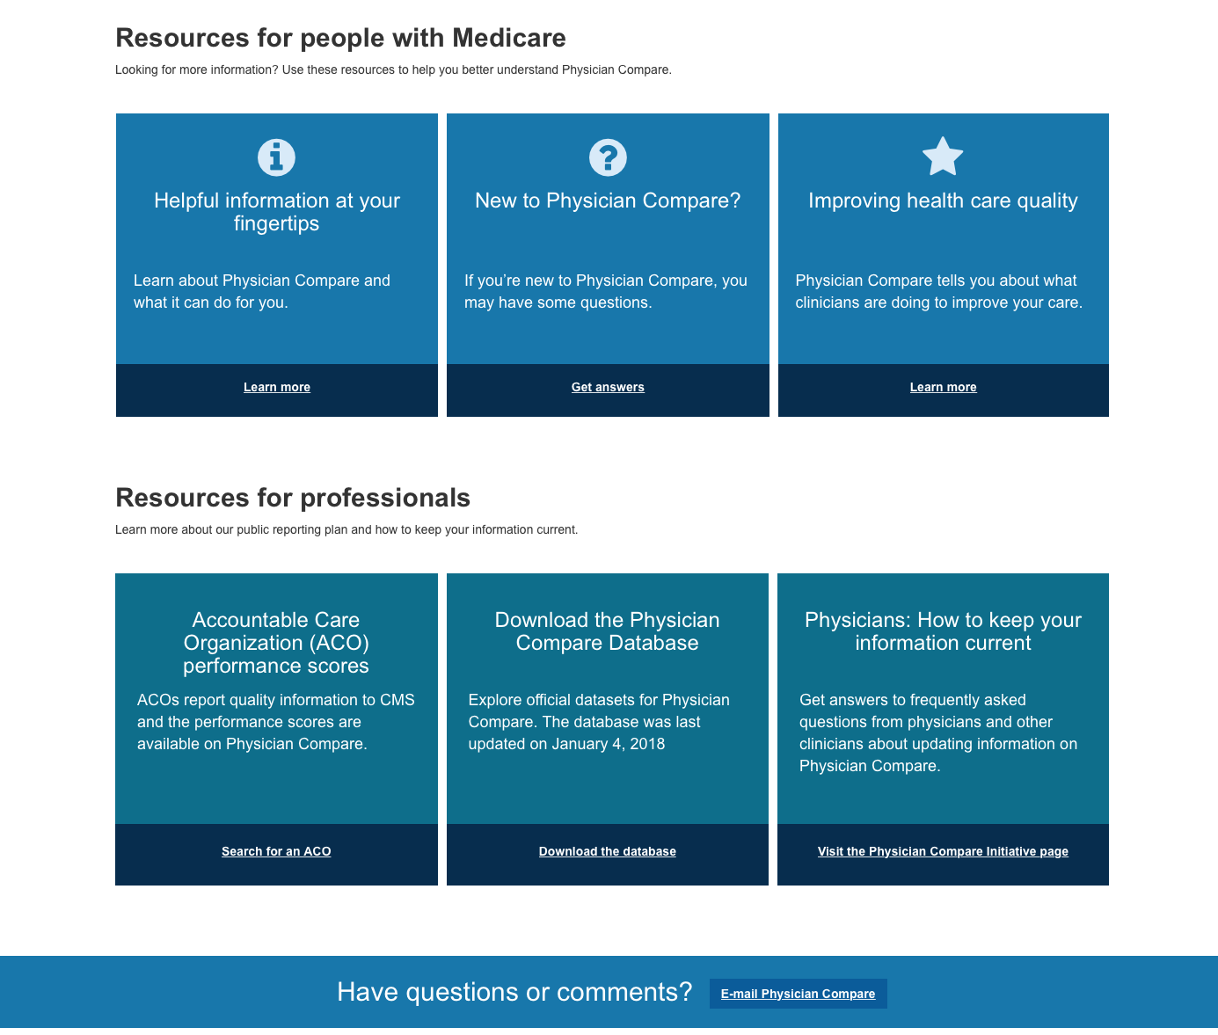
Physician Compare: Your Data is Public!

Slide 19
MIPS Outlook
MedPAC recommended elimination of MIPS; however, legislative modifications to the program unlikely
Potential for minor regulatory tweaks under “Meaningful Measures” and “Patients Over Paperwork” initiatives
Further emphasis on cost and resource use measurement, despite a lack of rheumatology-focused episode-based cost measures
Increased pressure to engage as penalties, rewards increase and publicly reported data are used for external activities
QCDR, EHR participation possibly best option for physicians as a long-term strategy for quality reporting and program engagement

Slide 20
Key Drug Policy Proposals

Slide 21
Int’l Pricing Index (IPI) Model
Medicare Part B drug expenditures have increased significantly over time
From 2011 to 2016, Medicare FFS drug spending increased from $17.6 billion to $28 billion under Medicare Part B
United States’ cost for certain drugs is 1.8 times higher than 27 other countries on average
IPI Model Attributes
Run through the CMS Innovation Center
Mandatory for physicians and hospitals in regions representing 50% of Part B sales
Physicians would obtain drugs through “vendors,” eliminating the “buy-and-bill” model
Drugs would be reimbursed based on international reference prices
Physicians would be paid a “flat-fee” based on ASP+6% to “keep them whole”
CSRO dialogue with senior Administration officials
Proposed rule in Spring 2019

Slide 22
“Rebate” Rule
Part D plans shifting more costs to seniors
More medicines are subject to co-insurance (which has replaced co-pays), creating higher out-of-pocket costs for seniors
A recent Office of Inspector General (OIG) proposal would help address these concerns by
Removing the discount safe harbor protections (i.e., drug manufacturer rebates to plans, pharmacy benefit managers (PBMs) usually for preferred formulary placement)
Creating a new safe harbor for price reductions (ie, drug manufacturer rebates to beneficiaries at the point-of-sale)
Creating new safe harbor for fixed pharmacy benefit manager fees (ie, flat fees no longer tied to a drugs list prices)
In sum, if finalized, the rule should reduce cost sharing for patients taking rebated medicines (potential nominal increase in premiums)

Slide 23
Medicare Advantage Step Therapy Memo
CMS issued memo titled: Prior Authorization and Step Therapy for Part B Drugs in Medicare Advantage
Guidance recognizes that MA plans may apply step therapy to control the utilization of services in a manner that does not create an undue access barrier for beneficiaries.
CMS believes that appropriate patient engagement and care coordination services support appropriate pathways to access to Part B drugs such as step therapy.
CSRO has significant concerns with CMS’ memo given the lack of details and opposes step-therapy as a utilization management tool

Slide 24
Modernizing Part D and Medicare Advantage Proposed Rule
CMS issued a proposed rule in November 2018 that would amend the Medicare Advantage (MA) program (Part C) regulations and Prescription Drug Benefit program (Part D) regulations “to support health and drug plans’ negotiation for lower drug prices and reduce out-of-pocket costs for Part C and D enrollees.”
Key proposals
Step-therapy in Part B: As described in its aforementioned memo, CMS formalized its proposal to allow MA plans to utilize step therapy protocols for Part B drugs
Protected classes: CMS proposes to remove exceptions from six “protected classes” of drugs and allow insurers to use prior authorization and step therapy more broadly and to exclude certain products from formulary.
Establish Definitions in Sponsor and Pharmacy Benefit Manager (PBM) Contracting: CMS proposes to define “price concession” as broadly as possible, to include all forms of discounts, subsidies, and rebates (formulary and price protection), whether direct or indirect.

Slide 25
CSRO Collaborative Partners
Alliance of Specialty Medicine
Cognitive Specialty Coalition
Cognitive Care Alliance
AGS Coalition (51 Specialties)
Alliance for Transparent and Affordable Prescriptions (ATAP)
Collaboration with American College of Rheumatology (ACR)
Collaboration with National Organization of Rheumatology Managers (NORM)

Slide 26
Questions?

