Slide 1

Use of
Reclaimed Water
Texas Commission on Environmental Quality
Notes:
Background picture of water drop falling into bowl of water

Slide 2
30 TAC chapter 210
Subchapter A
General Provisions
Subchapter B
Requirements for Production, Conveyance, and Use of Reclaimed Water
Subchapter C
Quality Criteria and Specific Uses of Reclaimed Water
Alternative and Pre- Existing Reclaimed Water Systems
Subchapter E
Requirements for Use of Industrial Reclaimed Water
Subchapter F
Use of Graywater and Alternative Onsite Water
Subchapter D
Notes:
Subchapter A General Provisions
Subchapter B Requirements for Production, Conveyance and Use of Reclaimed Water
Subchapter C Quality Criteria and Specific Uses of Reclaimed Water
Subchapter D Alternative and Pre-Existing Reclaimed Water Systems
Subchapter E Requirements for Use of Industrial Reclaimed Water
Subchapter F Use of Graywater and Alternative Onsite Water
Subchapter G Fixed Film and Filtration Units
Subchapter H Natural Treatment Facilities
Subchapter J Sludge Treatment Units
Subchapter K Chemical Disinfection
Subchapter L UV Light Disinfection
Subchapter M Safety

Slide 3
ROLES
Producer
  Permittee or Entity responsible for the Domestic Wastewater Treatment Facility
Provider
  Entity responsible for supplying Reclaimed Water to Users
  Provider may also be the Producer
User
  Entity receiving and USING the Reclaimed Water
  User may also be the provider

Slide 4
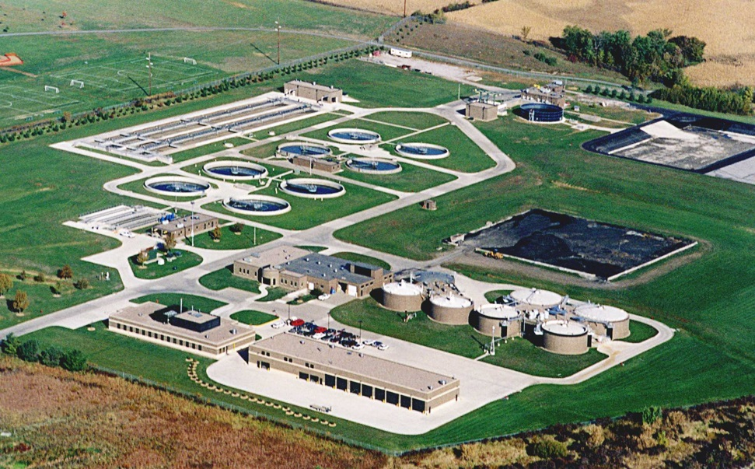
What is Reclaimed Water
Requirements:
  Reclaimed water must be treated in accordance with PRODUCER’S wastewater permit effluent limits
  Permit must provide for an alternative method of disposal when there is no demand for reclaimed water
    Discharge
    Land Application
Notes:
Picture of a wastewater treatment facility

Slide 5
Types of Reclaimed Water
TYPE I - For use where contact between water and humans is likely
  Uses:
    Irrigation of parks, athletic fields, school yards, and residences
    Wading, boating or fishing in impoundments
    Fire protection - internal sprinklers or hydrants
    Food Crop Irrigation where water may contact edible portion
    Toilet flushing
    Irrigating of Pastures for milking animals
    Any Type II use

Slide 6
Types of Reclaimed Water
TYPE II - For use where contact between water and humans is unlikely
  Uses:
    Irrigation of sod farms, silviculture, limited access highway rights of way, and other remote sites (sites not used by public during irrigation)
    Maintenance of impoundments or natural water bodies –no direct human contact
    Soil Compaction and Dust Control in construction sites – minimal aerosol drift
    Food Crop Irrigation where water will not contact edible portion
    Cooling Tower make up water
    Irrigating of animal feed crops other than pastures for milking animals

Slide 7
Reclaimed Water Quality Standards
Type I
  BOD5 or CBOD 5 5 mg/l
  Turbidity 3 NTU
  Fecal Coliform or E Coli 20 CFU/100 mil (30-day geometric mean)
  Fecal Coliform or E Coli 75 CFU/100 mil (max. single grab sample)
  Enterococci 4 CFU/100 mil (30-day geometric mean)
  Enterococci 9 CFU/100 mil (max. single grab sample)
  Note: the standards represent 30 day average

Slide 8
Reclaimed Water Quality Standards
Type II (for other than a pond treatment system)
  BOD5 20 mg/l
  CBOD 5 25 mg/l
  Fecal Coliform or E Coli 200 CFU/100 mil (30-day geometric mean)
  Fecal Coliform or E Coli 800 CFU/100 mil (max. single grab sample)
  Enterococci 35 CFU/100 mil (30-day geometric mean)
  Enterococci 89 CFU/100 mil (max. single grab sample)

Slide 9
Reclaimed Water Quality Standards
Type II (for a pond treatment system)
  BOD5 30 mg/l
  Fecal Coliform or E Coli 200 CFU/100 mil (30-day geometric mean)
  Fecal Coliform or E Coli 800 CFU/100 mil (max. single grab sample)
  Enterococci 35 CFU/100 mil (30-day geometric mean)
  Enterococci 89 CFU/100 mil (max. single grab sample)

Slide 10
Graywater and Alternative Onsite Water
Graywater
  Wastewater from showers, bath tubs, handwashing lavatories, clothes washing machines, sinks used for disposal of household or domestic products-except those used for food preparation or disposal
  Does not include wastewater from washing of material soiled with human excreta or wastewater that has come in contact with toilet water
Alternative Onsite Water (Alt Water)
  Rainwater, air conditioner condensate, foundation drain water, storm water, swimming pool backwash and drain water (limited), or reverse osmosis reject water
  Reverse Osmosis reject water from Industrial or Commercial facilities and Institutions as well as cooling tower blowdown are regulated by Subchapter E – Industrial Reclaimed Water

Slide 11
Graywater and Alternative Onsite Water
Subchapter F applies to Graywater and Alternative Onsite Water generated and used at a private residence, commercial facility, industrial facility, institution, or agriculture facility
Graywater Reuse System
  System designed to store and use only graywater
  Shall not contain, store or distribute any alternative onsite water
Alternative Onsite Water Reuse System
  Limitations on uses applicable, application rates and methods
  Storage can not create nuisance, or threat to human health
  May be used for beneficial purposes (e.g., landscape irrigation, gardening, composting etc.)
  RO reject water is prohibited from being stored and used in alt water reuse system

Slide 12

Domestic Reclaimed Water Authorization
Current Wastewater Permit
Application on Web TCEQ Form : TCEQ-20427
Does not expire
Items to Submit
  Application
  Operation and Maintenance Plan
  Service Area Map – clean, able to be photocopied
  User Service Agreement – sample; if user is different from Provider, and or Producer
  Note: each authorization has specific sampling, record keeping and reporting requirements
Notes:
Picture of a Paper Perm

Slide 13
Common Application Issues
Incorrect signature
Illegible service area map –glossy maps don’t really photocopy well
Incorrect Drastic zone selected – sets required liner permeability
Producer Listed not actual permittee
Producer address does not match permit address
Wastewater Permit not issued

Slide 14
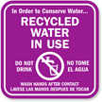
Common Questions Received
Signage
  How many signs must I have around my pond?
  What size do the signs have to be?
  Do I need to have signs up within my plant?
Do I need to change all the piping on my existing system to use reclaimed water?
Can I use an existing force main or collection system pipes for reclaimed water ?
  decommissioned (Y/N)
  must prevent cross contamination
Notes:
Picture of Recycled Water in Use sign

Slide 15
More Common Questions Received
Can I irrigate with reclaimed water if I have a TLAP permit?
Do I need to address all of the safety requirements at my plant ?
Can I place my storage in the floodplain?
What pressure do I need to have in my reclaim water distribution system?

Slide 16
Contact Information
Paul A. Brochi, P.E.
Phone: 512-239-1372
Email: Paul.Brochi@tceq.texas.gov

Slide 17

QUESTIONS?
Notes:
A background picture of a Question Mark?

