Slide 1
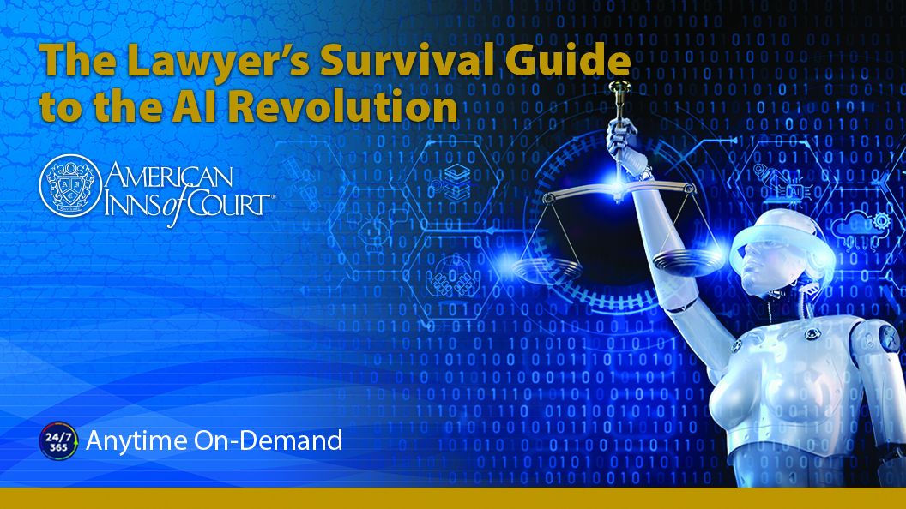

Slide 2
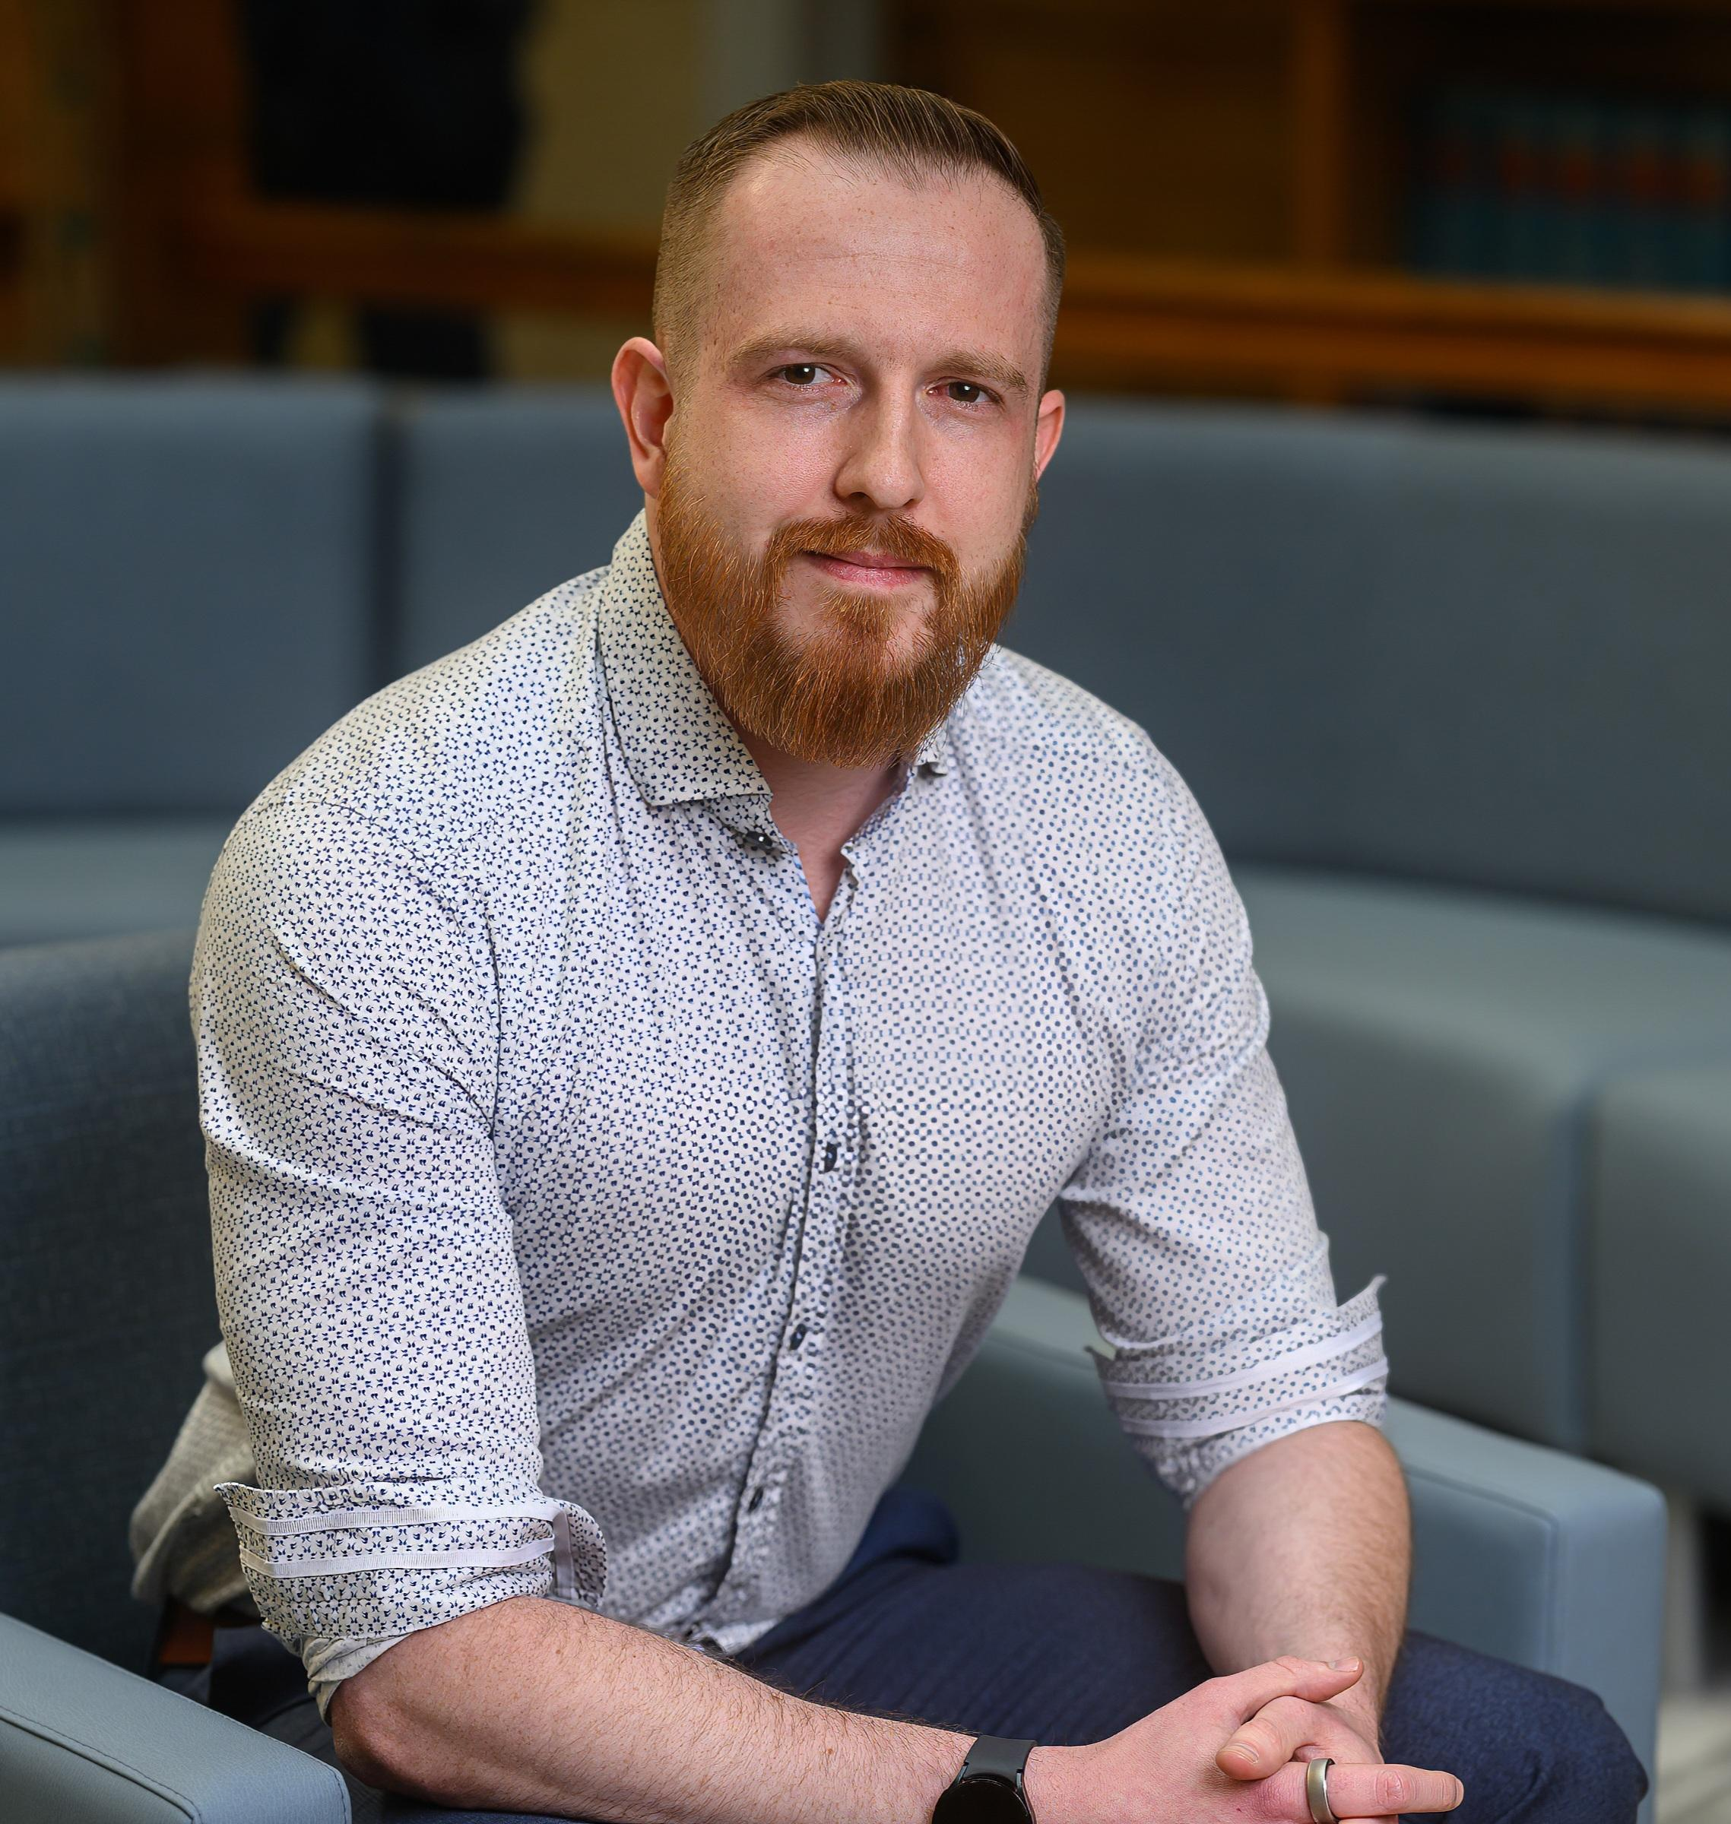

Arthur E. Rothrock, Esq.
Cofounder & CEO
Legion.Law
Arthur is the cofounder and CEO of Legion.law, an AI-powered litigation support platform. He also serves on the ABA’s National Institute on Artificial Intelligence & Robotics Committee.
A former Hopkins & Carley (now Lathrop GPM) litigator, Arthur's law firm, Rothrock Legal, is a first-of-its-kind litigation practice that incorporates AI in every aspect of practice.
He also hosts "The Litigator’s Path“ podcast, where attorneys share their journeys and lessons learned from running their practices.
Arthur holds a J.D. from Santa Clara Law where he served on the executive boards of Law Review and the High Tech Law Journal.

Slide 3
Agenda
Learning Objectives
In this program, you will:
Learn key AI concepts, capabilities, and limitations as relevant to the practice of law
Learn best practices for safety and ethically integrating AI tools into legal workflows
Learn about the privacy and data security risks associated with major AI platforms
Learn best practices for AI prompting
Learn about deepfakes and best practices for keeping them from making it into evidence

Slide 4
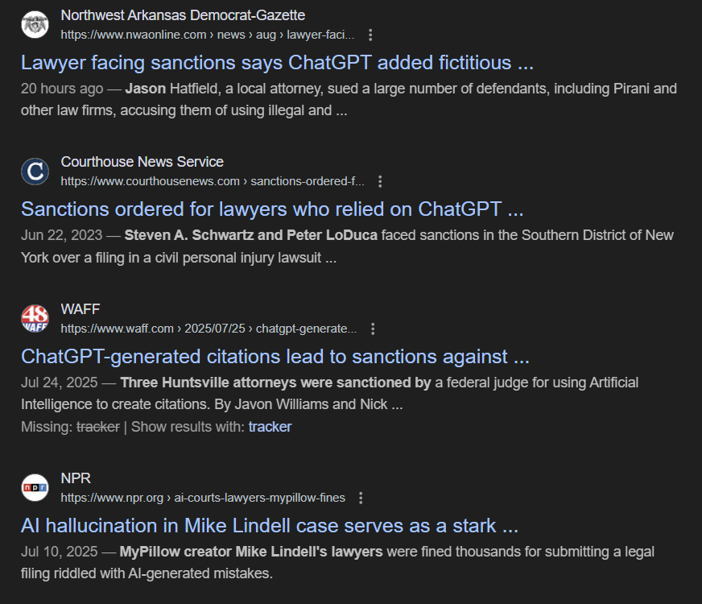
Current Developments
AI advancement and adoption are proceeding at a blistering pace but education on its effective use is lacking.
Over 200 attorneys and even a federal judge have faced sanctions for citing AI-generated fake cases, highlighting the risks of improper AI use in legal practice.
Even those who avoid using AI must understand it, as widespread adoption affects all legal professionals.
As AI democratizes the creation of deepfakes—fake images, audio, and video—any client or witness can now fabricate evidence, creating unprecedented evidentiary challenges.

Slide 5

Introduction to AI
What is Artificial Intelligence?
AI is a broad term that encompasses tech designed to simulate human intelligence and perform tasks that typically require human-like cognition.
While there is no single, universally accepted definition of AI, it generally refers to systems that can analyze data, recognize patterns, learn from experience, make informed judgments, predict future behavior, and automate functions.
While there are many types of AI, such as Machine Learning, Neural Networks, each use different methodologies.
What we’ll be discussing the most today is Generative AI or GenAI for short.

Slide 6
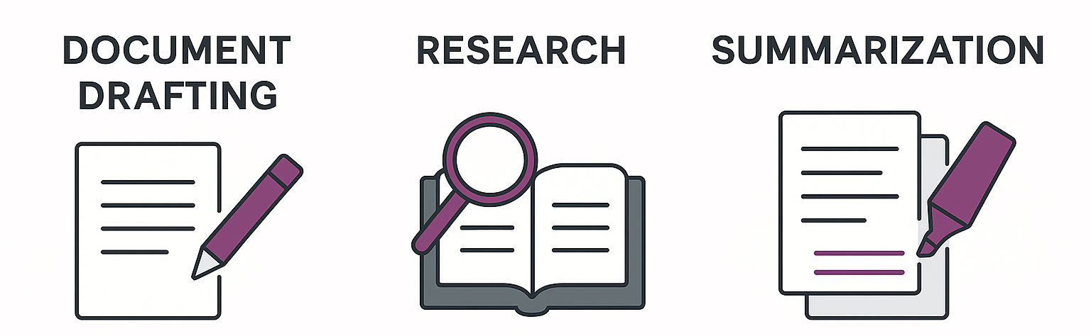
AI Uses
What are attorneys using AI for?
Examples: correspondence, opening & closing summaries
Examples:
case law, statutes, forms or sample language for orders
Examples:
case law, documents or action points

Slide 7
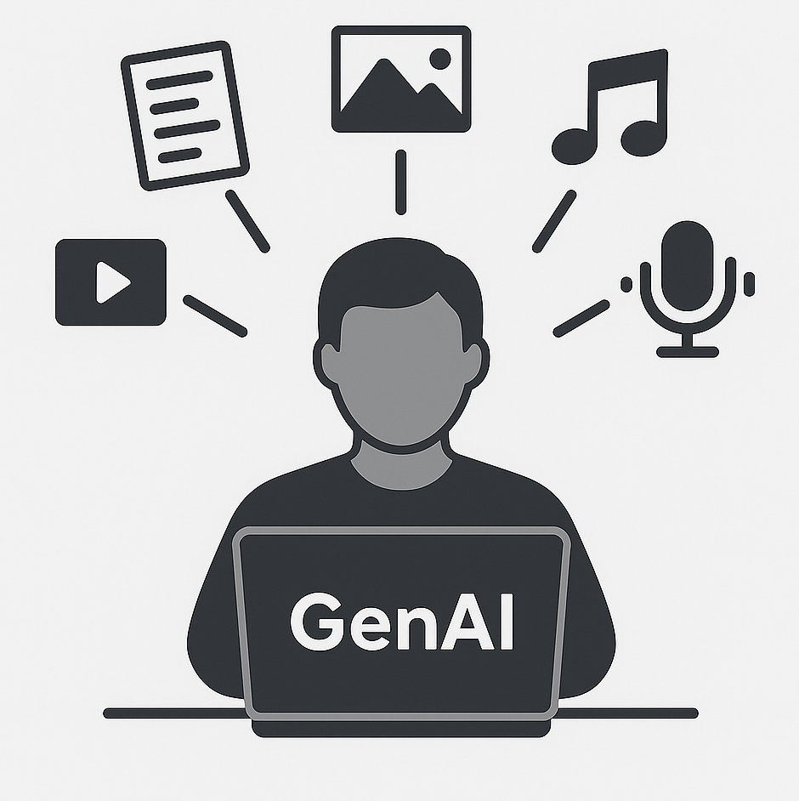
What is Generative AI?
Fun Fact: Many graphics for this presentation were created with GenAI!
This newer branch of AI uses algorithms to create original content – such as text, images, audio, and code – based on patterns in existing data. Prominent text examples include ChatGPT and Claude.
Also referred to as Large Language Models (LLMs or just models), these models are trained on large amounts of text to achieve their functionality. They are big and expensive to train and operate.
Smaller opensource models can be run on your computer but generally exhibit less intelligence.

Slide 8








Where can I find Generative AI?
Everywhere.
ChatGPT.com
Claude.ai
Perplexity.ai
Gemini.google.com
Deepseek.com
Meta.ai
Grok.com
Co-Pilot

Slide 9
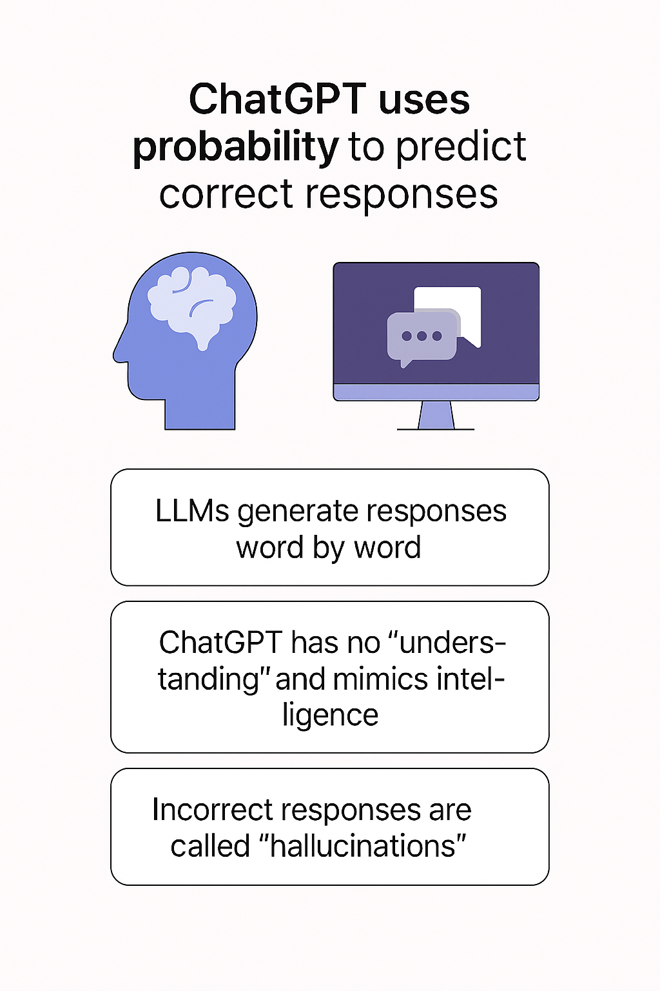
How does Generative AI work?
It’s simpler than you’d expect.
Just because a response is the most probabilistically correct does not mean it is correct.
A Supreme Court case, discussed repeatedly, and present in the data set many times, means you’re likely to receive a correct answer about it.
An obscure municipal code, barely talked about, appearing only passingly in the data set, means you’re likely to receive an incorrect answer.

Slide 10
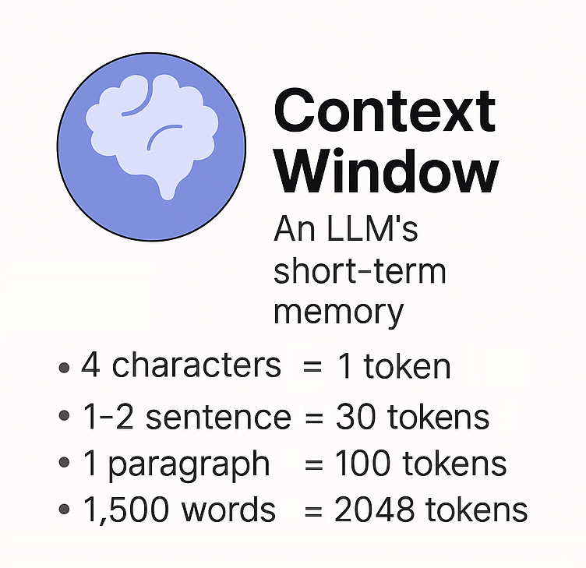
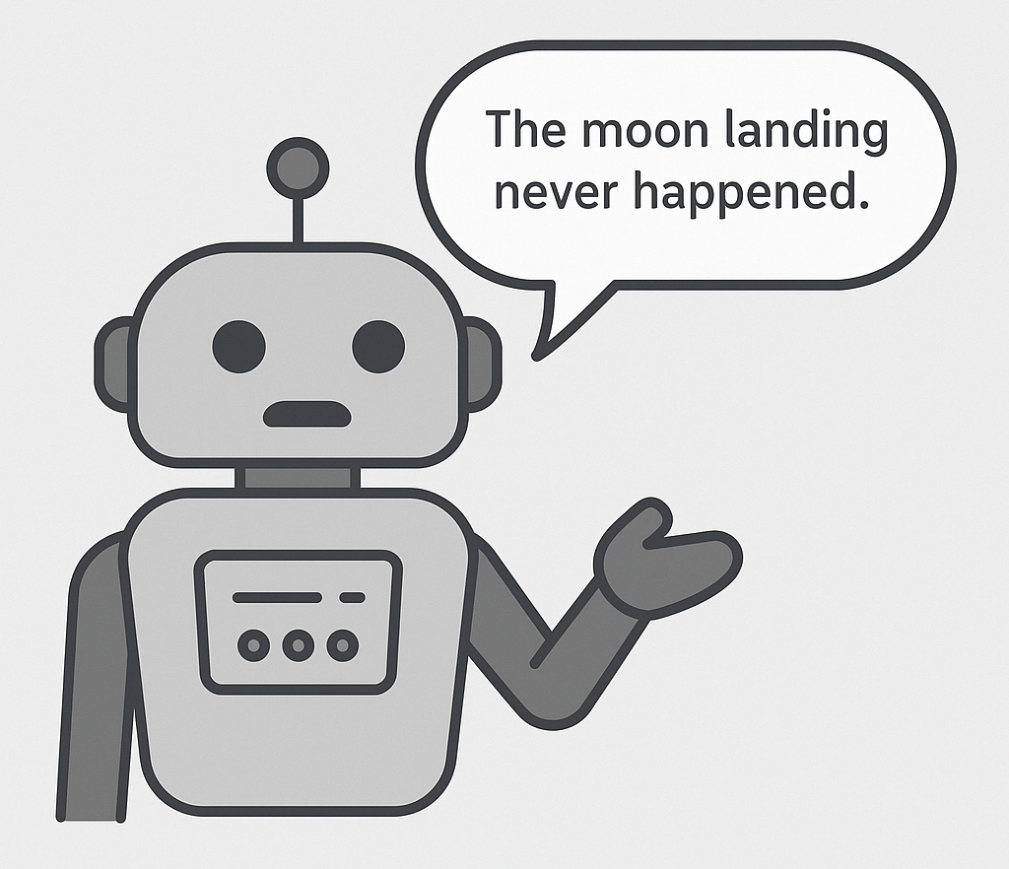
Gen AI’s Biggest Limitation
Hallucinations
Example: Claude’s 200k token context can hold roughly 300 pages of single-spaced text.

Slide 11
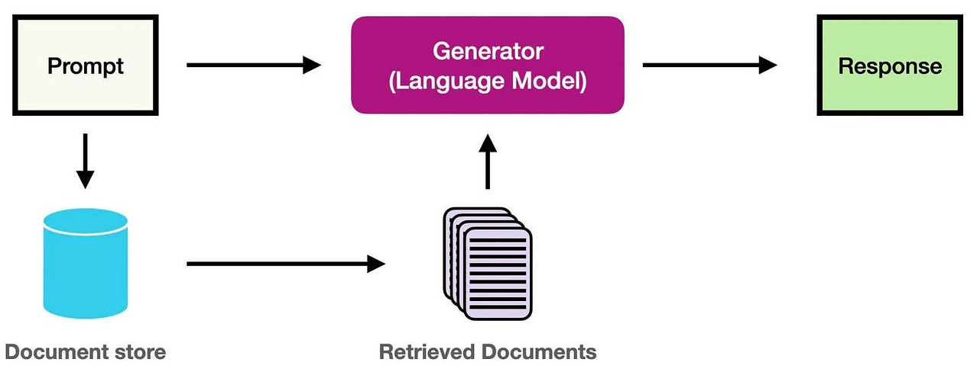
Technical Solutions to Hallucinations
Retrieval Augmented Generation (RAG)
RAG gives GenAI a “brain” or a repository of information that it can pull from when answering queries (like Westlaw’s and Lexis’ AI-assisted research). This information is assigned mathematical values (“embedding”).
When you type in a query, it is reduced to a mathematical value and used to determine the most likely matching information in its “brain.”
This information is then pulled and provided to the AI before it answers your query: “Before responding to the user review this [info].”

Slide 12

RAG Isn’t Perfect
Technical Limitations
  Chunking Dilemmas:
    Too small: Fragments contextual relationships
    Too large: Dilutes relevance and exceeds context windows
  Vector Similarity Limitations: May miss legally relevant documents that use different terminology
  Context Window Constraints: Large cases often exceed token limits
Hallucinations can persist.
Information Retrieval Challenges
  Query-Document Mismatch: Terminology varies between query and relevant documents
  Authority Ranking: RAG struggles to prioritize precedential value or jurisdictional relevance

Slide 13
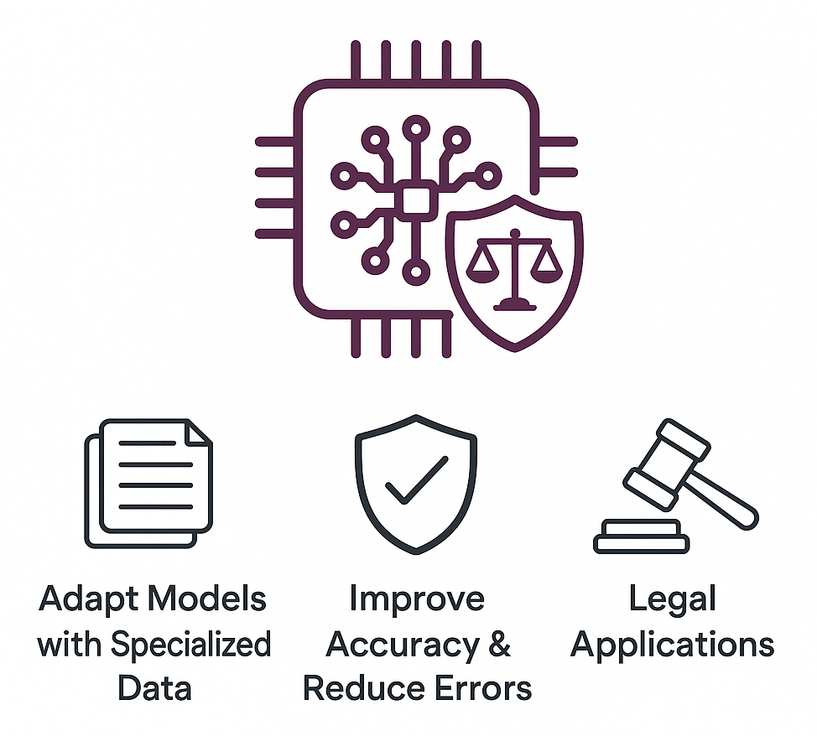
Technical Solutions to Hallucinations
Fine-Tuning: Customizing Models with Domain-Specific Data
  Fine-tuning adapts a pre-trained model by training it further on specialized datasets relevant to specific use cases or industries.
  This process aims to improve accuracy and reduce hallucinations by teaching the model domain-specific patterns, terminology, and facts.
  Legal organizations might fine-tune on case law, statutes, and legal documents to create more reliable legal AI assistants.

Slide 14
Fine-Tuning Isn’t Perfect Either
Limitations
Resource intensive – Requires significant computational resources, expertise, and high-quality curated datasets that many organizations lack.
Overfitting risk – Models can become too specialized, losing general capabilities or memorizing training data rather than learning patterns.
Maintenance burden – Requires continuous updates as laws change, new cases emerge, and domains evolve.
It can reduce but not eliminate hallucination risk.
Fine-tuned models still generate plausible-sounding but incorrect information, especially when queries fall outside training data.
HUMAN OVERSIGHT REMAINS ESSENTIAL.

Slide 15
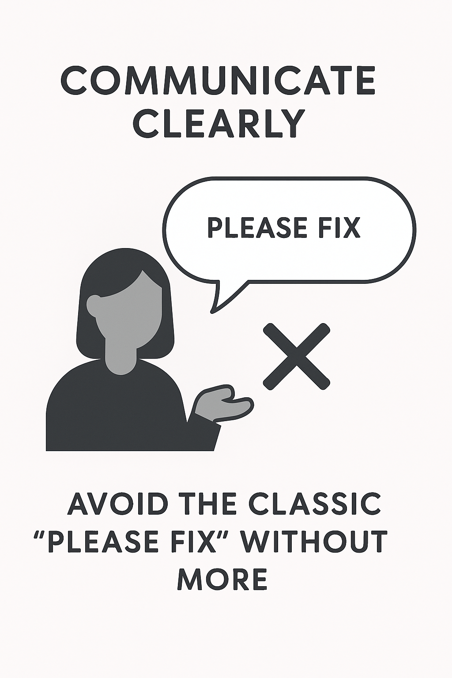
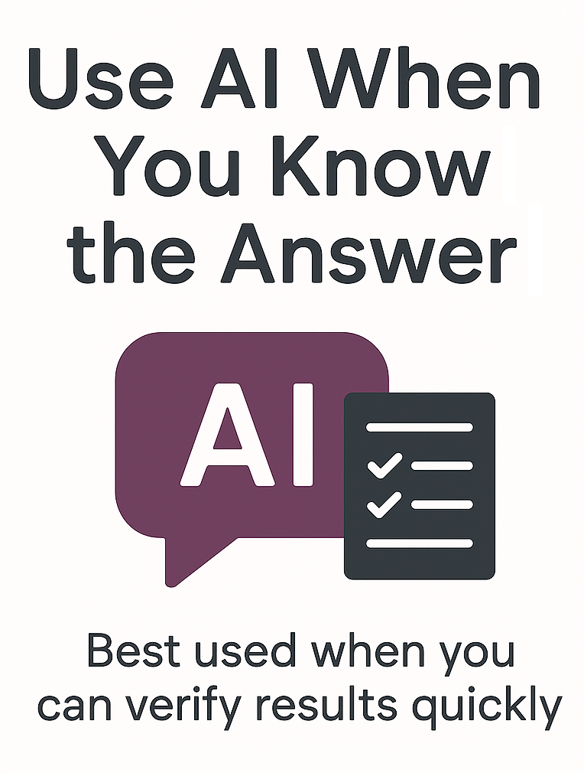
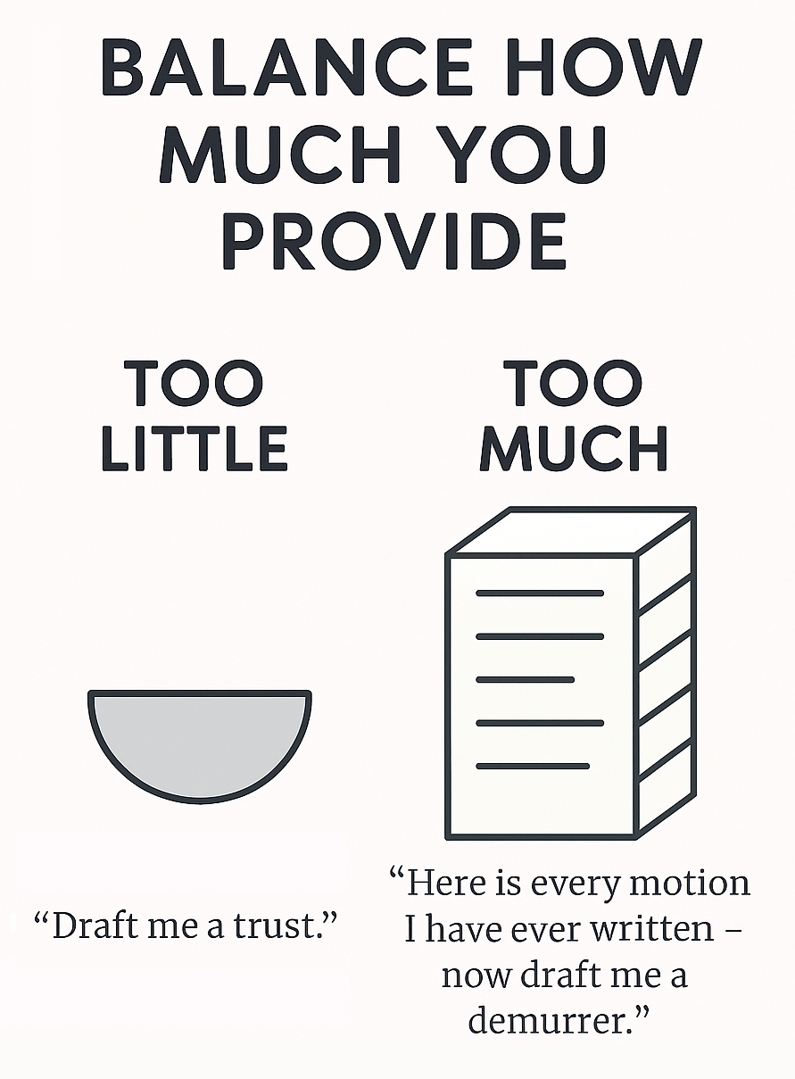


Effective Practices to Limit Hallucinations
Clarity, Balance, Practice and Checking the Work

Slide 16
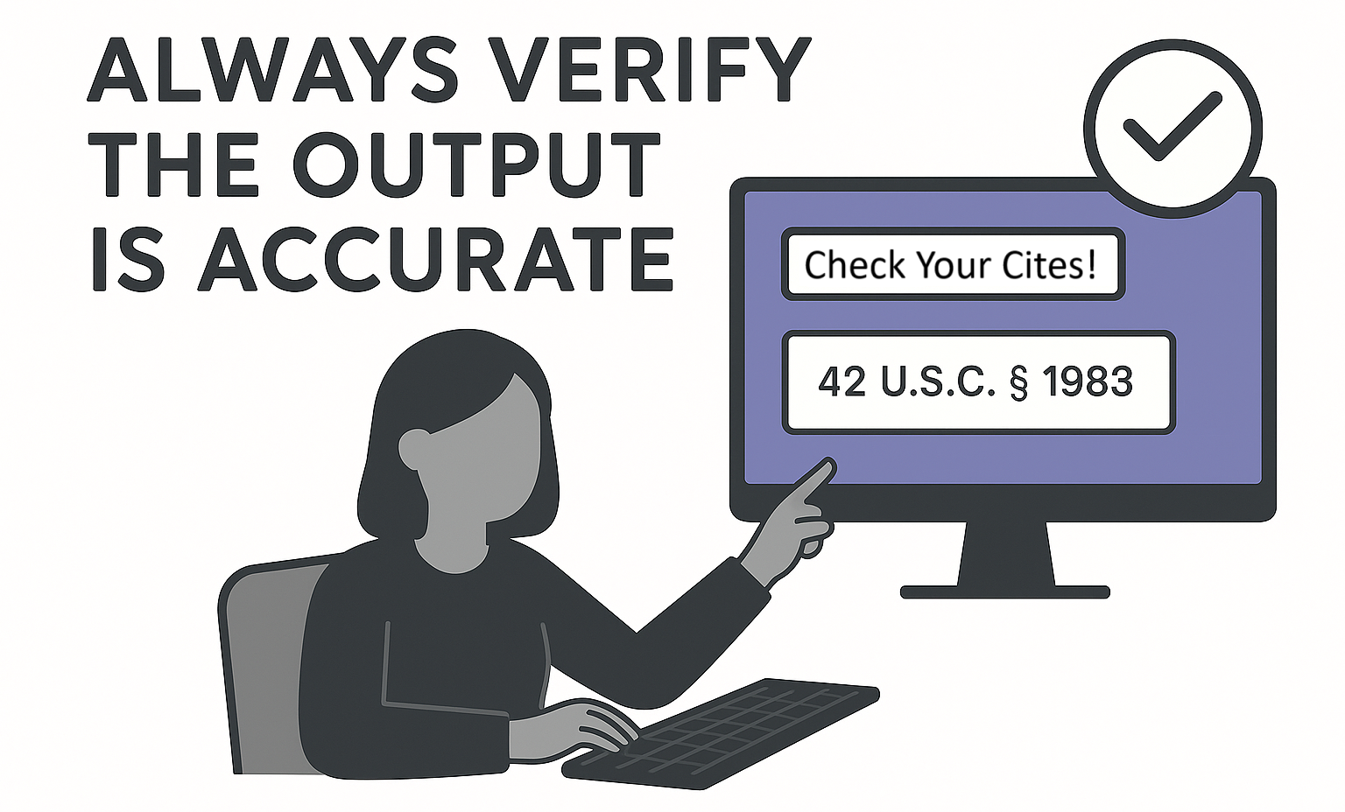
Effective Practices to Limit Hallucinations
Clarity, Balance, Practice and Checking the Work

Slide 17

The Anatomy of the Perfect Prompt
The Clearer the Direction and Information Inputs, the Better the Output
Step 1: Goal | Draft a professional demand letter to a commercial tenant who is three months behind on rent and violating lease terms.
Step 2: Return Format | Here's an example: [Provide an exemplar or short sample of what you want the response to look like and say clearly what you want it to use from this exemplar. Case law? Statutes? Writing style?].
Step 3: Warnings | Ensure the amounts are accurate, reference only actual lease terms, and make sure the contents of the letter satisfies the notice requirements in the lease.
Step 4: Context Dump | Upload: Lease agreement, payment ledger (Apr-Jun 2025), prior communications, and relevant case law or code sections.

Slide 18

Ways to Use AI in Legal Practice
If used properly, AI can make your practice more productive and efficient.
Transcribe Handwritten Documents
Recreate Charts & Tables from a PDF
Review Opposition Documents for Omissions
Outline Replies Based on Found Omissions

Slide 19
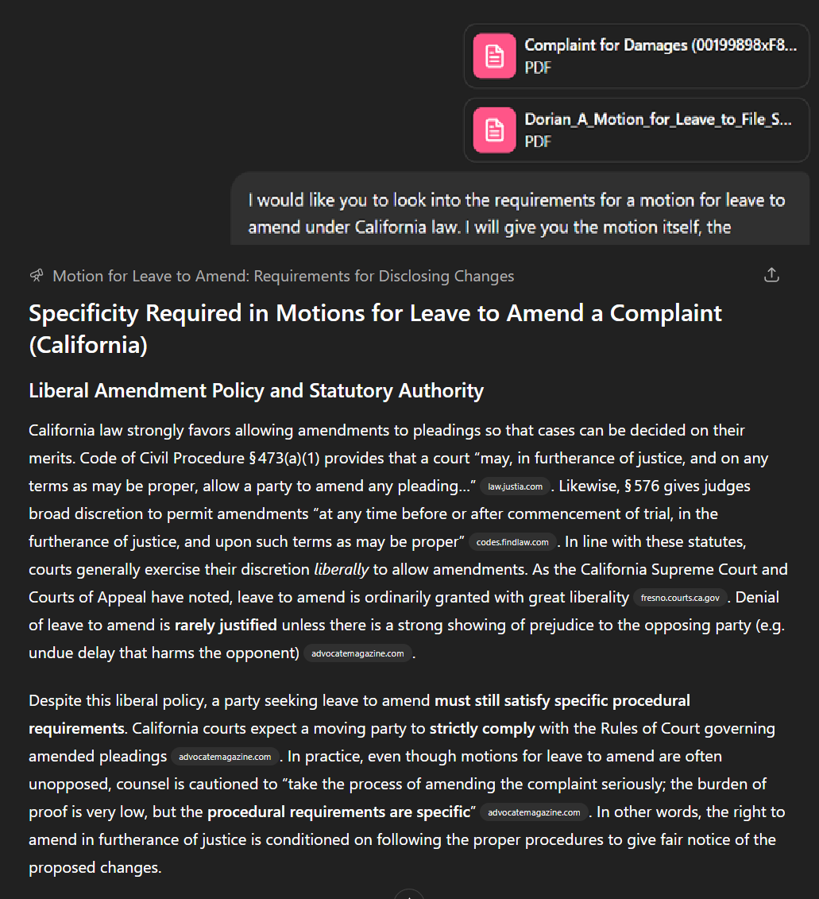
Ways to Use AI in Legal Practice
If used properly, AI can make your practice more productive and efficient.
Deep Research for Better Results to Simple Questions
Provide more inputs that are “clean” and proven.
Ask AI to use those to answer a query to limit the scope of what it uses.

Slide 20
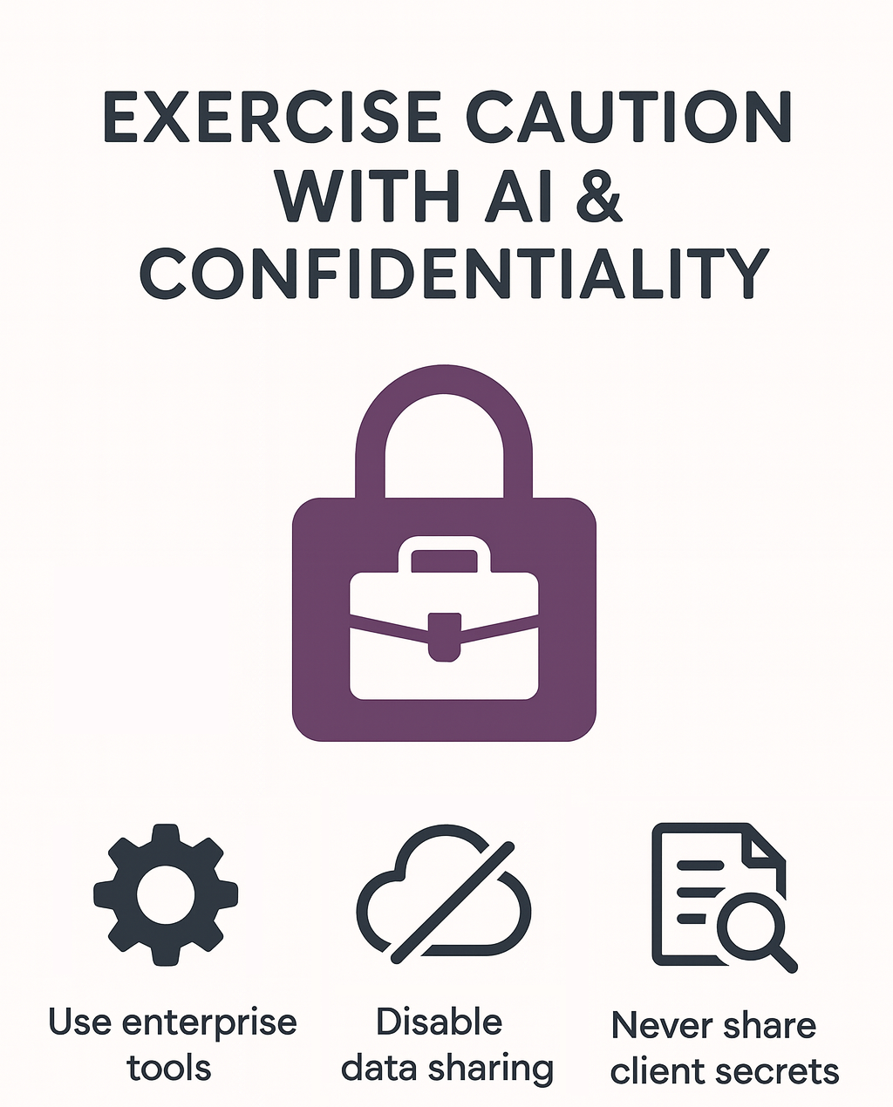
Ways to Use AI in Legal Practice
If used properly, AI can make your practice more productive and efficient.
None of these consumer AI tools guarantee attorney–client confidentiality by default.
Anything shared might be seen by company personnel or repurposed in training.
If you use AI, choose enterprise versions or privacy settings that disable data sharing (e.g. ChatGPT Enterprise, Claude for Work, Copilot Business, or Legion.law).
When in doubt, avoid inputting sensitive client information into any AI cloud service.
Always review the latest privacy terms, as policies are evolving alongside the technology.

Slide 21
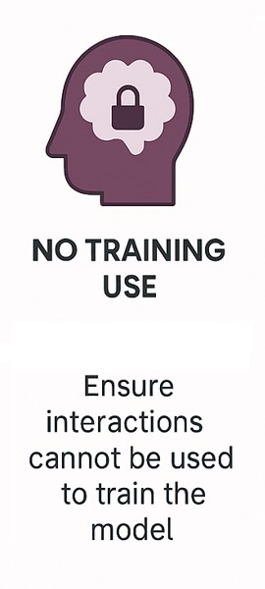
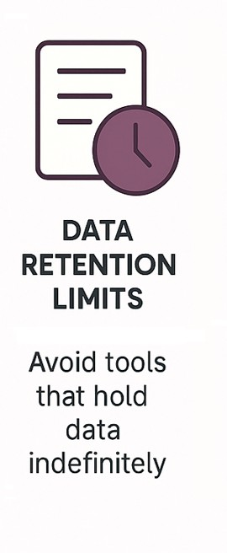
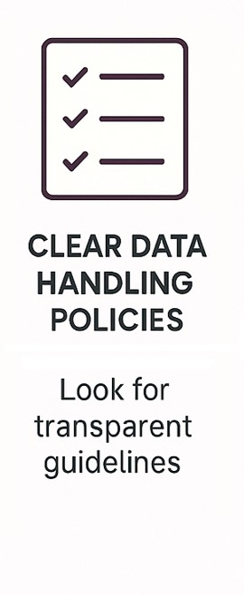
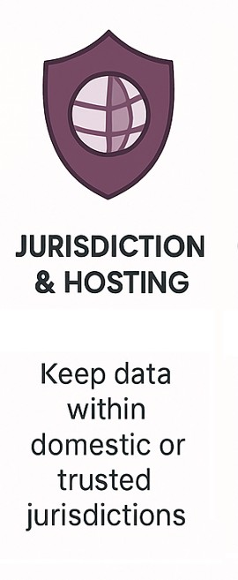
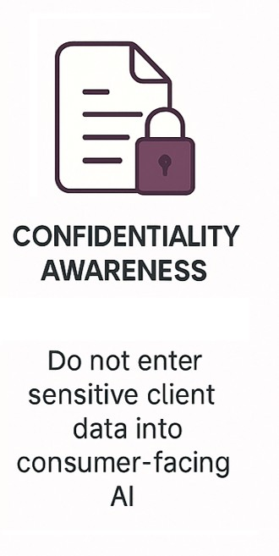
Ways to Use AI in Legal Practice
If used properly, AI can make your practice more productive and efficient.

Slide 22
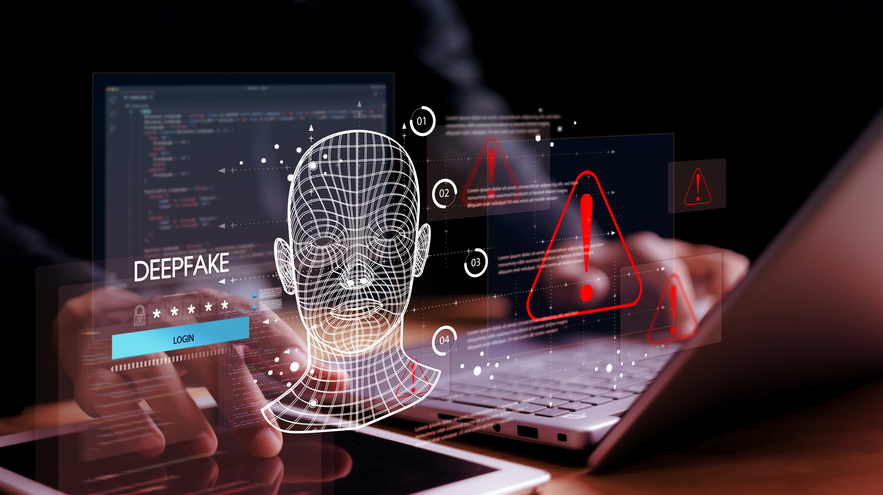
Deepfakes
Easier to make, harder to spot.

Slide 23
Deepfakes
Easier to make, harder to spot.
Multiple free or cheap online sites and platforms.
Social media amplifies fakes very quickly.
“How-to” instructions available with a simple online search.

Slide 24
Deepfakes
Visual information is very hard to forget.
Jurors retain up to 85% of visual information as opposed to only 10% of what they hear.
Zachary B. Parry, Digital Manipulation and Photographic Evidence: Defrauding the Courts One Thousand Words at a Time (2009)
U. ILL. J. L. TECH & POL’Y 175, 185
Even if a person is aware that evidence is fake, the fake evidence may still have a substantial impact on the person’s perception of the facts or situation.
Maura R. Grossman, The GPTJudge: Justice in a
Generative AI World (2023) 23
DUKE L. & TECH. REV. 1, 19
The Continued Influence Effect: The brain performs some knowledge revision with correction, but the prior information is not erased but rather “coexist[s] and compete[s] for activation.
Ullrich K.H. Ecker et. al. (2022) The Psychological Drivers of Misinformation Belief and its resistance to Correction, NATURE REVIEWS PSYCHOLOGY 1, 13-29.

Slide 25















Deepfakes
Telltale signs for spotting one.
 | What you might notice that tips you off:
 | Unrealistic human movement: unnatural gestures, awkward body mechanics
 | Facial expressions often appear uncanny or disconnected from speech emotions
 | Environmental interaction is poor: subjects rarely touch objects naturally
 | Odd lighting or shadow changes
 | Lip movements not perfectly matching spoken words
You'll know it when you see it.
Not anymore…

Slide 26

Deepfakes
So, what’s left?
Forensic analysis can detect AI artifacts (for now...).
Reliance on companies to use watermarks to indicate AI (which are easily edited/cropped out). Opensource AI will not have this ability.
Digital forensic chain of custody (documenting source, metadata, and handling from creation) remains the ONLY reliable method!
Notes:
.

Slide 27

Your turn…give it a try!
Select an AI provider that takes privacy seriously and pay for one month.
Free AI is often subpar and comes with rate limitations.
Make it a business (not personal) account.
Start with Claude Opus or ChatGPT Pro.
Playing with various scenarios with low stakes input/output is the best way to learn. The results may surprise you!
Experiment with a variety of platforms since their personalities and capabilities are all different.
Start with the examples from the presentation and start from there!
Get familiar with AI.

Slide 28
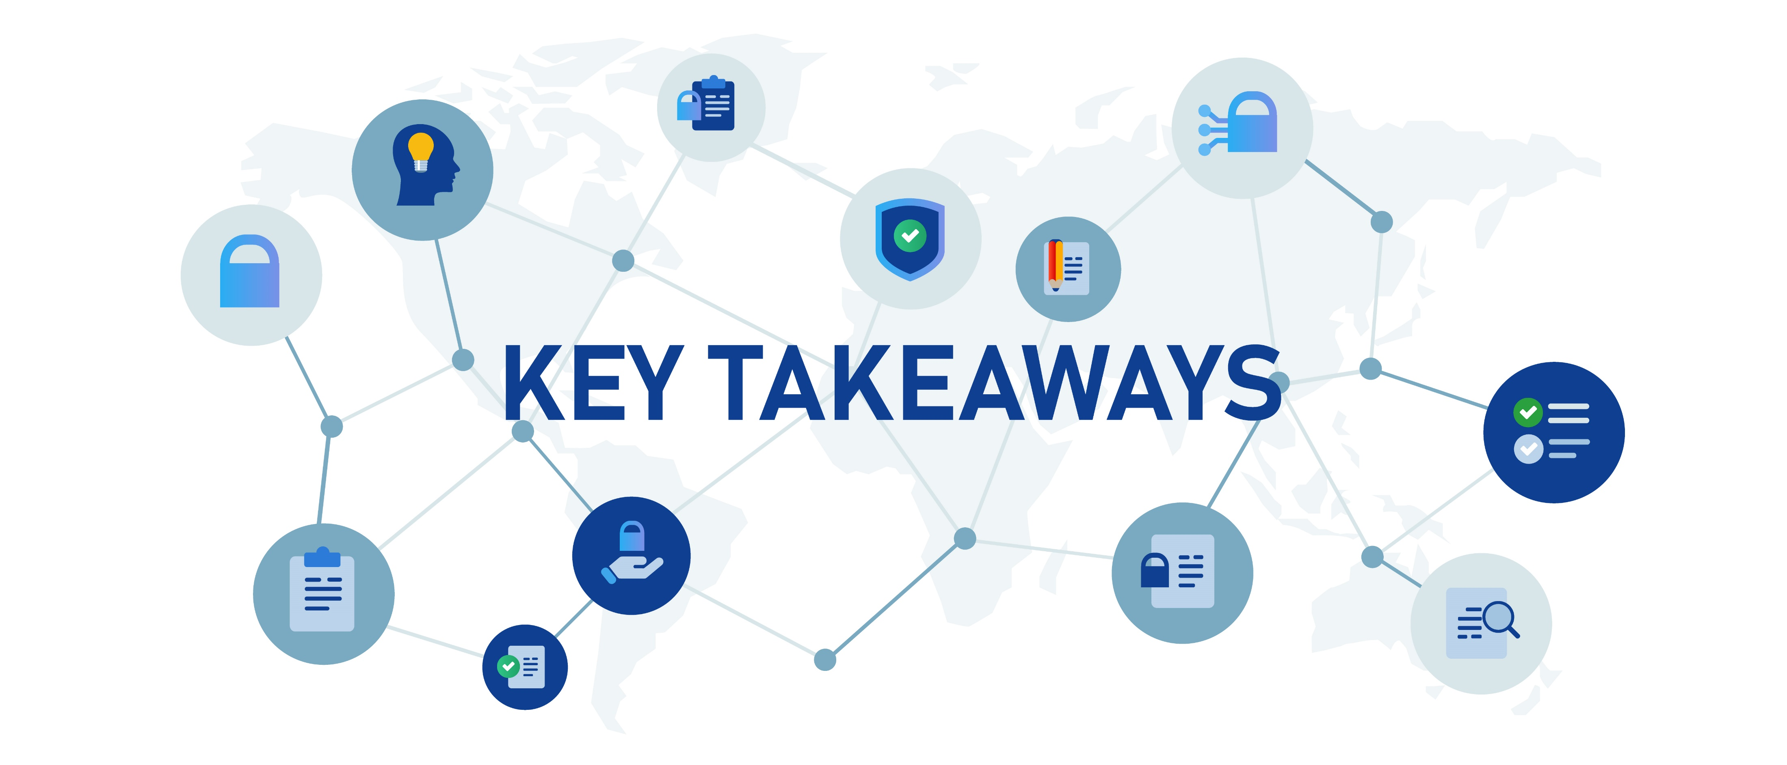
Key AI concepts, capabilities, and limitations related to the practice of law
Effective practices for safety and ethical integration of AI tools into legal work
Privacy and data security risks associated with major AI platforms
Effective practices for AI prompting
Deepfakes and tactics for keeping them from making it into evidence

Slide 29

Thank you!
Legion is a litigation support platform that uses AI to draft fully formatted pleadings, discovery, and motions in minutes.
We get you an initial draft and then provide AI-powered tools to make refinement quick and easy.
Legion evaluates the most advanced AI models and selects the best one for the task, so you don’t have to.
Legion has zero-data retention agreements with all our AI providers, so you and your client’s data is secure.
No more late nights. No more tedious drafting work. No more trouble finding good, reliable associates and support staff.
Arthur@Legion.Law
408.420.7034
Feel free to call or email me with questions!

