Slide 1
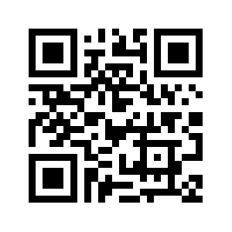
Behavioral and Social Sciences Research at NIH
Jane M. Simoni, Ph.D.
Associate Director for Behavioral and Social Sciences Research, NIH
Director, Office of Behavioral and Social Sciences Research (OBSSR)
Society for Research in Child Development
July 14, 2026

Slide 2

A bit about me…
Clinical psychologist
Behavioral health clinical trialist
NIH grantee for entire academic career with a Center on integrating mental health and primary HIV care
University of Washington 2001-2023
Joined OBSSR July 2023

Slide 3
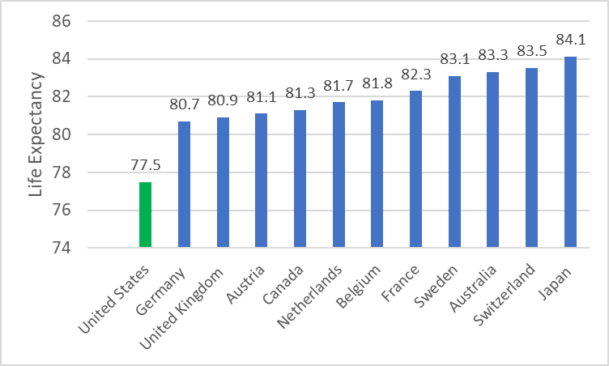
Life Expectancy in the U.S.
The U.S. has the lowest life expectancy (77.5 years) among similarly large and wealthy nations.
https://www.healthsystemtracker.org/brief/the-state-of-the-u-s-health-system-in-2022-and-the-outlook-for-2023/

Slide 4
Leading Causes of Mortality in the U.S.
https://www.cdc.gov/nchs/fastats/leading-causes-of-death.htm

Slide 5
Factors Influencing Health Outcomes
Social Factors and Structural Drivers
  Social isolation
  Limited access to healthful foods, economic advancement, safe places for physical activity, preventive services, and quality health care
  Environmental and occupational exposure to toxins and pollutants
  Low income and education levels (affects most of these other factors)
Behavioral Factors
  Poor diet
  Physical inactivity
  Smoking
  Excessive alcohol consumption
  Sun exposure
  Risky behaviors: unsafe sex, not wearing seat belts, driving under the influence, and unsafe work practices

Slide 6








BSSR Shapes Health Policies and
Improves Health Outcomes
Reducing Health Disparities
Adherence to Medical Treatment
Smoking Cessation Programs
BEHAVIORAL
AND
SOCIAL SCIENCES RESEARCH
Mental Health Interventions
HIV Prevention Strategies
Physical Activity Promotion
Dietary Interventions
Notes:
Smoking Cessation Programs: Understanding the psychological aspects of addiction and behavior change has led to the creation of interventions that promote smoking cessation and reduce tobacco-related health issues.
HIV Prevention Strategies: Studies on risk perception, stigma, and communication have helped develop targeted interventions to promote safe behaviors, increase awareness, and reduce the spread of HIV.
Physical Activity Promotion: Understanding social determinants and behavioral patterns has led to the development of programs encouraging exercise, ultimately reducing the risk of chronic diseases such as cardiovascular problems and obesity.
Mental Health Interventions: Evidence-based interventions for mental health issues include therapies, support systems, and awareness campaigns aimed at reducing stigma and promoting early intervention for mental health conditions.
Dietary Interventions: Social science research on dietary habits and cultural influences has informed public health efforts to combat obesity and related health issues. Tailoring nutrition education and interventions to specific communities has been shown to be more effective in promoting healthier eating habits.
Adherence to Medical Treatment: Understanding patient behaviors, motivations, and barriers has led to interventions that improve medication adherence and overall health outcomes.
Reducing Health Disparities: Social science research on disparities based on socioeconomic status, race, and ethnicity can lead to better health outcomes for all.

Slide 7
National Institutes of Health Mission
To seek fundamental knowledge about the nature and behavior of living systems and the application of that knowledge to enhance health, lengthen life, and reduce illness and disability.
NIH Supports:
Basic research…to fuel progress
Translational research…to move basic discoveries forward
Clinical research…to turn discoveries into prevention, treatments, and cures
A balanced research portfolio…to ensure high return on investment for the U.S. taxpayers
https://www.nih.gov/about-nih/mission-goals

Slide 8
Increased Focus on Behavioral and Social Sciences by NIH and Federal Government
NIH Strategic Plan Update
  2020: NIH updated its strategic plan for FY 2021-2025
  Expanded ‘biomedical research’ to include ‘biomedical and behavioral research’
Council of Councils Report on Integrating BSSR at NIH
  May 2022: NIH Council of Councils approved a Congressionally mandated report
  Recommendations: Provided specific guidance to every NIH Institute and Center on better integrating behavioral and social sciences
White House Blueprint
  May 2024: White House released a Blueprint for the Use of Social and Behavioral Science (SBS) to Advance Evidence-Based Policymaking
  Recommendations: Aimed at federal agencies to improve policymaking through SBS

Slide 9
NIH Funding for BSSR
Between 2010–2020, BSSR
accounted for 21% of new
and competing awards
across NIH¹
Categorical spending
continues to increase²
Integration of Behavioral and Social Sciences Research at the National Institutes of Health. NIH Council of Councils Working Group Report, 2022. https://dpcpsi.nih.gov/council/working-groups/nih-behavioral-and-social-sciences-research-bssr-integration-working-group
https://report.nih.gov/funding/categorical-spending#/

Slide 10
OBSSR Co-funding Amount by Fiscal Year, 2019–2025
*includes grants and contracts​

Slide 11

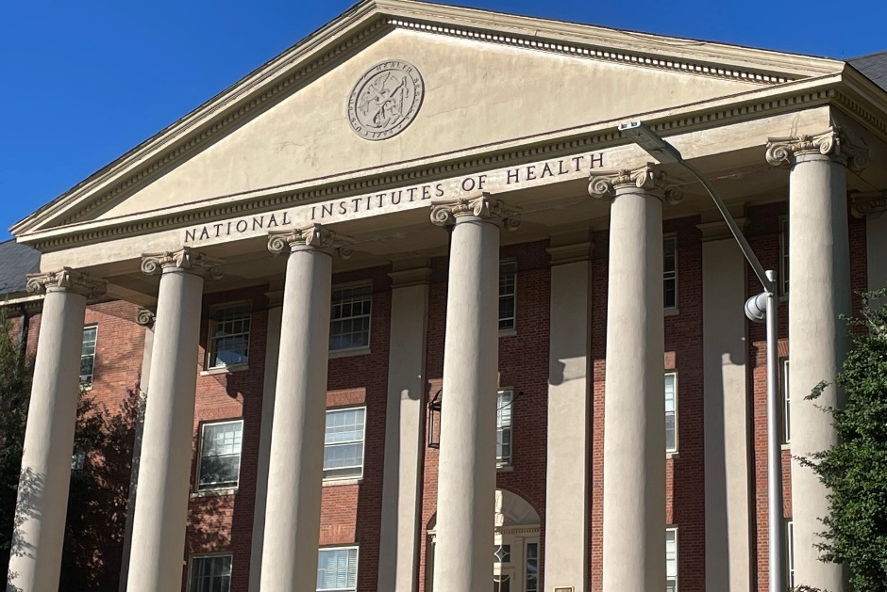
OBSSR: Our History and Purpose
The NIH Office of Behavioral and Social Sciences Research was created by Congress in 1993 (opened in 1995).
Photos taken by Jane M. Simoni

Slide 12

OBSSR
Vision
The synergistic integration of behavioral and social sciences in health research leading to accelerated scientific discovery, effective treatment and health-promotion interventions, and implementation strategies to improve health for all
Mission
Enhance the impact of health-related behavioral and social sciences research (BSSR) by:
Identifying gaps and opportunities for BSSR
Integrating BSSR within the larger NIH research enterprise
Developing and coordinating BSSR initiatives with NIH ICOs
Communicating significant BSSR findings within NIH and beyond

Slide 13





Strategic Priorities
CROSS-CUTTING THEME
HEALTH FOR ALL
RESEARCH
Collaborative Science
Integrate and Coordinate BSSR Across NIH
Build a Cumulative BSSR Knowledge Base
Enhance and Connect Basic and Applied BSSR
OPERATIONAL
Innovative Scientific Investigation
CAPACITY
Refine BSSR Measurement
Promote Novel Experimental Designs
Advance Data Analytics
BSSR Workforce Development
Collaborative Partnerships
Implementation, Dissemination, and Impact
Communication and Outreach
Organizational Climate
Encourage Rigorous and Innovative Implementation and Dissemination Research Methods
Center Health for All in Implementation and Dissemination Research

Slide 14
OBSSR Budget
With an annual budget of more than $45 billion, NIH is the largest single public funder of biomedical and behavioral research in the world.
OBSSR’s Budget
  ~$41 million in FY24
  Steady increase over time, with the largest jump in FY22
  ~75–80% distributed across NIH Institutes and Centers to co-fund high-quality BSSR that is consistent with the OBSSR mission

Slide 15
Maximizing BSSR Integration at NIH
OBSSR has led coordinating efforts to stimulate innovation in the following critical areas, and many more:
  Population health research
  Health economics
  Early relational health/child development
  Pain and opioid initiatives
  Science of health behavior change and maintenance
  Social isolation
  Excessive screen time usage among youth
  Organized sports
  Data infrastructure (e.g., demographic and mortality data)
Notes:
https://obssr.od.nih.gov/about/coordination-and-collaboration

Slide 16
Current Initiatives Led or Co-Led by OBSSR
National Death Index and Data Linkages
BRAIN Initiative®: Brain Behavior Quantification and Synchronization (BBQS)
Violence Research Initiatives
EC-bBSSR (formerly NIH Basic Behavioral and Social Science Opportunity Network
Social, Behavioral, and Economic Impacts of COVID Coordinating Center
Research and Application in Team Science
Behavioral Ontologies

Slide 17
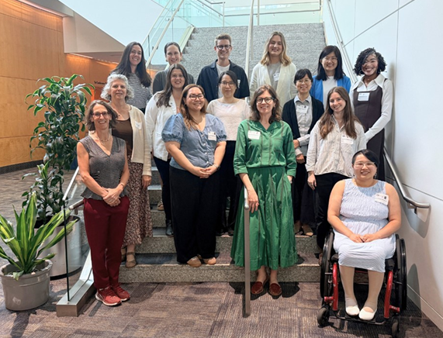
Training the Next Generation of Researchers
T32 Program on Training in Advanced Data and Analysis for BSSR (TADA-BSSR) program
R25 annual short courses in novel methodologies
OBSSR highlights the work of early career investigators in an annual Matilda White Riley Behavioral and Social Sciences Honors Lecture
Investment in and focus on Early Stage and New Investigators
June 2026 Behavioral & Social Science Early Career Research Workshop
Photo by Karin Han

Slide 18
Implementing a Unified NIH Funding Strategy
Effective January 2026 Council round, this framework provides the rubric by which ICO funding strategies are to be developed, implemented, and evaluated to achieve NIH’s goals.
Core Tenets
All ICO funding policies should:
  Align with the NIH’s mission
  Prioritize scientific merit; ICOs should consider peer review information in its entirety
  Integrate a breadth of topics and approaches relevant to the ICO’s priorities
  Consider investigator career stage and promote sustainability of the biomedical research workforce
  Promote broad distribution and geographic balance of funding, considering the total amount and type of NIH funding already available to each investigator
  Align with the availability of ICO funds
https://grants.nih.gov/news-events/nih-extramural-nexus-news/2025/11/implementing-a-unified-nih-funding-strategy-to-guide-consistent-and-clearer-award-decisions

Slide 19
NIH Funding Policy Updates
NIH Guide will continue to have notices (NOT) of new guidelines and policies
https://grants.nih.gov/policy-and-compliance

Slide 20
Updates to Finding NIH Funding Opportunities and Information
Consolidation of NIH Grants and Funding Information:
Central resource for general research grants and funding information: https://grants.nih.gov/
NIH ICO Profile pages for funding ICOs: https://grants.nih.gov/funding/find-a-fit-for-your-research/nih-institutes-centers-offices
Overall reduction in number of NIH NOFOs: Intend to limit the number of highly specific NOFOS and increase reliance on parent announcements and other broad funding opportunities
Grants.gov will serve as the single official source for NIH grant and cooperative agreement funding opportunities

Slide 21
New Resource: Highlighted Topics
Highlighted Topics
Benefits for Research Community
Informs the research community about NIH areas of scientific interest.
Encourages investigator-initiated applications in those topic areas.
May include new or emerging areas.
Will expire after 1 year. NIH may extend.
Help reduce NIH’s use of funding opportunities by highlighting a topic instead (as appropriate).
Reduce the effort to search and apply for funding opportunities.
Apply through one of the NIH Parent Announcements or other broad NIH opportunities at Grants.gov.
Search topics by keyword and filter by participating NIH Institutes, Centers, or Offices.
Weekly subscription emails of new topics released
Check back often for new topics and webpage features.
https://grants.nih.gov/funding/find-a-fit-for-your-research/highlighted-topics

Slide 22
Highlighted Topics vs. NOFOs
Highlighted topics (HTs) are a communication tool, NOT a new form of funding opportunity or NOSI
HTs aim to be less prescriptive, giving the applicant more freedom and creativity in what they propose
HTs focus on an area of science (and don’t include other information such as budget, review, etc. that you see in NOFOs)
HTs do not have an assigned, unique number that can be noted on an application

Slide 23
NIH SimplerNOFO
An HHS department-wide modernization initiative to make NOFOs more accessible, understandable, and actionable, while reducing administrative burden.
Standardizes structure across HHS; enhances plain language; includes shorter, more focused application guidance and easier identification of key requirements.
  Changes to format and language – not to scientific standards.
First SimplerNOFO launched: PAR-27-032, Maximizing Investigators’ Research for ESIs, with more to come.
https://grants.nih.gov/news-events/nih-extramural-nexus-news/2026/05/implementing-simplernofo-at-nih-a-clearer-simpler-path-for-applicants

Slide 24
Request for Information: Proposal to Cap the Number of Simultaneous Research Project Grants (RPG) per Principal Investigator (PI)
NIH is soliciting public input on a proposed policy¹ that would cap the number of RPGs an individual can simultaneously hold as PI or Multi-PI
  Considerations: diminishing returns on concentrated funding; inequitable concentration; potential to support more investigators; alignment with broader Unified Funding Strategy.
Under the proposal, a PI over the cap would need to relinquish one RPG in order for their institution to accept a competing renewal of an existing grant, gradually reducing their portfolio to the cap level
Submit comments² by August 3, 2026.
https://grants.nih.gov/grants/guide/notice-files/NOT-OD-26-086.html
https://rfi.grants.nih.gov/?s=6a1f200c6e0a7544e30b3f12

Slide 25
A Call to Action - What You Can Do
Research
  Team science, multi-disciplinary
  Basic AND applied BSSR
  Multi-level, addressing SDOH and structural factors
  Methodologically innovative and rigorous
  Addresses health disparities
  Plans for feasibility and impact
  Communication/Outreach
  Publish widely
  Disseminate your successes
  Educate peers, leaders, and biomedical colleagues
  Engage with decision-makers
  Mentoring/Training
  Focus on advanced quantitative skills and mixed methods
  Promote collaboration in team science approaches
Baron, J., & Burg, M. M. (2025). Leveraging the behavioral sciences to serve the mission of the Advanced Research Projects Agency for Health (ARPA-H). Health Psychology, 44(1), 1–4.

Slide 26


obssr.od.nih.gov
Healthier Lives Through Behavioral and Social Sciences
obssr.od.nih.gov
Subscribe to our Email Updates

