Slide 1
Delivering an Exceptional Moving Experience
GHC Transition Updates
US Transportation Command - Global Household Goods Contract

Slide 2
Agenda
HomeSafe Alliance Engagements Update
Phase-In Schedule
Carrier Quality Index (CQI)
Supplier Registration

Slide 3
Conditions Based Phase-In Approach (DRAFT)
2023
2024
2025
Aug | Sep | Oct | Nov | Dec | Jan | Feb | Mar | Apr | May | Jun | Jul | Aug | Sep | Oct | Nov | Dec | Jan | Feb | Mar | Apr | May
PEAK
Modified Conditions based Domestic Phase-In dHHG & PPM
AAR
2024 SUMMER PEAK
Modified Conditions based International Phase-In iHHG & iUB
AAR
PEAK
75-200
200-500
500-1,000
1,000-1,500
25%
50%
75%
100% Domestic dHHG & PPM
CAN / PR
AK
GUAM
HI
50%
75%
100%
AAR
PACOM EUCOM
NW NC SW MA
SC
SE
NE
NW NC SW MA
SC
SE
NE
NW NC SW MA
SC
SE
NE
NW NC SW MA
SC
SE
NE
NW NC SW MA
SC
SE
NE
NW NC SW MA
SC
SE
NE
NW NC SW MA
SC
SE
NE
Shift AK, CAN and HI from Domestic to International Phase-In Mitigate Risk
100% Domestic dHHG & PPM
100% of Both Domestic
And 100% International
IHHG & iUB

Slide 4
USTC Transition Phase-in (Subject to Change)

Slide 5
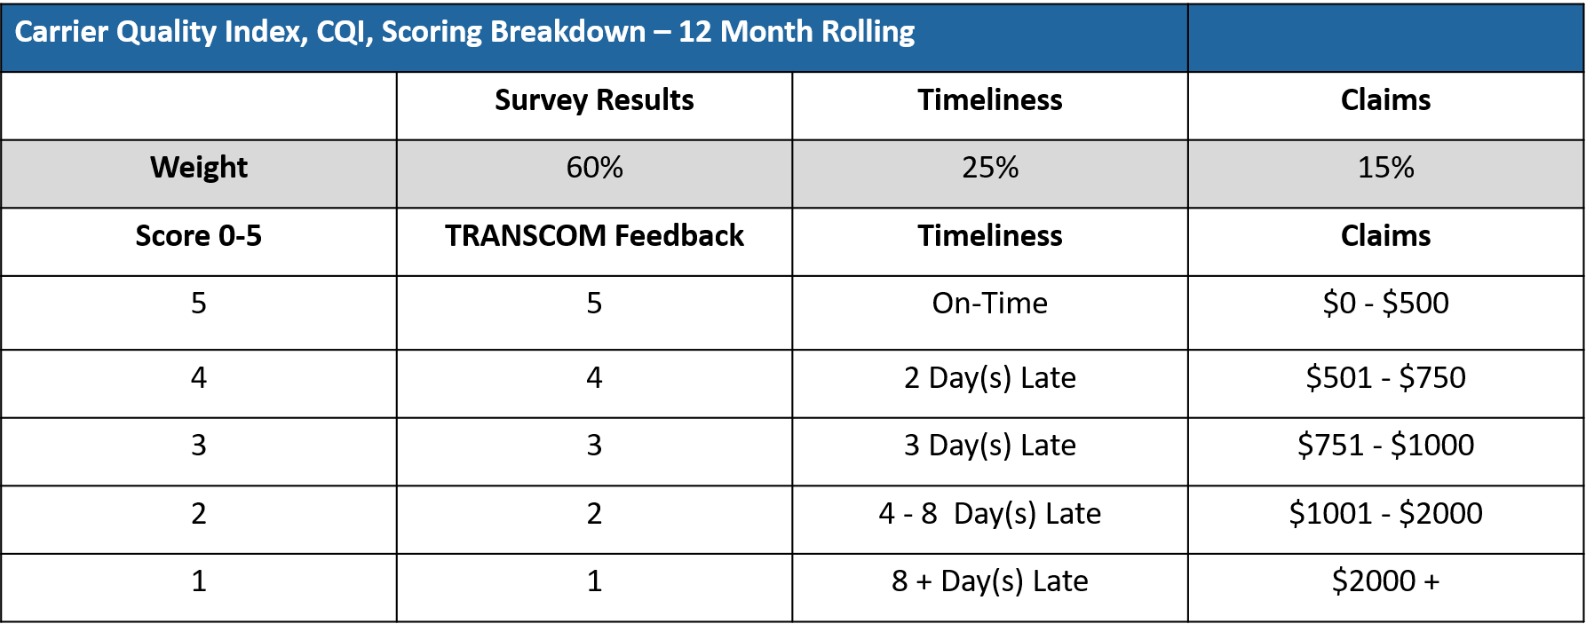
Carrier Quality Index (CQI)

Slide 6
CSS Survey to CQI Scoring
Response Scale | Response
0 | No Likert Response
1 | Unsatisfied
2 | Poor
3 | Satisfied
4 | Good
5 | Excellent

Slide 7
Origin Services – Likert Score Questions
Origin Services – CSS Questions Which Apply
4. Evaluate services provided at origin such as the quality of packing, labeling, and organizing. | Packer
5. Evaluate origin services such as care, courtesy, and attitude of the loading crew. | Packer
6. How satisfied were you with the timeliness of the pickup of your personal property by the Transportation Provider (mover)? | Hauler

Slide 8
Destination Services - Likert Score Questions
Destination Services – CSS Questions Which Apply
5. Evaluate services provided at destination such as the care, courtesy, attitude of the crew, unloading and unpacking. | Destination
6. How satisfied were you with the timeliness of the delivery of your personal property by the Transportation Provider (mover)? | Destination
7. How would you rate your overall satisfaction with the moving company's timeliness, courtesy, professionalism, and responsiveness in all phases of your move from first contact through delivery, to include any follow up? | All Providers

Slide 9
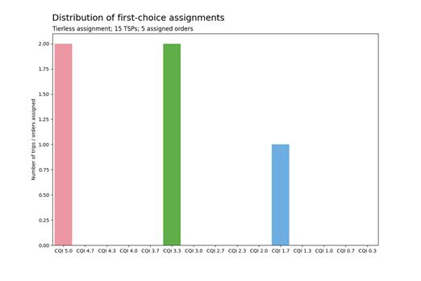
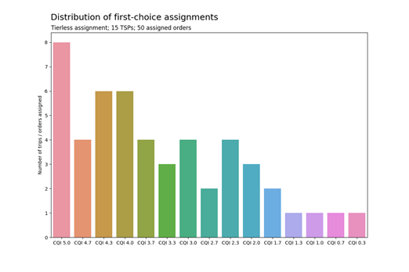
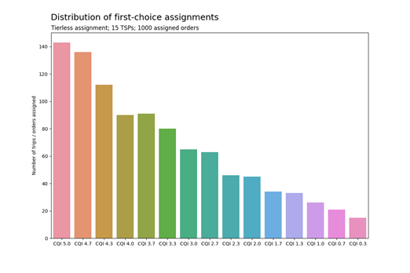
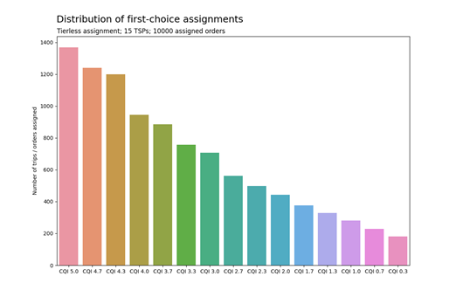
Progressive Weighted Quality Distributions
5
50
1K
5K
Notes:
Top chart can’t read
Progressively Weighted Distro

Slide 10
HomeSafe Alliance Supplier Registration
HomeSafe Supplier:
Go to Supplier Registration, HSASupplier.com to create your company profile. (2 Step Process)
1st Step – Create Profile (General Information, Company Address, Business Data, Company Classification)
NOTE: Geographical Service Areas is for OA/DA and 3rd Party Services ONLY
Registration is required for each local agency
2nd Step – Accounts Payable and Tax Information
Accuracy and thoroughness of your records will help HomeSafe have the best possible view of your firm and how we may be able to work together.
Service Provider Terms and Conditions:
General Framework Agreement (Company Specific, to be sent direct via email)
Exhibits (To be posted on www.HomeSafeAlliance.com)
HomeSafe Standards Performance Work Statement
General Terms and Conditions (Insurance, Indemnities, etc.)
Flowdowns (Mandatory FAR and DFAR Clauses)
Service Contract Act Wage Determinations
For questions, please contact us at Contact@HomeSafeAlliance.com

Slide 11
Please visit us for more information at:
Main Website: www.homesafealliance.com
Supplier Registration: HSASupplier.com
Facebook: www.facebook.com/HomeSafeAlliance
LinkedIn: www.linkedin.com/company/homesafe-alliance
Twitter: @homesafe_all
Email: Contact@homesafealliance.com

