Slide 1
RCRA Requirements for Land-Based Units
Charles Brown, P.G.
Michael Pimentel, P.E.
Industrial and Hazardous Waste Permits Section
May 15, 2018
Notes:
RCRA Requirements for Land-Based Units
Charles Brown, P.G.
Michael Pimentel, P.E.
Industrial and Hazardous Waste Permits Section
May 15, 2018
<Alt Text> Picture of land based unit in background of slide theme

Slide 2
Outline
Land Disposal Restrictions (LDR’s)
Types of Land-Based Units (LBUs)
RCRA and State Requirements
Notes:
Types of Land-Based Units (LBUs)
RCRA and State Requirements
Land Disposal Restrictions (LDR’s)

Slide 3
Types of Land-Based Units
Surface Impoundments
Waste Piles
Land Treatment Units
Landfills
Corrective Action Management Units (CAMU)
Notes:
Types of Land-Based Units (LBUs)
RCRA and State Requirements
Land Disposal Restrictions (LDR’s)

Slide 4
Land Based Units in Texas
Notes:
<ALT TEXT>Graphics of breakdown of land based units:
76% of permitted units are not land based.
Second graphic land based units breakdown by unit type: 31% landfills, 59% Surface impoundments, 8% Land Treatment Units. 2% Waste Piles
Date is approximate based on latest available information.
Surface impoundments counted based on original permit status. Surface Impoundments may be closed as a landfill.

Slide 5
Requirements and Standards
40 CFR Part 264 and 30 TAC Chapter 335
Location Standards
Design Standards
Operation Standards
Closure Standards
Post-Closure Care Standards
Notes:
Requirements and Standards
40 CFR Part 264 and 30 TAC Chapter 335
Location Standards
Design Standards
Operation Standards
Closure Standards
Post-Closure Care Standards

Slide 6
RCRA Requirements
40 CFR Part 264
  Subpart B – General Facility Requirements
  Subpart K – Surface Impoundments
  Subpart L – Waste Piles
  Subpart M – Land Treatment Units
  Subpart N – Landfills
  Subpart S – Special Provisions for Clean-up
Notes:
RCRA Requirements
40 CFR Part 264
Subpart B – General Facility Requirements
Subpart K – Surface Impoundments
Subpart L – Waste Piles
Subpart M – Land Treatment Units
Subpart N – Landfills
Subpart S – Special Provisions for Clean-up

Slide 7
Land Disposal Restrictions (LDRs)
40 CFR 268
Apply to waste that is land disposed
  Surface Impoundments
  Waste Piles
  Landfills
  Land treatment units
  NOT APPLICABLE to CAMU’s
All waste must meet LDRs prior to disposal
Notes:
Land Disposal Restrictions (LDRs)
40 CFR 268
Apply to waste that is land disposed
Surface Impoundments
Waste Piles
Landfills
Land treatment units
NOT APPLICABLE to CAMU’s – waste from remediation activities
All waste must meet LDRs prior to disposal

Slide 8
Location Standards
(40 CFR Part 268)
Seismic Considerations
  Not within 200ft of a fault with displacement in the Holocene
Floodplains
  Must be designed to prevent washout from 100-year flood
Salt Formations
  Liquids prohibited
Notes:
Location Standards
(40 CFR Part 268)
Seismic Considerations
Not within 200ft of a fault with displacement in the Holocene – Last 10,000 years
Floodplains
Must be designed to prevent washout from 100-year flood
Salt Formations
Liquids prohibited

Slide 9
Location Standards
(30 TAC 335, Subchapter G)
Unsuitable Site Characteristics
  With 100-yr floodplains
  Wetlands
  Recharge zone of sole-source aquifer
    Edwards Aquifer in Texas
  Landfills may not overlie a regional aquifer unless
    Evaporation exceeds precipitation by >40 inches
    depth to groundwater is >100 feet
    10 feet of low permeability material beneath landfill containment structure and regional aquifer
Notes:
Location Standards
(30 TAC 335, Subchapter G)
Unsuitable Site Characteristics
Within 100-yr flood plain
Additional requirements to allow construction
Wetlands
Recharge zone of sole-source aquifer
Landfills may not overlie a regional aquifer unless
Annual evaporation exceeds precipitation by >40 inches and depth to groundwater is >100 feet
10 feet of low permeability material beneath landfill containment structure and regional aquifer

Slide 10
Location Standards
(30 TAC 335, Subchapter G)
LBUs may not be located:
  Where soil units within 5ft of the containment structure have a Unified Soil Classification of GW, GP, GM, GC, SW, SP, or SM, or a permeability greater than 10⁻⁵ cm/sec
  Exceptions:
    Evaporation exceeds rainfall by more than 40 inches
    The soil unit does not provide a pathway for waste migration.
Notes:
Location Standards
(30 TAC 335, Subchapter G)
LBUs may not be located:
Where soil units within 5ft of the containment structure have a Unified Soil Classification of GW, GP, GM, GC, SW, SP, or SM, or a permeability greater than 10⁻⁵ cm/sec
Exceptions:
Where the average annual evaporation exceeds average annual rainfall by more than 40 inches
Based on most recent available data
The soil unit is not sufficiently thick and laterally continuous to provide a significant pathway for waste migration.
Determined by a qualified and licensed P.G.

Slide 11
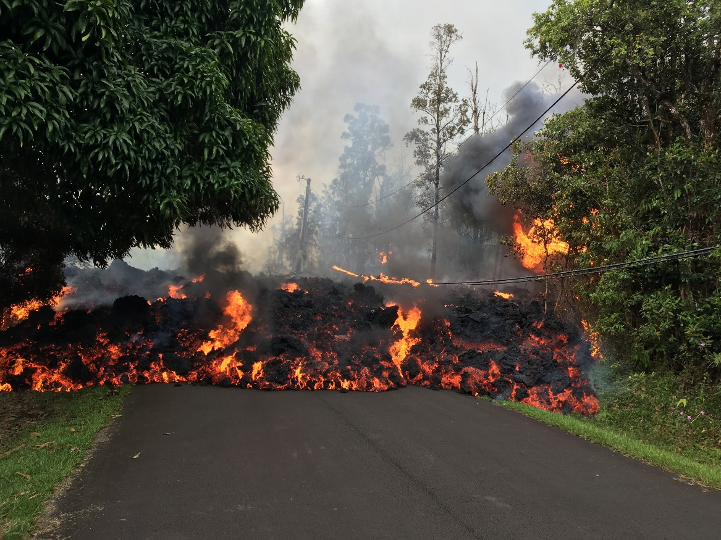
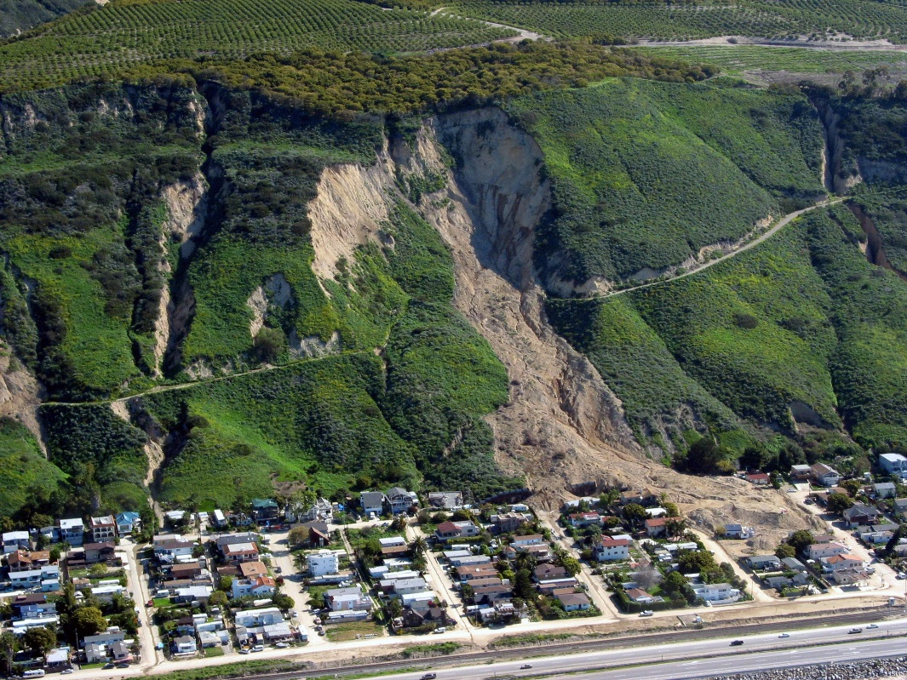
Location Standards
(30 TAC 335, Subchapter G)
An LBU may not be located in areas of active geologic processes.
  unless designed, constructed and operated to prevent adverse effects
Notes:
Location Standards
(30 TAC 335, Subchapter G)
An LBU may not be located in areas of active geologic processes.
unless designed, constructed and operated to prevent adverse effects resulting from the geologic processes.
Geological process may include, but not limited to – Active Subsidence, Mass wasting (soil creep, landslides), Seismic activity, volcanic activity
<Alt Text> Pictures of a landslide and lavaflow

Slide 12
Location Standards
(30 TAC 335, Subchapter G)
In areas protected by a barrier island or peninsula
Within 1,000 ft. of an area subject to active coastal shoreline erosion.
    unless designed, constructed and operated to prevent adverse effects resulting from storm surges or scouring.
Notes:
Location Standards
(30 TAC 335, Subchapter G)
In areas protected by a barrier island or peninsula
An LBU may not be located within 1,000 ft. of an area subject to active coastal shoreline erosion.
unless designed, constructed and operated to prevent adverse effects resulting from storm surges or scouring.

Slide 13
Location Standards
(30 TAC 335, Subchapter G)
An LBU may not be located near a fault
  Within 30 feet of the upthrown side
  Within 50 feet of the downthrown side
  Actual or inferred surface expression
  Demonstrated displacement of shallow Quaternary sediments or man-made structures
  unless designed, constructed and operated to prevent adverse effects resulting from fault motion
Notes:
Location Standards
(30 TAC 335, Subchapter G)
An LBU may not be located near a fault – inactive or not
within 30 feet of the upthrown side
within 50 feet of the downthrown side
actual or inferred surface expression
Demonstrated displacement of shallow Quaternary (2.5 Ma) sediments or man-made structures
unless designed, constructed and operated to prevent adverse effects resulting from fault motion

Slide 14
Surface Impoundments
Design and Operational Requirement's
  40 CFR Subpart K and 335.168
Liner Systems (after July 29, 1992)
  Top Liner (geomembrane)
  Leachate Collection System (LCS)/Leak Detection System (LDS)
    k = 10⁻¹ cm/sec
    Typically sand/gravel or geonet
Notes:
Surface Impoundments
Design and Operational Requirement's
40 CFR Subpart K and 335.168
Liner Systems (after July 29, 1992)
Top Liner (geomembrane)
Leachate Collection System (LCS)/Leak Detection System (LDS)
k = 10⁻¹ cm/sec
Typically sand/gravel or geonet

Slide 15
Surface Impoundments
Liner Systems (after July 29, 1992)
  Composite bottom liner
    Upper component – geomembrane
    Lower component – compacted clay
      3 feet thickness
      k less than/equal to 10-7 cm/sec
Notes:
Surface Impoundments
Liner Systems (after July 29, 1992)
Composite bottom liner
Upper component – geomembrane – 60mil HDPE
Lower component – compacted clay
3 feet thickness
k less than/equal to 10-7 cm/sec

Slide 16
Surface Impoundments
Action Leakage Rate
  Maximum design flow rate that LDS can remove without the fluid head on the bottom liner thickness of drainage media.
    Average daily flow rate for each sump (gallons per acre per day)
    Calculated weekly during active life and closure period, monthly during post-closure care
Notes:
Surface Impoundments
Action Leakage Rate
Maximum design flow rate that LDS can remove without the fluid head on the bottom liner thickness of drainage media
Average daily flow rate for each sump (gallons per acre per day)
Calculated weekly during active life and closure period, monthly during post-closure care

Slide 17
Surface Impoundments
Alternative Designs
  Must be at least as effective as composite liner system
  Must include a LDS
  GCL is common
Notes:
Surface Impoundments
Alternative Designs
Must be at least as effective as composite liner system
Must include a LDS
Geocomposite liner is most common
Bentonite clay between fabric sheets

Slide 18
Surface Impoundments
Monitoring and Inspection Requirements
  Weekly and after storms
    Freeboard (2’)
    Deterioration
    Malfunctions
    Severe Erosion
    Leaks
    Presence of Leachate in Sumps
Notes:
Surface Impoundments
Monitoring and Inspection Requirements
Weekly and after storms
Freeboard (2’)
Deterioration
Malfunctions
Severe Erosion
Leaks
Presence of Leachate in Sumps

Slide 19
Surface Impoundments
Perimeter Dikes
  Structural Integrity Certified by P.E.
    Able to withstand pressure exerted by waste placement
    Will not fail due to scouring or piping
Notes:
Surface Impoundments
Perimeter Dikes
Structural Integrity Certified by P.E.
Able to withstand pressure exerted by waste placement
Will not fail due to scouring or piping
piping is internal erosion by seepage

Slide 20
Surface Impoundments
Closure
  Remove and decontaminate all waste and containment system components
  Unit may be closed as a Landfill if:
    Eliminate free liquids, stabilize remaining wastes (Meets LDR)
    Final cover surface impoundment
      Provide long term minimization of migration of liquids
      Function with minimum maintenance
      k less than or = k of bottom liner
Notes:
Surface Impoundments
Closure
Remove and decontaminate all waste and containment system components
Unit may be closed as a Landfill if:
Eliminate free liquids, stabilize remaining wastes (Meets LDR)
Final cover surface impoundment
Provide long term minimization of migration of liquids
Function with minimum maintenance
k less than or = k of bottom liner

Slide 21
Surface Impoundments
Post-closure care
  For units closed as a Landfill
  Maintain Final Cover
  Maintain and monitor leak detection system
  Maintain groundwater monitoring system
Notes:
Surface Impoundments
Post-closure care
For units closed as a Landfill
Maintain Final Cover
Maintain and monitor leak detection system
Maintain and monitor groundwater monitoring system

Slide 22
Surface Impoundments
If Minimum Technology Requirements (MTR) not meet
  Facilities constructed prior to 1992
  Removal of Waste
  Decontamination of containment system components
  Contingency Plan to address waste left in place
    Final Cover System, groundwater monitoring
Notes:
Surface Impoundments
If Minimum Technology Requirements MTR) not meet
Facilities constructed prior to 1992
Removal of Waste
Decontamination of containment system components
Contingency Plan to address waste left in place
Final Cover System
Groundwater monitoring

Slide 23
Waste Piles
Design and Operating Requirements
  40 CFR Subpart L and 30 TAC 335.170
Liner system
  Top liner – (geomembrane)
  Composite bottom liner –
    Upper component – geomembrane
    Lower component – compacted clay liner
      3 feet thick
      k less than/equal to 10⁻⁷ cm/sec
Notes:
Waste Piles
Design and Operating Requirements
40 CFR Subpart L and 30 TAC 335.170
Liner system
Top liner – (geomembrane)
Leachate Collection System/Leak Detection system
k is 10⁻² cm/s and 12” thickness; or
geonet where k is 10⁻⁵ cm/s or greater
THE INFORMATION FOR WASTE PILES IS HERE FOR REFERENCE IF TIME IS NEEDED.

Slide 24
Waste Piles
Leachate Collection System/Leak Detection system
    k is 10⁻² cm/s and 12” thickness; or
    geonet where k is 10⁻⁵ cm/s or greater
Notes:
Waste Piles
Design and Operating Requirements
40 CFR Subpart L and 30 TAC 335.170
Liner system
Composite bottom liner –
Upper component – geomembrane
Lower component – compacted clay liner
3 feet thick
k less than/equal to 10⁻⁷ cm/sec

Slide 25
Waste Piles
Closure
  Must remove waste
  Decontaminate all containment system components
  If contaminated soils can’t be removed, must close to landfill requirements
    Post-closure plan
Notes:
Waste Piles
Closure
Must remove waste
Decontaminate all containment system components
If contaminated soils can’t be removed (ie. Clean Closure), must close to landfill requirements
Contingent post-closure plan

Slide 26
Waste Piles In Texas
Approximately 6 initially permitted
All closed or undergoing closure
Notes:
Waste Piles In Texas
Approximately 6 initially permitted
All closed or undergoing closure

Slide 27
Land Treatment Units (LTU)
40 CFR 264 Subpart M and 30 TAC 335.171
Program to ensure
    Degradation;
    transformation or;
    immobilization
      Of all hazardous constituents
Notes:
Land Treatment Units (LTU)
40 CFR 264 Subpart M and 30 TAC 335.171
A treatment program to ensure that hazardous constituents placed in or on the ground are degraded, transformed or immobilized within the treatment zone.

Slide 28
LTU Treatment Program
Treatment demonstration
  Wastes that are capable of being treated
  Field tests, laboratory analysis, operating data
Operated in a manner to maximize degradation, transformation and immobilization
Unsaturated (Vadose) Zone Monitoring
Notes:
LTU Treatment Program
Treatment demonstration
Wastes that are capable of being treated
Field tests, laboratory analysis, operating data
Operated in a manner to maximize degradation, transformation and immobilization
Unsaturated (Vadose) Zone Monitoring

Slide 29
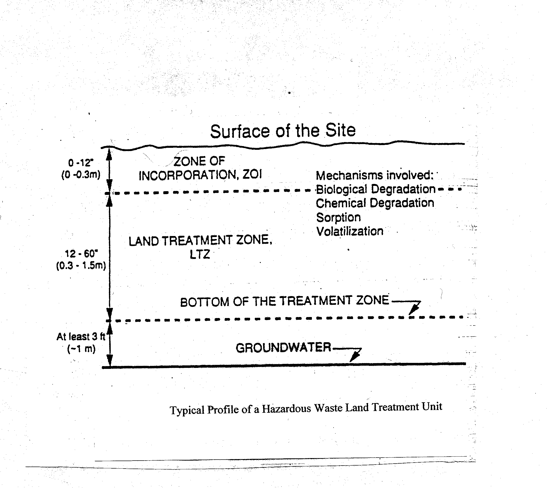
LTU Profile
Notes:
Graphic of Typical Profile of Hazardous Waste Land Treatment Unit

Slide 30
LTU Treatment Demonstration (LTD)
Field tests, laboratory analysis, operating data
Must simulate operating conditions
    Wastes
    Climate
    Topography
    Soil characteristics
    Operating practices
Notes:
LTU Treatment Demonstration
Field tests, laboratory analysis, operating data
Must simulate operating conditions
Wastes
Climate
Topography
Soil characteristics
Operating practices

Slide 31
Land Treatment Units
Design and Operation Requirements
  Must continue to maximize degradation, transformation and immobilization of wastes
  Use same conditions as LTD
    Rate and Method of Waste Application
    Measures to control soil pH
    Measures to enhance microbial activity
    Measures to control moisture
Notes:
Land Treatment Units
Design and Operation Requirements
Must maximize degradation, transformation and immobilization of wastes
Use same conditions as LTD
Rate and Method of Waste Application
Measures to control soil pH
Measures to enhance microbial activity
Measures to control moisture

Slide 32
Land Treatment Unit
Design and Operation Requirements
  Maintain run-on control system from 25-year storm
  Manage run-off from 24-hour, 25-year event
  Inspect LTU weekly and after storms
    Deterioration
    Malfunctions
Notes:
Land Treatment Units
Design and Operation Requirements
Maintain run-on control system from 25-year storm
Manage run-off from 24-hour, 25-year event
Inspect LTU weekly and after storms
Deterioration
Malfunctions

Slide 33
Land Treatment Units
Unsaturated Zone Monitoring
  Monitor soil and soil-pore liquid beneath treatment zone
    Obtain background soil core and soil-pore liquid concentrations
    Sample for principal hazardous constituents
    Site specific locations and frequency
      Statistical analysis allowed
Notes:
Unsaturated Zone Monitoring
Monitor soil and soil-pore liquid beneath treatment zone
Sample for principal hazardous constituents (PHC)
Obtain background soil core and soil-pore liquid concentrations
Site specific locations and frequency
Conduct statistical analysis

Slide 34
Land Treatment Units
Closure
  Cease receipt of new waste
  Continue operation
    Maximum Degradation, Treatment, and Immobilization
  Maintain
    Aeration
    Moisture
    pH
    Nutrients
  Unsaturated Zone Monitoring
    Soil-pore monitoring may be terminated after 90 days
    If documented SSI – continue until no migration demonstrated
Notes:
Closure
Cease receipt of new waste
Continuation of Operation other wise
Goal is maximum degradation, treatment, and immobilization
Maintain unit by:
Continuing aeration
Maintain appropriate moisture content
Ensure proper pH
Ensure adequate soil nutrients
Unsaturated Zone Monitoring
Soil-pore monitoring may be terminated after 90 days – from last application of waste unless an SSI is detected
Continue soil core monitoring until PHC concentrations are below background.
If documented SSI – continue until no migration demonstrated

Slide 35
Land Treatment Units
Closure (cont.)
  Minimize run-off of hazardous constituents
  Maintain run-on/off control systems
  Continue Groundwater monitoring
Closure Activities
  180 day completion
    Longer period may be approved
    Period Dependent on :
      Waste loading rate at closure
      Waste degradation rate
    Typically can be completed in 90 to 360 days

Slide 36
Land Treatment Units
Post-Closure Care
  Begins once Unsaturated Zone Monitoring Data shows equilibrium or background
  Active Management may continue
    Tilling
    Soil Amendments
    Vegetative Cover
  No post-closure release of hazardous constituents
Notes:
Post-Closure Care
Begins once Unsaturated Zone Monitoring Data shows equilibrium or background
Active Management may continue
Tilling
Soil Amendments
Vegetative Cover
No post-closure release of hazardous constituents

Slide 37
Land Treatment Units
Groundwater Monitoring during Post-Closure
  Required unless
    Hazardous Constituents do not exceed background
    No SSIs in Unsaturated Zone during active life
Releases
  PHCs migrated beyond treatment zone are above MCL or Background
    Removal of Contaminated Soil
    Placement of impermeable cap
    Continued management and monitoring
Notes:
Groundwater Monitoring during Post-Closure
Required unless
Hazardous Constituents do not exceed background
No SSIs in Unsaturated Zone during active life
Releases
PHCs migrated beyond treatment zone are above MCL (Maximum Contaminant Level) or Background.
Removal of Contaminated Soil
(OR) Placement of impermeable cap
Continued management and monitoring (Post Closure Care)

Slide 38
Land Treatment Units in Texas
Approx. 24 Units are permitted in 1980s
  11 undergoing closure or post-closure care
  1 never constructed
Notes:
Approx. 24 Units are permitted in 1980s
11 undergoing closure or post-closure care
1 never constructed

Slide 39
Landfills
40 CFR 264 Subpart N
Design and Operating Requirements
  Liner System
    Top liner – i.e. geomembrane
    Leachate Collection System/Leak Detection System
      10⁻² cm/sec and 1’ thickness or geonet with 10⁻⁵ cm/sec or greater
    Composite bottom liner –
      Upper component – geomembrane
      Lower component – compacted clay liner
        3 feet thick
        k less than/equal to 10⁻⁷ cm/sec
Notes:
40 CFR 264 Subpart N
Design and Operating Requirements
Liner System
Top liner – i.e. geomembrane
Leachate Collection System/Leak Detection System
10⁻² cm/sec and 1’ thickness or geonet with 10⁻⁵ cm/sec or greater
Composite bottom liner –
Upper component – geomembrane
Lower component – compacted clay liner
3 feet thick
k less than/equal to 10⁻⁷ cm/sec

Slide 40
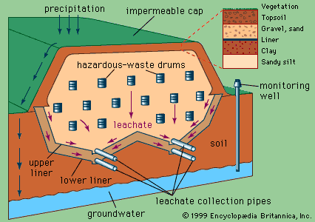
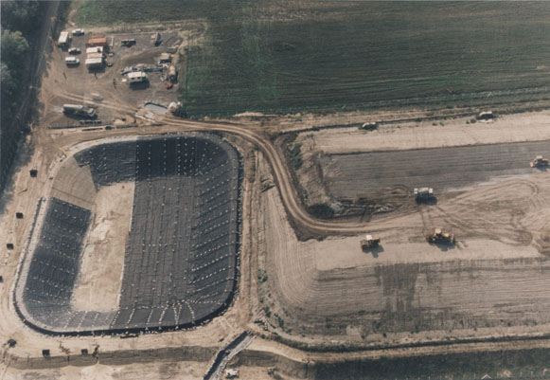
Landfills
Cover System
  Long-term minimization of liquid migration
  k less than or equal to that of the bottom liner system
Notes:
Cover System
Long-term minimization of liquid migration
k less than or equal to that of the bottom liner system
Graphic of landfill cross-section
Graphic of landfill cell under construction

Slide 41
Landfills
Alternative Designs
  Must be at least as effective as composite liner system
  Leak Detection
Operating Requirements
  Must prevent run-on from a 25-year storm
  Must contain a 24-hour, 25-year storm event
Notes:
Alternative Designs
Must be at least as effective as composite liner system
Leak Detection
Operating Requirements
Must prevent run-on from a 25-year storm
Must contain a 24-hour, 25-year storm event

Slide 42
Landfills
Action Leakage Rate (ALR)
  Maximum design flow rate that LDS can remove without the fluid head on the bottom liner exceeding thickness of drainage media.
    Average daily flow rate for each sump (calculated as gallons per acre per day)
    Calculated weekly during active life and closure period, monthly during post-closure care
Notes:
Action Leakage Rate (ALR)
Maximum design flow rate that LDS can remove without the fluid head on the bottom liner exceeding thickness of drainage media.
Average daily flow rate for each sump (calculated as gallons per acre per day)
Calculated weekly during active life and closure period, monthly during post-closure care

Slide 43
Landfills
Response Action Plan (RAP) – if flow rate exceeds ALR
  Notify TCEQ within 7 days
  Submit assessment report within 14 days
  Determine if waste receipt should cease
  Within 30 days, report your action taken and action planned
Notes:
Response Action Plan (RAP) – if flow rate exceeds ALR
Notify TCEQ within 7 days
Submit assessment report within 14 days
Determine if waste receipt should cease
Within 30 days, report your action taken and action planned

Slide 44
Landfills
Closure
  Final cover system
    Provide long term minimization of migration of liquids
    Function with minimum maintenance
    Promote drainage and minimize erosion
    Accommodate settling and subsidence
    k less than k of bottom liner
  Components (Bottom to Top)
    3ft of compacted clay with k of 10⁻⁷ cm/sec or less.
    Geomembrane
    Drainage Layer
    Soil capable of sustaining native plant growth
Notes:
Closure
Final cover system
Provide long term minimization of migration of liquids
Function with minimum maintenance
Promote drainage and minimize erosion
Accommodate settling and subsidence
k less than k of bottom liner
Components (Bottom to Top)
3ft of compacted clay with k of 10⁻⁷ cm/sec or less.
Geomembrane
Drainage Layer
Soil capable of sustaining native plant growth

Slide 45
Landfills
Post-closure care
  Maintain final cover
  Continue to operate
    leachate collection system
    leak detection system
  Continue GW monitoring
  Prevent run-on and run-off from storm events damaging cover system
Notes:
Post-closure care
Maintain final cover
Continue to operate
leachate collection system
leak detection system
Continue GW monitoring
Prevent run-on and run-off from storm events damaging cover system

Slide 46
Corrective Action Management Units (CAMU)
  40 CFR 264, Subpart S – Special Provisions for Cleanup
  Special Unit for the disposal of waste from on-site clean up.
  Implemented to remove the disincentives to
  clean-up
Notes:
40 CFR 264, Subpart S – Special Provisions for Cleanup
Special Unit for the disposal of waste from on-site clean up.
Implemented to remove the disincentives to
clean-up

Slide 47
Corrective Action Management Units (CAMU)
Design Standards
  Composite Liner
  2 foot thick clay with k =10⁻⁷ cm/sec
  FML = 30-mil or HDPE = 60-mil
  Leachate Collection System
    Maintain less than 1’ of leachate over liner
Alternative Designs
  Must be at least as effective as proscribed liner system
  Leachate Collection System
Notes:
Design Standards
Composite Liner
2 foot thick clay with k =10⁻⁷ cm/sec
FML = 30-mil or HDPE = 60-mil
(Flexible Membrane Liner)
Leachate Collection System
Maintain less than 1’ of leachate over liner
Alternative Designs
Must be at least as effective as proscribed liner system
Leachate Collection System

Slide 48
Corrective Action Management Units (CAMU)
Closure
  Final cover system
    Provide long term minimization of migration of liquids
    Function with minimum maintenance
    Promote drainage and minimize erosion
    Accommodate settling and subsidence
    k less than k of bottom liner
  Groundwater Monitoring Required
    Existing/Suspected releases to from within CAMU
    Wastes will remain in place after closure of the CAMU
Notes:
Closure
Final cover system
Provide long term minimization of migration of liquids
Function with minimum maintenance
Promote drainage and minimize erosion
Accommodate settling and subsidence
k less than k of bottom liner
Groundwater Monitoring Required
Existing/Suspected releases to from within CAMU
Wastes will remain in place after closure of the CAMU

Slide 49
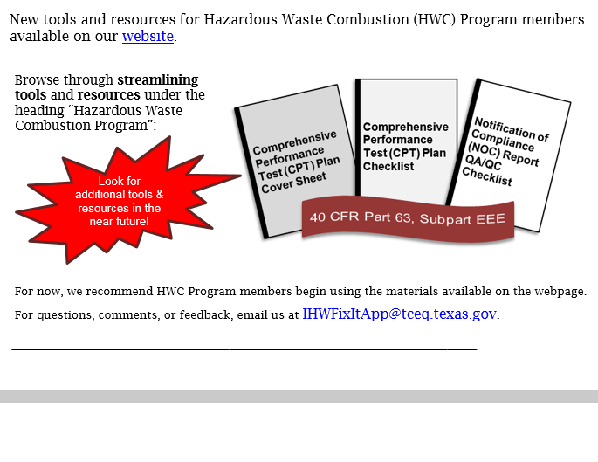
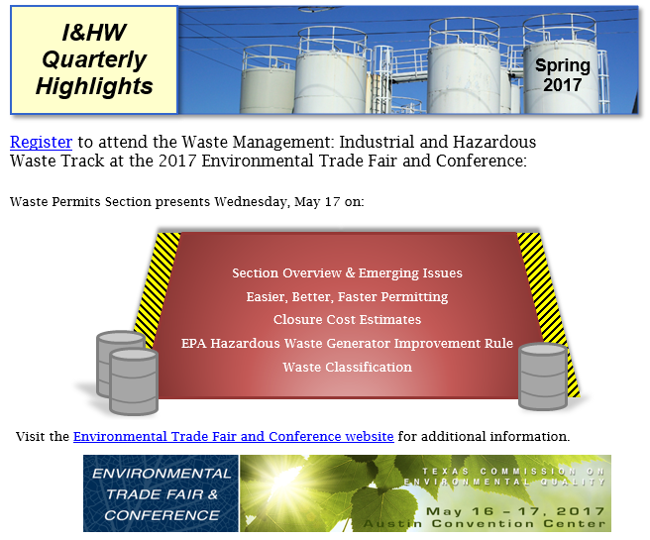

Sign Up for GovDelivery
[Pictures of the first and second pages of the Spring 2017 I&HW Quarterly Highlights.]
Receive the I&HW Quarterly update, and notification of IHW forms, rule, guidance, and procedure updates:
http://www.tceq.texas.gov/permitting/
waste_permits/ihw_permits/signupihw
Notes:
Sign Up for GovDelivery
Receive the I&HW Quarterly update, and notification of IHW forms, rule, guidance, and procedure updates:
http://www.tceq.texas.gov/permitting/waste_permits/ihw_permits/signupihw
[Pictures of the first and second pages of the Spring 2017 I&HW Quarterly Highlights.]
There is possibility for adding subgroups to the listserv (for example, rulemaking or combustion groups).

Slide 50

Useful Agency Links:
TCEQ Home Page:
http://www.tceq.texas.gov/
Has links to 30 TAC Rules and Federal sites
IHW Permitting Home Page: https://www.tceq.texas.gov/permitting/
waste_permits/ihw_permits/ihw.html

Slide 51
More Information?
Contact the I&HW Permits Section at
(512) 239-2335
or
ihwper@tceq.texas.gov

Slide 52
Questions
Charles Brown, P.G.
(512)239-6234
Charles.Brown@tceq.texas.gov
Michael Pimentel, P.E.
(512)239-6409
Michael.Pimentel@tceq.texas.gov

