Slide 1
A Deep Dive Into the Proposal Process
Strategies for Success in Creating an APTA VA Fall Summit proposal

Slide 2
Objectives
Learn about the APTA VA new Fall Summit conference structures
Understand the proposal process
Develop strategies for creating a strong proposal
Understand the criteria that will be used by reviewers

Slide 3
Fall Summit Formats
Save the date: Fall Summit 2025
October 24-25 at South University
New programming
1.5 hour education sessions on a variety of topics running concurrently
Members meeting October 24
PAC Trivia night immediately following
Continue with poster and platform presentations & meetups

Slide 4
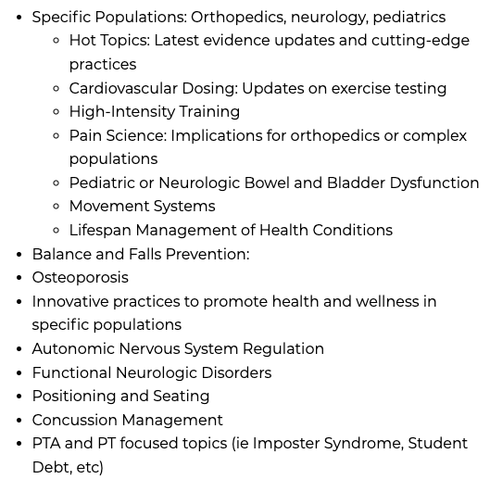
Suggested Presentation
Topics

Slide 5
What information is needed for the proposal application
Title
Session Description
3-4 Learning Objectives
At least 5 references
Timed Outline
Key words
Teaching and learning assessment methods
Key words
5 references
Speaker Information
Biographical Information
Recommended content level
Conflict of interest disclosure

Slide 6
Title
No more than 15 words
Readers should know what the topic is about
Concise wording
Catchy/Engaging if possible
Topic should be relevant to the profession, addressing current needs or trends, innovative ideas
If having trouble coming up with something, can use AI

Slide 7
Session description
250 word maximum
Brief overview of what the topic is about
Highlight important things that will be covered
Use clarity

Slide 8
Learning objectives
3-4 objectives
Similar to writing a goal
Measurable
What should the attendee learn
  Should include an action word
  Bloom's taxonomy provides lots of possible words to use
  Search for Blooms Taxonomy – lots of resources like this one
    https://cft.vanderbilt.edu/guides-sub-pages/blooms-taxonomy/
Example:
Following the presentation the participant will:
compare interventions used for strength training

Slide 9
Outline
Detailed
Timed
Aligns with objectives
Should add up to 1.5 hours (90 minutes)
Example:
Topic: Strength training
Benefits of strength training (5 mins)
Types of strength training (5 mins)
Dosage for strength training (20 minutes)
Strategies for strength training (30 mins)
Case example (15 mins)
Conclusions (5 mins)
Question/answer (5 mins)

Slide 10
Key Words & Teaching and Learning Methods
Key words
List words that would help if someone were to search for the topic
Teaching and Learning Methods
Include how will you engage the attendee
Ex. Lecture, Case Study, Think Pair Share, Lab, etc.

Slide 11

Speaker Information
How are you qualified to speak to this topics
Years of experience/patient population
Research
Leader or member of a SIG
Etc.

Slide 12
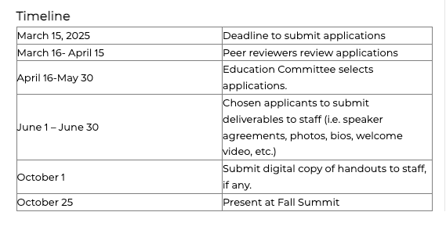
Timeline

Slide 13
What to expect if you are chosen to speak
Provide with a short (1-2 minute) mp4 summarizing the course and inviting
attendees to the course.
Submit course materials for approval via CEU Locker (staff will provide information).
Provide digital handouts.
Receive one complimentary registration to the conference.
Sign a speaker agreement.
Please meet all deadlines

Slide 14
Preparing to speak at the Conference
Practice makes perfect!!!
Practice out loud for pacing, etc
Practice in a room that is close to the size you will be speaking in for loud vs soft
Get feedback from another person/record yourself
Make notes but please don’t read your notes
Stay on track

Slide 15
Help?
Email: Connie Johnson at vpta@vpta.org
Virtual Open House Proposal Development Session
January 14
January 27
Please register for these using this link

Slide 16

Questions

