Slide 1
Session 2: Prioritizing and Deploying AI in Primary Care;
User‑Centered Design & the Quintuple Aim
User-Centered Design in Action
April 17, 2026
NAPCRG Course
Notes:
Welcome participants. Frame session as practical and participatory. Emphasize real clinic workflows.

Slide 2
Session Goals
Integrate new participants
Discuss pre-work
Understand UCD
Prepare for workshops
Notes:
Set expectations clearly. Keep tone focused.

Slide 3
Introductions
Name, role, setting
One workflow frustration
Notes:
Keep fast. Capture frustrations visibly.

Slide 4
Discussion: Pre-Work
What felt true?
What felt unrealistic?
Where is AI helpful?
Notes:
Facilitate actively. Call on participants.

Slide 5
Key Themes
Workflow burden
Fragmentation
Misaligned tools
AI opportunity
Notes:
Reflect and synthesize participant input.

Slide 6
What is UCD?
Design WITH users
Focus on workflows
Iterative
Notes:
Keep simple, avoid jargon.

Slide 7
Why UCD Matters
Time constraints
Team complexity
Cognitive load
Notes:
Connect to real frustrations.

Slide 8
UCD and CBPR
Co-creation
Lived experience
Shared power
Notes:
Key: UCD is CBPR applied to design.

Slide 9
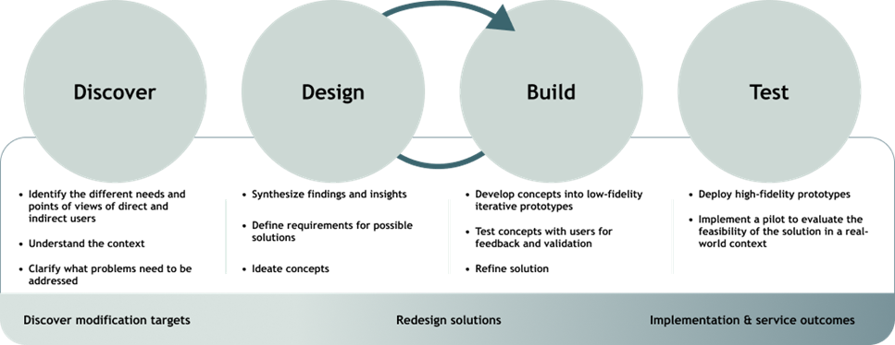
User-Centered Design Process
UW ALACRITY Center

Slide 10
From Frustration to Opportunity
What is happening?
Who is involved?
Where can AI help?
Notes:
Set up exercise.

Slide 11
Exercise:
10 minutes
Work in
Work in groups
Pick
Pick frustration
Map
Map workflow
Identify
Identify opportunity
Notes:
Circulate and guide.

Slide 12
Report Out
2–3 groups
1 minute each
Notes:
Keep tight.

Slide 13
Clinic Workshops
Run mini session
Use structured methods
Focus on workflows
Notes:
Re-anchor in action.

Slide 14
Minimum Workshop
4–8 participants
Multiple roles
45–60 minutes
1–2 domains
Notes:
Keep doable.

Slide 15
Key Message
Identify the right problems
Not solving yet
Notes:
Critical mindset shift.

Slide 16
Closing
Today: understanding
Next: applying
Choose focus
Notes:
End with momentum.

