Slide 1

Digital Accessibility Basics Part 2: Using Microsoft PowerPoint
Rachael Sessler Trinkowsky, Ph.D., CRC, CATIS
Technology Training & Vocational Manager
Lighthouse for the Blind of the Palm Beaches
Assistive Technology Program Coordinator
University of Massachusetts Boston
Notes:
Title: Digital Accessibility Basics Part 2: Using Microsoft PowerPoint
Come join us to learn the essentials for creating accessible documents using Microsoft PowerPoint, which can then be converted into other formats, such as .PDF files. We will explore methods to develop an accessible document using keyboard commands or mouse pointer commands. Methods will be discussed and demonstrated for ensuring that various elements are accessible in Microsoft PowerPoint, including text, images, slide titles (headings), links, color contrast, theme settings, transition sounds, slide layouts, and considerations for captioning. We will discuss recommended strategies for verifying accessibility manually, as well as using the accessibility checker. Additional resources will be shared for further exploration and services to assist with developing accessible digital content.

Slide 2
Purpose of this Workshop
Introduction to creating accessible PowerPoints.
for professionals who create or advocate for documents or content for employees, students, or others.
2

Slide 3
Learning Objectives
Describe at least 5 different strategies for creating accessible Microsoft PowerPoint slide presentations using both keyboard commands and the mouse pointer.
Recommend at least 2 methods for verifying and remediating accessibility in a Microsoft PowerPoint file.
Identify at least 3 specific resources for further exploration or services to assist with developing accessible digital content.
3

Slide 4
Speaker Disclosures (Financial and Non-Financial)
Dr. Rachael Sessler Trinkowsky is on the Subject Matter Expert (SME) Committee for the CATIS certification through ACVREP.
Rachael receives a full-time salary from the Lighthouse for the Blind of the Palm Beaches, and part-time salaries from UMass Boston as the AT Program Coordinator, as well as UIC as adjunct faculty.
Rachael is the co-Strand Advisor for the Vision & Hearing Strand for ATIA (2019 to present).
Rachael is a board member for the Florida AER (FLAER) and is also on the AER Accessibility Committee.
4

Slide 5
Why is accessibility important?
Policies
It is the law!
Increase market and participation.
More cost effective than retrofitting.
It is the right thing to do.
5

Slide 6

Accessibility Basics Part 1
Digital Accessibility Basics Using Microsoft Word on AER eLearning
6

Slide 7
Create with Accessibility in Mind
Consider accessibility prior to creation
Not after the fact
We will discuss general concepts and basic techniques.
Additional resources will be provided.
7

Slide 8
Recommended Workflow for Accessibility
Start with PowerPoint
  Word, Excel or other applications may be a better starting point depending on the type of document.
Create accessible content
If needed, save as PDF
  Note that additional work will be needed using software, such as Adobe Professional to ensure full accessibility for PDF files.
  This is beyond the scope of this short webinar.
8

Slide 9
Common areas of accessible PowerPoints that we will explore
Graphics/Images need “Alt Text” to describe what is displayed.
When using standard slide layouts, the slide titles will become headings.
Links (Display text with name of link rather than showing address).
Fonts, Colors and non cluttered backgrounds
9

Slide 10
Links
Links should make sense if the link text is read by itself.
People who use screen reading software may choose to read only the links in a file or web page.
Never use “click here,” “here,” “more,” “read,” or other generic terms to describe links.
  There are often numerous instances of repetitive link names on web pages or documents.
  Out of context, these are meaningless.
10

Slide 11
Color Contrast Free Tools
“Colour Contrast Analyser”
  Download the Color Contrast Analyser
Color Contrast Checker from WebAIM
  This website can be used to check whether colors used for the foreground and background pass the WCAG standards.
11

Slide 12
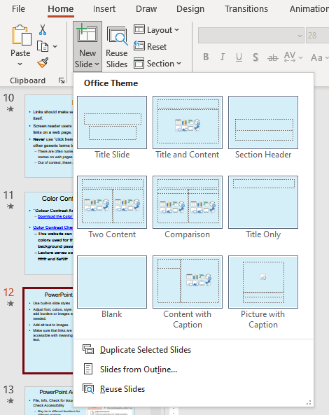
Use Built-in Slide Styles to add a New Slide
With a mouse: Home, New Slide, then left click to choose the slide layout.
Keyboard shortcuts:
Alt, H, I.
  Then, right and left to choose the slide layout and press enter.
  Optional commands: Alt, tab to New Slide, Alt with down arrow to open the menu, then use right or left arrow keys to select the layout followed by enter.
12

Slide 13
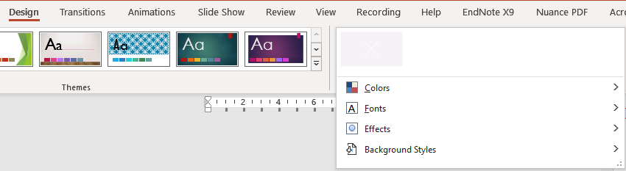
Adjust Theme, Font, Colors, and
Background Style Theme options
With a mouse: Design, then left click to expand themes or variants.
Keyboard shortcuts: Alt, G, H for themes and Alt, G, V for variants.
  Be sure to choose non-cluttered backgrounds and use high contrast colors.
  Avoid “Design ideas”
13

Slide 14
Link Accessibility Example
Control with K to insert a hyperlink.
  This can be done to add a new link or after selecting an existing link or text in a document.
With Mouse: Right click in black space in a text object or after selecting a link or text.
  Then, left click on either Link or Hyperlink.
  Let’s try this.
AER eLearning
  The link for the line above will be added during the presentation.
14

Slide 15
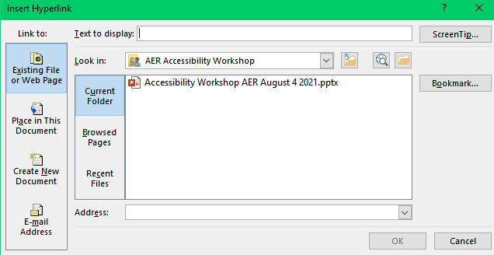
Insert Hyperlink dialog box
15

Slide 16
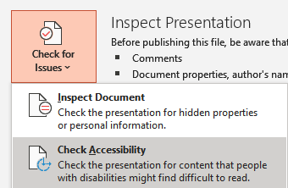
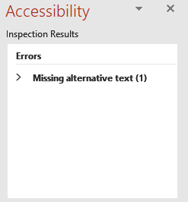
PowerPoint Accessibility Checker
File, Info, Check for Issues, Check Accessibility
  May be in different locations for different versions.
  In Windows version for PowerPoint 365, you can use the keyboard commands: Alt, F, I, I, A
F6 to focus on the results (F6 navigates between the different areas of PowerPoint)
16

Slide 17
Manually Checking a PowerPoint for Accessibility
Tab through objects on a slide.
  F6 and Shift with F6 will navigate between the window areas.
  Best to use a screen reader on the computer while doing this.
Check the object order on each slide
  Home, Arrange, Selection Pane.
Manually check alt text for graphics
Color contrast verification
Font accessibility
Link accessibility
Tables and other elements
17

Slide 18
More PowerPoints and Slide Show Tips
Although you should avoid unnecessary animation and transitions, it does help to have simple animations to split up content.
In PowerPoint, using the simple “appear” or “fly in” animations” is recommended.
Avoid flashy features and more advanced features that may cause accessibility issues.
Transition from slide to slide using a simple non-interrupting sound.
  “click.wav”
Leave room for closed captioning.
18

Slide 19
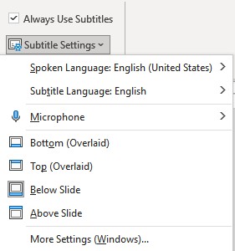
Enabling Automated Captioning (Subtitles)
Slide Show menu, check Always Use Subtitles.
Adjust subtitle settings as needed.
Automated captioning is not ideal in all situations.
This does not replace the need for a human captioner or interpreter when needed.
19

Slide 20
Use Real Text!
Make sure that pages with text are not simply graphics, and that text is “real text.”
  SmartArt is not recommended.
20

Slide 21
Presentation Accessibility Links
Make your PowerPoint presentations accessible to people with disabilities (Microsoft)
PowerPoint Accessibility from WebAIM
PDF Accessibility: Converting Documents to PDFs: WebAIM
Creating and Sharing Successfully Accessible Presentations (also from AER eLearning - archived webinar) Nell Koneczny from the American Anthropological Association
Presentation Guidelines for Success & Accessibility (American Anthropological Association) (Nell Koneczny)
Virtual Presentation Guidelines (American Anthropological Association) (Nell Koneczny)
APH Hive Courses for PowerPoint and Word Accessibility
21

Slide 22
Resources
W3C Overview: Before and After Demonstration for Web Accessibility
Adobe Acrobat DC Accessibility Guides
PDF Accessibility from WebAIM
Using Microsoft Word to create accessible content
List of Accessibility Resources from the Lighthouse for the Blind of the Palm Beaches
22

Slide 23

Thank you for joining us today!
Questions?
Question Mark with Cartoon Person by Unknown Author is licensed under CC BY-NC-ND
23

