Slide 1
IRI PILOT
Practices in Innovation Leadership, Operations, and Talent
Notes:
2018 is a year of experiments as we trial new offerings for PILOT, ‘Practices in Innovation Leadership, Operations, and Talent’. IRI’s Research on Research program is being reworked to improve learning for members by benchmarking current best practices and studying ways to build on them to recommend future practices.

Slide 2

PILOT 2018 Experiments
Produce faster results
Are highly relevant to IRI’s primary and secondary customers (CTOs and their direct reports)
Create highly actionable and measurable deliverables
Toolbox of Processes
Notes:
PILOT will encompass the Research on Research working groups that IRI is known for, as well as shorter, more agile and resilient processes for developing best practices.
The purpose of PILOT is to engage members and other thought leaders to identify, sponsor, lead, support, and conduct activities that advance the understanding and development of best practices in innovation management.
As the IRI Research program transitions to PILOT, the PILOT Steering Committee has begun examining activities that:
Produce faster results
Are highly relevant to IRI’s primary and secondary customers (CTOs and their direct reports)
Create highly actionable and measurable deliverables
The results will be a Member Toolbox of processes for getting results in developing best practices.

Slide 3
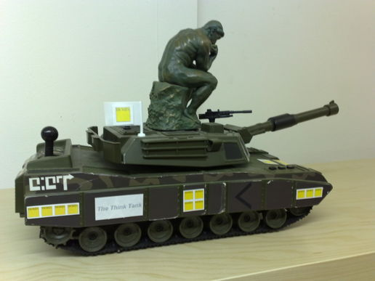
Experiment 1
IRI Think Tanks
First Think Tank – Hosted by Axalta Coating Systems, April 2018.
  Topics: Recruiting and Retaining Early Career Technical Talent; Creating a Culture of Innovation
Second Think Tank – Would you like to host?
Notes:
The goal of our first experiment was to get attendees discussing a hot topic and to capture the learnings from that conversation. Axalta kindly hosted that session and they chose ‘Recruiting and Retaining Early Career Technical Talent’ and ‘Creating a Culture of Innovation’ as their topics. As luck would have it, we recently had two Research on Research projects that tackled those topics. The results of those projects were shared by one of the lead researchers, Susan Neylon of ITECS, and she then facilitated a discussion on those topics. The meeting went well and a summary of the discussion is available on the IRI website. We would like to host at least one more Think Tank this year. Please contact Lee Green if you would like to host one. You get to pick the topic!

Slide 4
Experiment 2
Community Forum Survey +
Innovation Dashboard Metrics
  Take the survey:
  https://www.surveymonkey.com/r/innovationdashboardmetrics
Notes:
For our second experiment, we wanted to plus the successful IRI Community Forum. We have brought together a dedicated group of members who have been tasked with improving dashboard metrics in their organization. The group has worked to identify key benchmarking points on innovation dashboard metrics and created a survey to get feedback on those points. The survey is still open for this and I encourage you to take 10 minutes to complete it. Once they have a good spread of responses from a variety of industries and sizes of companies, they will work with IRI staff to analyze the results and share them through a whitepaper and webinar.

Slide 5
Experiment 3
Partnering with IRI Networks
PILOT
Networks
Benchmarking
Notes:
For our third experiment, we are looking to partner with the IRI Networks program to identify topics that are of interest to the Networks members, but can’t be tackled in the Networks format. We aim to work with the chairs of the Networks to identify topics and work out a relevant research plan and outputs.

Slide 6
PILOT
Questions? Contact Lee Green, green@iriweb.org

