Slide 1
The Devil is in the Details:
Little Known Details about Selected Methods
Dr. Michael Shepherd, Mei Beth Shepherd, and
Michael Hintz
Shepherd Technical Services, LLC
2018 TCEQ Environmental Trade Fair

Slide 2
Acknowledgment
This presentation represents a compilation of the experience of all of
Shepherd Technical Services’
Assessors
from all of the programs STS supports.

Slide 3


About this talk…
We hope the information is “old news”
Our experience is that it isn’t…

Slide 4
Requirements in the Standard
NELAC 5.5.9.2 Essential Quality Control Procedures
“The laboratory shall ensure that the essential standards outlined in Appendix D or mandated methods or regulations (whichever are more stringent) are incorporated into their method manuals.”

Slide 5
Requirements in the Standard
TNI V1M4 1.2 Scope
“Additional quality control requirements that are either specified by method, regulation or project shall be met by laboratories.”

Slide 6
BOD SM 5210 B (2001)
  NOT the same as EPA 405.1
  pH: Section 4.b: Sample preparation and pretreatment:
      “All samples—Check pH; if it is not between 6.0 and 8.0, adjust sample temperature to 20 ± 3°C, then adjust pH to 7.0 to 7.2”
  Time: Section 5.g:
“After preparing dilution, measure initial DO within 30 min.”

Slide 7
HEM EPA 1664A/B
Balance checks: Section 9.5 and Section 10
9.5 Calibration verification—Verify calibration of the balance per Section 10 before and after
each analytical batch. If calibration is not verified after measurement of the analytical batch, recalibrate the balance and reweigh the batch.
10.1 Calibrate the analytical balance at 2 mg and 1000 mg using class "S" weights.

Slide 8
HEM EPA 1664A/B
Reagent Specifications: Section 7.0
7.3 n-Hexane—85% minimum purity, 99.0% min. saturated C₆ isomers
7.7 Silica gel—Anhydrous, 75 - 150 micrometers
7.8 Hexadecane—98% minimum purity.
7.9 Stearic acid—98% minimum purity.
PRACTICAL or LABORATORY GRADE IS NOT SUFFICIENT!

Slide 9
Mercury EPA 245.1
7.3 Nitric Acid (HNO₃ ), concentrated (sp.gr. 1.41), assayed mercury level is not to exceed 1 µg/L.
7.4 Sulfuric Acid (H₂SO₄), concentrated (sp.gr. 1.84), assayed mercury level is not to exceed 1 µg/L
5.6.4.2 Documentation and Labeling of Standards, Reagents, and Reference Materials
a) The laboratory shall retain records for all standards, reagents, reference materials, and media, including the manufacturer/vendor, the manufacturer’s Certificate of Analysis or purity (if available),

Slide 10
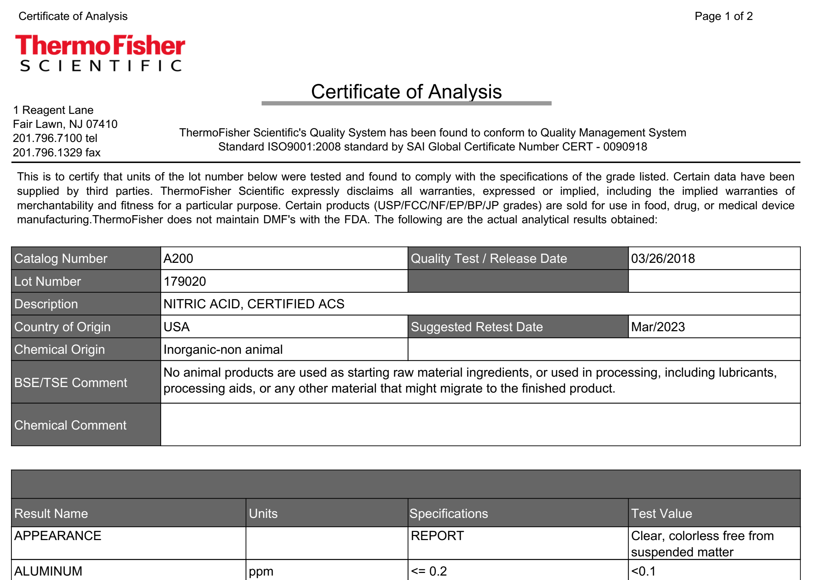
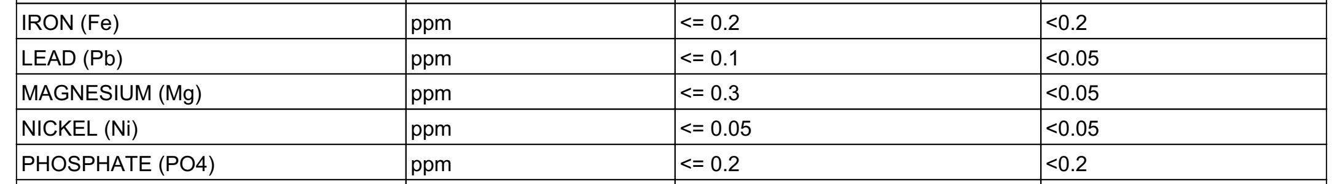
Hg?

Slide 11
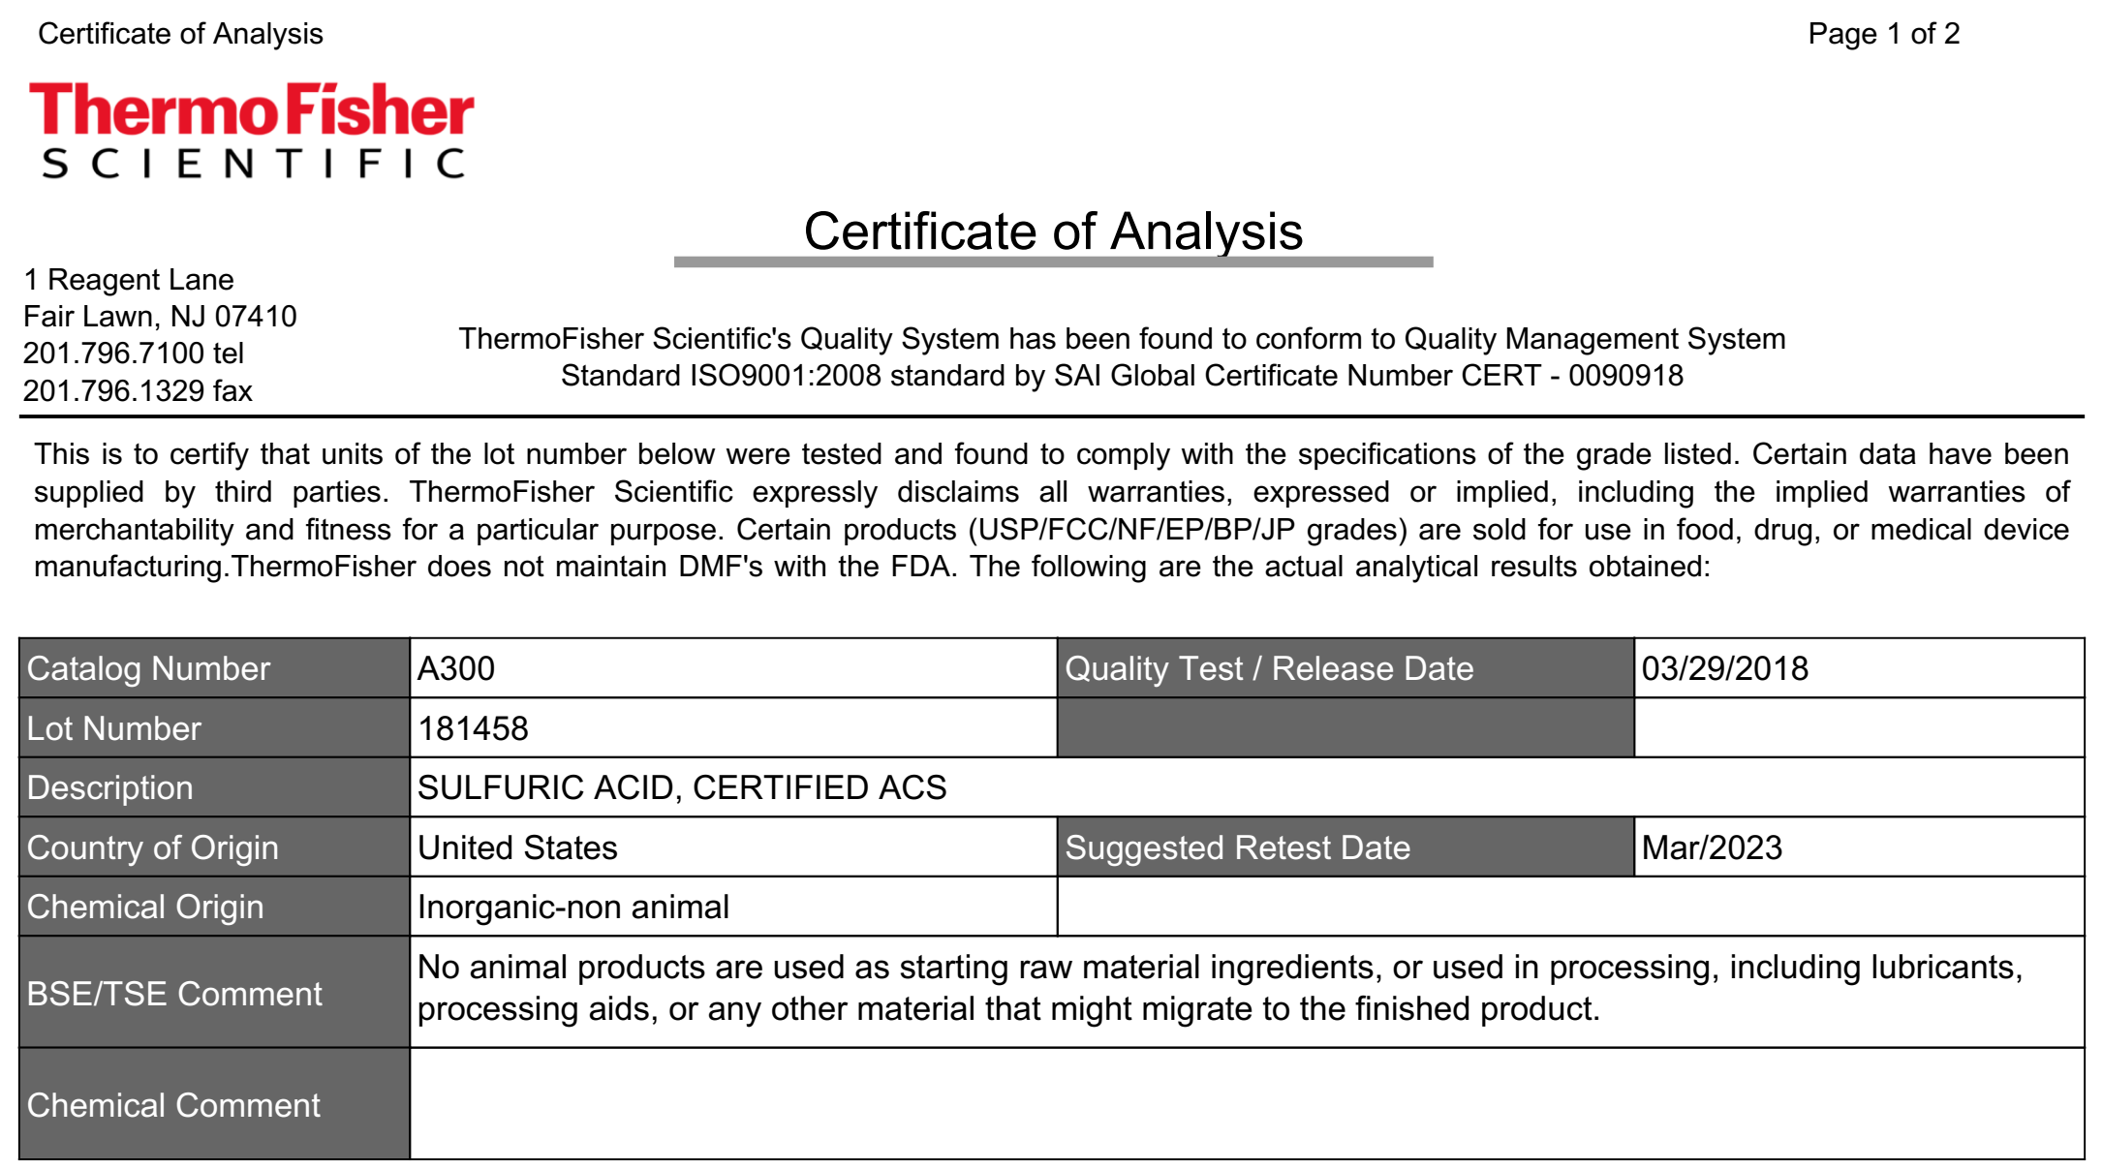

Slide 12
Mercury EPA 245.1
11.2.2 Prepare calibration standards by transferring 0.5, 1.0, 2.0, 5.0, and 10 mL aliquots …. Dilute the standard aliquots to 100 mL with reagent water (Section 7.2) and process as described in Sections 11.1.2, 11.1.3 (without heating), and 11.1.5.
Drinking Water: MUST NOT CHANGE THE PROCEDURE

Slide 13
EPA Method 8270
Resolution check:
7.6.1.4 Structural isomers that produce very similar mass spectra should be identified as individual isomers if they have sufficiently different GC retention times. Sufficient GC resolution is achieved if the height of the valley between two isomer peaks is less than 25% of the sum of the two peak heights. Otherwise, structural isomers are identified as isomeric pairs. (8270C)

Slide 14
EPA Method 8270
Resolution check:
11.6.1.4 Structural isomers that produce very similar mass spectra should be identified as individual isomers if they have sufficiently different GC retention times. Sufficient GC resolution is achieved if the height of the valley between two isomer peaks is less than 50% of the average of the two peak heights. Otherwise, structural isomers are identified as isomeric pairs. (8270D)

Slide 15
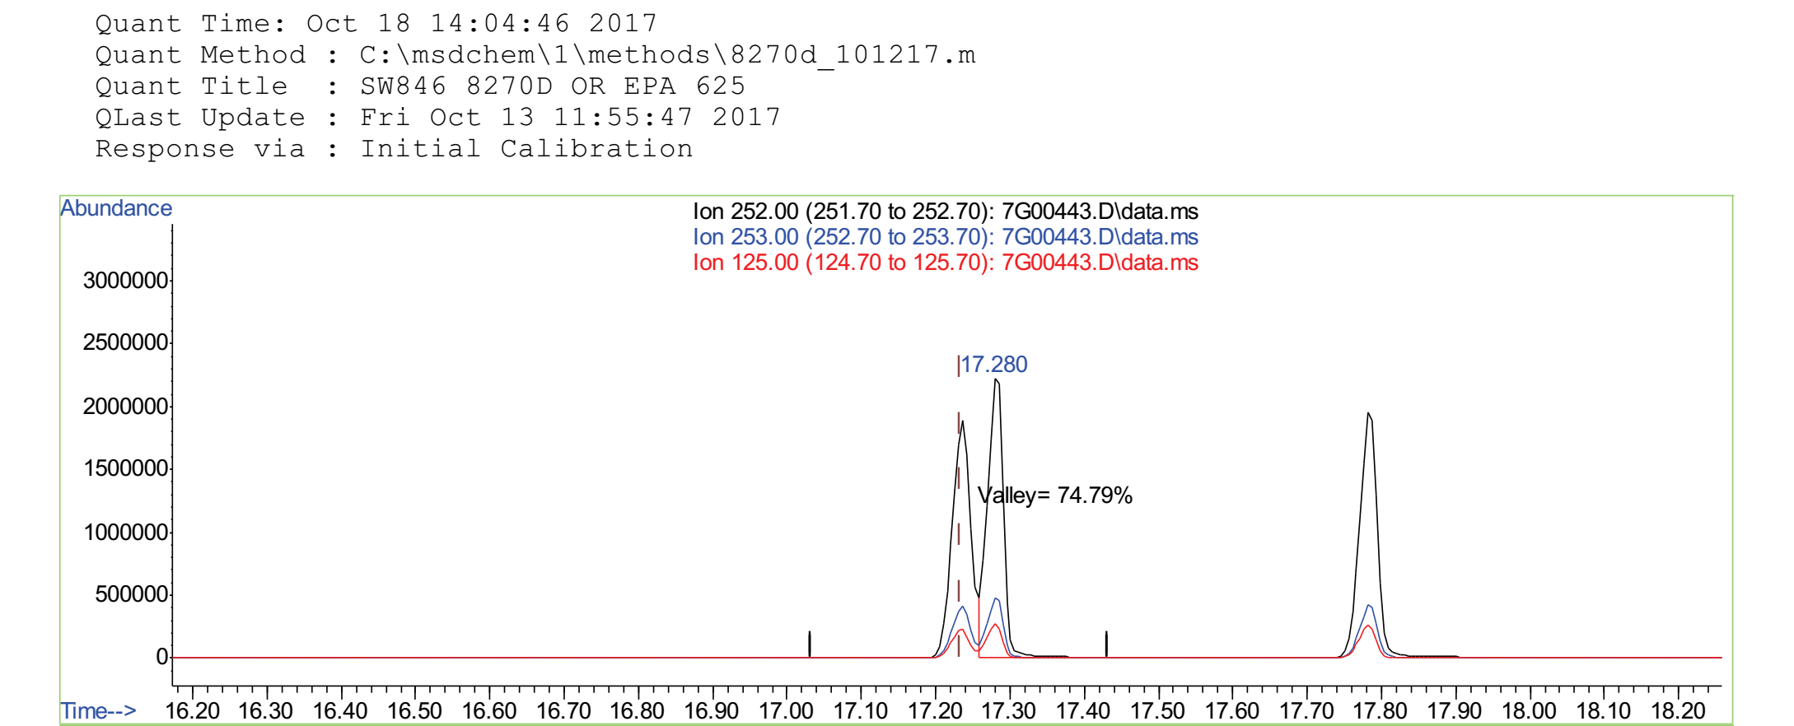
By the way…also in EPA 625.1

Slide 16
Units of Measure
SM 2510 B Conductivity
      Section 5:
      Report temperature-compensated conductivities as “µmho/cm @ 25.0 °C.”
      EPA 9045 pH in Soils
      7.2.5 Report the results as "soil pH measured in water at °C" where " °C " is the temperature at which the test was conducted.
  SM 5540 C. Anionic Surfactants as MBAS
      Section 5:
      Report as “MBAS, calculated as LAS, mol wt .”

Slide 17
Conductivity Calibration
SM 2510 B:
SM 2020 B: 2. Ongoing Quality Control
a. Calibration/standardization: Calibrate the method or standardize titration reagents using the directions in the procedure.

Slide 18
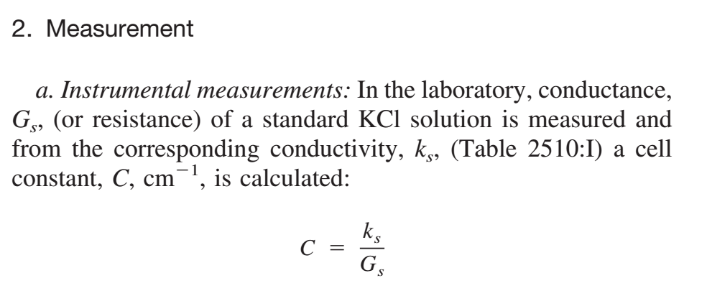
Conductivity Calibration
SM 2510:

Slide 19
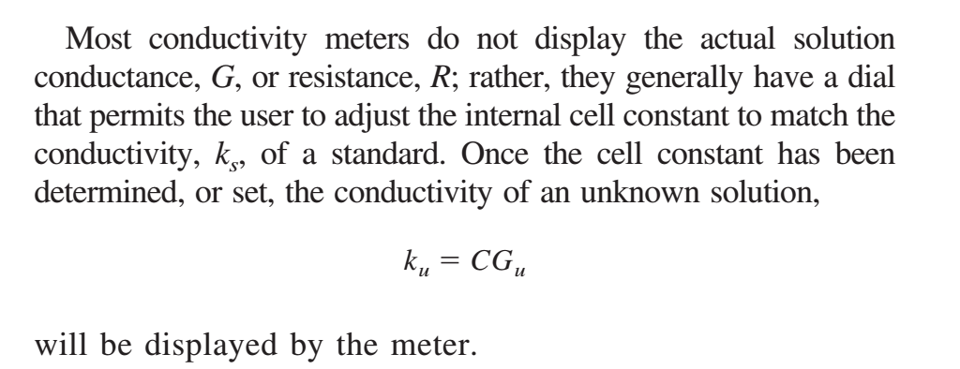
Conductivity Calibration
SM 2510:

Slide 20
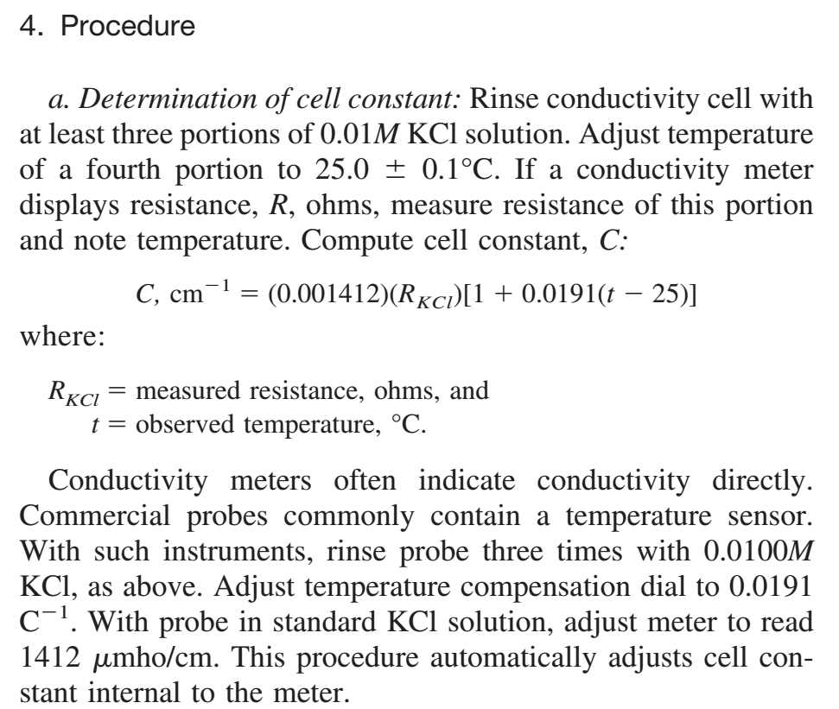
Conductivity Calibration
SM 2510 B:

Slide 21
Quanti-Tray® wells
Problem with empty wells
  MPN based upon number of positive wells out total number of wells on the tray (97 total wells for Quanti-Tray®/2000).
Empty wells acceptable if <2 wells per tray
  (IDEXX Memo)

Slide 22
SM 9020 B Sample Receipt
Section 12.c :
  Actual laboratory reports may be kept, or data may be transferred to tabular
  summaries, provided that the following information is included: date, place, and time of sampling; name of sample collector; identification of sample; date and time of sample receipt; condition and temperature of received sample…

Slide 23
Microbiology Media pH
NELAC App. D 3.6.d)
  Documentation for media purchased pre-prepared, ready-to-use shall include manufacturer, lot number, type and amount of media received, date of receipt,
  expiration date of the media, and pH of the media.
Similar language in TNI V1M5 1.7.3.5.d

Slide 24
EPA Method 524.2
Preparation of Calibration Standards
  Section 7.8.2
    “To prepare a calibration standard, add an appropriate volume of a primary dilution standard containing all analytes of concern to an aliquot of acidified (pH 2) reagent water in a volumetric flask.”
4 minute Desorb Time

Slide 25
TCLP …<groan>
18 hour temperatures-min/max
Matrix spikes for metals:
  8.2.1 Matrix spikes are to be added after filtration of the TCLP extract and before preservation. Matrix spikes should not be added prior to TCLP extraction of the sample.

Slide 26
TCLP …<groan vol. 2>
Standard Additions:
  8.4 The use of internal calibration quantitation methods shall be employed for a metallic contaminant if: (1) Recovery of the contaminant from the TCLP extract is not at least 50% and the concentration does not exceed the regulatory level, and (2) The concentration of the contaminant measured in the extract is within 20% of the appropriate regulatory level.
  8.4.1. The method of standard additions shall be employed as the internal calibration quantitation method for each metallic contaminant.

Slide 27
SM 4500-NO₃¯ E or F/EPA 353.2
Method E
3. Reagents
b. Copper-cadmium granules: Wash 25 g new or used 20- to 100-mesh Cd granules† with 6N HCl and rinse with water. Swirl Cd with 100 mL 2% CuSO4 solution for 5 min or until blue color partially fades. Decant and repeat with fresh CuSO4 until a brown colloidal precipitate begins to develop. Gently flush with water to remove all precipitated Cu.

Slide 28
SM 4500-NO₃¯ E or F/EPA 353.2
Method F
3. Reagents
  d. Copper-cadmium granules: See 4500-NO₃¯ E.3b

Slide 29
SM 4500-NO₃¯ E or F/EPA 353.2
EPA 353.2
7.0 REAGENTS AND STANDARDS
  7.1 Granulated cadmium: 40-60 mesh (CASRN 7440-43-9). Other mesh sizes may be used.
  7.2 Copper-cadmium: The cadmium granules (new or used) are cleaned with dilute HCl (Section 7.6) and copperized with 2% solution of copper sulfate (Section 7.7) in the following manner: …

Slide 30
SM 4500-NO₃¯ E or F/EPA 353.2
TNI V1M4 4.13.3 Additional Requirements
    f/xi): standard and reagent origin, receipt, preparation, and use;
NELAC 2003 5.4.12.2.5.3 Analytical Records
    The essential information to be associated with analysis, such as strip charts, tabular printouts, computer data files, analytical notebooks, and run logs, shall include:
    i) standard and reagent origin, receipt, preparation, and use;

Slide 31
SM 2020/3020/4020/5020 Tables
The “Section XX20” portions of Standard Methods provide the Quality Assurance and Quality Control requirements for the relevant methods
Aside from specific requirements there are Tables listing required QC elements (e.g. MS, LCS, etc.) for each method

Slide 32
SM 2020/3020/4020/5020
2012 Method Update Rule
Federal Register / Vol. 77, No. 97 / Friday, May 18, 2012
“Consequently, today’s rule clarifies that an analyst using these consensus standard body methods for reporting under the CWA must also comply with the quality assurance and quality control requirements listed in the appropriate sections in that consensus standard body compendium.”

Slide 33
SM 2020/3020/4020/5020
Particular requirements:
3020/4020:
    Section 2.a
    “Repeat initial calibration daily or when starting a new batch of samples, unless the method permits calibration verification between batches.”

Slide 34
SM 2020/3020/4020/5020
Particular requirements:
2020:
    2. Ongoing Quality Control
    a. Calibration/standardization: Calibrate the method or standardize titration reagents using the directions in the procedure.
    Methods in Part 2000 that require calibration or titration reagent standardization are indicated in Table 2020.II.

Slide 35
SM 2020/3020/4020/5020
Particular requirements:
2020:
    2. Ongoing Quality Control
    a. Calibration/standardization verification: Verify standardized titration reagents by periodically re-standardizing .... Re-standardize reagents once a month or when improper storage occurs. If the titration reagent’s normality (titer value) has changed, then use the measured value, adjust the normality (titer value) as the procedure describes, or prepare and standardize fresh titration reagent as needed.

Slide 36
Summary
Many methods have complex details that require careful attention to these details
Some methods are Method Defined Parameters and must be followed exactly
Some methods have QC detailed in another document (e.g., SM 4020)
There is no substitute for reading the methods and developing intimate familiarity with the DETAILS of each method in your lab.

Slide 37
Conclusion
Know your Reference Methods!
Thank You
sts@sheptechserv.com

