Slide 1
ATRA Standards for the Practice of Recreational Therapy
International Knowledge Exchange
February 2025

Slide 2
Standards of Practice Committee
Chairs:
  Heather Bright, Ph.D., CTRS, FDRT
  MaryJo Archambault, Ed.D., CTRS
Team Members:
  Joan Sutton, MS, CTRS, FDRT
  Beth Vance, CTRS-BH
  Ex Officio: Ray West, MS, CTRS
  Ex Officio: Marcia Smith, MA,CTRS
Board Liaisons:
  LeAnn Redman-Wheeler, PhD, CTRS, ATRIC
  Nancy Nesbitt, EdD, CTRS, RTC, FDRT
Notes:
MJ

Slide 3
Purpose of the SOP Committee
Mission:
To educate the ATRA membership on the Standards of Practice, and use of the manual, to promote the delivery of quality recreational therapy services, and to ensure that the standards align with the primary regulatory agencies.
To provide appropriate guidance through professional training so that recreational therapists learn how to comply and improve compliance with the ATRA SOP-RT
Vision:
For practitioners, educators, and students to feel comfortable and competent to use the SOP manual within the field of recreational therapy
Notes:
MJ

Slide 4
History of Standards
1965 Betty Van der Smissen | Evaluation of Community Recreation: A Guide to Evaluation with Standards & Evaluation Criteria
1971 Doris Berryman | Recommended Standards with Evaluation Criteria for Recreation Services in Residential Institutions
1972 Jerry Kelly & B.L. Smith | Standards for Therapeutic Recreation in Psychiatric Facilities
1979 National Therapeutic Recreation Society | Guidelines for Community Based Recreation Programs for Special Population
1979 National Therapeutic Recreation Society (Judith Goldstein & Glen Van Andel) | NTRS Guidelines for Therapeutic Recreation Services in Clinical & Residential Facilities; later became Standards for Therapeutic Recreation Services
Notes:
HB

Slide 5
History of Standards
1991 American Therapeutic recreation Association: Huston, Riley, Van Andel & West | Standards of Practice of Therapeutic Recreation Services
1993 Self-Assessment Guided added | Standards for the Practice of Therapeutic Recreation & Self Assessment Guide
2000 American Therapeutic recreation Association: Barrett, Huston, Riley, Van Andel & West | Standards for the Practice of Therapeutic Recreation
2013 American Therapeutic recreation Association: Barrett, Smith & West | Standards for the Practice of Recreational Therapy & Self –Assessment Guide
Notes:
HB

Slide 6
Standards for the Practice of
Recreational Therapy
Standards are designed to be universal, not specific to service setting or patient/client population:
    Example-Standards do not specify time frames for documentation but require that the agency specify in policies and procedures the time frames for documentation that meet agency standards and those of the regulatory agencies to whom they are accountable.
The ATRA SOP are a comprehensive description of quality recreational therapy practice.
Notes:
MJ

Slide 7
Why Have Standards of Practice?
It is the responsibility of the professional organization to provide standards of practice that guide and direct best practice and conduct, to assure quality outcomes (valued by patients/clients and other stakeholders) and to protect the consumer from potential harm
To provide standards that are consistent with accreditation and regulatory agencies
SOP are a benchmark of a profession
Notes:
MJ

Slide 8
The Standards
1. Assessment
2. Treatment Planning
3. Plan Implementation
4. Re-Assessment and Evaluation
5. Discharge and Transition Planning
6. Prevention, Safety Planning and Risk Management
7. Ethical Conduct
8. Written Plan of Operation
9. Staff Qualifications and Competency Assessment
10. Quality Improvement
11. Resource Management
12. Program Evaluation and Research
Notes:
HB
Important to note:
Standards built on the framework of CMS regulations, but are applicable to ANY setting.
RT vs Organizational policies- we can have policies for RT, but we also need to look at what the agencies policies are. Do they work? If yes, then get the RT name put in it. Be sure that your policies align with what the greater organization is doing. Do they align with the mission and vision?
You give yourself a voice by sharing your policies and upholding our ideals, and by developing procedures for how we want our assessments done, and who is providing the oversight

Slide 9
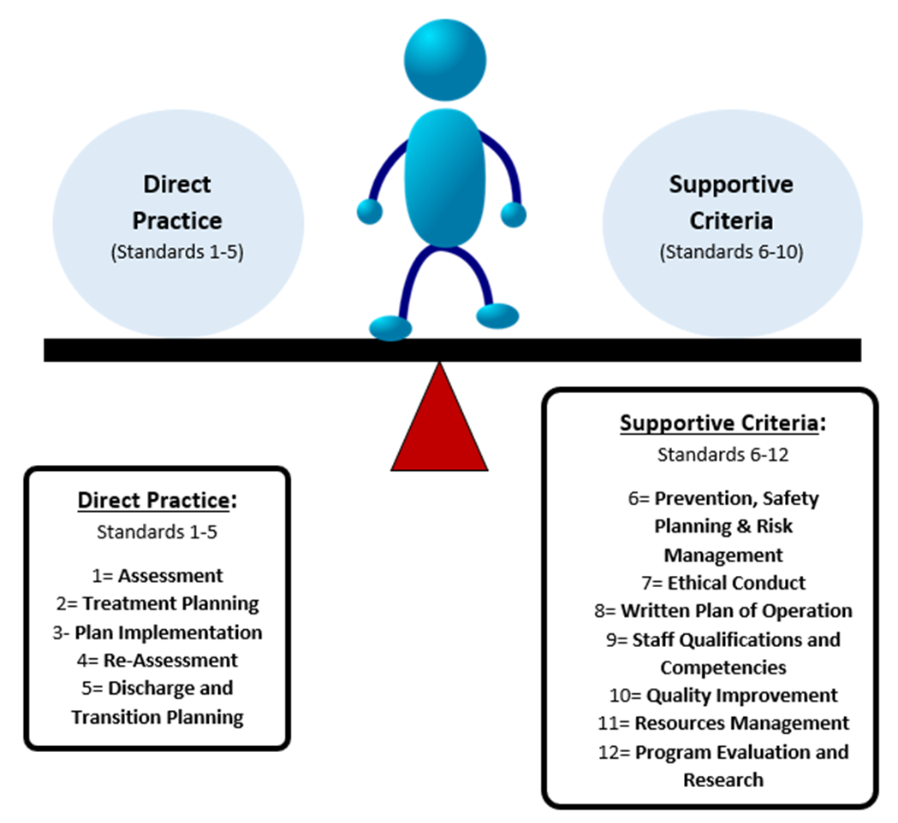
Therapists should consider the influence that each standard has on their practice
Notes:
HB

Slide 10
Standard One: Assessment
“The recreational therapist receives and responds to referrals and/or physician orders, for assessment and treatment and conducts an individualized assessment to collect systematic, comprehensive and accurate data necessary to determine a course of action and subsequent individualized treatment plan.”
Notes:
MaryJo
How is this standard applied in your setting? How is recreational therapy initiated? In some human service agencies admission to the agency or program may constitute a referral. It should be described in the policy and procedure manualCenters for Medicare and Medicaid require skilled therapies providing active treatment to have physician orders. What is your assessment process? How do you conduct an assessment? Physician orders may not be required by cms for activities or recreation provided for persons with illness or disabling conditions but are required for safe and effective recreational therapy practice

Slide 11
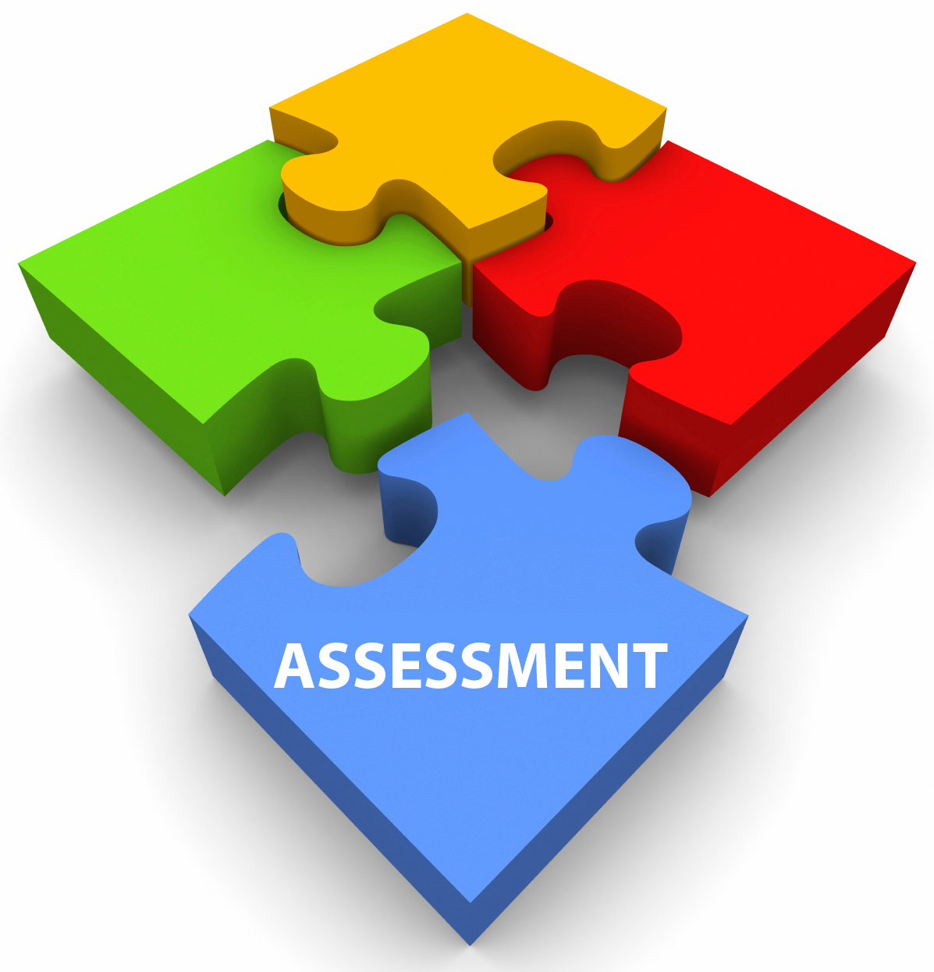
Process
Responds to request in a timely manner
Seeks collaboration with patient/client
Use standardized assessment procedures as appropriate
Analyze data; Formulate impressions and recommendations for treatment
Report assessment findings/document
Notes:
MaryJo
Based on the process defined in the written plan of operation. Informs them of the responsibilities in the assessment. If unable to participate, seek involvement of family/significant others. Structured interview, direct observation, secondary resources May also recommend no treatment or a referral to another discipline

Slide 12
Standard Two: Treatment Planning
“The recreational therapist plans and develops the individualized treatment plan that identifies goals, objectives and treatment intervention strategies.”
Notes:
MaryJo
Foundation for the implementation of a successful treatment program and desired patient outcomes. Selecting evidenced based interventions, collaboration with patient

Slide 13
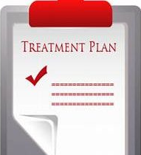
Process
Need to consider all relevant factors that may influence treatment strategies
Collaborate with patient/family, team members in establishing individualized treatment goals
Treatment plan should be sensitive to cultural values, beliefs and quality of life considerations
Notes:
MaryJo
Diagnosis, precautions, contraindications, cultural concerns evidenced based care considerations

Slide 14
Standard Three: Plan Implementation
“The recreational therapist implements the individualized treatment plan using evidenced-based practice to restore, remediate or rehabilitate in order to improve functioning and independence as well as reduce or eliminate the effects of illness or disability. “
“Implementation of the treatment plan by the recreational therapist is consistent with the overall patient/client treatment program.”
What are your responsibilities?
Notes:
MaryJo

Slide 15

Process
Implementing the evidence-based intervention with the frequency, duration and intensity to achieve desired outcomes
Reviews, continues, modifies or discontinues RT interventions based upon patient progress/ change of condition
Documents and evaluates the implementation and response to the treatment interventions according to policy & procedure
Collaborates
Reports all adverse reactions and incidents
Notes:
MaryJo

Slide 16
Standard Four: Re-Assessment and Evaluation
“The recreation therapist systematically reassesses, evaluates and compares the client's response to the individualized treatment plan. The treatment plan is revised based upon changes in the interventions, diagnosis and patient/client responses.”
Notes:
MaryJo
The process of formative and summative evaluation allows the RT to monitor the patient’s response to treatment and revise treatment plan as necessary

Slide 17

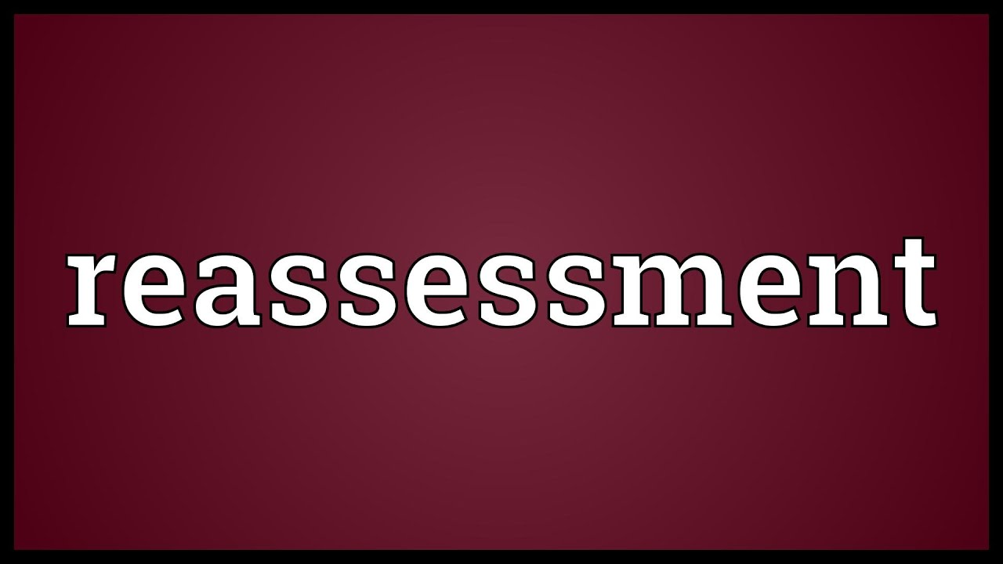
Process
Conducts treatment evaluation on a timely basis and according to policy and procedures
Collaborates with appropriate individuals to complete the evaluation, communicate results, document results in the record
Notes:
MaryJo
Communicate to treatment team, patient/family,

Slide 18
Standard Five: Discharge and Transition Planning
“The recreational therapist develops a discharge plan in collaboration with the patient/client, family, and other treatment team members in order to continue treatment, as appropriate.”
Notes:
MaryJo
Should be addressed from the initiation of RT services. Summarizes treatment, responses and functional outcomes in preparation of the next level of care. To ensure the continuation of treatment/ development of lifelong healthy habits

Slide 19
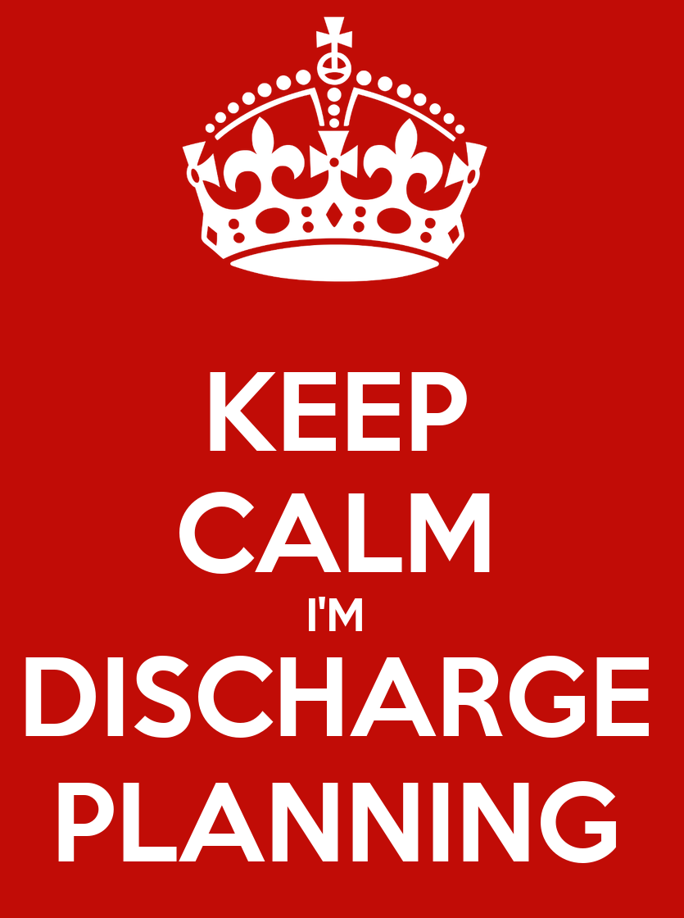

Process
Document discharge plan in a timely manner and according to policy and procedure
Participate in the comprehensive discharge planning process
Notes:
MaryJo

Slide 20
Standard Six: Prevention Safety Planning and Risk Management
“Recreational therapist systematically plans to improve patient and staff safety by planning for prevention and reduction of risks in order to prevent injury and reduce potential or actual harm.”
Notes:
MaryJo
Risk Assessment. Develop specific plans to improve safety, minimize risks, and maximize benefits

Slide 21
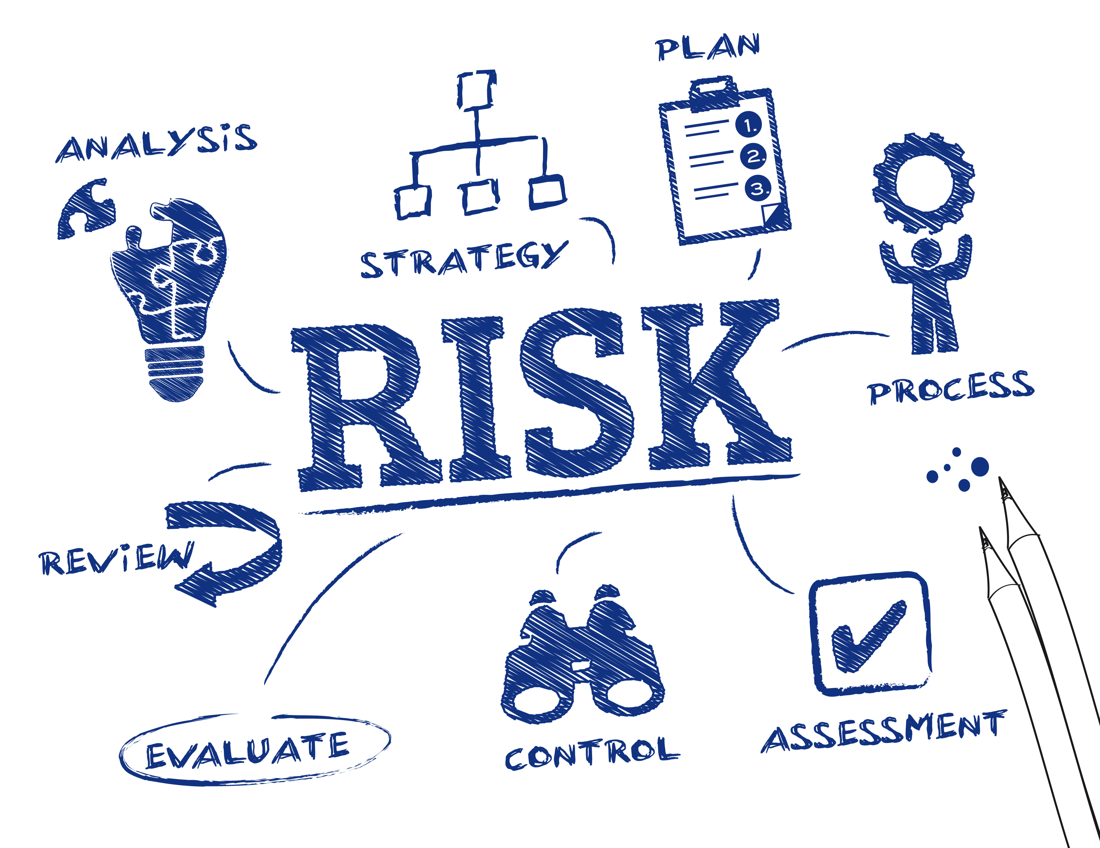
Process
Complies with policy and procedures…
for patient safety goals injury prevention, and minimizing risks
for routine inspection, evaluation, and maintenance of supplies, equipment and facilities prior to use to minimize injury or harm
for transporting patient for treatment interventions and for supervising the client during treatment interventions
Assures that facilities and equipment are clean, safe and maintained in accordance with infection control, health, fire and safety codes
Notes:
MaryJo

Slide 22
Standard Seven: Ethical Conduct
“The recreational therapist adheres to the ATRA Code of Ethics in providing patient treatment and care that is humane and ethical.”
Notes:
HB
Agency standards of conduct, professional ethical standards, report all suspected instances of ethical misconduct

Slide 23

Process
Complies with all related agency standards of conduct and professional codes of ethics
Reports all suspected instances of ethical misconduct to appropriate parties
https://www.atra-online.com/general/custom.asp?page=Ethics
Notes:
HB

Slide 24
Standard Eight: Written Plan of Operation
“The recreational therapy treatment and care is governed by a written plan of operation that is based upon ATRA Standards of the Practice of Recreational Therapy, state and federal laws and standards of other accrediting/regulatory agencies, as appropriate.”
Notes:
HB
Be familiar with your written plan of operation. It provides guidance for the management of staff practice, quality improvement, resource management and program evaluation

Slide 25


Process
Participate in the development, annual review and revision of the written plan of operation
Complies with all aspects
Participates in the orientation session and becomes familiar with all aspects of the written plan
Notes:
HB

Slide 26
Standard Nine: Staff Qualifications and Competency Assessment
“Recreational Therapy staff meet the defined qualifications, demonstrate competency, maintain appropriate credentials and have opportunities for professional development.”
Notes:
HB
Competency and qualifications for using modalities and facilitation techniques for treatment interventions and continually enhancing competencies for safe effective practice

Slide 27


Process
Adheres to competency requirements, policies and procedures
Annually develop an individual development plan to improve practice competencies
Participates in the evaluation of the department’s professional development program and makes recommendations for improvement
Participates in competency enhancement opportunities on a regular basis
Attends required safety, risk management and emergency disaster training.
Notes:
HB
Maintains credentials for safety as needed: CPR, First Aid, CPI

Slide 28
Standard Ten: Quality Improvement
“There exists an objective and systematic processes for continuously improving patient safety and for identifying opportunities to improve recreational therapy treatment and care and patient outcomes.”
Notes:
HB
Part of ethical practice to continually improve patient safety and quality of treatment for improved patient outcomes

Slide 29
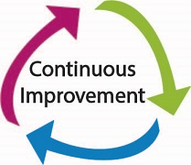
Process
Engage in safety and quality improvement processes
Participate in routine and systematic evaluation and improvement of safe and effective recreational therapy practice, treatment and care
Uses the results of the safety and quality improvement processes to modify and improve recreational therapy practice, treatment and care
Notes:
HB

Slide 30
Standard Eleven: Resource Management
“Recreational therapy treatment and care are provided in an effective and efficient manner that reflects the reasonable and appropriate use of resources.”
Notes:
HB

Slide 31

Process
Identify resource needs or problems
Achieves predetermined department standards for patient contact, caseload and productivity
Assesses cost per unit of service level (cost/hour, cost/day, cost/program, cost/diagnostic group)
Determines patient’s treatment status including initiation, continuation, revision and discontinuation
Notes:
HB

Slide 32
Standard Twelve: Program Evaluation and Research
“Recreational therapy staff engages in routine, systematic program evaluation and research for the purpose of determining appropriateness and efficacy.”
Notes:
HB

Slide 33
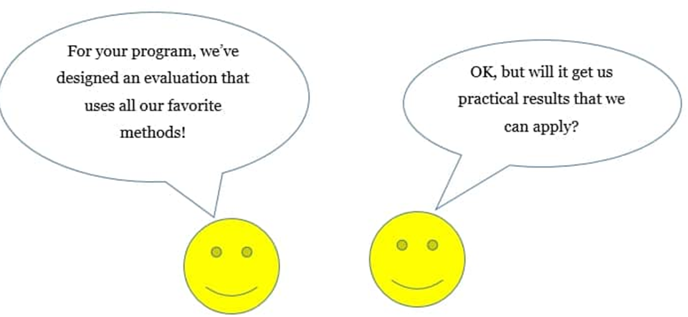
Process
Routinely reviews evidence-based care literature and research findings and incorporates the findings and recommendations into recreational therapy practice as appropriate
Participates in research projects involving the evaluation of recreational therapy treatment
Notes:
HB

Slide 34
Standards of Practice
Why Comply?
It’s your professional and ethical responsibility
Validates and provides structure to our services
Consistency leads to respect
Compliance with the ATRA Standards of Practice provides compliance with
    Joint Commission (JC)
    Commission on Accreditation of Rehabilitation Facilities (CARF)
    Centers for Medicare and Medicaid (CMS) standards/regulations
Notes:
MJ

Slide 35
What if my setting is not governed by CMS, JCAHO, or CARF?
Based on YOUR setting, and state, you may be bound by other agencies.
These are still good practices to follow
There are other community based regulatory agencies or laws to consider when writing policies.
  Just a few examples: Will vary by state or setting
  Americans with Disabilities Act
  Department of Health- are you serving food, or providing overnight accommodations, or swimming?
  Department of Agriculture
  Department of Aging or local Agency Area on Aging
  State Office of Developmental Programs (ODP)
Notes:
HB

Slide 36
Use the Self-Assessment Guide to…
Evaluate compliance
Identify areas of improvement
Create a Policy and Procedure Manual
  Employers can use P&P manual as a training resource
  Employees will know exactly what is expected of them
  Improve communication and teamwork
  Improved accountability
  Validates RT/TR services
  Promotes a well run and efficient RT/TR department
Increase and improve outcomes valued by stakeholders
Notes:
HB

Slide 37
ATRA SOP/SAG 2013 Table of Contents
        ATRA Definition Statement
        Preface
        Introduction
Assessment of Compliance
Standards of Practice Standards (12)
Self-Assessment Guide:
Scoring Summary Instruments & Work sheets
Management Audit
Documentation Audit
Outcomes Audit
Competency Assessment
Clinical Performance Appraisal
Bibliography
Glossary
ATRA Code of Ethics
ATRA Patient’s /Client’s Bill of Rights

Slide 38

Q&A

