Slide 1
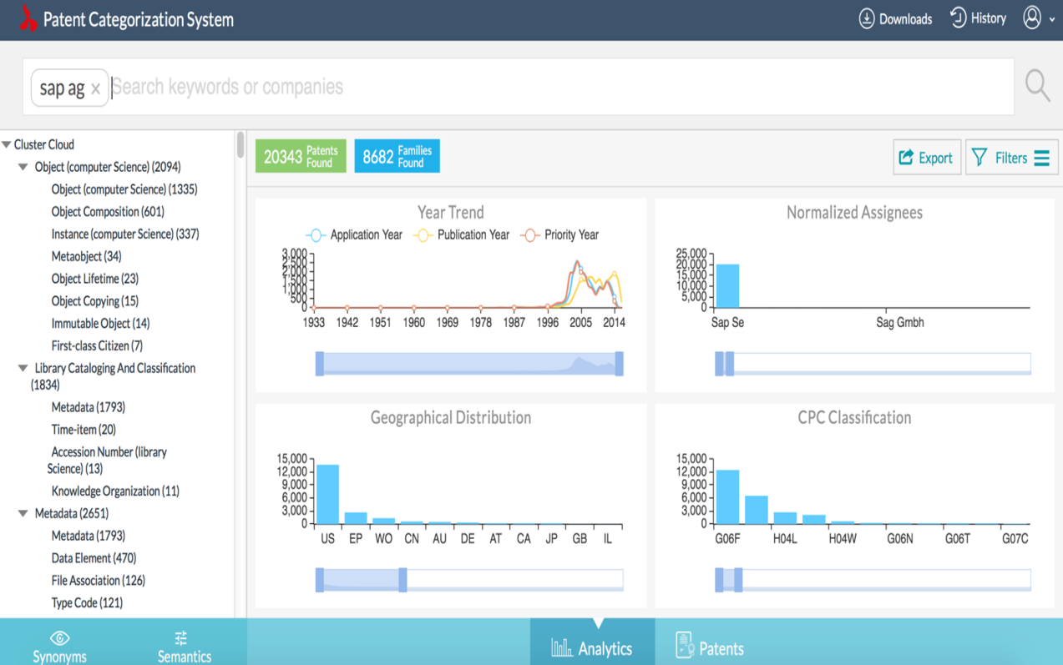
Artificial Intelligence
to
Patent Intelligence

Slide 2


About Us
Dolcera’s deep understanding of patents and expertise in software helps it provide unique solutions to the raise the value of corporate patent portfolios
Dolcera is a leading patent analytics provider with 14 years experience in serving the needs of prosecution, licensing & innovation departments
Dolcera’s software tools are used by leading innovation and licensing teams for day to day patent related needs
Patent analysis
Software Tools
Data Warehousing
Data Science
Dolcera has built unique databases related to patent, business and technology data which help our clients spot salient trends in their industry
Dolcera’s Data Science offerings aid our clients accelerate their processes by building custom solutions for their data processing needs
We help companies across the world be more tactical and strategic with their patents

Slide 3
Services Overview
IP Search
State of art/Landscape searches
Business Research
Primary research
Ease of Use
Wiki
Solutions
Open Innovation Landscaping
Patents & Scientific Literature
Clinical trials
Regulations
Patentability/Prior art
Opposition/Invalidation
Freedom to operate
Alerts & Updates
Secondary research
Competitive analysis
Investment landscape
Mergers & Acquisitions, IPO intelligence
Deal analysis
White Space analysis
Opportunity assessment
Technology scouting
Modeling and forecasting
Literature Reviews
Pathway Mapping
Product & Patent Portfolio Mapping
Patent Scoring/Ranking
Problem Solution Breakdown
Product forecasting & pricing strategy
Technology Watch
Competitor Activity alert
Technology Tree
Heat Maps
Dashboard
Patents
Scientific Literature
Products
Trademarks
IP Maps
White Space Analysis
Market research

Slide 4
Why search patents?
Patent documents represent a rich source of technical, legal and business information. Following are the primary reasons to search patents database.
Competitive Intelligence
Technology scouting
Locating acquisition targets
Finding licensing opportunities
IP Audit
Knowing strengths or weaknesses of competitors in terms of technology
Tracking general developments in emerging technologies. Identifying white spaces
Finding companies to acquire with great complimentary technology
Analyzing other company portfolios to assess licensing opportunities
Studying your own patent portfolio for estimating values, knowing weaknesses in IP

Slide 5
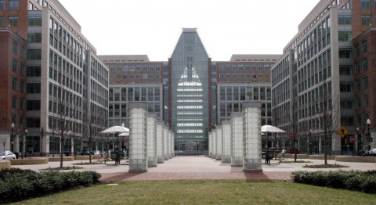
Evolution of patent search
Generation 0 : Patent offices
Before 1997, only way to run exhaustive patent search was to go to patent offices of different countries and use their systems and libraries
For example USPTO office in Arlington used to have two sections in building which were relevant to patent searchers
  Patent Search and Image Retrieval Facility (PSIRF) also known as public search room
  Actual examining division for examiner searches
It was highly inefficient and inaccurate process
Generation 0: Patent offices
Generation 1: Basic search
Generation 2: Advanced search
Generation 3: Basic analytics
Generation 4: Advanced analytics

Slide 6
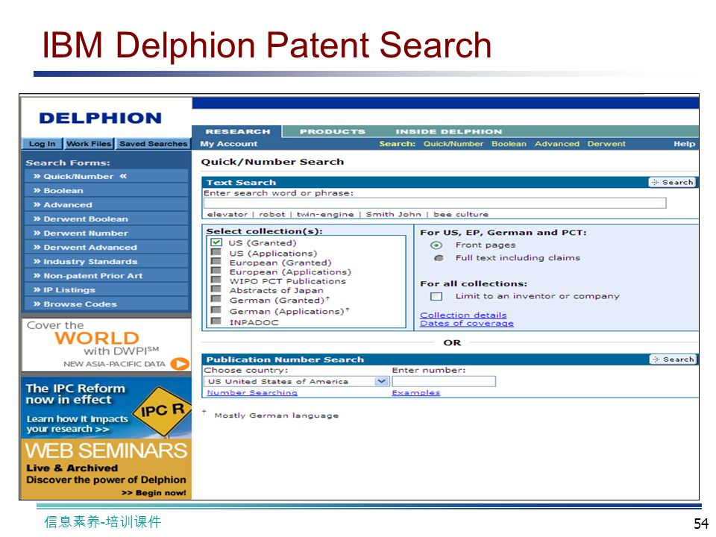
Evolution of patent search
Generation 1: Basic searching
First computer based patent searcher became available in 1997 when IBM Delphion came into existence
Delphion was able to search into patents from different patent offices like US, EP, DE, JP, CH, WO.
This was simple keyword based search interface. It was not able to handle even basic Boolean operators till much late in 2003.
Although information was largely available through search, query interfaces and workflow options were primitive limiting usage of these tools
Generation 0: Patent offices
Generation 1: Basic search
Generation 2: Advanced search
Generation 3: Basic analytics
Generation 4: Advanced analytics

Slide 7
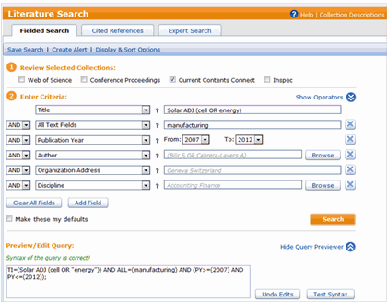
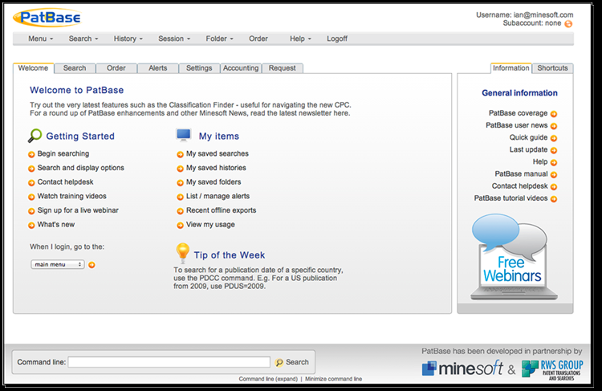
Evolution of patent search
Generation 2: Advanced searching
Boolean operators and complex queries were supported by multiple computer based searchers from 2002 onwards.
Some popular tools were Thomson Innovation, PatBase, TotalPatent, LexPat, PatentMax
Some of these tools were sourcing data from patent offices over 80+ countries.
These tools also built some workflow functionalities like saving and combining searches and exporting results.
While searching for patents became relatively easier, these tools has a steep learning curve and required experts to make exhaustive precise query to generate results.
Generation 0: Patent offices
Generation 1: Basic search
Generation 2: Advanced search
Generation 3: Basic analytics
Generation 4: Advanced analytics

Slide 8
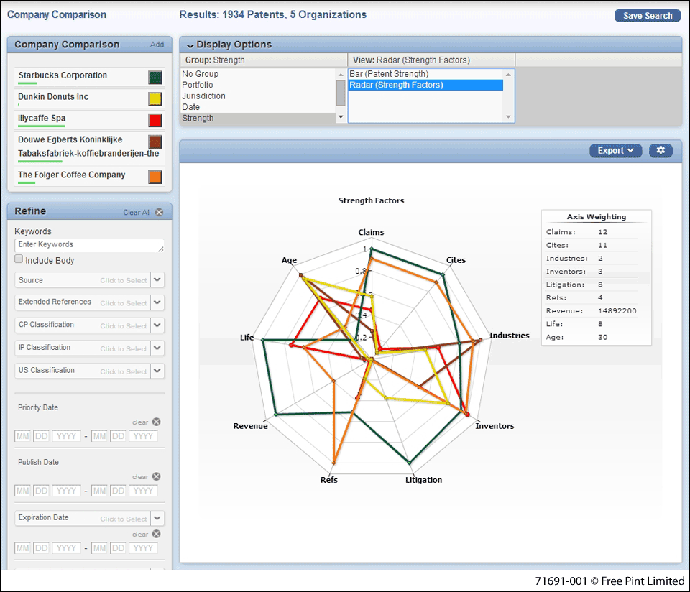
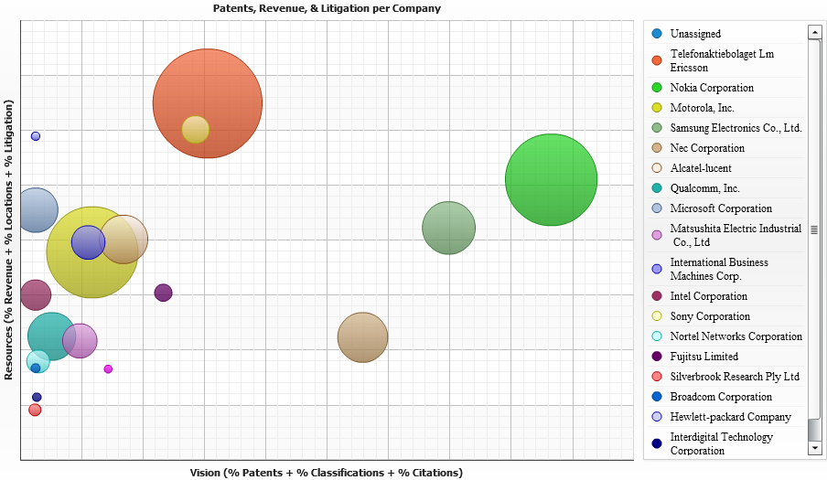
Evolution of patent search
Generation 3: Basic analytics
Next generation tools processed patents data and also introduced basic machine learning in patent searches to get ready made answers to some of business questions.
This included generating various charts like top assignees, temporal trends and some basic clustering.
Most famous tool of this time was Innography.
While Innography made generating insights lot easier, it was still lacking in exhibiting human like intelligence in query formations and analyzing results.
Generation 0: Patent offices
Generation 1: Basic search
Generation 2: Advanced search
Generation 3: Basic analytics
Generation 4: Advanced analytics

Slide 9
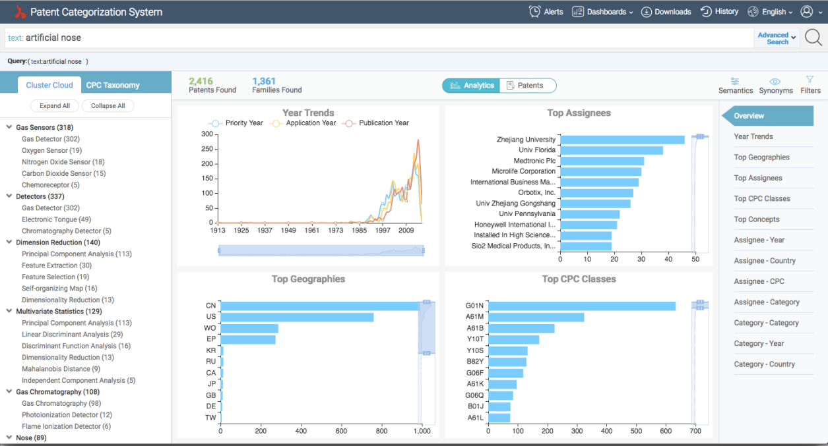
Evolution of patent search
Generation 4: Advanced analytics
Current era of patent search. PCS belongs to this generation. It takes advantage of latest research in deep learning based natural language processing.
PCS makes queries for any searched topic using knowledge harnessed from open data including patents.
It also maps these search results onto relatable taxonomy structure. This features also allows for quick audit of company portfolios.
Generation 0: Patent offices
Generation 1: Basic search
Generation 2: Advanced search
Generation 3: Basic analytics
Generation 4: Advanced analytics

Slide 10

Unmet needs in patent analytics
Solutions worked out
AI in Action

Slide 11
Innovation in Patent Searching and Analytics
  Artificial Intelligence
Empowers users to answer the right questions
  Synonyms and semantics
High quality analytics
  Map patent disclosures
Value added layers
  Assignee normalization
  Inventor normalization
  Legal Information
User friendly interface

Slide 12
Introduction
Use cases
    Instant landscape reports
    Portfolio audit
    Prior art searches
    Technology scouting
    Identifying assets for licensing
Dolcera PCS Tool

Slide 13
Dolcera PCS Tool
PCS Advantage
PCS is Dolcera’s flagship patent analytics platform
With a corpus of over 150 million worldwide patents updated daily, PCS provides answers to every patent question in detail, and blindingly fast
PCS aggregates data from multiple sources (patent data, open source knowledge, paid data sources)
Information is then subjected to Natural Language Processing and machine learning algorithms to generate relevant content for the report
State of the art assignee standardization
semantic search capabilities
dynamic taxonomy

Slide 14
Salient features
Semantic search
Inventor Normalization
11+ million concepts, semantically linked
Enriched semantics from IEEE, Wikipedia and other sources
Based on best deep learning principles
World class algorithm that takes signals no one has attempted before
Signals involve normalized assignee names, technical area of work, name variations of inventors, time of employment, geography, address, co-inventors
26 million inventors normalized with very high precision
Assignee Normalization
Prior Art Search
Millions of assignees normalized
Built on top of Linked Open Data principles and curated data from S&P
Millions of subsidiaries normalized
Very high accuracy
Re-assignments normalized and adjusted for in asset allocations
Re-assignments adjusted for heuristics to avoid considering collateralized obligations made to banks
Re-assignment heuristics to allocate assets appropriately based on transactions between buyers and sellers (and not just time, where transactions reporting is delayed and hence leads to noise)
Combination of deep learning tools with patent ranking principles
Learns from old searches
AIA friendly to check for double patenting
Takes input from text, products, Invention disclosure statements or patent number

Slide 15
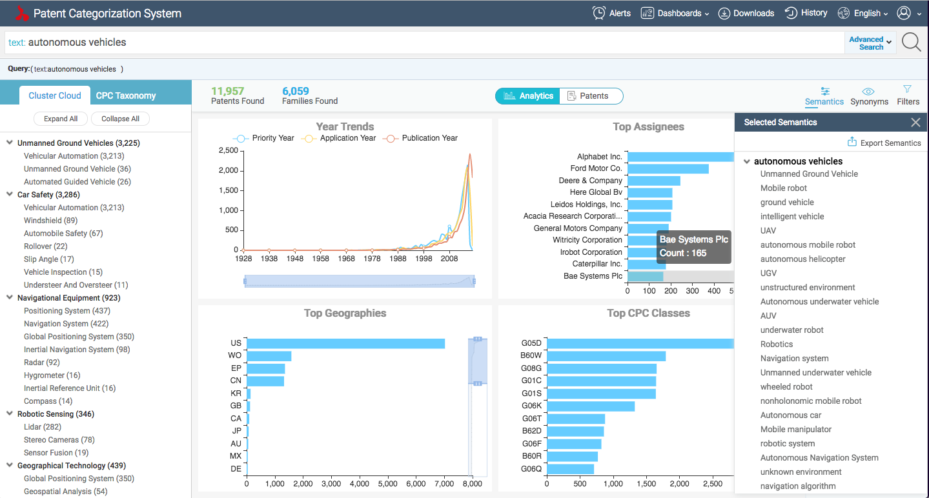
Instant patent landscape report
PCS generates instant patent landscape report on any topic
Typical price of landscape report charged by patent analytics services
$20,000
Average Time saved by PCS over traditional process of landscape report
2 weeks
PCS uses its knowledge base to generate exhaustive but precise query for any given topic automatically.
Results fetched by query are analysed to give insights within seconds.
Patents are classified into intuitive taxonomy that explains distribution of patents obtained in search results.
Additionally user is able to create different charts to dissect data as per requirement
Why create patent landscape report?
For discovering patents that needs to be acquired/licensed to support your product
To assess focus and strength of competitors and guide your own IP strategy
To discover white spots in technology that can be exploited to create competitive advantage

Slide 16
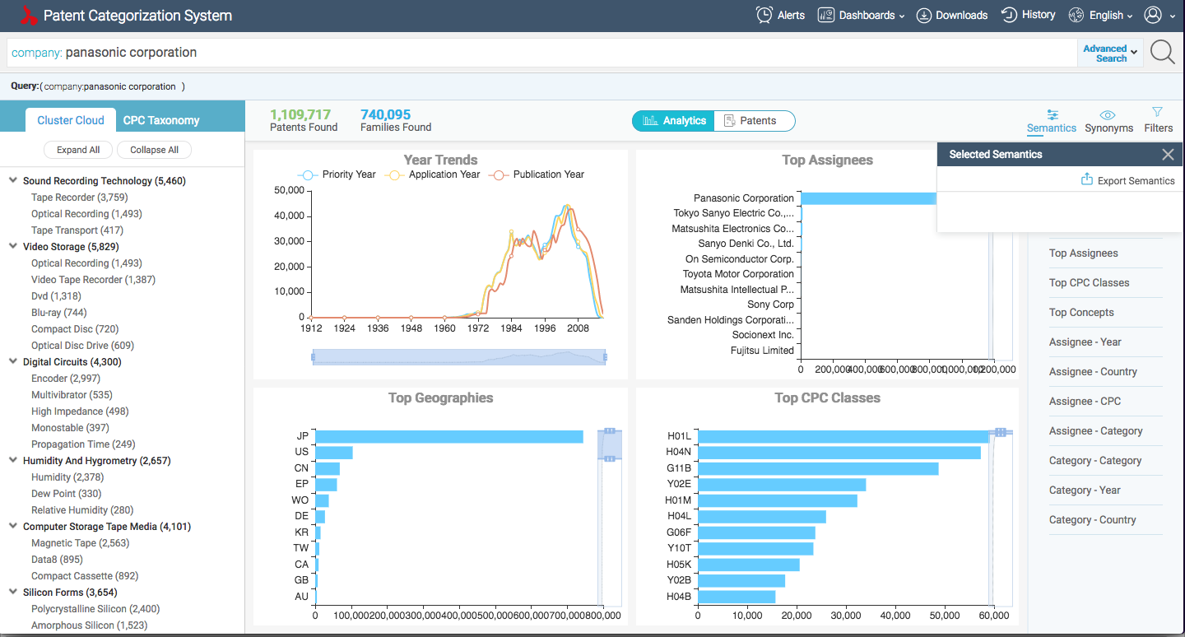
Instant audit of patent portfolio
PCS can analyse any organization’s patent portfolio within seconds
Typical price charged by patent analytics services for portfolio analysis report of bigger organizations like IBM, Samsung
$10,000
Average Time saved by PCS over traditional process of landscape report
1 week
PCS uses proprietary company name standardization algorithm to normalize assignee names in patent databases
Reassignment, corporate trees of organizations are also takes into consideration to find ultimate owner of any technology
This standardized data also allows PCS to generate report on any company’s patent portfolio
Like in landscape report users get insights on number of patents/families, classification of them in taxonomy, filing trends and variety of filters to analyse data in more details
Why audit patent portfolios?
To know strengths and weaknesses of your/competitors’ portfolio in technology
To check alignment between your products and patents
To assess innovation growth across organization over time

Slide 17
Prior-art search
PCS uses new age deep learning methods to search for prior-art
Typical price of prior art search report
$750
Average Time saved by PCS over traditional process of prior art search report
1 day
For given concept or for patent, PCS extracts key concepts
Using pre-processed patent data, its able to identify all different variations of expression of same concept
Consequently its able to identify documents which are semantically very similar to given concept.
This heuristic works exceptionally well compared to traditional document similarity algorithms
Apart from speed it also provides consistency and accuracy in prior art searches
Why search for prior-art for patents/concepts?
To know patentability of inventions i.e. to check if same concept is patented before
To check if patent can be invalidated by any previously published literature

Slide 18
Identifying assets for licensing
PCS has in-built industry proven ranking mechanism which allows users to identify valuable patents in their portfolio
Typical price charged by patent analytics services for identifying best patents report using qualitative analysis of bigger organizations like IBM, Samsung
$10,000
Average Time saved by PCS over traditional process of patent ranking
1 week
Dolcera has developed patent ranking module to score patents which has very high correlation with expert assessment
This is saving lot of efforts for organizations wanting to choose their best assets for licensing out to other companies
On the other note, ranking module also helps in putting dollar value onto set of patents which can be then used as securities/mortgage
Why search for prior-art for patents/concepts?
To know patentability of inventions i.e. to check if same concept is patented before
To check if patent can be invalidated by any previously published literature

Slide 19
Comparison table
Tool Characteristics | Relecura | Innography | PCS | Comment
Data Coverage |  |  |  | Similar/comparable coverage
Assignee Normalization Precision |  |  |  | 10+ million assignees normalized into 756,000 unique companies
Inventor Normalization |  |  |  | 26 million unique inventors normalized
Prior Art search |  |  |  | Not a black box, gives user strong control and provides solid results
Semantic Search |  |  |  | Semantic search based on deep learning models, reduces need for expert searcher
Patent Ranking |  |  |  | High quality and industry proven patent ranking based on a multi parameter framework
Legal Status Filters |  |  |  | High variety of legal filters based on INPADOC legal status for opposition alerts, active/inactive etc.
Advanced Search Features |  |  |  | Similar/comparable features
Search Expertise Required |  |  |  | Operating requires little prior IP searching experience and retrieves expert level reports
Technology Categorization Quality |  |  |  | Rich knowledge base results into relatable technical and application based nodes
Pricing |  |  |  | PCS is very cost effective to use and has saved thousands of dollars per user for our customers
Low score
Medium score
High score
Same

Slide 20
Contact
Thank you
Sign up:
https://pcs.dolcera.com/
Contact:
Shreya Dua
Shreyasi.dua@dolcera.com
+1 630 991 0634
www.dolcera.com
info@dolcera.com

