Slide 1
Presenter Training
February 28, 2024

Slide 2
Welcome
Use the Q&A to submit questions at any point. We will have set times through the webinar to address questions.

Slide 3
Presenter Guides
All presenters, chairs and attendees are encouraged to review all related the materials on the General Session website at iadr.org/2024iags/presentations and follow the steps based on their presentation type.

Slide 4
Download the IADR Meeting App
www.iadr.org/2024iadrapp

Slide 5
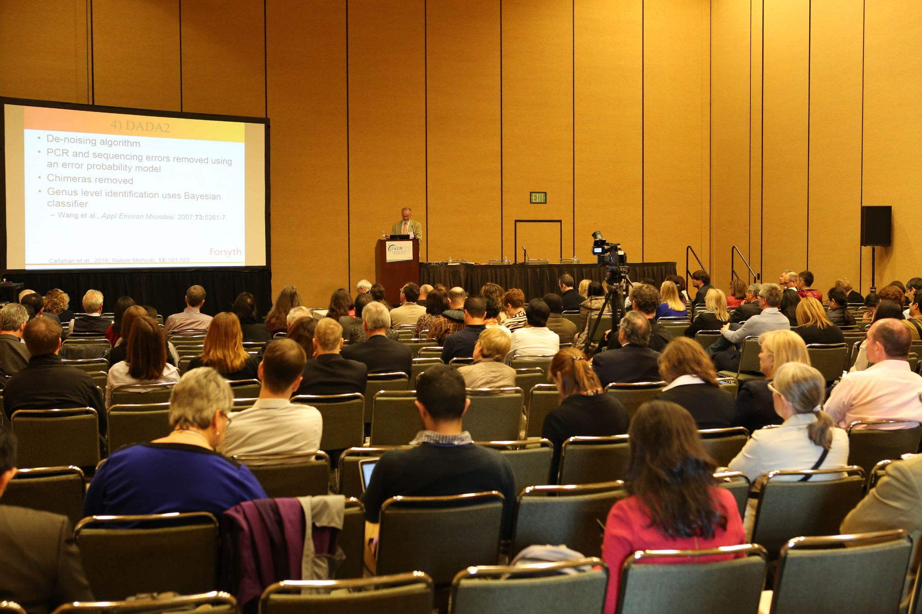
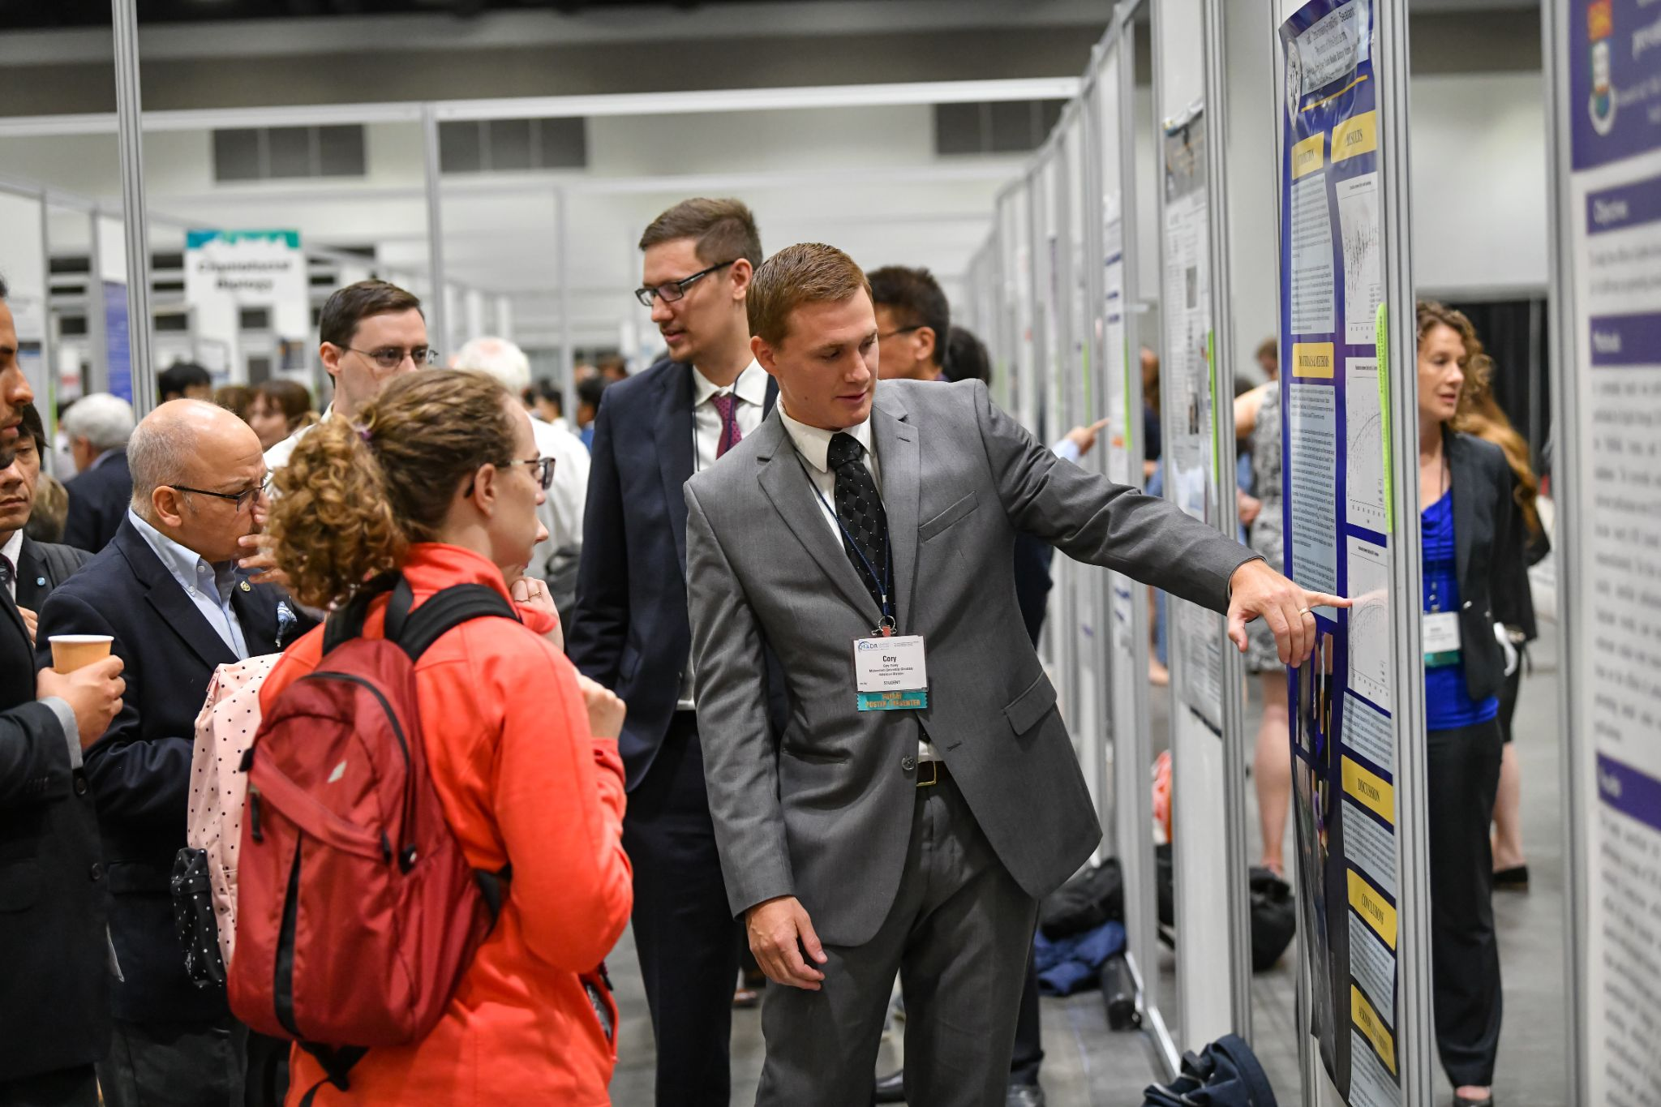
Types of Sessions
In Session Rooms
Oral Presentations (Abstract Based)
Symposia
Hands on Workshops
Poster & Exhibition Hall
Poster Presentations (Abstract Based)

Slide 6
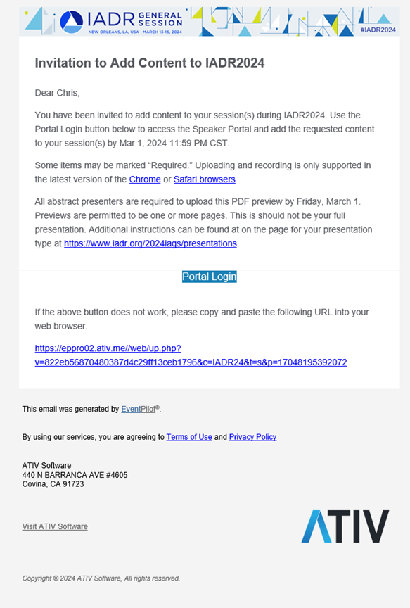
PDF Preview Upload Abstract Based (Oral Presentations ONLY)
Email sent from alerts@ativsoftware.com
All abstract presenters are required to upload a PDF preview of their presentation.
Not your full PowerPoint presentation, just a snapshot to encourage live presentation attendance
Must be a PDF file
Under 10 MB
Presenters received an email on Feb 15 & 26.
Deadline to upload is March 1.

Slide 7
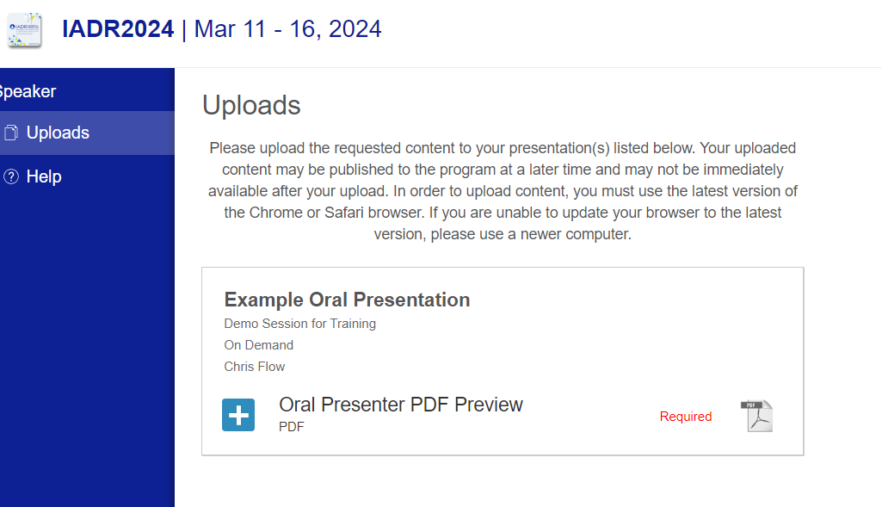
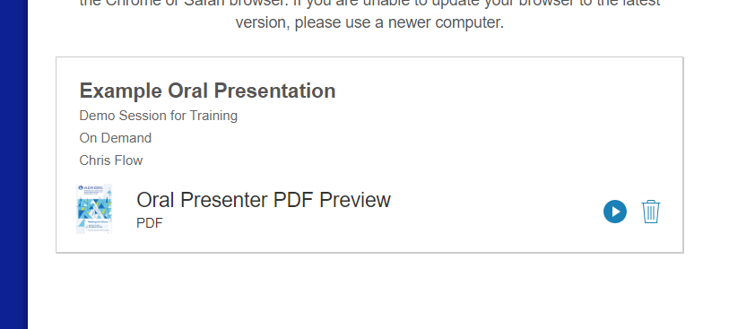
PDF Preview Upload Abstract Based (Oral Presentations ONLY)
After clicking link you will be directed to ATIV preview upload system.
Confirm the presentation displayed is yours.
Click the blue + and navigate to your file to upload.
Once uploaded, a preview icon of your PDF and a play button will appear. This confirms
it was successful.
It may take up to 24 hours for the PDF preview to display in your presentation in the program.

Slide 8
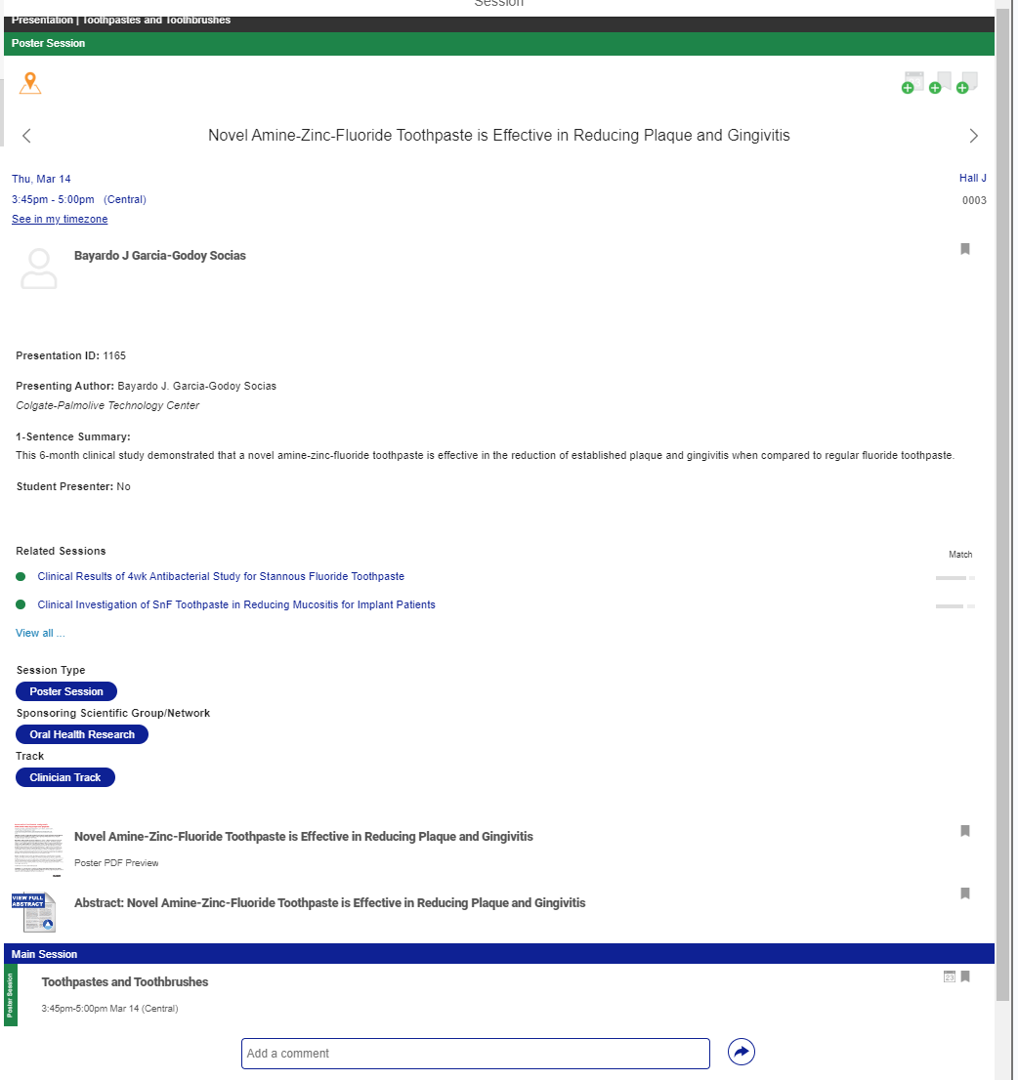
PDF Preview Upload Abstract Based (Oral Presentations ONLY)
Preview PDF will display within the online program and app right next to your full text abstract.
It is a teaser, not your abstract or full presentation.

Slide 9
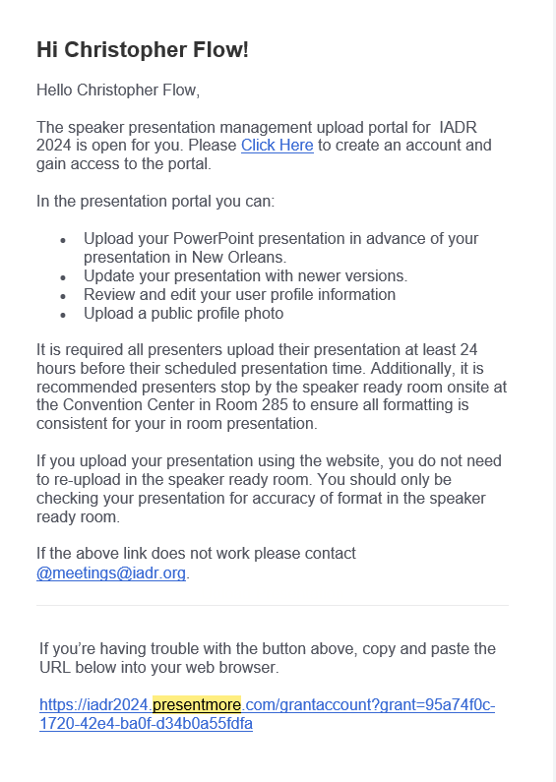
Upload to Speaker Management
(Oral, Symposia, HOW presenters)
Oral/SYM/HOW Presenters are required to provide their full PowerPoint slides for their full presentation through upload to the presentation management system that will be used in the Speaker Ready Room.
Notifications are sent February 29 from noreply@presentmore.com with your upload instructions. Subject line: “Upload your Full Presentation for New Orleans-2024 IADR General Session”
Once onsite, stop by Speaker Ready Room in Room 285 to confirm all is good on PowerPoint running in rooms.
Even if you pre-upload, it is recommended you bring a backup on a USB drive.

Slide 10
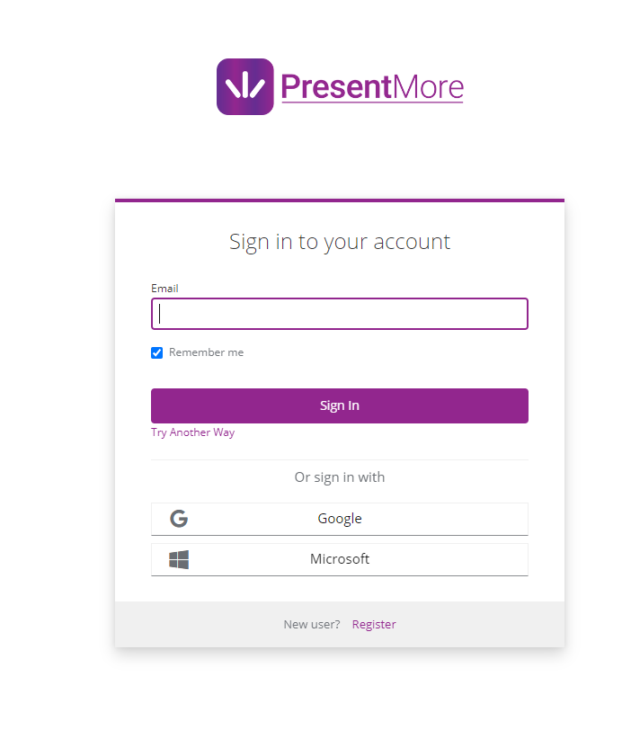
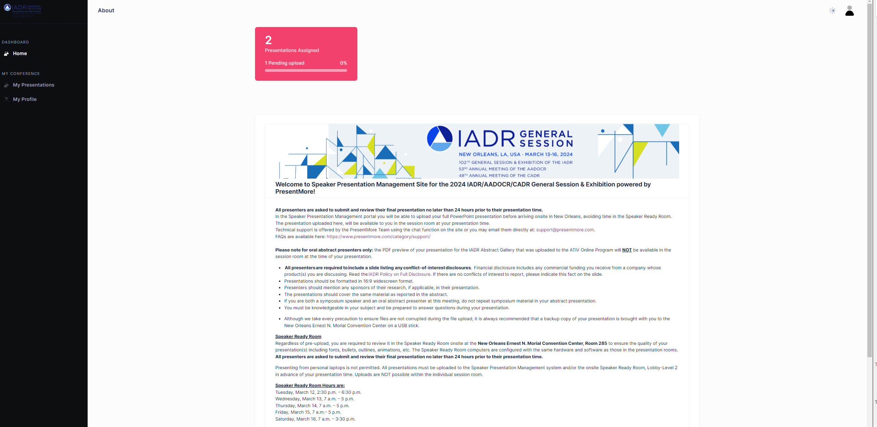
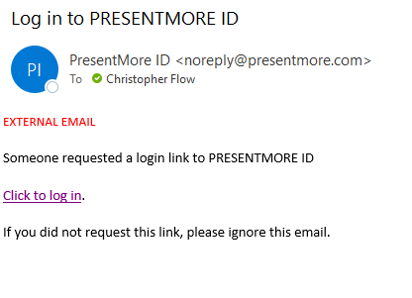
PresentMore Upload System
After Clicking the Email link you will need to enter your email in the system
Click the confirmation link sent to your email.
Then you will be logged into the system.
Live Demo of Upload

Slide 11
In Room Expectations
Every Session Room is Equipped With the Following:
Podium with networked laptop, microphone
Projector with a screen displaying slides
Aisle mic for audience questions
Wireless controller with laser pointer
In-room computers are PCs running PowerPoint. Presenter mode will be visible, so any notes and next slide will be visible to you as the presenter.
To check your presentation, visit the Speaker Ready Room. Presentations will not be synced into the session room until 2 hours before the session.
Personal laptops are not permitted, slides MUST be uploaded to Speaker Ready.

Slide 12
Oral Presenter Expectations
Arrive early
Introduce yourself to your session chair, letting them know you are there.
Sit at the front of the room for easy access to the stage for your presentation time and to be engaged in discussions.
15 minutes for presentation (10 minutes for presentation and 5 minutes for Q&A).
Stay until the end of the session.

Slide 13
Oral, SYM, HOW Presentation Questions?
Submit any questions about your preparation as a presenter in the Q&A Module.
Can also email meetings@iadr.org with any
support questions about the General Session.

Slide 14
Types of Sessions
In Session Rooms
Oral Presentations (Abstract Based)
Symposia
Hands on Workshops
Poster & Exhibition Hall
Poster Presentations (Abstract Based)

Slide 15
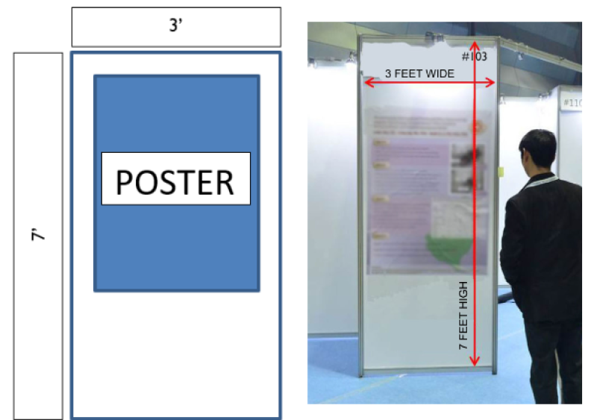
Poster & Exhibition Hall
Welcome back to posters!

Slide 16
PDF Preview Upload Abstract Based (Poster Presentations ONLY)
Email sent from alerts@ativsoftware.com
All abstract presenters are required to upload a PDF preview of their presentation.
Not your full poster, just a snapshot to encourage live presentation attendance
Must be a PDF file
Under 10 MB
Presenters received an email on Feb 15 & 26.
Deadline to upload is March 1.

Slide 17
PDF Preview Upload Abstract Based (Poster Presentations ONLY)
After clicking link you will be directed to ATIV preview upload system.
Confirm the presentation displayed is yours.
Click the blue + and navigate to your file to upload.
Once uploaded, a preview icon of your PDF and a play button will appear. This confirms
it was successful.
It may take up to 24 hours for the PDF preview to display in your presentation in the program.

Slide 18
PDF Preview Upload Abstract Based (Poster Presentations ONLY)
Preview PDF will display within the online program and app right next to your full text abstract.
It is a teaser, not your abstract or full presentation.

Slide 19
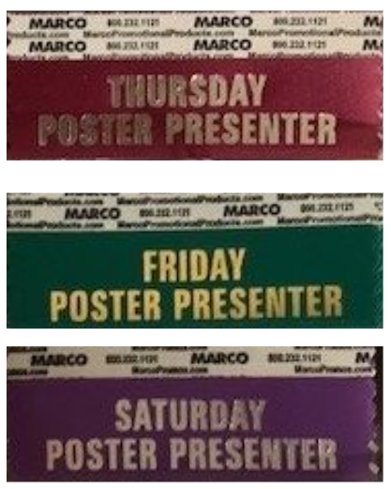
Registration Check In
When you arrive at the New Orleans Ernest N. Morial Convention Center your first stop should be registration to pick up your badge. Registration is located in Foyer - Hall I.
Be sure to pick up a Poster Presenter ribbon corresponding with your day of presentation. This ribbon will allow presenters access to the poster hall to set up and tear down posters when the hall is closed. You will not be allowed entrance into the hall without the proper ribbon.

Slide 20
Poster Hours
PRESENTATION BLOCKS
Thursday, March 14
Block 1: 11 a.m.-12:15 p.m. Block 2: 3:45 p.m.-5 p.m.
Friday, March 15
Block 1: 11 a.m.-12:15 p.m. Block 2: 3:45 p.m.-5 p.m.
Saturday, March 16
Block 1: 11 a.m.-12:15 p.m. Block 2: 3:45 p.m.-5 p.m
You are required to be at your poster board during the full session time.
MOUNT POSTERS:
7:15 a.m. - 8 a.m. the day of your presentation
POSTER VIEWING TIMES:
8 a.m. - 5 p.m.
REMOVE POSTERS:
5 p.m. - 5:15 p.m. the day of your presentation
Posters must remain up until the time specified for tear down
Any posters left after the tear tear-down period will be removed. IADR is not responsible for posters and materials left on poster boards after the stated hours.

Slide 21
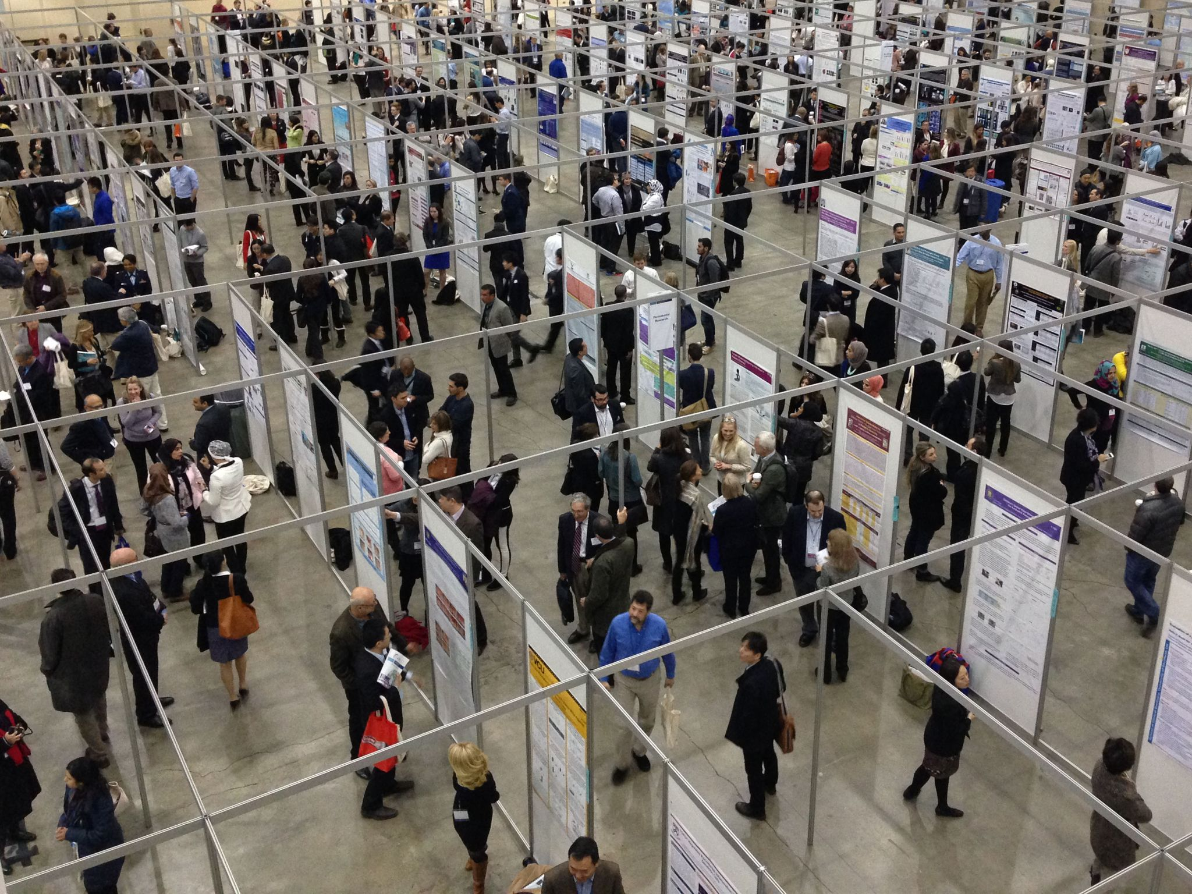
Locating your Poster Board
Locate your board using the aisle signs and the number label on the frame of each board.
A thin slip of orange paper will be on each board noting the poster numbers to be presented on that board each day.
Confirm the number matches your Final ID before putting up your poster
If a poster is up in your spot, notify staff at the poster hall check in desk. Do not remove yourself.
Final IDs were emailed January 22 to presenters
Available in the online scientific program and app

Slide 22
Claim Your Certificate of Presentation
After you present, visit the Continuing Education site for the General Session and claim your certificate of attendance & presentation, and claim CE.
This site will be added to the General Session homepage the week of the meeting. It will be open for one year after the conclusion of the General Session.

Slide 23
Poster Presentation Questions?
Submit any questions about your preparation as a presenter in the Q&A Module.
Can also email meetings@iadr.org with any
support questions about the General Session.

Slide 24
Are you also a session Chair?
Attend the Chair Training Webinar today at 3 p.m. EST (UTC -5) https://www.pathlms.com/iadr/webinars/41016

Slide 25
General Presenter Questions?
Can also email meetings@iadr.org with any
support questions about the General Session.

