Slide 1
Emerging Student Leaders: How to Provide a Valuable Experience
Seth Ellsworth – Muscle Foods Division Senior Representative
Nick Tarleton – Food Laws & Regulations Student Representative
Laura Willis – International Division Super User

Slide 2
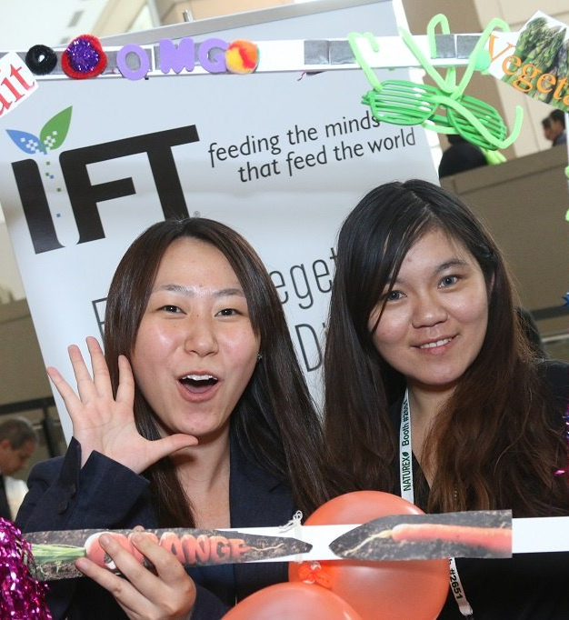
Division Student Representative Opportunity
Student Representatives support the Division Leadership Team and Division by reaching out to food science and technology students worldwide, encouraging them to join and participate in the Division. Student Representatives are engaging and enthusiastic with new members and do their best to connect them to others in the industry.

Slide 3
Why Students Get Involved in Divisions
Goal: Learn outside of the classroom and college food curriculum
Better understand what’s going on in the industry through professionals who are actually in the industry
Learning about current and future obstacles/challenges
Applying their education and how it is important to the industry
Learning in the classroom truly applicable to the industry? If so, how does it apply?
Professional Network
Being connected through professional social media such as LinkedIn or email
Possible career shadow professional during breaks (Fall, Winter, Spring)
Mentorship
Students want to feel supported and see value in entering the food industry

Slide 4
How to get student leaders involved?
Make connections with student leaders
Ask them what they are passionate about?
What would they like to learn?
What are their strengths and weaknesses?
How do they want to contribute to the division?

Slide 5
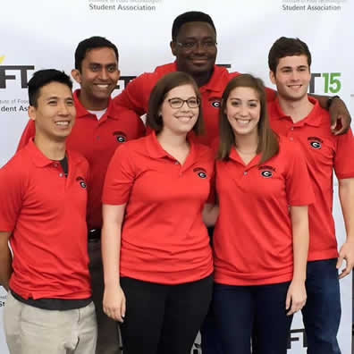
Opportunities to Think Outside the Box
Provide opportunities for students to learn about what your Division does and engage them
Brainstorming new ways to attract and engage new members
Allow them to share what they are learning with professionals by providing feedback or advice through discussions or webinars
Collaborate with other relevant Divisions on IFT Connect discussions or webinars

Slide 6
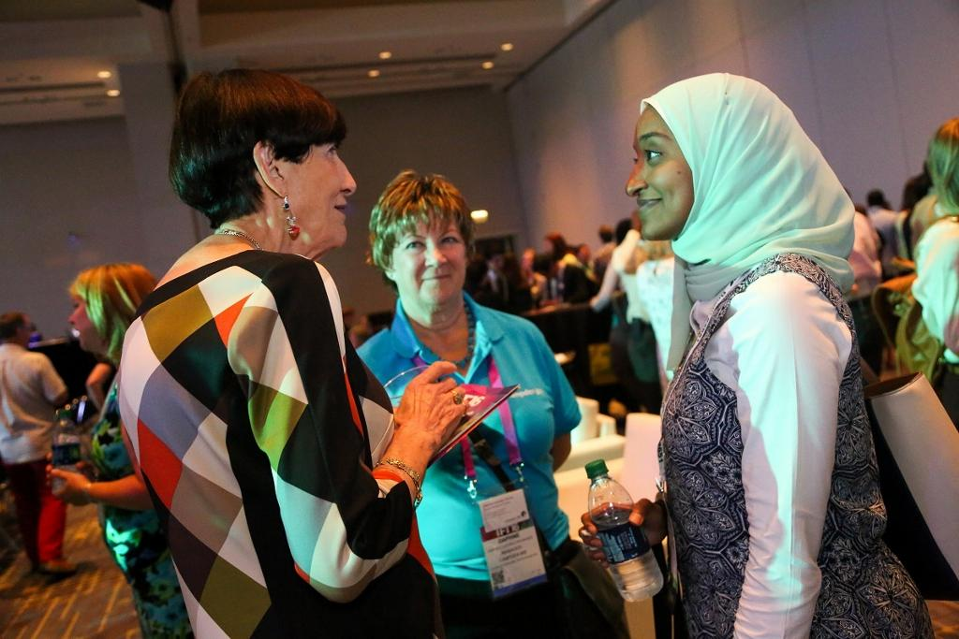
Opportunities to Think Outside the Box
Allow students to bring new ideas to the table whether it be through social media, planning for events such as the Division sessions at the Annual IFT Meetings
Invite them to attend Division board meetings providing face-to-face interaction
Asking, asking, asking students how you can help them achieve their goals and dreams
Mentorship
Division Networking Sessions

Slide 7
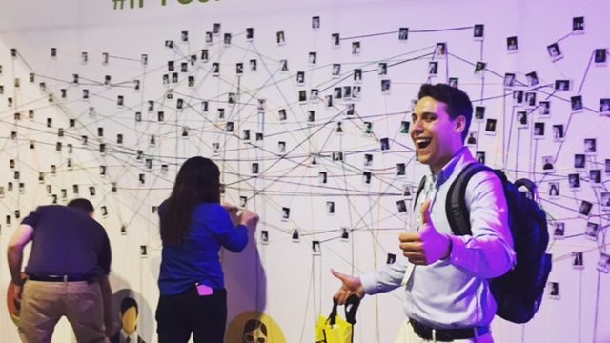
Utilize Students’ Strengths
Provide opportunities to:
Contribute articles to Division eNewsletters
Participate on regular Division calls by being the call organizer and/or secretary
Send personal messages to welcome new student members to the Division

Slide 8
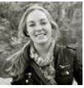
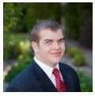
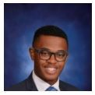
Questions & Discussion
Laura Willis
International Division Super User,
IFTSA Food Communicator and New Professional
lauraperpetua@gmail.com
Seth Ellsworth
Muscle Foods Division Sr. Student Representative,
Quality Assurance Division Super User and
IFTSA South Central Area Representative
Seth.Ellsworth@gmail.com
Nick Tarleton
Food Laws & Regulations Division Student Representative and New Professional
tarletn2@illinois.edu

Slide 9
Thank you for attending today’s webinar!

