Slide 1
Waste Determination Tool
Kristen Fenati
Small Business and Local Government Assistance Program
Region 4

Slide 2
Overview
Regulations
Purpose
Walking through the tool
Examples

Slide 3
Regulations
30 Texas Administrative Code (TAC) 335.62 and 40 Code of Federal Regulations (CFR) 262.11
  Facilities that generate a solid waste must determine if it is hazardous and must also classify any industrial nonhazardous waste
30 TAC 335.513
  Facilities are required to maintain documentation of a waste determination

Slide 4
Hazardous vs Nonhazardous
Hazardous
  Characteristic
    Ignitability, corrosivity, reactivity, or toxicity
  Listed
    Acutely hazardous waste and listed waste from specific and non-specific sources
Nonhazardous
  Industrial waste (Texas only)
    Class 1
    Class 2
    Class 3

Slide 5
Waste Determination
Two ways to conduct a waste determination
  Process knowledge
    Safety Data Sheets, manufacturers’ literature
    A full description of the process
    A full description of the waste
  Sampling
    Take a representative sample of the waste and send it to a lab to be analyzed
    Maintain documentation of sampling results
Notes:
including a list of chemical constituents that enter the process

Slide 6
Waste Determination Tool
A template form that can be used to document a waste determination
Also includes documentation of generator status
Will need to have one form for each waste stream

Slide 7
General Waste Stream Information
First, enter the name of the waste
Then, enter the full description of the process generating the waste and what constituents are likely to be in the waste
Next, enter the estimated volume generated of that waste per month
  This is used to determine your monthly generator status
Notes:
Once you have finished completing the waste determination tool you will create a Texas Waste Code and list it at the top of the form
To generate a Texas Waste Code, refer to RG-022: Guidelines for the Classification and Coding of Industrial and Hazardous Waste

Slide 8
General Waste Stream Information
Is the waste a solid waste?
  A solid waste is any garbage, refuse, sludge from a waste treatment plant, and other discarded materials
  Does not refer to the physical state of the waste
Is the waste excluded from RCRA?
  Some waste streams are excluded from the definition of waste in the RCRA rules
  Examples: used oil and oil filters

Slide 9
General Waste Stream Information
Is the waste a discarded or expired chemical product?
  If yes, and it can be used for its intended purpose and you intended to use it, it is not necessarily a waste
Is the waste a spent/used process waste?
  Has the waste been used for its intended purpose and based on that use become unusable
  If not, it could be a P or U listed waste
What is the physical state of the waste stream?
Notes:
Will cover P and U listed wastes, later

Slide 10
Part I: Hazardous Waste Determination
Is the waste an F, K, P, or U listed waste
  F listed waste: non specific sources
    Solvents
  K listed waste: specific sources
    Example: wood preserving wastes
  P listed waste: discarded commercial chemical products that are acutely toxic
  U listed waste: discarded commercial chemical products

Slide 11
Part I: Hazardous Waste Determination
Is the waste ignitable?
  Liquid wastes that have a flash point less than 140 degrees Fahrenheit
  Nonliquid waste that under standard temperature and pressure, are capable of causing fire through friction
Is the waste corrosive?
  Aqueous wastes with a pH of 2 or below or of 12.5 or above
  Liquid wastes that corrode steel at greater than 6.35 mm per year

Slide 12
Part I: Hazardous Waste Determination
Is the waste reactive?
  It is capable of detonation or explosive decomposition or reaction
    At standard temperature and pressure
    If subjected to a strong ignition source

Slide 13
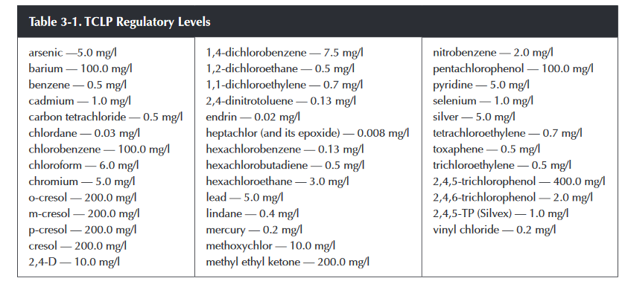
Part I: Hazardous Waste Determination
Is the waste toxic?
  If the Toxicity Characteristic Leaching Procedure (TCLP) shows that a sample of the waste contains one or more constituents at or above the levels in the table below (taken from RG-022)

Slide 14
Waste Determination Tool
If you answered yes to any of the questions we just covered, the waste is hazardous
If you answered no to all the questions we just covered, is the waste industrial?
Industrial waste
  Nonhazardous waste generated at industrial facilities
Industrial facilities
    Making a product for wholesale with an organized plan and division of labor
    Change materials by processing them or
    Substantially support either of the activities above

Slide 15
Waste Determination Tool
Examples of Industrial Facilities
  Formulating operations
  Electronic assembly facilities
  Fabricated metal products facilities
  Product testing facilities
  Wineries

Slide 16
Part II: Nonhazardous Class 1 and 2
Industrial waste generators can choose to classify nonhazardous waste as Class 1
  To avoid having to conduct sampling or find documentation to determine if Class 2
Notes:
If the answer is “yes”, the waste is Class 1 waste.

Slide 17
Part II: Nonhazardous Class 1
Is the waste a container which has held a hazardous waste or a Class 1 waste?
  If no, continue to next slide
  If yes, has the container had all its residues removed and has the container been rendered unusable ?
    If yes, the waste may be a Class 2 waste
    If no, the waste is a Class 1 waste
Notes:
Container greater than 5 gallons in holding capacity
Previously held:
hazardous substance,
hazardous waste,
Class 1 waste,
And/or
Material that would be classified as a hazardous or Class 1 waste if disposed of?

Slide 18
Part II: Nonhazardous Class 1
Does the waste contain asbestos material identified as Regulated Asbestos Containing Material (RACM)?
RACM is defined as
  Friable asbestos containing more than 1 percent asbestos that, when dry, can be crumbled, pulverized, or reduced to powder by hand pressure;
  Nonfriable asbestos-containing material containing more than 1 percent asbestos
  More information on the definition of RACM can be found in RG 022
Notes:
RACM needs to be managed carefully to eliminate any risk of asbestos exposure
If the answer is “yes”, the waste is Class 1 waste.

Slide 19
Part II: Nonhazardous Class 1
Is the waste contaminated by a material that originally contained 50 or more parts per million (ppm) total PCBs?
Notes:
If the answer is “yes”, the waste is Class 1.

Slide 20
Part II: Nonhazardous Class 1
Is the waste identified as a petroleum substance or contaminated with a material identified as a petroleum substance ?
  If no, continue to next slide
If yes, does the waste contain more than 1,500 ppm of total petroleum hydrocarbons (TPH)?
  If yes, then the waste is Class 1
  If no, then it may be classified as Class 2

Slide 21
Part II: Nonhazardous Class 1
Is the waste from the production of a “new chemical substance”?
Is the waste generated outside of Texas?
  If yes and transported into Texas for disposal, then Class 1
Notes:
New chemical substance means any chemical substance which is not included in the chemical substance list compiled and published undersection 2607(b) in the Toxic Substances Control Act
Outside of Texas: Can be Class 2 or 3 if it meets the criteria and a waste determination with required documentation is submitted to the TCEQ for approval

Slide 22
Part II: Nonhazardous Class 1
Is the waste a liquid with a flash point less than 150°F?
Is the waste a solid or semi-solid that under normal conditions for storage, transportation, and disposal:
  Is liable to cause fires through friction or through retained heat from manufacturing or processing; or
  Readily ignites and burns so vigorously and persistently it creates a serious hazard?
Notes:
If the answer is “yes”, the waste is Class 1.

Slide 23
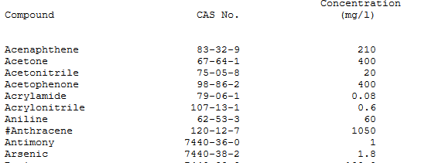
Part II: Nonhazardous Class 1
Is the waste a semi-solid or solid that has a pH of equal to or less than 2 or equal to or more than 12. 5?
Does the waste leach Class 1 toxic constituents at or above the levels listed in Table 1, Appendix 1 of 30 TAC 335 Subchapter R when submitted for TCLP?
Notes:
If the answer is “yes”, the waste is Class 1.

Slide 24
Part II: Nonhazardous Class 1
Is information lacking that demonstrates the waste belongs in Class 2 or 3?
  You must document the waste is Class 2 or 3, or you have to default to Class 1

Slide 25
Waste Classification Tool
If you determined the waste is Class 1, skip to Part V
Otherwise continue to Part III to determine if the waste is Class 2 or 3

Slide 26
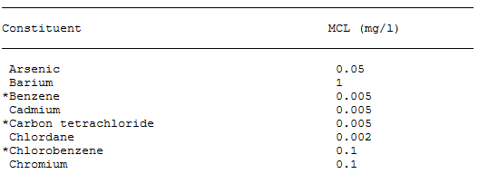
Part III: Nonhazardous Class 2 or 3
Is the waste an empty container?
Is the waste medical waste regulated under 30 Texas Administrative Code (TAC) 326?
When subjected to the 7-day distilled water leaching test, does the waste leach constituents at or above the maximum contaminant levels in Table 3, Appendix 1 of 30 TAC 335, Subchapter R

Slide 27
Part III: Nonhazardous Class 2 or 3
Does the waste contain detectable levels of petroleum hydrocarbons?
Does the waste contain detectable levels of polychlorinated biphenyls (PCBs)?
Is the waste readily decomposable?

Slide 28
Part III: Nonhazardous Class 2 or 3
If the answer to any of the questions in Part III is yes
  Then the waste cannot be considered a Class 3 waste
  Therefore it is a Class 2 waste

Slide 29
Part IV: Nonhazardous Class 3
If the answer to all of the questions in Part III, was no, then move to Part IV
Is the waste inert and essentially insoluble?
  Inert: Refers to the chemical inactivity of a waste.
If the answers to all the questions in Part III are no, and the answer to the question in Part IV is yes then the waste is a Class 3 waste
Notes:
Essentially insoluble: Any material, which if representatively sampled and placed in static or dynamic contact with deionized water at ambient temperature for seven days, will not leach any quantity of any constituent of the material into the water in excess of current United States Environmental Protection Agency limits for drinking water

Slide 30
Part V. Additional Information
In 30 TAC 335.511, process knowledge is described as:
  Material safety data sheets,
  Manufacturers' literature,
  Description of the process including a list of chemical constituents that enter the process, and
  A full description of the waste, including a list of chemical constituents likely to be in the waste.
Attach process knowledge documentation to the waste classification form

Slide 31
Part V. Additional Information
If you use sampling data for your waste determination
  Attach the lab analysis to the waste classification form

Slide 32
Part V. Additional Information
If the waste is hazardous list the transporter and the final destination facility
  You are still required to maintain manifests demonstrating proper disposal
Indicate if the waste is a restricted waste and is subject to Land Disposal Restrictions (LDRs)
  LDRs are for hazardous waste that needs to be treated before final disposal
  CESQGs are excluded from this requirement

Slide 33
Part V. Additional Information
Universal waste include the final destination facility
  Maintain bills of lading to demonstrate proper disposal
Industrial nonhazardous waste list the transporter and final destination facility
  For Class 1 nonhazardous waste, maintain manifests
  For Class 2 or 3, maintain bill of ladings to demonstrate proper disposal
Legitimately recyclable/reusable material must list who manages it
  Maintain documentation to show proper management

Slide 34
Part V. Additional Information
Generator Status
  Determined based on the amount of hazardous waste generated on-site in a month
    Conditionally Exempt Small Quantity Generators (CESQGs) generate no more than 220 pounds of hazardous waste per month
    Small Quantity Generators (SQG) generate between 220 and 2,200 pounds of hazardous waste per month
    Large Quantity Generators (LQGs) generate more than 2,200 pounds of hazardous waste per month

Slide 35
Part V. Additional Information
Industrial CESQGs generate more than 220 pounds of Class 1 waste
Universal Waste Handlers
  Small Quantity Handlers (SQGs)
    Maintains less than 11,000 pounds of universal waste
  Large Quantity Handlers (LQHs)
    Maintain more than 11,000 pounds of universal waste

Slide 36
Examples
A facility has a laboratory for testing products. The laboratory has a five gallon container of pure acetone, that has not been used for it’s intended purpose, but has expired.
Acetone Properties
  Flashpoint of 2 degrees Fahrenheit
  pH of 7
  Not reactive
  Liquid
Is the waste hazardous or nonhazardous?
Notes:
Hazardous for ignitability, because the flashpoint is less than 140 degrees Fahrenheit

Slide 37
Examples
An industrial facility spills 50 gallons of gasoline on some soil on their property. They excavated the contaminated soil and placed it into a roll-off container. The facility took representative samples from the contaminated soil and the results are below.
Sample Results
  Toluene 2,000 mg/L
  1,600 parts per million of total petroleum hydrocarbons
  Flash point 210 degrees Fahrenheit
  Benzene 0.2 mg/L
How should the waste be classified?
Notes:
Class 1 nonhazardous waste. TPH is above 1,500 ppm. Class 1 list of maximum leachable concentrations for toluene 1000 mg/L. Benzene 0.50 for hazardous and class 1.

Slide 38
Examples
An industrial facility has a pile of bricks that they classifying to prepare for disposal. The brick has the following characteristics:
  pH 7
  Not ignitable, not reactive
  No detectable levels of PCBs or total petroleum hydrocarbons
  Not readily decomposable
  Inert
  When subjected to the 7-day distilled water leaching test, the waste does not leach constituents at or above the maximum contaminant levels in Table 3, Appendix 1 of 30 TAC 335
How should the waste be classified?
Notes:
Class 3 nonhazardous waste

Slide 39
Questions?
Kristen Fenati
Compliance Assistance Specialist
Region 4- Dallas Fort Worth
817-588-5827
Kristen.Fenati@tceq.texas.gov

