Slide 1
Case Study on Identifying Innovator Talent at W. L. Gore & Associates
Dr. Debra France
February 2, 2018

Slide 2
Our conversation today:
Previous approaches to identifying innovator talent
Problem Statement
Innovator Competency Model
Introducing the Swarm Innovation Profile
The experiment: Testing the Profile
What We Learned
Our Next Explorations

Slide 3
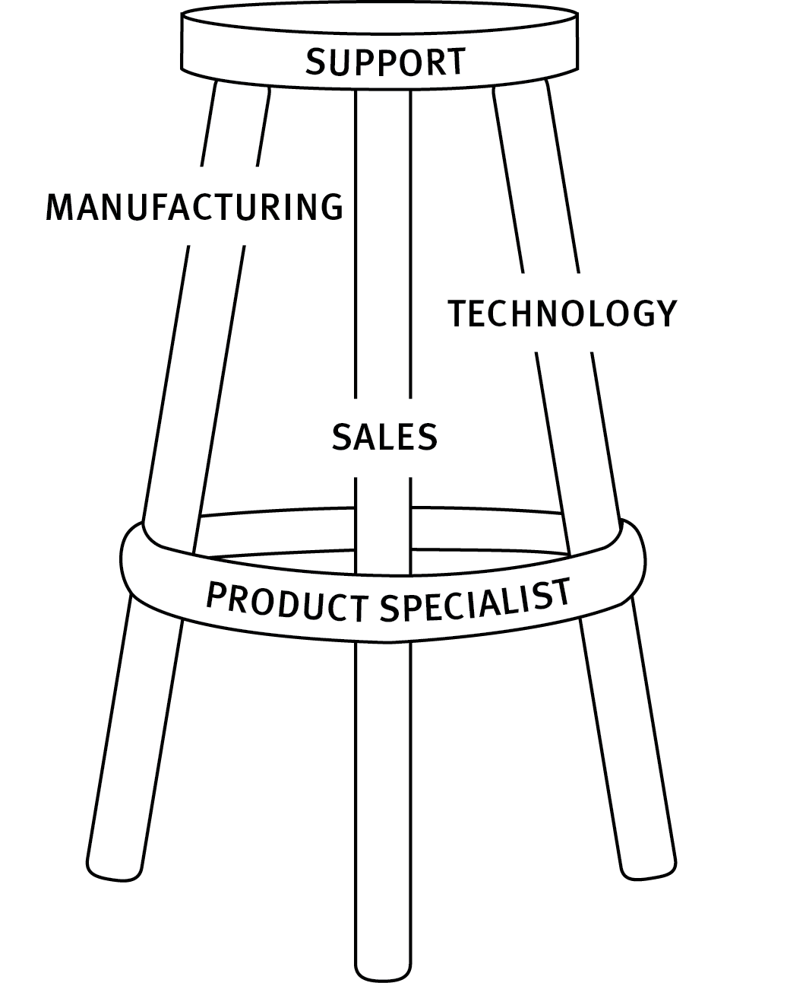
Previous approaches to identifying innovator talent
Opportunities to discover talent:
Small Plants
Functional Excellence Teams
Sponsors
Notes:
Every associate has a sponsor
Sponsoring is a formal commitment to help an associate succeed at Gore
The sponsor ensures the associate is growing and contributing according to their strengths and interests, which enhances discretionary energy
The sponsor advocates for the associate and ensures fairness
The sponsor helps the associate build relationships and credibility
Lend their networks and their creativity until the innovators have their own
Drive their development
Scout for desirable opportunities
Moderate conditions to be optimal for each innovator

Slide 4
What are some of the ways your company identifies innovator talent?
A question for you:

Slide 5
Problem Statement
Almost 10,000 Associates worldwide
Many relationships are now global and virtual
New Associates are attracted to Gore to work in innovation, and we need to provide opportunities to retain them
How can we improve our ability to identify innovator aptitude?

Slide 6
Innovator Competency Model
Technical Knowledge
Profound knowledge and ability to describe unique and valuable features and capabilities of Gore materials, processes and complementary technologies to solve customer problems
Experimental
Imagines and tests a broad range of options to create new solutions or possibilities
Disciplined Execution
Approaches exploration, experimentation and innovation rigorously and systematically
Early Adopter
Scans for and eagerly applies new approaches, tools and technologies to accelerate or enhance outcomes
External Focus
Crosses internal and external boundaries to learn from and collaborate with customers, suppliers and industry observers
Market Sensitive
Continuously challenges and calculates the potential value of innovations to the customer and to Gore’s capability and profit
Entrepreneur
Drives projects that test more radical approaches to developing new products to create unique and valuable custom
Anthropologist
Investigates and experiences unique customer perspectives, problems and requirements

Slide 7
The Opportunity: The Swarm Innovation Profiler
Use an external, validated assessment to identify and differentiate different types of innovator talent in Gore associates with
8 innovation skill clusters
26 innovation sub-clusters
Learn how to combine these different types of talent more effectively in teams
Learn how to deepen these capabilities through development

Slide 8
Are any of you using an innovator profile tool? Can you share insights? benefits?
A question for you:

Slide 9
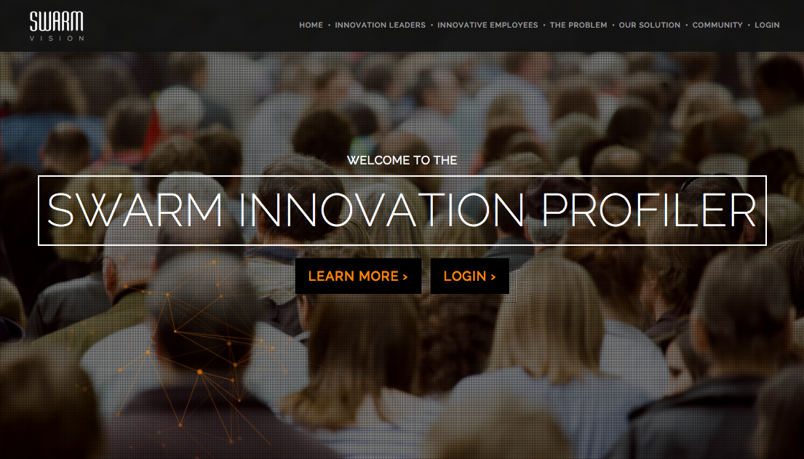
The Experiment: Testing the Swarm Innovation Profile
Invited 150 Associates to complete the profile
80% invited because they demonstrated innovator attributes or have a long-term track record of innovating at Gore
20% invited as ‘controls’ (associates who openly admit they are not innovators)
Invited a second round of 100 Associates – some in H1, H2, H3 roles
Invited 1000 more Associates
Recent hires
Innovation-related functions
Adjacent functions

Slide 10
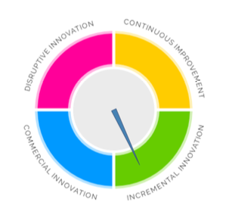
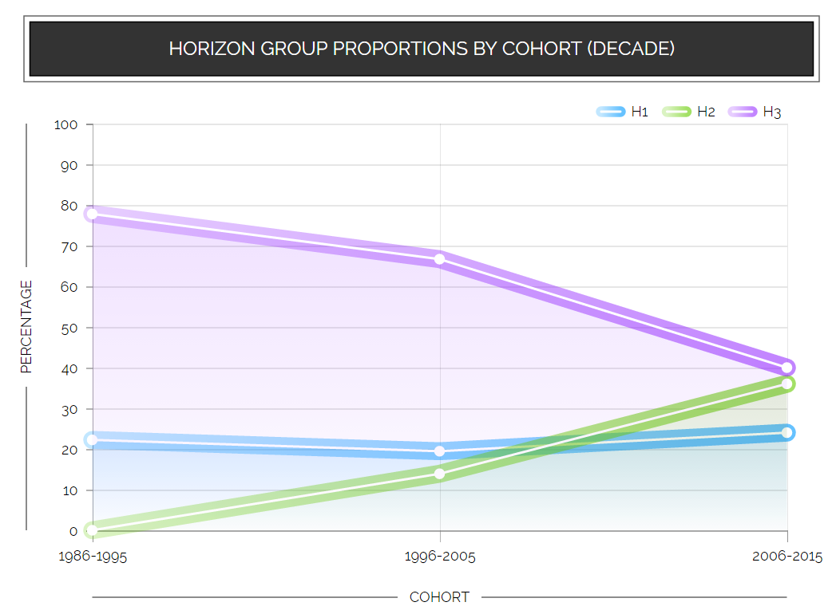
Swarm Vision system enables visibility into your innovation talent
Assessment
Dashboard
Discover your innovation talent
Visualize & analyze your innovation talent
Notes:
Our core solution has 2 parts:
We have our own IP around assessing innovation talent in the enterprise based on our rigorous research.
And our dashboard (in beautiful D3) makes that talent visible and clear, so manager can make decisions vs. flying blind.

Slide 11
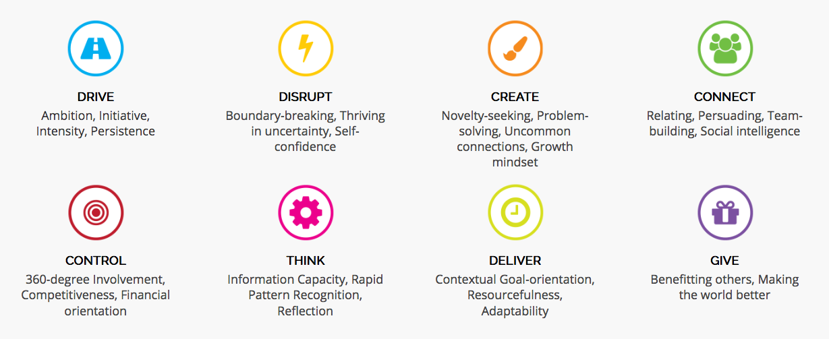
What the Profiler Measures
Notes:
Aesthetic organizing and Self-expression are other motivations associated with Creativity but not correlated with innovation business outcomes.

Slide 12
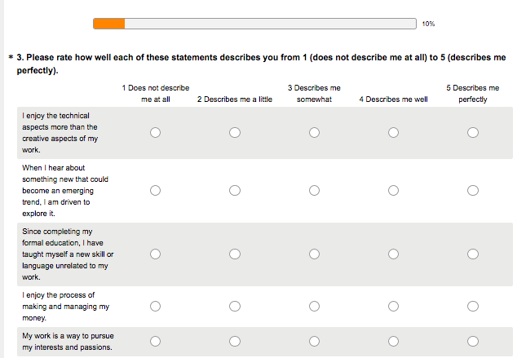
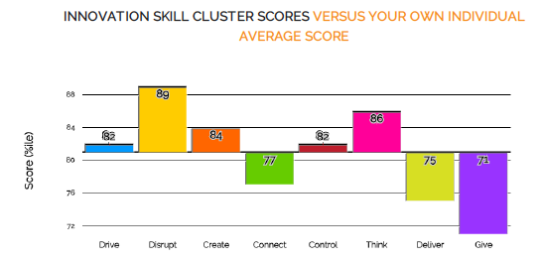
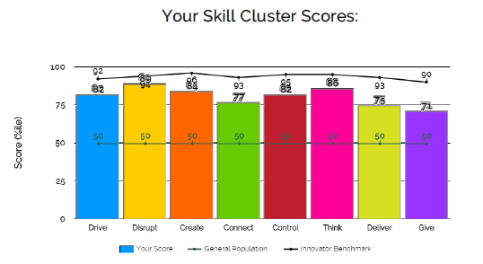
How Swarm works: Assess
Individual takes the Swarm Innovation Profiler.
Individual receives their results instantly.
Innovation Horizon
Personal Strengths
8 Innovation Talents
Notes:
First, employees take our proprietary innovation assessment, based on our own IP, and instantly receive their results.
The 8 skills we measure are the behaviors that correlate strongest with innovation business results.

Slide 13
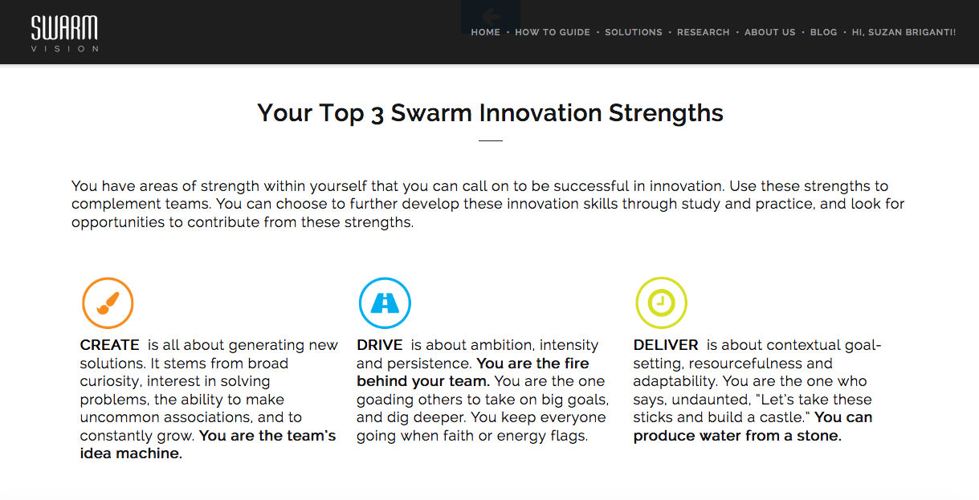
Employee View
Notes:
First, employees take our proprietary innovation assessment, based on our own IP, and instantly receive their results.
The 8 skills we measure are the behaviors that correlate strongest with innovation business results.

Slide 14
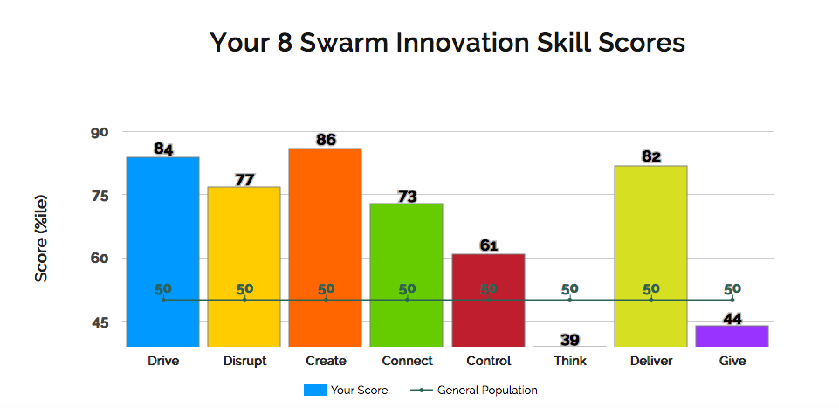
Employee View

Slide 15
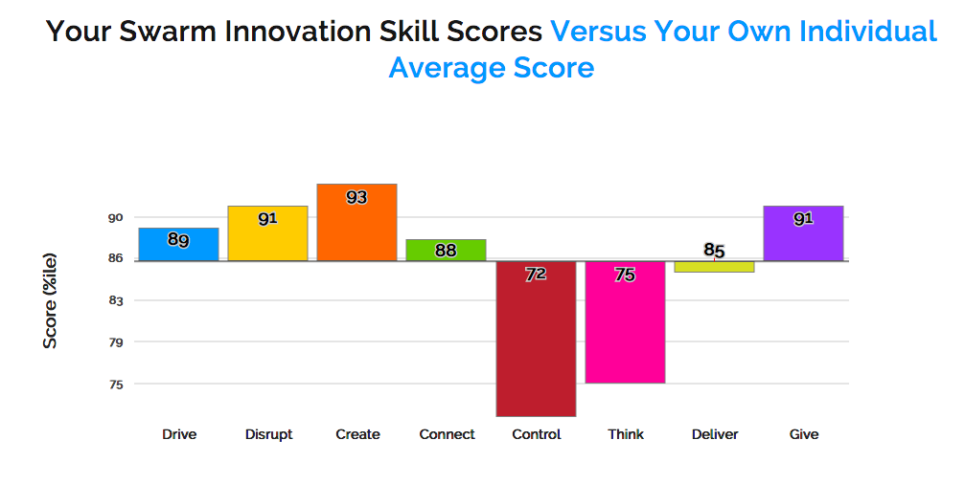
Employee View

Slide 16
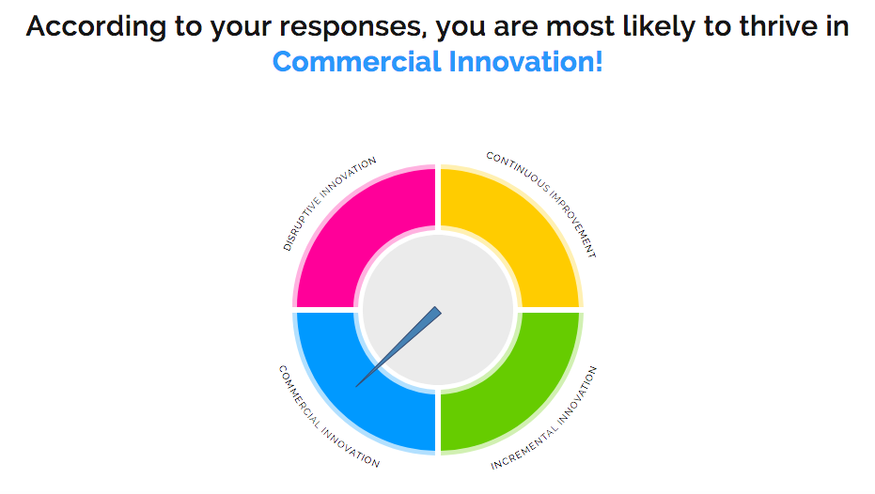
Employee View

Slide 17
Employee View

Slide 18
Employee View

Slide 19
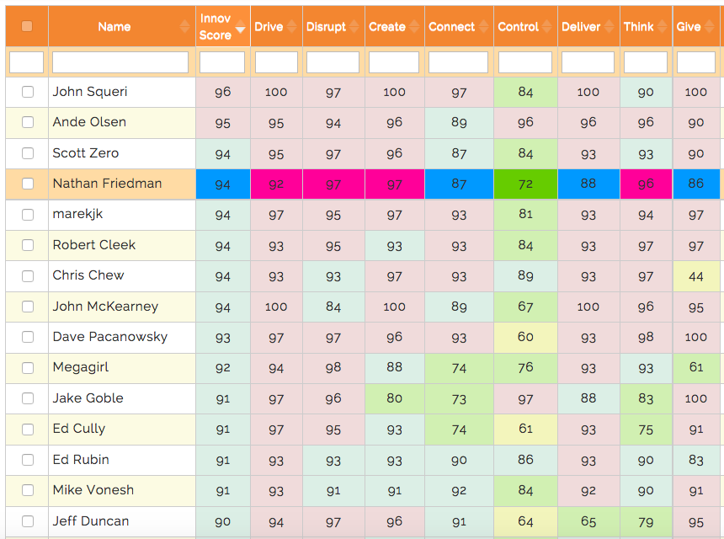
How Swarm works: Analyze
Results are color coded by quartile and innovation horizon
0-24% Continuous improvement
25-49% Incremental Innovation (H1)
50-74% Commercial innovation (H2)
75-100% Disruptive innovation (H3)
Basic: Table View
Sort, filter and search by Innovation Score and Eight Skills
Notes:
Management views all of the results on our dashboard and uses the data to benchmark, track & engage their innovation talent to drive growth. On the right, you see a decline in disruptive innovation talent in a real client company over 2 decades. That’s the kind of Board-level insight our dashboard delivers.
Major use cases:
Discover talent in workforce beyond the usual suspects. Many can contribute beyond stereotypical creative type.
Identify innovation profile of YOUR best talent & teams – search for more like them, scaleably.
Assign talent to innovation initiatives by horizon.
Form stronger teams w coverage of all 8 skills
Drive culture of innovation based on data not guesswork.

Slide 20
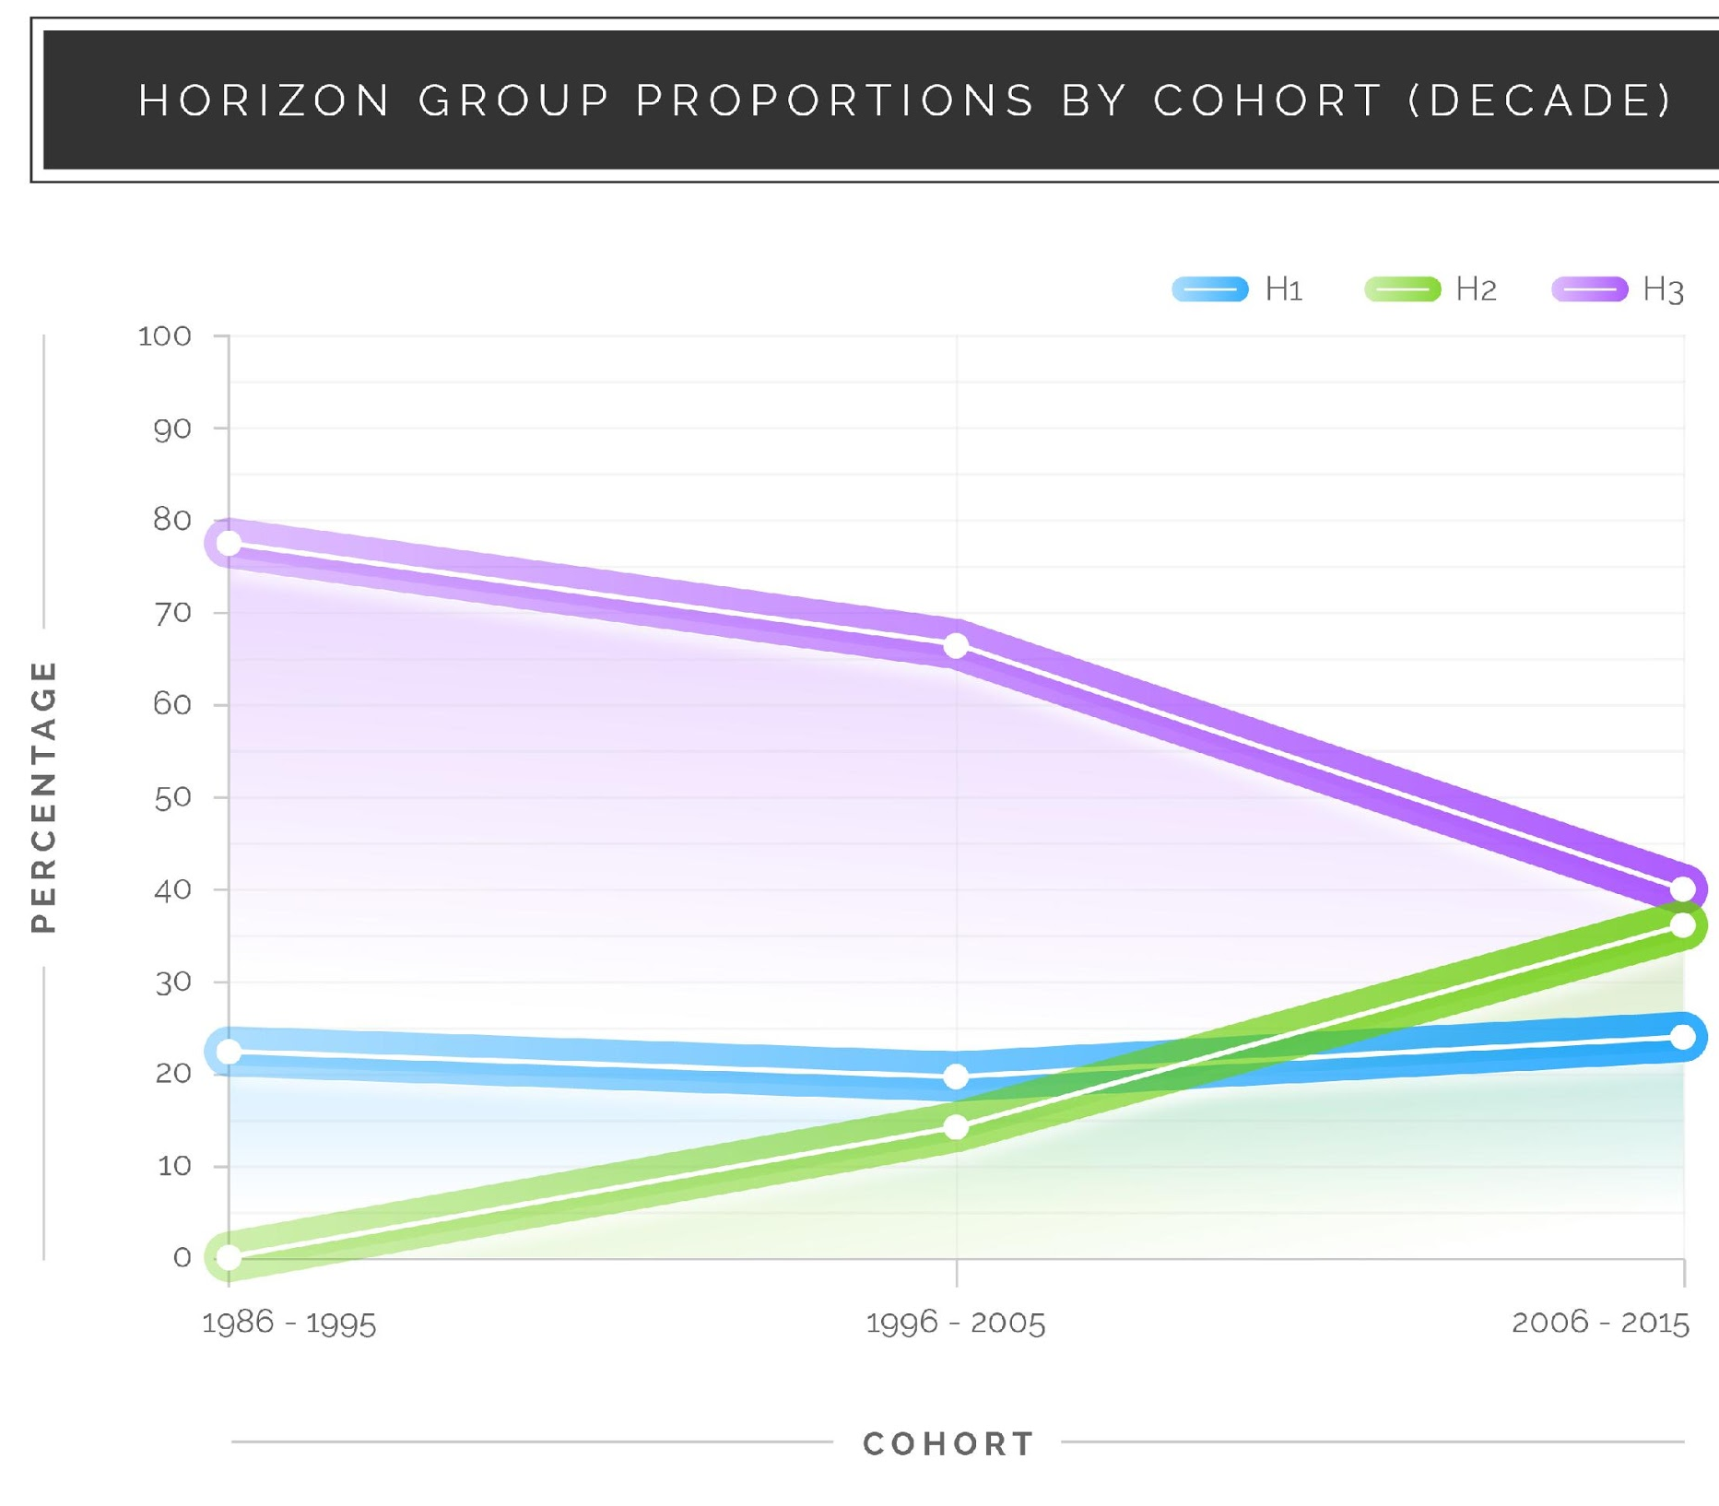
Analyze Innovation Talent Over Time
Pro: Insights View
Analyze innovation talent by location, function, department, hire date.
Notes:
Management views all of the results on our dashboard and uses the data to benchmark, track & engage their innovation talent to drive growth. On the right, you see a decline in disruptive innovation talent in a real client company over 2 decades. That’s the kind of Board-level insight our dashboard delivers.

Slide 21
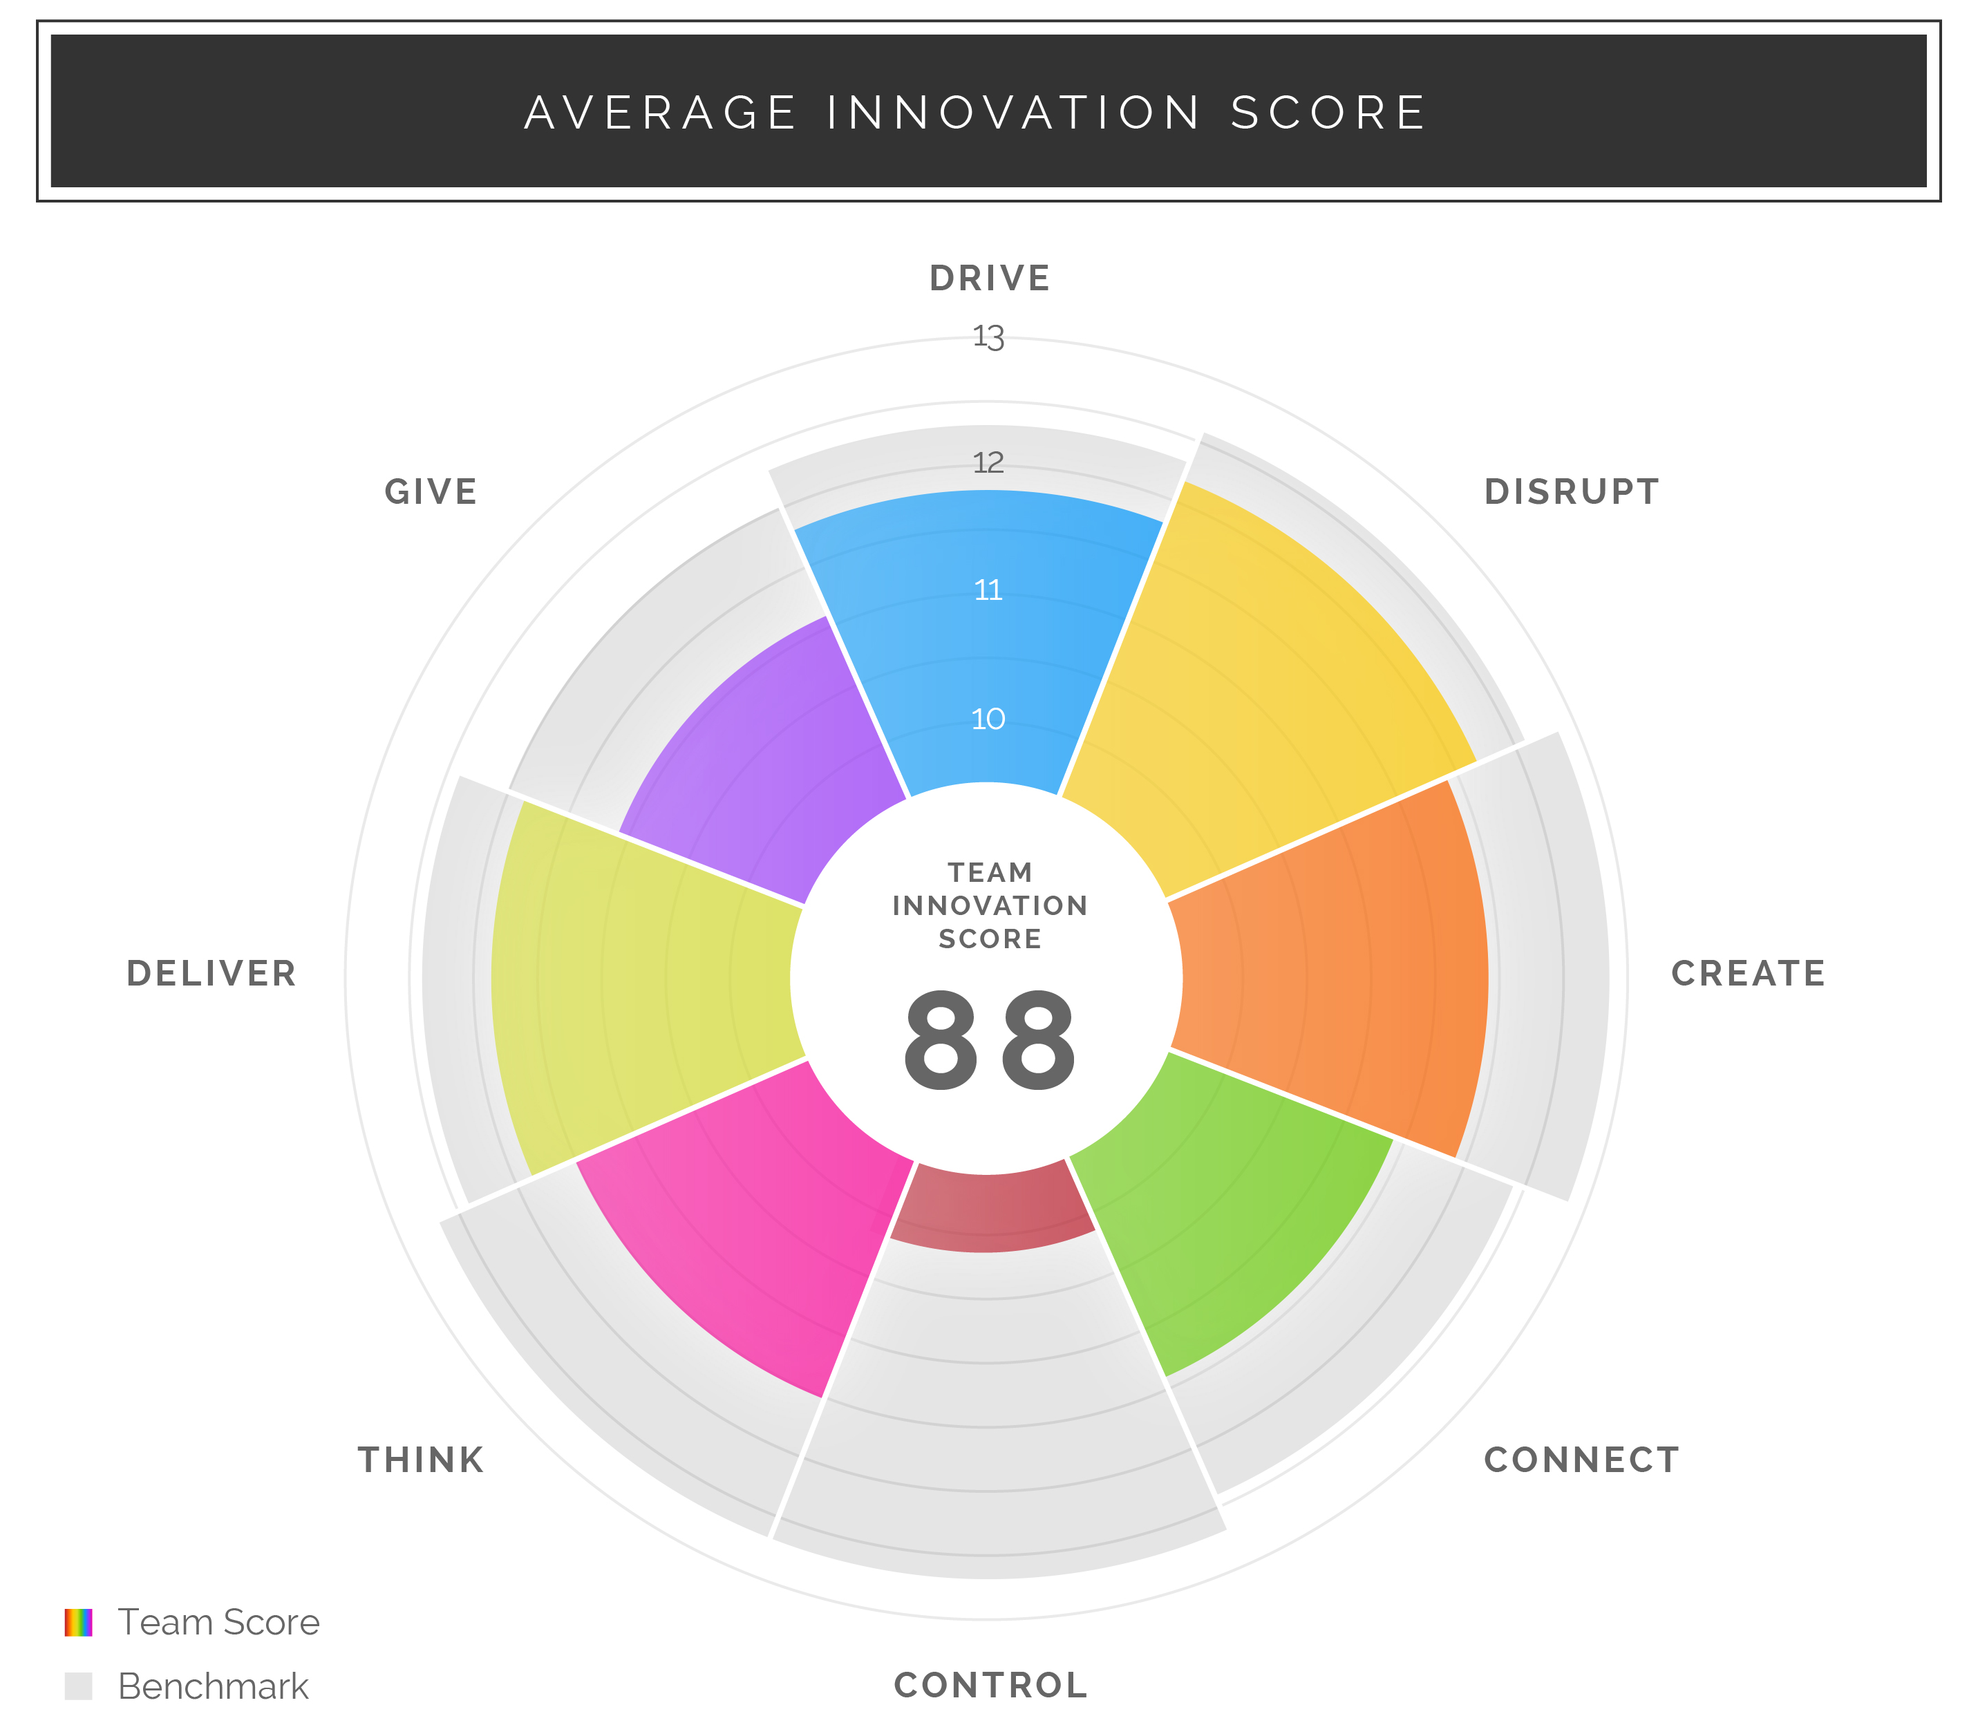
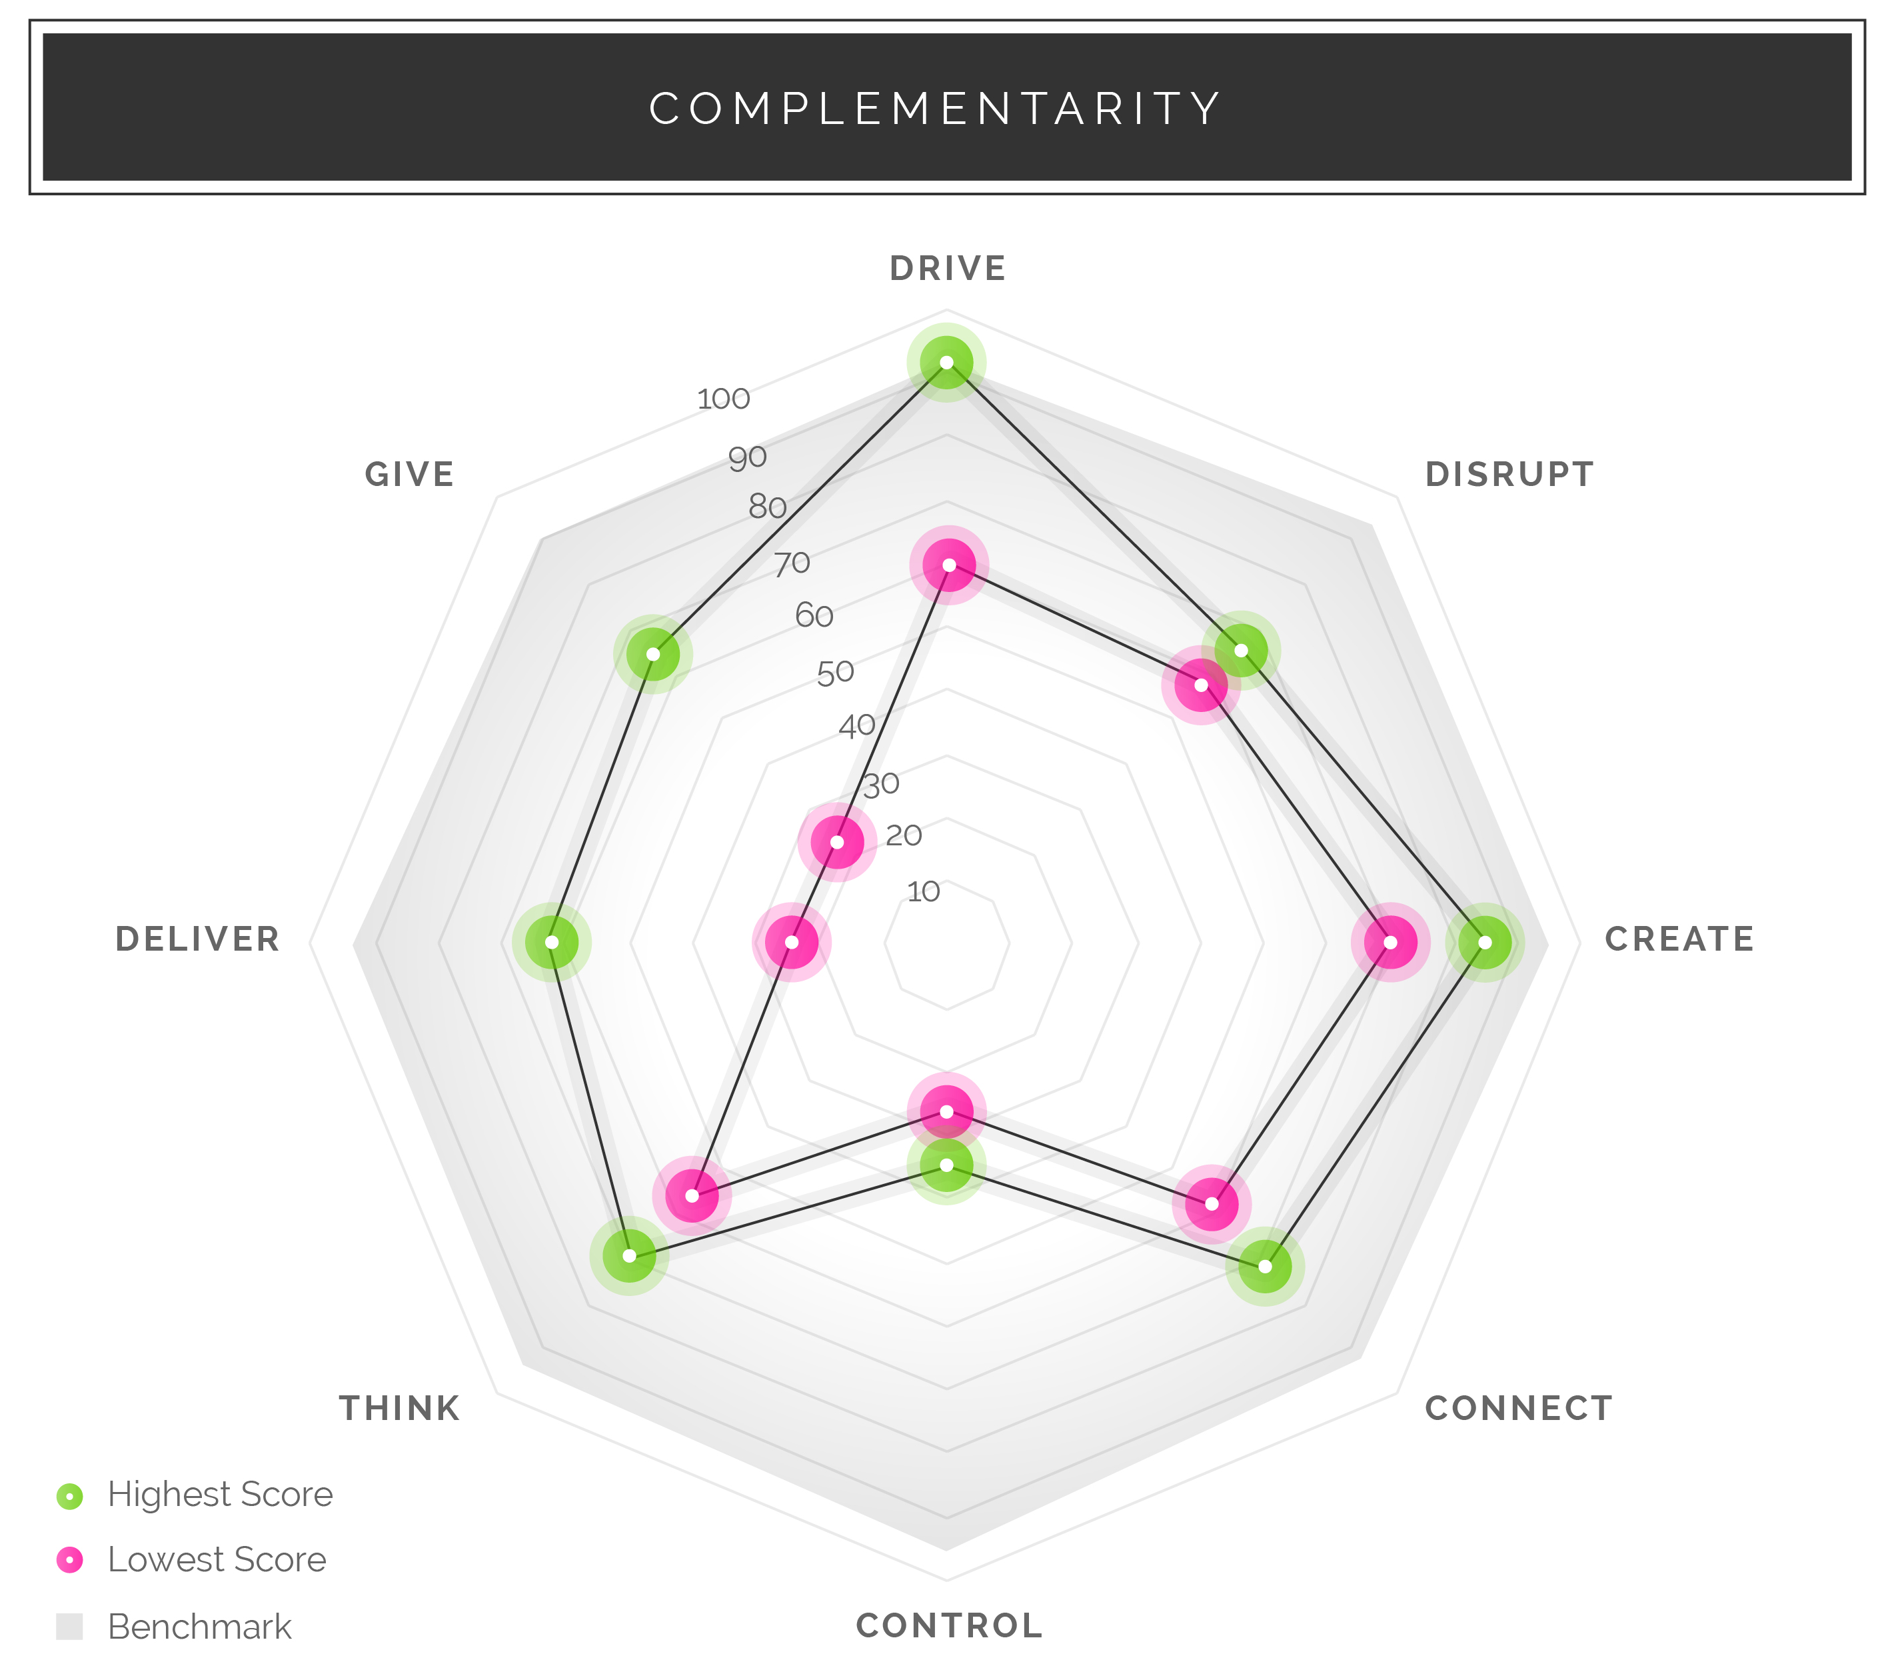
Form and Analyze Teams
Enterprise: Team View
Enterprise: Team View
Analyze teams by Average Innovation Score, Coverage and Complementarity
Notes:
Using our dashboard, built in beautiful D3, managers can see where in the world their innovation talent is, by location, BU & function – and take action to remediate gaps. And coming up, on the right, they will soon be able to form more effective innovation teams, using our team algorithm, and criteria they set.

Slide 22
Understand Your Hiring and Culture Patterns
DISPERSION: 8 INNOVATION SKILLS
Drive
Disrupt
Create
Connect
Control
Think
Deliver
Give

Slide 23
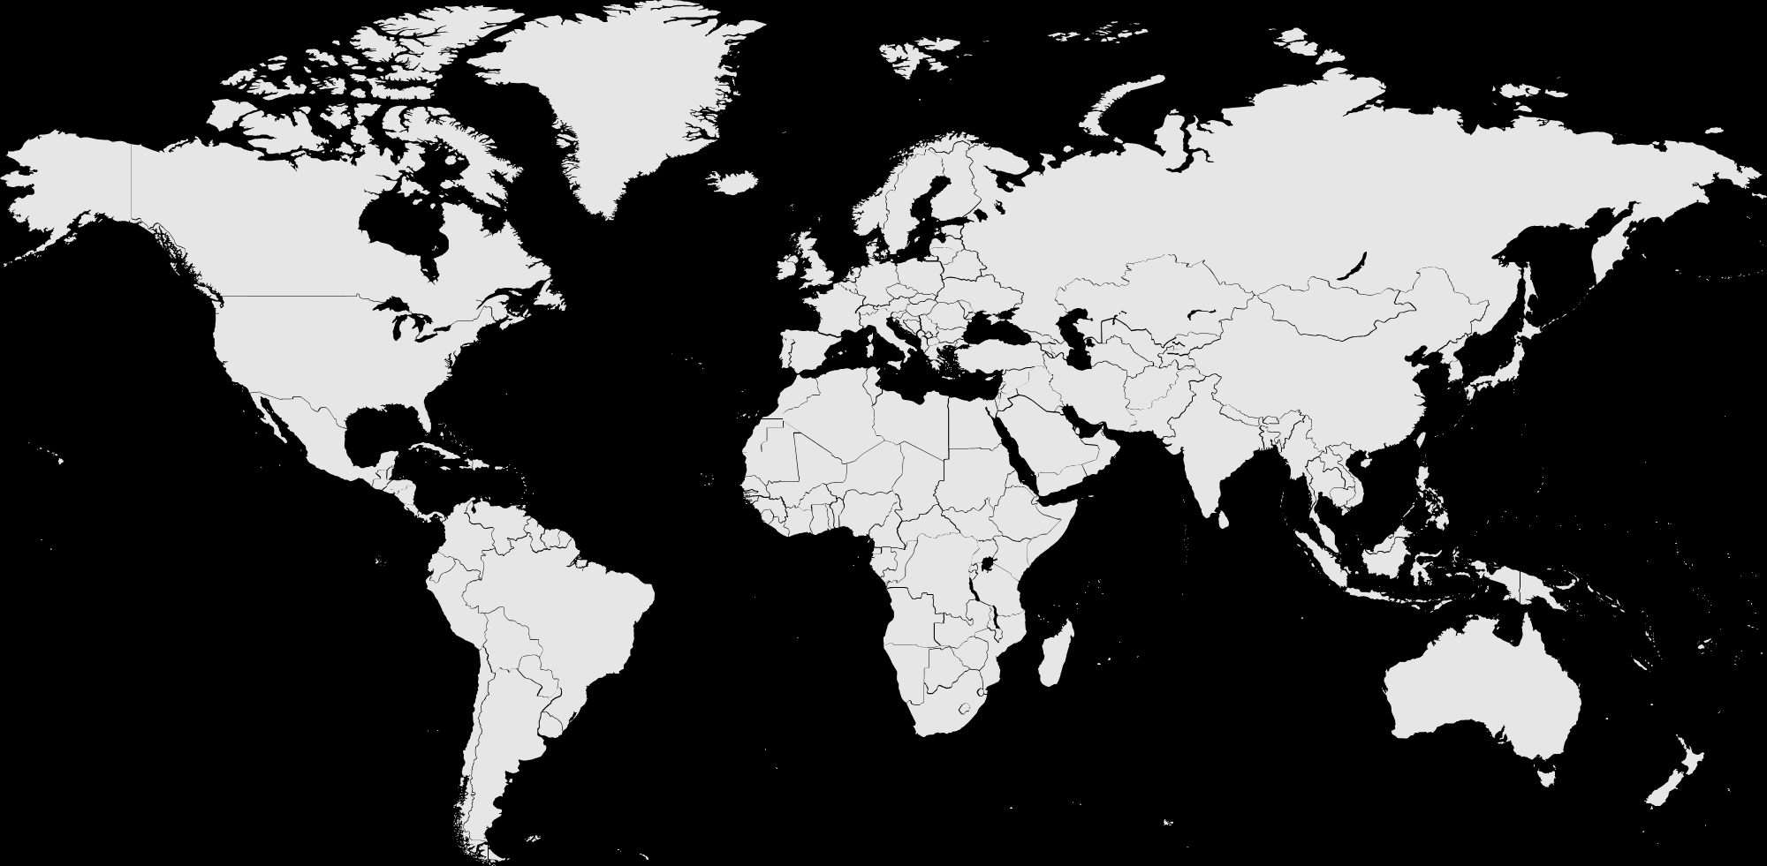
Diagnose and Remediate Gaps by Region
INNOVATION SCORE BY LOCATION
Americas
66
Europe
72
Asia
68
Europe is slightly more innovative than ROW. Perhaps it is of concern that America is lowest!
Note: differences are not statistically significant

Slide 24
Track Your Progress vs. Peers
INNOVATION SCORE VS SELECT COMPANIES

Slide 25
What we learned
Our assessment of innovator talent was highly correlated with the Profile scores
Profile scores partially reflected our assessment of H1, H2, H3 capability
Not all Associates wanted to share their scores
Some skill clusters were more prevalent and others less in our company than in comparison companies
Analysis of aggregate scores by divisions and functions businesses was valuable
Demographic sorts have been valuable: Tenure, geographic region, etc.

Slide 26
Our next explorations
Integrate scores as one data point in talent discussions to create opportunities for Associates to:
Explore or observe innovation work
Demonstrate highly scored capabilities in projects
Meet other Associates with same strengths to learn about their work
Provide insight into assembling more rounded teams
Drill into the skill subclusters for more analysis of strengths and gaps to drive development
Create support for Associates and sponsors to apply the scores and reports to career and development planning

Slide 27
Feel free to reach out:
Debra France
dfrance@wlgore.com

