Slide 1
Winning the Competition for Connection
The case for using advanced technologies to personalize your fundraising practices.

Slide 2
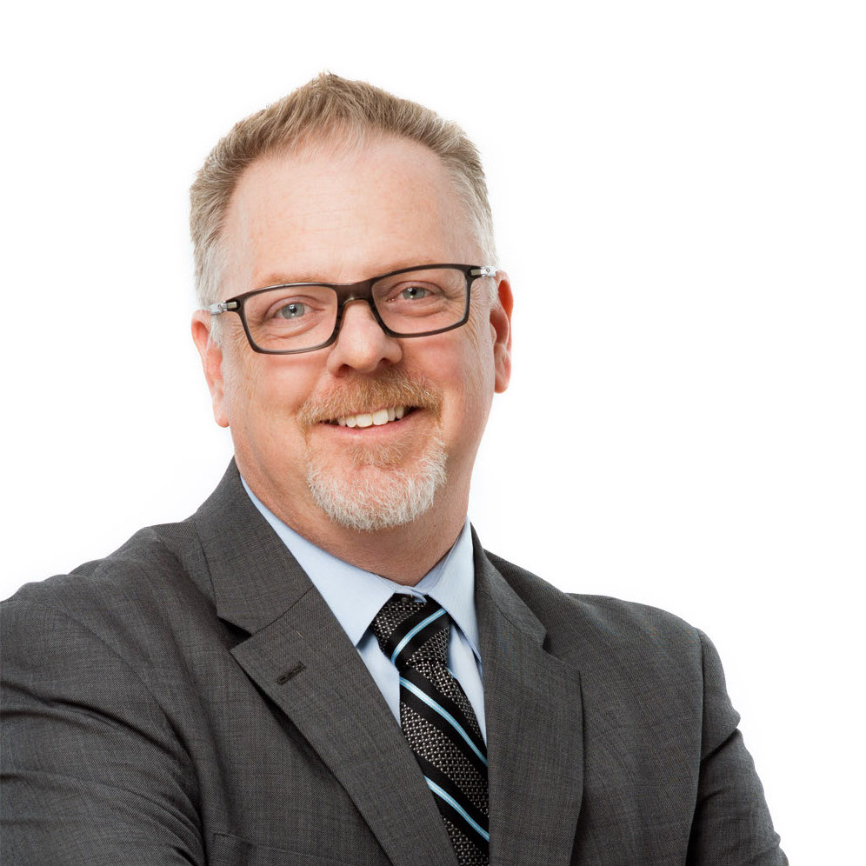
Meet your Presenters
Bill TeDesco CEO & Managing Partner
DonorSearch
Sarah TeDesco
Executive Vice President
DonorSearch
Nathan Chappell Senior Vice President
DonorSearch Ai
aasp Summit | 2022
AFP Global | 2022

Slide 3
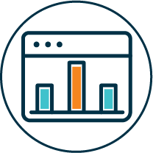
DonorSearch At-A-Glance
Family Owned Business Est. 2007
850+ Data Points
340 Mil+ Individuals
9,000 + Clients
Largest Charitable Giving Data
AI/ML support for nonprofits of all sizes
Ultra high net worth & Core Logic real estate
AFP Global | 2022

Slide 4
Quantifying Connection with Deep Learning
30.7 million+ predictions monthly
33,011 ML models interrogated
17,704,992 Constituents
3,208,318 Donors
40,876,791 Charitable Gifts
$5,775,202,729 in Donations
30,785,429
Clinical Encounters
500,121,848 Emails Sent
3,650,387
Event Invitations
View from the Field | Part 2
AFP Global | 2022
Notes:
5.4 BILLION CALCULATIONS PER MONTH
Predictions Created to Date: 108,331,289
DSAi Trends (NEED TO DECIDE WHICH TO USE)
5x effort required when using Wealth vs Ai
9x donors acquired using Ai vs Wealth
6.5 dollars raised using AI vs Wealth

Slide 5
Before We Begin…
Think about these questions:
Do you interact with AI in your daily life?
What are your feelings about AI?
Do you use AI at work?
Do you think AI can help you and your nonprofit be more effective?
Write down your answers, will come back to it!
AFP Global | 2022

Slide 6
Remember Those Questions?
Do you interact with AI in your daily life?
Do you use AI at work?
Nonprofit-specific AI is reaching less than 23% of nonprofits
AFP Global | 2022
Notes:
Nonprofit practitioners are aware of AI, but have reservations ⁃ 59% of nonprofits hear about AI from their CRM provider ⁃ 83% of nonprofits believe an ethical framework needs to be defined before full adoption of AI in the sector 2. Nonprofit-specific AI is not widely adopted today, but it is beginning ⁃ Most nonprofits are using well known apps (e.g., Gmail or Facebook suggestions), while nonprofit-specific AI is reaching less than 23% of nonprofits ⁃ 73% of nonprofits believe AI innovation aligns with their beliefs and 75% believe AI makes their life easie

Slide 7
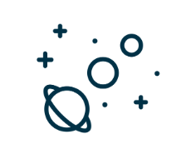
Remember Those Questions?
The State of Artificial Intelligence in the Nonprofit Sector, 2019
75% believe AI makes their life easier
73% of nonprofits believe AI innovation aligns with their beliefs
83%
People believe there needs to be an ethical framework in place before wider adoption
52% of people are afraid of AI
AFP Global | 2022
Notes:
Nonprofit practitioners are aware of AI, but have reservations ⁃ 59% of nonprofits hear about AI from their CRM provider ⁃ 83% of nonprofits believe an ethical framework needs to be defined before full adoption of AI in the sector 2. Nonprofit-specific AI is not widely adopted today, but it is beginning ⁃ Most nonprofits are using well known apps (e.g., Gmail or Facebook suggestions), while nonprofit-specific AI is reaching less than 23% of nonprofits ⁃ 73% of nonprofits believe AI innovation aligns with their beliefs and 75% believe AI makes their life easie

Slide 8
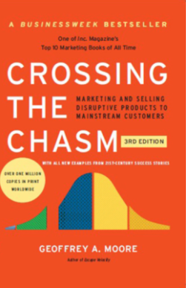
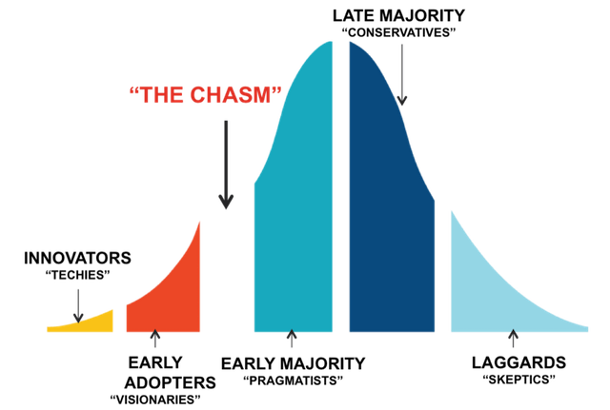
What’s Your Adoption Rate?
SOLUTION OVERVIEW
Notes:
Concentrated effort and focus to improve your efforts
Break down silos
Dynamic scoring
Bringing engagement & experiential data, philanthropic & wealth data into one profile
Major gifts have the highest ROI and are given by a small portion of the population
Need to be strategice
Datasets are needed to provide a more holistic way of predicting likelihood and segmenting capacity:

Slide 9
So What?
What does connection have to do with the psychology of giving?
aasp Summit | 2022
AFP Global | 2022

Slide 10
Everything.
aasp Summit | 2022
AFP Global | 2022

Slide 11
aasp Summit | 2022
AFP Global | 2022

Slide 12
Responsibility diminishes as connection to the mission becomes less personal.
The competition for connection has a direct (negative) impact charitable giving.
aasp Summit | 2022
AFP Global | 2022

Slide 13
“The future of generosity in America is not guaranteed.”
Generosity Commission, 2021
“Relative to 2000, 20 million fewer American households give— with the steepest declines among Millennials.”
aasp Summit | 2022
AFP Global | 2022

Slide 14
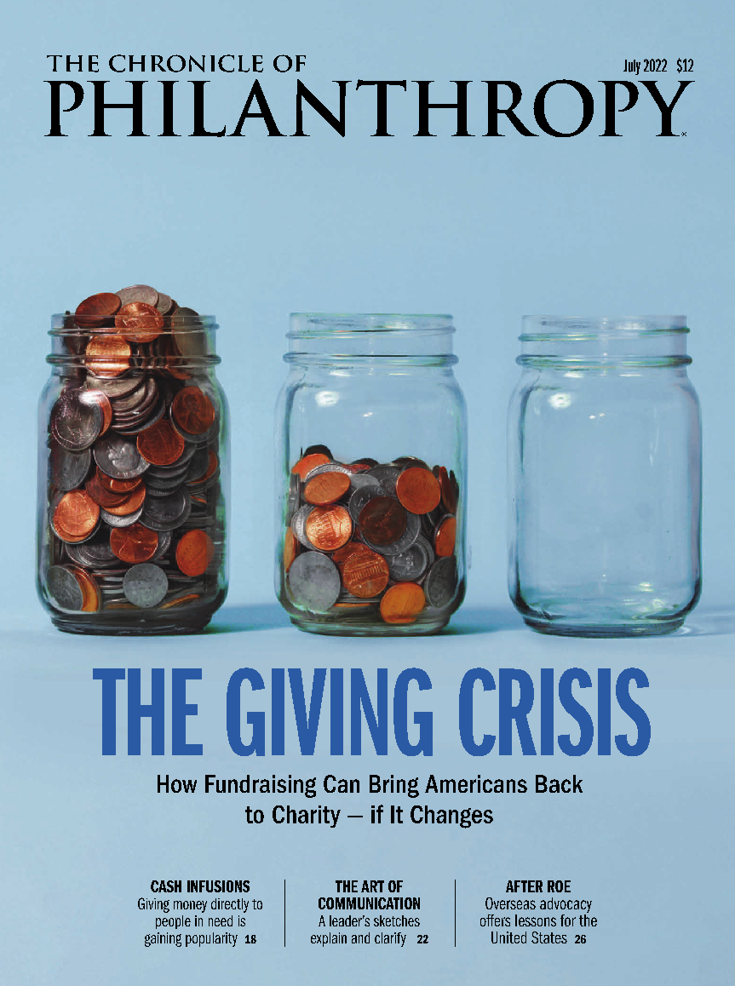
% of Households that Give to Nonprofit Orgs
Giving USA: -16%
Gallup: -13%
Where does this end?
aasp Summit | 2022
AFP Global | 2022

Slide 15
In 2021, total giving remained flat from 2020
$14.9 billion came from Mega Gifts ($350M+)
Compared to $10.1 billion in 2020
$4.8 billion less from non-Mega Gifts
aasp Summit | 2022
AFP Global | 2022
Notes:
Mega Gifts ($350M+) were $14.9 billion in 2021 as compared to $10.1 billion in 2020, thus $4.8 billion less was contributed by non-UHNW individuals.
With an average gift of $813 for non-UHNW individuals, this equates to over 5.9 million fewer charitable gift transactions given by individuals in 2021 alone.

Slide 16
With an average gift of $131 for non-UHNW individuals, more than 34.8 million fewer charitable gifts were made in 2021.
aasp Summit | 2022
AFP Global | 2022
Notes:
Mega Gifts ($350M+) were $14.9 billion in 2021 as compared to $10.1 billion in 2020, thus $4.8 billion less was contributed by non-UHNW individuals.
With an average gift of $813 for non-UHNW individuals, this equates to over 5.9 million fewer charitable gift transactions given by individuals in 2021 alone.

Slide 17
What would it look like
if everyone stopped giving?
aasp Summit | 2022
AFP Global | 2022

Slide 18
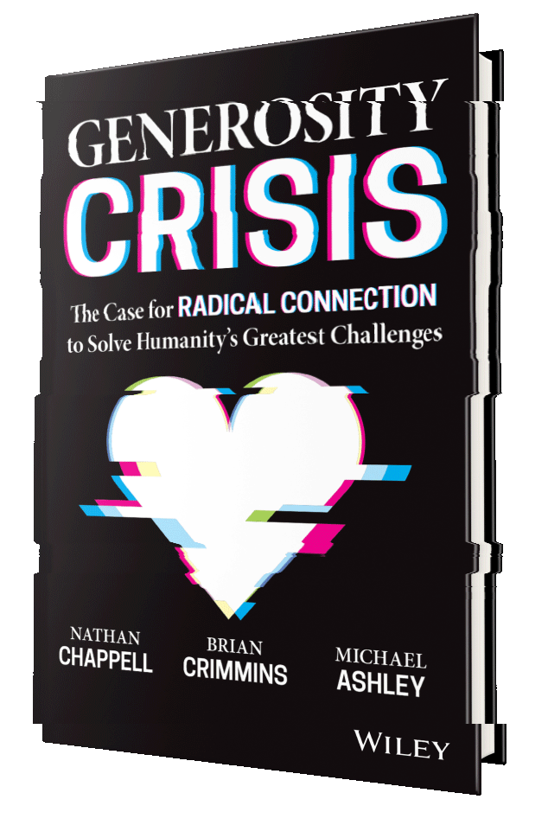
AVAILABLE
AVAILABLE
AVAILABLE
NOVEMBER 15
Notes:
We wrote the Generosity Crisis as a way to spark conversation about generosity… the good and the bad - and to create awareness

Slide 19
Competition for Connection
Attention is no longer sufficient.
“This is a race to the bottom of the brainstem”. – Tristan Harris, Social Dilemma
aasp Summit | 2022
AFP Global | 2022

Slide 20
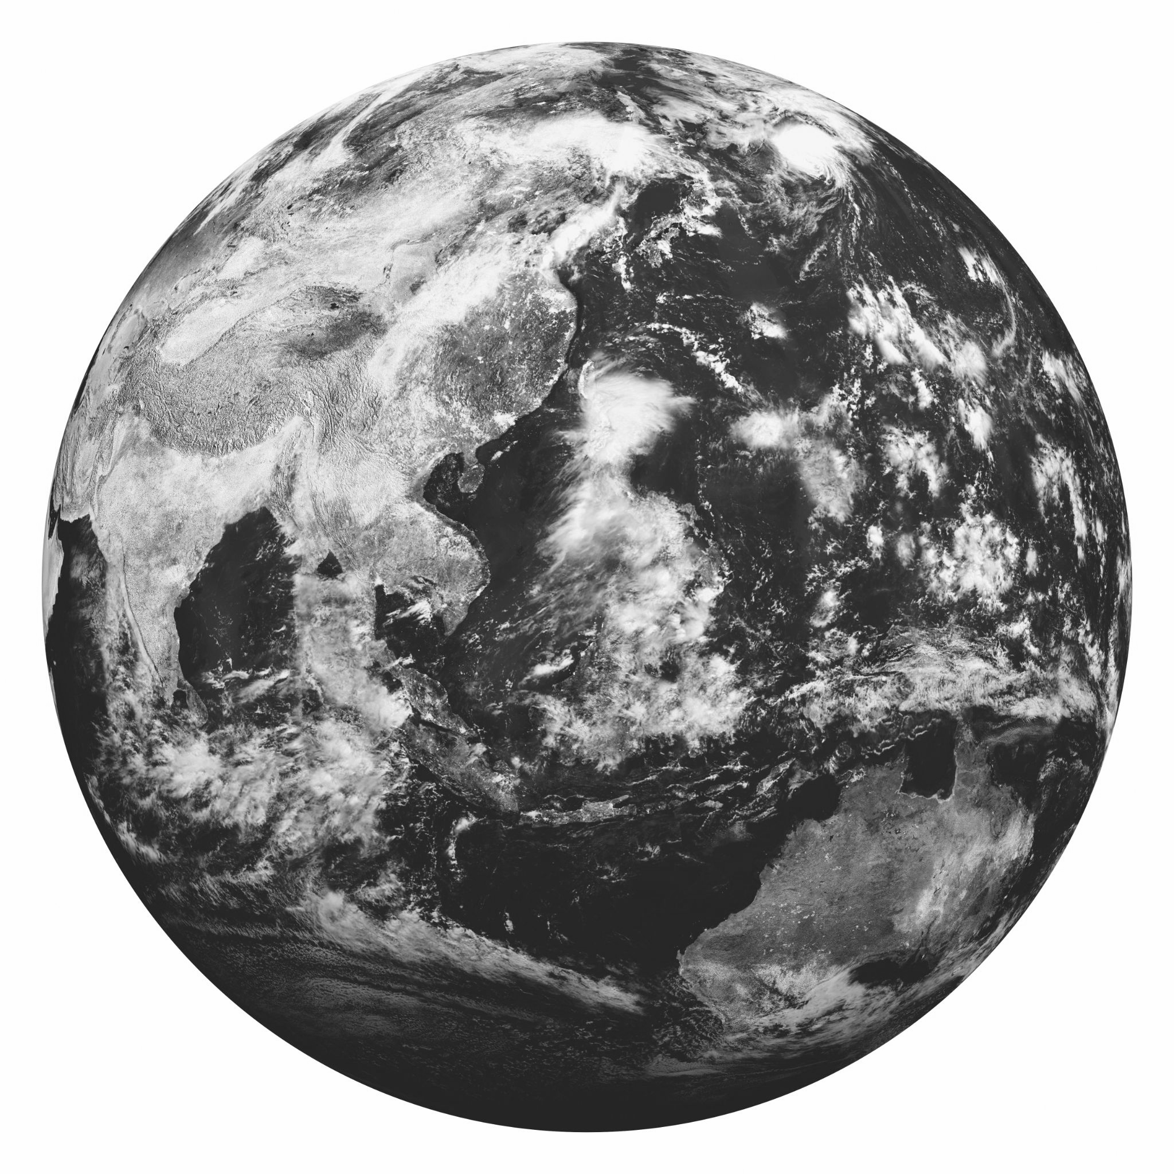
Big Data +
97 zettabytes (97 trillion gigabytes) of data generated
Today it would take a person approximately 181 million years to download all the data from the internet
aasp Summit | 2022
AFP Global | 2022
Notes:
So we all hear about ‘big data’ but how big is it really?
97 zettabytes created … a zettabyte is one trillion gigabytes or a billion terrabytes
projected to almost double by 2025
For perspective, one hour of iphone video is around 5.5 Gb. To create 97 zettabytes, you’d have to film continuously for over 2 million years
Former Google CEO Eric Schmidt said that from the very beginning of humanity until the year 2003
an estimated 0.5% of one zettabyte was created
Data has increased nearly 20,000x since then
181 million years to download all of the data
Storage wise, if you downloaded all of this data on the largest capacity ipad pro (2TB), and stacked them high it would take you 2/3 the way to the moon.
what does big data mean for big businesses?

Slide 21
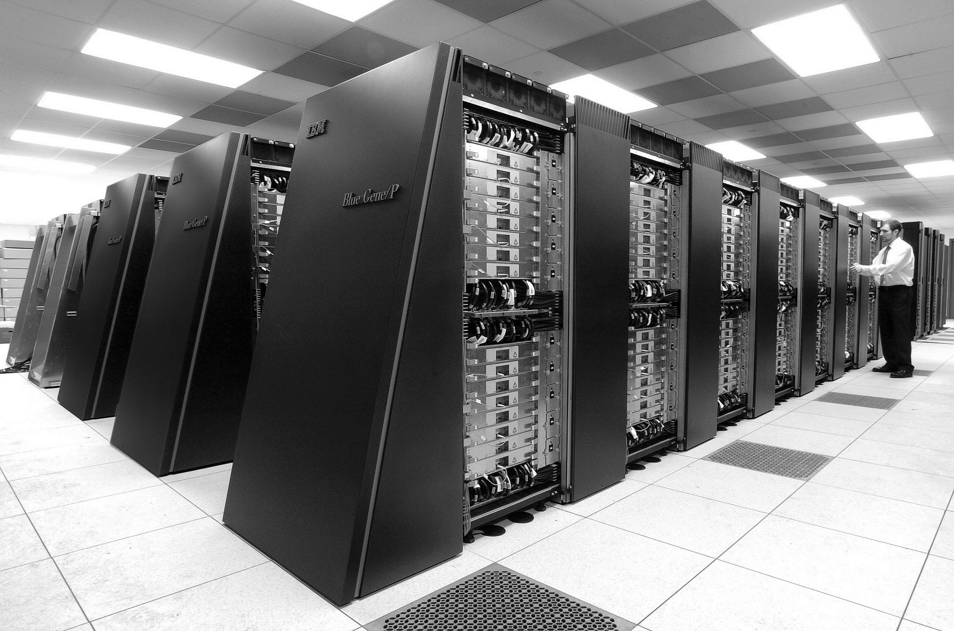
Big Data + Big Computing
97.2% of organizations are investing in big data and AI
96% of companies expect positive outcomes from AI investments
The global artificial intelligence industry is expected to grow from $59.6 billion in 2021 to $422 billion by 2028
aasp Summit | 2022
AFP Global | 2022

Slide 22
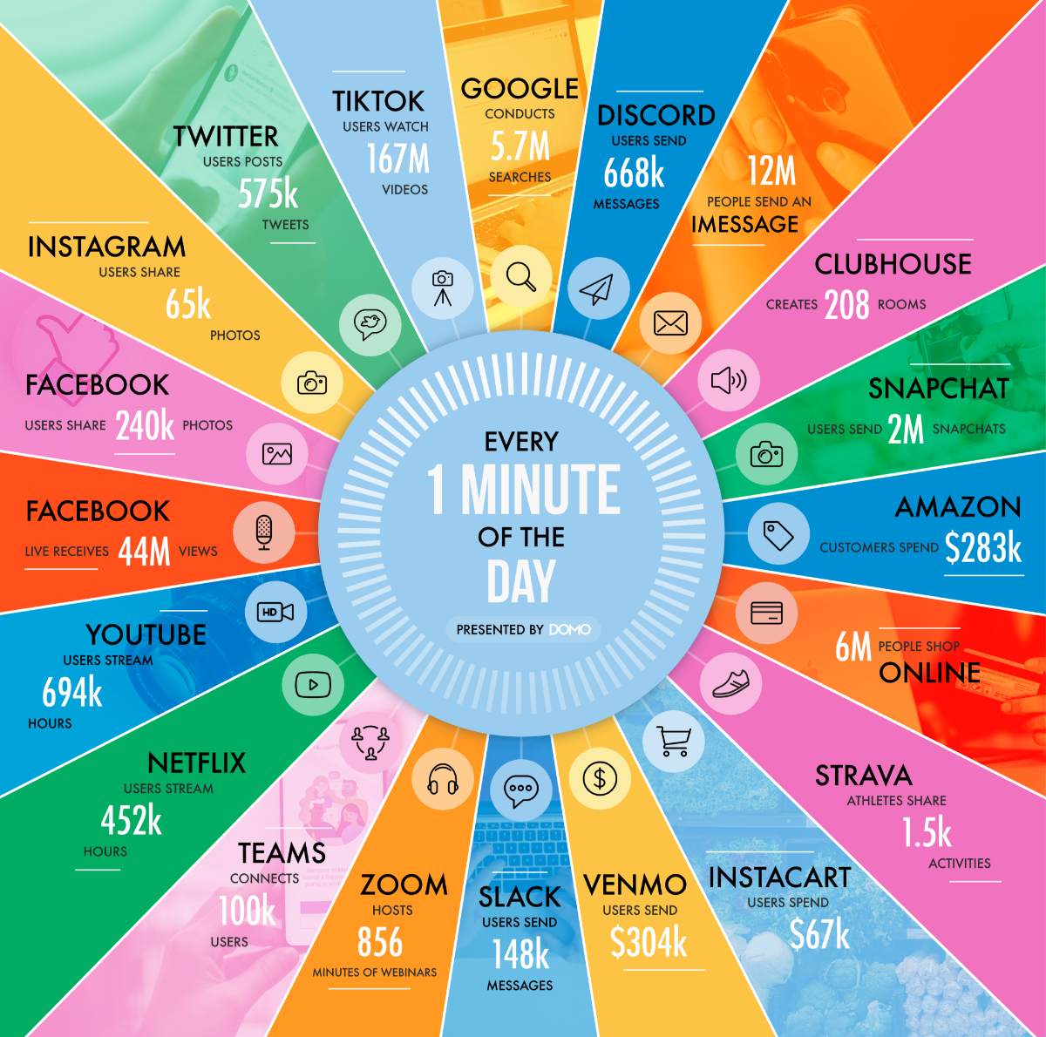
Big Data + Big Computing
= Big Business
The average person receives 333.2 emails and sees 4k-10k ad images a day.
That’s 121 thousand emails and 7.3 million ad images a year.
What is Netflix’s biggest competition?
aasp Summit | 2022
AFP Global | 2022
Notes:
This is a race to the bottom of the brainstem - Tristan Harris
The average person receives 333.2 emails a day, (increasing to 376.5 per day by 2025).
The average person sees between 4,000 and 10,000 ads in a single day. (was just 500 per day in 1970)
Most users have more than 80 apps installed on their phones. (TechJury
Most smart phone users have use 9 apps per day on average and 30 apps per month.

Slide 23
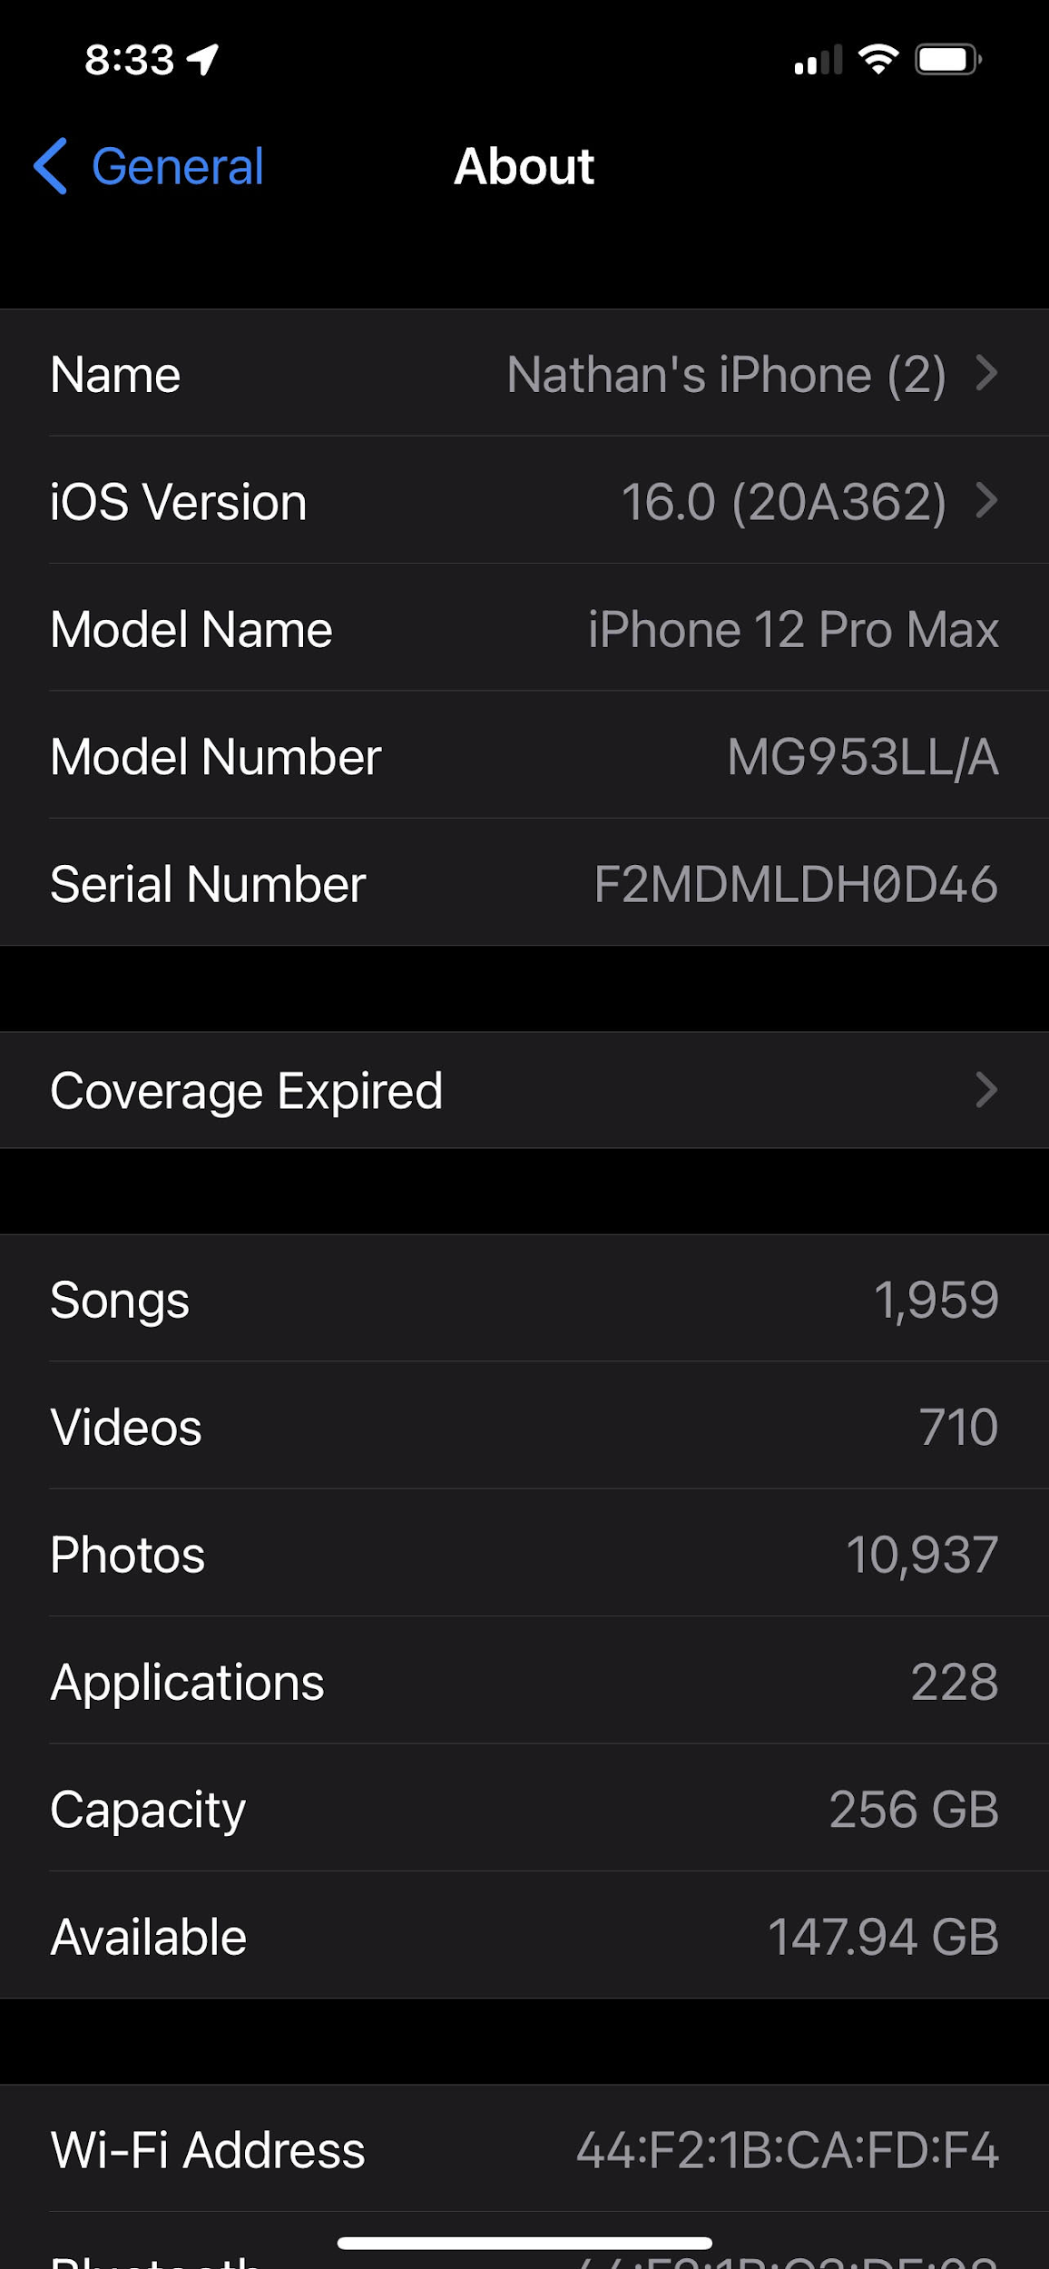
Competition for Connection
Your attention is loss leader.
Your association is big business.
Your connection is the holy grail.
aasp Summit | 2022
AFP Global | 2022
Notes:
Association = something you think of when you think of something else.
Connection = relationship between two things.

Slide 24
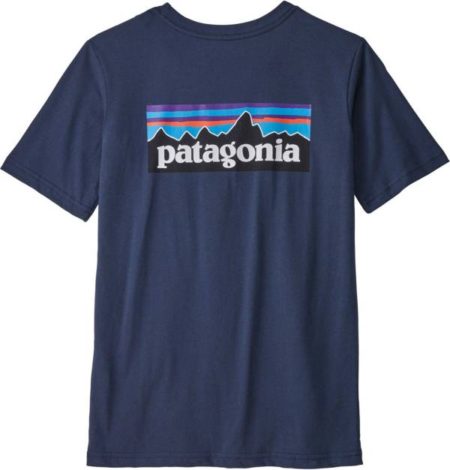
A Changing Definition of Philanthropy?
MISSION
"We're in business to save our home planet.”
VALUES
"Human Rights & Dignity
Social & Economic Justice
Environmental Protection, Restoration, & Regeneration”
PURPOSE
"The Body Shop exists to fight for a fairer, more beautiful world."
aasp Summit | 2022
AFP Global | 2022
Notes:
Newman’s own: 100% of its profits and royalties to nonprofit organizations
Bombas: donates a pair of socks for every pair sold
Patagonia Vision: “use of all its resources to protect life on Earth.”
The Body Shop: green peace, save the whales, equity and protetction of women and girls

Slide 25
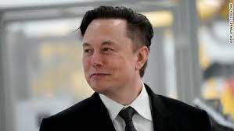
A Changing Definition of Philanthropy?
"SpaceX, Tesla, Neuralink and The Boring Company are philanthropy. If you say philanthropy is love of humanity, they are philanthropy. Tesla is accelerating sustainable energy. This is a love of philanthropy." Elon Musk
aasp Summit | 2022
AFP Global | 2022

Slide 26
Who Wins This Game?
More than half of consumers would stop buying from brands that defy their personal values
But are for-profit businesses incentivized to build and sustain authentic connection?
aasp Summit | 2022
AFP Global | 2022

Slide 27
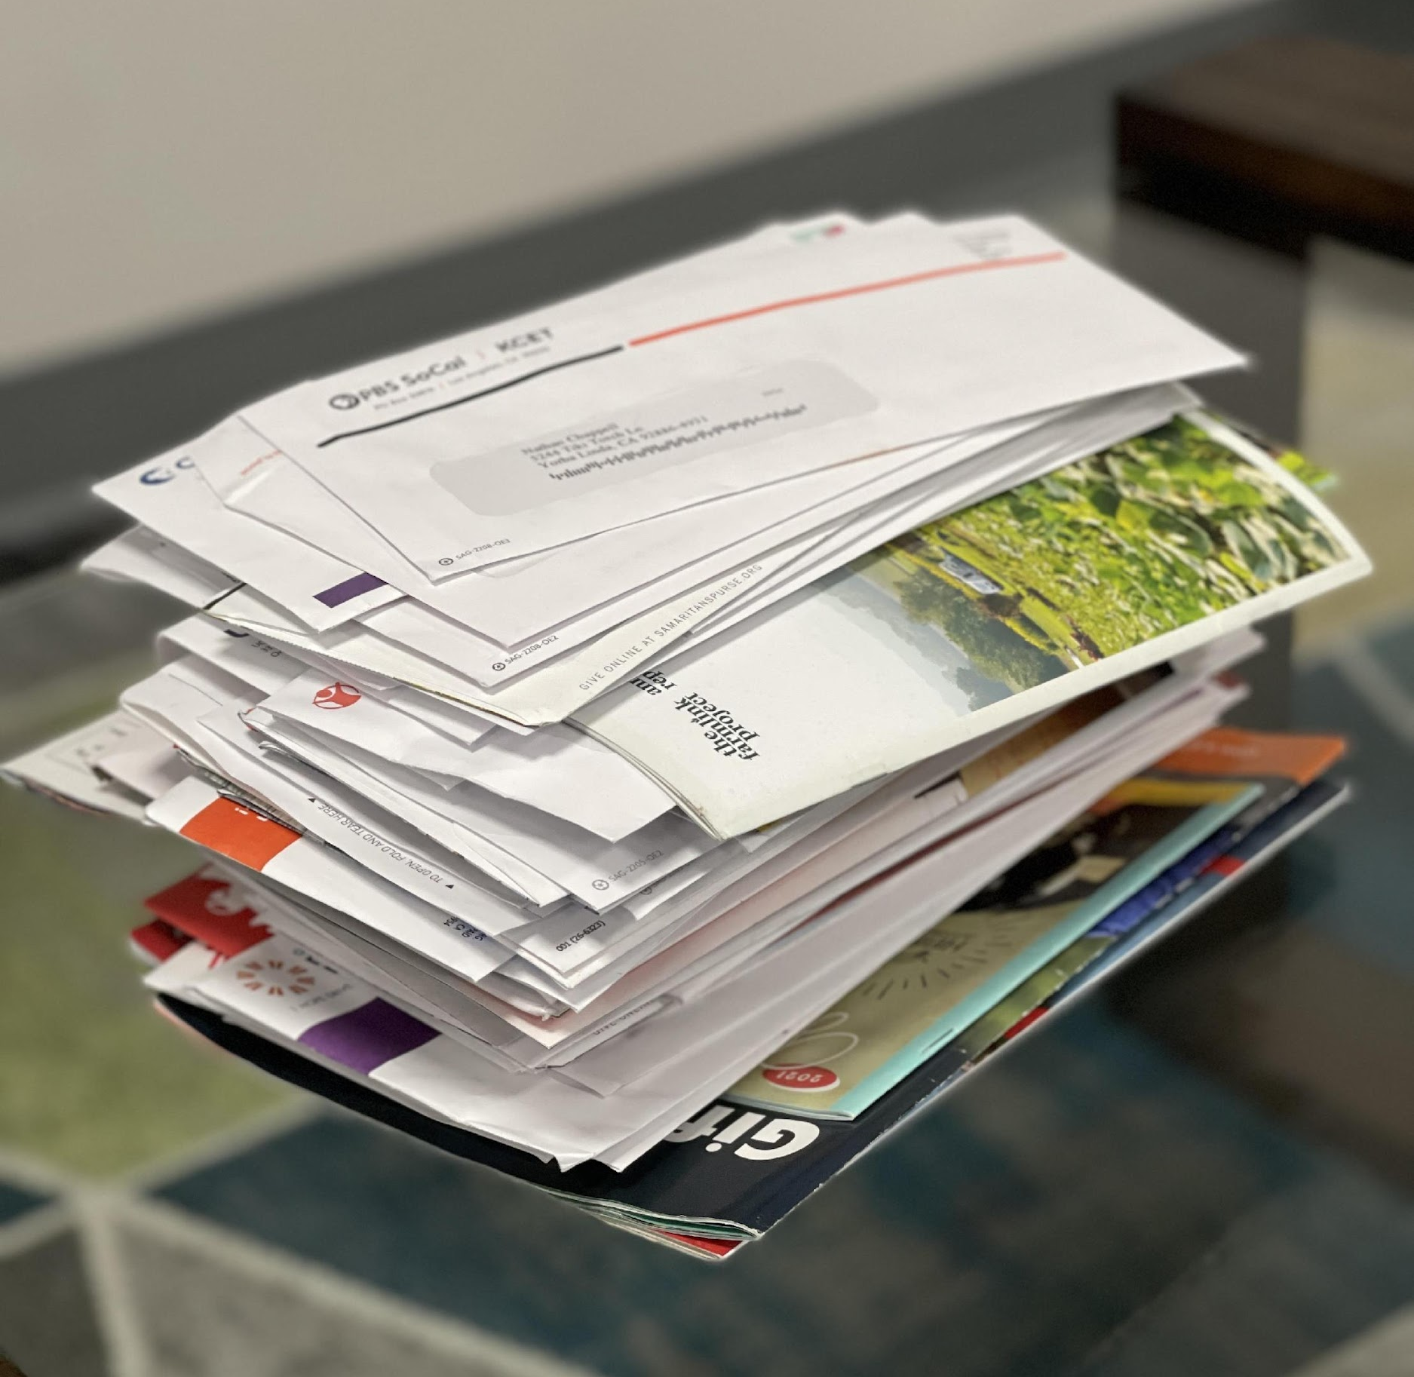
Are Nonprofits Keeping Up?
1.5 million nonprofits, competing via omni-channel
Reinforced transactional fundraising with spray and pray
In 9.5 months
95 mail solicitations (14 from 1)
487 email solicitations
Given to 7 orgs
aasp Summit | 2022
AFP Global | 2022

Slide 28
Nonprofits are built to bring people together,
to accomplish things that neither could do alone.
To inspire more giving, we must adopt a new golden rule.
aasp Summit | 2022
AFP Global | 2022

Slide 29
Generosity is the Manifestation of Radical Connection
aasp Summit | 2022
AFP Global | 2022

Slide 30
Embracing a New Connection Paradigm
Traditional Connection (Association) Radical Connection
Surface level Deep connection
Mere preference Love something
Do as little as possible Go out of your way (to make it happen)
Mention in passing Share with everyone you know
Second degree affiliation Primary affiliation and part if your identity
Forms an opinion Fosters a visceral reaction
It’s nice when you have it Something you crave & miss when you don’t have it
Can take it or leave it Would sacrifice to get it
Neutral Brings joy, meaning, purpose
Happens one time then forgotten Happens one time and stays with you forever
Something that you did once Something that becomes part of your legacy
I know them or they know me When I know them, and they know me
aasp Summit | 2022
AFP Global | 2022

Slide 31
A New Frontier for Nonprofits
BIG DATA
For the first time in history, we’re able to quantify connection in real-time.
ARTIFICIAL INTELLIGENCE
FAST COMPUTING POWER
AFFORDABLE COMPUTING POWER
aasp Summit | 2022
AFP Global | 2022

Slide 32
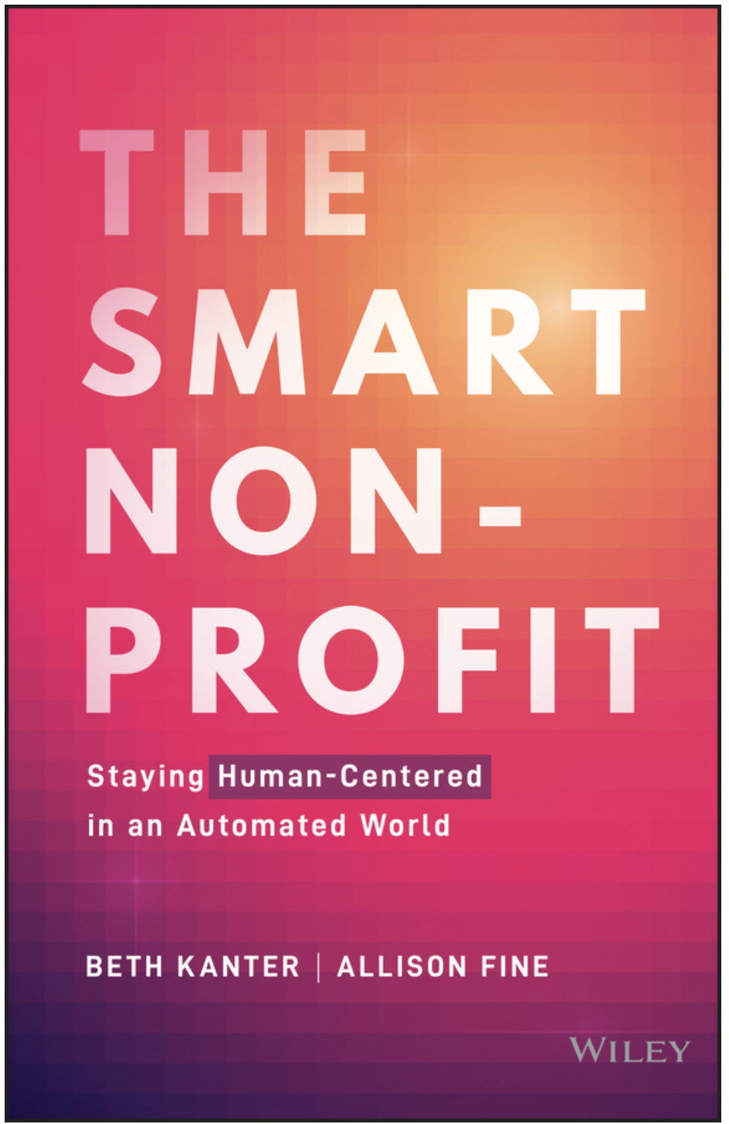
Where are We At?
“We are at a tipping point for sector-wide adoption of AI systems and practices. The philanthropic and nonprofit sectors have an opportunity to proactively shape this next era and ensure that at least a significant portion of the technology remains dedicated to the values underpinning philanthropy such as generosity, empathy and transparency.”
Beth Kanter, Allison Fine
2020 AI4GIVING REPORT
aasp Summit | 2022
AFP Global | 2022

Slide 33
S
Modern Analytics for A Modern Era
RFM
Modeling
Scoring/Ranking Models
Deep Learning Models
Standard Predictive Models
EXPERIENCES
GIVING PATTERNS
GIVING PATTERNS
GIVING PATTERNS
DEMOGRAPHICS
GIVING PATTERNS
WEALTH
INDICATORS
DEMOGRAPHICS
GIVING PATTERNS
DEMOGRAPHICS
WEALTH
INDICATORS
WEALTH INDICATORS
aasp Summit | 2022
AFP Global | 2022

Slide 34
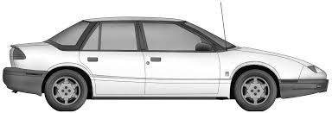
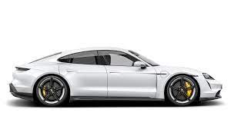
S
Modern Analytics for A Modern Era
RFM
Modeling
Scoring/Ranking Models
Dynamic ML/DL Models
Standard Predictive Models
aasp Summit | 2022
AFP Global | 2022
Notes:
Porsche TYCAN

Slide 35
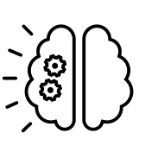
Six Advanced Technologies are Changing Fundraising Practices
ML / DL
NLP
Crypto
Predictions
Personalization
Options
Blockchain
NFT
AR/VR
Accountability
Events
Empathy
AFP Global | 2022

Slide 36
A New Way of Thinking
“The value of your database is can’t not be measured in terms of wealth but must be quantified by the depth of connection.”
How do you measure it?
aasp Summit | 2022
AFP Global | 2022

Slide 37
Internal Data (50-200 Data Points)
External Data (850+ Data Points)
Gift Officer Outreach
Purchases & Event Info
Demographic
Information
Business Information
Giving History
Email Activity
Charitable Giving
Real Estate
+
Your Constituents
Your Constituents
Clinical History
Purchase/ Membership History
Consumer Information
Stock Holdings
Academic/ Alumni History
Volunteer History
Board Membership
Family Foundation
aasp Summit | 2022
AFP Global | 2022

Slide 38
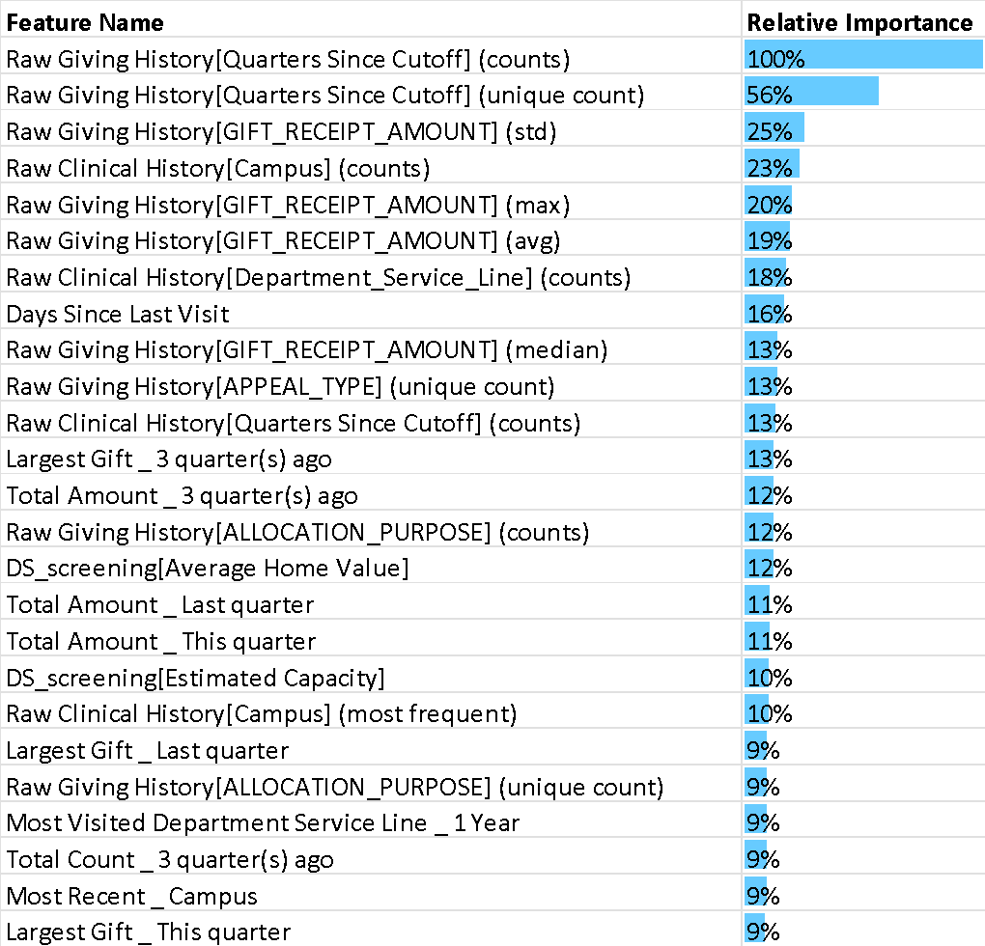
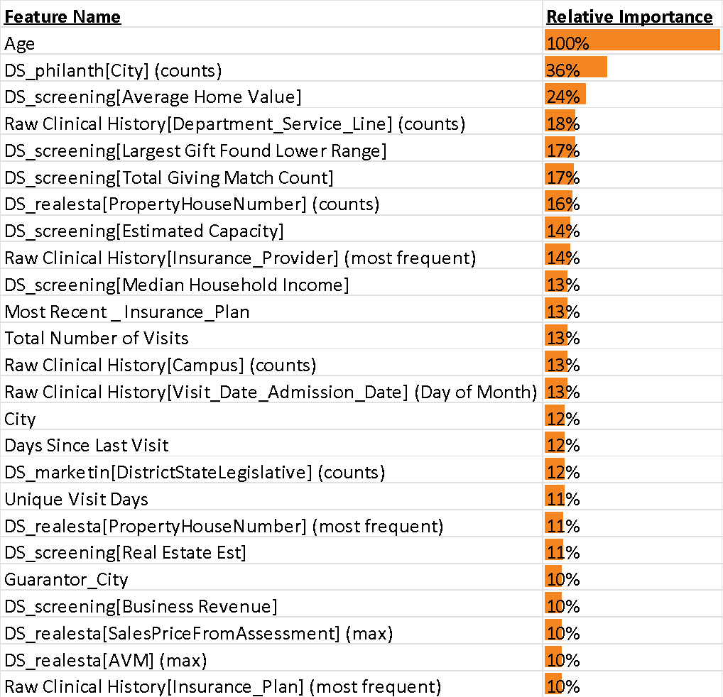
Donors
Prospects
=CRM DATA
=EMR DATA
=EXTERNAL DATA
1007 Variables % of Impact
Client Data 193 61%
External Data 814 39%
202 Variables % of Impact
Client Data 83 40%
External Data 119 60%
aasp Summit | 2022
AFP Global | 2022

Slide 39
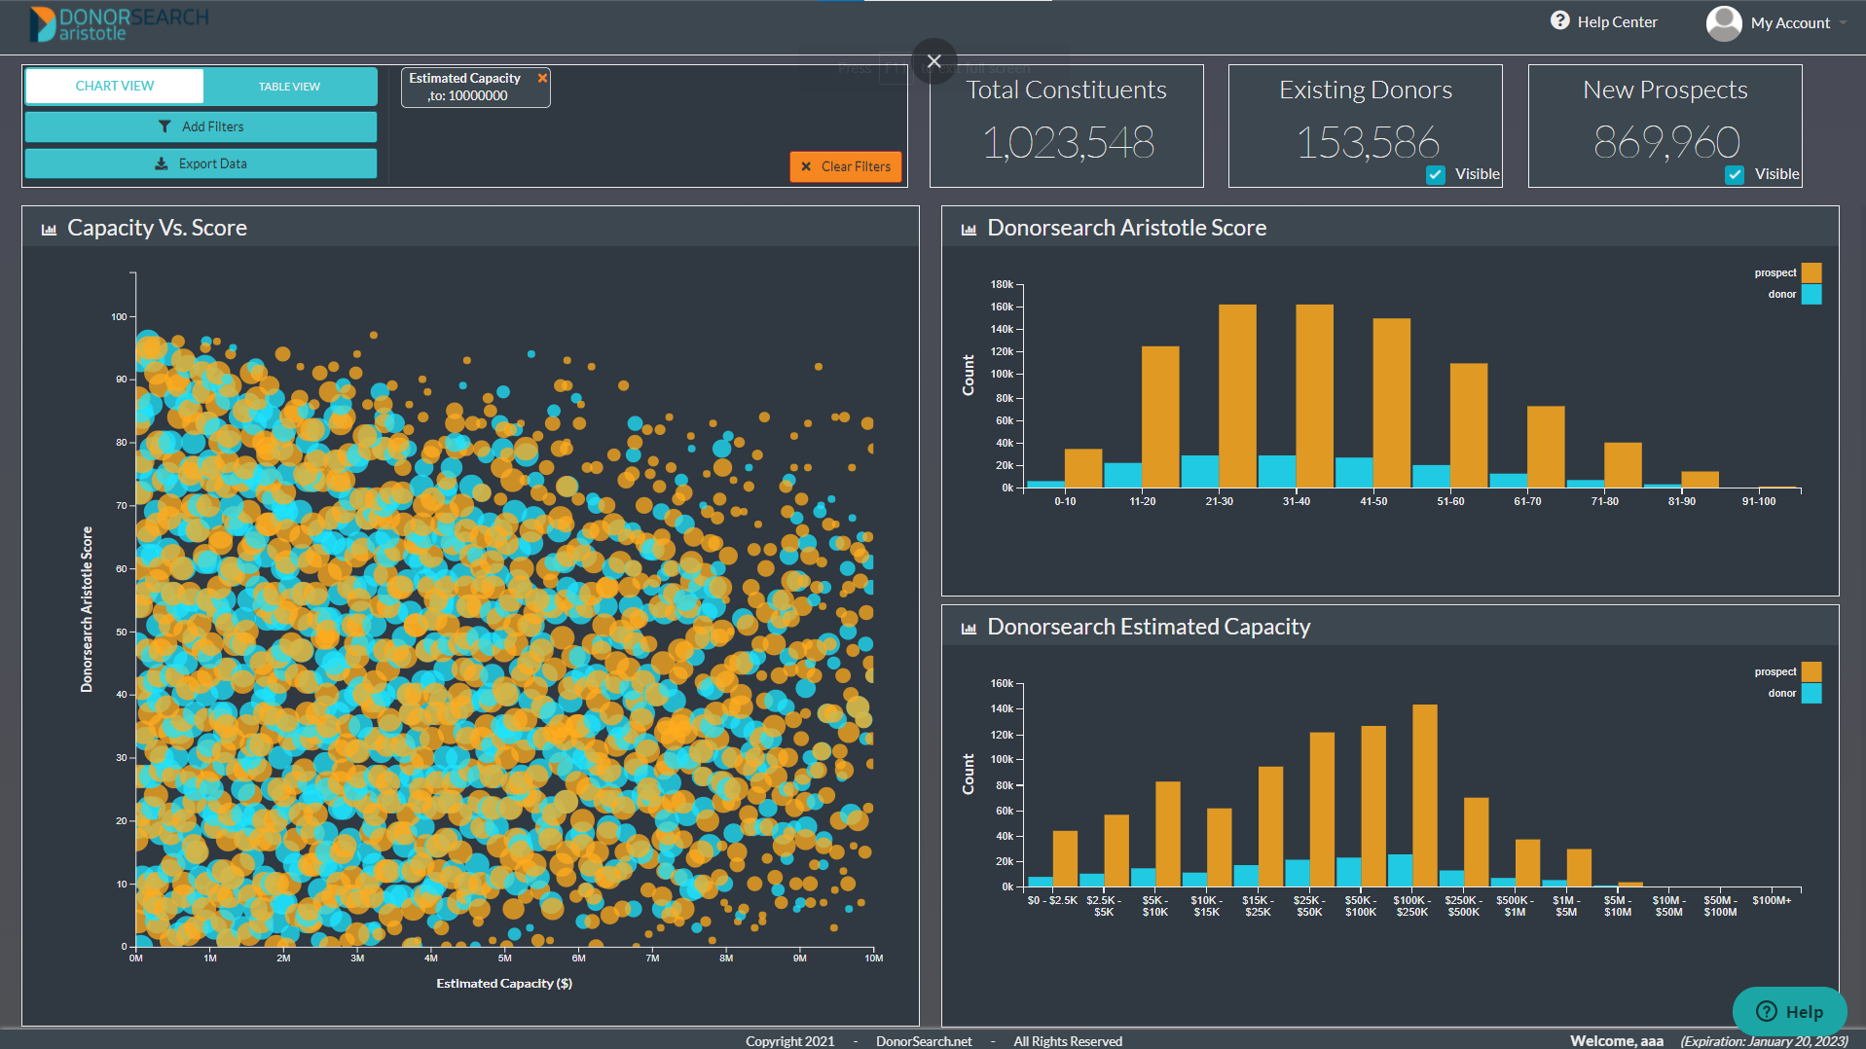
DASHBOARDS
S
ANNUAL GIFTS
HIGH LIKELIHOOD
+
LOW WEALTH
MAJOR GIFTS
HIGH LIKELIHOOD
+
HIGH WEALTH
LIKELIHOOD
LOW LIKELIHOOD
+
LOW WEALTH
LOW LIKELIHOOD
+
HIGH WEALTH
WEALTH

Slide 40
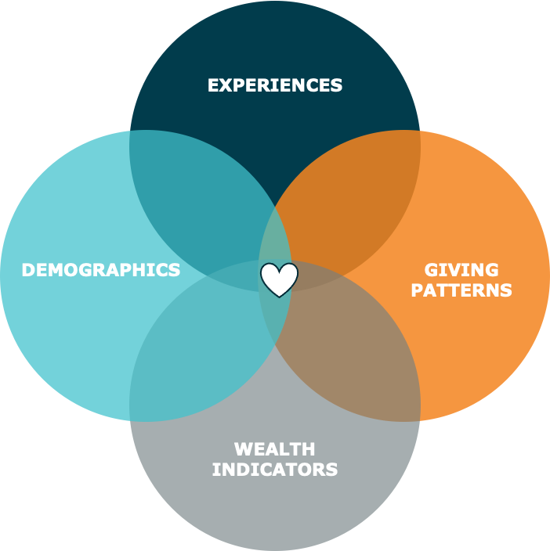
Ingredients to Quantify Connection Using Ai
Acknowledge that generosity is the result of the depth of connection
Reduce bias and increase data equality efforts
Reinforce the relationship of experiences and quantifiable activities
Use big data + deep learning to measure the depth of connection as of N-of-1
Acknowledge that donors and non-donors are unique & must be modeled independently
Recognize that people are dynamic so measure their connection continuously
aasp Summit | 2022
AFP Global | 2022

Slide 41
Four Key Takeaways
Rethink everything you think you know about connection, and determine what would make giving to your mission compulsory.
Center efforts inward by focusing on relationships over annual revenue goals. (KPI’s on retention vs revenue)
Prioritize data collection and enrichment efforts that help reduce bias (more holistic) and quantify connection.
Leverage technology to that allows you to know people intimately and enhance true personalization at scale.
aasp Summit | 2022
AFP Global | 2022

Slide 42
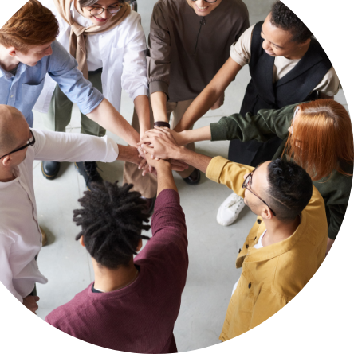
Questions?
Website
www.donorsearch.net
Email address
info@donorsearch.net

