Slide 1
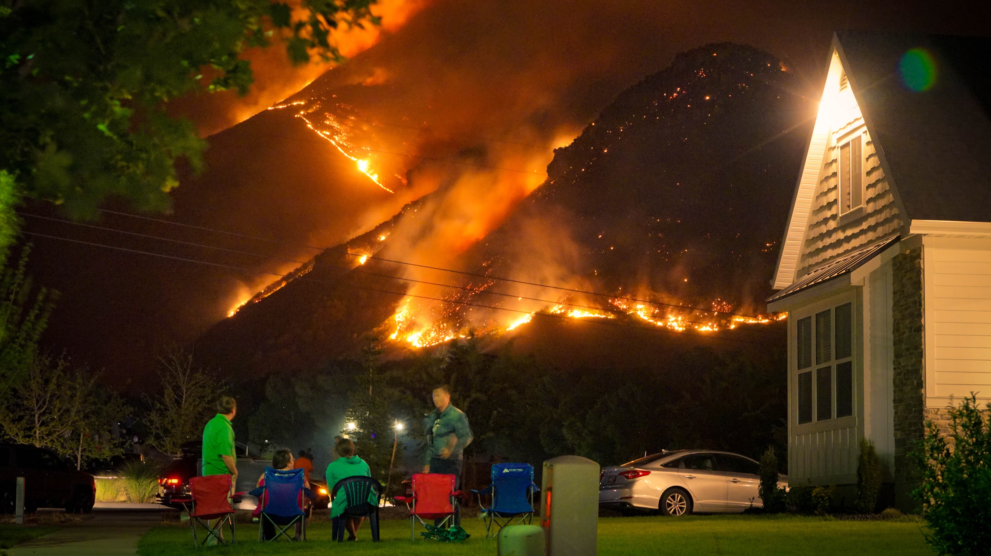
National Public Health Week
Building Resilience to Climate Trauma, April 11th, 2025
Professor Emily Diamond, The Wright Institute
Director: The Health Inequality Studies Group
Author: Basic Disaster Preparedness for the Western States
Berkeley, California

Slide 2
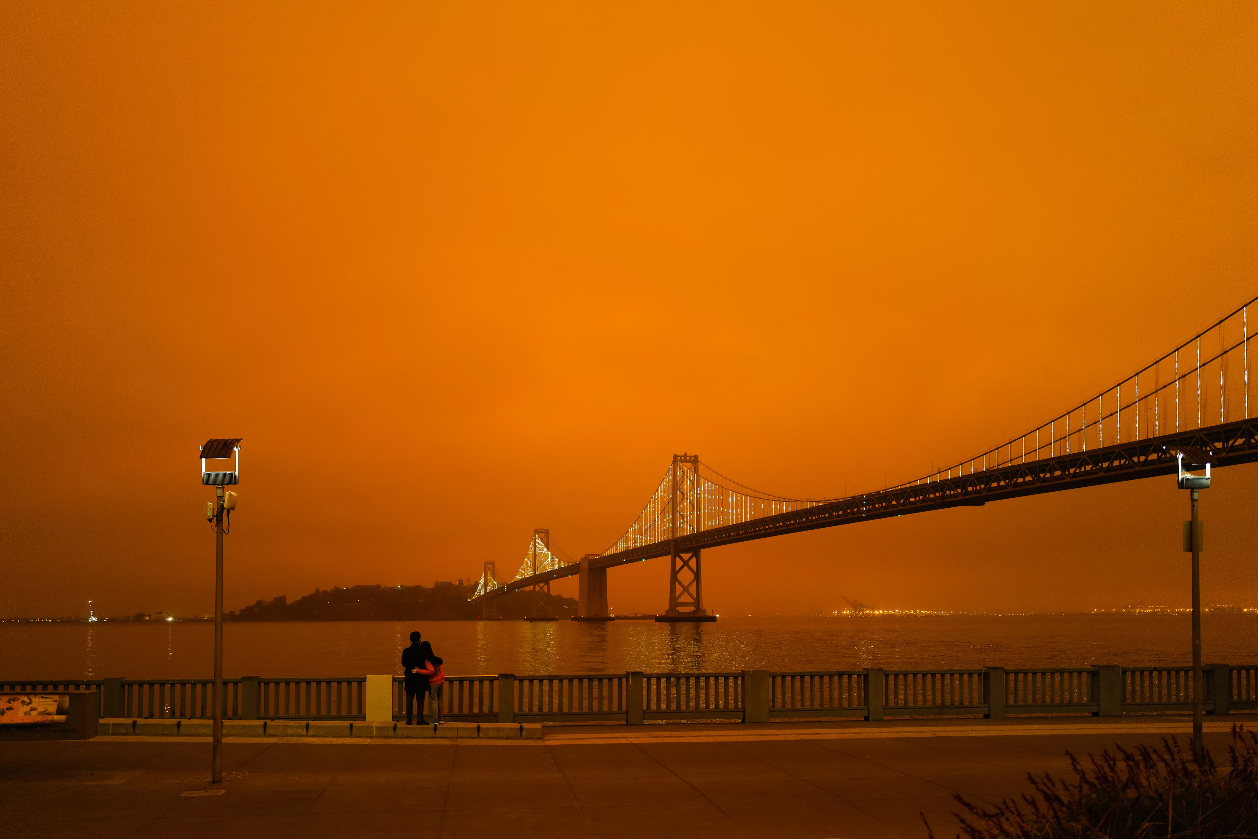
This is a very brief presentation that will focus on these things:
Disaster and climate-related events as nested events
Why many climate events can also be characterized as toxic events
How impacts from climate events intersect with stage-of-life and pre-existing vulnerabilities
Why time to recovery can vary so much—the cumulative impacts from different sources of adversity

Slide 3

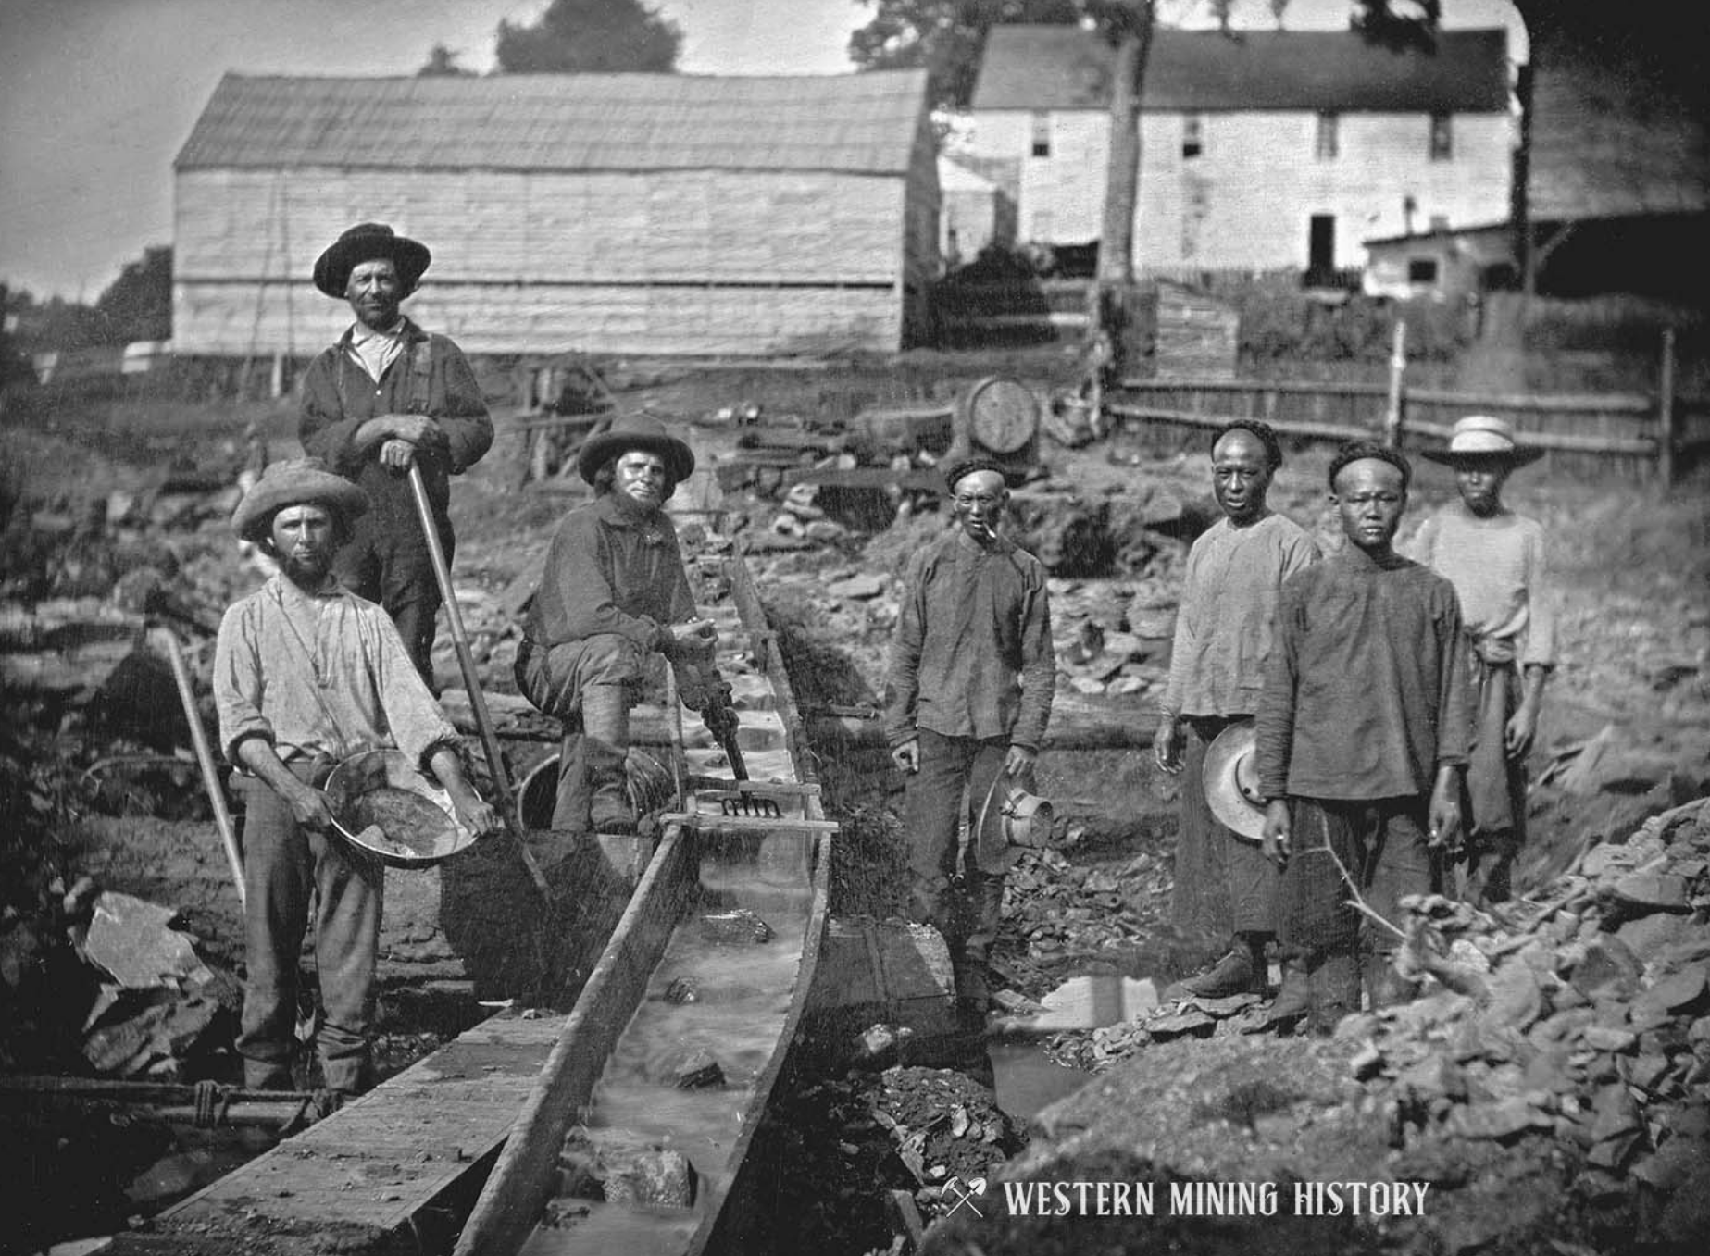
In 2011, Japan experienced an earthquake that led to a tsunami, and both of these led to a nuclear meltdown. The contaminated water used to cool the reactors has been partially treated and is now slowly being released into the Pacific. While this wasn’t a climate-related disaster, having unpacked disasters for 20 years, they tend to be like Russian dolls, one inside of another. Here are some others that are more climate-related:
1. Flooding from a hurricane, which rusts out the underground containment for toxic industrial chemicals that now threaten groundwater
2. Sustained heat and drought that leads to wildfires unleashing weeks of carcinogenic smoke and leaving toxic particles across the landscape that may be taken up by food crops in coming years
3. Hurricanes and floods that lead to mold growth in homes, businesses, and schools, that later worsen respiratory health. This often leads to spraying with fungicides, which has its own risks
To your right is a photo of gold miners in California from 1852. It’s the oldest disaster I’ve unpacked. Like many gold miners, they likely used mercury in the process. When areas that had gold mining 170 years ago burn in a wildfire today, that mercury can be released as part of the air pollution not only in the vicinity but will travel by air currents to other areas. Naturally occurring arsenic comes up with gold in some places, and this has been remobilized through the fires we have now, too.

Slide 4
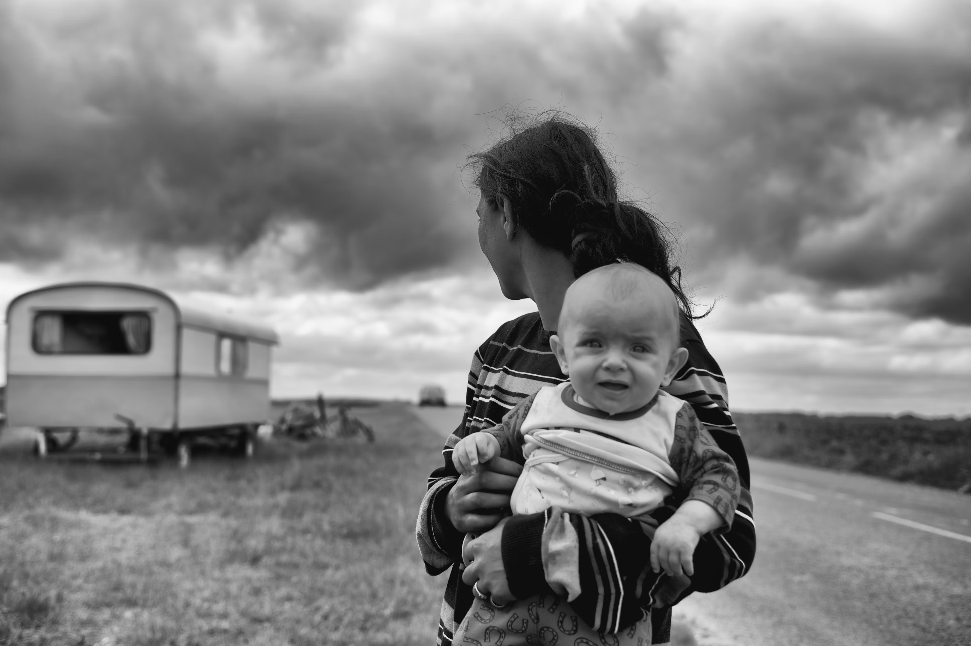
The development of 3 studies I work on
The first is called the Health Path Project, and it helps me understand the background level of trauma people are living with.
The 2nd study is a survey of US adult and their experiences of climate events and disasters. A subset of this sample are first responders.
The 3rd study I work on is looking at how children go through disasters and their experiences.

Slide 5
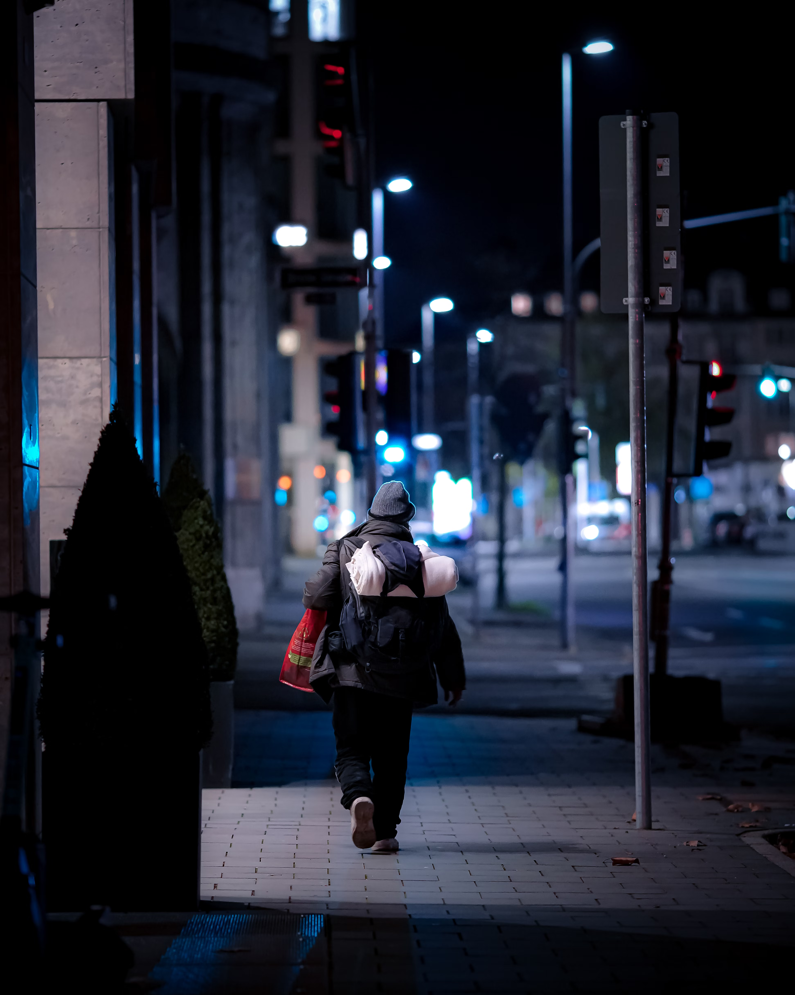
Our trauma context that we bring into climate disasters: the history of nearly 3000 participants
Not surprisingly, traumas cluster.
For example, about 50% of respondents told me that they’ve experienced housing insecurity, 14% experienced it in childhood, 11% in childhood and now, and 26% said that they only experienced now, as an adult.
If I look for statistical relationships, I see that this group is more likely to have experienced food insecurity, and going without needed care & medications
They are more likely to say that they have lived where there are air and water quality concerns, or that they live near a toxic waste site.
They are more likely to be caretakers of someone in the home with a disability.
They are more likely to be survivors of violence
For these reasons, care needs to be responsive to history.

Slide 6
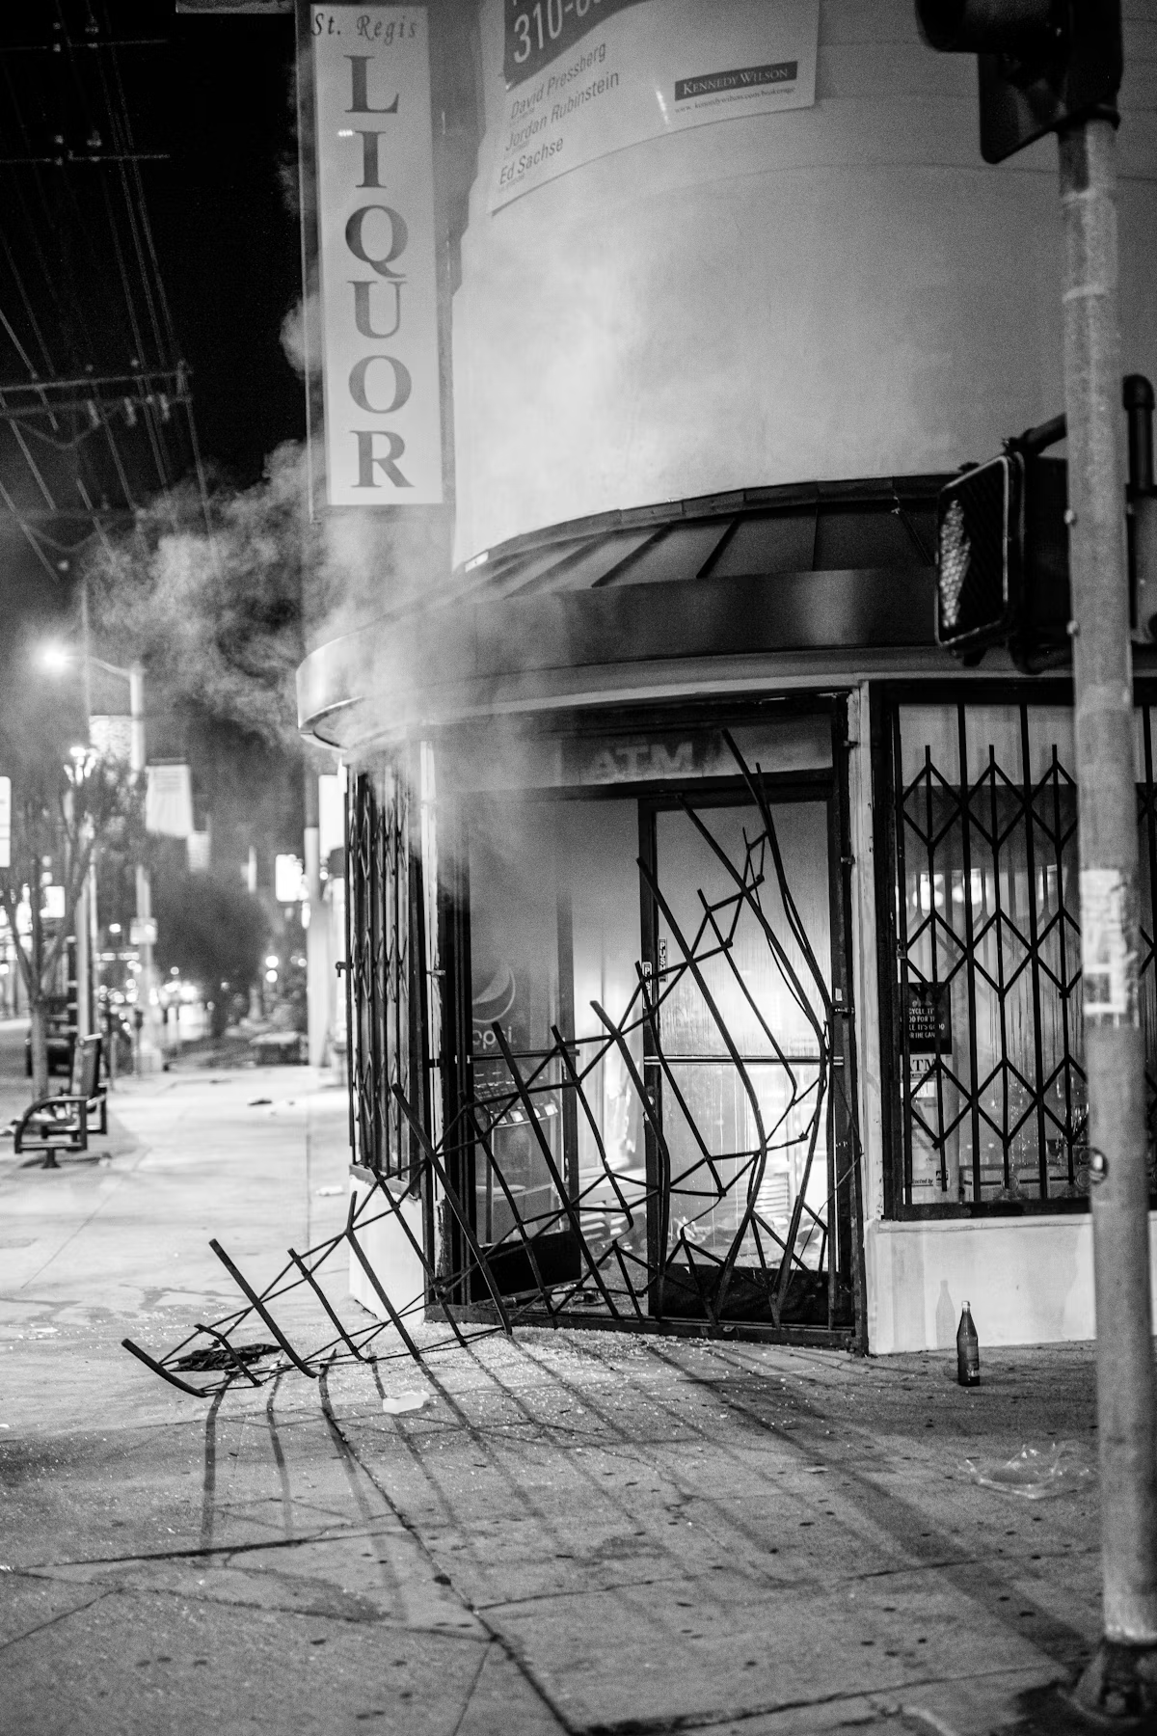
Looking at some of the data from the adult study of disaster survivors
People in the study averaged having gone through 2 disasters in which they feared for their lives, their family and/or their home.
41% said that they had gone through a natural disaster which was also an industrial disaster.
22% said that they had also experienced ongoing looting and violence in their community, aside from the climate-related disaster they had experienced.
Here it’s easy to see why care in the aftermath may differ between communities.
When I asked people what they needed for their general resilience, many said more equality between people, access to healthy foods and affordable housing.
When I asked disaster survivors what helped them through, leading the list, it was family, friends, community and their spiritual practice

Slide 7
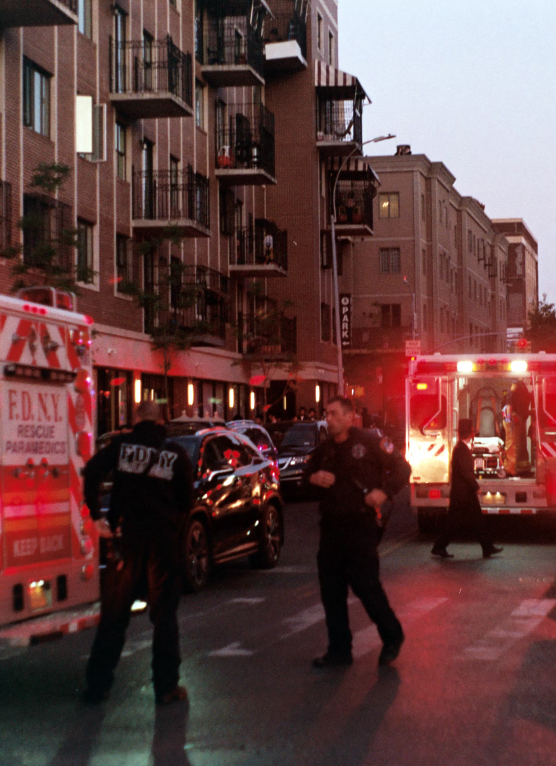
Often not talked about when we talk about recovery from disasters is crime & violence exposure
21% of adults said that they had experienced violence or crime during or immediately after the disaster
19% said they witnessed it happen to others
Among children, about a third said they knew someone who was a victim of crime during the disaster
For first responders, crime & violence exposure was higher. Furthermore, they are exposed to the worst aspects of disasters, such as body recovery, working in heat, smoke, and contaminated water, and in the context of often having their own family home in jeopardy as they work.
Are they working on a climate disaster or a riot that emerged from it? Regardless of how they categorize it, their cells may bear the impacts.

Slide 8

Different needs by life-stage and occupation
For adults, some had miscarriages, some had the worsening of their respiratory disease, a return to substance dependency, pregnancy complications, marriages that broke up, worsening of memory issues and other struggles.
For first responders, particularly for firefighters, it’s well known that they have elevated rates of certain types of cancers, though I didn’t track this in my study.
Children in my study had numerous health and well-being issues which tended to cluster, such as anxiety, asthma, ADHD, depression, and sleep issues, which for many, worsened. I tracked these specifically because research has tied them to exposure to PM2.5 air pollution either in gestation, in the communities in which they live, and sometimes both.
While air pollution is not a typical kind of climate-related disaster that comes to mind, global warming pollutants such as carbon dioxide, methane, and nitrous oxide are part of the reasons behind it. There are now counties within my state of California where a quarter of children have been diagnosed with asthma. (https://www.cdph.ca.gov/Programs/CCDPHP/DEODC/EHIB/CPE/Pages/CaliforniaBreathingCountyAsthmaProfiles.aspx)
A young person now who has been impacted in various ways by a destabilizing climate may soon be a parent to a child who is coming into the world to face what their parents faced and very likely worse. One of the greatest tasks of our time is to understand how to foster health & resilience in families and communities in the context of multiple societal adversities etching their presence into our minds & bodies over the lifespan.
Thank you

