Slide 1
Patient Advocacy Coordinator (PAC) Processes
(Flowcharts, Resource Guides, Forms)
Louisiana Tuberculosis Control
Created by Heather Manrique, Patient Advocacy Coordinator (PAC)
January 14, 2022
Play Slideshow from link at top on screen
(Start From The Beginning F5)

Slide 2
Table of Contents (Interactive Links Throughout Presentation)
Introduction
Slide 3
Resource Guide
Region 1
Resource Guide
Region 2
PAC Functions
Slide 4
Resource Guide
Region 3
PAC Action Request
Slide 30
Resource Guides
Slides 18-29
Resource Guide
Region 4
PAC as Resource
Slide 5
Click on links to pages
Resource Guide
Region 5
Resource Guide
Region 6
PAC Process Example Slides 6-8
Resource Guide
Region 7
Management of Adherence in Tuberculosis Treatment
Slide 31
Resource Guide
Region 8
Resource Guide
Region 9
PAC Flowcharts Slides 9-17
Resource Guide
Statewide
Resource Guide
Statewide

Slide 3
Introduction
Our TB Program has been a great success.
great success = great responsibility
This increase in responsibility has shown us that our world is changing every day and so are the needs of the TB Program. In order to keep up we all need to push to the next level of patient-care.
This guide includes flowcharts and documents needed to help Disease Intervention Specialists, nurses, and other public health personnel provide resources and assistance to OPH tuberculosis patients.
The guide goes through the processes that you and your PAC will use to collaborate care, resources, and program goals.
To Table of Contents

Slide 4
PAC Functions
PAC functions involve training, providing, and implementing tools (both cognitive and tangible) that DIS, nurses, and other health professionals can use to assist their patients in the treatment of TB.
Functions of the PAC include the quality of work environment of the TB workers, which positively correlates with obtaining program outcomes.
Examples of cognitive training tools:
Developing Cultural Diversity Understanding
Igniting Positive Influence in the Work Place
Guiding Ourselves and Others in Self-Care
Navigating Patient Needs
Involving Oneself in Language and Cultural of Others
Teaching Ourselves to Listen
Yesworthy: Knowing Your Intrinsic Value
Example of Tangible Tools:
Resource Guides
Flowcharts for Decision Making
PAC Action Requests
Field Kits
Supplies
To Table of Contents

Slide 5
PAC as Resource
The PAC rarely deals directly with patients on their issues, but rather the PAC will function as the mediator/advisor between the patient and the TB worker [in finding solutions and resources to patient issues].
An example of the process/flowcharts to follow when needing assistance with non-medical TB issues begins on the following slide.
The flowcharts are to be used as guides in decision making. However, anytime you need to communicate immediately for guidance don’t hesitate to call the PAC. Heather Manrique (cell) 337-303-5167.
To Table of Contents

Slide 6
PAC Processes (Example):
Sally is a DIS. Sally’s patient refuses to take her TB medications for active TB. Sally has tried talking to her patient, offering incentives, and even explaining the sanitary code. Her patient continues to insist that she knows her body and that these medications are not going to heal her. Sally is at her wits end yet remembers that she can get help.
Sally refers to the PAC Action FlowChart (Appendix 1) for assistance. After answering the questions and following the flow of the chart (noted with dotted line) she is directed to: Medications (Appendix 2).
To Table of Contents

Slide 7
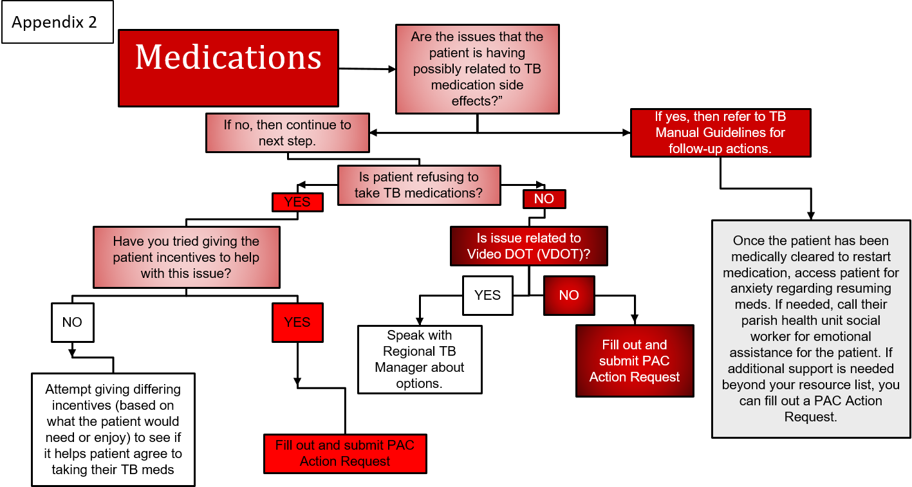
PAC Process (Example Continued)
Sally now does the same question-answering on the Medications Flowchart and dependent upon her answers, the flowchart will guide her in ideas to try with her patient.
You can see below that the dotted line represents the flow she followed and advice given.
After trying each suggestion and still not seeing results it is recommended that Sally fill out a PAC Action Request (PACAR)(Appendix 10), shown on next slide for instructions.
Through this PACAR, Sally and the PAC will work together to find a solution to the issue. If a solution/remedy cannot be found then the issue may be bumped to the Adherence Management Timeline (Appendix 11) for legal action.
To Table of Contents

Slide 8
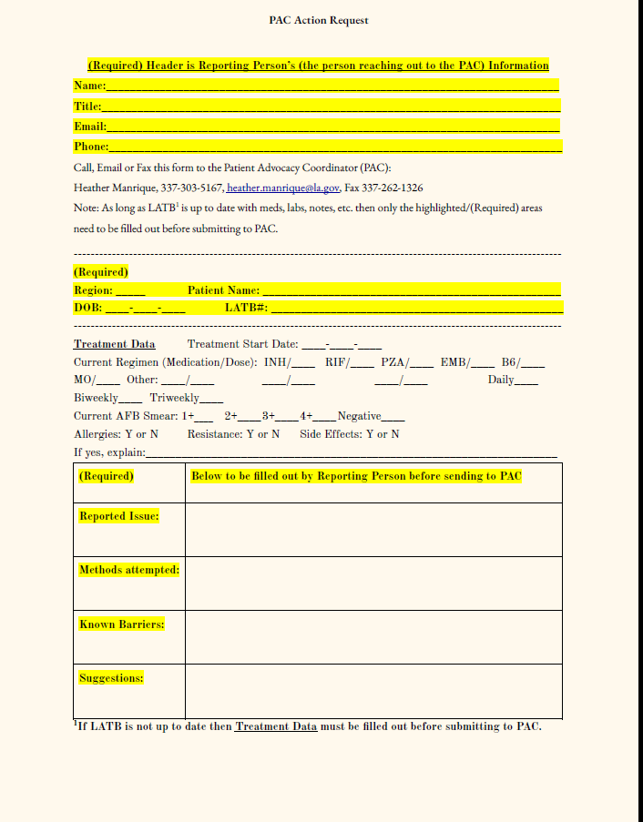
PAC Process (Example of PAC Action Request)
Fill out PAC Action Request (Available on Moodle):
When flowchart refers you to do so
When you need assistance with non-medical issues with your patient
Call or email PAC to discuss issue with patient:
When you feel like you need assistance but aren’t able to submit form or simply need a quick help
Anytime you want to talk about PAC trainings, issues with patients, guidance, etc.
When you’re working through the TB Treatment Adherence Process (Appendix 11) and need guidance.
Remember: This is all to make things clear and help with decision making. If it makes things harder give me a call.
Click for PAC Action Request
Back To Table of Contents

Slide 9
PAC Action Flowchart
Appendix 1
If yes, then use incentive funds as needed per Incentive Fund guidelines.
Can the issue be resolved with Incentive Money?
If NO, continue to next box.
Is the issue a matter of imminent danger or a medical emergency?
Medications
If no, then what is the nature of the issue?
Mental Health
Issue Encountered by DIS/Nurse
Transportation
Click on 1 of the 8 Categories at the left to be advanced to correct slide
Financial
Safety
Health
Conflicting Medical Info
If YES then Call 911 and notify your manager.
Reliability
You should see colorful Issue Buttons to the right. Click here ONLY if you don’t see them to refresh page.
To Table of Contents

Slide 10
Medications
Appendix 2
Are the issues that the patient is having
possibly related to TB medication side effects?”
If no, then continue to next step.
If yes, then refer to TB Manual Guidelines for follow-up actions.
Is patient refusing to take TB medications?
YES
NO
Have you tried giving the patient incentives to help with this issue?
Is issue related to Video DOT (VDOT)?
Once the patient has been medically cleared to restart medication, access patient for anxiety regarding resuming meds. If needed, call their parish health unit social worker for emotional assistance for the patient. If additional support is needed beyond your resource list, you can fill out a PAC Action Request.
YES
NO
NO
YES
Speak with Regional TB Manager about options.
Fill out and submit PAC Action Request
Attempt giving differing incentives (based on what the patient would need or enjoy) to see if it helps patient agree to taking their TB meds
Back to PAC Action Flowchart
Fill out and submit PAC Action Request
To Table of Contents

Slide 11
Mental Health
Appendix 3
Is the patient threatening violence against anyone, including self-harm?
If yes, call 911 and discuss situation with Regional Medical Director and Central Office.
If no, then continue to next step.
Make sure you are safe. Always make sure your manager knows where you will be for field visits. Be aware of your surroundings. Take all threats of violence seriously.
Has patient expressed the need for mental health assistance?
YES
NO
Speak with your regional social worker to see if he/she can assist the patient in finding care. Also, use TB Resource Guide to provide information to patient for mental health services. Assist as needed in creating connections.
Why do you believe mental health issues are a concern?
Patient exhibiting signs of:
anxiety (nervousness, expresses constant worry, scared),
depression (continual crying, expresses hopelessness, lethargic without medical reason),
anger (sudden bursts of yelling, throwing objects, expression of anger), or
psychosis (reports hearing things that others do not hear, paranoia, behaviors not typical for patient, hallucinations).
Patient has a history of mental illness that is not currently being treated.
Notify TB Clinician of concern and request his/her recommendations
Back to PAC Action Flowchart
If no success in finding care, fill out and submit PAC Action Request
Fill out and submit PAC Action Request
To Table of Contents

Slide 12
Transportation
Appendix 4
Is patient having trouble keeping medical appointments, including DOT, due to lack of reliable transportation and/or is patient having transportation issues that affect daily living (work, school, getting food)?
NO
Is the issue with transportation due to infectiousness of patient?
YES
YES
NO
Does patient have transportation options (has a car, has a friend with a car, access to bus, etc.?
Fill out and submit PAC Action Request
YES
Have you provided patient with incentives like gas, money, etc. to help with issue?
NO
Coordinate with TB Manager, Regional Nurse/Medical Director for parish nurse or DIS to do home visits for monthly nurse assessments, DOT, and follow-up labs while patient is infectious. CXRs can be done with coordination of care with closest hospital.
YES
NO
If no success with incentives, assist patient with alternative options (VDOT, medicaid transport, Taxi, etc.) that can be found on your PAC Region Resource List
Give patient incentives according to TB Incentive Guidelines.
Talk with patient about services that may be available.
Back to PAC Action Flowchart
If still no success, fill out and submit PAC Action Request
To Table of Contents

Slide 13
Financial
Appendix 5
Is patient in need of food, shelter, or other financial assistance?
NO
Is patient inquiring about assistance for a family member or friend?
YES
Has patient expressed concern or requested financial assistance for daily supplies or utilities, etc.?
YES
NO
YES
Fill out and submit PAC Action Request
Have you provided patient with incentives like food, money, supplies, etc. to help with issue?
NO
Coordinate with Parish Health Unit Social Worker to have them reach out to patient regarding friend, etc.
YES
NO
Talk with patient about things you could help with if they would like. Example: Ms. Smith, I just wanted to let you know that as part of my job I can get you some “cash”, “food”, etc. Is that something you would accept?
Use, or continue to use, incentive money to assist, as needed. You can help pay small utility bills, buy some food, etc. Also, see Regional PAC Resource List for additional links and phone number to help patient with assistance.
Back to PAC Action Flowchart
If still in dire need of essentials, fill out and submit PAC Action Request
To Table of Contents

Slide 14
Safety
Appendix 6
If you are in immediate danger or have been threatened or harmed call 911 and contact your Program Manager.
Are you or anyone around you in immediate danger?
YES
NO
Is the safety issue related to behavior of you or another human?
Fill out and submit PAC Action Request AND have conversation with your manager.
NO
YES
Is the safety issue related to conditions in the field?
YES
NO
Would incentive money help with the issue? If so, try using incentive money to resolve the issue.
Is the safety issue related to coworkers or office work environment?
Have a talk with your manager to brainstorm solutions.
NO
If incentive money can not resolve issue then fill out and submit a PAC Action Request
YES
Fill out and submit PAC Action Request AND have conversation with your manager or Central Office
Back to PAC Action Flowchart
To Table of Contents

Slide 15
Health
Appendix 7
Is the health issue a matter of life/death or risk of serious illness?
If you or anyone around you in critically ill or at risk of serious harm call 911 and contact your Program Manager.
YES
Is the health issue related to your health?
Have conversation with your doctor, manager, etc. Seek care.
NO
YES
Is the health issue related to your patient or a contact to a patient?
If still needing assistance then fill out and submit PAC Action Request parish social worker
YES
NO
Have a talk with your manager to brainstorm solutions.
Look in TB Manual guidelines for assistance. If still need assistance continue below.
NO
Reach out to TB Clinician for advice on the matter.
If in doubt of who to refer patient to or what action to take regarding clinician’s advice then, speak with TB manager and submit a PAC Action Request
Back to PAC Action Flowchart
To Table of Contents

Slide 16
Conflicting Medical Information
Appendix 8
Has patient received conflicting medical information regarding tuberculosis than that which OPH TB Program is transmitting?
NO
Is patient under a differing belief about medical information than that TB Program is transmitting?
YES
Is the conflicting information coming from a local medical provider?
YES
YES
NO
Listen to patient’s beliefs and conceptions about his/her health. Attempt to understand their point of view. Sometimes just showing that respect and listening can help a patient be open to what TB Program has to say. After that if reinforcement of ideas is needed, set up time for patient to speak with clinician. If issue does not seem to be resolved…
Reach out to other medical provider and discuss issue. Once on the same page have other medical provider, request that he/she speak with patient or write notes that are in agreement with OPH TB Program. Provide these notes to patient and have a follow-up discussion.
If an agreement cannot be reached with the other medical provider then request that State TB Medical Advisor reach out to other medical provider.
If the issue does not get resolved
Fill out and submit PAC Action Request
Back to PAC Action Flowchart
To Table of Contents

Slide 17
Reliability
Appendix 9
Is patient showing signs of not being reliable with DOT, appointments, etc.?
NO
Is the reliability dependent upon a family or friend of the patient?
YES
YES or NO
Try using incentives that directly correlate to patient’s care. You could, for example, provide gas money to a friend to bring the patient to DOT or bring the patient breakfast everytime he has his sputum collected and ready for pick up.
Have you tried using incentives for patient to assist in reliability?
YES
NO
If using incentives does not help enough, talk to the patient about the barriers he/she is having for attending DOT and appointments, etc. Listen for clues that may help you help them. Use the Resource Guide for links to assistance that may help.
If patient is still having reliability issues, discuss with TB Manager options that may help patient such as VDOT, social service needs, etc.
If incentives are not helping the issue enough, you and patient could together have a conversation with a friend or family member about the patient’s needs.
If the issue still remains…
If the issue does not get resolved
Fill out and submit PAC Action Request
Back to PAC Action Flowchart
To Table of Contents

Slide 18
Resource Guides
The following slides have some resources that I have verified as being “real” for each region.
You can use these to click on links to help your patient find the assistance they need.
Print out the resources or email to patients so they can also utilize it all.
To Table of Contents

Slide 19
Region 1: Resources for Tuberculosis Patient Care
Catholic Charities – Bills, utilities, immigrant services, etc.
https://www.ccano.org/
Disaster Assistance
http://ready.nola.gov/assistance/#broadmoor (assisted evacuation, disabled transport, shelter registry, etc.)
Energy Bill Assistance in Louisiana
888.454.2001; #3 can provide parish numbers to call (call for your patient)
Families Helping Families (With Disabilities)
https://fhfofgno.org/resources
Help With Bills, Rent, and other Financial Needs (Takes a lot of digging)
https://www.needhelppayingbills.com/html/get_help_paying_rent.html
Medical Transport for Disabled Persons
https://jeffersontransit.org/
Application: https://jeffersontransit.org/wp-content/uploads/2021/07/Mits-App-Complete.pdf
https://www.norta.com/Accessibility/Paratransit
Parish Specific Resources
https://wellaheadla.com/community-resource-guide/?resource_type=healthy-eating-and-food-resources
Rental assistance
1.877.459.6555, and follow prompts
Utilities Assistance Application
https://nola.gov/community-development/utility-assistance-program/
To Table of Contents

Slide 20
Region 2: Baton Rouge
Assistance With Food
https://brfoodbank.org/mobile-food-distributions/ (This food bank updates weekly)
https://www.freefood.org/c/la-baton_rouge?_gl=1*1l34fr5*_ga*NUdZV2o1NmNGd29ERlpIejZmT1UxLXFoTWVhcjBCbzYzbzNnYTE5X0luN3VlWkQyZjlqaFF5czRwdlpiUC1OaQ..
(This is a comprehensive food bank list with links)
Catholic Diocese of East Baton Rouge (Housing, immigration, bills, food)
https://www.ccdiobr.org/
Comprehensive Guide to Many Resources
https://ideapublicschools.org/wp-content/uploads/2020/03/Community-Resource-Guide-Baton-Rouge.pdf
District Attorney Resource Guide (You have to dig a bit and some links don’t work)
https://www.ebrda.org/community_resources.php
Energy Bill Assistance in Louisiana
888.454.2001; #3 Energy assist program can provide parish numbers to call (call for your patient)
Rental Assistance
1.877.459.6555, and follow prompts
Transient Living (web address brings you to fees, qualifications)
http://www.icarol.info/ResultDetails.aspx?org=2021&agencynum=359788
Women’s Care
https://thewomenshelpcenter.org/
To Table of Contents

Slide 21
Region 3: Houma
Energy Bill Assistance in Louisiana
888.454.2001; #3 Energy assist program can provide parish numbers to call (call for your patient)
Food and Charity Calendar
https://catholiccharitiesht.org/
Government Help
https://www.financialhelpresources.com/city/houma-la.html
Homeless Housing Resources
http://www.lchcoalition.org/resources/
Rental Assistance (not always available)
https://offices.sc.egov.usda.gov/locator/app?service=page/ServiceCenterSummary&stateCode=22&cnty=109
https://www.rentassistance.us/ci/LA-houma
Rental Assistance
1.877.459.6555, and follow prompts
Resource List (lots of digging required)
https://www.needhelppayingbills.com/html/terrebonne_parish_assistance_p.html
Resource List (Multiple links)
https://www.findhelp.org/money/financial-assistance--houma-la
To Table of Contents

Slide 22
Region 4: Lafayette
Catholic Charities Application for Assistance
https://www.tfaforms.com/4887868
Energy Bill Assistance in Louisiana
888.454.2001; #3 Energy assist program can provide parish numbers to call (call for your patient)
Families Helping Families (With Disabilities)
https://www.fhfacadiana.org/resources
Help With Bills, Rent, and other Financial Needs (Takes some digging around on the site)
https://www.needhelppayingbills.com/html/get_help_paying_rent.html
Medical Transport for Disabled Persons
http://www.acadianatransit.com/services/paratransit.html
Application: http://www.acadianatransit.com/images/Paratransit_Application_8-31-17.pdf
Rental Assistance
1.877.459.6555, and follow prompts
Transportation Assistance (Medicaid Members)
http://ready.nola.gov/assistance/#broadmoor.
To Table of Contents

Slide 23
Region 5: Lake Charles
Energy Bill Assistance in Louisiana
888.454.2001; #3 Energy assist program can provide parish numbers to call (call for your patient)
Families Helping Families (With Disabilities)
https://fhfswla.org/
Medical Transport for Disabled Persons
https://www.cityoflakecharles.com/eGov/apps/services/index.egov?view=detail;id=43
Miscellaneous Resources
https://www.cityoflakecharles.com/eGov/apps/services/index.egov
Non-emergency Medical Transport (Medicaid not a must for most on list)
https://npidb.org/organizations/transportation_services/non-emergency-medical-transport-van_343900000x/la/?location=lake+charles
Rental Assistance
1.877.459.6555, and follow prompts
Transportation Assistance (Medicaid Members)
https://www.cityoflakecharles.com/egov/apps/services/index.egov?view=detail;id=43
To Table of Contents

Slide 24
Region 6: Alexandria
Assistance From Cenlacac (food, utilities assistance)
https://www.cenlacac.org/programs
Energy Bill Assistance in Louisiana
888.454.2001; #3 Energy assist program can provide parish numbers to call (call for your patient)
Food and Shelter
https://www.uwcl.org/emergency-food-shelter
Homeless Shelters
https://www.shelterlistings.org/city/alexandria-la.html
Parish Specific Resources
https://wellaheadla.com/community-resource-guide/?resource_type=healthy-eating-and-food-resources
Rental Assistance
1.877.459.6555, and follow prompts
https://www.needhelppayingbills.com/html/rapides_parish_rent_assistance.html
Transportation (Non-Emergency)
https://ldh.la.gov/page/352
To Table of Contents

Slide 25
Region 7: Shreveport
Energy Bill Assistance in Louisiana
888.454.2001; #3 Energy assist program can provide parish numbers to call (call for your patient)
Food and Bus Tickets
http://www.lsndc.org/index.php/component/cpx/?task=resource.view&id=466073&search_history_id=17732987
Non-Emergency Medical Transport
https://npidb.org/organizations/transportation_services/non-emergency-medical-transport-van_343900000x/la/?location=shreveport
Para Transport
http://www.sportran.org/101/LiftLine
Rental Assistance
1.877.459.6555, and follow prompts
Resource Guide (Great Info)
https://www.shreveportla.gov/DocumentCenter/View/14051/Community-Assistance-Resource-Guide-2018
https://fhfregion7.com/wp-content/uploads/2017/05/FHFReg7-Resource-Guide.pdf
To Table of Contents

Slide 26
Region 8: Monroe
Application
https://monroela.us/sites/default/files/Paratransit%20Eligibilty%20%20Application%202017.pdf
Bus Service for People With Disabilities
https://monroela.us/services/bus-service-monroe-transit/paratransit
Energy Bill Assistance in Louisiana
888.454.2001; #3 Energy assist program can provide parish numbers to call (call for your patient)
Northlake Homeless Coalition
https://northlakehomeless.org/?page_id=797
Medical Transportation
https://ldh.la.gov/page/352
Rental Assistance
1.877.459.6555, and follow prompts
To Table of Contents

Slide 27
Region 9: Covington
Cash Aid Call
888-524-3578
Energy Bill Assistance in Louisiana
888.454.2001; #3 Energy assist program can provide parish numbers to call (call for your patient)
Food Resources
https://www.freefood.org/c/la-thibodaux
https://catholiccharitiesht.org/good-samaritan-food-bank-of-thibodaux
Miscellaneous Phone Numbers for Food, supplies, etc.
https://www.needhelppayingbills.com/html/terrebonne_and_lafourche_catho.html
Rental Assistance
1.877.459.6555, and follow prompts
http://stmaryoutreach.org/
To Table of Contents

Slide 28
Statewide Resources
Apply Medicaid
https://sspweb.lameds.ldh.la.gov/selfservice/
Energy Assistance Providers
https://www.lhc.la.gov/hubfs/Document%20Libraries/Energy%20Assistance/LIHEAP%20Provider%20Directory%20-%20Revised%2012%2009%202021-1.pdf
Free Bus Pass
https://www.southeastrans.com/louisiana-members/#open-overlay
Gas Reimbursement (Call three days ahead)
https://www.southeastrans.com/louisiana-facilities/#open
HealthConnect Toolkit (help with coping, seeking services)
https://www.louisianahealthconnect.com/providers/resources/provider-toolkits.html
Help With Bills, Rent, and other Financial Needs (Takes a lot of digging)
https://www.needhelppayingbills.com/html/get_help_paying_rent.html
Medicaid: Ride
https://www.aetnabetterhealth.com/louisiana/medicaid-eligibility-qualifications.html
https://www.louisianahealthconnect.com/members/medicaid/benefits-services/transportation-to-appointments.html
Medicaid: See if Qualify
https://ldh.la.gov/page/220
To Table of Contents

Slide 29
Statewide Resources (Continued)
Motorist Assistance Patrol (MAP) (Baton Rouge, New Orleans, Lake Charles, Shreveport-Bossier City, Alexandria, and Northshore)
http://wwwsp.dotd.la.gov/Inside_LaDOTD/Divisions/Operations/MAP/Pages/default.aspx
FREE SERVICES; Provide one gallon of fuel, Change a flat tire, Jump start car, Fill radiator with water, use of cell phone
Non-Emergency Medical Transport (List of rides that you can pay for)
https://npidb.org/organizations/transportation_services/non-emergency-medical-transport-van_343900000x/la/?location=
https://ldh.la.gov/page/352
RunAway Resources
https://www.1800runaway.org/youth-teens
Youth must initiate the process by calling NRS’ hotline at 1-800-786-2929
To Table of Contents

Slide 30
PAC Action Request Form
Appendix 10
*For actual document click Moodle link to right.
Click for PAC Forms in Moodle
Back to PAC Action Flowchart
To Table of Contents

Slide 31
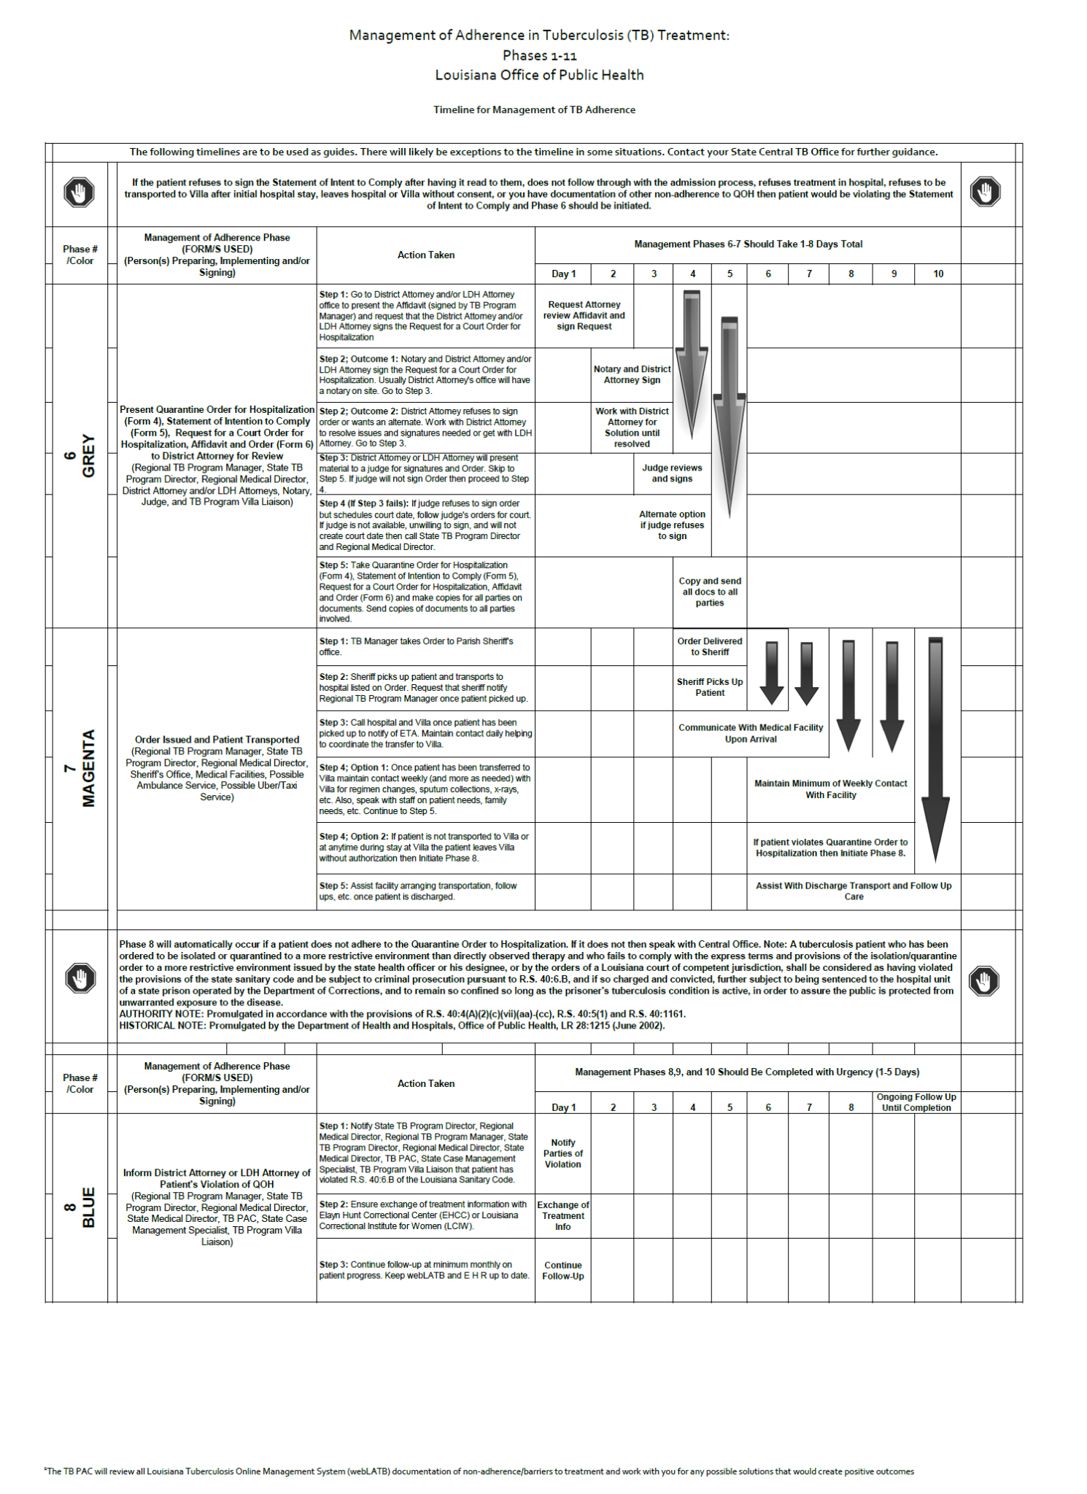
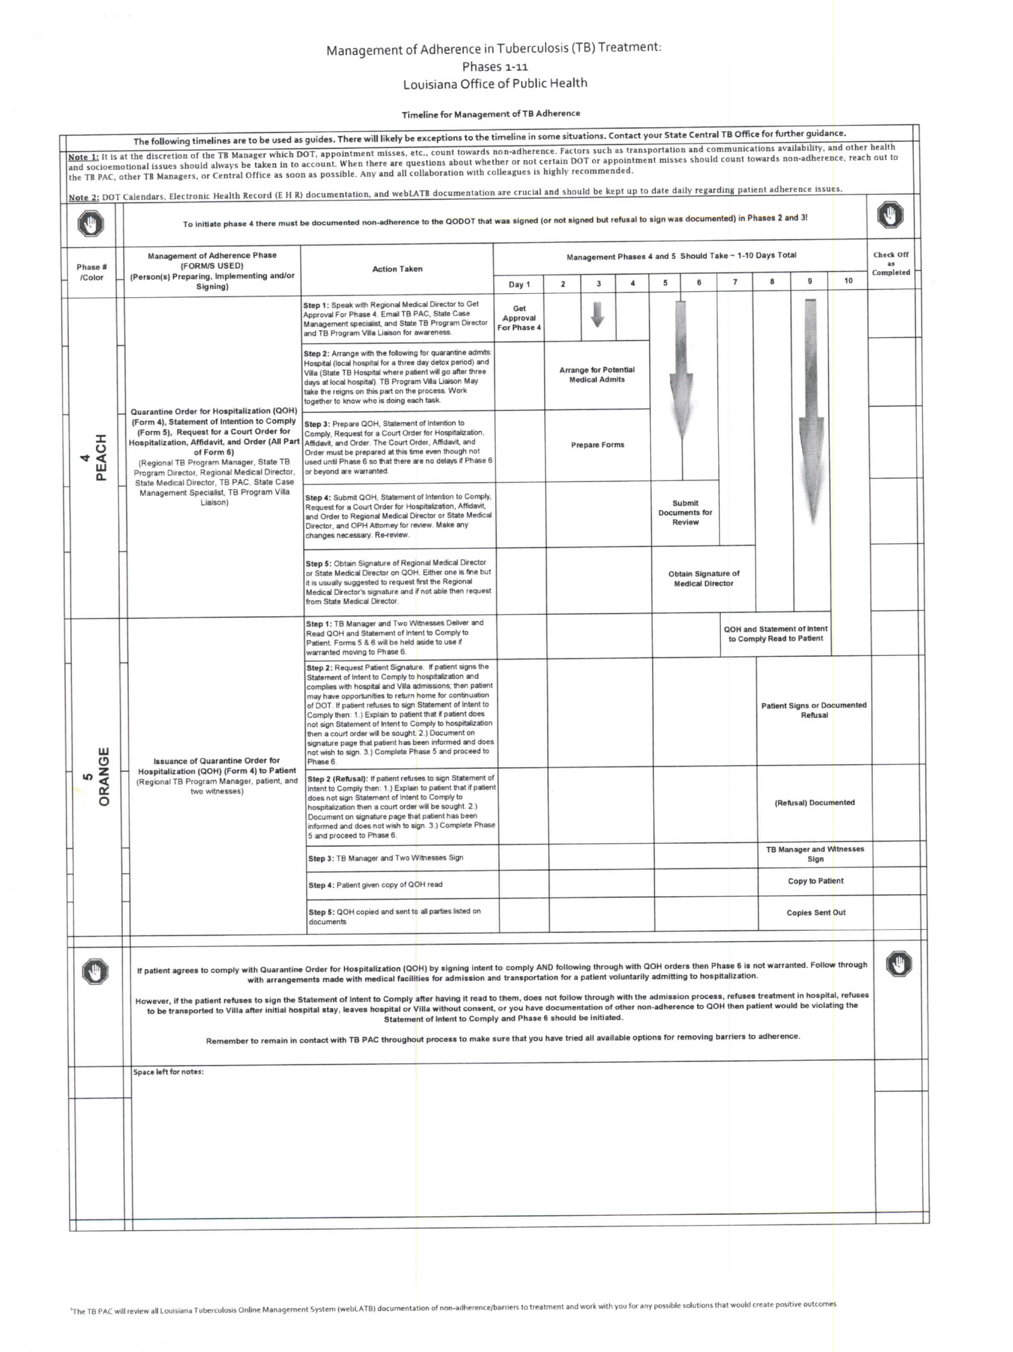
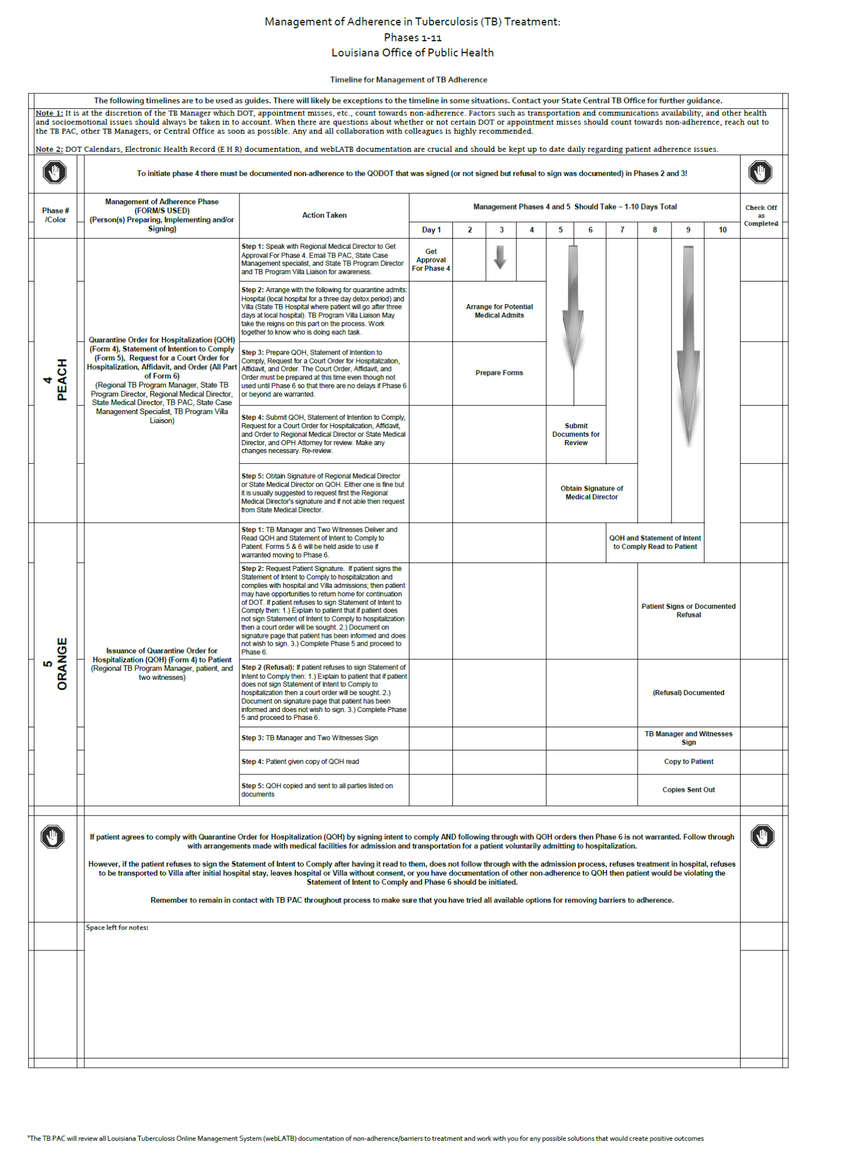
Appendix 11
Management of Adherence in Tuberculosis Treatment (MATT)
Click for PAC Forms in Moodle
*For actual document click Moddle link to right.
Back to PAC Action Flowchart
To Table of Contents

