Slide 1
Understanding and Applying the LIMA (Least Intrusive, Minimally Aversive) Approach
Kristina Spaulding, PhD, CAAB
Smart Dog Training and Behavior LLC

Slide 2
Overview
What is LIMA?
Suggested Methods for Behavioral Modification
Reasoning behind LIMA
What you can do/next steps

Slide 3
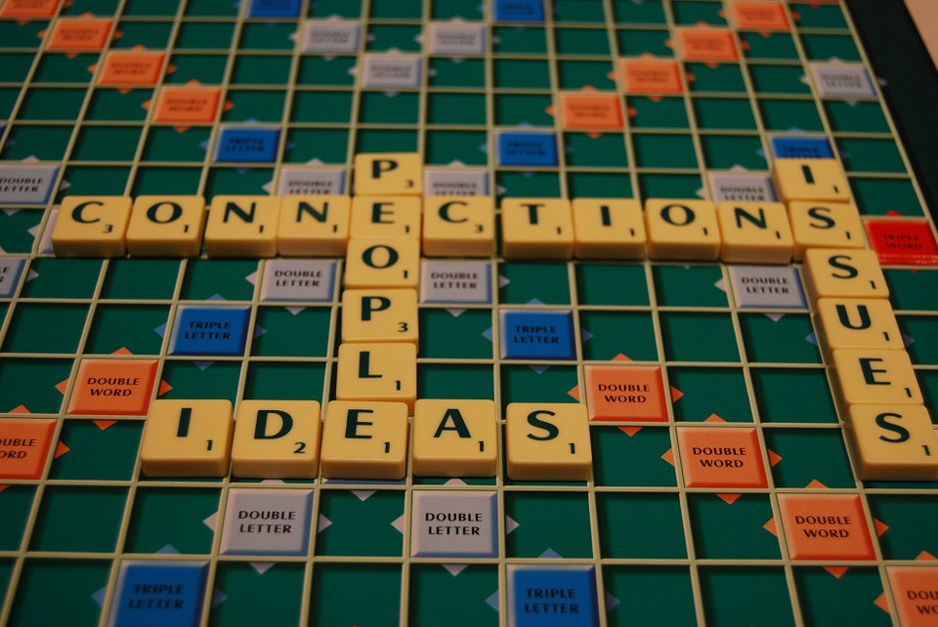

Discussion
Training methods can be a hot button issue
Opportunity to learn and grow as trainer/behaviorist
Be open and non-judgmental
Be kind and respectful

Slide 4
What is LIMA?
Position statement jointly adopted by APDT and International Association of Animal Behavior Consultants (IAABC)
Ethical standard
Reasoning
Methods used should:
Be effective*
Minimize aversive experience for animal
Minimize side effects
Notes:
Without ethical standard – no guidelines
Methods likely based on effectiveness, but also convenience, familiarity, limitations of applicant’s knowledge, emotion
Instead, let’s advocate for effectiveness, compassion and humane treatment

Slide 5
Behavior Analyst’s Standards
From Susan Friedman:
Protect participant’s welfare at all times
Use interventions custom tailored to individual
Design interventions on basis of functional assessment of behavior
Evidence-based treatment
Use scientific methods to implement and evaluate interventions
Notes:
List of behavior analyst’s standards for working with children. Taken from a paper by Susan Friedman, still very applicable to dogs

Slide 6
Why minimize (not eliminate)?
Eliminate may be too high a bar in some cases
Global fear
Some minor errors are unavoidable – eg. reactive dogs
Can still make elimination a goal
Recognizes that not always possible
Notes:
Eliminate too high – examples – global fear, minor errors (eg reactive dogs)
Reducing to zero is still minimizing

Slide 7
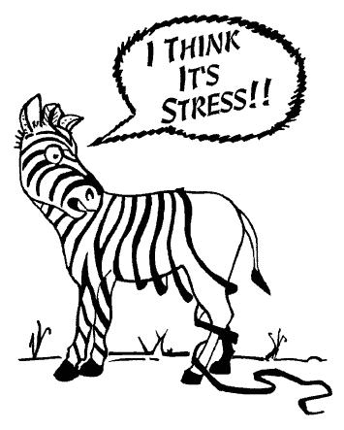
A note on stress
Stress
Challenge to homeostasis release of stress hormones
ALL training will produce some stress (because it’s change)
Too MUCH stress is detrimental

Slide 8
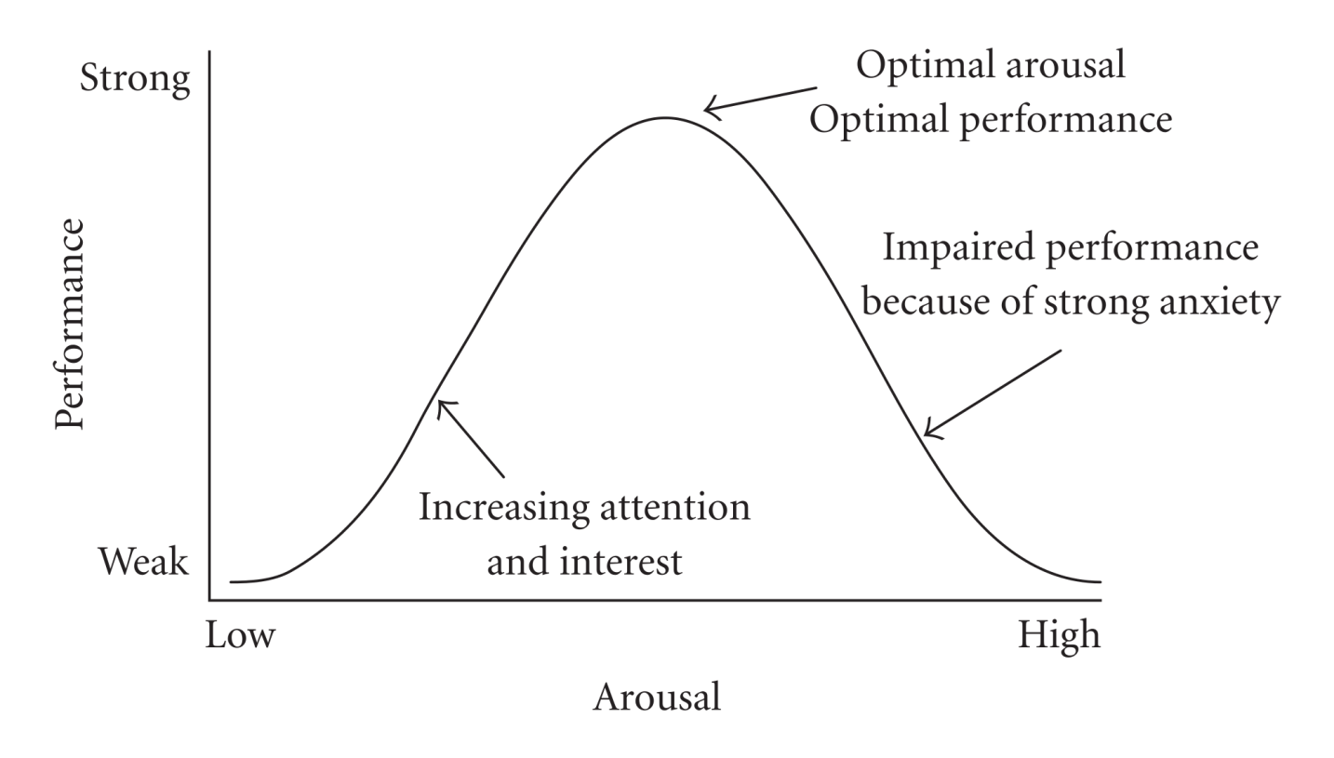
Yerkes-Dodson Law
Performance
Moderate arousal ideal
Notes:
Exam example/graphic

Slide 9
LIMA definition
LIMA requires that trainers and behavior consultants
use the “least intrusive, minimally aversive technique
likely to succeed in achieving a training [or behavior
change] objective with minimal risk of producing
adverse side effects.” It is also a competence criterion,
requiring that trainers and behavior consultants be
adequately trained and skilled in order to ensure that
the least intrusive and aversive procedure is in fact used.

Slide 10
LIMA definition
LIMA requires that trainers and behavior consultants
use the “least intrusive, minimally aversive technique
likely to succeed in achieving a training [or behavior
change] objective with minimal risk of producing
adverse side effects.” It is also a competence criterion,
requiring that trainers and behavior consultants be
adequately trained and skilled in order to ensure that
the least intrusive and aversive procedure is in fact used.

Slide 11
Definitions
Intrusive
Learner’s level of control during intervention
Should be able to use behavior to control events
Consistent with evolved function of behavior
Lack of control one of major factors associated with stress
Aversive
Stimulus causes avoidance
Notes:
Check Friedman paper – how much is hers?

Slide 12
Rank aversiveness of methods
Leaning forward makes the dog cringe
Yelling at the dog doesn’t cause it to bat an eye
Kicking a dog in the side
Using a “scat mat” on a couch so that if the dog jumps up, it gets a mild shock
Using a citronella collar to avoid barking
Stopping when a dog pulls
Shaping a dog that is whining

Slide 13
Humane Hierarchy
Set of procedures for “humane and effective practices”
Components (in alphabetical order)
Antecedent arrangements
Differential reinforcement of alternative behaviors
Extinction, negative reinforcement, negative punishment
Positive punishment
Positive reinforcement
Wellness: Nutritional, physical

Slide 14
Antecedent arrangements
Definition?
Notes:
Ask attendees

Slide 15
Antecedent arrangements
Definition
Managing or changing the environment to prevent behavior in first place
Examples
Separate desks to prevent chatting
Avoid having junk food in house
Walk dog in quiet areas
Keep trash can in cabinet

Slide 16
Differential reinforcement of an incompatible behavior (DRI)
Choose a behavior that is incompatible with the unwanted behavior
That is, cannot do both behaviors at once
Examples
Jumping and sitting
Lunging at another dog and making eye contact with person

Slide 17
Differential reinforcement of an incompatible behavior (DRI)
Make the incompatible behavior (sitting) more reinforcing than the unwanted behavior (jumping)
Results in a decrease in jumping

Slide 18
Extinction
Extinction
Behavior decreases because it’s no longer being reinforced

Slide 19
Learning theory – outdated?
Has anyone heard or read this?

Slide 20
Learning theory – outdated?
Myth
Learning theory is outdated
Calls animals a black box
Replaced by animal cognition
Fact
Early learning theory has been expanded upon
Thorndike and Skinner – early 1900’s – 1970’s
Input/output devices
Study of animal cognition adds complexity to learning theory – does not replace it
Notes:
Add photo of learning books – sampling of undergrad books – required course in most undergrad psych departments
Photos of animals that have demonstrated learning

Slide 21
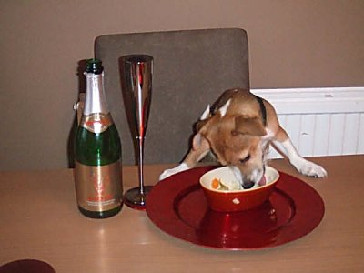
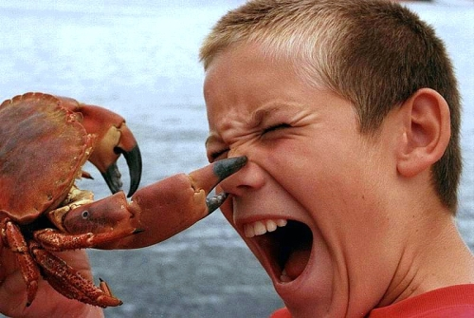
Thorndike’s Law of Effect
A behavior that causes an event that is pleasant for the animal will be strengthened
A behavior that causes an event that is unpleasant for the animal will be weakened.

Slide 22
Instrumental Conditioning
Consequences of an animal’s behavior result in an increase or decrease in the probability of that behavior occurring again
Positive Reinforcement
Addition of desirable event/object
Behavior strengthened or more likely in future

Slide 23
Instrumental Conditioning
Consequences of an animal’s behavior result in an increase or decrease in the probability of that behavior occurring again
Positive Reinforcement
Negative Reinforcement
Addition of desirable event/object
Behavior strengthened or more likely in future
Removal of undesirable event/object
Behavior strengthened or more likely in future

Slide 24
Instrumental Conditioning
Consequences of an animal’s behavior result in an increase or decrease in the probability of that behavior occurring again
Addition of undesirable event/object
Weakens behavior
Positive Reinforcement
Negative Reinforcement
Addition of desirable event/object
Behavior strengthened or more likely in future
Removal of undesirable event/object
Behavior strengthened or more likely in future
Positive
Punishment
Addition of undesirable event/object
Weakens behavior

Slide 25
Instrumental Conditioning
Consequences of an animal’s behavior result in an increase or decrease in the probability of that behavior occurring again
Addition of undesirable event/object
Weakens behavior
Positive Reinforcement
Negative Reinforcement
Addition of desirable event/object
Behavior strengthened or more likely in future
Removal of undesirable event/object
Behavior strengthened or more likely in future
Positive
Punishment
Negative
Punishment
Addition of undesirable event/object
Weakens behavior
Removal of desirable event/object
Weakens behavior

Slide 26
Wellness: nutritional, physical
Make sure basic nutritional and physical needs are being met
Rule out possible medical factors
Notes:
Examples from CAABs??

Slide 27
Suggested Hierarchy of Behavioral Change
Place in order from 1 – 6 based on which approach you would use FIRST.
1 = first method/approach, 6 = last method/approach
Antecedent arrangements
Differential reinforcement of alternative behaviors
Extinction, negative reinforcement, negative punishment
Positive punishment
Positive reinforcement
Wellness: Nutritional, physical

Slide 28
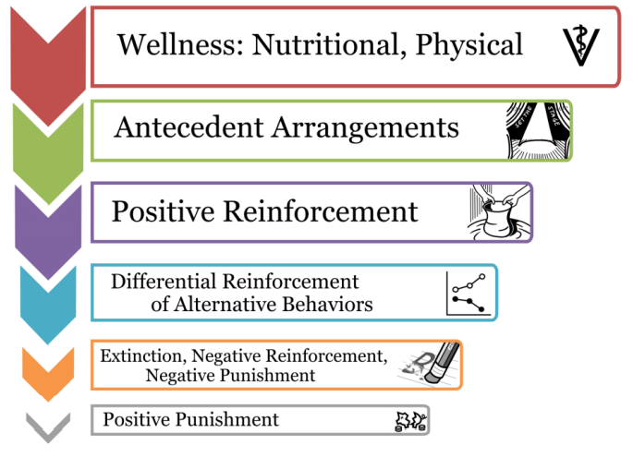
Suggested Hierarchy

Slide 29
Reasoning
“We seek to prevent the abuses and potential
repercussions of unnecessary, inappropriate, poorly
applied or inhumane uses of punishment.”

Slide 30

Reasoning
Top three – Wellness, Antecedent arrangements, positive reinforcement
What if you start with positive reinforcement?
Haven’t addressed wellness or management
Unlikely to be effective
Notes:
Remember – needs to be effective too
Example: Dog won’t come inside – not enough enrichment, letting dog loose in yard

Slide 31
Extinction, -R, Punishment
Extinction can be stressful
Also less effective on it’s own
Better combined with teaching dog what TO do
Negative reinforcement, punishment -> side effects
Notes:
Extinction can also be hard to implement – used to recommend extinction for barking for attention – often don’t recommend that alone anymore because compliance is very low (at least if dog is very persistant)

Slide 32
Cooper et al., 2014
First study
Preliminary study
Observed dogs trained on e-collars
Second study
Three groups of dogs:
Trained using e-collar by industry approved trainers
Started at lowest stim, gradually increased
Used pre-warning cue
Same trainers as 1st group, but without e-collars
Positive reinforcement trainers with positive reinforcement
Notes:
First study – observational – records dog’s reactions when rec’d stimulation
Second study – measured cortisol, observed dog’s behavior, looked at effectiveness of training and owner’s comfort level in implementing

Slide 33
Cooper et al., 2014
First study
Abrupt changes in movement
Increase in vocalizations, including yelps and whines
Increase in percentage of time tail was tucked (2% -> 20%)
Increase in percentage of time “tense” (10% -> 50%)
Decrease in amount of time investigating (20% -> 5%)
Increase in interaction with owners (14% -> 56%)
Elevated cortisol levels after stimulation
Notes:
Remember - no

Slide 34
Cooper et al., 2014
2nd study
Dogs trained with recc. use of e-collar (compared to dogs without e-collar):
More tense
Less time sniffing and exploring
No different in lip licking or yawning
No different in cortisol levels
No different in efficacy
Owners of e-collar trained dogs less confident in applying methods

Slide 35
Herron et al., 2009
Aggression in response to training methods
Aversive, direct confrontation (alpha roll, dominance down)
Aversive, indirect confrontation (yelling, stare down)
Reward based (food rewards, NILF)
Neutral (avoidance of triggers, increase exercise)
Aggression = growl/bare teeth/snap/lunge/bite
Notes:
Sample of dogs that had scheduled appointments at a behavior clinic – send survey as part of intake forms for appointment

Slide 36
Herron et al., 2009
What percentage of dogs reacted aggressively to:
Alpha roll:
Yelling “no”:
Food reward training:
Increasing exercise:

Slide 37
Herron et al., 2009
What percentage of dogs reacted aggressively to:
Alpha roll: 31%
Yelling “no”: 15%
Food reward training: 2%
Increasing exercise: 0%

Slide 38
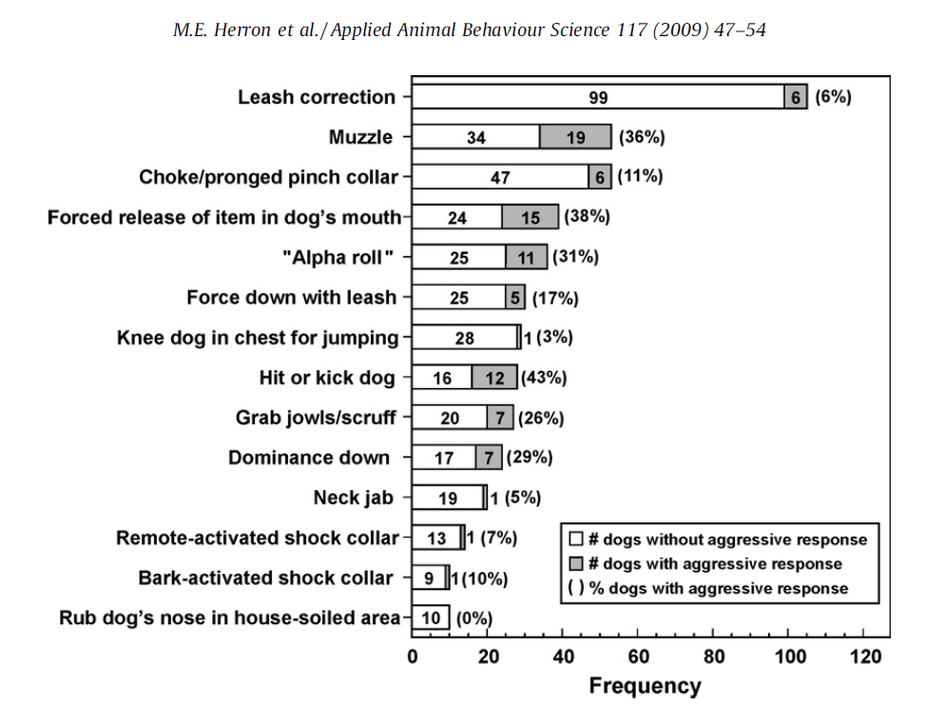
Notes:
Some instances of aggression in all cases, with exception of rubbing dog’s nose in soiled area
Some show higher percentages than others – but don’t have information on if these differences are statistically significant

Slide 39
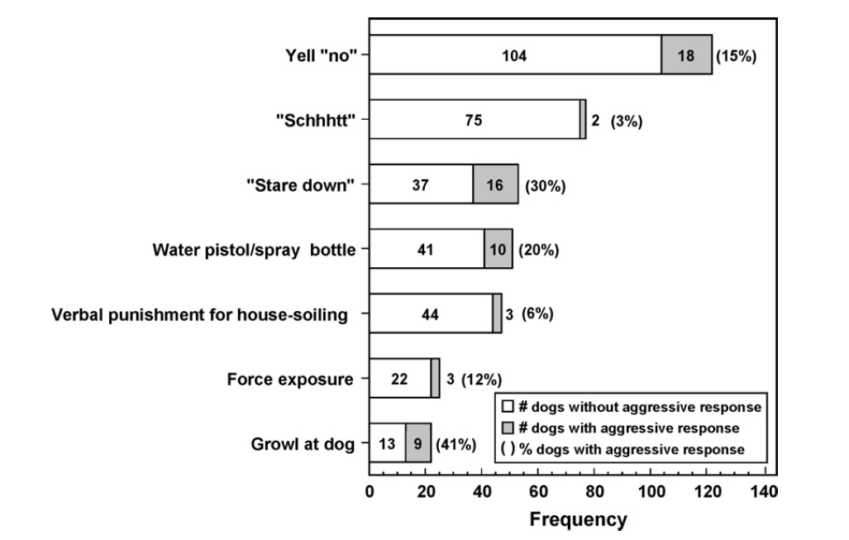
Notes:
Not physical, but still some high percentages here, and again, all methods provoked aggression in at least some cases

Slide 40
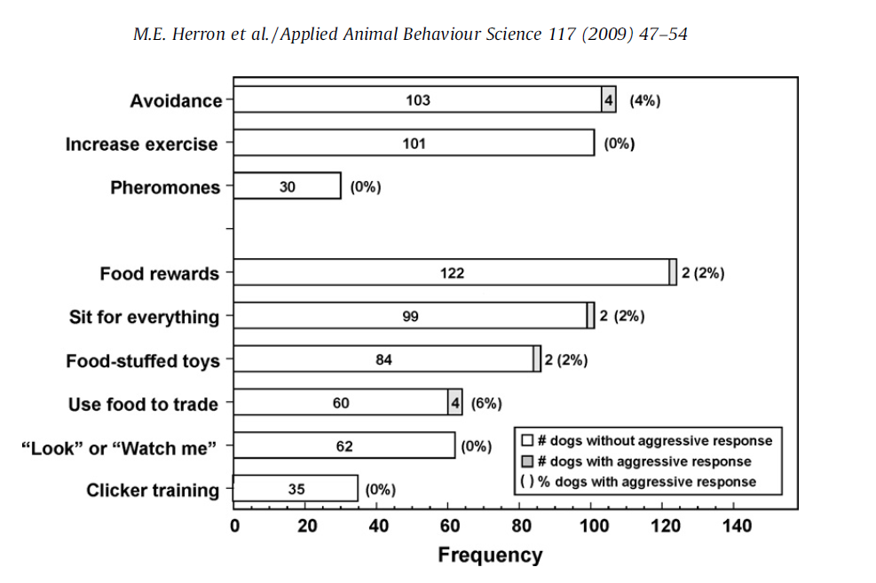
Notes:
Several methods still provoked aggression, but percentages are MUCH lower (usually 2%, one is 6%) – most of confrontational methods were 10% or more, several were over 25%
But, again – remember – no statistical tests for significance
That means it’s difficult to say if this is due to experimental set up or just chance (we’ll come back to this)

Slide 41
Summary
Aggressive responses even with indirect confrontations
Some aggression with reward based methods, but much lower
Dogs with aggression toward people, significantly more likely than other dogs to show aggression in response to:
Alpha roll
Yelling no
Not black and white
Significant??

Slide 42
Schilder & van der Borg, 2003
Police service dogs
Experimental group – trained with shock
Control group – no shock
Direct results of shock
21% of dogs showed no response
Remaining – variety of behaviors
Notes:
Most common (over 40% of dogs) – lowering of ear position, yelp, tongue flicking, lowering of tail, squeal

Slide 43
Schilder & van der Borg, 2003
Observations taken while no shocks applied to either group
Conclusions
Differences between groups were small, but consistent
Shocked dogs:
More stressed than control dog at training grounds and park
Connect handlers with shock
Important points
Control dogs still trained using “fairly harsh” methods
Presumably bred for police work
Notes:
Most common (over 40% of dogs) – lowering of ear position, yelp, tongue flicking, lowering of tail, squeal

Slide 44
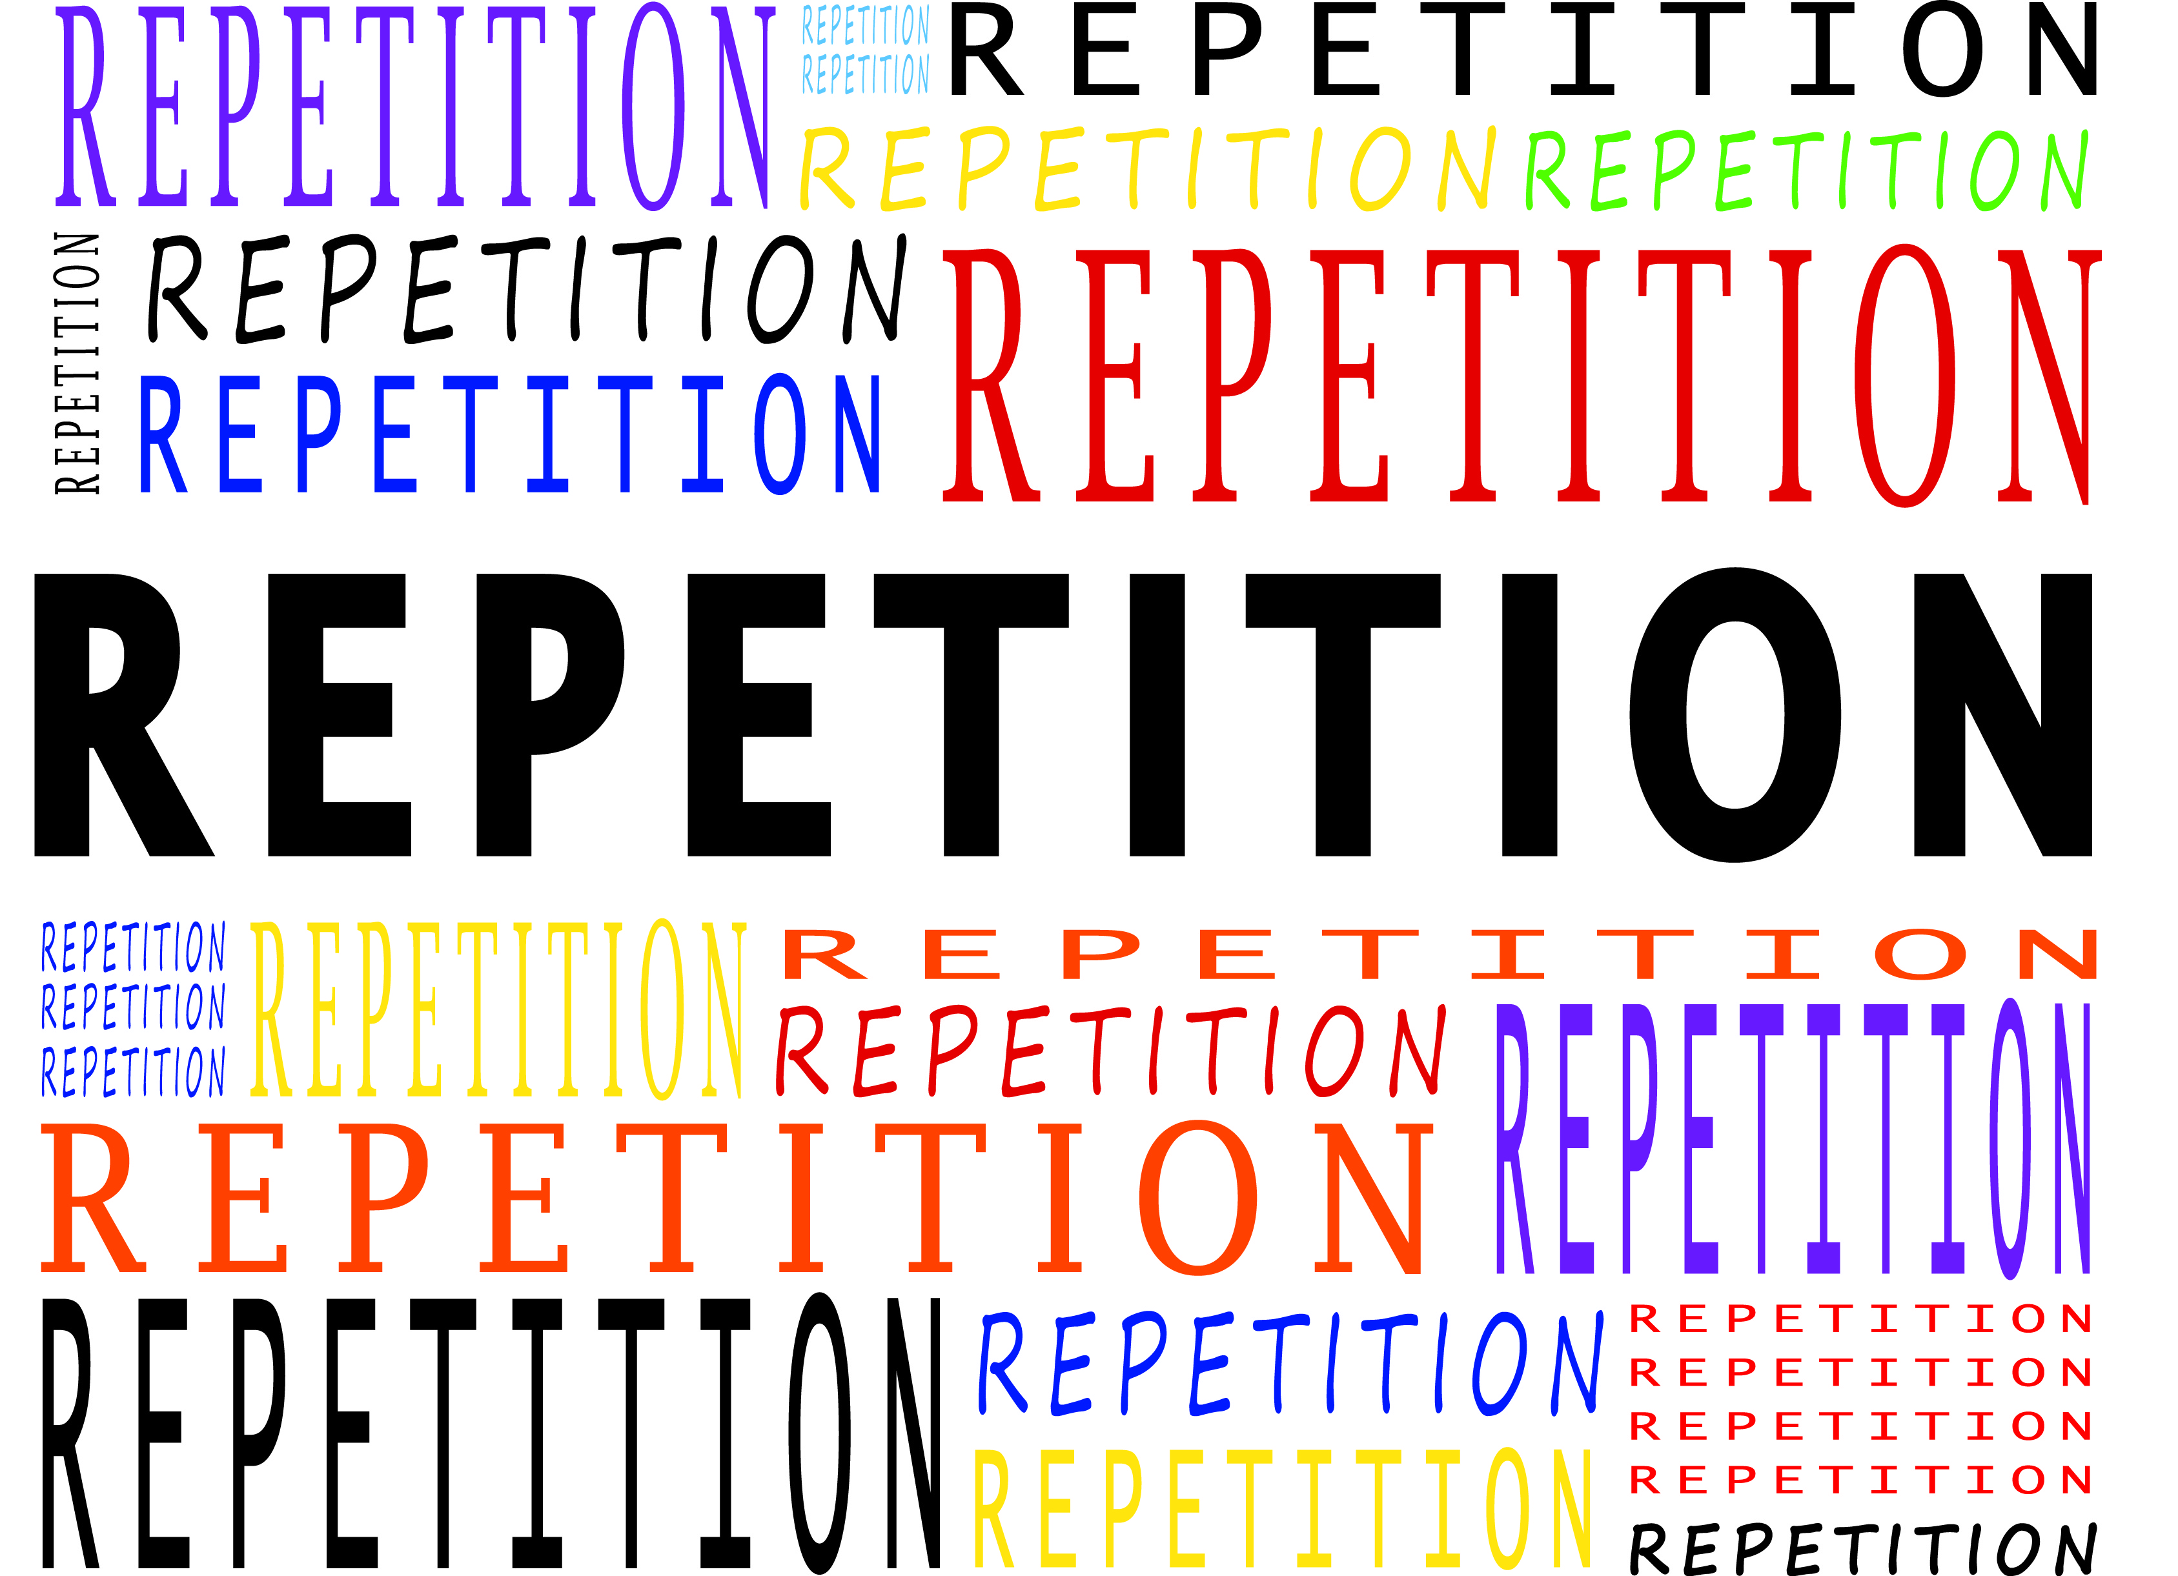
Just a few papers…
Each of these papers have flaws
Easy to argue reasons they may not be valid
Notes:
No paper is perfect. They all have flaws. This is why repetition is so important
And in this case, we are lucky, because this particular subject has been studied a LOT. For many decades. In many different experimental set ups and with many different species (including dogs). And the results are now very clear and have been replicated many times. So, I am now going to go into what we know about the use of punishment from decades of research. This is likely review for some of you, but I hope it will be useful review, and possible new information for some people. This information is a large part of the rationale for the LIMA approach.

Slide 45
Effective punishment

Slide 46


Effective punishment

Slide 47
Think about it
The examples below share at least one characteristic that makes them less effective than they could be. What is it?
Mother threatening child to take away privileges when get home (two problems with this)
Detention at school
Correcting a dog for destructive behavior or peeing in house when you get home from work
Justice system
Answer in 1 word

Slide 48
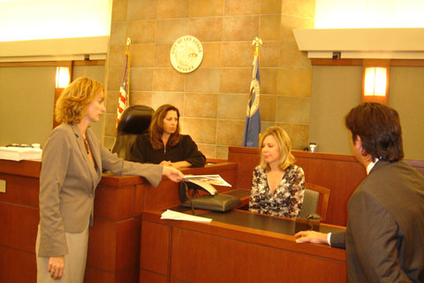
Effective Punishment
In order to be effective, punishment should:
Show contiguity
Occur immediately after the behavior

Slide 49
Effective Punishment
In order to be effective, punishment should:
Show contiguity
Occur immediately after the behavior
Show contingency
Occur consistently after (and only after) the behavior

Slide 50
Effective Punishment
In order to be effective, punishment should:
Stop the behavior the first time
“Goldilocks” intensity
Gradually increasing intensity
Increases tolerance

Slide 51
Effective Punishment
In order to be effective, punishment should:
Stop the behavior the first time
“Goldilocks” intensity
Gradually increasing intensity
Increases tolerance
10 v
Behavior continues

Slide 52
Effective Punishment
In order to be effective, punishment should:
Stop the behavior the first time
“Goldilocks” intensity
Gradually increasing intensity
Increases tolerance
10 v 20 v
Behavior continues

Slide 53
Effective Punishment
In order to be effective, punishment should:
Stop the behavior the first time
“Goldilocks” intensity
Gradually increasing intensity
Increases tolerance
10 v 20 v 30 v
Behavior continues

Slide 54
Effective Punishment
In order to be effective, punishment should:
Stop the behavior the first time
“Goldilocks” intensity
Gradually increasing intensity
Increases tolerance
10 v 20 v 30 v 40 v Develops tolerance
Behavior continues

Slide 55
Effective Punishment
In order to be effective, punishment should:
Stop the behavior the first time
“Goldilocks” intensity
Gradually increasing intensity
Increases tolerance
30 v Stops behavior
Notes:
To be clear – not advocating this, but this is an issue with punishment, because -
How do you know????
If intensity is too low, won’t work. If it’s too high, welfare of animal becomes a concern – and it’s really easy to make either mistake

Slide 56
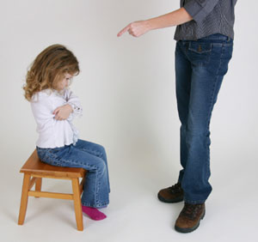
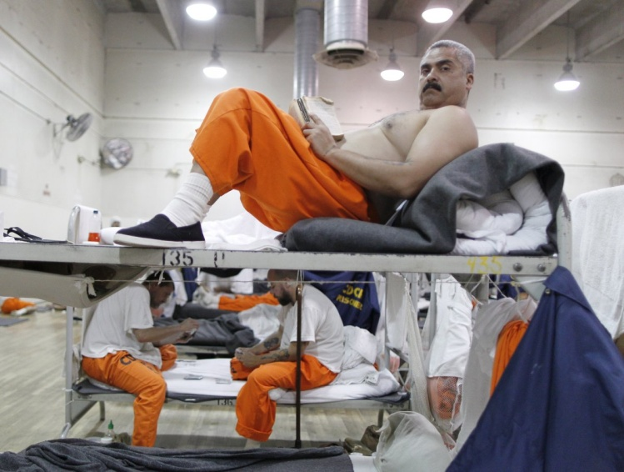
Does it work?
Can be effective in the short-term
Rarely effective in long-term

Slide 57
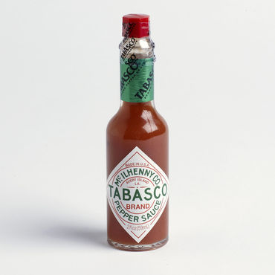

Why punishment doesn’t work
Why doesn’t it work?
Often (almost always) not used correctly
Sometimes the “punishment” is reinforcing
Notes:
Often (almost always) not used correctly
Based on emotion
Lack of training
Intensity necessary to stop behavior is unethical (or just unknown)
Sometimes the “punishment” is reinforcing
Acting out
Suspensions
Tabasco sauce

Slide 58
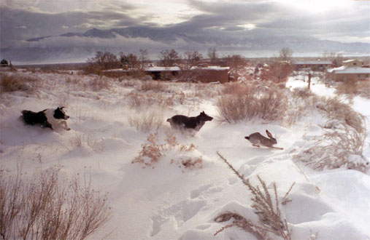
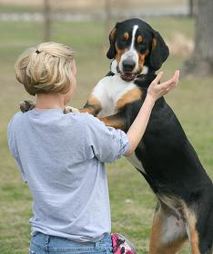

Why punishment doesn’t work
Has to overcome the reinforcer**
There is no alternative (real or perceived)
Notes:
Has to overcome the reinforcer**
Chasing animals
Release from emotional distress
Stealing food
There is no alternative
Real or perceived
Crime
Release from emotional distress
Jumping

Slide 59

Why punishment doesn’t work
In sum
It doesn’t address the cause of the behavior
It doesn’t provide an alternative
Very difficult to use correctly
Even for trained professionals (intensity)

Slide 60
Punishment
Okay, but it DOES work some of the time
If all criteria are met
High contiguity
High contingency
Intense enough to stop behavior the first time
High risk of side effects
Ethical concerns

Slide 61
Side Effects of Punishment
Notes:
Include human examples as well because sometimes I think it helps us relate and better understand the examples

Slide 62
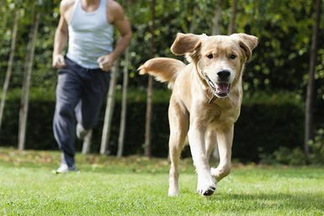

Escape
Attempts to escape or avoid punishment
Run away
Hide
Frequent punishment -> good at escape tactics
Notes:
Punished for going to the bathroom in the house -> hide

Slide 63



Aggression
Increased aggression for defense
Dog bites when being alpha rolled
Defiant/angry children
Ethnic/country disputes – Ukraine/Russia
More common when escape is not
possible
Notes:
Bullies, vandalism at work

Slide 64

Aggression
Redirected aggression
Punished animal attacks “innocent bystander”
Increased stress
Examples
Lab animals
Injury
Notes:
Punished dog redirects onto other person or dog

Slide 65
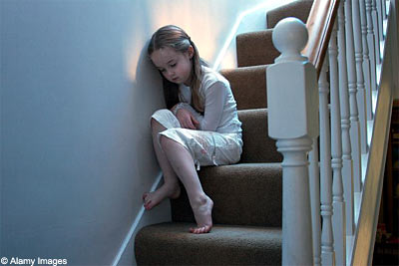
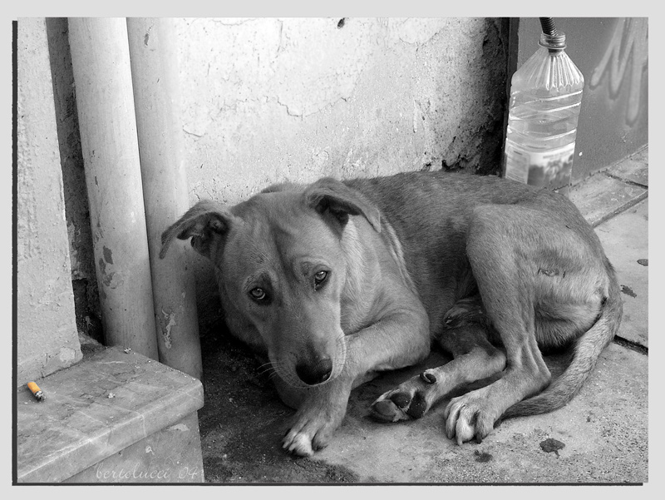
Learned helplessness
General suppression of behavior
Especially when aggression and escape are not possible
Children and animals
Learned helplessness -> depression

Slide 66
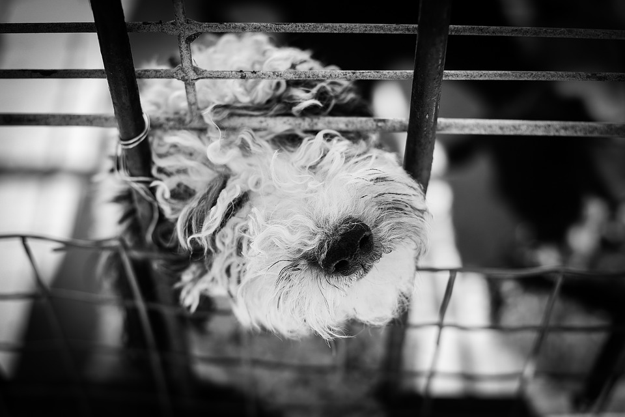
Selgiman studies
Content warning
Dogs placed in “box” and shocked
Normal reaction – escape shock
Prevent escape – dog becomes passive
After TWO trials
Behavior very persistent
Notes:
Persisted – even when removed barrier, even if called dog, even if enticed with food

Slide 67

Stop warning
Can teach a dog not to warn
Still fearful or stressed
May bite without ritualized warnings

Slide 68
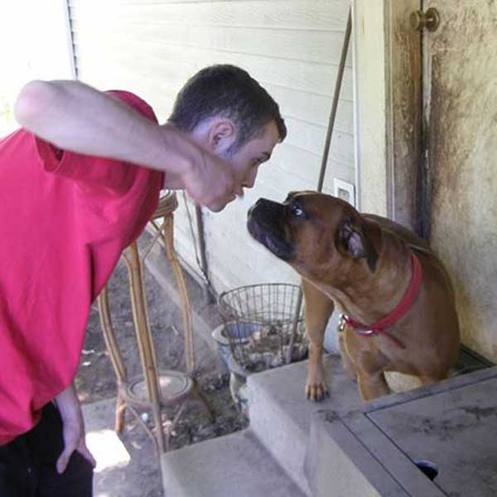
Abuse
Abuse
Often punishment that gets out of hand
Often starts mild and gradually escalates
What does this do?

Slide 69
What about negative reinforcement?
This can lead to unwanted side effects as well
Escape avoidance learning
Behavior initially reinforced by escaping aversive stimulus
Quickly learn to avoid situation entirely
Metronome?
https://www.metronomeonline.com/

Slide 70
Answering quickly
I am going to play a sound
Will turn off sound once you answer two questions:
Negative reinforcement ______ behavior.
Negative punishment removes something ______.
Notes:
1. Increases
2. Pleasant

Slide 71
How did you feel while the sound was playing?
If I did this every time I asked a question:
How might it effect your learning?
Would you continue to come to my talks?

Slide 72
What about positive reinforcement?
Can it have negative side effects too?
Yes!
Milder
Lower risk – generally can avoid completely if done correctly

Slide 73
Summary
Punishment can be effective, but hard to implement correctly
Doesn’t appear to be MORE effective than other methods
Has more side effects

Slide 74
Other concepts of LIMA

Slide 75
Additional concepts
Competence-based
Positive reinforcement and understanding the learner
Clarity and consistency in Problem Solving
Preventing the abuse
Choice and control for the learner
What do you want the animal TO do?

Slide 76
Competence-based
Responsibility of trainer and behaviorist to ensure have skills to follow hierarchy
Always room for improvement
Can you imagine a doctor saying, “Well, I’ve learned all there is to know about medicine. I am going to stop learning now.”
There is a reason there are continuing ed requirements!
Notes:
Find that you’re using positive punishment a lot?
Refer those cases out
Continue to increase your education
Even if not using punishment? Always strive to improve your education.
I have PhD – very well trained
Do not, by any stretch of the imagination, think I have nothing left to learn
Be better at: environmental rewards, play, communicating with clients
Part of aims of LIMA is for methods to be maximally effective

Slide 77
Positive reinforcement and understanding the learner
“Positive reinforcement should be the first line of teaching, training and behavior change program considered, and should be applied consistently”
Understanding the learner
Type of reinforcement
Environmental sensitivity
Stamina for training
Specific limitations

Slide 78
Clarity and consistency in problem solving
“Clear, consistent and possible”
Apply to dogs and people
Clear, consistent criteria
Good communication
Effective coaching and teaching skills
Notes:
Responsibility to learn about working with people too

Slide 79
Preventing abuse
We seek to prevent the abuses and potential repercussions of unnecessary, inappropriate, poorly applied or inhumane uses of punishment.
Notes:
Talked about this earlier – many side effects, usually better options

Slide 80
Choice and control for the learner
“LIMA guidelines require that consultants always offer the learner as much control and choice as possible during the learning process, and treat each individual of any species with respect and awareness of the learner’s individual nature and needs.”
Hot topic lately
Make best choice for the dog the easiest choice - Susan Garrett

Slide 81
What do you want the animal TO do?
Addresses issue of punishment – no other options (remember, can be real or perceived)
Teach the behavior you want
Notes:
Examples – go to place, heel

Slide 82
Applying LIMA

Slide 83
What can you do?
Familiarize yourself with the hierarchy
Do a self evaluation
Make an education plan
Develop a clear cut, easy to follow protocol for referring out
Ask for help

Slide 84
Self Evaluation
Proactive vs. reactive?
Do you follow the hierarchy?
Current education level and mechanical skills
APDT Body of Knowledge
CCPDT
Appropriate referrals?
Continuing education
Notes:
Proactive – acting in anticipation of future problems, needs or changes
Reactive – acting in response to a situation rather than creating or controlling it
How does your use of punishment compare to reinforcement? Are there areas where you could prioritize other approaches that may be more effective? What is preventing you from using approaches prioritized in the hierarchy?
What are your strengths? Your weaknesses? Where could you improve your knowledge? Are there mechanical skills you are lacking?
Do you pursue continuing education? How do you choose which education sources to pursue?

Slide 85
Education plan
APDT Body of Knowledge
Critical thinking skills
Mechanical skills
Familiarize yourself with the research
Current papers
Analysis, interpretation, critique and application of scientific papers

Slide 86
Referrals and Advice
Know your limits
Get to know other trainers and behaviorists in your area
Ask for help when needed
Find a mentor or internship
Look for evidence based groups/trainers that adhere to LIMA standards

Slide 87
Moving forward
As a field, we need to:
Continue and expand education efforts
Be inclusive
Focus on prevention
Behavioral impacts of early experience
Do it right the first time
Educate owners about early warning signs

Slide 88
Moving forward
Focus on prevention
Improved understanding of:
Causes of behavior problems
Dog cognition
Animal learning
Effectiveness of various treatments
Factors influencing variability
Improved ability to predict future behavior
Pet dogs
Shelter dogs
Notes:
Promote, conduct research, seek out research

Slide 89

Wrap up
Effectiveness is not enough
Also owe it to our dogs to use humane methods
Our responsibility to make sure this happens
Notes:
Our responsibility as trainers or behaviorists is to make sure that we have the skills and knowledge necessary to make this happen. We need to ALWAYS be striving to use more humane and more effective methods and to continue our education in order to consistently improve our skills and knowledge. We need to promote, read and learn to apply behavior research. Also need to communicate with community and others in the field so that we can share this information with as many people as possible. If you think you already know it all, you are wrong and you are doing yourself and your clients – dog and human alike – a disservice. Never give up on becoming a better, kinder, more effective trainer or behaviorist – this is how we change the field and the whole dog community – one person, one step at a time. Thank you.

