Slide 1


ISMPP University
Member Research Oral Presentations from the 20th Annual Meeting
May 29, 2024
Webinar will begin promptly at: ​​
11 AM ET / 4 PM GMT
Notes:
Hi everyone; welcome and thank you for joining today’s ISMPP U on “Member Research Oral Presentations from the 20th Annual Meeting.”
This webinar has been approved for 1 ISMPP CMPP Recertification Credit. You may continue to collect a screenshot for CMPP certification but you will now be sent a certificate of attendance after every ISMPP U that you can also upload into the credit tracker. ​
​
This webinar is being recorded and will be made available on the ISMPP website within 24 hours after the webinar.

Slide 2








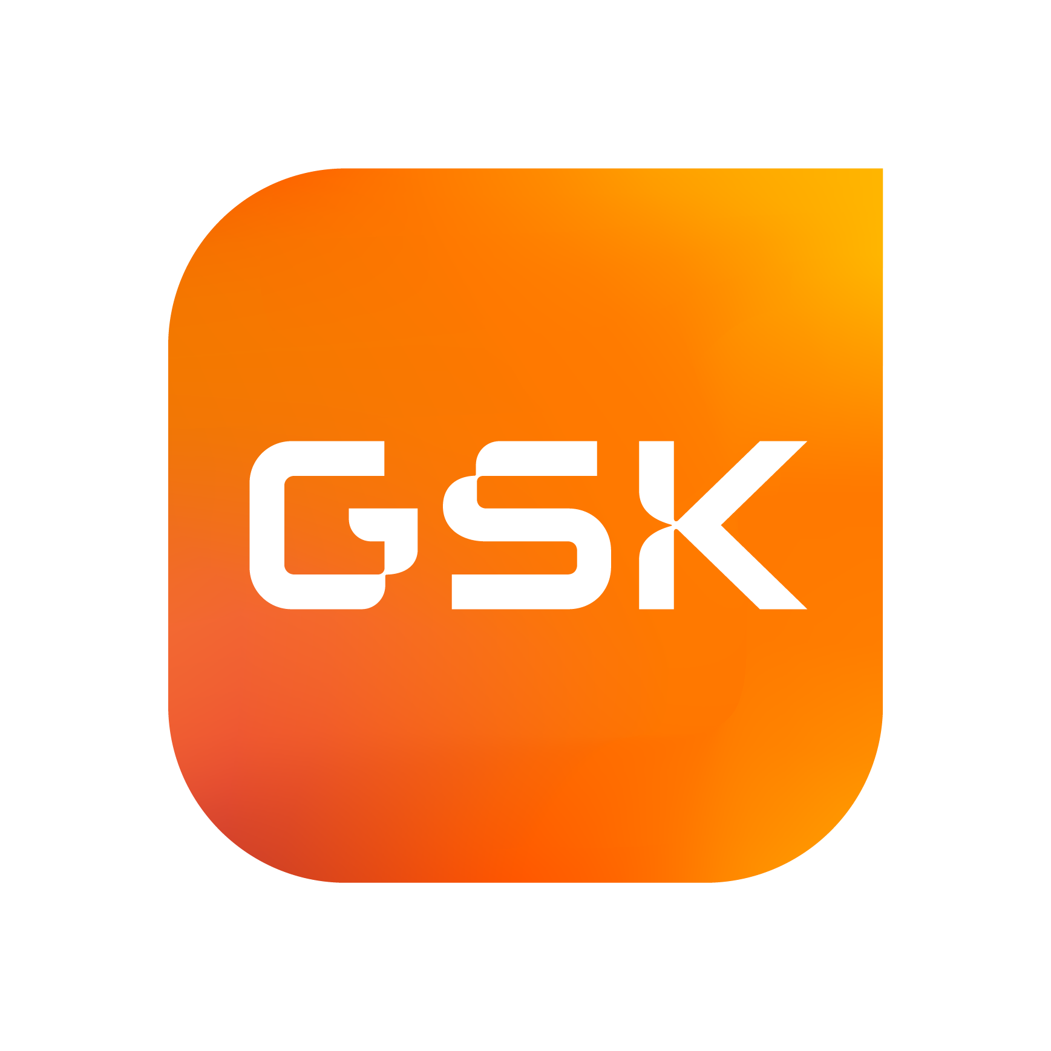







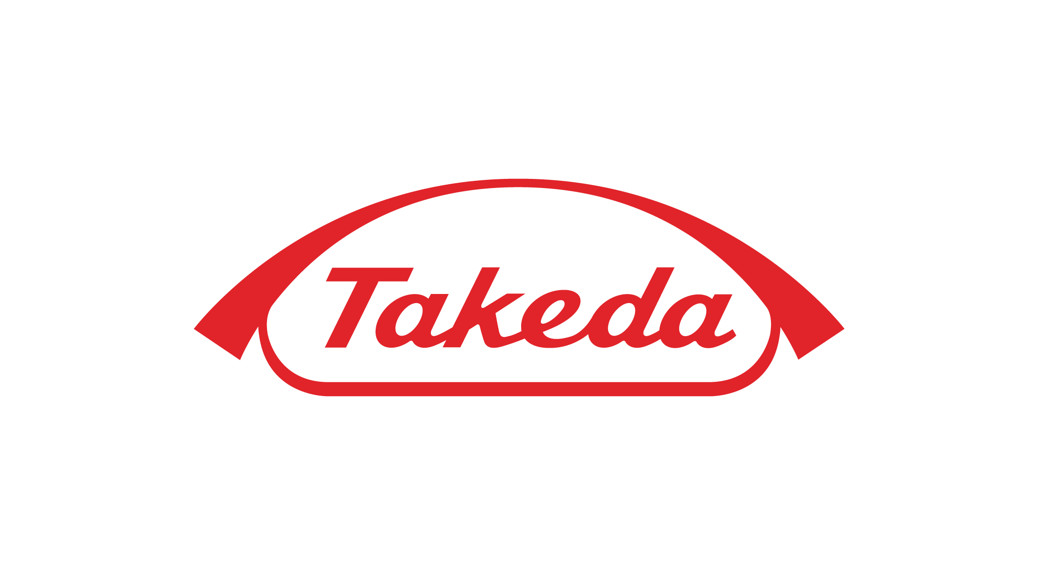




ISMPP Would Like to Thank…
2
. . . the following Titanium and Platinum Corporate Sponsors for their ongoing support of the Society:
Notes:
First a sincere thank you to all of ISMPP’s titanium and platinum corporate sponsors for their ongoing support of the Society.

Slide 3

ISMPP Announcements
Application deadline for the September CMPP
exam is August 1
Notes:
And, for those who are seeking to become CMPP-certified or looking to renew your certification, The application deadline for the next exam window is August 1, 2024

Slide 4
How to Ask Questions
4
Feel free to ask a question at any time; however, all questions will be held until the end of the presentation.
To ask a question, open the Q&A window and type your question into the
Q&A box. Click Send.
Note: Check Send Anonymously if you do not want your name attached
to your question in the Q&A.
We will make every effort to respond to all questions live (out loud).
Notes:
Reminder that for today’s webinar, You can submit a question at any time during the presentation by following the instructions on this slide.
To ask a question, open the Q&A window, type in your question, and click send.
The faculty will answer questions at the end of all the presentations.

Slide 5
Disclaimer
Information presented reflects the personal knowledge and opinions of the faculty and does not necessarily represent the position of their current or past employers
Notes:
Please take a moment to read our general disclaimer.
OR
Please know that the Information presented by our speakers today reflect their personal knowledge and opinions and do not necessarily represent the position of their current or past employers

Slide 6
Objectives
Understand how genAI can be used as an analytical tool to understand the content of text at scale.
Learn how artificial intelligence can assist them in the difficult task of conveying complex ideas with clarity and simplicity.
Appreciate approaches that can be used to quantify the narrative properties of journal articles and narrative elements that might translate to effective storytelling
Notes:
These are the learning objectives for today’s webinar. We want you to....
1. Understand how genAI can be used as an analytical tool to understand the content of text at scale.
2. Learn how artificial intelligence can assist them in the difficult task of conveying complex ideas with clarity and simplicity.
3. Appreciate approaches that can be used to quantify the narrative properties of journal articles and narrative elements that might translate to effective storytelling

Slide 7





Today’s Presenters
Moderator: Gary Burd
EVP, Head of Medical Services
Caudex, an IPG Health company
Tomas Rees
Director of Innovation
Oxford PharmaGenesis
Stephen Towers
Senior Vice President,
Strategy & Innovation
Healthcare Consultancy Group
Zeynep Turan
Associate Scientific Director,
Healthcare Consultancy
Group
Walter Bender
Chief Scientific Officer & Co-founder, Sorcero, Inc.

Slide 8
An artificial intelligence (AI) approach to analyze the context of publication citations
David Lickorish,¹ Tomas Rees,^{2,a} Hollie Rawlings,² Eileen Burkart-Hartman,¹ Shailesh Desai¹
¹Takeda Pharmaceuticals U.S.A., Inc., Lexington, MA, USA
²Oxford PharmaGenesis, Oxford, UK
ªPresenting author

Slide 9
Acknowledgements
DL, EB-H and SD are employees of Takeda Pharmaceuticals U.S.A., Inc., and hold stock and/or stock options in Takeda Pharmaceutical Company Limited. TR and HR are employees of Oxford PharmaGenesis, which was contracted by Takeda Pharmaceuticals U.S.A., Inc. to conduct the study
This study was funded by Takeda Pharmaceuticals U.S.A., Inc. Medical writing support was provided by Michael Lee of Oxford PharmaGenesis, Oxford, UK, and funded by Takeda Pharmaceuticals U.S.A., Inc., in accordance with Good Publication Practice (GPP 2022) guidelines (https://www.ismpp.org/gpp-2022)

Slide 10
AI – A Tool for Understanding Publication Impact?
Generative AI can power the analysis of large volumes of unstructured text
Can it help us understand what people are saying about a clinical trial publication?
AI, artificial intelligence
This information is for educational use only. Do not copy. Do not distribute.

Slide 11



Methods
Takeda US publication portfolios
Conventional impact
metrics
Reach
Scored at 30 days after publication
Derived from number of mentions by:
  news outlets
  social media
Engagement
Scored at 6 months after publication
Derived from number of:
  article citations
  Mendeley saves
AI-powered content analysis
Citation statements
Retrieved by scite
Analyzed by a customized AI-powered tool using an LLM in a secure environment
Gastroenterology
Neuroscience
Rare disease
Articles published between
January 1, 2022 and November 30, 2023
AI, artificial intelligence; LLM, large language model

Slide 12
Results at the cutoff date of November 30, 2023
Takeda US publication portfolio
Reach and engagement
This information is for educational use only. Do not copy. Do not distribute

Slide 13



Reach and engagement scores

Slide 14
Exploring engagement: mentions of study drug
Neuroscience
98 citation statements
48 mention study drug
Gastrointestinal
6 citation statements
2 mention study drug
Rare disease
1 citation statements
0 mention study drug

Slide 15
An LLM classified the sentiment of citation statements towards the study drug

Slide 16
Comparison of drug sentiment with Scite classification
Scite classification

Slide 17
In-paper location of citation statements towards the study drug

Slide 18
Here’s why the LLM classified statements as positive
LLM: “The text describes significant and sustained improvements in patient functioning, depressive and cognitive symptoms, sexual function, and HRQoL during a 6-month period of vortioxetine treatment, indicating a positive sentiment towards the drug.”
LLM: “The text describes observed improvements in DSST score with vortioxetine treatment, indicating a clinically meaningful increase, and consistency with previous studies, which suggests a positive sentiment towards the drug's effects.”
LLM: “The text describes observed improvements in DSST score with vortioxetine treatment, indicating a clinically meaningful increase, and consistency with previous studies, which suggests a positive sentiment towards the drug's effects.”
LLM: “The text describes observed improvements in DSST score with vortioxetine treatment, indicating a clinically meaningful increase, and consistency with previous studies, which suggests a positive sentiment towards the drug's effects.”
Citation statement: “Integral to its real-world design, RELIEVE had no exclusion criteria for concomitant anxiety disorders, and thus included a significant proportion of patients with diagnoses of both MDD and GAD. Findings in the overall study population of patients with MDD in RELIEVE revealed significant and sustained improvements in patient functioning, as well as in measures of depressive and cognitive symptoms, sexual function and HRQoL, across a period of 6 months of vortioxetine treatment ( <cite data-doi="10.3389/fpsyt.2022.824831"> Mattingly et al, 2022 </cite> ). In this subgroup analysis of data from the RELIEVE study, the effectiveness and safety of vortioxetine in patients with MDD and co-morbid GAD was assessed through measures of self-reported patient functioning, depression, cognition, sexual function, HRQoL and adverse events (AEs).”
Citation statement: “The observed improvements in DSST score seen in our study appear clinically meaningful in a community setting, with an increase in the mean DSST score of approximately 4 points observed over the 24 weeks of vortioxetine treatment. While this change from baseline did not reach statistical significance, it is in line with the results of previous studies in more homogeneous patient groups ( <cite data-doi="10.1097/yic.0b013e3283542457"> Katona et al, 2012 </cite> ; <cite data-doi="10.1017/s1461145714000546"> McIntyre et al, 2014 </cite> ; <cite data-doi="10.1038/npp.2015.52"> Mahableshwarkar et al, 2015 </cite> ; <cite data-doi="10.3389/fpsyt.2022.824831"> Mattingly et al, 2022 </cite> ). In a randomized controlled trial in elderly patients with MDD without a diagnosis of dementia, mean change in DSST score after 8 weeks of vortioxetine treatment was approximately 3 points ( <cite data-doi="10.1097/yic.0b013e3283542457"> Katona et al, 2012 </cite> ); this is consistent with the mean change from baseline of approximately 2 points after 8 weeks of vortioxetine treatment in the present study.”
DSST, digit symbol substitution test; HRQoL, health-related quality of life; LLM, large language model;
MDD, major depressive disorder; RELIEVE, Real-Life Effectiveness of Vortioxetine in Depression

Slide 19
A summary of the citations of a single paper
Summary of 13 positive citations
Summary of 12 neutral citations
“A published clinical study on the use of vortioxetine for treating Major Depressive Disorder (MDD) has demonstrated positive outcomes. Patients experienced significant improvements in functioning, depressive and cognitive symptoms, sexual function, and health-related quality of life over a 6-month period.
Vortioxetine treatment was associated with minimal weight change, which is considered favorable and aligns with its safety profile. These benefits were most pronounced when vortioxetine was used as first-line therapy, although clinically meaningful improvements were also observed in patients who had received prior antidepressant therapy.
The drug was found to be well-tolerated even in specific patient subgroups, such as elderly individuals and those with comorbidities, including Alzheimer's disease, with adverse events being mostly mild to moderate in intensity.”
“The clinical study, known as the RELIEVE study, assessed the effectiveness and safety of vortioxetine in patients with Major Depressive Disorder (MDD).
Throughout various excerpts, factual details are presented regarding the study's design, patient treatment regimes, and subgroup analyses, but no explicit results or judgments on the efficacy or safety of vortioxetine are offered, maintaining a neutral sentiment.
The study also compared adverse event rates across different study settings and acknowledged the general variability of psychopharmacologic therapy effectiveness across countries. While specific outcomes of vortioxetine's use as a third-line treatment and its administration in French patients are mentioned, the texts refrain from making qualitative assessments or drawing conclusions, instead suggesting the need for further research.
The tolerability profile of vortioxetine reported reflects known data, without indicating any new or unexpected safety issues.”
“A published clinical study on the use of vortioxetine for treating Major Depressive Disorder (MDD) has demonstrated positive outcomes. Patients experienced significant improvements in functioning, depressive and cognitive symptoms, sexual function, and health-related quality of life over a 6-month period.
Vortioxetine treatment was associated with minimal weight change, which is considered favorable and aligns with its safety profile. These benefits were most pronounced when vortioxetine was used as first-line therapy, although clinically meaningful improvements were also observed in patients who had received prior antidepressant therapy.
The drug was found to be well-tolerated even in specific patient subgroups, such as elderly individuals and those with comorbidities, including Alzheimer's disease, with adverse events being mostly mild to moderate in intensity.”
“The clinical study, known as the RELIEVE study, assessed the effectiveness and safety of vortioxetine in patients with Major Depressive Disorder (MDD).
Throughout various excerpts, factual details are presented regarding the study's design, patient treatment regimes, and subgroup analyses, but no explicit results or judgments on the efficacy or safety of vortioxetine are offered, maintaining a neutral sentiment.
The study also compared adverse event rates across different study settings and acknowledged the general variability of psychopharmacologic therapy effectiveness across countries. While specific outcomes of vortioxetine's use as a third-line treatment and its administration in French patients are mentioned, the texts refrain from making qualitative assessments or drawing conclusions, instead suggesting the need for further research.
The tolerability profile of vortioxetine reported reflects known data, without indicating any new or unexpected safety issues.”
RELIEVE, Real-Life Effectiveness of Vortioxetine in Depression

Slide 20
The really simple summary
Improvements
  in patient functioning, depressive and cognitive symptoms, sexual function, Health-Related Quality of Life - HRQoL
Tolerability
  minimal mean weight change, well tolerated in elderly patients with Alzheimer’s
Efficacy
  reduction in SDS score, first-line treatment benefits, effective in specific patient subgroups
Cognitive Function
  improvements in DSST score, cognitive symptoms and performance
Safety
  consistent safety profile, mild to moderate adverse events, no significant weight changes
Prompt: Here is a list of statements about a published clinical study. Choose four or five key words that summarise the observations relating to vortioxetine (do not report vortioxetine as a key word).
DSST, digit symbol substitution test; SDS, Sheehan Disability Scale
This information is for educational use only. Do not copy. Do not distribute

Slide 21

Conclusions
We combined conventional impact metrics with a custom generative AI solution to identify and to characterize citation statements that discuss a target drug entity
Similar approaches could be used to support insight analysis relating to a wide variety of questions and content sources (e.g. news articles)
AI, artificial intelligence
This information is for educational use only. Do not copy. Do not distribute.

Slide 22
Using Storytelling to Communicate Complex Science: a Quantitative and Qualitative Assessment of the Narrative Properties of Journal Articles on Genetic Medicines
Stephen K. Towers, Zeynep Turan, Kelly Spataro
Healthcare Consultancy Group, New York, NY, USA
Notes:
On behalf of my co-authors, Zeynep Turan and Kelly Spataro, thanks to the Committee for selecting our abstract for presentation.

Slide 23





Use of a narrative style to communicate complex science
Storytelling has several advantages over a more expository writing style for communicating science^{1,2}
In the complex and rapidly advancing field of genetic medicines, education gaps are widespread among clinicians and nonexperts alike³⁻⁵
We wanted to understand the extent to which a narrative style is being used in industry–supported journal articles on genetic medicines
1. Zabrucky KM, Moore D. Educ Gerontol. 1999;25(8):691-710. 2. Dahlstrom MF. Proc Natl Acad Sci U S A. 2014;111 Suppl 4(Suppl 4):13614-13620. 3. Hansen J, et al. Clin Ther. 2022;44(8):1045-1056. 4. Hermans C, et al. Ther Adv Hematol. 2023;14:1–14. 5. Peyvandi F, et al. Res Pract Thromb Haemost. 2020;4(4):644–651.
Notes:
As we all know, storytelling has several advantages over a more expository writing style for communicating science.
Many healthcare providers struggle to keep up with scientific and medical advances.
In a complex field such as genetic medicines, education gaps are widespread – among clinicians and nonexperts alike.
We wanted to understand the extent to which a narrative style is being used in industry–supported journal articles on genetic medicines.

Slide 24
The 3 objectives of our pilot study
Characterize the narrative structure of industry-supported journal articles on genetic medicines, using abstracts as a surrogate for the full texts
Evaluate the degree of narrativity of article abstracts by assessing them for an additional 11 narrative elements thought to underlie effective storytelling
Determine whether a more-narrative style of abstract might increase the influence of the articles
Notes:
The 3 objectives of our pilot study were…
First, to characterize the narrative structure of industry-supported journal articles on genetic medicines, using abstracts as a surrogate for the full texts
Do these abstracts have what we’d recognize as a standard story structure – a sequence of Exposition, Rising Action, Climax, Falling Action, and Resolution?
Second, to evaluate the degree of narrativity of the abstracts by assessing them for an additional 11 narrative elements thought to underlie effective storytelling
Third, to understand whether a more-narrative style of abstract might increase the influence of the articles

Slide 25
Methods

Slide 26


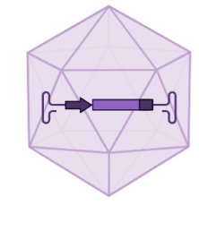
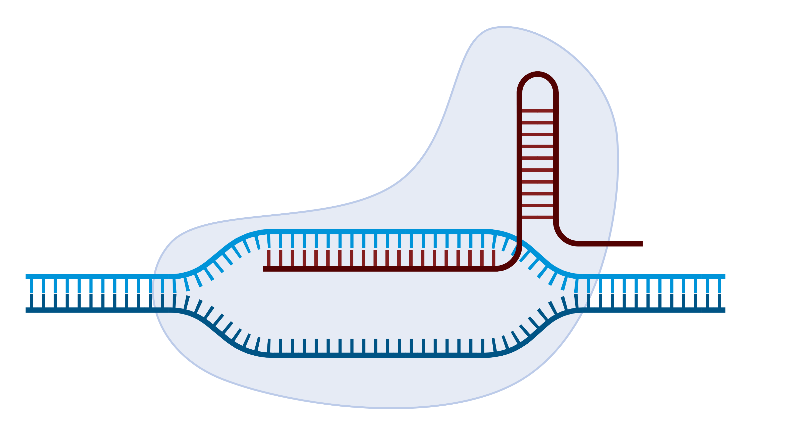

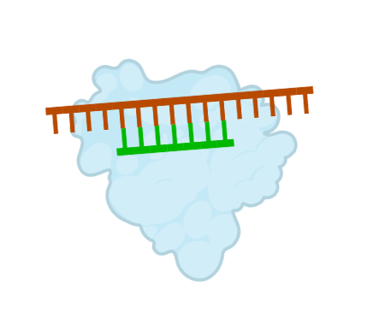


Selection of journal articles
Embase was used to search for primary articles and review articles
Topics of articles
Authorship
Time frame
‘Title or abstract’ field
‘Affiliation’ field
Gene therapies
Gene-editing therapies
143 companies with clinical-stage genetic medicines (ClinicalTrials.gov)
≥1 industry-affiliated author
5-year period (2018-2022)
Data collected January 17, 2024
RNA interference therapies
Antisense oligonucleotides
JAN
17
Notes:
Embase was used to search for both primary and review articles on each therapeutic modality of genetic medicine that’s been approved so far.
To find industry-supported articles, we included the names of 143 clinical-stage genetic medicine companies in the ‘affiliation’ field.
We included articles published over a 5-year period. With all the data being collected on a single day – in January.

Slide 27
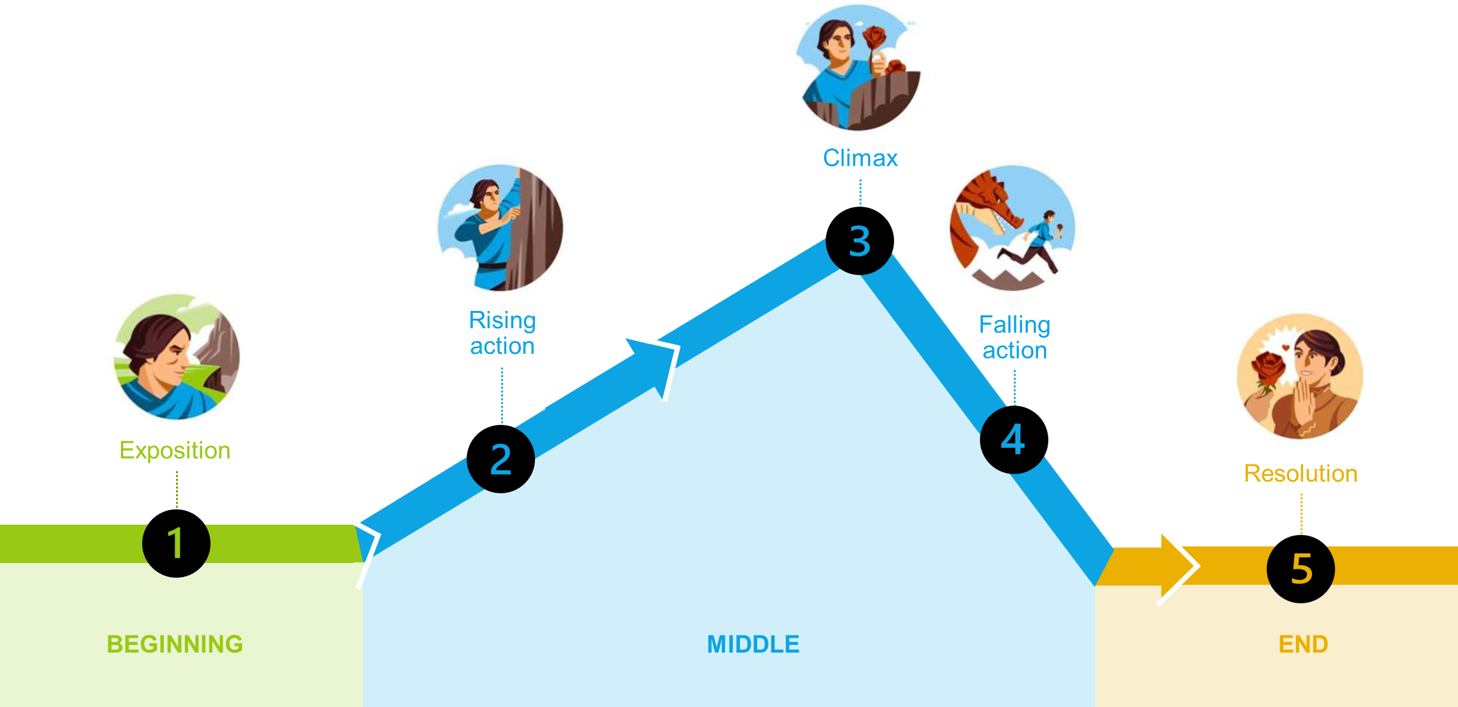
Freytag’s dramatic arc: a traditional story structure^{1,2}
1. Freytag G. 1900. Freytag’s technique of the drama: an exposition of dramatic composition and art. 3rd ed. Chicago (IL): Scott, Foresman and Company. 2. Boyd, RL, et al. Sci Adv. 2020;6(32):eaba2196.
Notes:
To characterize the narrative structure of the abstracts, we used LIWC-22 – a dictionary-based text analysis software.
The abstracts were divided into 5 equal-sized segments.
The software measured 3 narrative processes that unfold throughout a story by calculating the % of words in the text that fall within certain linguistic categories and comparing them to a normative story structure.
The graph shows how each of the 3 narrative processes changes over the course of a traditionally-structured story:
Staging (the blue line) is the process of exposition and establishing context.
Plot Progression (the green line) refers to actions that drive the story forward.
Cognitive Tension (the red line) indicates cognitive processes, conflict, and uncertainty that characters in a story face.
From these 3 process scores we derived an Overall Narrativity score for each abstract. This shows the extent to which the abstract resembles a traditional or normative story structure. It’s scaled from -100 (completely dissimilar) to +100 (complete match).

Slide 28
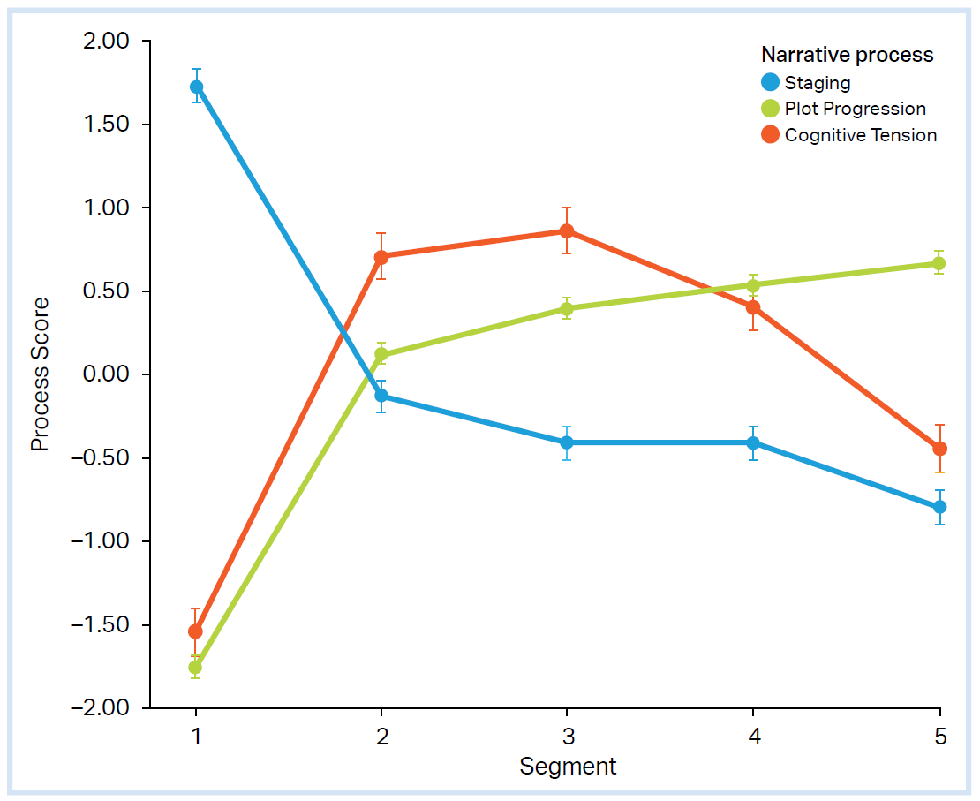
First, we characterized the narrative structure of the abstracts using LIWC-22 text analysis software^{1,2}
Abstracts were divided into 5 equal-sized segments
3 narrative processes that unfold throughout a story were measured by calculating the % of words that fall within certain linguistic categories and comparing them to the normative story structure:
Traditional story structure
Staging | Exposition and establishing context | articles: a, an, the prepositions: to, of, in
Plot Progression | Actions that drive the story forward | pronouns: I, you auxiliary verbs: is, was
Cognitive Tension | Cognitive processes, conflict, or uncertainty | cognitive process: think, believe, understand
Overall Narrativity score | Extent to which the text resembles a normative narrative arc | Average of the 3 process scores Range: -100 to +100
LIWC, Linguistic Inquiry and Word Count.
1. Pennebaker JW et al. Linguistic Inquiry and Word Count: LIWC-22. Pennebaker Conglomerates; 2022. 2. Boyd, RL, et al. Sci Adv. 2020;6(32):eaba2196.
Notes:
To characterize the narrative structure of the abstracts, we used LIWC-22 – a dictionary-based text analysis software.
The abstracts were divided into 5 equal-sized segments.
The software measured 3 narrative processes that unfold throughout a story by calculating the % of words in the text that fall within certain linguistic categories and comparing them to a normative story structure.
The graph shows how each of the 3 narrative processes changes over the course of a traditionally-structured story:
Staging (the blue line) is the process of exposition and establishing context.
Plot Progression (the green line) refers to actions that drive the story forward.
Cognitive Tension (the red line) indicates cognitive processes, conflict, and uncertainty that characters in a story face.
From these 3 process scores we derived an Overall Narrativity score for each abstract. This shows the extent to which the abstract resembles a traditional or normative story structure. It’s scaled from -100 (completely dissimilar) to +100 (complete match).

Slide 29
To evaluate the degree of narrativity of article abstracts, we assessed them for an additional 11 narrative elements
Narrative elements were derived from literature in the fields of narrative theory, psychology, and linguistics¹⁻⁷
S
STRUCTURE
T
TIME or LOCATION
O
ORIGINALITY
or CREATIVITY
R
RECOMMEND-ATIONS
I
IMMEDIACY
E
EMOTION
S
SIMPLICITY and CLARITY
Staging
Setting
(time or location) included
Lexical diversity
Recommendation from the authors included
First-person narration (eg, we, our)
Emotional tone
Words per sentence
Plot Progression
Hook (to grab attention in title or first 3 sentences)
Frequency of articles (eg, a, an, the)
Connectives
(words that link ideas)
Cognitive Tension
Concreteness
of content words
Several approaches were used to collect the data
Overall Narrativity
LIWC-22: dictionary-based text analysis software with >12,000 words, word stems, and phrases⁸
Coh-Metrix 3.0: computational tool that analyzes text for cohesion, language, and readability⁴
Manual assessment: 12 medical communications professionals (mean 10.5 years’ industry experience)
Supporting resources
1. Hillier A, et al. PLoS One. 2016;11(12):e0167983. 2. Graesser AC, et al. The Elementary School Journal. 2014;115(2):210-229. 3. Petty RE, DeSteno D, Rucker DD. The Role of Affect in Attitude Change. In JP Forgas (Ed.), Handbook of Affect and Social Cognition Lawrence Erlbaum Associates. 2001. 4. Graesser AC, et al. Educ Res. 2011;40(5):223-234. 5. Pennebaker JW et al. Linguistic Inquiry and Word Count: LIWC-22. Pennebaker Conglomerates; 2022. 6. Matthews N, Folivi F. PLoS One. 2023;18(2):e0282146. 7. Pal A, et al. Curr Med Res Opin. 2024;40(4):677-687. 8. Pennebaker JW et al. Linguistic Inquiry and Word Count: LIWC-22
Notes:
After characterizing the narrative structure, we evaluated the degree of narrativity of the abstracts – assessing them for 11 narrative elements that may correspond to properties of good storytelling, based on literature from the fields of narrative theory, psychology, and linguistics.
Several approaches were used to collect the data: LIWC software, a computational tool called Coh-Metrix that analyzes text on measures of cohesion, language, and readability, and manual assessment for elements that were more subjective or difficult to automate.
The narrative elements we measured were grouped into various themes – Time or Location, Originality, Recommendations, Immediacy, Emotion, and Simplicity.

Slide 30
Finally, we tested whether a more-narrative style of abstract might increase the influence of review articles
Two measures of review article influence
Individual narrative elements and article influence
Multiple linear regression models
Citation count
(Web of Science)
Altmetric Attention Score
These variables were log‑transformed to mitigate their skewed distributions
Wilcoxon rank-sum test (binary variables)
Pearson or Spearman’s correlation coefficients (continuous variables with normal and non‑normal distributions, respectively)
To identify narrative elements predictive of citation count or Altmetric Attention Score
Notes:
Finally, we tested whether a more-narrative style of abstract might increase the influence of review articles.
We used 2 measures of influence – citation count and Altmetric Attention Score.
We assessed the relationships between individual narrative elements and influence.
And we developed multiple linear regression models to identify narrative elements predictive of influence (citation count or Altmetric Attention Score).

Slide 31
Results

Slide 32


How does the narrative structure of abstracts from genetic medicine articles compare to traditional stories?
STRUCTURE
Traditional narrative structure of stories
Staging
Staging
Overall Narrativity
(range: -100 to +100)
Higher narrativity scores do not necessarily imply a "better" story. Instead, they suggest the text conforms to well-established methods for structuring narratives
The qualities that make a "good" story are complicated and the subject of much ongoing research
P<0.0001
Mean score
Plot Progression
Plot Progression
Staging
Plot Progression
Cognitive Tension
Staging
Plot Progression
Cognitive Tension
P=NS
Cognitive Tension
Cognitive Tension
Mean score
P=0.0003
P<0.0001
Notes:
1,145 industry-supported articles on genetic medicines were included in our analysis.
[CLICK]
We plotted the 3 narrative processes for primary articles and review articles separately. If you look at these charts, you can see they differ quite substantially from the shape of a traditional story – for both types of article.
[CLICK]
Looking at the Overall Narrativity scores confirms this. Remember a score of +100 means perfect alignment to a traditional story structure. In our study, the means scores were 17.2 for review article abstracts and -3.6 for primary articles.
The significantly higher score for review articles appears to have been driven by higher scores for Plot Progression and Cognitive Tension.
[CLICK]
It’s worth pointing out that higher narrativity scores do not necessarily imply a "better" story. But they suggest the text conforms to well-established methods for structuring narratives.
The qualities that make a "good" story are complicated and the subject of much ongoing research.

Slide 33




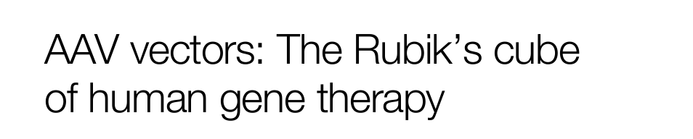
Degree of narrativity of review article abstracts:
11 narrative elements
TIME or LOCATION
ORIGINALITY or CREATIVITY
RECOMMENDATIONS
Setting
(time or location) included
Hook
to grab attention in title or first 3 sentences
Recommendation
from the authors included
figurative language
unanswered question
declarative title
quotation
Review articles, %
Review articles, %
Review articles, %
IMMEDIACY
EMOTION
First-person narration
Emotional tone
Review articles had a significantly higher emotional tone vs primary articles
P<0.0001
P<0.0001
Frequency of first-person plural pronouns
Emotional tone, mean
Review articles
Primary articles
Review articles
Primary articles
Notes:
For the remainder of our study, we focused mostly on review articles, and we assessed them for 11 narrative elements that may underlie effective stories.
[CLICK]
Almost one-third of review article abstracts included setting (a mention of time or location)
[CLICK]
Over half included 1 or more “hooks” – features included in the title or first 3 sentences to grab attention, such as use of figurative language, an unanswered question, declarative title, or quotation.
[CLICK]
You can see some examples here – titles that include a declarative statement and use of figurative language (metaphor and idiom).
[CLICK]
About one-quarter included a recommendation or advice from the authors – somethings that’s been shown to increase the appeal of articles.
[CLICK]
First-person narration, which can increase the immediacy of writing, was used less extensively in review articles compared to primary articles.
[CLICK]
The language used in the review articles had a significantly higher emotional tone than that of primary articles.

Slide 34
Degree of narrativity of review article abstracts:
11 narrative elements
SIMPLICITY and CLARITY
Words per sentence, mean | 26
Concreteness of content words, mean | 368
Connectives (words that link ideas), incidence, mean | 106
Supporting resources
Graphical abstract,
19%
30%
Review articles, %
Bulleted takeaway,
10%
Glossary, 2%
Plain-language summary, 2%
Video, 1%
Notes:
To measure the simplicity and clarity of the review articles abstracts, these are the data we obtained for sentence length, concreteness of content words, and incidence of connectives (words that link ideas in the text).
[CLICK]
Another way to make journal articles easier to understand is to provide supporting resources. We found that 30% of the review articles came with supporting resources, with the most popular being graphical abstracts.

Slide 35
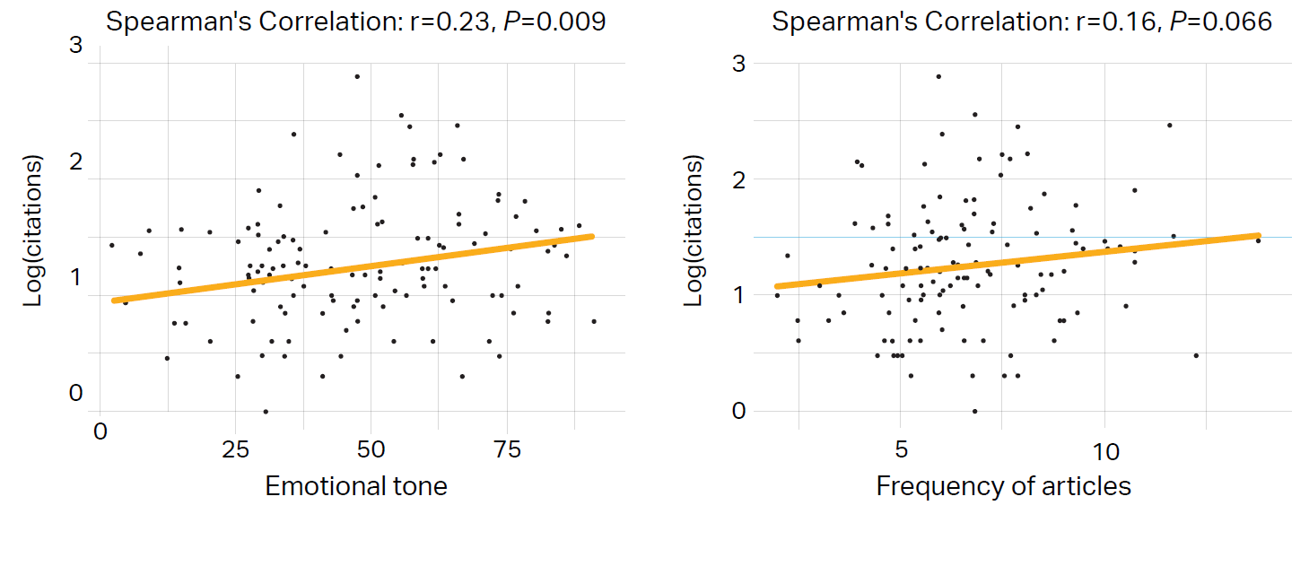
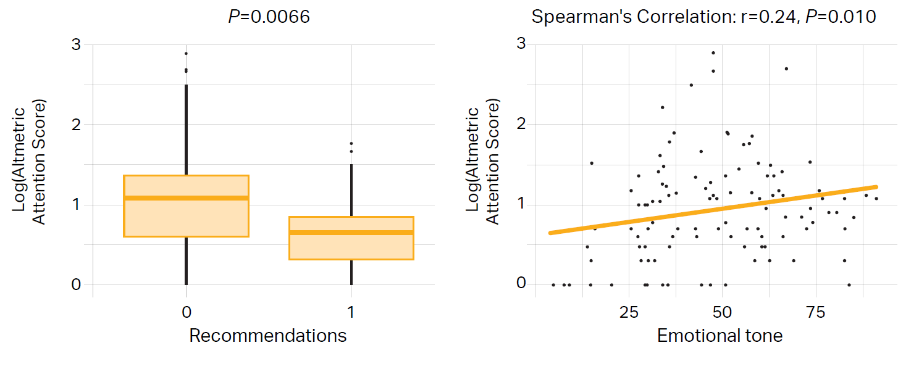
Do individual narrative elements predict the influence of review articles?
Citation count
Altmetric Attention Score
Emotional tone
Frequency of articles
(ie, a, an, the)
Recommendations
Emotional tone
Emotional tone was positively associated with both measures of influence – citation count and Altmetric Attention Score
Notes:
So, do individual narrative elements predict the influence of review articles?
Well, the extent to which the abstracts conformed to a traditional story structure (measured by LIWC Overall Narrativity score) was not predictive of citation count or Altmetric Attention Score.
We found that Emotional tone was positively associated with citation count.
And there was a nonsignificant trend toward frequency of articles and citation count being positively associated.
When we looked at predictors of Altmetric Attention Score…
Surprisingly, there was a negative association between inclusion of a recommendation or advice from the authors and Altmetric Attention Score.
And, similar to citation count, increased Emotional tone was associated with higher Altmetric Attention Score.
[CLICK]
Emotional tone was positively associated with both measures of influence – citation count and Altmetric Attention Score

Slide 36
Multiple linear regression analyses: Does the degree of narrativity of the abstracts predict review article impact?
Citation count
Altmetric Attention Score
Citation count
Positive association with:
Frequency of articles (P=0.013)
Emotional tone (P=0.004)
Positive association with:
Emotional tone (P=0.017)
Negative association with:
Recommendations (P=0.004)
    15.3% of variance in
    citation count explained by the model
    F-statistic of 1.71 (P=0.073)
    18.3% of variance in
    Altmetric Attention Score explained by the model
    F-statistic of 1.81 (P=0.056)
We found trends toward the narrative elements studied being collectively predictive of review article influence, though this did not reach the 0.05 level significance threshold
Notes:
For the multiple linear regression analyses…
Citation count was positively associated with frequency of articles and emotional tone.
We found that 15.3% of the variance in citation count was explained by the model.
The model was not statistically significant at predicting citation count.
Altmetric Attention Score was positively associated with Emotional tone and negatively associated with Recommendations.
18.3% of the variance in Altmetric Attention Score was explained by the model.
With an F-statistic of 1.81 at P=0.056.
[CLICK]
So, we found trends toward the narrative elements studied being collectively predictive of review article influence, although these did not quite reach the 0.05 level significance threshold.

Slide 37
Conclusions
Abstracts of journal articles on genetic medicines have low narrativity relative to traditional stories (eg, novels, movies), but review articles score higher than primary articles
Increased emotional tone was associated with both increased citation count and higher Altmetric Attention Score
Our pilot study had several limitations: small sample size, inclusion of a broad range of journal titles, and the omission of journal impact factor as a variable in the analyses
Given the trends in favor of these narrative elements being collectively significant in predicting review article influence, authors should explore ways to incorporate a
more-narrative writing style in their future publications
Notes:
To summarize our findings…
Abstracts of journal articles on genetic medicines have low narrativity relative to traditional stories (eg, novels, movies), but review articles score higher than primary articles.
Increased emotional tone was associated with both increased citation count and higher Altmetric Attention Score.
This was a pilot study with several limitations: small sample size, inclusion of a broad range of journal titles, and the omission of journal impact factor as a variable in the analyses.
Given the trends in favor of these narrative elements being collectively significant in predicting review article influence, authors should explore ways to incorporate a more-narrative writing style into their future publications.

Slide 38
Acknowledgements
We would like to thank the following volunteers for assisting with reviews of the abstracts:
Kristen Andersen, PhD
Kristin French, PhD
Jeff Hannah, PhD
Brianna Hoang, PharmD
Mike Hobert, PhD
Sarah Hutchinson, PhD
Dan Hutta, PhD
Dina Marenstein, PhD
Meghan Mooring, PhD
Justin Potuzak, PhD
Levy Reyes, PhD

Slide 39
Examining the Time- and Effort-saving Utility of Tailored AI-tooling for Abstract Plain Language Summary Development
W Benderª, T Grant^{b}, V Porkess^{b}, M Lens^{b},
C Rapier^{b}, D McMinnª
ª Employee of Sorcero with ownership interest; ^{b} employee and shareholder of UCB, ^{c} employee of Sorcero.

Slide 40
Studies¹⁻³ have shown that accessible scientific communication has the potential to:
enhance patient adherence;
empower informed decision-making; and
promote health equity.
Recognizing this, regulators and medical organizations have established guidelines recommending a 6-8th grade reading level for patient communication^{4,5}.
Wolf MS, et al. Health literacy and functional health status among older adults. Arch Intern Med. 2005.
DeWalt, DA, et al. Literacy and health outcomes. J GEN INTERN MED 2004.
Papadakos WF et al. Plain language communication as a priority competency for medical professionals in a globalized world. Can Med Educ J. 2018.
Good Lay Summary Practice. Regulation (EU) No. 536/2014 of the European Parliament and of the Council of 16 April 2014.
Plain Language Act of 2010. Public Law 111-274. An act to enhance citizen access to Government information and services by establishing that Government documents issued to the public must be written clearly, and for other purposes.

Slide 41
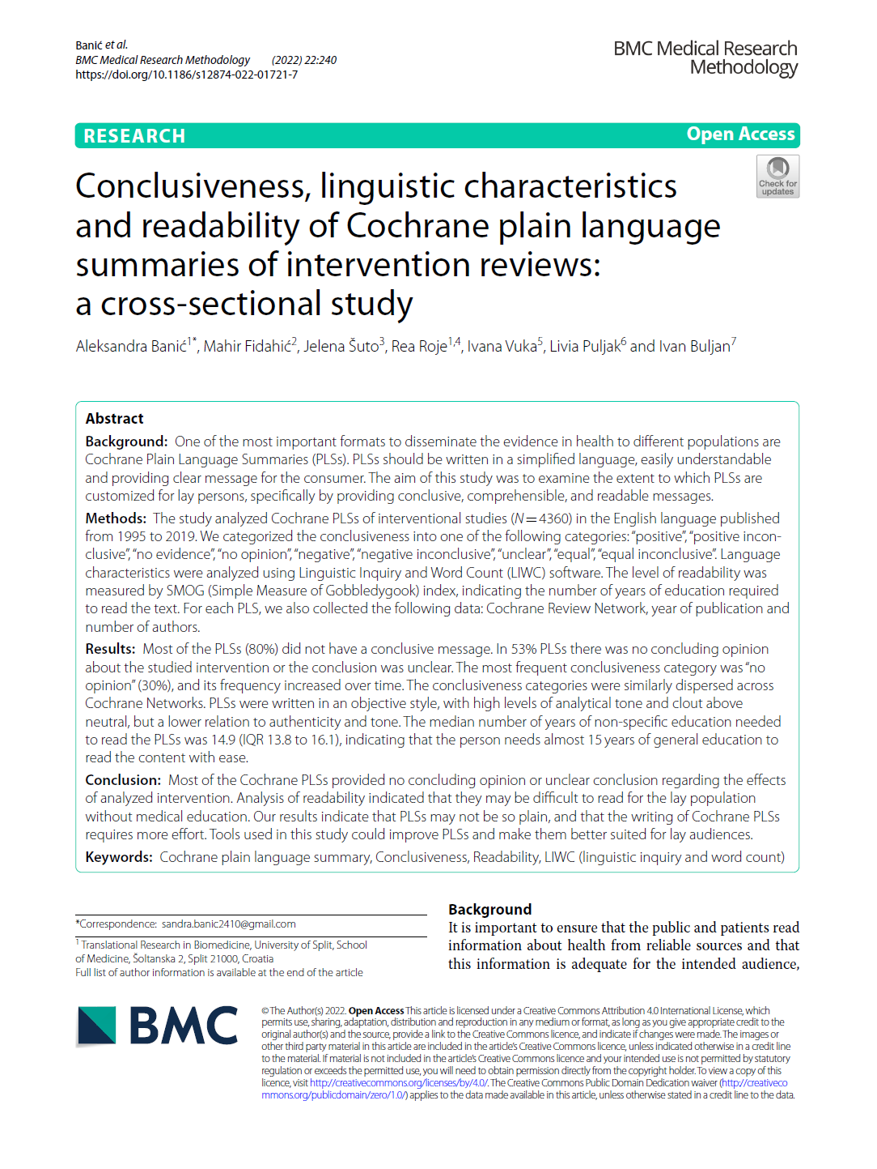
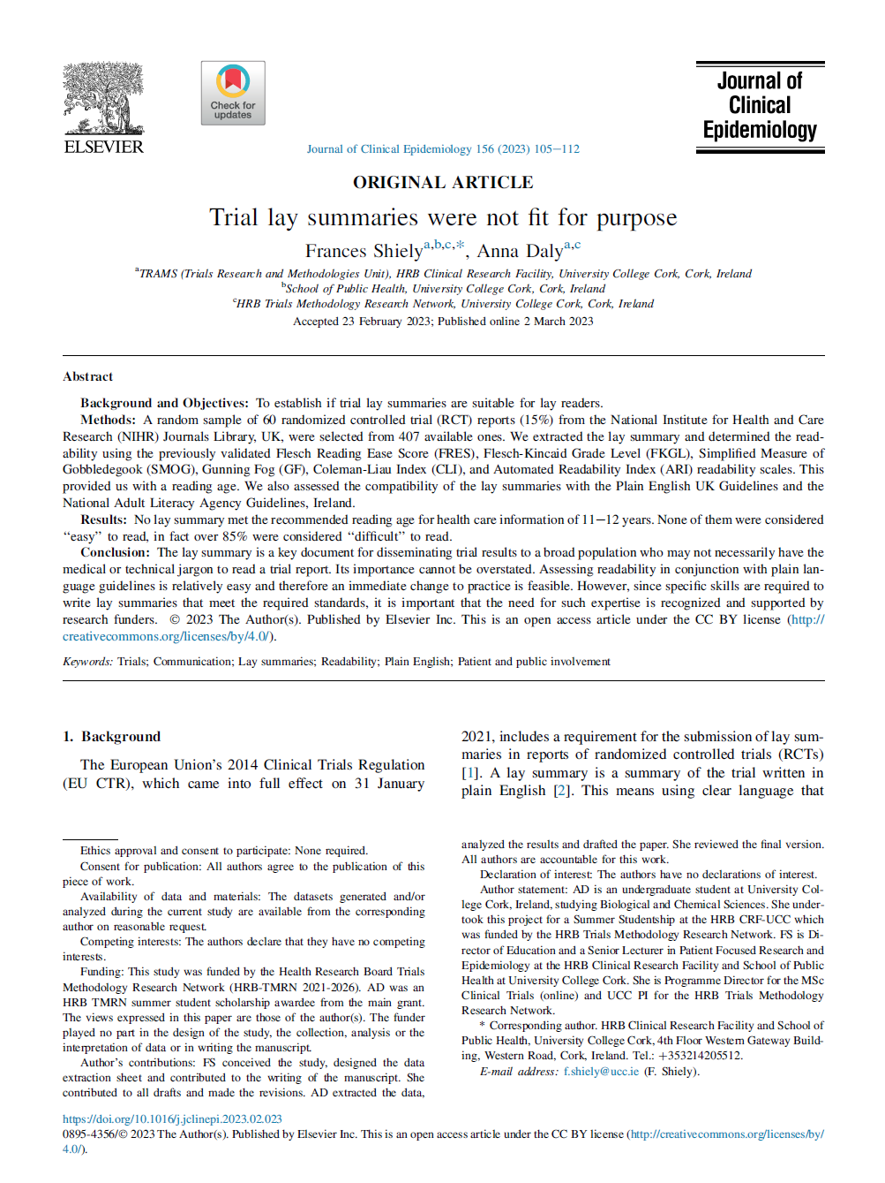
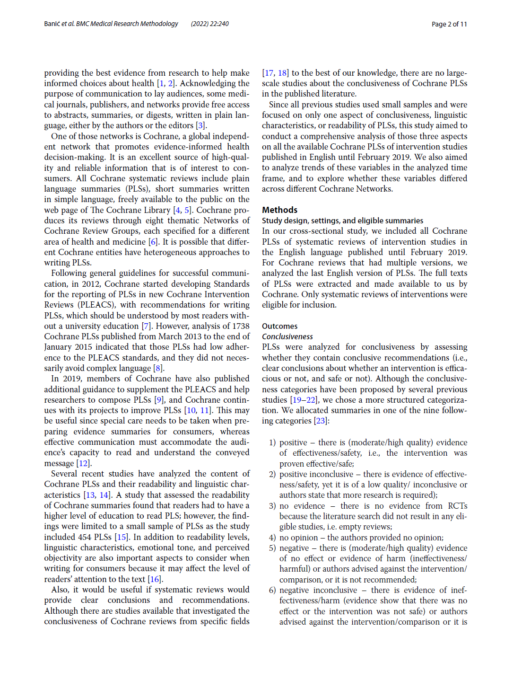
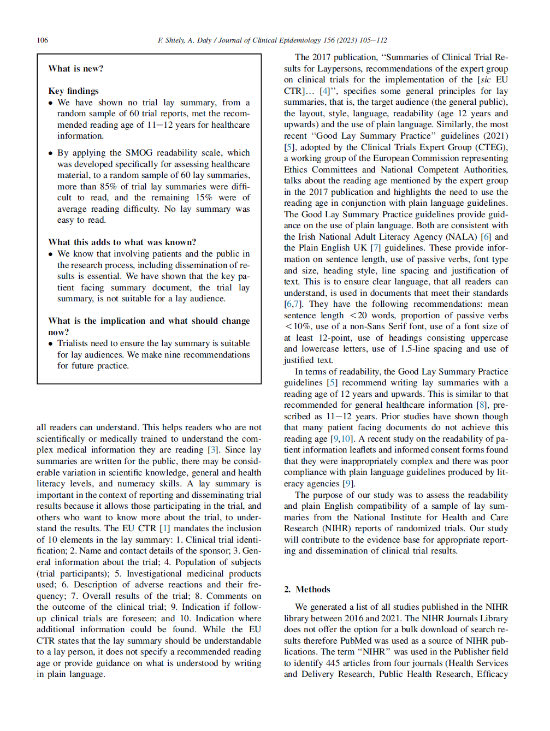
But current PLSAs are not fit for purpose.¹
“Analysis of readability indicated that they may be
difficult to read for the lay population without medical education. Our results indicate that PLSs may not be so plain, and that the writing of Cochrane PLSs requires more effort.”²
“No lay summary met the recommended reading age for health care information... None of them were considered ‘‘easy’’ to read, in fact over 85% were considered ‘‘difficult’’ to read.”³
PLS, plain language summary.
Agbonbhase A, et al. Readability of plain language summaries (PLS): are they getting better? International Society of Medical Publication Professionals (ISMPP) 20th Annual Meeting
Banic A, et al. BMC Medical Research Methodology 2022;22:240.
Shiely F & Daly A. Journal of Clinical Epidemiology 2023;156:105-112.
Notes:
David

Slide 42
It is difficult to convey complex ideas with clarity and simplicity.

Slide 43
Can Generative Artificial Intelligence (AI) Be of Assistance to Medical Writers in the Plain Language Summary (PLS) Abstract Creation Process?

Slide 44
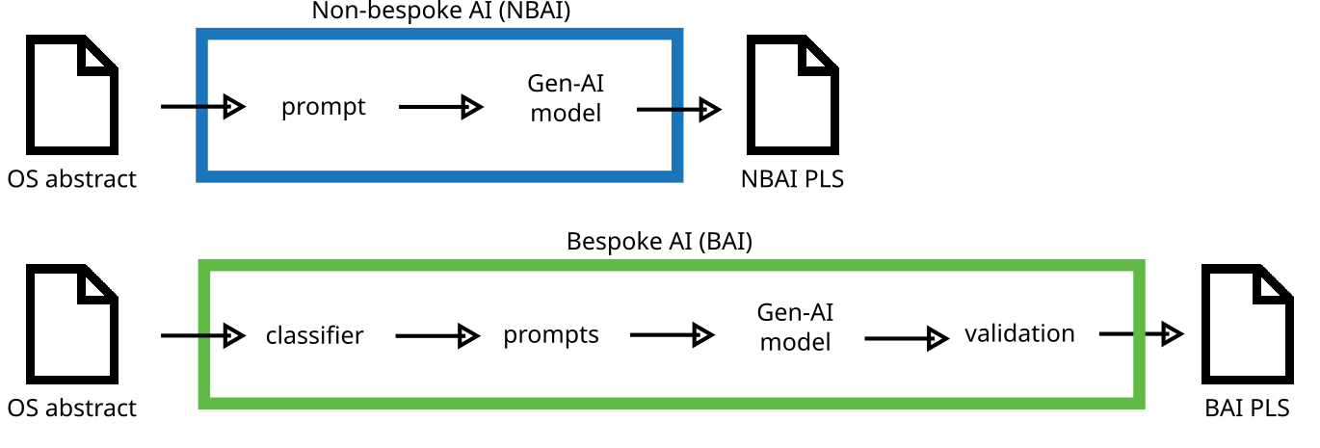
Non-bespoke AI (NBAI) and Bespoke AI (BAI) processes
AI, artificial intelligence; BAI PLS: Bespoke-AI plain language summary abstract; NBAI PLS: Non-bespoke-AI plain language summary abstract; OS abstract: Original Scientific abstract;

Slide 45
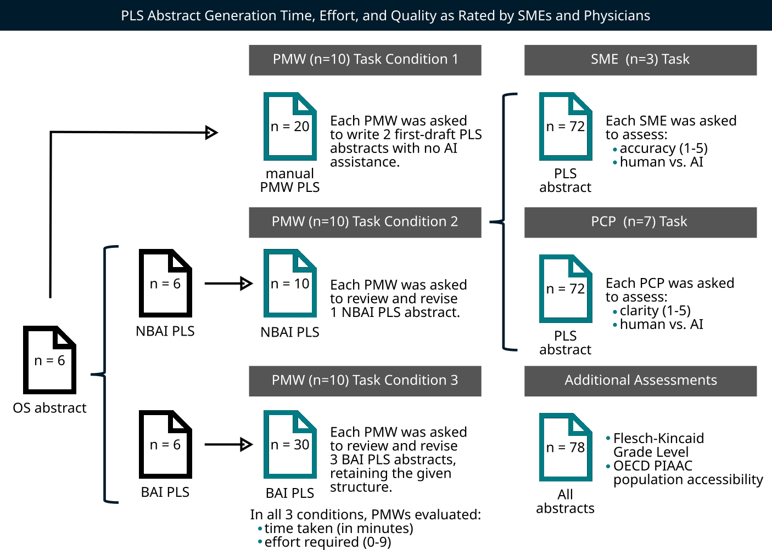
Study: PLS Abstract Generation Time, Effort, and Quality
AI, artificial intelligence; BAI PLS: Bespoke-AI plain language summary abstract; NBAI PLS: Non-bespoke-AI plain language summary abstract; OECD: Organisation for Economic Co-operation and Development; OS abstract: Original Scientific abstract; PCP: primary-care physician; PIAAC: Programme for the International Assessment of Adult Competencies; PMW: professional medical writer; PMW PLS: professional medical writer plain language summary abstract; SME: subject-matter expert

Slide 46
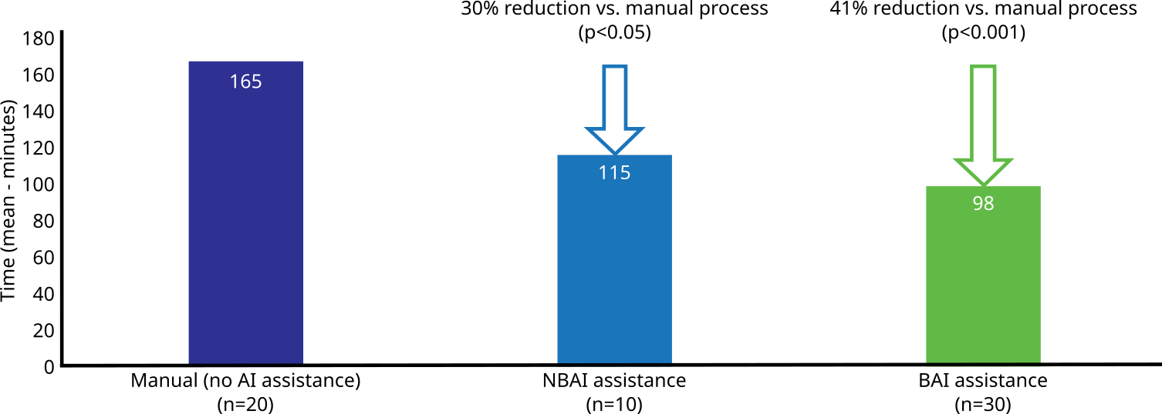
Findings: Time to Complete PLS Abstract (n=60)
Bespoke-AI assistance significantly reduced the time to PLS abstract completion
(by 41% vs. the traditional manual method).
AI, artificial intelligence; PLS, plain language summary.
Time to complete each task was self-reported by professional medical writers.

Slide 47
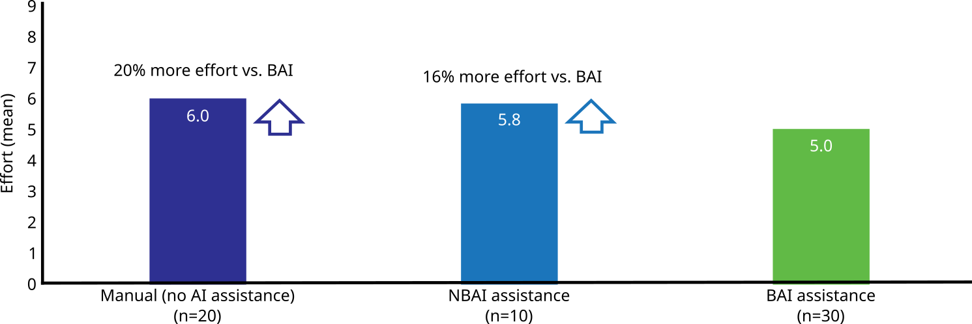
Findings: Effort to Complete PLS Abstract (n=60)
Both the traditional manual method and non-bespoke AI approaches required relatively 16%-20% more perceived effort vs. the bespoke-AI approach.
BAI, bespoke artificial intelligence; NBAI, non-bespoke artificial intelligence; PLS, plain language summary.
Effort required to complete task as reported by professional medical writers.

Slide 48
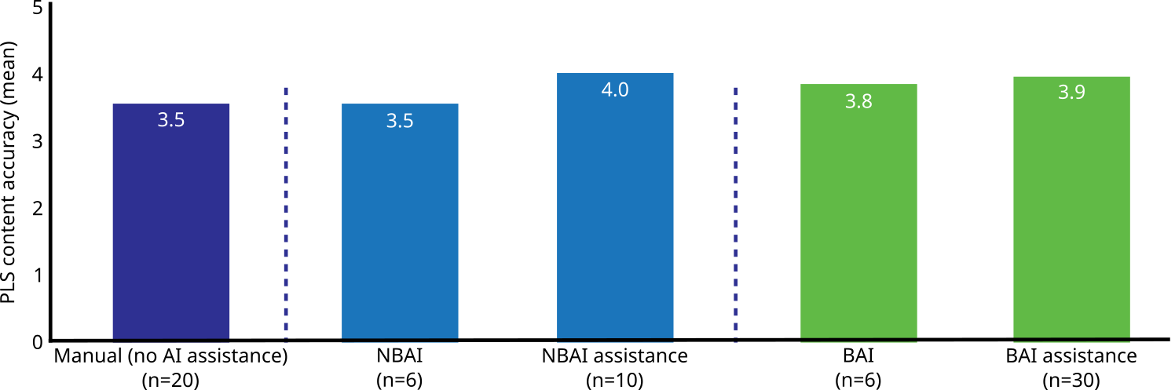
Findings: Subject-matter Expert review (n=72)
AI-assisted PLS abstracts more accurately reflected the original scientific abstract than did the manually written PLSAs.
AI, artificial intelligence; BAI, Bespoke artificial intelligence; NBAI, Non-bespoke artificial intelligence; PLS, plain language summary.

Slide 49
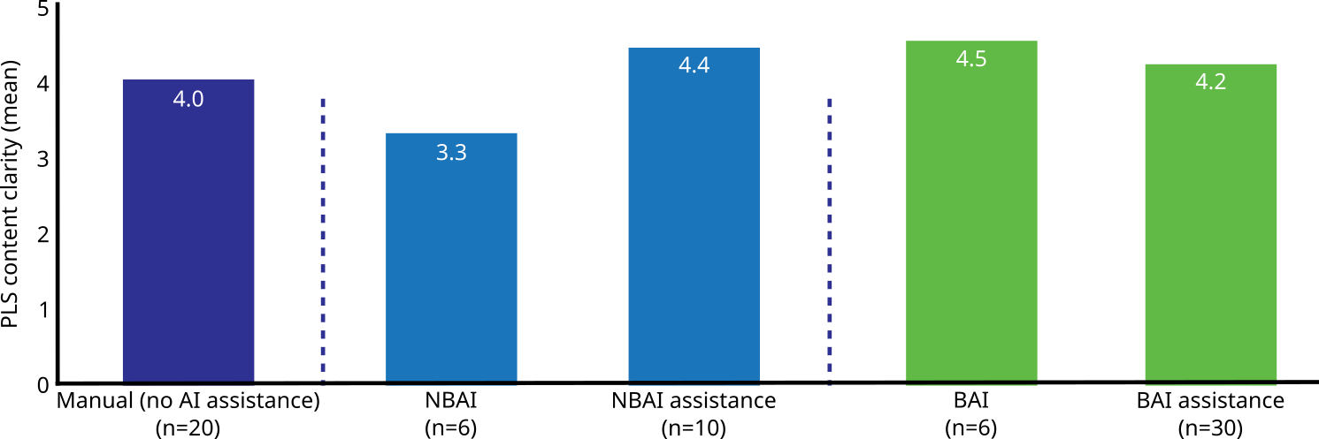
Findings: Primary Care Physician Review (n=72)
The AI-assisted PLS abstract development process resulted in PLSAs that were most suited to explaining the research findings to patients.
AI, artificial intelligence; BAI, Bespoke artificial intelligence; NBAI, Non-bespoke artificial intelligence; PLS, plain language summary.

Slide 50
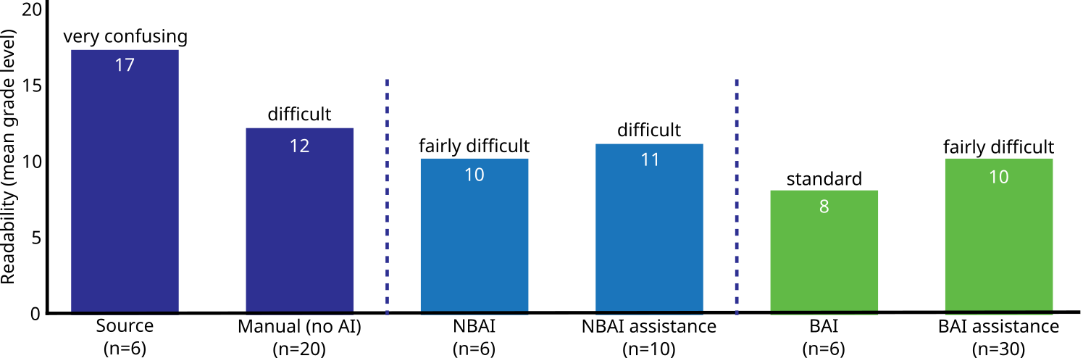
Findings: Readability (Flesch-Kincaid Grade Level) (n=78)
AI-assisted PLS abstracts are easier to read than PLSAs written manually. Unrevised PLS abstracts generated using the bespoke-AI process were easiest to read.
AI, artificial intelligence; BA, Bespoke artificial intelligence; NBAI, Non-bespoke artificial intelligence; PLS, plain language summary.
Flesch-Kincaid Grade Level scores were derived using MS Word.

Slide 51
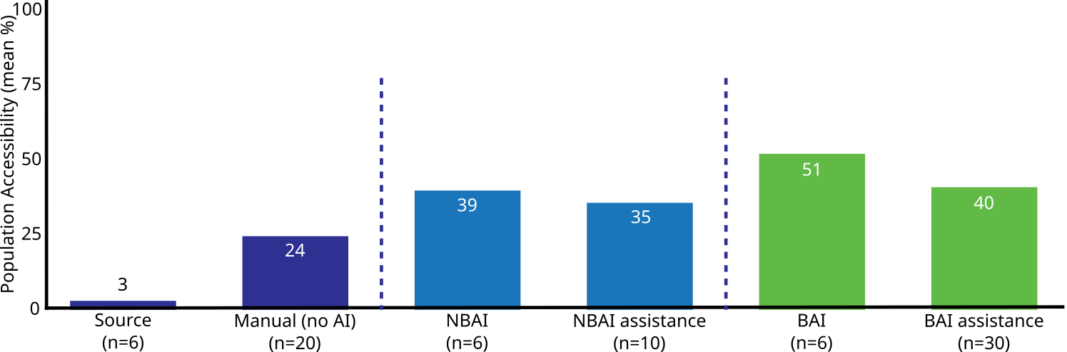
Findings: Population-level Accessibility (n=78)
AI-assisted PLS abstracts are understandable to a larger percentage of the population than the original scientific abstract and the PLS abstracts written manually.
AI, artificial intelligence; BAI, Bespoke artificial intelligence; NBAI, Non-bespoke artificial intelligence; PLS, plain language summary.

Slide 52
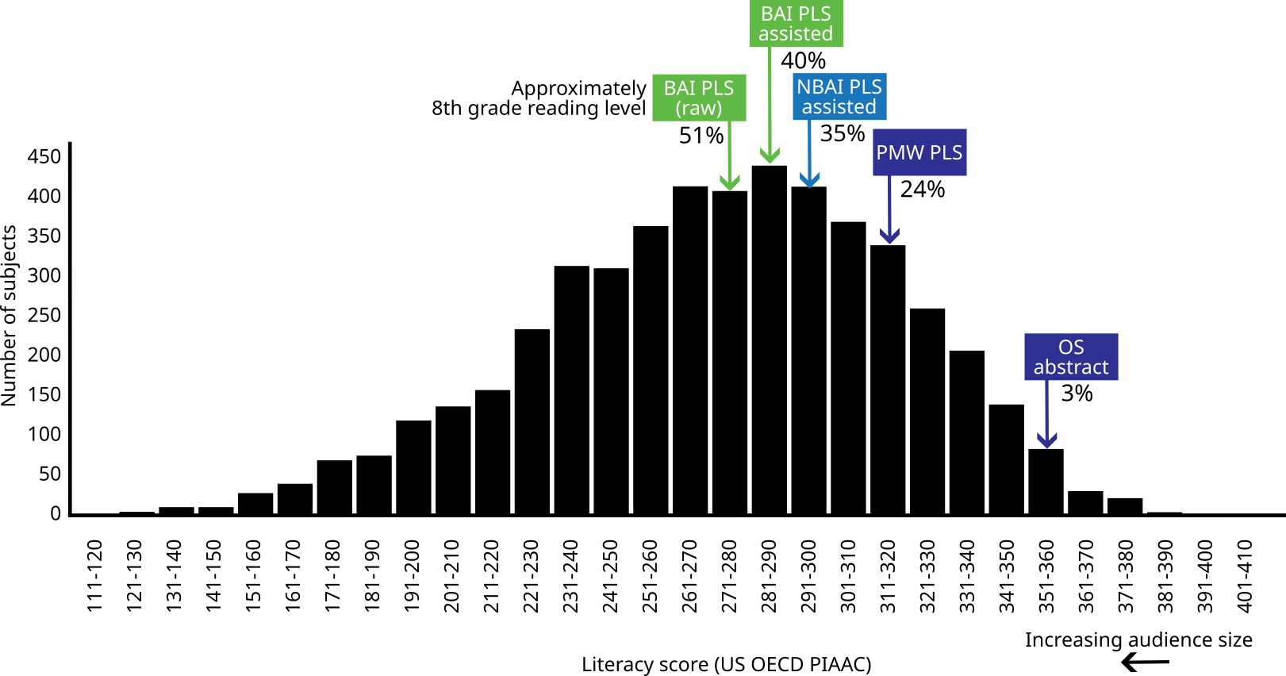
Findings: Population-level accessibility (n=78)
AI-assisted PLSAs are understandable to a larger percentage of the population than the original scientific abstract and the manually written PLSAs.
Condition 3
Condition 2
Condition 1
AI, artificial intelligence; BAI: Bespoke artificial intelligence; NBAI: Non-bespoke artificial intelligence; PLS, plain language summary.

Slide 53
Limitations:
Small sample size for NBAI (Condition 2);
No target grade level provided to medical writers;
Readability metrics have limited utility.

Slide 54
Follow-on study* using 11 qualitative metrics:
BAI PLSAs were of higher quality according to medical writers;
BAI PLSAs were of higher quality according to patients/patients advocates.
(readability, comprehensibility, jargon use, clarity and flow, inclusion of key data, accuracy of content, summarization of the overall message, relevancy clearly described, proper grammar, actionability, and empathy and understanding)
* Watts L, McMinn D, Bender W, Joe W, and Becker T. Comparative analysis of plain language summary abstracts: generative artificial intelligence versus human medical writers. International Society of Medical Publication Professionals (ISMPP) 20th Annual Meeting

Slide 55
Gen-AI is “always certain, sometimes right”, hence, the importance of maintaining human oversight when utilizing Gen-AI for medical communication.

Slide 56
Gen-AI is a “thing to think with”.

Slide 57
Bespoke AI technology saves medical writers time and effort in developing plain language summary abstracts and helps them to be understood by a broader audience without any degradation of accuracy.

Slide 58
What is next?
Reaching new audiences
Building more trust
Defining better metrics
Defining better guidelines
Thank you. Questions?

Slide 59
Audience Q&A
To ask a question, open the Q&A window and type your question into the Q&A box. Click Send.
Notes:
And now it's time to answer your questions. As a reminder, please type them into the Q&A box at the bottom of your screen.
[ask seeding question]

Slide 60
Upcoming ISMPP University Webinars
June 2024
AI in the development of PLS
June
2024
Incorporating AI in Medical Storytelling
Notes:
Also, be on the lookout for ISMPP’s next 2 ISMPP U’s…in June

Slide 61
ISMPP University
Member Research Oral Presentations from the 20th Annual Meeting
May 29, 2024
Webinar will begin promptly at: ​​
11 AM ET / 4 PM GMT
Notes:
If you were unable to take a screenshot for credit at the beginning of the webinar, you may do so now. Again, a certificate will be mailed upon completion of the webinar.

Slide 62

Thank You for Attending!
We hope you enjoyed today's presentation.
After closing out of Zoom, please click the CONTINUE button
on your screen to take our short survey. Thank you!
Notes:
Thank you again for attending today’s webinar. Please take a moment to fill out the survey link that will be sent to you.
After closing out of ZOOM, please click the ‘continue’ button on your screen to take a short survey.
Thank you!

Slide 63
Faculty Bios

Slide 64

Tomas Rees
Tomas has a longstanding interest in the transformation of scientific publications in the digital environment, including strategic planning, increasing reach and engagement across broad stakeholder audiences, and assessing the effectiveness and impact of publication plans.
He currently leads the development of strategic communication plans and scientific platforms and supports the testing and implementation of innovative solutions.
He is co-chair of the ISMPP Social Media and Web-based metrics committee.
CMPP, certified medical publications professional; ISMPP, international society of medical publications professional

Slide 65
Stephen Towers
Stephen is a passionate believer in the power of storytelling to… bridge the gap between groundbreaking new technologies (eg, genetic medicines) and clinicians’ and patients’ *understanding* of those technologies, humanize scientific research, enhance health literacy, center patients in clinical development, ensure diverse voices are heard, and combat misinformation and disinformation.
He is excited by the immense potential for improvements in storytelling across the pharmaceutical and healthcare communications industries. At HCG, he designs and leads narrative skills training sessions for Medical Affairs clients and internal agency teams and explores how novel technologies and channels might facilitate storytelling.
Stephen has broad medical communications agency experience, but his current focus is Medical Affairs. Prior to medical communications, he obtained his PhD in neuroscience and spent several years in postdoctoral research at Stanford.
CMPP, certified medical publications professional; ISMPP, international society of medical publications professional

Slide 66
Zeynep Turan
With a keen interest in discovering new methodologies and tools, Zeynep is dedicated to making the latest research and clinical data accessible to a wide range of audiences, including healthcare professionals, patients, and caregivers.
From interactive dashboards to engaging infographics, her work is focused on simplifying complex information for better understanding.
Beyond just making data comprehensible, she is passionate about bringing the excitement of scientific discovery and medical advancements to everyone, regardless of their background.
Zeynep obtained her PhD in neurobiology (Caltech), MS in epidemiology (Columbia), and BS in biochemistry & cell biology (Bucknell).
CMPP, certified medical publications professional; ISMPP, international society of medical publications professional

Slide 67
Walter Bender
Walter Bender is the Chief Scientific Officer at Sorcero, a venture-backed startup whose AI Platform revolutionizes how Life Sciences companies ask – and answer – their most critical medical strategy questions.
He is the former Executive Director of the MIT Media Lab, where he led the Electronic Publishing Group.
He is the founder of Sugar Labs, which develops and maintains educational software.
In 2006, Walter co-founded One Laptop per Child, with Nicholas Negroponte and Seymour Papert. Bender received his undergraduate degree from Harvard University in 1977 and a master’s degree from MIT in 1980.
CMPP, certified medical publications professional; ISMPP, international society of medical publications professional

Slide 68

Moderator: Gary Burd
Gary has almost 20 years of medical communications and scientific publishing experience. Prior to his career in medical communications, he gained valuable editorial experience in journal publishing with Portland Press.
Gary has been involved in medical communication planning and publication planning in several therapy areas, including solid tumour and haematological oncology, multiple sclerosis, diabetes, transplantation, rheumatology, dermatology and respiratory disease. He has developed and managed a wide variety of communication outputs, including manuscripts, monographs, abstracts, posters, competitive intelligence reports, advisory boards, symposia and standalone meetings.
Gary completed his PhD at the Kennedy Institute of Rheumatology, University of London in 1998, studying a biologic monoclonal antibody therapy for systemic lupus erythematosus. He graduated from St Catherine’s College, University of Oxford with a BA in Biochemistry, with supplementary working as a medical writer,
CMPP, certified medical publications professional; ISMPP, international society of medical publications professional

