Slide 1
Implications of electronic and mobile health technologies for chronic pain
Rajat Moman, MD, MA
3/20/22

Slide 2
Implications of electronic and mobile health technologies for chronic pain
No disclosures
No presentation of off-label and/or investigational uses of drugs or products

Slide 3
What are electronic and mobile health applications
How can they help patients
Barriers to use
Future directions
References:
Moman RN, Dvorkin J, Pollard EM, Wanderman R, Murad MH, Warner DO, Hooten WM. A Systematic Review and Meta-analysis of Unguided Electronic and Mobile Health Technologies for Chronic Pain-Is It Time to Start Prescribing Electronic Health Applications? Pain Med. 2019 Nov 1;20(11):2238-2255. doi: 10.1093/pm/pnz164. PMID: 31386151.
Moman RN, Hooten WM. The Major Barrier Facing Patients and Clinicians Who Are Interested in Utilization of Electronic and Mobile Health Technologies. Pain Med. 2020 Feb 1;21(2):e243-e246. doi: 10.1093/pm/pnz273. PMID: 31633783.

Slide 4
Electronic and Mobile Health Applications
Electronic or communication-based therapies to aid or provide healthcare in some form
Broadly grouped into:
1) education
2) pain measurement
3) pain therapy
4) some applications fall into more than one category

Slide 5
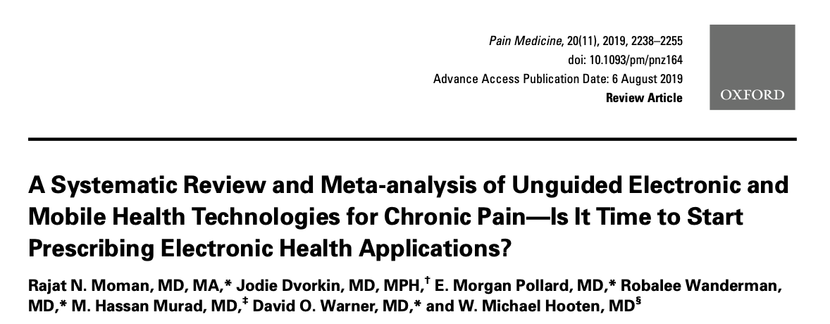

Slide 6
Methods
Search from Jan 1 2000 to Jan 31 2018.
MEDLINE Epub Ahead of Print, Medline In-Process and Other Non-Indexed Citations, MEDLINE, EMBASE, Cochrane Central Register of Controlled Trials, and Scopus
Inclusion criteria: 1) RCTs; 2) adults with chronic pain; 3) outpatient setting; 4) used only an eHealth or mHealth application; and 5) English
Exclusion criteria: 1) non-pain indications (e.g., restless leg syndrome, diabetes mellitus, weight loss); 2) required clinician response or action as part of the intervention; 3) studies that included patients with progressive/recurrent disease processes (e.g., hemophilia, sickle cell disease, rheumatoid arthritis, systemic lupus erythematosus)

Slide 7
Methods
Outcomes fell into three domains:
Pain intensity (NRS, VAS, Brief Pain Inventory [BPI] Pain Subscale, Fibromyalgia Impact Questionnaire Pain Subscale)
Functional (BPI Interference Subscale, Short Form [SF] 12 and 36)
Mental health-related (Center for Epidemiologic Studies – Depression Scale, Depression Anxiety Stress Scale, PHQ9, Hospital Anxiety and Depression Scale, Pain Catastrophizing Scale)

Slide 8
Results
20 studies included in qualitative analysis and 17 included in quantitative analysis.
All RCTs
Descriptions of interventions included: CBT, mindfulness, exposure therapy, exercise, self-management, coping skills

Slide 9
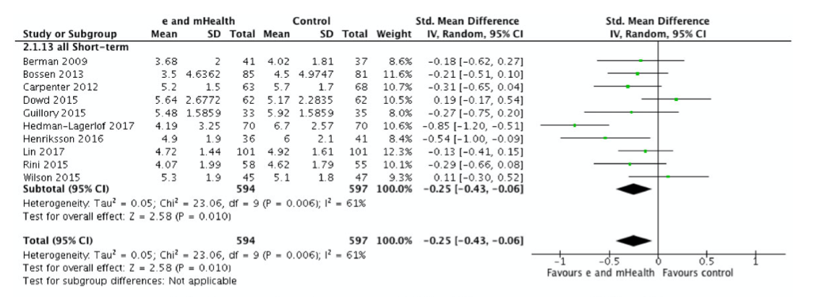
Pain Intensity
Significant decrease in pain intensity in short-term (outcomes reported 3 months or less)
Not seen at immediate or long-term follow-up

Slide 10
Functional Scores and Depression
No difference in functional outcomes
Significant improvement in depression scores at short-term (3 months or less) and intermediate-term (4 to 6 months) follow-up
No difference in anxiety scales

Slide 11
Pain Catastrophizing Scale
Significant improvement in PCS at short-term follow-up

Slide 13
Barrier to Use
Applications available to patients for download are not the same as those used in research
Nine of 20 (45%) applications included in our systematic review were available for download or use online

Slide 14
Next Steps
Need to focus on underrepresented patients
Challenge to get patient with Medicaid into a pain psychologist without comorbid psychiatric condition
Studies do not incorporate e and mHealth into multimodal regimen to treat chronic pain
What is the effect when accompanied with non-opioid medication use and targeted interventions to treat chronic pain
How to incorporate these technologies into a practice and medical record

