Slide 1
Encouraging Communication and Routine Participation in Children with Significant Disabilities, Including Visual Impairment and Deafblindness

Slide 2
Introduction: My Background
Special Education: Severe Interventions
Teacher for Students with Visual Impairments
Certified Orientation and Mobility Specialist
Cerebral/Cortical Visual Impairment Certificate
17 Years of experience as a TVI/COMS in classrooms for kids with multiple impairments
14 Years of experience as an Early Intervention home visitor

Slide 3
Why Was This Book Created?
Meshing strategies from the VI and SXI worlds
Sharing the success of other families and service providers
An organized way to:
  Learn how to read a child’s cues
  Find motivating ways to encourage communication
  Provides ways to more fully engage in their world
Done in a positive way, focusing on what they can do

Slide 4
Terminology
Children with significant disabilities includes:
  Children with multiple areas of need
  Needing the support of several professionals
  Most often includes significant motor delays
  Often also includes vision and/or hearing differences
These principals may also apply to a wide range of children with speech and/or motor delays

Slide 5
Steps in the Process
Step 1: Building a Good Foundation
Step 2: Reading Cues
Step 3: Discovering Sensory Preferences and Interests
Step 4: Adding Cues to Signal an Upcoming Activity or Event
Step 5: Shaping Cues into Communication
Step 6: Encouraging Participation in Daily Routines
Summary and Next Steps

Slide 6
Step 1: Building a Good Foundation

Slide 7
Step 1: Team Approach
A team approach is needed:
Parents and caregivers
Teachers, teaching assistants
Ancillary staff:
  OT, PT, SLP, SW, AT, DHH, TVI, COMS
Doctors, outpatient therapists, and home medical staff

Slide 8
Step 1: Review of Medical History
Medical condition and how it may affect development
Effects of seizures and seizure medication
Motor ability and positioning needs
Results of developmental assessments
Vision and hearing
Current goals and interventions being tried
Priorities and concerns of the family
Any cultural or religious practices to be mindful of through this process?

Slide 9
Step 1: Visual Impairment
Ocular forms of visual impairment
Cerebral/Cortical Visual Impairment (CVI)- vision loss caused by injury to the visual processing centers of the brain or to the brain’s visual pathways
CVI Stats:
  It is estimated that only about 20% of CVI cases currently have a diagnosis
  20% of diagnosed CVI cases also have ASD
  60-70% of diagnosed CVI cases also have CP
  64% of diagnosed CVI cases also have epilepsy

Slide 10
Step 1: CVI Visual Behaviors
Ocular forms of visual impairment
Cerebral/Cortical Visual Impairment (CVI)- vision loss caused by injury to the visual processing centers of the brain or to the brain’s visual pathways
CVI Stats:
  It is estimated that only about 20% of CVI cases currently have a diagnosis
  20% of diagnosed CVI cases also have ASD
  60-70% of diagnosed CVI cases also have CP
  64% of diagnosed CVI cases also have epilepsy

Slide 11
Step 1: Hearing
Deaf and Hard of Hearing
Deafblind- dual sensory loss
Central Auditory Processing Disorder-CAPD is a hearing difference caused by damage to the areas in the brain responsible for processing sounds and noise

Slide 12
Step 1: Vision and Hearing Considerations
Level and extent of sensory loss
Receiving services?
Needed accommodations
Do they have a processing delay
How are they using their vision and hearing?
What do they understand by hearing and seeing?

Slide 13
Step 1: Additional Assessment
Considering the “inch-stones” in between developmental assessment age ranges
Examples:
  Attending to the caregiver and the environment
  Types and levels of voluntary movement
  Are they making choices and how are they doing this?
    Pointing/direct select
    Eye gaze
    Vocalizations

Slide 14
Step 2: Reading Cues

Slide 15
Step 2: Importance of Reading Cues
Examples:
Highlighting the importance of caregiver responsiveness and the caregiver-child relationship *
Learning to Observe the child’s current cues
Cues in children with complex health needs may look different or be subtle
Startle response
Quiets or becomes still
Body movement- may be subtle
Slowing or accelerating respiration
Slowing or accelerating heart rate
Changes in body tone (tensing/releasing)
Vocalizing or crying
Movement of the eyes, blinking
Turning the head
Smiling, laughing, or frowning
Fussing or cooing
Moving toward or away

Slide 16

Step 2: Reading Cues, cont.
Work towards enhancing the caregiver’s ability to:
Recognize
Interpret
Respond to the child’s behaviors
Honoring their efforts to communicate
Doing this by:
Observing cues in daily routines
Noting the child’s internal state (hunger, pain, etc.) and how you know
What does it look like when they are in each of the behavioral states (ex. Quiet alert, fussy, sleepy, etc.)
Considering their individual temperament (ex. Adaptability, regularity, etc.)

Slide 17
Step 3: Discovering Sensory Preferences and Interests

Slide 18

Step 3: Sensory Preferences and Interests
Making lists of what we already know they like or dislike:
Who the child enjoys working with and why?
Who may the child have a hard time working with and why that might be?
Preferred/non-preferred toys/objects
Preferred/non-preferred activities and routines
Discovering Sensory Preferences:
Vestibular
Proprioceptive
Tactile
Visual
Auditory
Olfactory (smell)
Gustatory (taste)

Slide 19
Step 3: A Few Words of Caution
Do nothing medically contraindicated *
Be aware of any allergies to materials used
Be considerate of the child’s behavioral and internal states (Not when ill, tired, or post seizure) **
Be mindful of the environment by reducing any extraneous sensory information
Tell the child what you will be doing before you do it. Name any items that are to be used.

Slide 20
Step 3: A Few More Words of Caution
Be quiet! Only communicate what is needed
Give breaks and space activities out
Discontinue with any signs of distress: pale skin, heightened changes to breathing and/or heart rate, sweating, gagging, seizure activity, crying, or any other indication that the child is in distress.
Utilize hand-under-hand support rather than hand-over-hand support
Always allow a child to pull their hands back and never force an interaction.

Slide 21
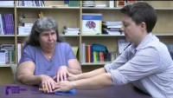
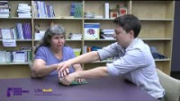
Hand-Under-Hand Vs. Hand-Over-Hand
Hand-Under-Hand Technique
Hand-Over-Hand Technique

Slide 22
Step 3: Recording
Name the experience
What positioning is being used for the activity
For each attempt, what was the child’s response (no response, startle, purposeful response
Any observations of the child’s reaction
Reflect on the experience, did the child like it, dislike, or it is unclear
Some activities may have to be tried a few times
Stop any activity the child is clearly not enjoying
The purpose is to find a few activities that can later be used to encourage communication

Slide 23
Step 4: Adding Cues to Signal an Upcoming Activity or Event

Slide 24
Step 4: Signaling an Upcoming Activity or Event
What can we add to a child’s daily routine to give them more information about what is happening around them
The hope is to add cues to help:
Reduce the child’s startle reflex
Encourage anticipation and with that participation
Understanding someone is communicating with them
You cannot communicate well if:
You are in a constant state of startle and uncertainty
You don’t know what is going on

Slide 25

Step 4: Auditory/Sign Language Cues
Consists of:
  Spoken words
  Sign language
  Noting environmental sounds (ex. Click of a seatbelt, water running for bath, etc.)
  Adding or emphasizing environmental sounds
Reduce background noise
Increase verbal description due to lack of incidental learning
  Increases understanding
  Decreases anxiety and a startle reflex
Cartoon person showing how to sign the symbol for "bath." Sign bath by making a fist out of your two hands with your thumbs sticking out, then moving the fists vertically up and down your chest. from: https://babysignlanguage.com/dictionary

Slide 26


Step 4: Object Cues
Using an object from a routine to represent the routine (Ex. Diaper, wash cloth, spoon)
Choose objects the child will touch or interact with directly
Avoid using miniatures for now (ex. Toy car for a car ride, instead use a buckle)
Interaction with the objects can be tactile and/or visual
Make sure to provide any visual accommodations (high contrast, light, etc.)
Can be set up in a calendar system

Slide 27
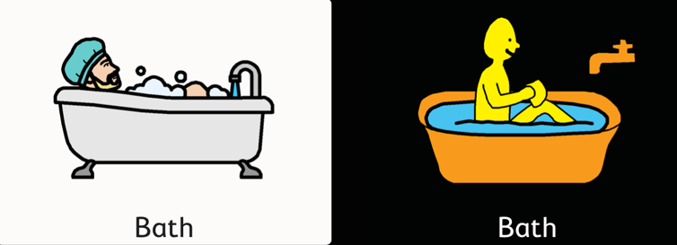
Step 4: Picture Cues
Pictures used to represent an event, activity, or person
More portable than object cues, but also more abstract
Ensure that the child can see and interpret images

Slide 28

Step 4: People Cues
Using a touch to the communication partner, to the child, or an object that represents a person
  Based on that person and the child’s relationship with them (Ex. feeling dad’s beard or mom’s glasses)
  Professional’s cues could be more periphery (Ex. touching a badge or a watch)
  Representative objects can be used to signal the person and the activity done with them (Ex. a ball for PT)
Sign for “nurse” from: https://babysignlanguage.com/dictionary

Slide 29


Step 4: Olfactory Cues
Noting smells in the environment tied to routines
  Smelling the shampoo or soap before washing
  Smelling food before the first bite
  Noting a specific perfume or cologne that a familiar person uses
Be mindful of strong smells and sensitivity to smell
Natural smells are safer than oils, essential oils should not go on their skin

Slide 30
Step 4: Tactile Touch Cues
A set of touches done to specific locations on the child’s body
Need to be specific and consistent
Touch should be just right- not too light nor too hard
Provide one touch at a time to allow them to process
Alter touches to reduce startle response if needed (ex. Touching elbows instead of the hands) *
Examples:
  Diaper changing- Touch to location of diaper tabs
  Suctioning- Touch near cheek for suctioning mouth/nose, near trach when suctioning there
  Connecting g-tube- Touch next to the g-tube site
  Tooth brushing- Touch to the side of the mouth
  Feeding- Touch center of the lips before providing a spoonful of food or a bottle

Slide 31
Step 4: Kinesthetic Cues
Similar to Touch cues, but using movement
Used to signal a position change or movement activity
Provide a pause in between the cue and the event- processing time
Examples:
  Rocking- Doing a slight rocking motion before sitting down with them in a rocking chair
  Swing- Doing a slight swinging motion before putting them in a swing
  Picking up from a chair- Putting pressure upwards under the armpit
  Picking up from laying down- Putting pressure beneath the head and legs in an upward direction
  Taking off their shirt- Lifting arms up (little movements) before taking off their shirt

Slide 32
Step 4: Putting it all Together
What routines can you add cues to?
Multiple types of cues can be used in a single routine
Add verbal/sign cues to provide more information
Sequentially or simultaneously- Consider the child’s sensory and processing needs
State the child’s name when talking to them
Do not use cues when providing emergency care (seizure care, rescue breathing), instead debrief the child after the event has passed

Slide 33
Step 4: Example Routine- Mealtime
Routine Steps | Potential Cues
Signaling the start of the routine | ● Saying and/or signing that it is time to eat ● Showing the child their spoon ● Letting the child feel and hold their spoon ● Touch cue for eat, tap next to child’s mouth
Putting the child in their highchair | ● Saying they will pick the child up and/or signing “up” ● Kinesthetic cue, putting pressure upward under the armpit
Putting on the child’s bib | ● Saying they will put on the bib and/or signing “bib” ● Showing the child the bib and/or letting them feel it ● Touch cue to the chest where the bib will go
Giving the child a bite | ● Say and/or signing that you will give them a bite ● Show the spoon ● Tactile cue, tape next to the mouth to signal the coming bite
Food is gone or child appears done | ● Say and/or sign that the routine is “all done”

Slide 34
Step 4: Example Routine-Physical Transfers
Verbal Cue:
Say his name when talking to him
Tell him what you are going to do before you do it
Tell him why you are moving him
Kinesthetic/Touch Cue:
Touch and give upward pressure where you will lift him
Pause, then complete the lift
Cues for the Car Seat/Rifton/Stroller:
Auditory Cue: Click of the buckle before he gets in
Touch Cue: Firm pressure where his chest buckle will go

Slide 35
Step 5: Shaping Cues into Communication
Communicative Methods

Slide 36
Step 5: Body Movements
Receptive form: touch and kinesthetic (movement) cues
Expressive form: cues we were observing in steps 2 and 3, including facial expressions
  Also includes gestures that signal an activity (ex. hopping to do a jumping activity, rocking back and forth to get in a swing)
Acknowledging and honoring body movements as communication
Telling the child what their movement indicated by their movement
Work towards shaping this pre-intentional communication into intentional use of movement as communication

Slide 37
Step 5: Gestures
Non vocalized forms of communication (ex. Waving, thumbs up, shaking the head yes/no
  These may not be seen or interpreted by children with vision concerns *
  These may look different for a child with a physical impairment
Pointing towards something, either an area, object, or person
Alternative forms of “yes” or “that’s the one I want” to be used with auditory scanning
Less clear gestures could be shaped into more conventional signs

Slide 38
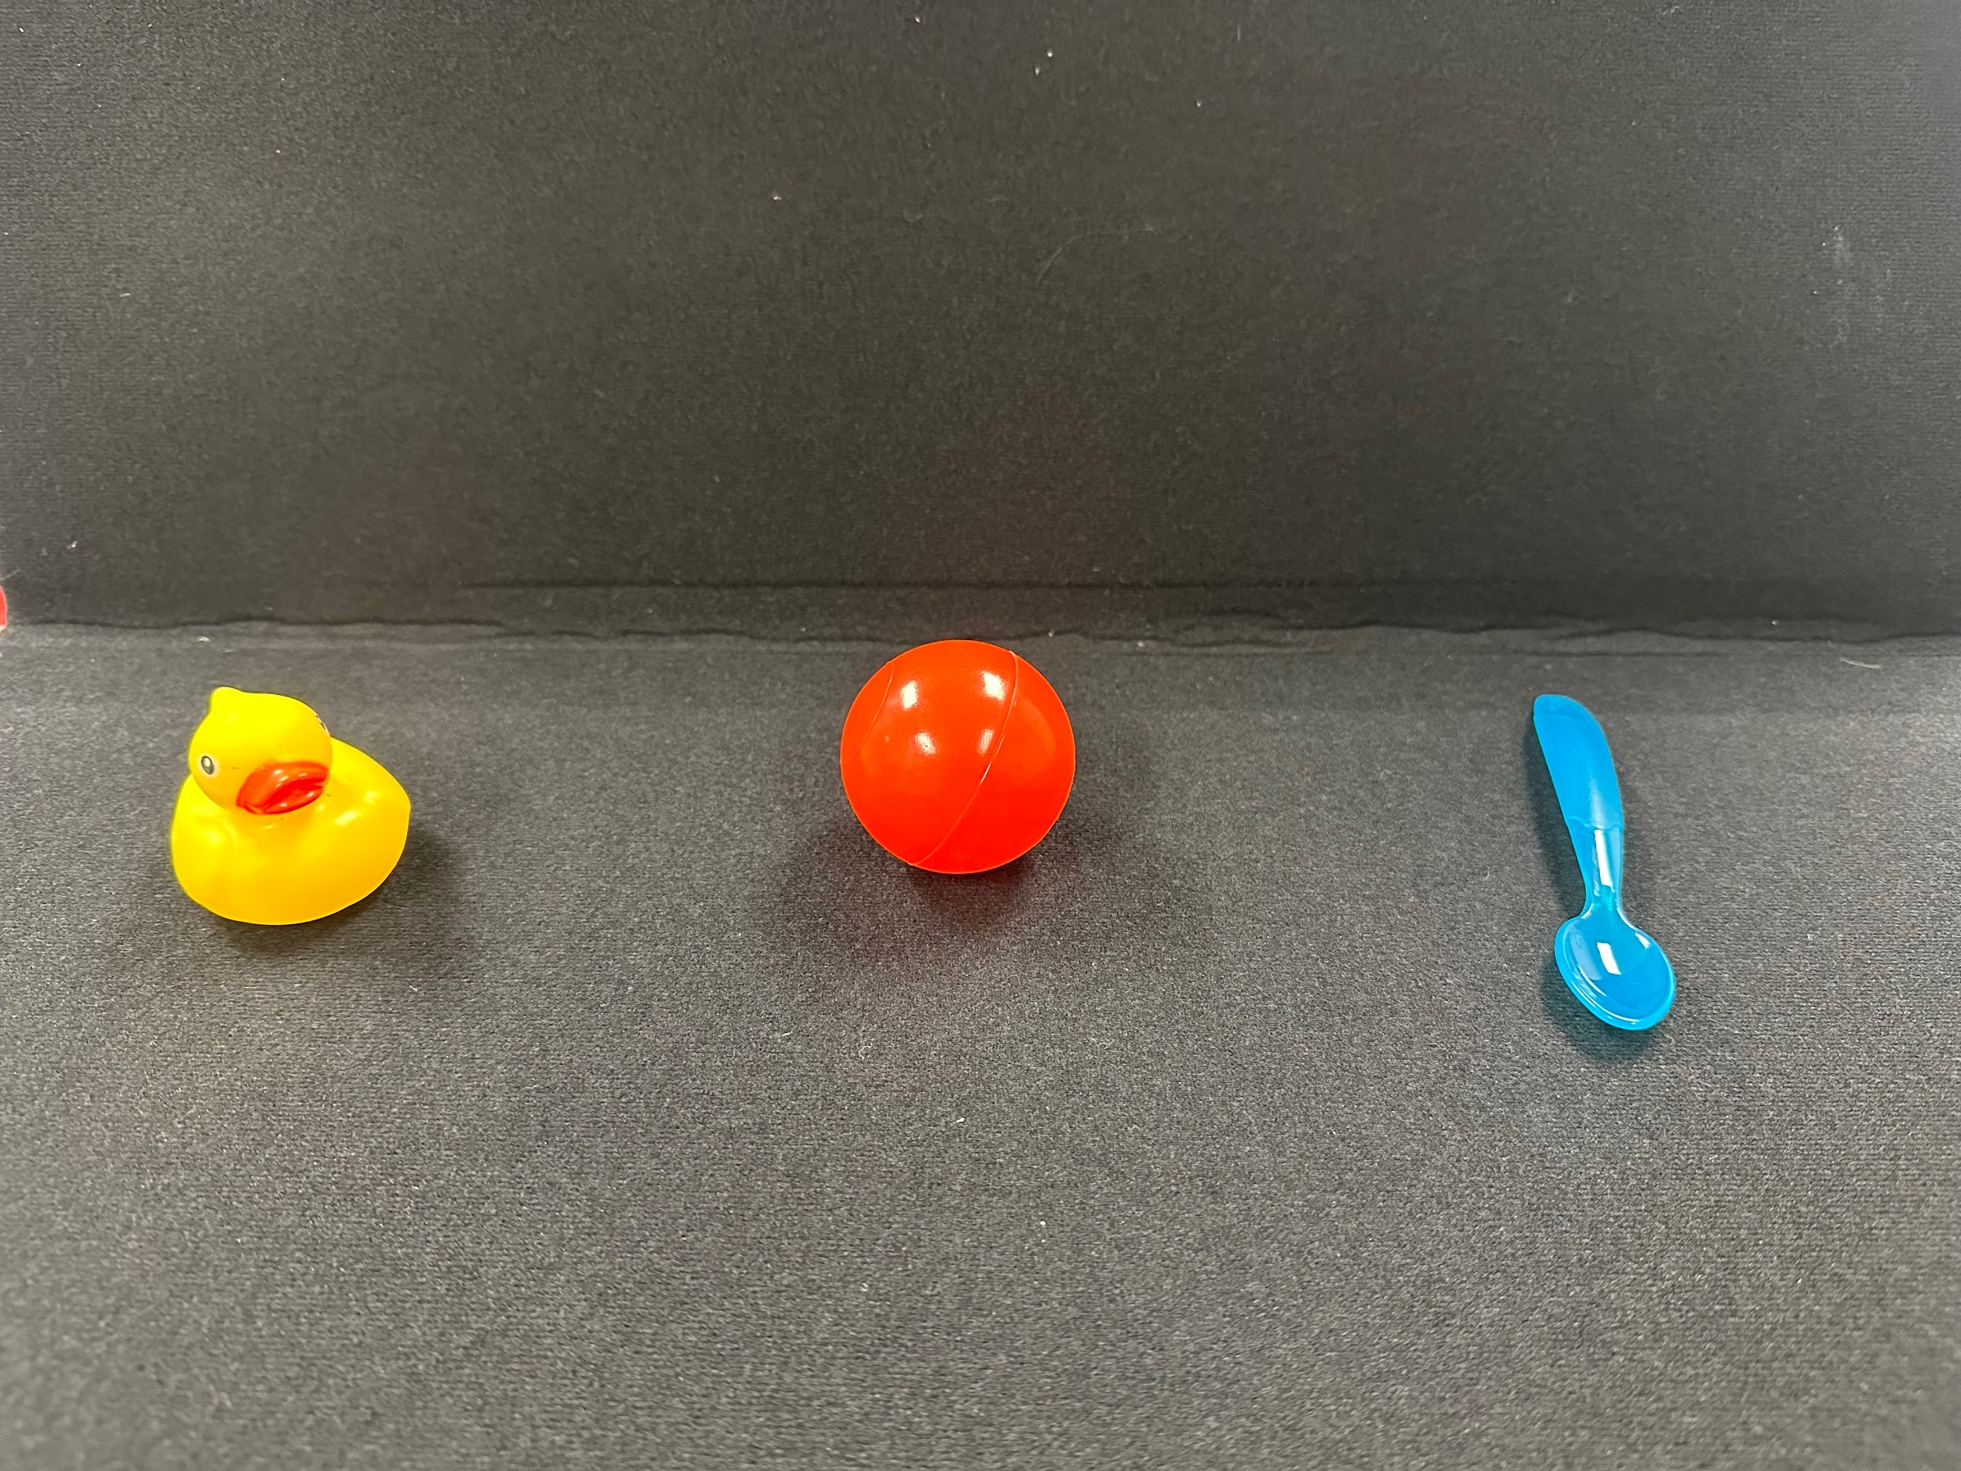
Step 5: Selecting Objects
Receptive form: understanding that an object represents an event or person
Expressive form: A child may select an object to represent the desire to do something associated with that object
Objects can be selected by reaching towards, pointing, directing their eye gaze, or by auditory scanning

Slide 39
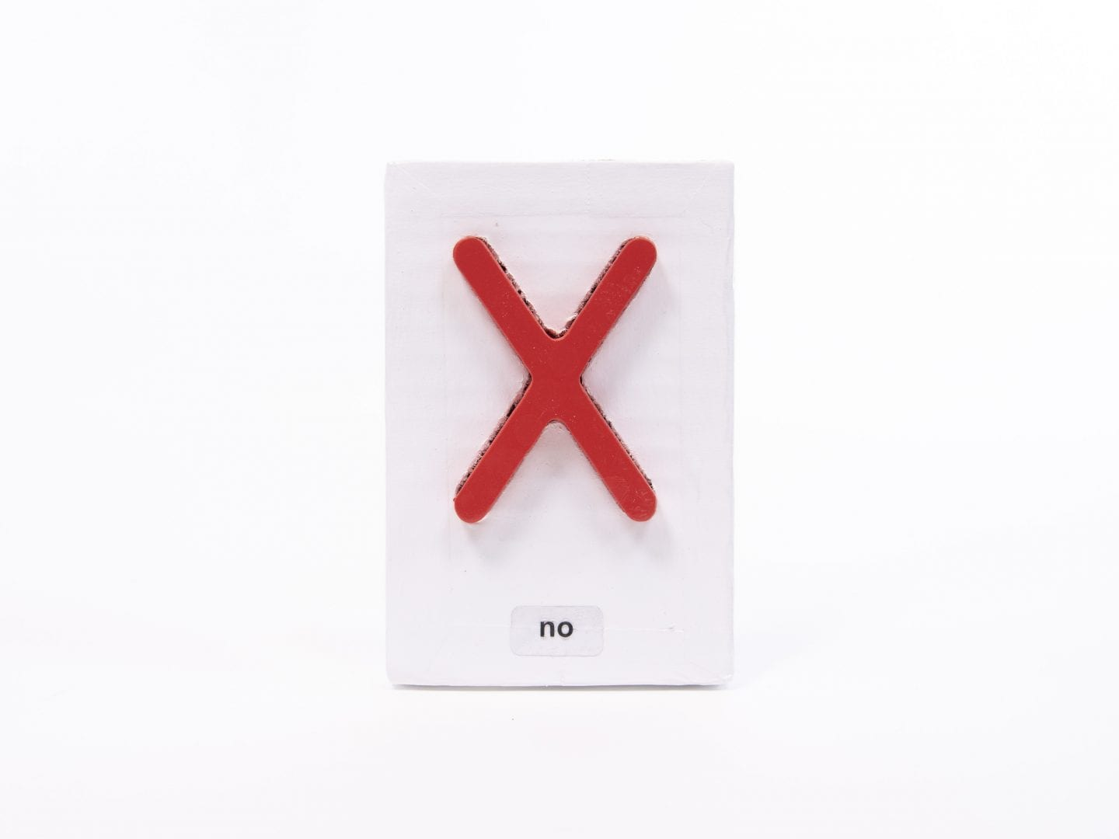
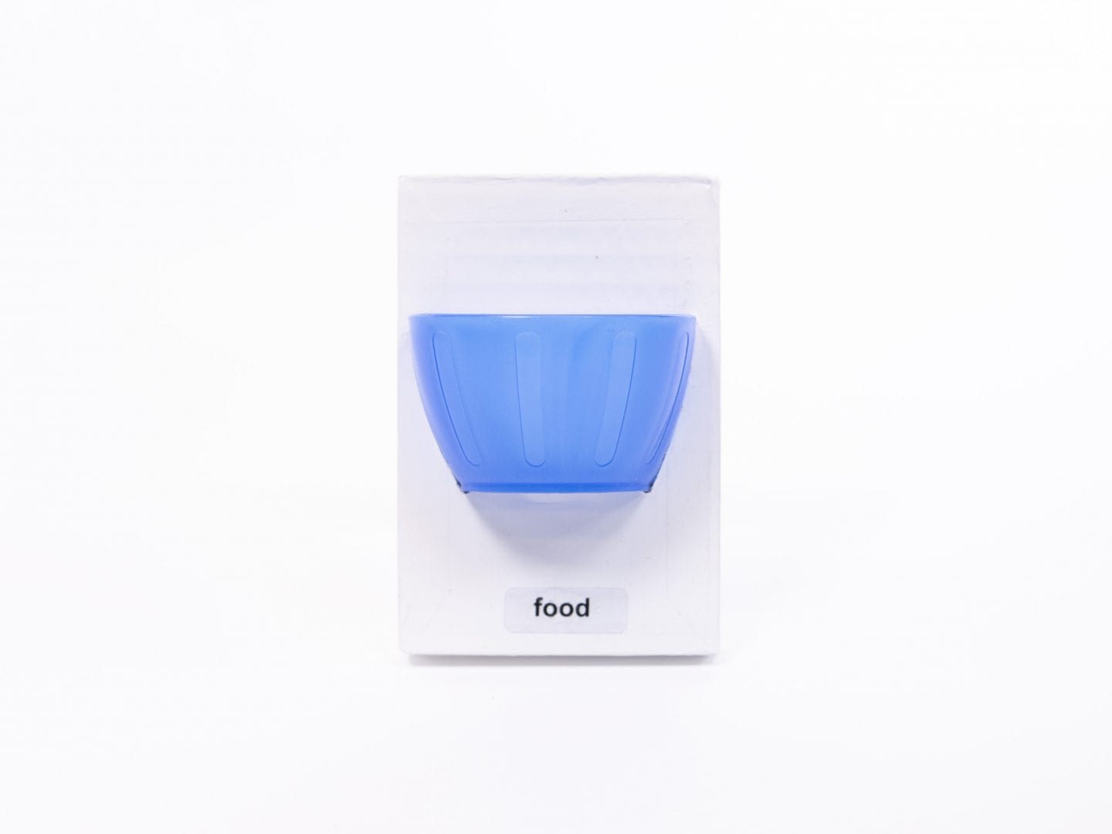
Step 5: Selecting Tactile Symbols
More abstract version of object cues using pieces of objects or textures
Leading towards more symbolic communication
Often used when a child cannot see or interpret pictures
Examples: Standardized Tactile Augmentative Communication Symbols Kit (STACS, from APH)

Slide 40
Step 5: Selecting Pictures
Pointing to or handing a picture to communicate a message
Can be part of an AAC system presented on paper and/or electronically
More abstract than objects or tactile symbols
Careful assessment is needed to ensure that vision accommodations are provided if needed
  Type of picture used
  How many are presented at once
  How close they are presented
  Background color

Slide 41
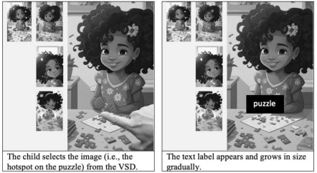
Step 5: Video Scene Display (VSD)
Evidence based practice in AAC
Images with hotspots embedded with words and phrases
Can also be used with videos that pause at specific spots to offer communication options
Can be made on the spot during the activity

Slide 42
Step 5: Auditory Scanning
Providing choices verbally
Can be paired with images, objects, or a touch cue
Can be done with a communication partner or an AAC device with switch access
Communication Partner- constructs meaning out of what the child communicates
Start with scanning through 2-3 options in context
Build to scanning systems for more robust communication
Can use a premade scanning set modified to fit the child’s favorite activities, people, and daily routines

Slide 43
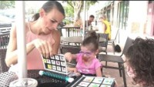
Step 5: Video
The little one by mom is using picture selection, while the little one across the table is using auditory scanning.

Slide 44
Step 5: Signs Language
Requires at least some level of motor ability in the arms
Sign approximations
Children who are blind or have low vision can use signs with support
  Sign in their near space
  Sign on their body in the location of the sign (ex. Eat by their mouth)
  Sign under their hands
  Pro-tactile and other techniques for communication with children who are Deafblind
  Use of an interpreter or intervener
  Contact your state Deafblind Central for more supports

Slide 45
Step 5: Vocalizations
An audible noise (ex. Fussing, crying, laughing, grunting) indicating a need or want
Some will have specific sounds they use to represent specific requests
Children with trachs may be able to vocalize some, but the sound may be different than expected
Highlights the importance of the family being part of the process

Slide 46
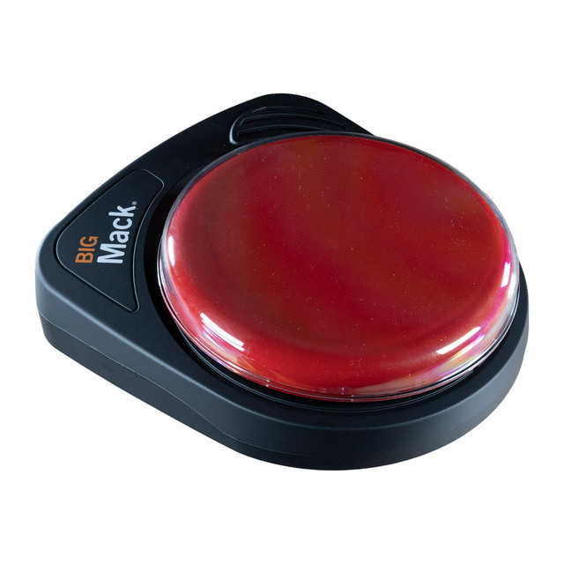
Step 5: Speech
Some children will be able to use some speech and supplement with some of the methods previously mentioned
Some children may use single switch buttons with verbal messages recorded
  Can be a consistent message
  Could be changed based on the activity (repeating phrase in a story)
It is important that communication partners provided pauses for the child to take their turn with all types of communication

Slide 47
Step 5: Shaping Cues into Communication
Communicative Functions

Slide 48
Step 5: Protesting, Refusing, Rejecting
Examples: pushing/moving away, hitting, biting, crying/fussing, increased heart rate, shaking their head, saying “no”
Make sure their communication system has the vocabulary for this
Acknowledge and honor their communication when able
Acknowledge when you cannot and share that the routine must be completed (medical treatment or hygiene routines)
Modeling more efficient and appropriate ways to protest, refuse or reject

Slide 49
Step 5: Greeting/Leave Taking
Make sure their communication system has the vocabulary for this
State their name and yours- Makes sure the child is aware when you are initiating communication
Announce the end of the exchange or if you will temporarily leave them
Consider using people cues or object cues as part of the greeting/leave taking
Consider cultural and religious norms

Slide 50
Step 5: Requesting More
Make sure their communication system has the vocabulary for this
Play pause and wait games with favorite activities from Step 3
Model signing “more” or use their known “yes” gesture to continue activity
When they no longer participate, model “all done”

Slide 51
Step 5: Attention Seeking
AAC considerations-can they access it independently?
Is a communication partner or equipment required?
Requires attention and observation from the communication partner
Model intentional ways to seek attention for those still using preintential methods (ex. crying/fussing)
Speech button for calling someone over to initiate a conversation
AAC with names of specific people to call over
Encourage initiation of communication with delay of start activities

Slide 52
Step 5: Making a Choice
Present two preferred items at the start
Gradually move to presenting a non preferred item with a preferred item
May work towards adding more items, leading toward scanning
Visual cues could be added in the form of objects or images to represent choices
Touch cue supports could be added with options being associated with, for example, each arm to raise the choice they want
Give what they choose, even if you feel they chose incorrectly- gives them a chance to practice refusing and rejecting an item
Offer “something different” when providing choices, so the child is able to choose outside of what is offered

Slide 53
Step 5: Expressing Needs/Wants
Starts with making a choice, then with adding more options turns into expressing their needs and wants
Having a larger set of options allows for greater autonomy
Less reliance on the communication partner to select what they may want
Make sure their communication system has the vocabulary for this
Let’s try it….think about what you would like for a snack.

Slide 54


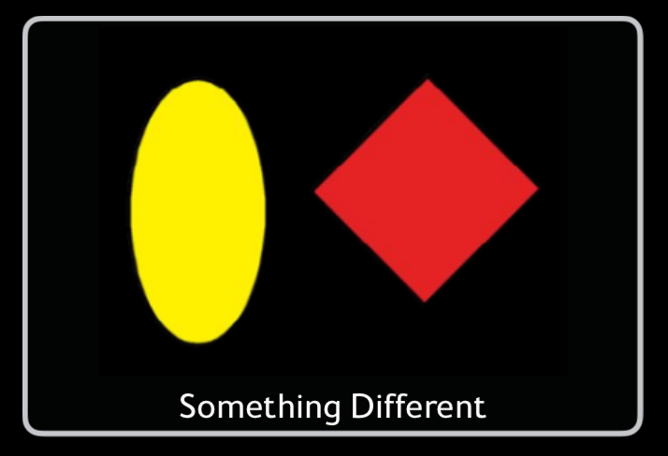
Step 5: Making Choices Example
Did I pick what snack you would like?

Slide 55
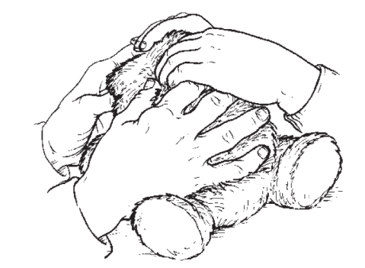
Step 5: Social Interactions
Make sure their communication system has the vocabulary for this
Play turn taking games with modeling sounds, movements, or vocalizations
Joint attention activities- both attuned to the same activity and sharing communication about the experience
How to include them in the play of their peers and siblings
Training peers and siblings on their AAC usage
Image from: https://www.nationaldb.org/info-center/educational-practices/hand-under-hand/

Slide 56
Step 5: Commenting
Make sure their communication system has the vocabulary for this
Model commenting with attribute words for an object or experience
Responses at first will be inferred by their facial expressions and body language, acknowledge this to give them the vocabulary for what they are communicating
When a child comments, respond and add a comment of your own to further expand the child’s vocabulary
Be sure to comment about activities currently happening and those that happened in the past

Slide 57
Step 5: Requesting Information/Asking Questions
Make sure their communication system has the vocabulary for this
Observe the child looking around or feeling around for something. Model questions for them to match the situation
Observe their facial expressions and body movements and phrase them as questions.
Model questions during social interactions and while commenting

Slide 58
Step 5: Learning and Access
Make sure their communication system has the vocabulary for this
Using VSDs and Video VSDs and academic content within AAC
Incorporating literacy in AAC
Environmental access and control with AAC

Slide 59
Step 6: Encouraging Participation in Daily Routines
Making Accommodations

Slide 60
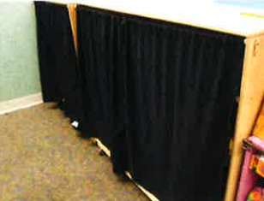
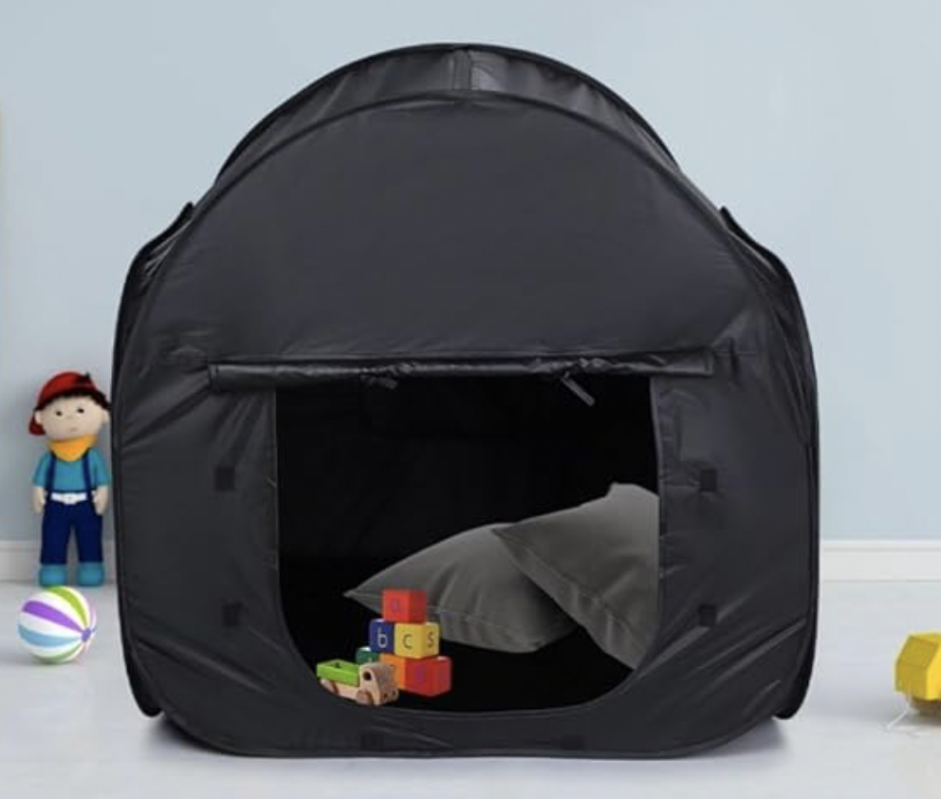
Step 6: Modifying the Environment
Reducing clutter
Solid colored curtains, walls and bedspreads at home
Organizing, putting away materials, and covering shelves
Use of a calm clutter-free corner in the classroom
Use of a tent in the home
Adjusting lighting
Turned away from glare and outdoor windows
Covering fluorescent lights
Adjusting light for preference (color and position)
Reducing/Amplifying sound

Slide 61
Step 6: Materials Adaptations
Individualized and based on assessment
Functional Vision Assessment, Cerebral/Cortical Visual Impairment Assessment
Learning Media Assessment:
  How does the child currently access their environment?
  What media best fits their needs- visually and physically
Reevaluations should happen often to ensure appropriate adaptations

Slide 62
Step 6: Early Intervention LMA Questions
Finds toys by: ☐ Visually ☐ Tactile Searching ☐ No attempt to find items
Explores toys using ☐ Vision ☐ Touch ☐ Hearing ☐ Other:
How does the child find their shoes (or other item): ☐ Vision ☐ Touch ☐ Other:
Identifies Items by: ☐ Vision ☐ Touch ☐ Hearing ☐ Other:
When reading a book, the child show interest in: ☐ Pictures ☐ Textures ☐ Braille
Does the child scribble, write, and draw using ☐ Vision ☐ Touch
Observed visual fatigue:
Primary sense used for access: ☐ Vision ☐ Tactile ☐ Mouthing ☐ Sound ☐ Smell
Secondary senses observed: ☐ Vision ☐ Tactile ☐ Mouthing ☐ Sound ☐ Smell

Slide 63

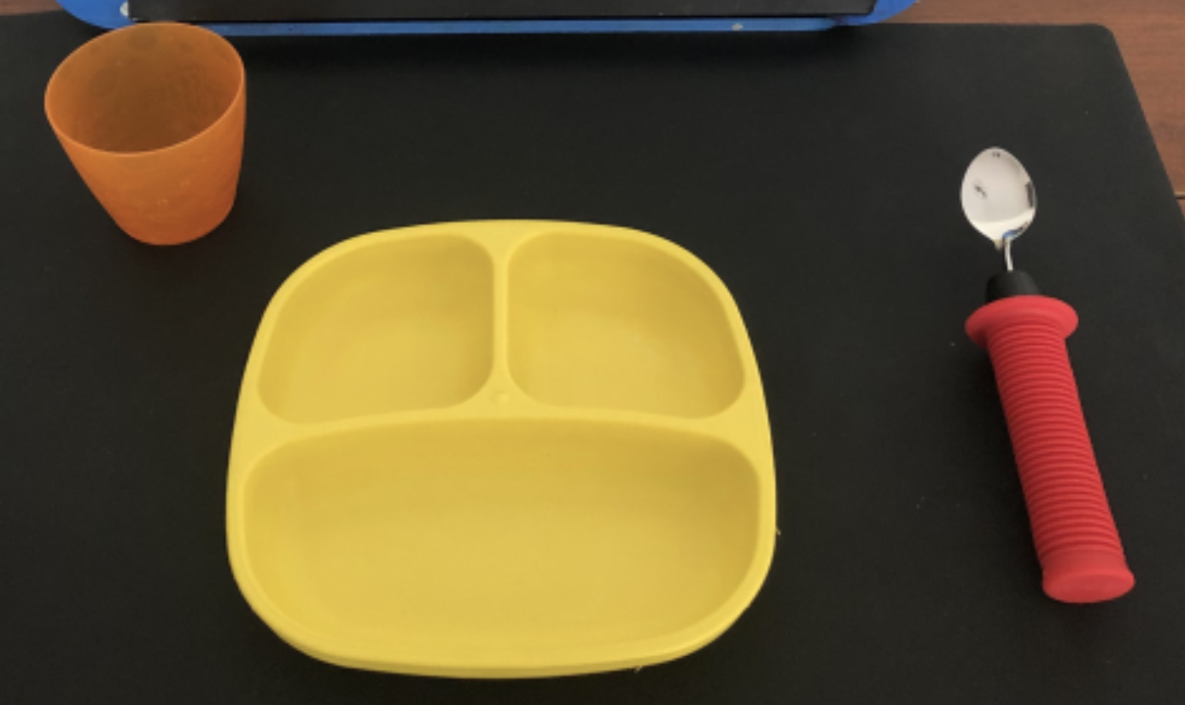
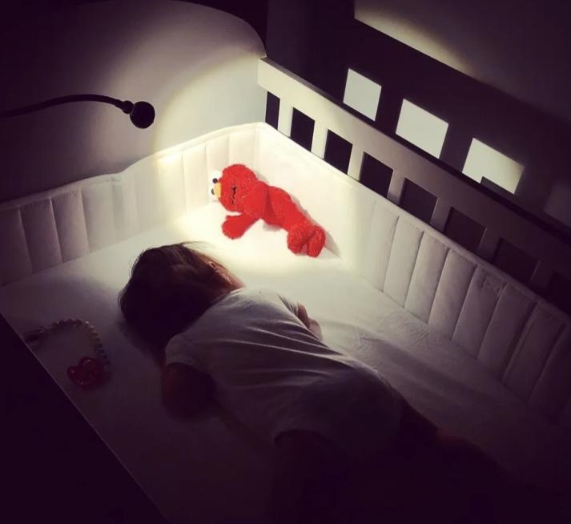
Step 6: Adaptations to Images and Objects
What types of images to use
High Contrast
Color Highlighting
Adding Light
Interest and Familiarity
Reduced array (AAC device)
Needing to add light and/or movement to support attention

Slide 64
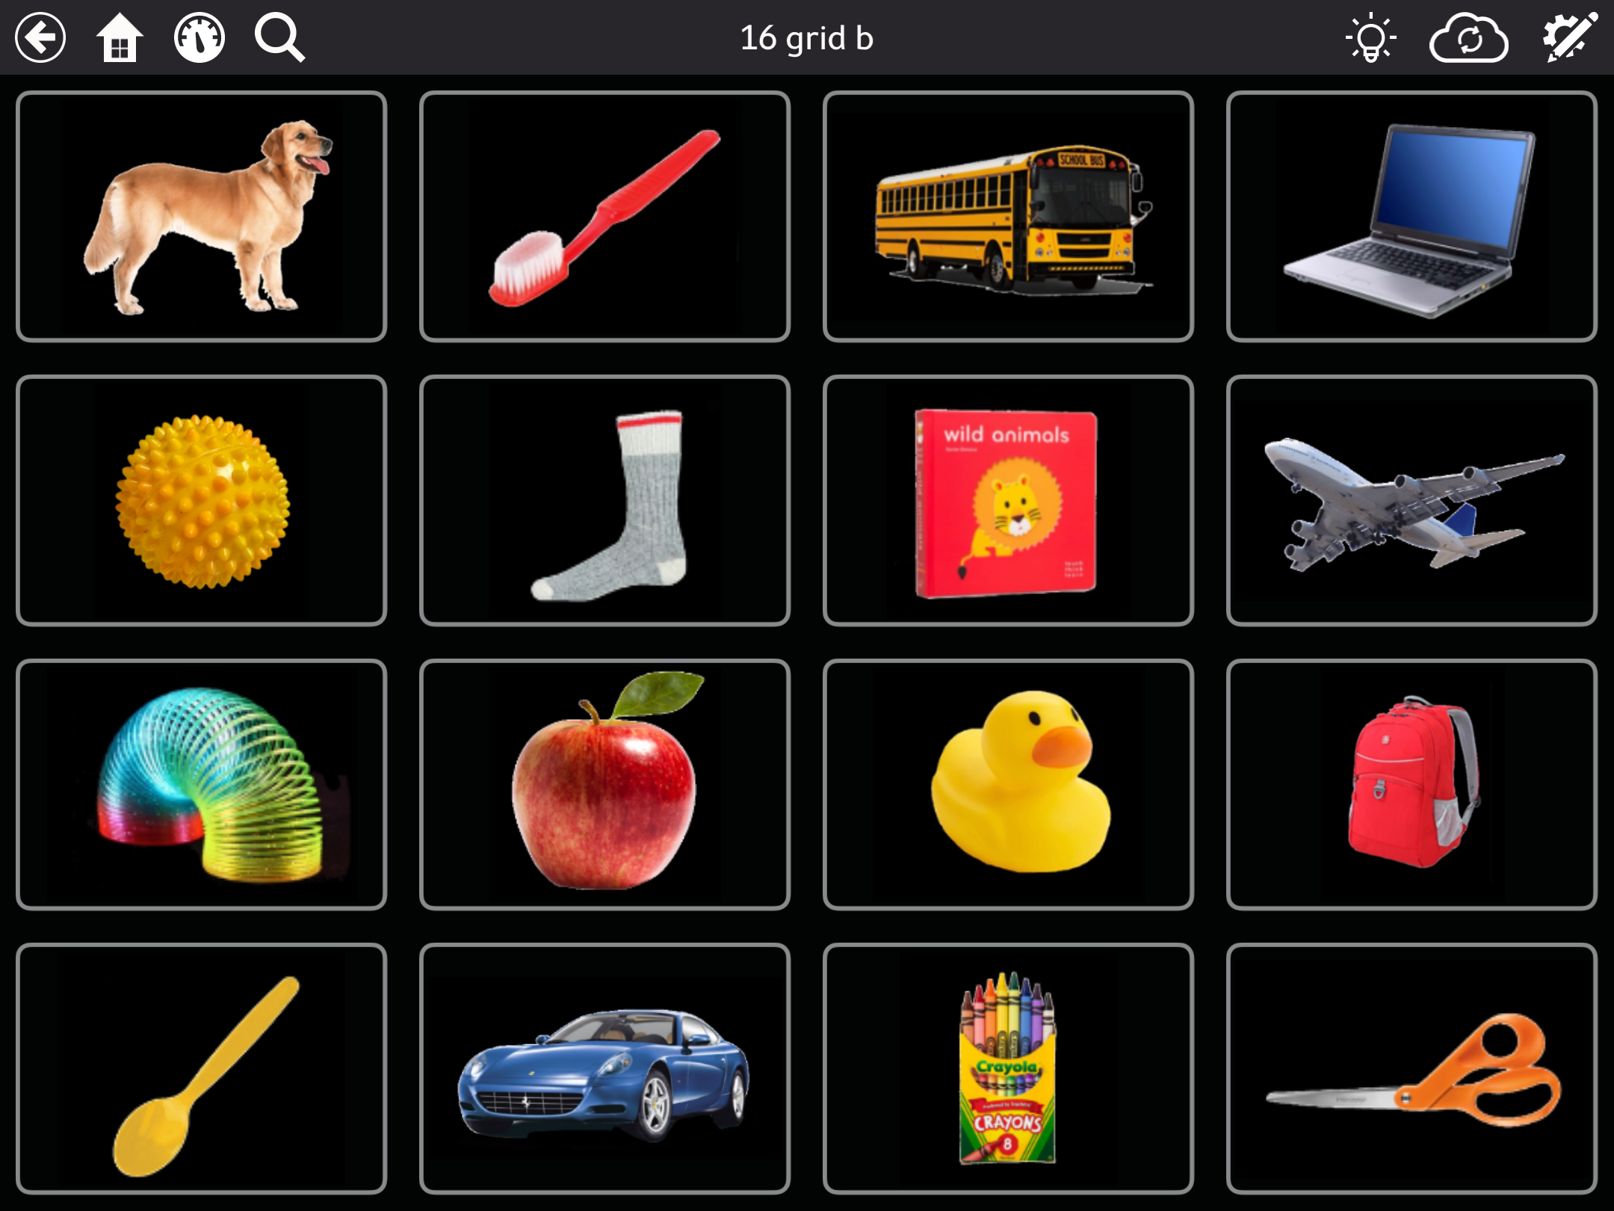
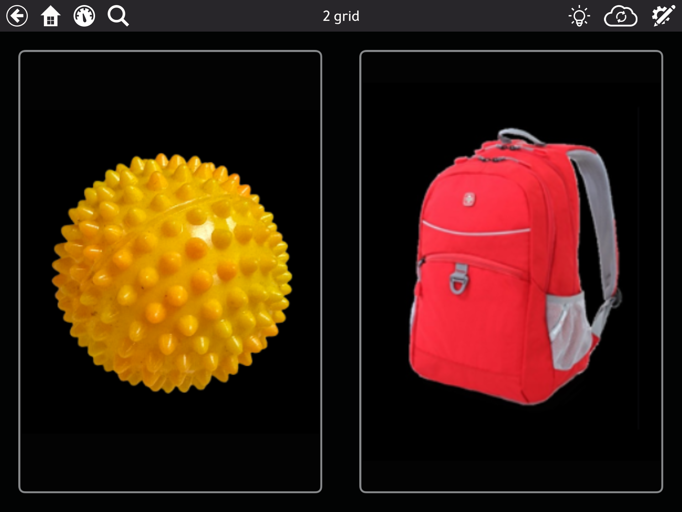
Step 6: Image and Array Assessment
Example array assessment created in TD Snap-
Find the yellow ball in an increasingly complex page set.
The icon moves around on the board
Some pages have same colored distractors

Slide 65
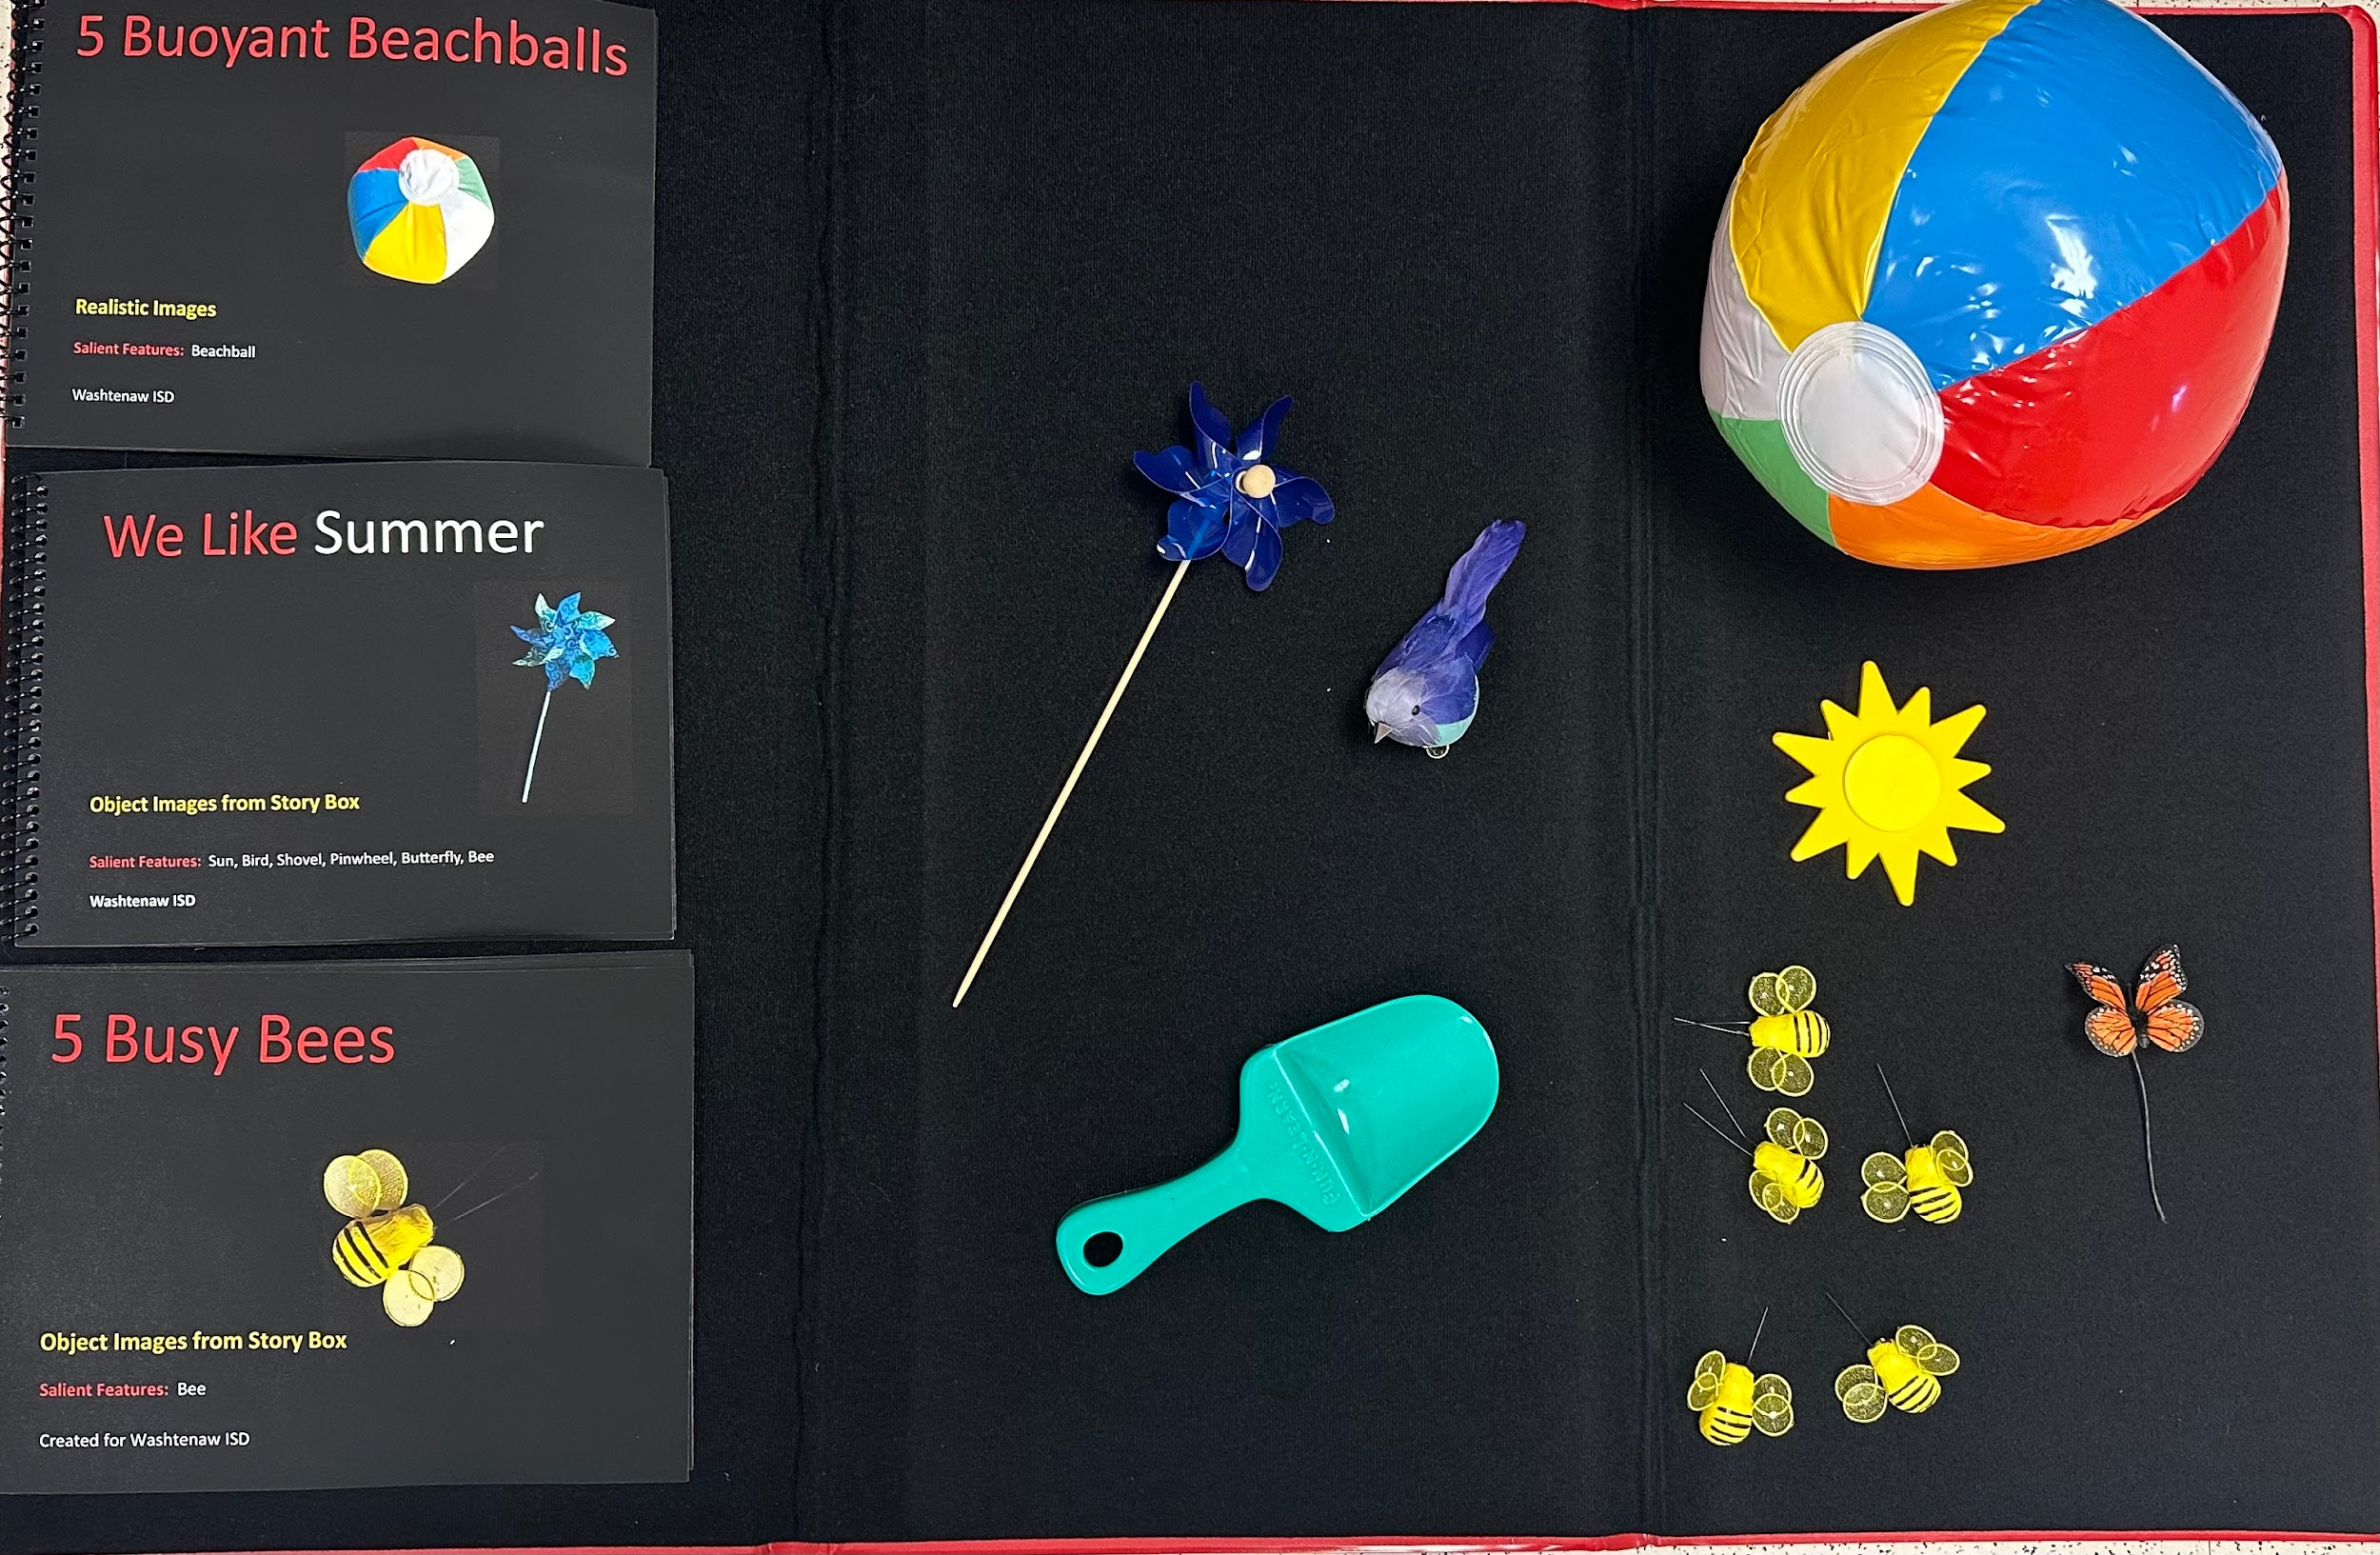
Step 6: Alternative Access Methods
Alternative Access methods
Incidental learning
Increased verbal description
Multi-sensory approach-Book Bags/boxes
Pauses and quiet wait time- time for processing and for responding
Notes:
Children with significant disabilities may also have reduced incidental learning due to their physical limitations and general lack of experience- cooking example, they are not even in the room sometimes
Book boxes

Slide 66
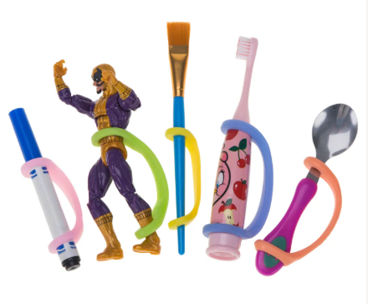
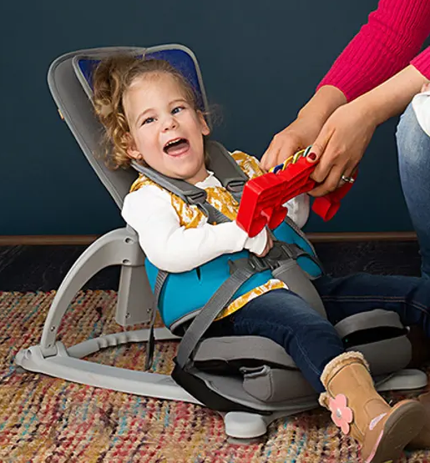
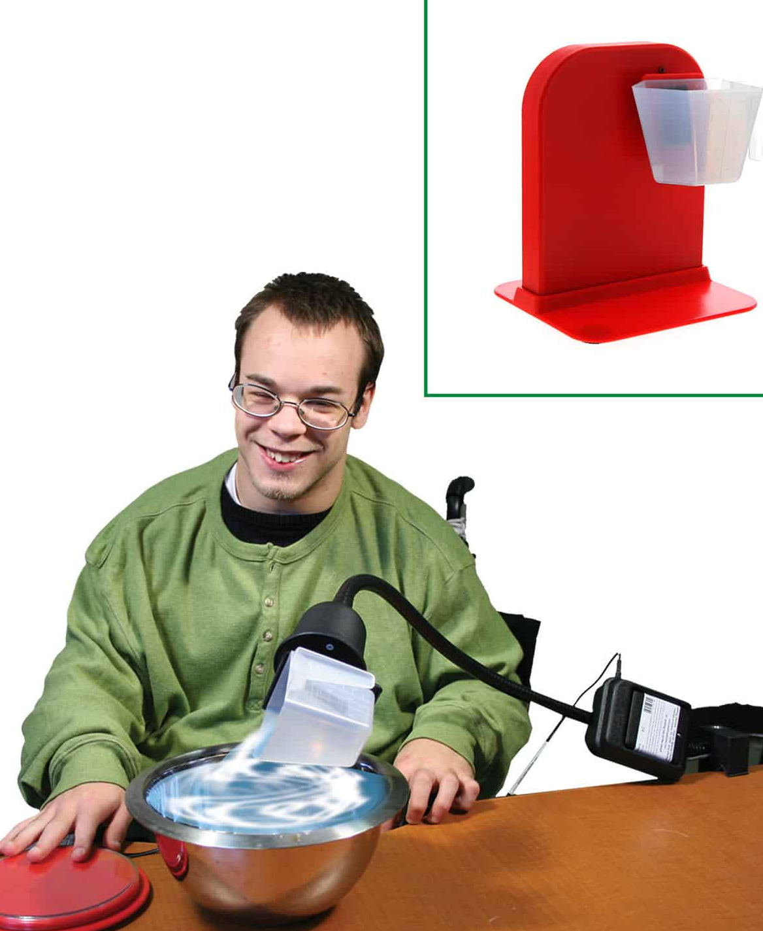
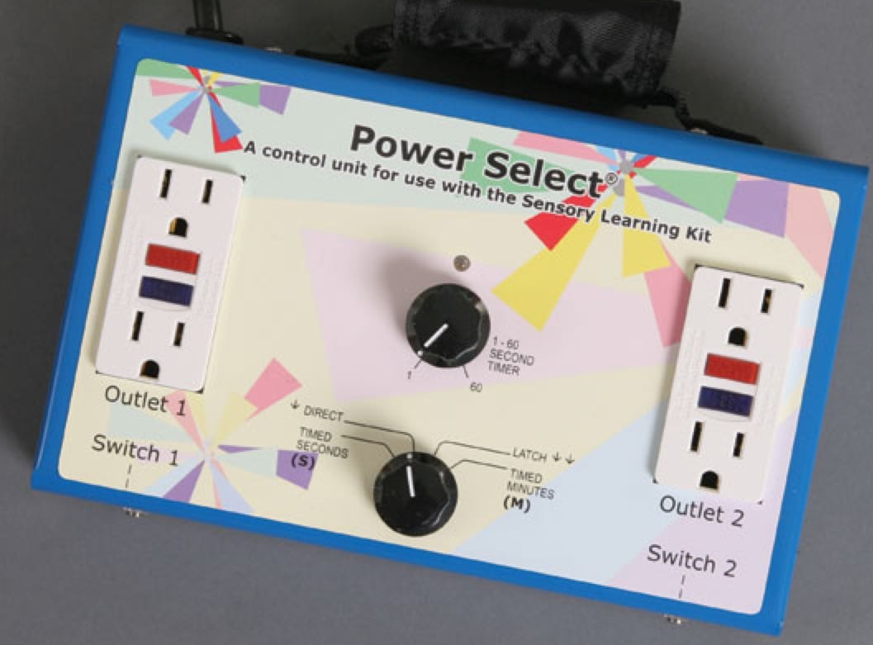
Step 6: Positioning Equipment and Supports
Adaptive switch toys
Adaptive switch devices (Power Select)
Positioning equipment (Firefly seat)
Supports for holding items (Eazy Hold)
Notes:
Physical positioning- what is alerting, but not a lot of physical work (ideal for learning)
When in positions what require a lot of work, communication system should be easier to use

Slide 67
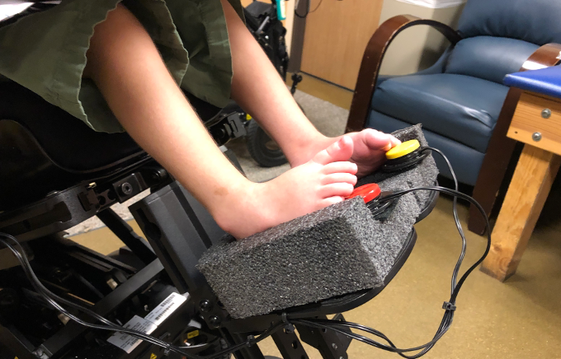
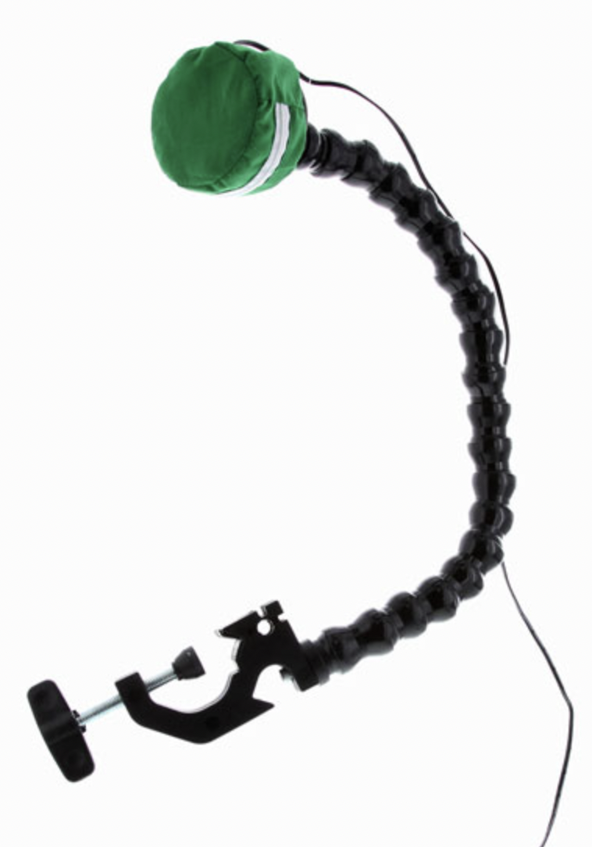
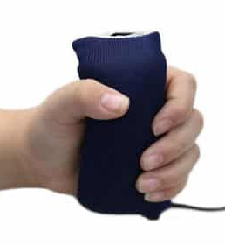
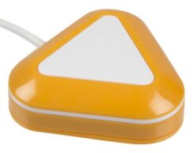
Step 6: Switch types and Mounts
A variety of switch types
Switch and ipad/AAC mounting supports
Notes:
Physical positioning- what is alerting, but not a lot of physical work (ideal for learning)
When in positions what require a lot of work, communication system should be easier to use

Slide 68
Step 6: Encouraging Participation in Daily Routines
Alternative Strategies

Slide 69
Step 6: Expanded Core Curriculum
Assistive Technology- AAC and switch toys
Career Education- Future needs
Compensatory Skills- Use of other methods of interaction
Independent Living Skills (ILS)- How can they contribute and participate?
Orientation and Mobility (O&M)-Self-directed travel
Recreation and Leisure- Ways to engage with the community
Self-Determination-Advocating
Sensory Efficiency-Using their modalities to the best of their ability
Social Interaction Skills-Specific practice in social skills/AAC instruction

Slide 70
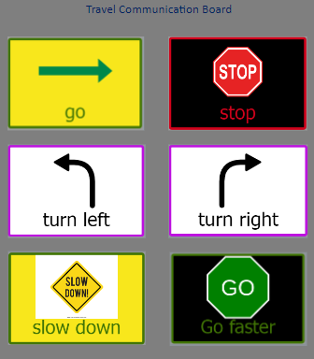
Step 6: Expanded Core Curriculum-O&M
Example AAC board to use during travel,
Can be used with wheelchair users who are pushed to give them agency in where they go
Notes:
Physical positioning- what is alerting, but not a lot of physical work (ideal for learning)
When in positions what require a lot of work, communication system should be easier to use

Slide 71
Step 6: Strategies
Timing of the instruction:
  Fluctuating alert times- having activities ready
  Breaks in between challenging activities
  Allowing pauses and wait time
  Know and recognize signs of fatigue
Partial participation
  Completing part of the routine
  Utilizing a switch device to participate
  Task analysis
Make it fun
  Make it playful
  Motivating activities
  Familiar routines
  Playtime/hobbies

Slide 72
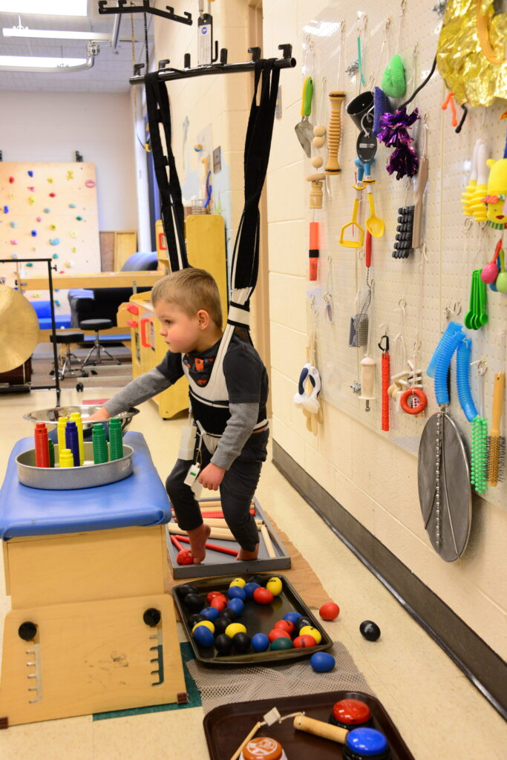
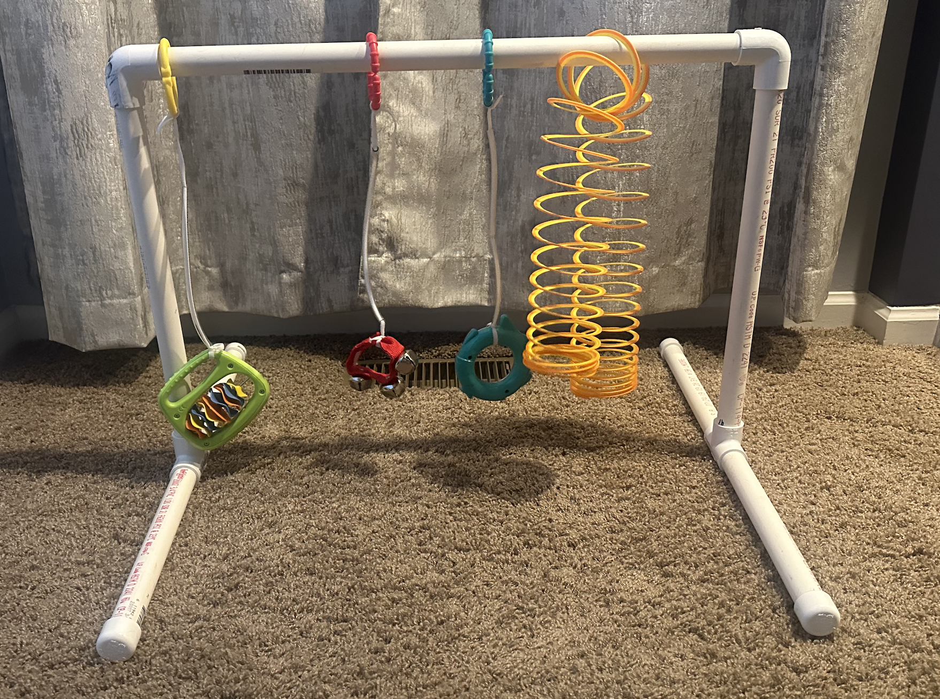
Step 6: Active Learning Approach
An assessment and curriculum that encourages children with very little motor movement to gradually increase their involvement with their surroundings by using various play set-ups
Notes:
Physical positioning- what is alerting, but not a lot of physical work (ideal for learning)
When in positions what require a lot of work, communication system should be easier to use

Slide 73
Step 6: Goals Matrix
Goals | Mealtime | Diaper change | Bath time | Playtime
Cameron will reach out and touch and explore a variety of toys, objects, and family faces in his environment. | Show him his bright colored or lighted spoon to reach for or other tray toys | Have items to play with dangling above the diaper change area | Provide bath toys that are bright colored to look for and reach | Place items around him and dangling above him during play time
Cameron will maintain head control while supported in a seated position. | Join the family at the table in a high chair with supportive shoulder straps |  |  | Provide him a preferred toy or lighted target to look for while seated in a supportive play chair or while being held
Cameron will move in some way to indicate that he wants an activity to continue. | Pause to wait after giving him tastes of a keto sugar-free sucker | Pause to wait while playing a tummy tickle game | Pause to wait after making water splashes or blowing bubbles | Pause after a few bounces on a therapy ball
Notes:
Family priorities and routines-based goals: embedded in routines so that they are practiced consistently in context

Slide 74
Step 6: Task Analysis: Getting Dressed
Steps | How could the child participate?
Go to the closet | Depending on their level of independent mobility, the child could take steps in their gait trainer, roll or crawl towards the closet.
Open the door | The child could sign to the caregiver “open”.
Choose a shirt | The child could be provided two shirts to point to or gaze towards their choice. The child could choose what color shirt with a choice board of colors using auditory scanning or with a color selected from their AAC device.
Put the shirt over your head | The child could briefly work on head control to steady themselves, then be provided support in holding their head as the shirt is pulled over.
Put each of your arms in | The child could be provided some support at the elbow to lift their arms as they move as much as they can into the sleeves.
Notes:
Family priorities and routines-based goals: embedded in routines so that they are practiced consistently in context

Slide 75
Summary
Once all this work is done, it provides a clear picture of the child to use for:
Guidelines for building an AAC system
Goals for IFSPs and IEPs
Accommodations to make in the home or classroom
Supports to providing instruction
Sharing information at transitions
Increasing the child’s access to their world
Improving their quality of life

Slide 76
Reading List
Beukelman, D. R., & Light, J. C. (2020). Augmentative & Alternative Communication: Supporting Children and Adults with Complex Communication Needs
Chen, D. (2014). Essential Elements in Early Intervention: Visual Impairment and Multiple Disabilities
Klein, M. D., Chen, D., & Haney, C. M. (2000). Promoting Learning Through Active Interaction: A Guide to Early Communication with Young Children who Have Multiple Disabilities.
Korsten, J. E., Foss, T. V., & Berry, L. M. (2007). Every Move Counts Clicks and Chats: Sensory-based Strategies for Communication and Assistive Technology.
Nielsen, L. (n.d.). Functional Scheme: Functional Skills Assessment and Learning Reassessment.
Sacks, S., & Silberman, R. K. (Eds.). (1998). Educating Students who Have Visual Impairments with Other Disabilities.
Sacks, S., & Zatta, M. C. (Eds.). (2016). Keys to Educational Success: Teaching Students with Visual Impairments and Multiple Disabilities.

Slide 77
Thank You
Jessicia Klenk
jklenk@washtenawisd.org

