Slide 1

Topics in
Texas Air Quality Science
Mark J. Estes
Senior Air Quality Scientist, Texas Commission on Environmental Quality
Mark.Estes@tceq.texas.gov

Slide 2
Outline
Background ozone and international emissions, and their effects upon ozone in Texas. Discussion of the upcoming review article by panel of experts.
Effects of the emissions from oil and gas development on ozone in Texas

Slide 3
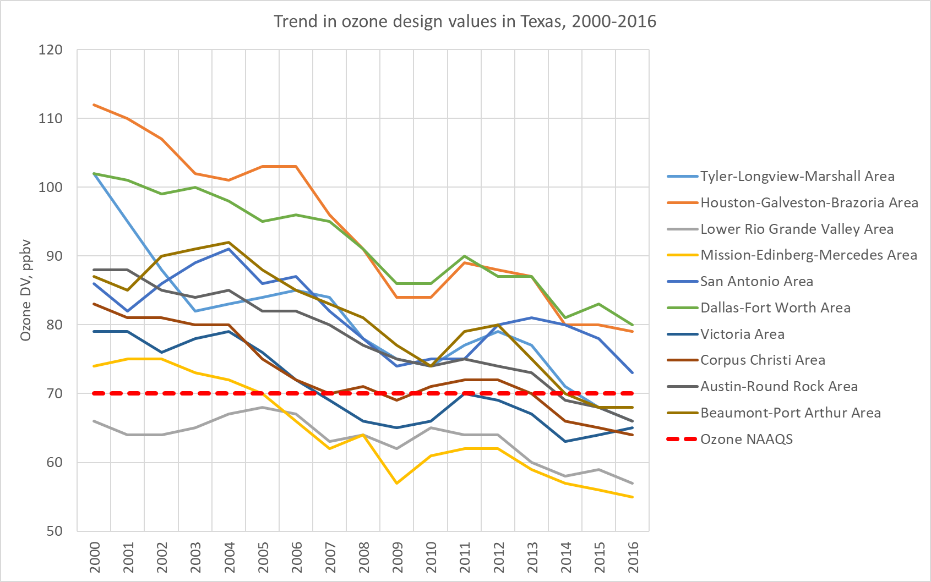
As ozone levels decrease, background ozone plays a larger role. By quantifying background, we can determine the magnitude of local contributions.

Slide 4
Upcoming review article by experts on background ozone and international contributions
D. Jaffe’s American Meteorological Society background ozone presentation: Definitions
U.S. background (USB) O₃ or North American background (NAB) O₃ : O₃ formed from all natural sources plus anthropogenic sources in countries outside the U.S. (N.A.), plus methane.
USB and NAB must be determined using chemical transport models or statistical models that yield source apportionment. Both of these methods have notable uncertainties.
Baseline O₃ : O₃ measured at relatively remote sites that have little or no recent influence from US domestic emissions.
Non-Controllable O₃ sources (NCOS): These are sources of O₃, or its precursors, that could not be reasonably controlled by domestic legislation, e.g., stratospheric intrusions or wildfire contributions.

Slide 5
What are consistent patterns for observed O₃?
(Jaffe AMS 2018)
Highest Maximum Daily eight-hour Average (MDA8) values are seen in urban areas of the U.S. Most of these areas show significant downward trends in the 4th highest MDA8 values.
At high elevation sites in the western U.S., the 4th highest MDA8 values are close to 70 ppb.
Inter-annual variations can be very important in calculating design values. These variations occur due to El Niño/Southern Oscillation (ENSO) and other large-scale weather oscillations, wildfire influence, and/or temperature influence.
Trends at high elevation sites are more flat or increasing (e.g., Mt. Bachelor in Washington state). Some urban sites in the west are not showing significant reductions in the 4th highest MDA8.

Slide 6
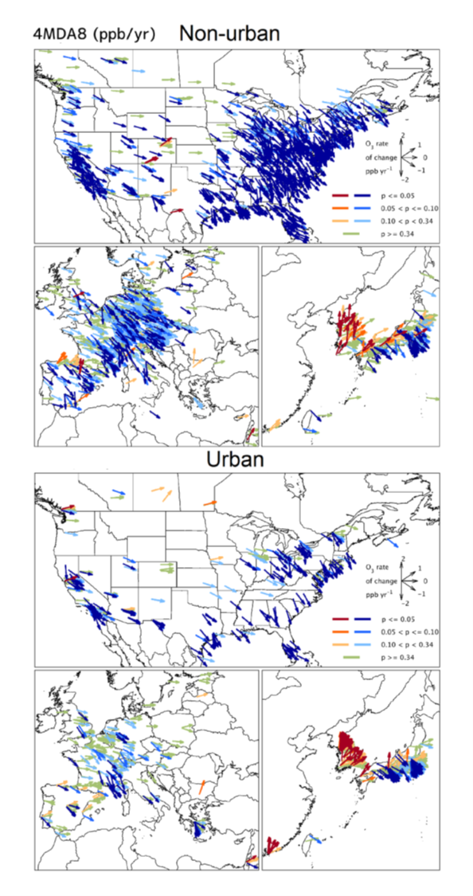
Nationwide ozone trends, 4th highest annual daily maximum eight-hour ozone
Fleming, ZL, et al. (2018), Tropospheric Ozone Assessment Report: Present-day ozone distribution and trends relevant to human health. Elem Sci Anth, doi: 10.1525/elementa.273.

Slide 7
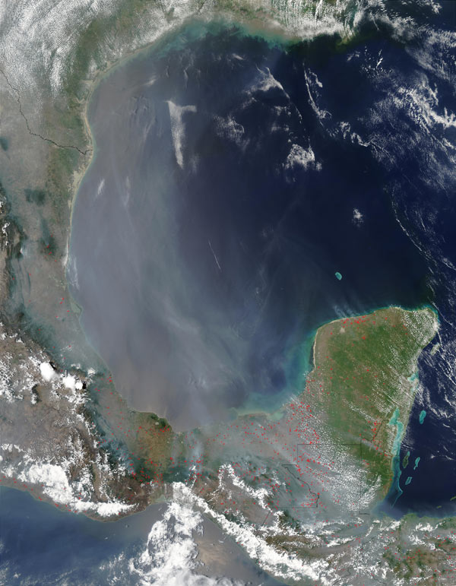
Examples of international contributions
Right: Trans-Pacific Asian pollution event in May 2010 as seen from AIRS satellite retrievals
of CO total columns (10¹⁸ molecules per cm²) Transport from mid-Pacific takes 5 days. Figure from Lin et al. 2012.
Left: Smoke from fires in Mexico and Central America, observed by the MODIS satellite-based spectrometer on May 9, 2003.
Note: Transported smoke may or may not contain ozone.

Slide 8
Emissions of ozone precursors in Asia are linked to higher baseline ozone on the US West Coast
Economic development occurring in China since 1990 has spurred the construction of power plants, especially in NE China and the eastern coastal areas. Consequently, NO_{x} emissions have greatly increased from 1990 to 2010.
Spatial distribution of NO_{x} emissions from China’s coal-fired power plants in 1990, 2000, 2005, and 2010.
From Atmos. Chem. Phys., 15, 13299–13317, www.atmos-chem-phys.net/15/13299/2015/doi:10.5194/acp-15-13299-2015. High-resolution inventory
of technologies, activities, and emissions of coal-fired power plants in China from 1990 to 2010. F. Liu, Q. Zhang, D. Tong, B. Zheng, M. Li, H. Huo, and K. B. He

Slide 9
Since 2010, however, Chinese NO_{x} emissions have been decreasing
From Souri et al. JGR 2017.
Left: Satellite-observed NO2 trends in China are upward from 2005-2014, indicating large increases in NO_{x} emissions. Increases are largest in NE China.
Center: Most of the NO2 increases, however, occurred between 2005-2010. The Pearl River Delta and cities in Japan had substantial decreases in NO_{x} during the same period.
Right: From 2010-2014, the trend has reversed in NE China, so that large decreases in NO_{x} emissions have occurred. Although emissions are still higher than they were in 2005, control measures by China have proven effective in reducing NO_{x} . The increase of NO2 in western China (i.e., Shaanxi province) is probably due to efforts to increase economic development in the western provinces.
Notes:
Data from the Ozone Monitoring Instrument (OMI), which flies on a NASA satellite. OMI measures O3, NO2, formaldehyde, and a few other parameters from a polar orbit, so it is not geostationary, and obtains daily but not continuously.

Slide 10
Satellite NO2, Chinese provinces
Bottom-up NO_{x} EI, Chinese provinces
Trends are reversing in OMI satellite NO₂ observations and NO_{x} emissions inventories
The box plots show the relative changes in (a) the average OMI tropospheric NO2 column densities for provinces in China; (b) the anthropogenic NO_{x} emissions for provinces in China; (c) the fitted NO_{x} emissions for cities investigated in this study; and (d) the anthropogenic NO_{x} emissions for the corresponding cities.
The blue horizontal line is the median of the relative differences; the red horizontal line is the mean of the relative differences; the box denotes the 25 and 75% percentiles; and the whiskers denote the 10 and 90% percentiles. The bottom-up emission data are derived from the MEIC model.
Liu, Fei et al. (2017), NO_{x} emission trends over Chinese cities estimated from OMI observations during 2005 to 2015, Atmos. Chem. Phys., 17, 9261–9275, doi: 10.5194/acp-17-9261-2017.
Satellite NO2,
Chinese cities
Bottom-up NO_{x} EI, Chinese cities
Notes:
Satellite data from left figures shows emissions peaking about 2012. Note that OMI is on a NASA satellite.

Slide 11
Reversal of Long-Term Trend in Baseline Ozone Concentrations
at the North American West Coast
D. D. Parrish1,2 , I. Petropavlovskikh1,3 , and S. J. Oltmans1,3
1Cooperative Institute for Research in Environmental Sciences, University of Colorado Boulder, Boulder, CO, USA, 2NOAA
ESRL Chemical Sciences Division, Boulder, CO, USA, 3NOAA ESRL Global Monitoring Division, Boulder, CO, USA
Plain Language Summary In U.S. urban and rural areas, ozone transported into the country from the Pacific (i.e., baseline ozone) makes substantial contributions to exceedances of the ozone National Ambient Air Quality Standard. Over past decades, baseline ozone concentrations increased, which made achievement of ozone air quality goals increasingly difficult. However, that increase ended in the early to mid-2000s, and the baseline concentrations have begun to decrease, thus easing this particular difficulty. Global modes are relied upon to quantify the influence of this ozone transport, but they poorly reproduce
observed baseline ozone concentrations.
Parrish, D. D., Petropavlovskikh, I., & Oltmans, S. J. (2017). Reversal of long-term trend in baseline ozone concentrations at the North American West Coast. Geophysical Research Letters, 44.
https://doi.org/10.1002/2017GL074960

Slide 12
Non-controllable O₃ Sources (NCOS)
(Jaffe AMS 2018)
Stratospheric transport, wildfires, lightning, biogenic emissions and international sources all contribute to USB O₃.
Daily variations in stratospheric transport and wildfires can be large and on some days make significant contributions to O₃ MDA8s above 70 ppb.
At present, the tools to identify and quantify these contributions to O₃ are limited.
Numerous research campaigns have successfully quantified these contributions, but doing so often depends on advanced tools, not available in routine monitoring networks. Identifying an NCOS is easier for a large O₃ contribution, harder for smaller contributions.

Slide 13
What are consistent and robust patterns in modeled US background O₃ or North American background O₃? (Jaffe AMS 2018)
Models consistently show that highest seasonal mean USB O₃ is in the spring in intermountain west and at highest elevations.
Models estimate the seasonal mean USB O₃ at 20-40 ppb for low elevation sites (e.g. east and west coast of U.S.) and over 50 ppb at some high elevation sites.
Significant model differences due to boundary conditions, resolution, treatment of stratosphere, wildfires, etc.
Difficult to compare across studies due to different reported metrics, years, definitions, etc.
How well do we really know USB and NAB O₃ ? How well do different models agree on USB/NAB? How accurate are the models compared to observations?
Key conclusion: Our best estimate of uncertainty in seasonal mean US background O₃ is ± 10 ppb. Uncertainty is even larger for individual days, or time periods shorter than 3 months.

Slide 14
From Fiore et al. 2014: Modeled estimates of 2006 North American background (NAB) ozone from two different global models, AM3 and GEOS-Chem. Models give NAB values differing by 10 ppb or more in many locations. North American anthropogenic emissions are set to zero in both models.

Slide 15
TCEQ measures to improve estimates of background ozone and international contributions
Expand the modeling domain. CAMx model is used to simulate ozone at high resolution within the US and state of Texas; GEOS-Chem global model is used to simulate ozone outside the CAMx modeling domain, that is, to set the boundary conditions. By expanding the domain, we can include Canadian and Mexican emissions within the higher-resolution domain, and improve our estimates of their contributions to Texas background ozone. Also, a larger domain pushes the boundaries further from the cities of interest.
Run GEOS-Chem at TCEQ. By running the global model in-house, we can run it for the exact times that we are interested in simulating, rather than having to rely upon someone else’s runs, or upon monthly averages.
Improve our understanding of the weather patterns that transport background air into Texas during ozone season: Bermuda High, Great Plains low-level jet, frontal passages, El Niño/Southern Oscillation. Better knowledge of transport patterns helps us understand when international transport is likely (or unlikely), helps us interpret our modeling results, and can identify exceptional events.

Slide 16
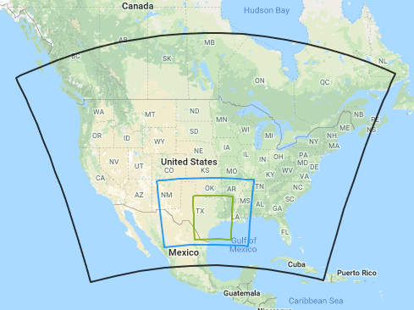
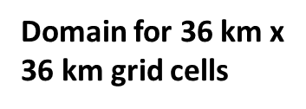
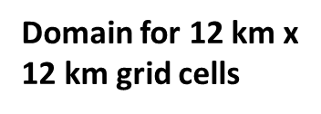

Slide 17
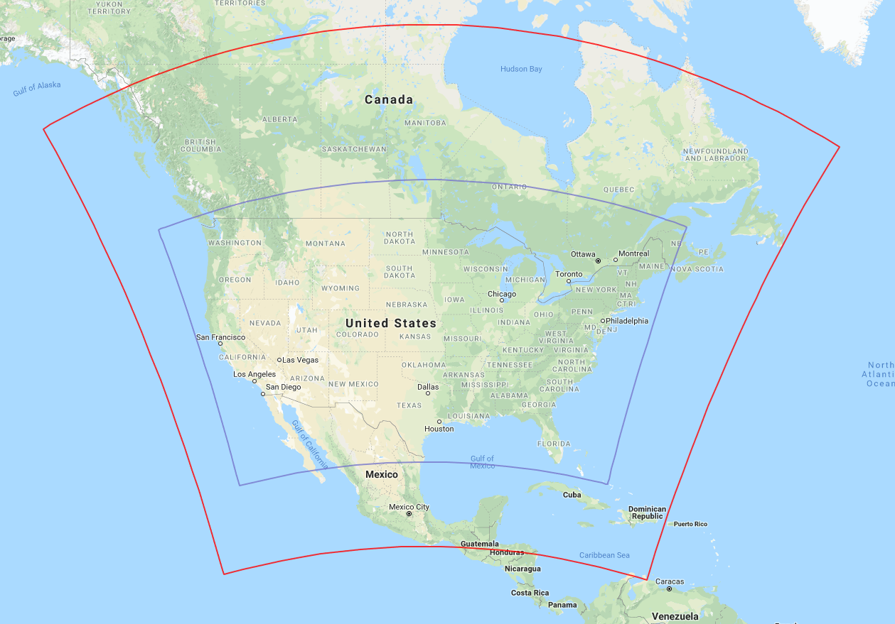
Domain for 36 km x 36 km grid cells
Domain for 12 km x 12 km grid cells

Slide 18
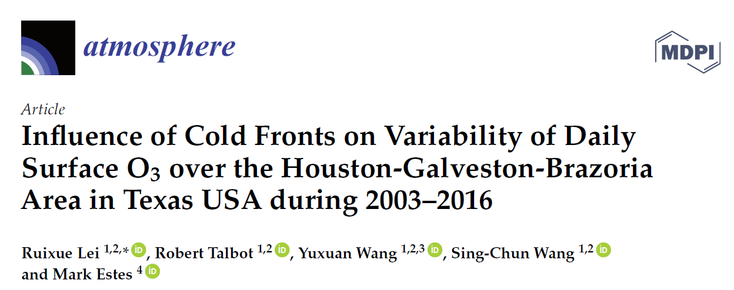

Slide 19
Effects of oil and gas development on ozone
The TCEQ commissioned a review and synthesis study of recent research that examined how oil and gas emissions affect air quality.

Slide 20

Study of oil and gas emissions by airborne sampling
SONGNEX study took place in 2015 https://www.esrl.noaa.gov/csd/projects/songnex/
Koss, A. et al. (2017) Observations of VOC emissions and photochemical products over US oil- and gas-producing regions using high-resolution H3O+ CIMS (PTR-ToF-MS), Atmos. Meas. Tech., doi:10.5194/amt-10-2941-2017.
Notes:
Nationwide, oil and gas development has been booming, with large increases in production and activity in many parts of the US. Tight gas and shale plays in the Permian, Barnett, Haynesville, and Eagle Ford in Texas were studied by NOAA in 2015 in an independent study. Parrish based some of his findings upon this study, as well as many others.

Slide 21
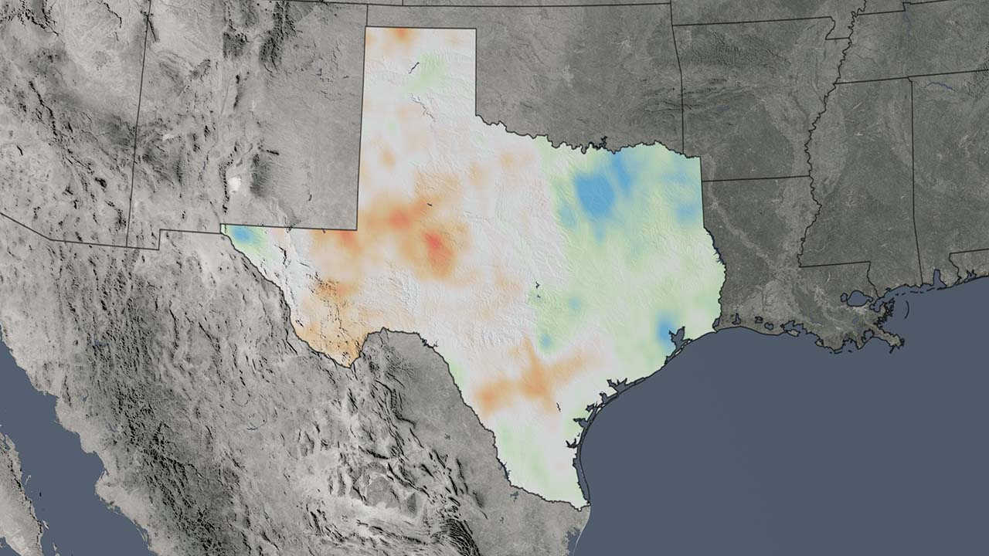
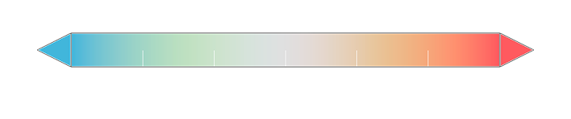
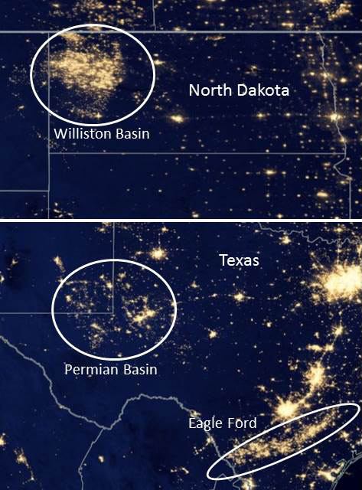
Notes:
Suomi satellite image shows nighttime lights in the oil and gas development areas. OMI satellite NO2 measurements show that there is an upward trend in NOx emissions in the Eagle Ford and Permian, in the same locations as the nighttime lights. However, city NOx emissions in DFW, HGB, San Antonio, Austin, and El Paso are decreasing.

Slide 22
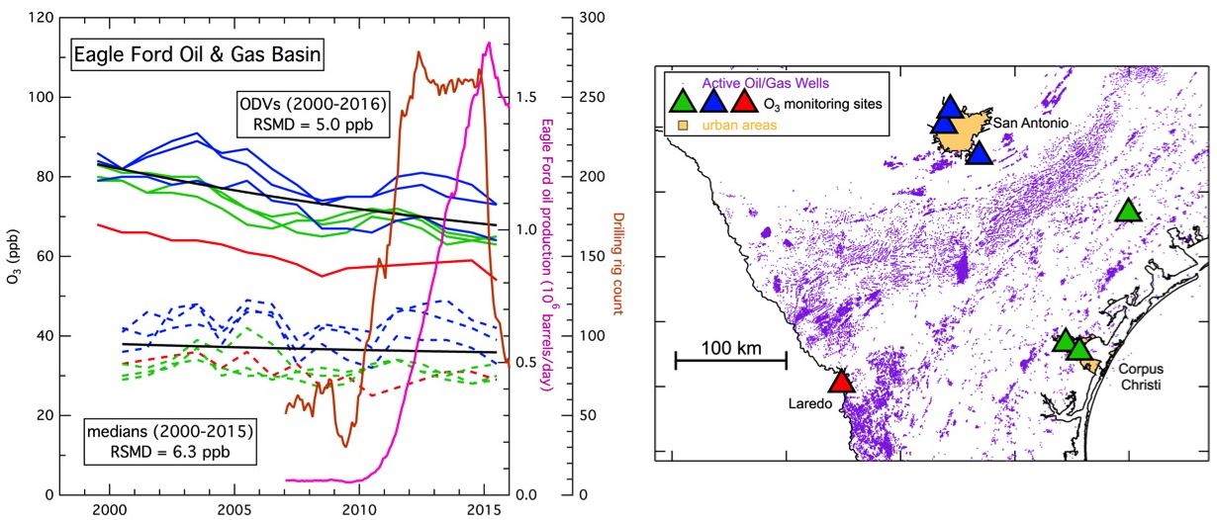
What are the contributions of emissions from oil and gas development to ambient O₃ concentrations at regulatory monitors in Texas?
Emerging Hypothesis: O&G impacts on summertime O₃ concentrations in Texas are small
Notes:
Drill rig count increases from ~30 to >250, oil production increases from ~50,000 bbl/day to 1.7 million bbl/day, but ozone barely changes, and some of those changes are due to meteorological conditions. Poor correlation between O&G activity and ozone.

Slide 23
Ozone concentrations are not very sensitive to immense increases in oil and gas activity or emissions
From Parrish 2017: “What are the contributions of emissions from O&G development to ambient ozone concentrations at regulatory monitors in Texas?
An observationally based analysis could discern no impact of O&G activity on ozone concentrations within or near Texas O&G basins. The smallest discernable impact is estimated as < 5 ppb, but could not be more quantitatively defined.”

Slide 24
For further information
Parrish et al., 2017. Report to TCEQ, completed in 2017. https://www.tceq.texas.gov/assets/public/implementation/air/am/contracts/reports/oth/582166321516-20170629-environ-oilgas_impact_aq_synthesis.pdf

