Slide 2
Nurse Licensure Compact (NLC): What Is It and Is Your State a Member? National TB Nurse Coalition March 31, 2022
Jim Puente, Director, NLC

Slide 3
Goals/Objectives:
1. Discuss what it means to be part of the Nurse Licensure Compact (NLC) state and how it affects your nursing practice.
2. Discuss reasons why states may choose not to enact the Nursing Licensure Compact.
3. Define the scope of practice for nurses to provide telenursing including eDOT outside of the state you are licensed.

Slide 4
Terminology
Multistate License or Compact License: one license issued in the home state valid for practice in all NLC states.
Single State License: valid only in state of issuance.
Home State: the primary state of residence
Remote States: NLC states other than the home state
PSOR: Primary State of Residence
PTP: Privilege to Practice. The authority for a multistate license holder to practice in other NLC states.

Slide 5
What is the NLC?
A statutory agreement between two or more states established for the purpose of remedying a particular problem of multistate concern.
Each party state is a signatory to the same contract. For that reason there is a need for “substantive sameness.”
The NLC allows for a nurse to have one multistate license (issued from his/her primary state of residency).
The NLC permits the nurse to practice in other compact states (physically or via telehealth) subject to each states laws.

Slide 6
NLC States

Slide 7
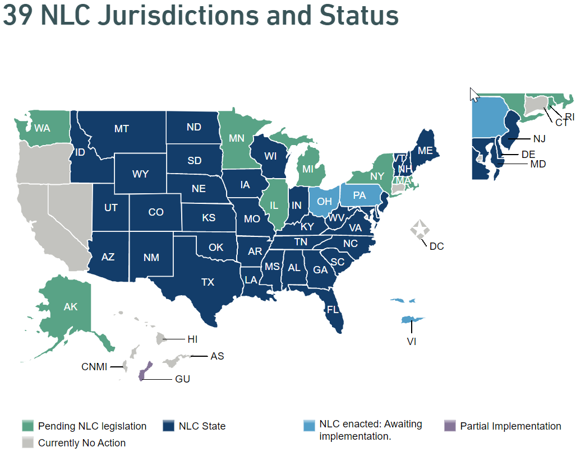
39 Jurisdictions and Status

Slide 8
Poll Question
A nurse who resides in a compact state and who holds a multistate license is authorized to practice:
In all compact states when practice is in-person
In all compact states, both in-person and telephonically
In all compact states and in non-compact states, prn

Slide 9
Why Aren’t All States a Member of the NLC?
A compact nation is the goal.
Each state must enter the NLC through the legislative process.
Some states have an opposition to the NLC which causes an impediment to successful passage.

Slide 10
How Does it Work?
A resident of a compact state is issued a multistate license that is valid for practice (physically or telephonically) in all Compact states.
In order to be eligible for a multistate license a nurse MUST be a legal resident of a compact state.
A nurse needs to meet the Uniform Licensure Requirements for a compact license.

Slide 11
Primary Concepts of a Multistate License
A nurse can only hold one multistate license issued by the home state.
A multistate license is NOT a national license, it is a state- based license.
A nurse has multistate licensure privilege to practice in other compact states (remote states)

Slide 12
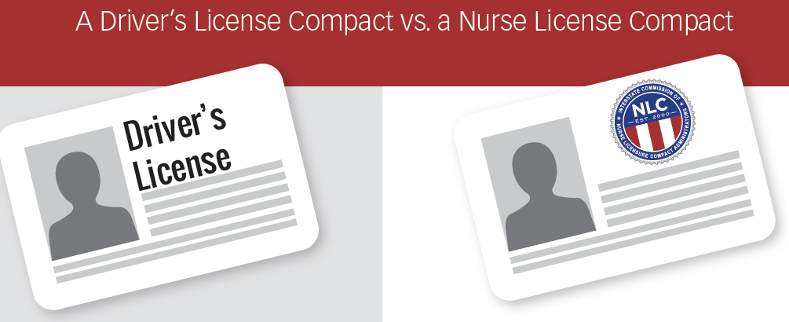
The NLC is Similar to the DLC
LICENSURE MODEL
OF MUTUAL RECOGNITION…
The NLC was originally developed based on the Driver’s License Compact (DLC).
It shares the same concept of one multistate license issued in the Primary State of Residence (PSOR) and accepted in all member states.
You can drive across state lines with one license because other states are members of the driver’s license compact. They accept the license of your PSOR.

Slide 13
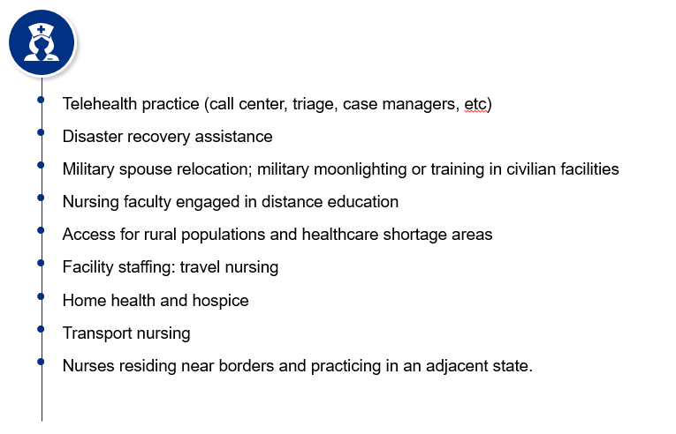
Why Need More than One License?
You need more than one license because practice requires licensure.
Practice takes place in the state where the patient/consumer is located at the time nursing service is provided.
MSL Enhances Mobility and Portability

Slide 14
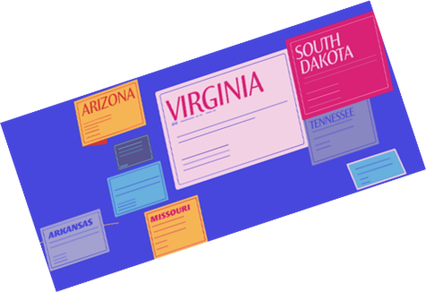
Where Does Practice Take Place?
A nurse must have the authority to practice (PTP) in the state where the patient/consumer is located at the time nursing service is provided.
“As the organizations representing…state…licensing boards…that regulate the practice of medicine, pharmacy and nursing, … (we) affirm that in a consumer protection model, health care practice occurs where the recipient of healthcare services is located.”
Source: The Tri-Regulator Collaborative Position Statement on Practice Location for Consumer Protection

Slide 15
A Definition of Nursing Practice
Most states will define practice as when a nurse utilizes her or his:
Education / knowledge / training
Judgment
Decision-making skills

Slide 16
Poll Question
When a nurse and the pt are in two different states, where does nursing practice take place?
In state where the pt is located
In the state where the nurse is located
Any state the nurse is licensed in

Slide 17
What is Scope Of Practice (SOP)?
The Scope of Nursing Practice describes the “who,” “what,” “where,” “when,” and “why” of nursing practice.
Scope of practice describes the services that a qualified health professional is deemed competent to perform, and permitted to undertake – in keeping with the terms of their professional license.
Source: ANA, https://www.nursingworld.org/practice-policy/scope-of-practice/

Slide 18
Source: David Swankin, CEO, Citizen Advocacy Center, 2011

Slide 19
NLC Does Not Address SOP or Delegation
You will find these in the state nurse practice act (NPA)

Slide 20
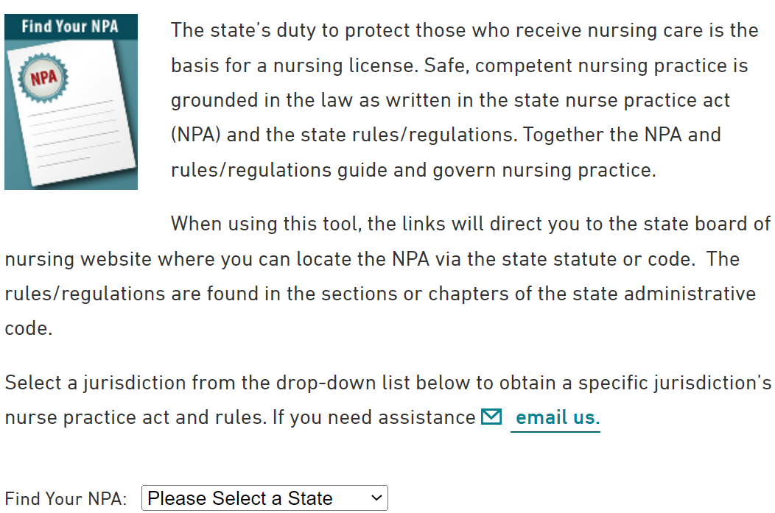
How to Locate the NPA www.ncsbn.org/npa

Slide 21
Poll Question
Scope of Practice
Is found in the Nurse Licensure Compact
Is state-specific and can be found in the state nurse practice act
Is the same across the nation

Slide 22
Exemptions / Exceptions to Licensure in a State Nurse Practice Act (NPA)
If a state offers an exemption to licensure, it may be very limited, but will generally require that the nurse holds a license in some state.
Examples:
When traveling through a state with a pt
A short trip as a school nurse on a field trip / church group trip.
A one-time situation (good samaritan) or declared emergency

Slide 23
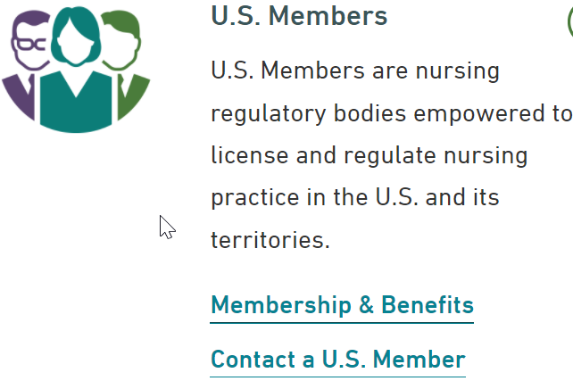
Contact your State BON with Questions About the NPA or SOP www.ncsbn.org

Slide 24
My State Joined the NLC, How do I Obtain a Multistate License?
If you are a legal resident of a NLC state that joined the NLC after 1/19/2018 (GA, FL, OK, WY, WV, KS, AL, LA, NJ, VT) and hold a single state license in that state…
Go to the board of nursing website
Complete the upgrade or conversion application

Slide 25
Nursys.com

Slide 26
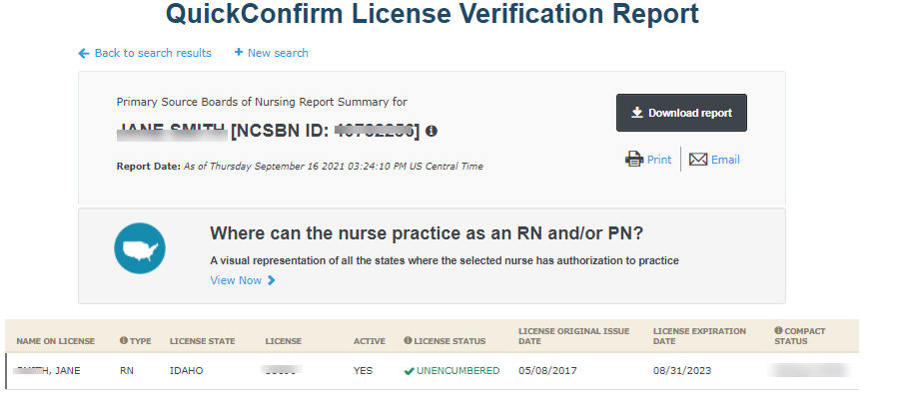
Nursys.com

Slide 27
Nursys.com

Slide 28
Nursys.com E-notify
Free license status notification service
Individual nurses may enroll by creating their secure e-profile access to the portal
Employers may enroll their nursing workforce by creating a credentialed secure account
Receive real-time notifications related to:
Expired licenses
Upcoming renewal reminder
Any changes in license status
Disciplinary actions

Slide 30
How Can Nurses Become Involved in Supporting Legislation?
Educate stakeholders about the NLC
Send a letter to legislator and governor via www.nursecompact.com
Contact or meet with these elected officials
Start a petition at www.change.org and send to your legislator
Volunteer to testify when a bill is heard before a legislative committee
Be the catalyst to get your national organization/employer to formally endorse the NLC

Slide 31
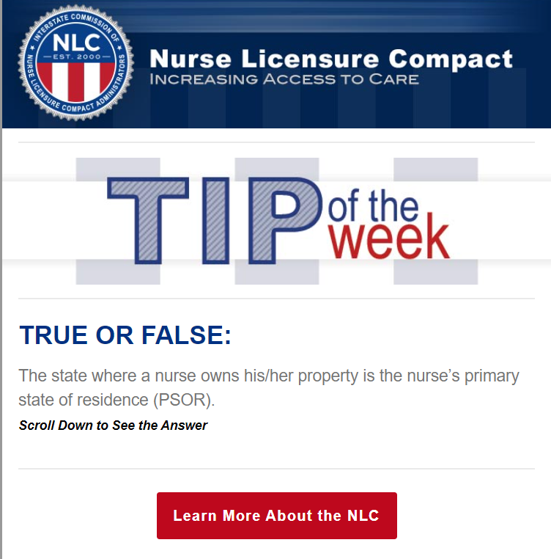
Subscribe
NLC Tip of the Week (Every Wednesday)
https://www.ncsbn.org/13615.htm

Slide 32
THANK YOU!
Email:
nursecompact@ncsbn.org Website:
Nlc.gov

