Slide 1
Legacy Fund: AASPT’s New Investigator Research Grant
AASPT Research Committee Co-Chairs:
Steph Di Stasi & Mark Paterno
AASPT Research Committee
June 2022

Slide 2
Objectives
Review the submission timeline
Provide an overview of the request for pre-proposals
Offer tips for developing a strong pre-proposal
Q&A
Notes:
Can quickly find practice guidance in one place, provide better quality care, change practice!
Resume/CV builder

Slide 3
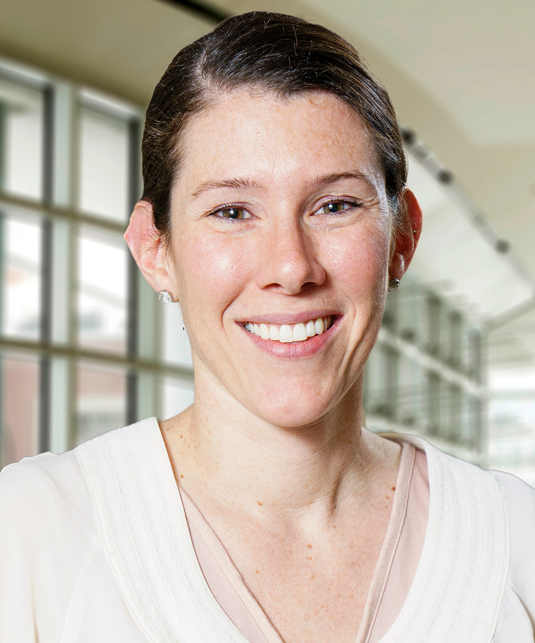
Introduction
Steph Di Stasi, PT, PhD
Division of Physical Therapy, The Ohio State University
Co-Chair, AASPT Research Committee
Former Legacy Fund awardee!

Slide 4
General Information
SUBMISSION AND REVIEW TIMELINE
• July 1, 2022 Pre-proposals due
• August 1, 2022 Selected applicants notified to submit a full proposal
• October 15, 2022 Submission deadline for full proposals
• December 1, 2022 Notice of award
Submit your applications to: https://sportspt.org/Members/Research/Legacy/Members/Legacy.aspx \
Other questions after today’s session?
Mark Paterno, PT, PhD, MBA, SCS, ATC (mark.paterno@cchmc.org), Co-Chair, AASPT Research Committee

Slide 5
General Information
The purpose of the New Investigator Research Grant is to support clinical research projects of AASPT members who are early in their professional careers.
Principal investigator (PI) must be an AASPT member
Principal investigator (PI) must be no more 5 years from clinical residency or research doctoral/post-doctoral training at the time of application
$10,000 budget x 1 year

Slide 6
Review process will focus on 4 main areas
Significance & Relevance: The potential for the proposal to make significant and timely contributions to the field of sports physical therapy.
Innovation: The novelty of the concepts, analytical techniques, and interventions, or the potential to challenge current clinical and scientific paradigms within sports physical therapy.
Approach: The extent to which the concept, research design, statistical methods and analyses are adequately described and appropriate for the proposed investigation.
Investigators & Environment: The ability of the PI and the research team to successfully complete the proposed investigation, including clear evidence of protected effort. Consideration is also given to the quality of the facilities and resources available to the research team.

Slide 7
“Tip Sheet”

Slide 8
Find a co-investigator with research experience
Strength of the application is in part based on strength of the team
Experienced researcher can help with:
Research team connections, clinical partnerships, ‘in-kind’ services, etc
Study design and appropriate analytics
Perspective on feasibility
Grant writing
Grant oversight

Slide 9
Keep it feasible – it’s only 1 year
What can you truly do in a year? Don’t bite off more than you can chew
Consider the $10k budget, the time you can (actually) dedicate to overseeing the implementation, etc.
Think about your ‘start-up’ time, regulatory timelines, research team training, recruitment rates (and provide evidence for it!)….etc…etc

Slide 10
Make clear how your work ‘moves the needle
How big is the clinical problem?
What’s the gap in our current knowledge? If you fill that gap, how will that help the population of interest?
How will this study fill that gap to positively impact the field of sports physical therapy, or be a significant step in the right direction?

Slide 11
Remember: Innovation is not novelty
Innovation is about challenging the ‘norm’ – how are YOU doing this?
Theoretical/Conceptual
Methodological
Intervention
Tool/instrumentation
Analytics
The reviewer should think, ‘Wow, this is a really different look at a problem that a lot of people are talking about!’
Significance and innovation should be well-connected in the application.

Slide 12
Bottom Line
Carefully consider your research question and hypotheses: is this truly significant and relevant to sports physical therapy?
Gather a great team and design an experiment that can actually be done in 1 year
Write clearly – if we can’t figure out what you are doing and why, you will not get the request to submit a full application.
Make the next steps in your work clear. Detail how this work springboards the next steps in this line of research. Remember, it’s a new investigator grant.

Slide 13
Q&A

