Slide 2

So You’d Like to Complete A Research Project- Now What?
Alison Mancuso DO, FACOFP
Vice Chair & Associate Professor, Residency Program Director
Rowan University School of Osteopathic Medicine
Stratford, NJ

Slide 3
Faculty Disclosure
It is the policy of the ACOFP Program Committee Annual Convention & Scientific Seminars organizers that all individuals in a position to control content disclose any relationships with commercial interests upon nomination/invitation of participation. Disclosure documents are reviewed for potential conflict of interest (COI), and if identified, conflicts are resolved prior to confirmation of participation. Only those participants who had no conflict of interest or who agreed to an identified resolution process prior to their participation were involved in this CME activity.
All faculty in a position to control content for this session have indicated they have no relevant financial relationships to disclose.
The content of this material/presentation in this CME activity will not include discussion of unapproved or investigational uses of products or devices.

Slide 4
Program Committee
Chair: Joel M. Feder, DO, FACOFP dist.
Vice Chair: Andrew D. Adair, DO FACOFP
AC 21 Chair: Matthew W. Told, DO
AC 21 Vice Chair: Rob Danoff, DO, MS, FACOFP, FAAFP
Ioanna Z. Giatis- Kessler, DO, FACOFP
Sonia Rivera-Martinez, DO, FACOFP
Karen Frayser Evans, DO
Bernadette A. Riley, DO, FACOFP
Jennifer L. Gwilym, DO, FACOFP
Thomas Zimmerman, DO, FACOFP
Rebecca D. Lewis, DO
Hallie Zwibel, DO
Katarina Lindley, DO, FACOFP
Patricia Eileen Happel, DO, FACOFP
Karen M. Sheflin, DO, FACOFP
Nancy A. Bono, DO, FACOFP
David. A. Connett, DO, FACOFP dist.

Slide 5
Learning Objectives
By the conclusion of this talk, participants can expect to:
Understand the overall process of starting and completing a research project, from idea formation through to publication
Learn strategies to find a research mentor
Learn strategies to determine the best format for a research project based on the research question

Slide 6
Defining “Research Project”
Scholarly Activity: A creative work that is peer reviewed and publicly disseminated.
  Discovery of new knowledge
  Development of new technologies, methods, materials, or uses
  Integration of knowledge leading to new understanding.
Examples of Scholarly Activity
- Original Research Projects (focus of our talk today)
- Case Reports
- Meta Analysis
https://www.cals.vt.edu/faculty-staff/evaluation/scholarly-activity.html#:~:text=Scholarly%20activity%20is%20a%20creative,knowledge%20leading%20to%20new%20understanding.

Slide 7
Why Should I Do a Research Project?
Medicine should be an environment of inquiry
  Constant advances
  Constant learning
  Needs constant contributions
Residency Program Directors like to see research in ERAS
  All residents are required to complete research projects per ACGME
  Nice to have a candidate who has done research before

Slide 8
Timeline: Original Research Projects
Finding a Research Mentor
Deciding on
a Research Topic
Starting an
IRB
Proposal
Data
Collection Phase
Data
Analysis
Phase
Preparing for Publication/
Presentation

Slide 9
Finding a Research Mentor
Opportunities vary by institution
Office of Research
  If your school has a division of research, contact them to see what student opportunities exist
Research Day
  Great time to view what faculty, residents and other students are doing for research. Networking opportunity
Student Research Programs
  Summer research opportunities
  Grant-funded research opportunities
  May have stipends
“Cold Calling”
  If you see a faculty mentor doing research that you are interested in, email them and introduce yourself

Slide 10
Deciding on a Research Topic
What interests you?
Clinical vs Basic Science
  Something unique but tied to prior literature
  Basic Science: “Bench” Research
  Clinical: Surveys, Chart Reviews, Clinical Trials
What question can you answer using research?
  Hypothesis
Where will you share your data?
  Conference: Poster/Abstract
  Publication

Slide 11
Starting an IRB Proposal
IRB= Institutional Review Board
  Human Subject Protection
  Each institution has their own (RowanSOM IRB, PCOM IRB, etc)
  Committee decides on if projects are ethical to perform
Application Process- unique to each IRB
  Online vs Paper (Most are online at this point)
  Document Submission (Protocol, Consent Forms, Proof of Training, etc)
  Researcher Training- Determined by your IRB
    HIPPA for Research
    Human Subject Research Training (ex: CITI Program)

Slide 12
Starting an IRB Proposal
Types of Studies
  Exempt: Little or no harm to subjects, no identifying info, no intervention directed at subject
    Example: Many chart reviews
  Expedited: Little or no harm to subjects, minimal PHI/identifying info, no intervention directed at subject but needs subject consent
    Example: Many patient or physician surveys
  Full: Possible harm, intervention to subjects, PHI involved
    Example: Clinical Trials

Slide 13
Starting an IRB Proposal
Includes all aspects of your project
  Background research
  Hypothesis
  Variables
  Methods, including any surveys or chart review tools you are using
  Subject consent
  Safety
  Data analysis and storage
  Intended dissemination of data
IRB Committee assigns a reviewer prior to their meeting
  Provision of feedback about proposal, consents, etc
  Address items they bring up quickly so your project can move to committee meeting if needed
Some IRB Committees only meet monthly-know your committee’s schedule

Slide 14
Data Collection Phase
IRB Approval MUST be in place before you begin
Follow IRB approved methods- if you want to change something, you must get permission from the IRB to deviate from your original protocol
Keep data secure- Password protected files on locked computers or paper in locked cabinets with minimal access. Only approved study staff should access data.

Slide 15
Data Analysis Phase
Once your data collection is complete (based on IRB protocol)
Helpful to have someone familiar with biostats assist
Look for associations between your variables
Test for statistical significance

Slide 16
Preparing for Publication/
Presentation
Where do you want to see this project go?
  Conference Poster/Abstract
  Publication
  Both
Conferences have specific applications/deadlines for poster submission
  Helpful to know when you start your project if this is the direction you are going in so you can set reasonable timelines
  Example: ACOFP- Deadline usually in mid-Fall for March conference
Publications generally are a rolling-basis

Slide 17
Preparing for Publication/
Presentation
Abstracts are the starting point for both conference and publication submissions
Generally standard format with several sections

Slide 20

Posters: An Example

Slide 21
Publications
Follow format from publisher’s website
Most journals have online submission portals now
Aim for peer-reviewed, Pub-Med indexed journals
Submission will be reviewed by an editor
  If accepted by editor, it gets sent to peer review
Timeline for submission to acceptance to publication is variable

Slide 22
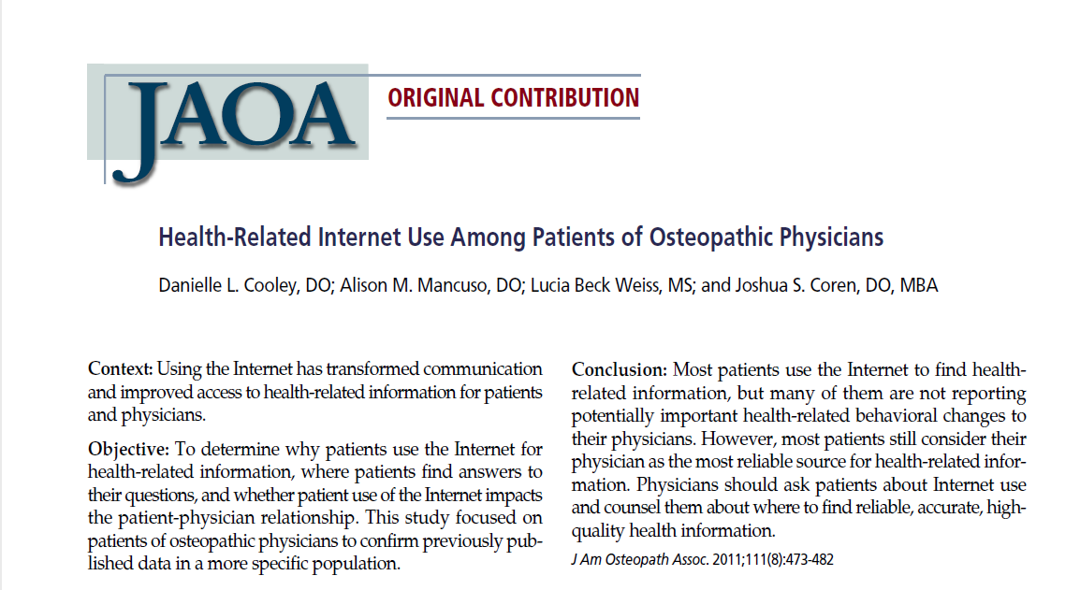

Slide 23
Summary
Research is a key part of medicine and helpful for medical students as they apply to residency programs
Selecting a topic area and a mentor are the first steps
Pick a mentor that is interested in your topic and is invested in helping you complete your project
Aim to publish ANY research project you do

Slide 24
Thank you!
Questions?

