Slide 1
Texas Disposal Wells
And Seismicity
Paul Dubois, P.E.
May 2019

Slide 2
Railroad Commission of Texas Jurisdiction
Permitting, monitoring & testing of injection wells
Class II
Enhanced recovery
Disposal of oil and gas wastes
Class III – Brine mining
Class V – Geothermal

Slide 3
Underground Injection Control (UIC)
Program Goals:
Confine fluids to the permitted strata
Protect groundwater (USDWs)
Protect surface water
Protect strata productive of hydrocarbons

Slide 4
Texas Disposal Well Rules
Seismologist on staff since 2014
Amended disposal well rules November 2014 in 16 Tex. Admin. Code §§ 3.9 and 3.46
Required seismicity screen for all disposal well applications in Texas
Historical USGS seismic events within a circular area of 100 square miles (5.64 mi or 9.08 km).
Notes:
Such conditions may include, but are not limited to
complex geology
proximity of the basement rock to the injection interval
transmissive faults, and/or
a history of seismic events in the area as demonstrated by information available from the USGS.
Refinery explosion 2/18/2008, 40 miles NE of Midland, magnitude 2.1.

Slide 5
TexNet
House Bill 2, 84th Texas Legislature (2016–17), Section 16 provides funding for TexNet:
“…for the purchase and deployment of seismic equipment, maintenance of seismic networks, modeling of reservoir behavior for systems of wells in the vicinity of faults, …”
Developed and operated by Bureau of Economic Geology (BEG), UT Austin

Slide 6
TexNet Seismic Monitoring System
Denser seismic monitoring array will result in:
Increased detection of smaller events
More accurate location of suitably oriented, critically stressed faults
More accurate location of epicenter/hypocenter
Better definition of suitably oriented, critically stressed faults
Notes:
CISR

Slide 7
Science and Application
BEG
Operates TexNet
Conducts Basic Seismicity Research
BEG, Academia, Industry
Conducts Seismicity Research
Conducts Related Studies
RRC
Regulates Industry Activity
Permits Disposal Wells
The Long Run
Immediate Need

Slide 8
Reeves County
Year | All Drilling Permits (injection wells) | USGS Earthquakes >3.0 M
2012 | 433 (27) | 1
2013 | 478 (27) | 0
2014 | 652 (56) | 1
2015 | 384 (30) | 5
2016 | 466 (42) | 6
2017 | 1082 (125) | 37
2018 | 1211 (101) | 36

Slide 9
We Need Guidelines
Internal guidelines to assist RRC staff with administrative processing and permitting of disposal well applications in areas of the Permian Basin that are experiencing seismic activity.
Not written to be guidance or instruction for industry applicants.

Slide 10
Guidelines Status
Development began early 2018
Development accelerated Summer 2018
Aides briefings in September 2018
Limited external peer review Fall 2018
Continued peer review January 2019
Green light to pilot February 2019
Anticipate full implementation Summer 2019

Slide 11
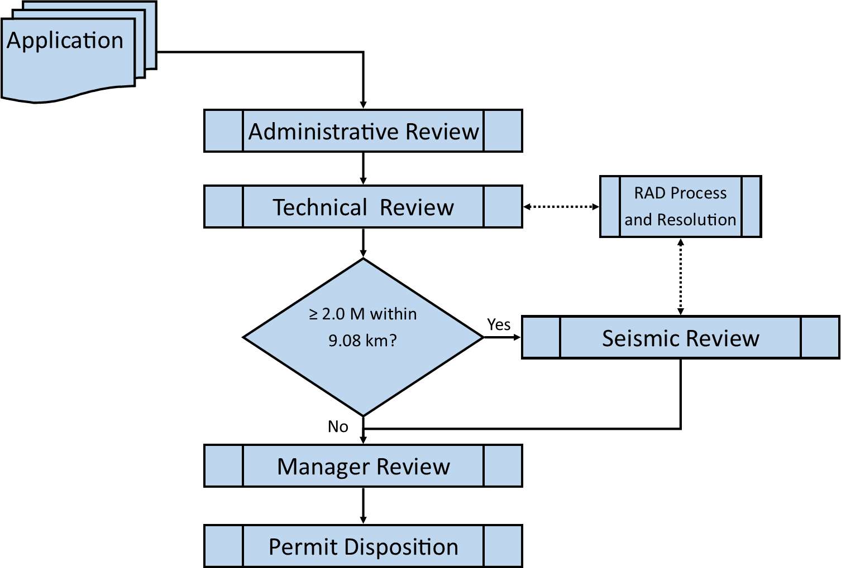
UIC High-Level Processes

Slide 12
UIC Review Elements
Administrative: Are the required elements of the application present and complete?
Technical: Do the elements of the application meet the requirements of Rule & Statute?
Seismic: Based on an assessment of potential seismic hazard, what is appropriate seismic mitigation?
Manager: Final decision.
Permit Disposition: Approve, deny, or refer to hearing.

Slide 13
Disposal Well Application Elements
Rule 9 disposal well (non-productive zone)
Rule 46 disposal well (productive zone)
Notice and publication
Well Log (preferably annotated)
Groundwater Depth Letter
No Harm Letter (W-14 applications only)
Area of Review (“AOR”) Analysis
Map
Table of Wells
Notes:
Move quickly through these,
Reference the online manual

Slide 14
Disposal Well Application Elements
Seismicity screen
See Statewide Rules 9(3)(B) & 46(b)(1)(C):
Historical USGS seismic events within a circular area of 100 square miles (5.64 mi or 9.08 km).
An earthquake event of 2.0 M or greater within the 5.64 km area of interest (“AOI”) will trigger the seismic review
RRC Staff will consider both USGS and TexNet catalogs in assessing the seismic trigger.
Notes:
Move quickly through these,
Reference the online manual

Slide 15
Elements of a Disposal Well Application
If seismicity screen is positive, supplemental information is required to assess the state of the disposal zone and adjacent strata:
Structure map(s)
Isopach map(s)
Cross-section(s)
Other relevant information
Fault stress analysis (may be required)
Notes:
Move quickly through these,
Reference the online manual

Slide 16
Seismic Review
The purpose of the supplemental information is to enable staff to conduct the seismic review.
The seismic review is a scoring system that considers:
8 Faulting and Seismicity Factors
2 Operational Factors
3 Reservoir Factors

Slide 17
Seismicity and Faulting Factors
Number of mapped faults in AOI
Horizontal distance to nearest mapped fault
Distance to basement
Number of earthquakes in AOI
Horizontal distance to nearest earthquake
Maximum seismic event magnitude in AOI
Years since last seismic event in AOI
Data confidence

Slide 18
Seismicity and Faulting Factors (cont.)
Seismicity & Faulting Data Confidence
A: High
Site specific, high resolution, compelling, and filed.
B: Medium
Intermediate resolution, interpreted derivatives from high quality data.
C: Low
Publicly available regional data with no new insights.

Slide 19
Operational Factors
Combined Permitted Injection Rate within 2.8 mi
Distance to Nearest Injection Well in Same Interval(s)

Slide 20
Reservoir Factors
Disposal Zone Static Permeability
Disposal Zone Cumulative Thickness
Disposal Zone Lithology

Slide 21
Scoring
Factor Category Scores (A, B or C)
The non-numerical center of distribution of factor scores in each category.
Overall Score (A, B or C)
The non-numerical center of distribution of factor category scores, in which the seismicity and faulting factor category is weighted twice.

Slide 22
Fault Stress Modeling
Is a known fault oriented to slip?
For “B” Applications
Fault stress analysis (for example, Fault Slip Potential) may be required if evidence of faulting (mapped faults or seismic event clustering) is within 2.8 mi.
For “C” Applications
Fault stress analysis is required if evidence of faulting is within the AOI.

Slide 23
Permit Conditions
Score A:
30,000 bpd max
Daily Records (volume, max pressure)
Initial Static Bottom-hole Pressure Test
Step Rate Test

Slide 24
Permit Conditions
Score B:
20,000 bpd max
Daily Records (volume, max pressure)
Initial Static Bottom-hole Pressure Test
Step Rate Test

Slide 25
Permit Conditions
Score C:
10,000 bpd max
Daily Records (volume, max pressure)
Initial Static Bottom-hole Pressure Test
Step Rate Test
Seismologist Review and Approval with Additional Conditions as Necessary

Slide 26
Mitigation Opportunities
Disposal wells scored as “B” or “C” may be authorized to inject an additional 10,000 bpd, provided:
Operator actively implementing a seismic monitoring plan that augments the open public data network
Operator develops and implements a seismic event response plan (submitted to RRC)

Slide 27
Seismic Monitoring Plan
Implement a seismic monitoring plan that provides for the contribution of data to an existing public seismic network (e.g., TexNet).
Monitoring to contribute to the body of public knowledge available to better resolve earthquake locations, especially depth.
Include method of monitoring, type of instrumentation, reporting of data analysis, and an archive of the data in a public seismic database.

Slide 28
Seismic Monitoring Plan
The minimal sensor and datalogger requirements for instrumentation are as follows.
Sensor:
3 Component orthogonal axis
Response: 1Hz to 100Hz
Datalogger:
24 bit digitizer
Sampling rate at least up to 200 sps
Integrated seedlink server
Timing using Global Positioning System (GPS).

Slide 29
Earthquake Response Plan
Implement an earthquake response plan.
Identify the actions that will be taken to inspect for damage, mitigate and/or manage risk by modifying operations, and establish thresholds for suspension of injection activity.
Specific elements of the earthquake response plan should include:
Monitoring plan will be filed with the Commission before disposal activities begin.
Operator will monitor TexNet and USGS catalogs.

Slide 30
Earthquake Response Plan
Elements of the response plan (continued):
Response plan triggered when a 3.5 M event is detected with a reported hypocenter location within the 9.08 km AOI.
Response plan will identify the actions the well operator will take when a 3.5 M event is detected with a reported hypocenter location within the 9.08 km AOI.
Operator will notify the Commission within 24 hours of a seismic event posting on an earthquake catalog that triggers the response plan.
Within 30 days of an earthquake trigger, the operator will file a report with the Commission documenting the event.

Slide 31
Guidelines – Going Forward
Anticipate full guidelines implementation Summer 2019
RRC Response Plan design began March 2019
For General UIC Guidance: https://www.rrc.texas.gov/oil-gas/applications-and-permits/injection-permit-types-and-information/oil-and-gas-waste-disposal/

